Slide 1
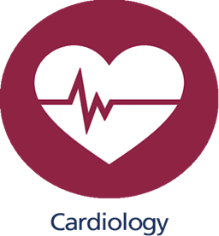
Introduction to cardiac physiology
Dr. Amir Al-Jaradli
Cardiologist

Slide 2
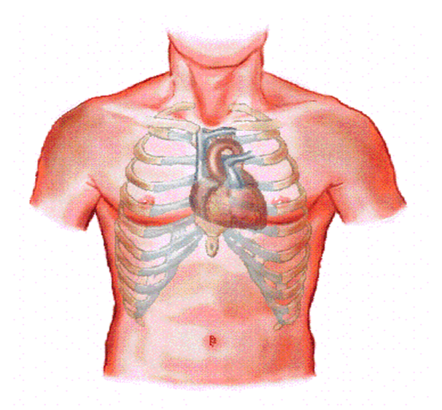
Heart :
The heart is situated obliquely in the middle Mediastinum
Its not in the median plan. Two-thirds to the left and
0ne-thirds to the right
The heart has a base (posterior aspect) , Apex : inferolateral

Slide 3
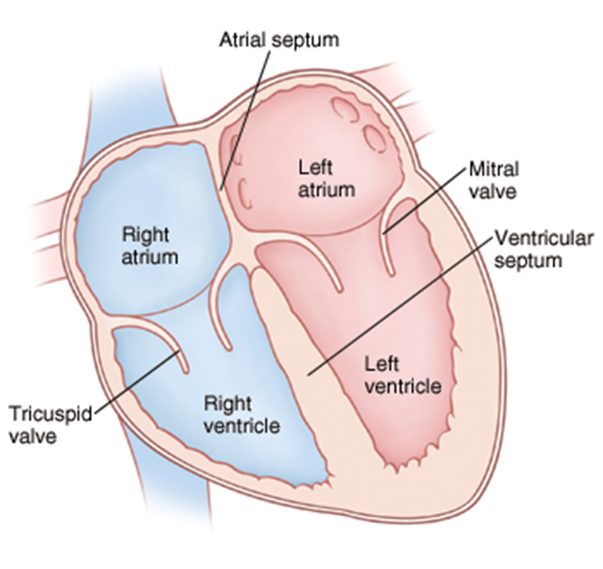
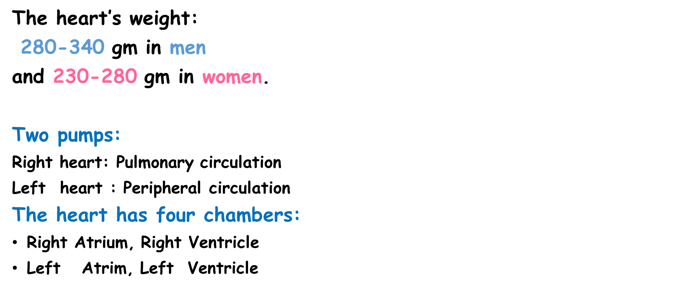
Chambers :

Slide 4
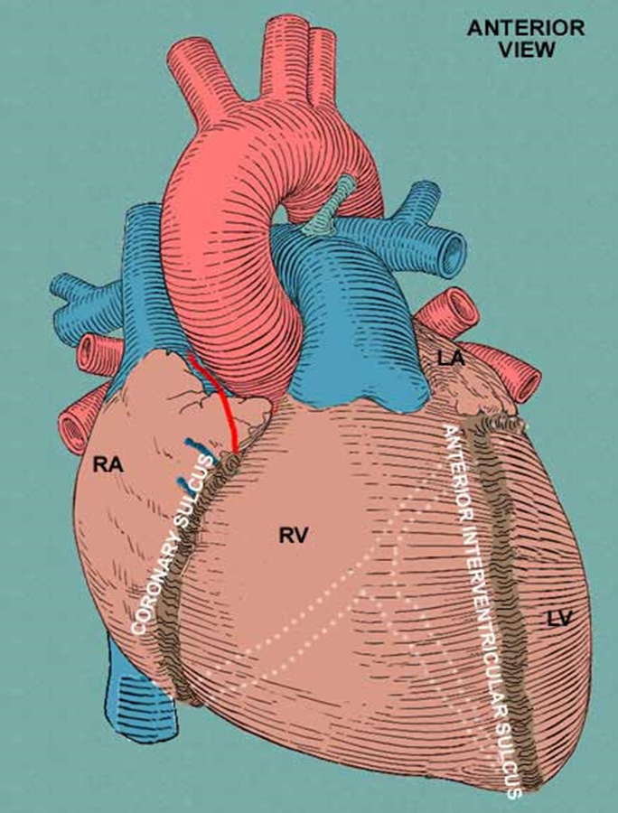

Slide 5
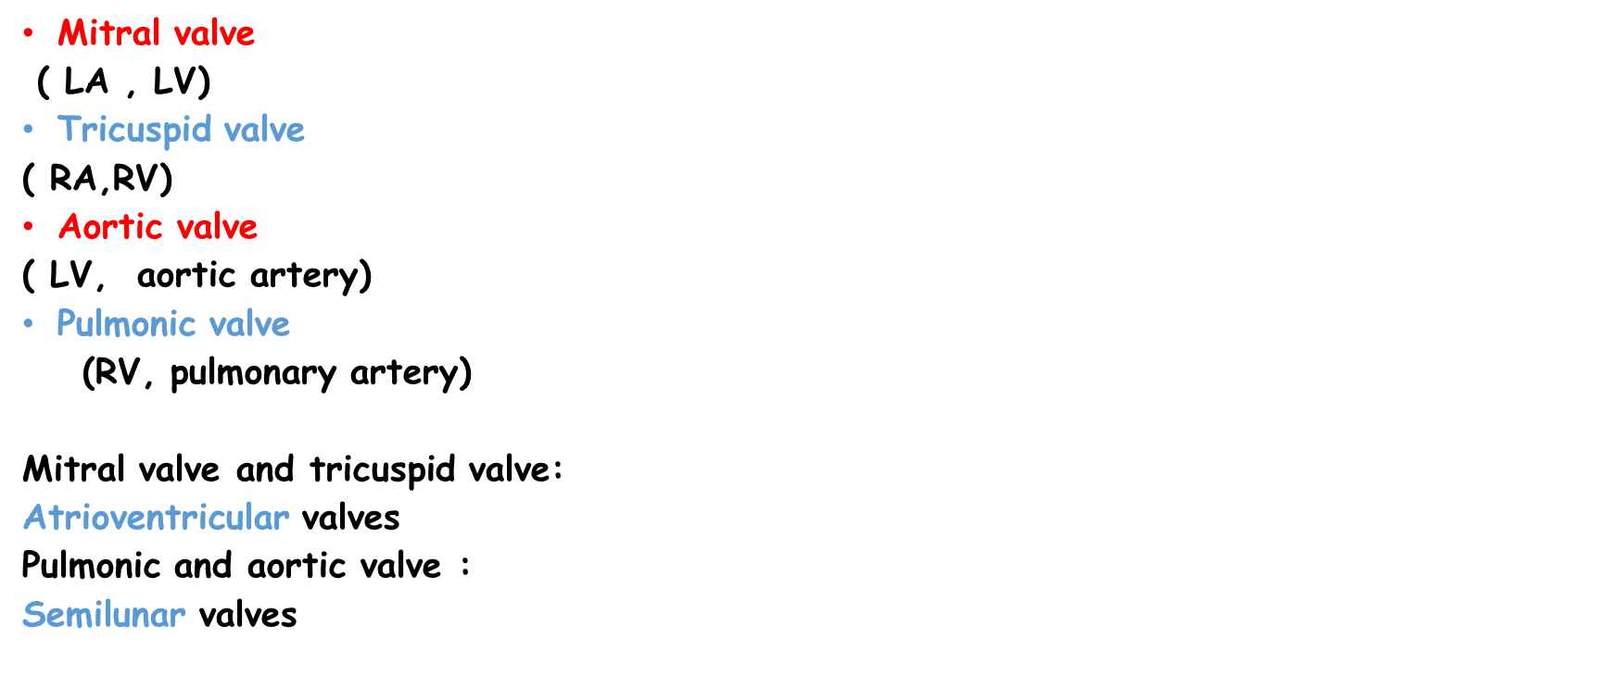
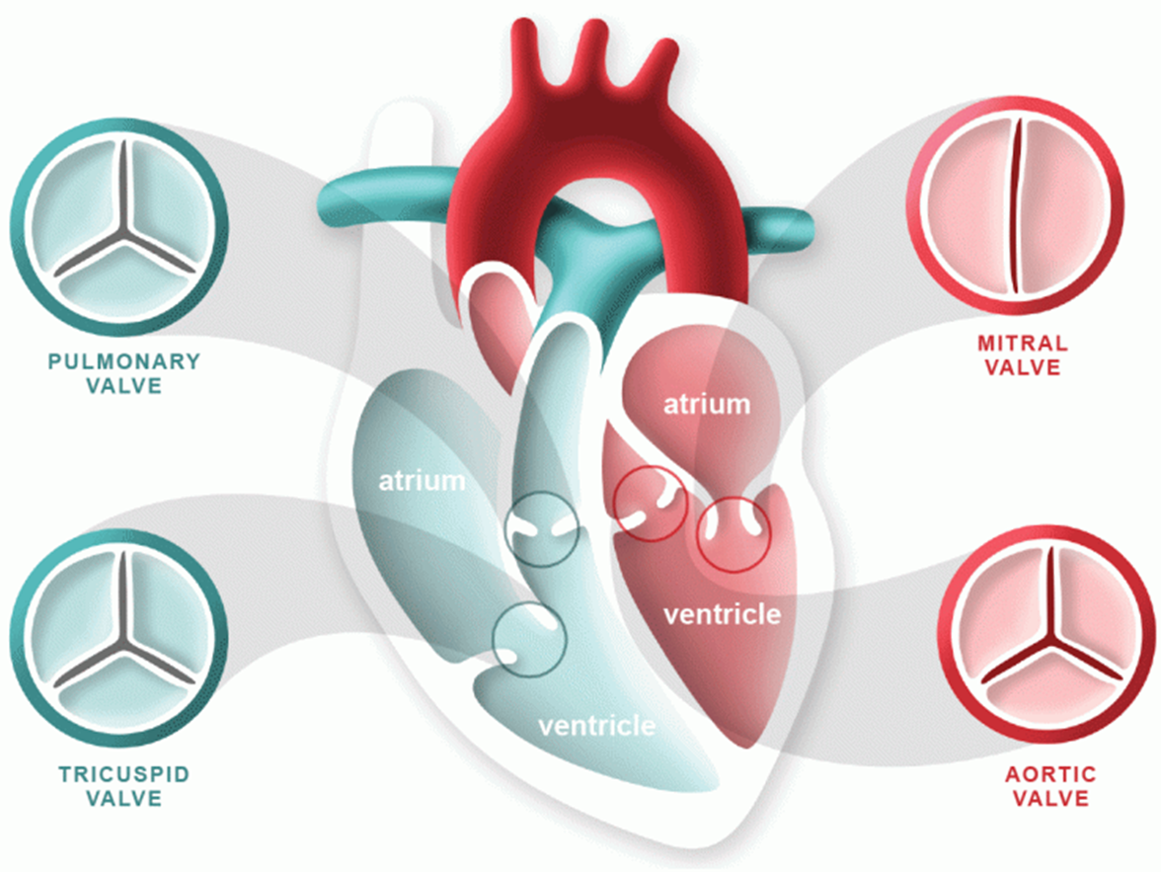

Slide 6
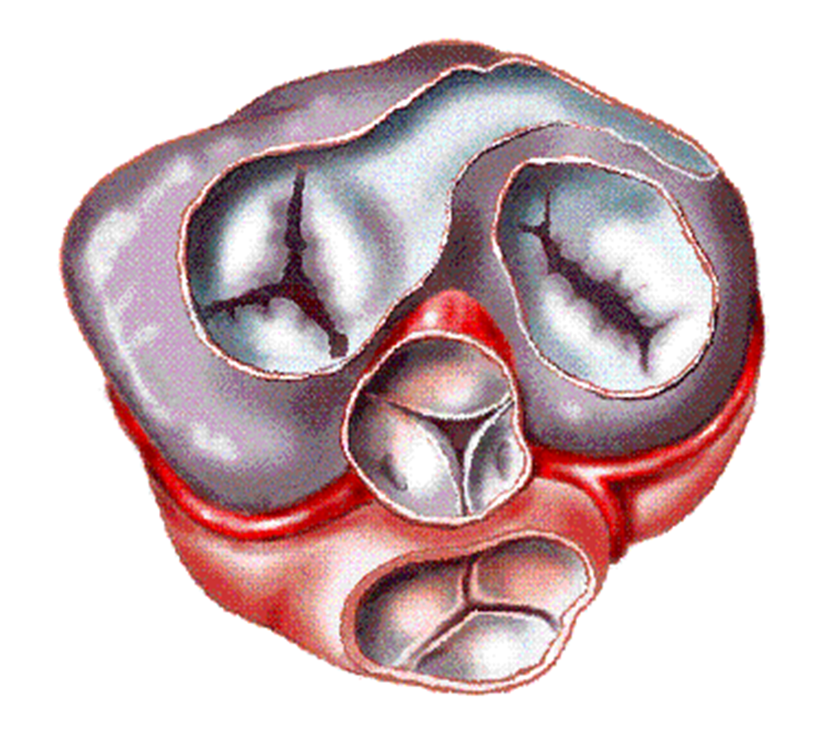
Valves :

Slide 7
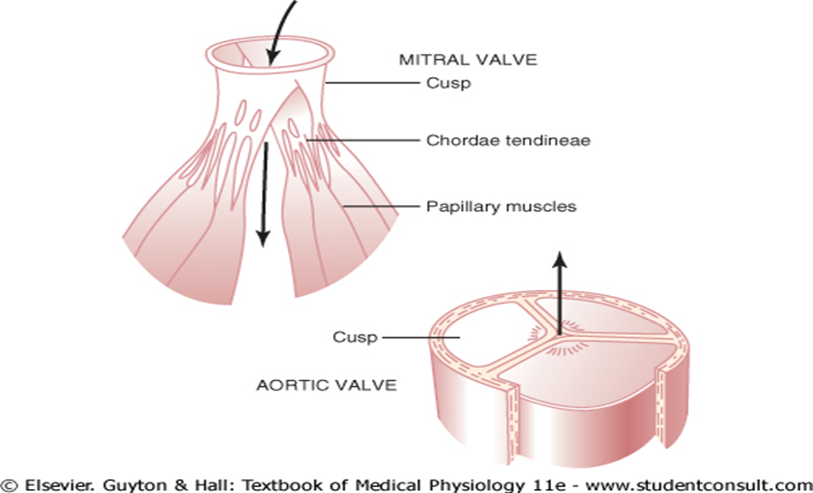
Valves :

Slide 8
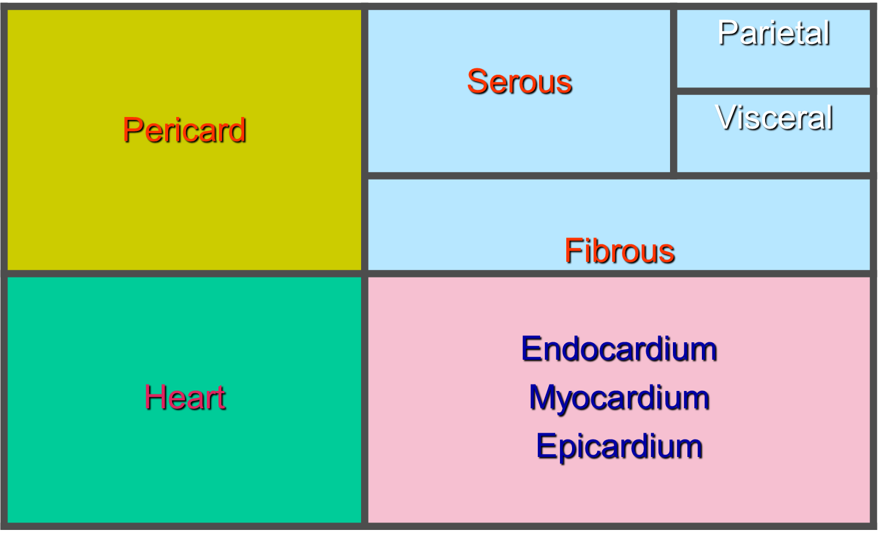
Layers :

Slide 9
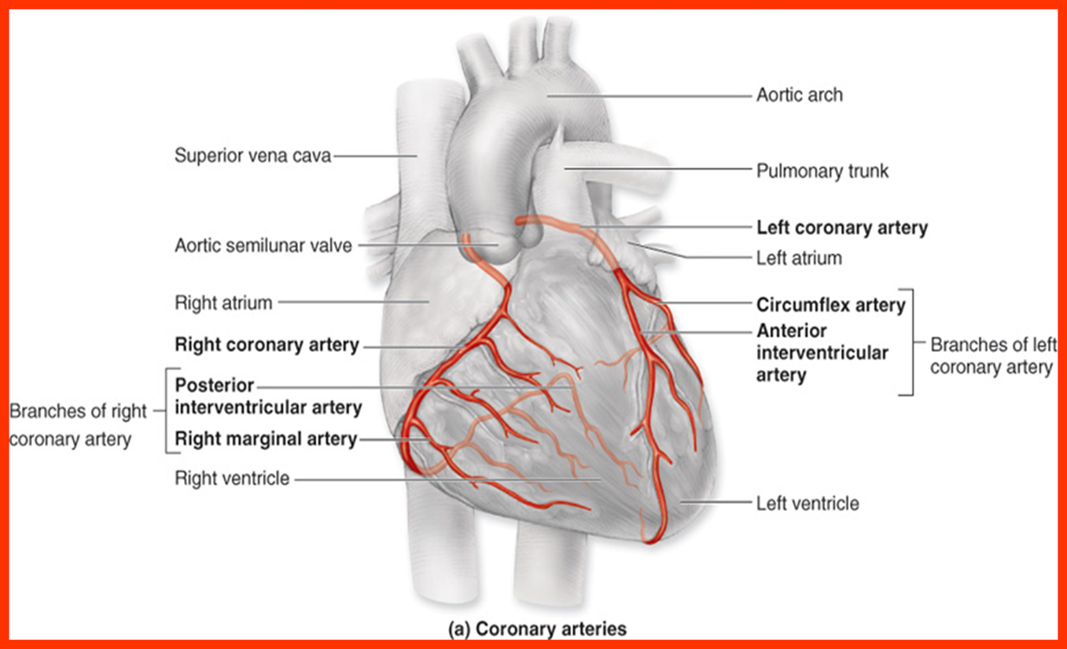
Coronary arteries :

Slide 10
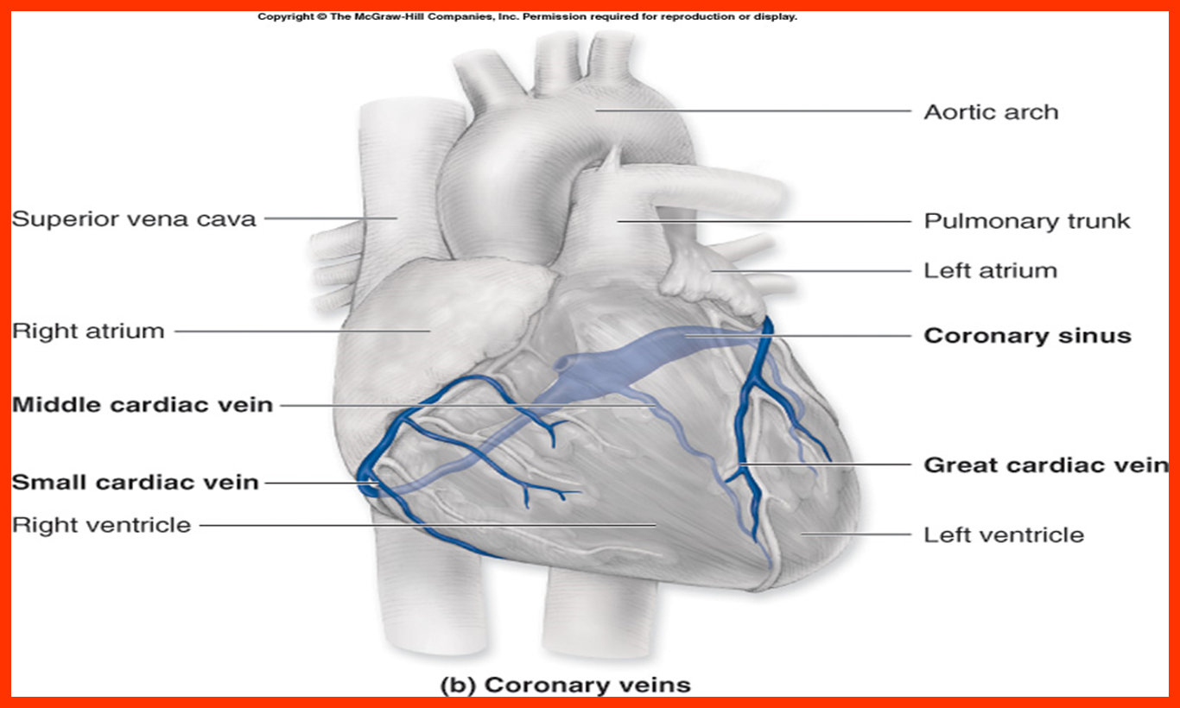
Coronary veins :
Coronary sinus
Small vein that open directly into the chambers of the heart : anterior cardiac veins, Vena cordis minimae (thebesian vein)

Slide 11
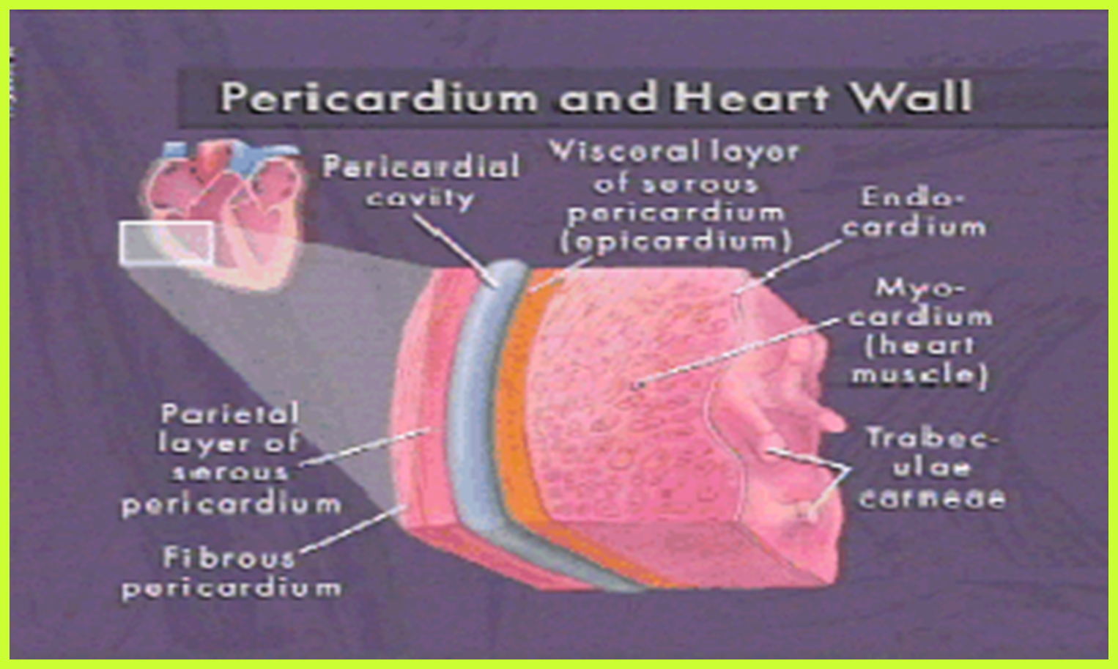
Layers :

Slide 12
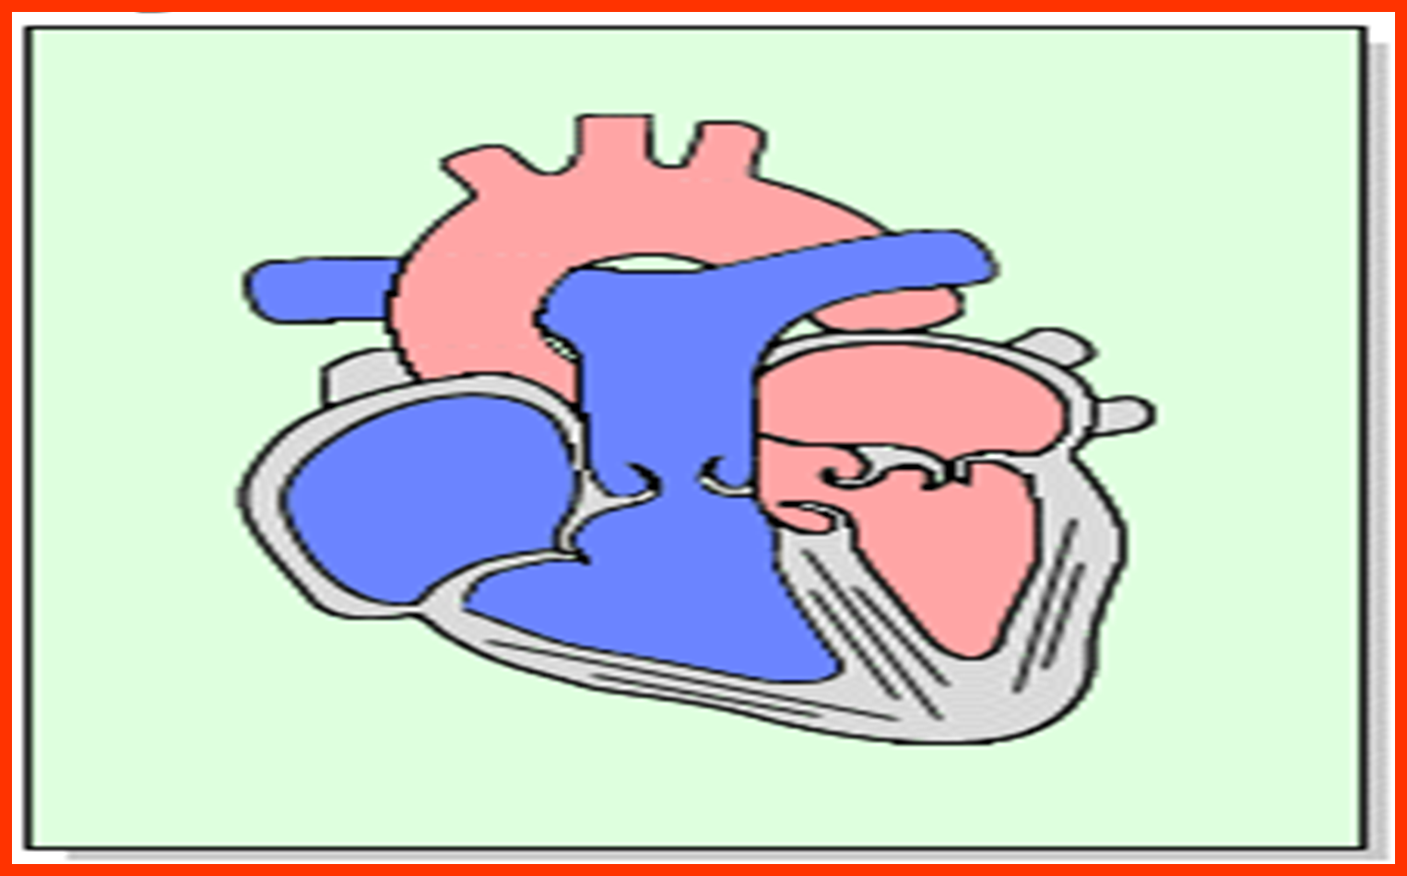
Normal pressure :
90-140
60-90
15-30
4-12
2-12
1-5
15-30
1-7
90-140
0-12

Slide 13
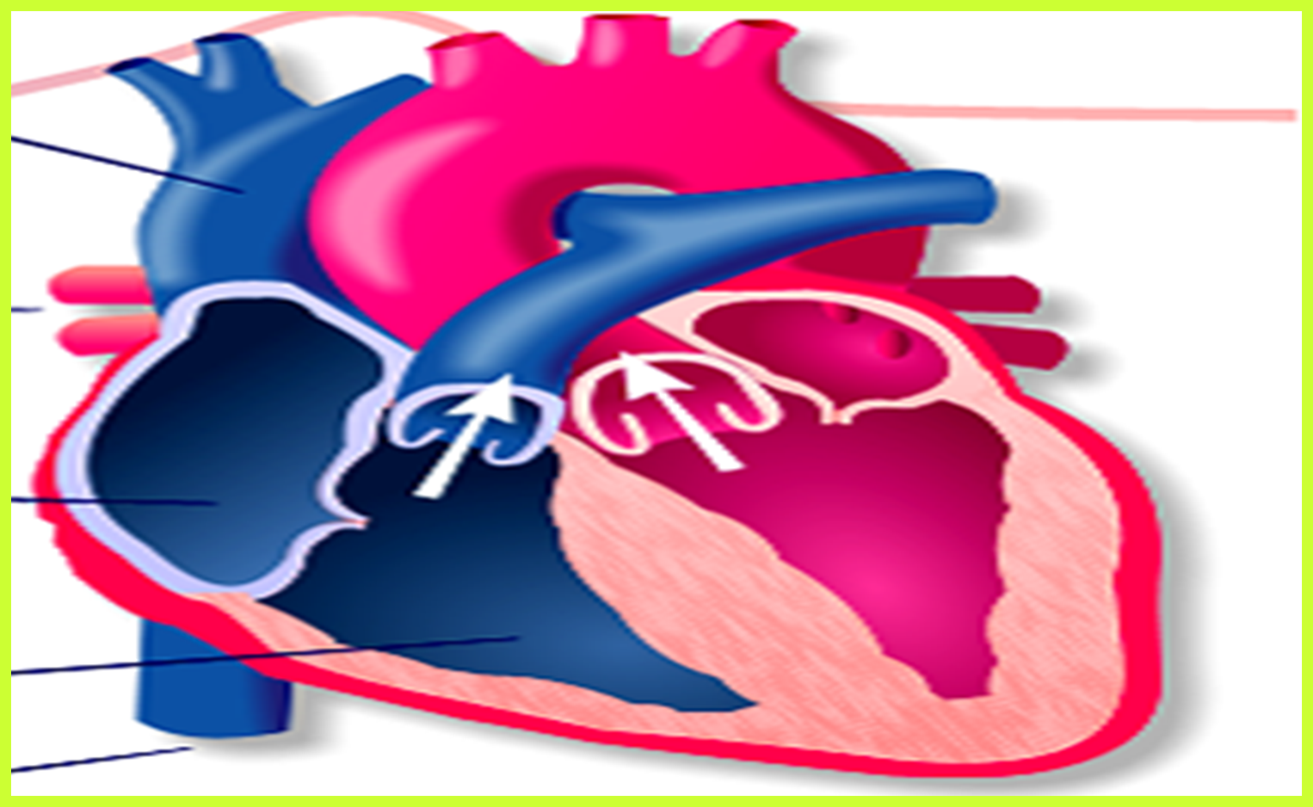
Normal O2 saturation :
95-100%
64-66%
64-67%
95-100%
64-67%
95-100%
64-67%
69-71%

Slide 14
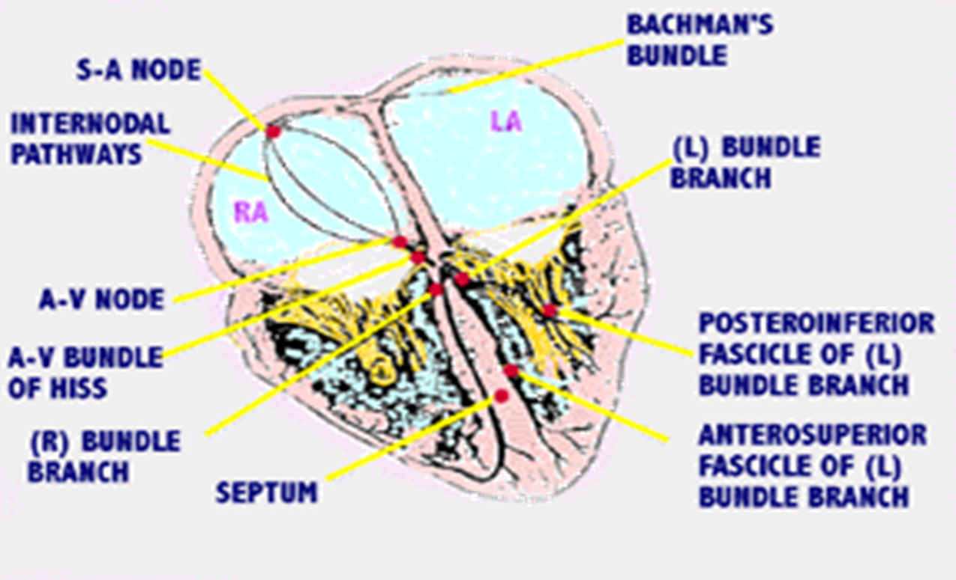
Conductive system :

Slide 15
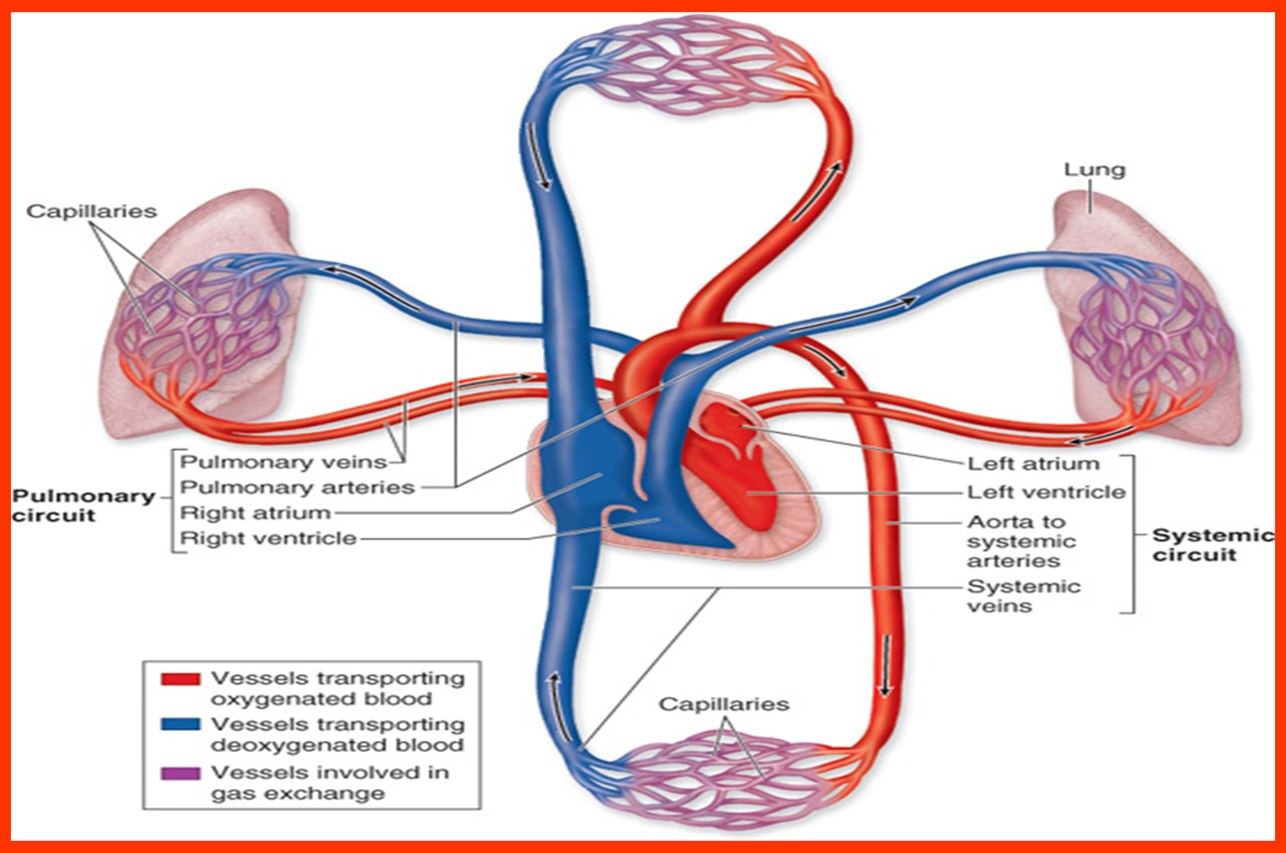
Circulation :

Slide 16
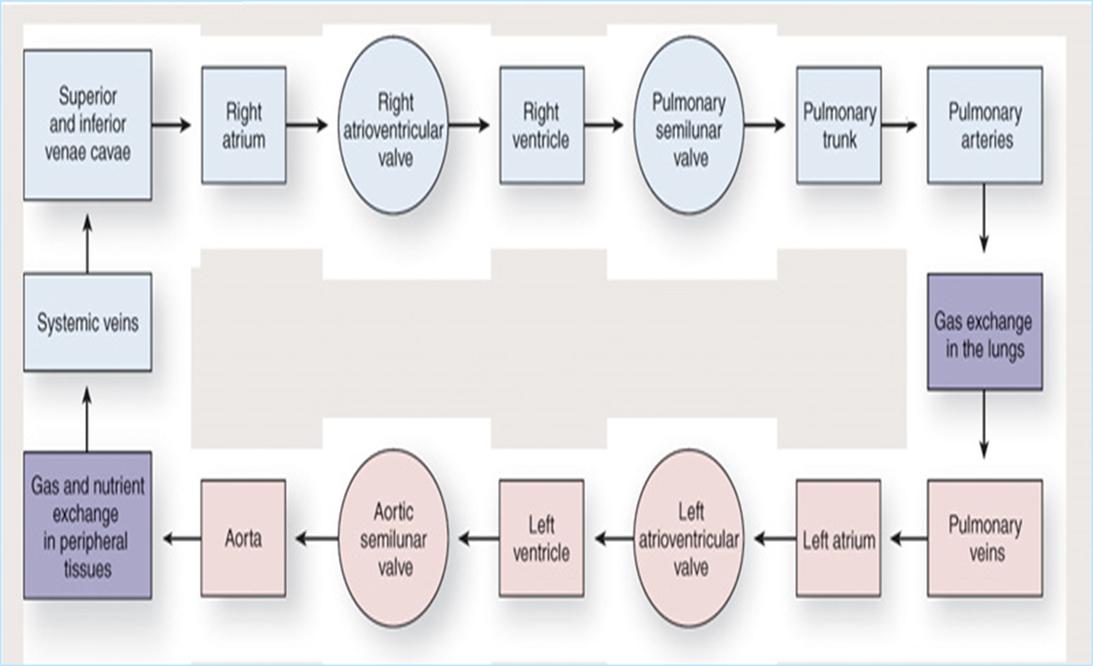
Circulation :

Slide 17
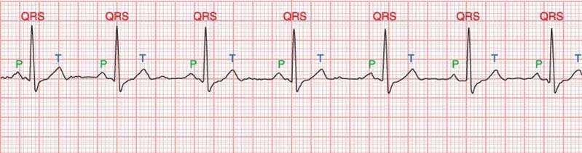

Electrocardiogram
Graphic representation of heart’s electrical activity
– often referred to as an ECG or EKG
I

Slide 18
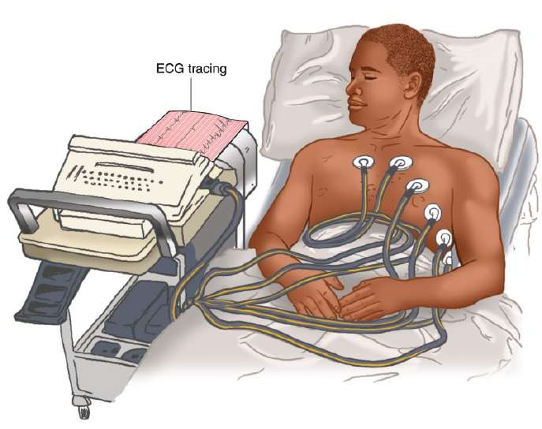
ECG Machine
Detects heart’s electrical current activity
– Displays it on a screen or prints it onto graph paper
I

Slide 19
ECG Machine
Identifies irregularities in heart rhythm
Reveals injury, death or other physical changes in heart muscle
Used as an assessment and diagnostic tool
Can continuously monitor heart’s electrical activity
I

Slide 20
What the ECG Won’t Do
Does not tell how well heart is pumping
– Patient must be properly assessed to ensure heart is functioning mechanically
I

Slide 21
The Heart
The pump of the circulatory system
  Contraction pushes blood throughout the body to deliver needed oxygen and nutrients to tissues and remove waste products
  Depending on body’s requirements, heart rate can either be increased or decreased
I

Slide 22
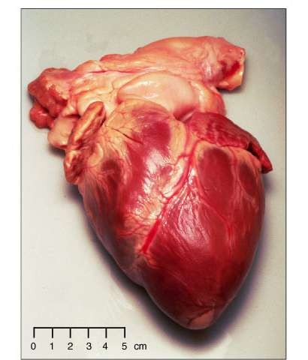
The Heart
Shaped like an
Base
inverted blunt cone
Base is the larger, flat part
Apex is the inferior end which tapers to a blunt, rounded point
Apex
I

Slide 23
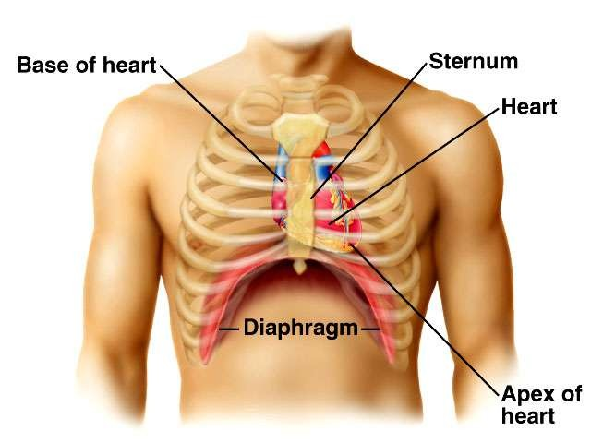
The Heart
Located between the two lungs in mediastinum behind the sternum

Slide 24
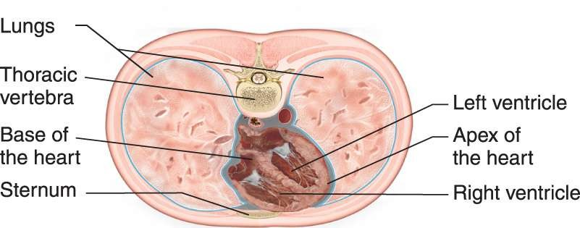
The Heart
Anterior-posterior orientation in the chest
  RV closer to front of left chest
  LV closer to side of left chest

Slide 25
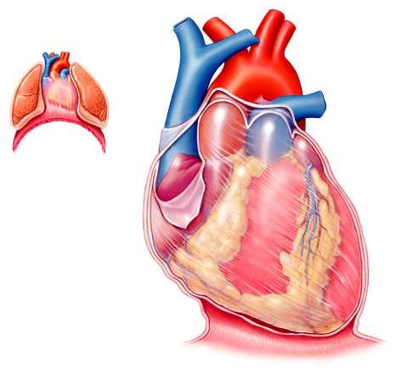
The Heart
Surrounded by pericardial sac (a double-walled closed sac)
  fibrous pericardium
  serous pericardium
I

Slide 26
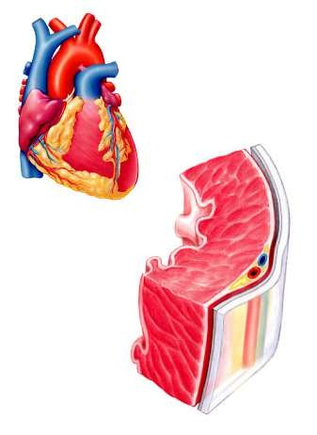
Heart Wall
Made up of three layers
  Epicardium (outermost)
  Myocardium (middle)
  Endocardium (innermost)
I

Slide 27
Heart Cells
Myocardial cells (working cells)
  Contract to propel blood out of heart’s chambers
Electrical conduction system cells
  Initiate and carry impulses throughout heart
I

Slide 28
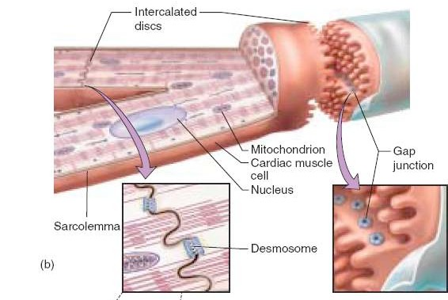
Myocardial Cells
Cylindrical and branching at their ends
  Intercalated disks and gap junctions allow rapid movement of electrical impulses from one cell to another
  Desmosomes hold cells together when heart muscle contracts
I

Slide 29
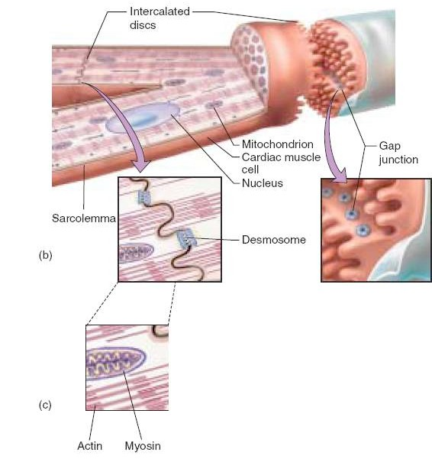

Working Cells
Myocytes
  Enclosed in sarcolemma
  Composed of two protein filaments
    Actin (thin)
    Myosin (thick)
I
A

Slide 30
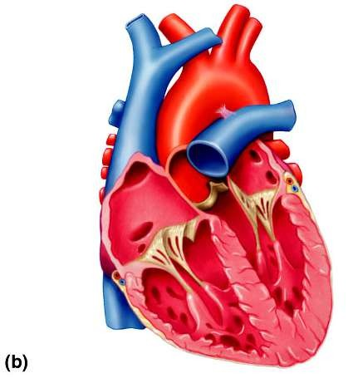
Internal Heart
Heart consists of four chambers
– 2 atria collect blood and deliver to ventricles
Left atrium
– 2 ventricles pump blood to pulmonary and systemic circulation
Septum separates heart into two functional units
Right atrium
Left ventricle
Right ventricle
Ventricular septum
I

Slide 31
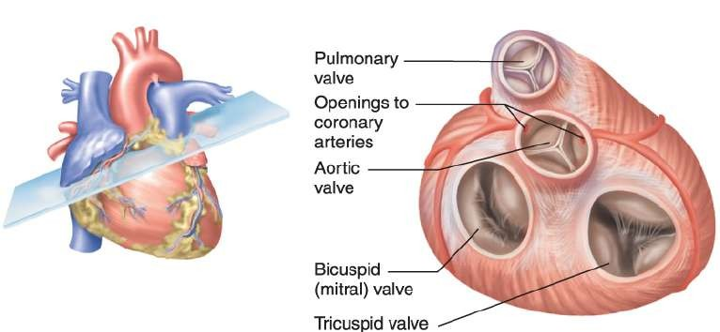
Heart Valves
Permit blood to flow through heart in only one direction
  Mitral and bicuspid valves (AV valves) located between
atria and ventricles
  Aortic and pulmonic valves (semilunar valves) located at base of aorta and pulmonary artery
I
A

Slide 32
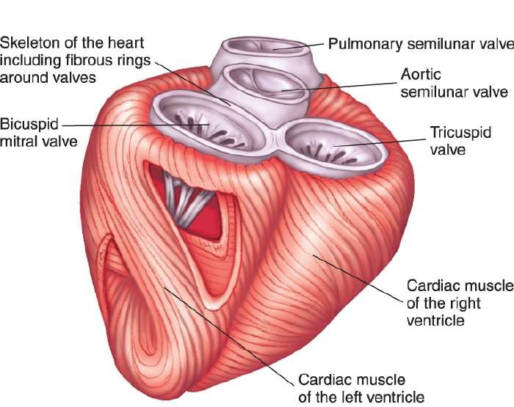
Skeleton of Heart
Forms fibrous rings around AV and semilunar valves
Provides firm support for valves and separates atria from ventricles
I

Slide 33
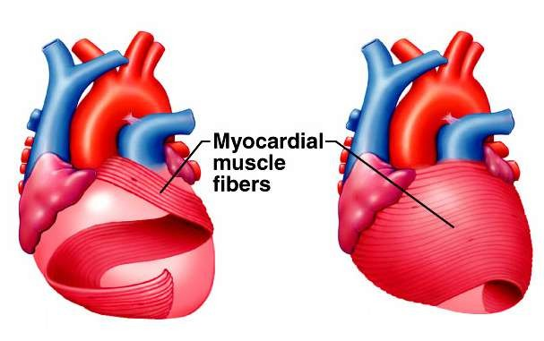
Cardiac Muscles
Attached to fibrous connective tissue
Contract ventricles in a wringing motion
I

Slide 34
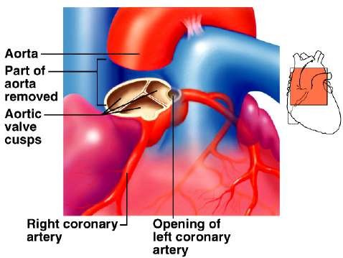
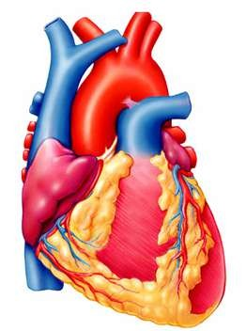
Coronary Arteries
Provide heart with most of its blood supply
Originate from base of ascending aorta
– Immediately above leaflets or cusps of aortic valve
I

Slide 35
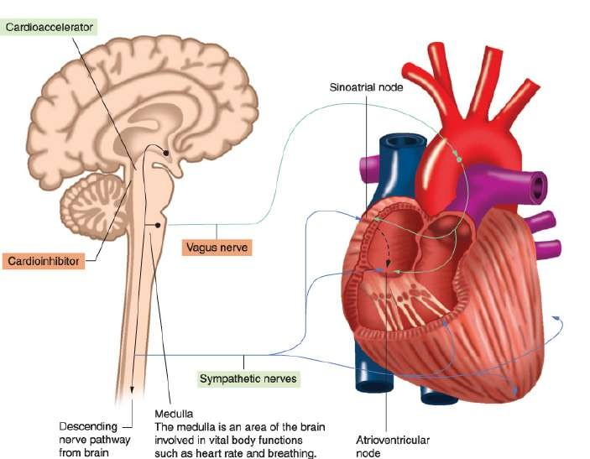
Blood Flow
Pulmonary circulation
  Pulmonary arteries carry deoxygenated blood to lungs
  Pulmonary veins carry oxygenated blood back to heart
Systemic circulation
  Arteries carry oxygenated blood
  Veins carry deoxygenated blood
I

Slide 36
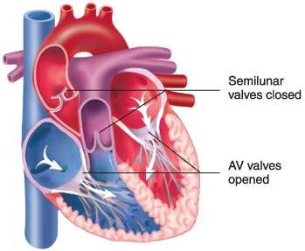
Cardiac Cycle
Diastole
– Relaxation and filling of atria and ventricles

Slide 37
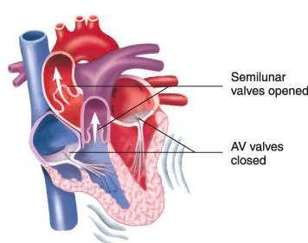
Cardiac Cycle
Systole
– Contraction of atria and ventricles

Slide 38
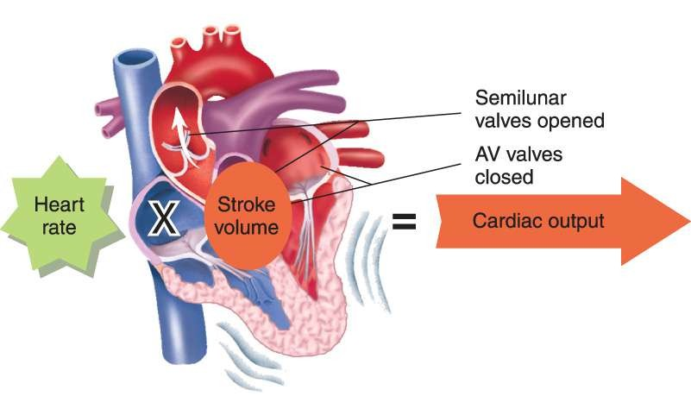
Cardiac Output
Amount of blood pumped from the heart in one minute
– Expressed in LPM
I

Slide 39
Blood Pressure
The force that blood exerts against walls of arteries as it passes through them
Equals cardiac output times peripheral vascular resistance
CO X PVR = BP

Slide 40
Influences on Heart
Receptors in blood vessels, kidneys, brain, and heart constantly monitor changes
  Baroreceptors identify changes in pressure
  Chemoreceptors sense changes in chemical composition of blood
A

Slide 41
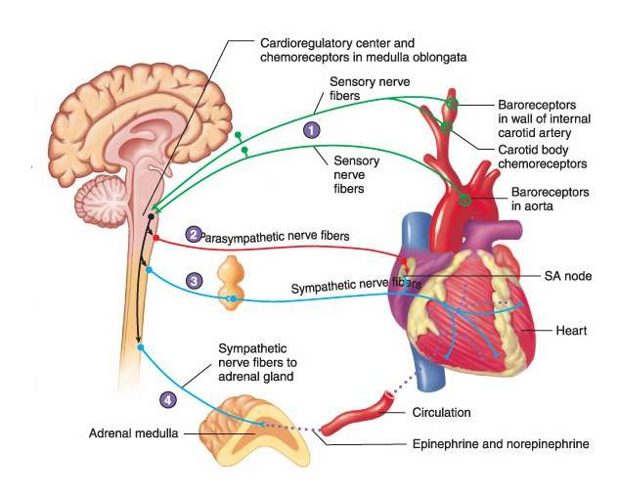
Baroreceptors and Chemoreceptors

Slide 42
Autonomic Nervous System
Helps regulate rate and strength of myocardial contractions
– Divided into sympathetic and parasympathetic nervous systems
I

Slide 43

Autonomic Nervous System

Slide 44
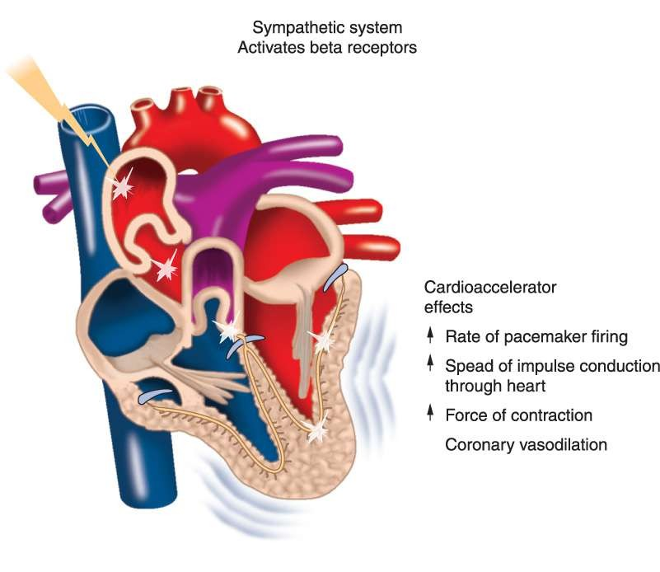
Sympathetic Stimulation
I

Slide 45
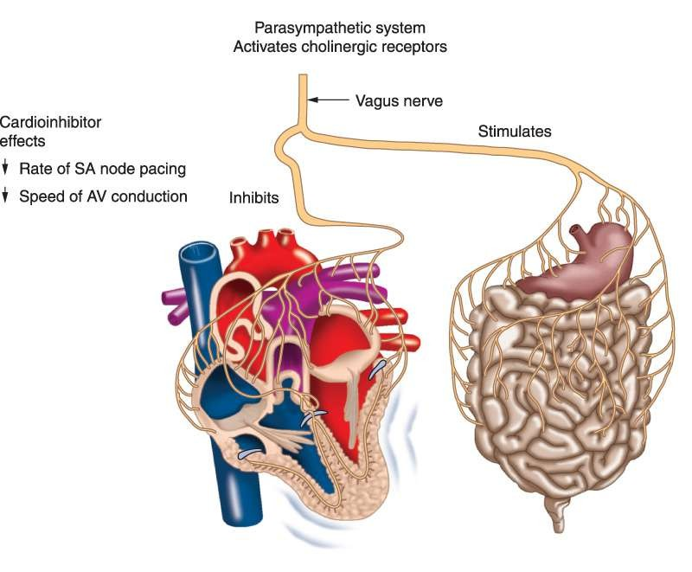
Parasympathetic Stimulation

Slide 46
Key Properties of Myocardial Cells
Automaticity
  Can produce electrical activity without outside nerve stimulation
Excitability
  Ability to respond to an electrical stimulus
Conductivity
  Ability to transmit an electrical stimulus from cell to cell throughout myocardium
Contractility
  Ability of myocardial cell to contract when stimulated by an electrical impulse

Slide 47
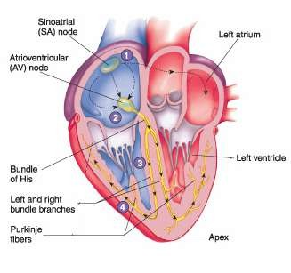
Heart’s Conduction System
Grouping of specialized tissues that carry wave of depolarization throughout heart
I

Slide 48
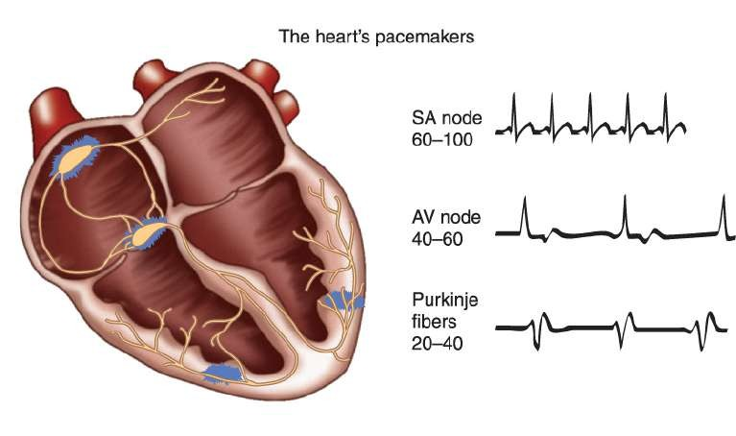
Pacemaker Sites
SA node is primary pacemaker site of heart
Other cardiac cells lower in conduction pathway play a back-up role
I

Slide 49
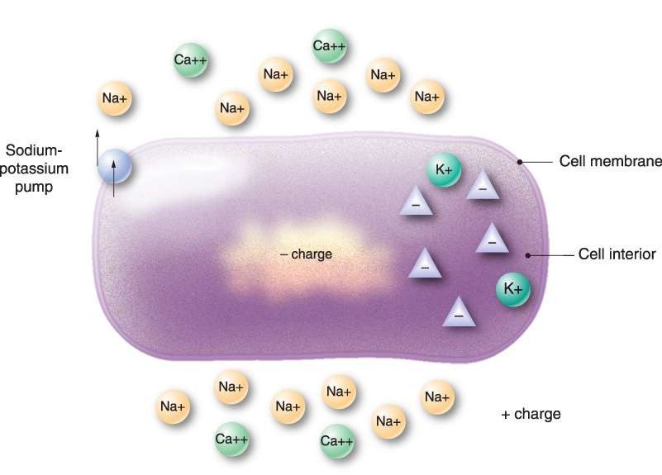
Polarized State
Inside of myocardial cells more negatively charged in relationship to outside where it is more positively charged
I

Slide 50
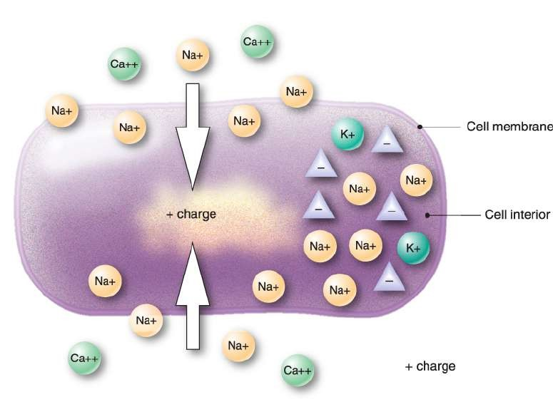
Depolarization
Occurs when positively charged ions move inside cells causing interior to become positively charged
– Change in electrical charge over time referred to as cell’s action potential
A

Slide 51
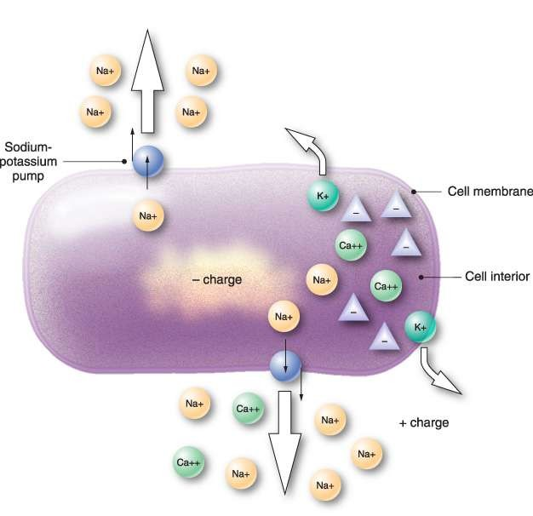
Repolarization
Follows depolarization and occurs when:
  Potassium leaves cell causing positive charge to lower
  Sodium and calcium are removed by special transport systems
I
A

Slide 52
Refractory Period
Absolute refractory period
  No stimulus no matter how strong will depolarize cell
Refractory period
  A sufficiently strong stimulus will depolarize myocardium

Slide 53
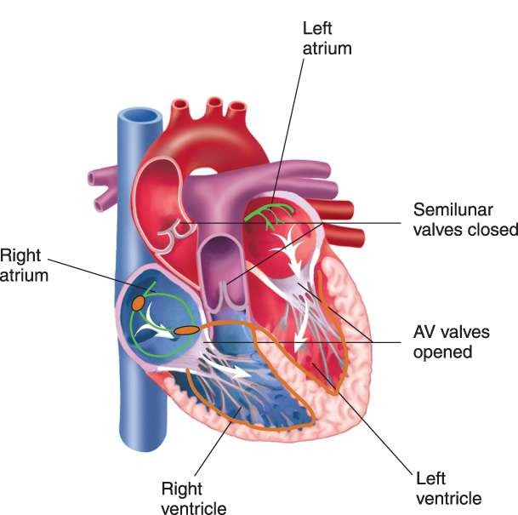
Putting it All Together
Cardiac cycle begins with RA and LA receiving blood from systemic and pulmonary circulations
– Rising pressure within atria forces tricuspid and mitral valves open
I

Slide 54
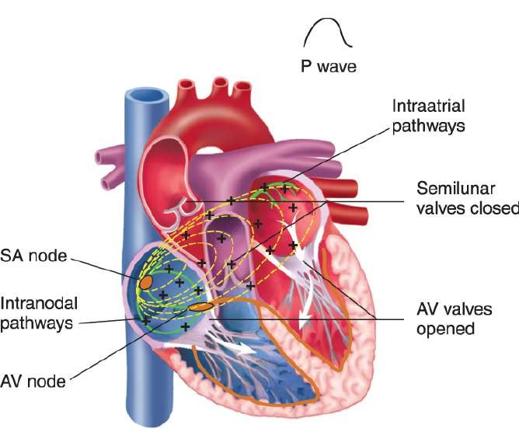
Putting it All Together
Heartbeat initiated by an electrical impulse that arises from SA node
Impulse travels through atria
– generates a positive waveform on ECG and contraction of atria
I

Slide 55
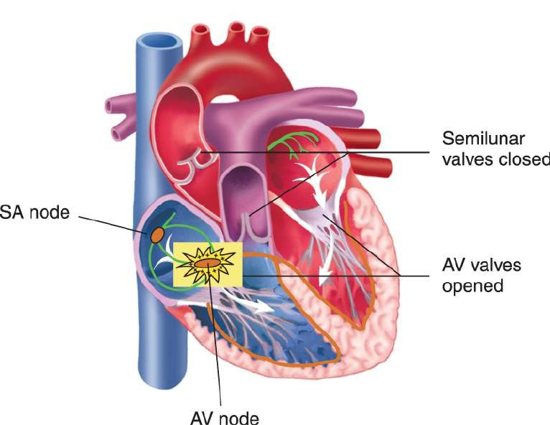
Putting it All Together
Impulse slows as it passes through AV node from atria to ventricles
– Allows atria time to finish filling ventricles

Slide 56
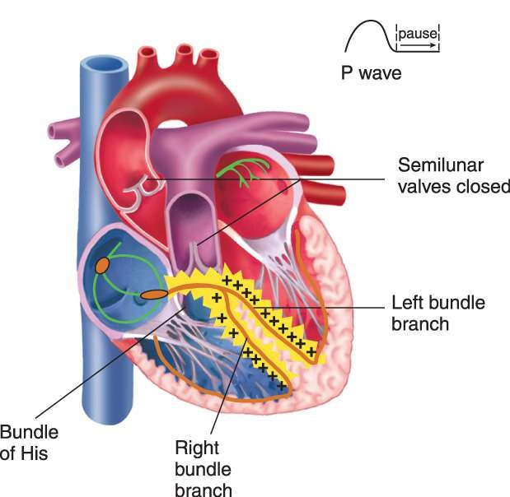
Putting it All Together
Impulse then rapidly travels through His- Purkinje system
– Seen as a flat line following P wave

Slide 57
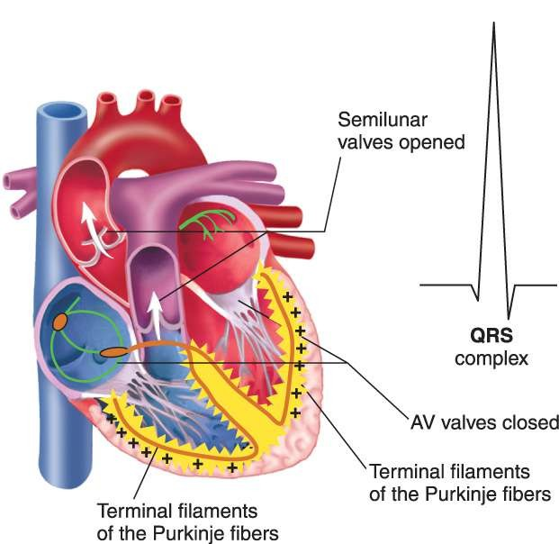
Putting it All Together
Depolarization of septum and ventricular walls generates QRS complex and contraction of ventricles
I

Slide 58

Putting it All Together
Repolarization of ventricles is represented on ECG by ST segment and T wave
I

Slide 59
Summary
Electrocardiogram detects electrical activity occurring in heart.
Nerve impulses stimulate cardiac muscles to contract.
Heart consists of two upper chambers, the atria and two lower chambers, the ventricles.
Heart is separated into right and left sides by the septum.
Coronary arteries perfuse myocardium during diastole.

Slide 60
Summary
Cardiac output is amount of blood pumped through circulatory system in one minute.
Rate and strength of myocardial contractions can be influenced by autonomic nervous system.
– Two divisions are the sympathetic and parasympathetic nervous systems.

Slide 61
Summary
Sodium, calcium and potassium are key electrolytes responsible for initiating electrical charges.
Depolarization of cells occurs when positive electrolytes move from outside to inside cell causing it to become more positively charged.
Depolarization of myocardial cells causes calcium to be released and come into close proximity with actin and myosin filaments of muscle fibers leading to myocardial contraction.

Slide 62
Summary
Myocardial depolarization progresses from atria to ventricles in an orderly fashion.
– Electrical stimulus causes heart muscle to contract.
Electrical impulse that initiates heartbeat arises from SA node.
From there it travels through atria generating a positive waveform on ECG and contraction of atria.
Impulse is slowed as it passes from atria to ventricles through AV node.

Slide 63
Summary
On ECG impulse traveling through His-Purkinje system is seen as a flat line following the P wave.
QRS complex is generated and ventricles contract as a result of electrical impulse stimulating ventricles.
ST segment and T wave represents repolarization of ventricles.
– Atrial repolarization occurs but is hidden by QRS complex.
Other sites in heart can assume control by discharging impulses faster than SA node or stepping in when SA node fails.
I

