Slide 1

Basic Physiological Parameters
Physiology Lab 1
Dr.Essa Allahham

Slide 2
Vital signs
Vital signs reflect the body's physiologic
status and provide information critical to
evaluating homeostatic balance.
Prior to measuring vital signs, the patient should have had the opportunity to sit for approximately 5 minutes .
All While patient is seated

Slide 3
It includes:
-Temperature,
-Respiratory rate
-Heart rate
-Blood pressure.

Slide 4
Purposes
To obtain base line data about the patient
condition
for diagnostic purpose
For therapeutic purpose

Slide 5
Time to assess vital signs:
-On admission to obtain baseline date
-symptoms such as chest pain or fainting
-Before and after the administration of certain medications that could affect RR or BP (Respiratory s. and CVS)
-Before and after surgery or an invasive diagnostic procedures

Slide 6
1.Temperature
It is the hotness or coldness of the body.
It is the balance between heat production &
heat loss of the body.
Normal body temperature using
oral 37 ° Celsius or 98.6 ° F
F = 1.8 °C + 32

Slide 7
Two types of body temp.:
1. Core temp.
Is the temperature of internal organs and it
remains constant most of the time (37°c);
with range of 36.5-37.5°c.
2. Surface Temperature:
• Surface body temperature: - is the temperature of the skin, subcutaneous tissue & fat cells and it rises & falls in response to the environment
• (Ranges between 20-40°c).

Slide 8
Factors affecting body temp.:
1.Age
2. circadian rhythm
3. Exercise
4. Hormones
5. Stress
6. Environment

Slide 9
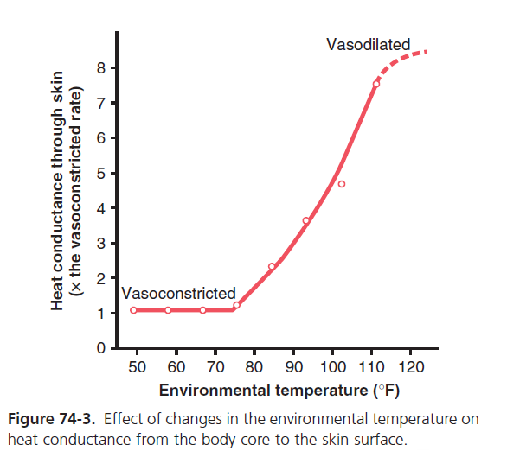

Slide 10
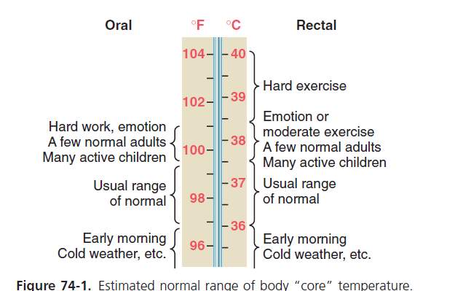

Slide 11
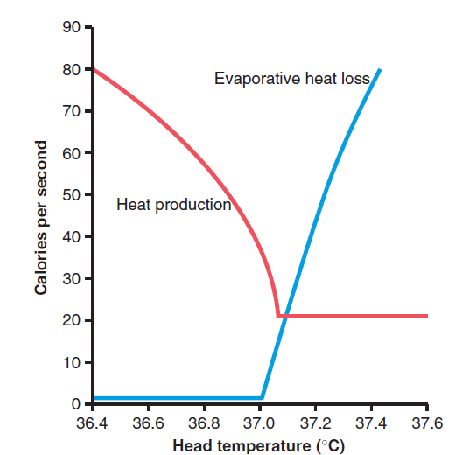
“SET POINT” FOR TEMPERATURE CONTROL
at a critical body core temperature of about 37.1°C (98.8°F), drastic changes occur in the rates of both heat loss and heat production.
At temperatures above this level, the rate of heat loss (e.g. sweating) is greater than that of heat production, so the body temperature falls and approaches the 37.1°C level.
At temperatures below this level, the rate of heat production (e.g. shivering) is greater than that of heat loss, so the body temperature rises and again approaches the 37.1°C level.
This crucial temperature level is called the “set point” of the temperature control mechanism—that is, all the temperature control mechanisms continually attempt to bring the body temperature back to this set point level.

Slide 12
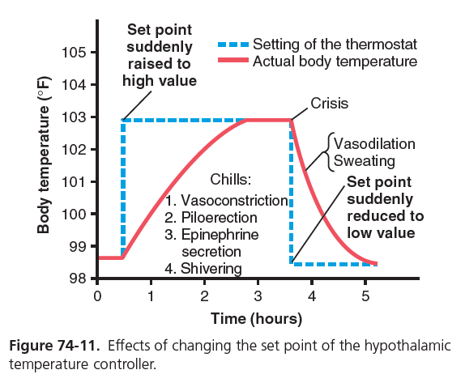
Resetting the Hypothalamic Temperature-Regulating Center in Febrile Diseases—Effect of Pyrogens
toxins released from bacterial cell membranes, can cause the set point of the hypothalamic thermostat to rise. Substances that cause this effect are called pyrogens.
When the set point of the hypothalamic temperature-regulating center becomes higher than normal, all the mechanisms for raising the body temperature are brought into play, including heat conservation and increased heat production. Within a few hours after the set point has been increased, the body temperature also approaches this level

Slide 13
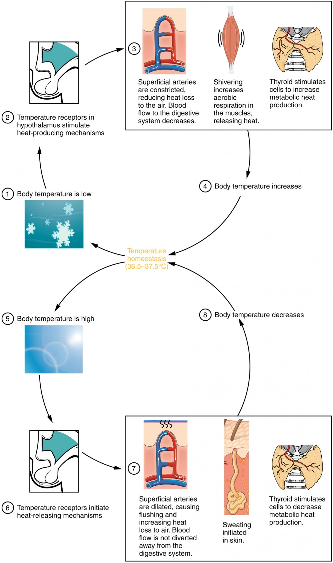

Slide 14
4 sites to measure temp.:
rectally , orally , axillary or tympanic (ears) .
Oral : The normal oral temperature for adults is about (37° C). The normal oral temperature for a child is between (36.4° and 37.4° C) using digital thermometer or mercury filled thermometer .
Rectally : The normal rectal temperature (36.0 to 37.7° C) using mercury or digital thermometer .
( 0.5-0.7 higher than orally)

Slide 15
Axillary temperature : A normal axillary temperature is between (35.9° C) and (36.7° C). The normal axillary temperature is usually a degree lower than the oral (by mouth) temperature. ( 0.3-0.4 lower)
Tympanic : a special thermometer can quickly measure the tempreture of the ear drum , which reflects the body’s core tempreture ..

Slide 16
Normal body temperature is 37 °c (range is 36-38 °c) (96.8 - 100 °F)
Body temperature may be abnormal due to fever(high temperature) or hypothermia (low temperature).
Pyrexia, fever: a body temperature above the normal ranges > 37.8 or > 38 °C
Hyperpyrexia: a very high fever >41 °c, >42 °c leads to death
Hypothermia: temp. between 34-35 °c, <34 °c leads to death

Slide 17
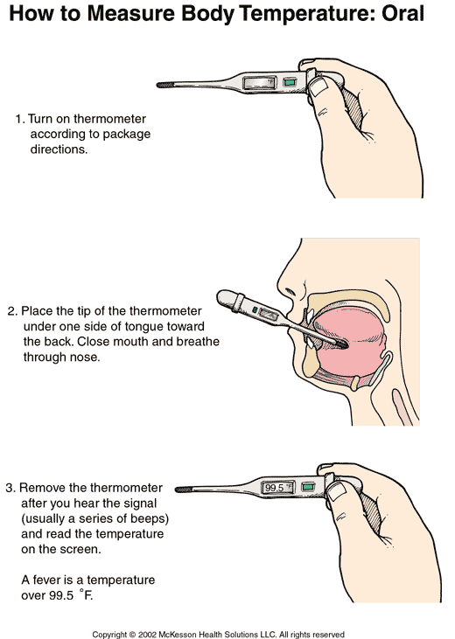
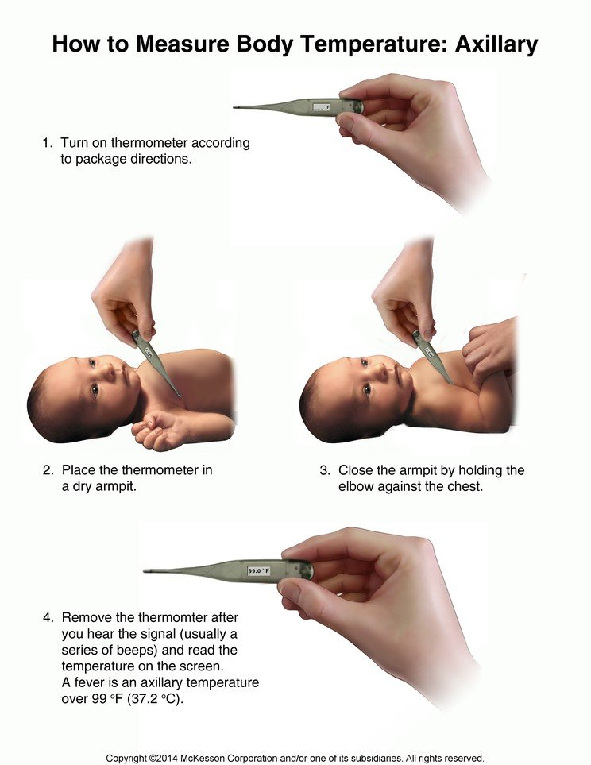

Slide 18
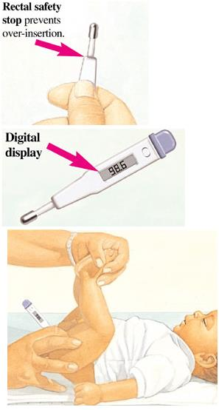
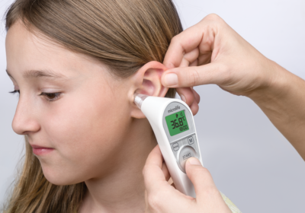

Slide 19
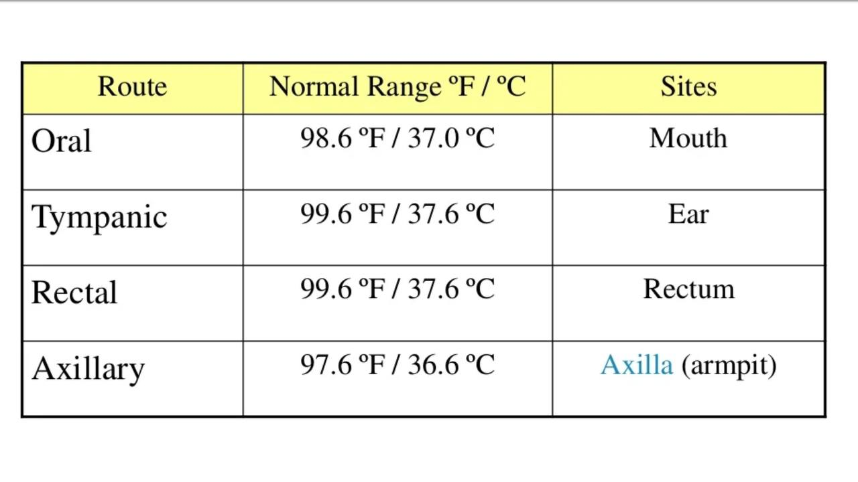

Slide 20
2. Respiratory rate
RR = the number of breaths a person takes per minute .
Respiration is the process of taking in oxygen and expelling carbon dioxide
​
1 inspiration + 1 expiration = respiration

Slide 21
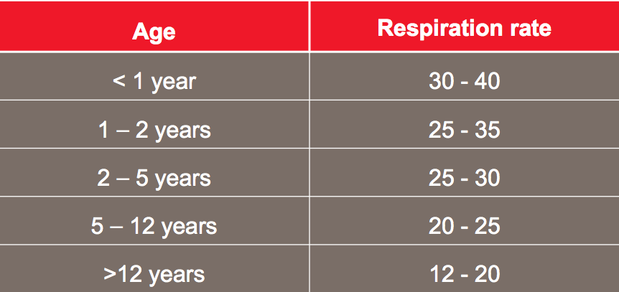
Normal respiratory rate

Slide 22
RR
Normal RR range from 12-20 breaths/minute ..
RR over 20 breaths/minute or under 12 breaths/minute may be considered abnormal .

Slide 23
Terminology
Dyspnea: difficult or labored breathing
Apnea: absence of respirations, usually temporary
Tachypnea: respiratory rate above 25 respirations per minute.
Bradypnea: slow respiratory rate, usually below 10 respirations per minute
Orthopnea: severe dyspnea in which breathing is very difficult in any position other than sitting erect or standing

Slide 24
Evaluate for …
Rhythm of respirations
Refers to the regularity or equal spacing between breaths Described as regular (or even) or irregular
Character of respirations
Refers to the depth and quality of respirations
Type of respirations
Thoracoabdominal
Abdominothoracic

Slide 25
Abnormal Respirations
Cheyne-Stokes: periods of dyspnea followed by periods of apnea; frequently noted in dying patient
Rales: bubbling or noisy sounds caused by fluids or mucus in the air passages
Wheezing: Difficult breathing with a high pitched sound during expiration caused by narrowing of bronchioles (as seen in asthma) and/or an obstruction or mucus accumulation in the bronchi
Kussmaul breathing is an abnormal respiratory pattern that is characterized by deep and rapid breathing. This is often seen in patients with metabolic acidosis.

Slide 26
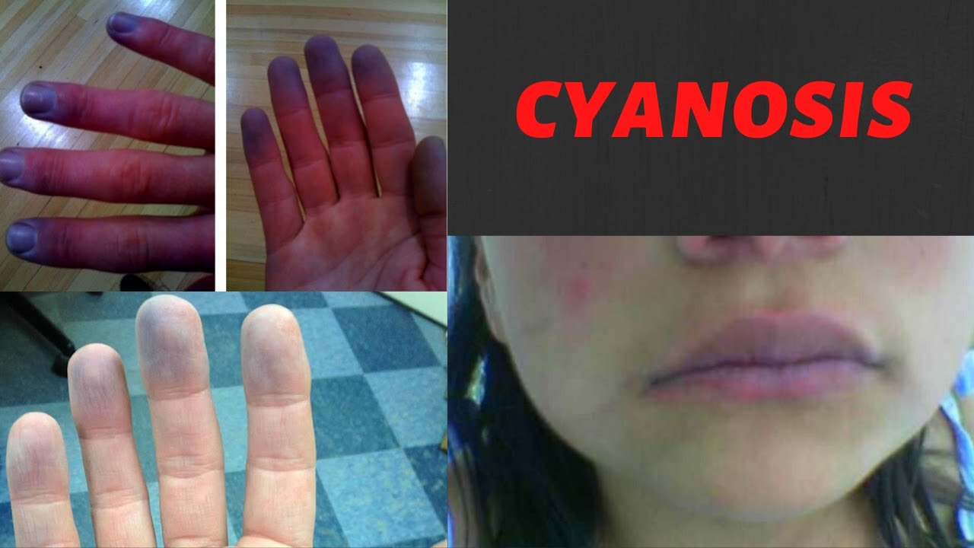
Cyanosis
Bluish discoloration of the skin, lips, and/or nail beds, as a result of increased the deoxygenated blood

Slide 27
RR assessment:
Respirations are partially under voluntary control
Do not tell a patient you are counting respirations
Keep your hand on pulse site while measuring respirations so the patient will think you are still counting pulse and will not be as likely to alter respiration

Slide 28
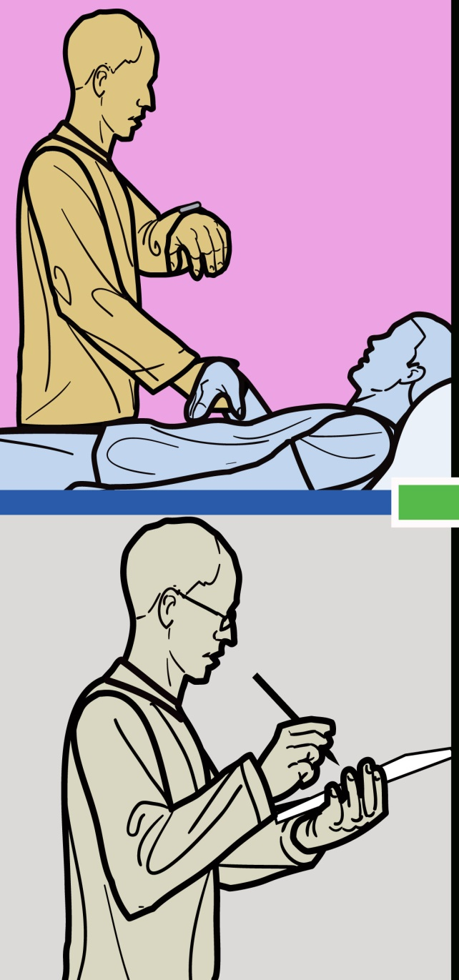
RR assessment:
The patient should be at rest
Assessed by watching the movement of chest or abdomen
They should be counted for at least 30 (if regular) sec then multiplied by 2.

Slide 29
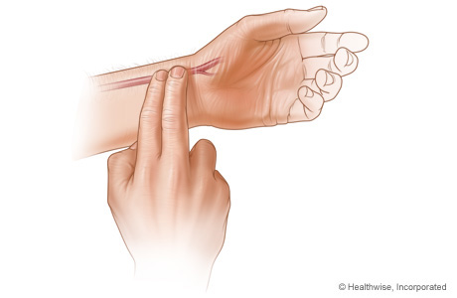
3. Pulse rate
pulse is a wave of blood created by contraction of left ventricle

Slide 30
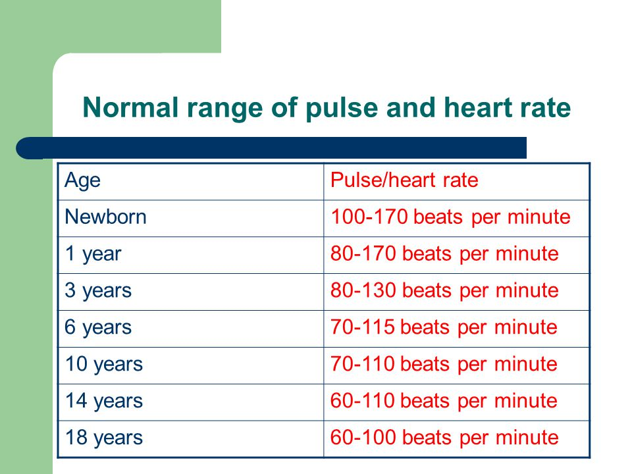

Slide 31
The normal pulse for healthy adults range from 60-100 beats/minute .
The pulse rate may be increased with exercise , illness , injury, fever and emotions .
Athlete’s , such as runners , may have heart rates in the 40’s and experience no problems .

Slide 32
Major Arterial/Pulse Sites
Carotid: side of the neck
Brachial: inner aspect of forearm at the antecubital space (crease of elbow), used for blood pressure
Radial: inner aspect of wrist, above thumb, most common site for measuring pulse
Femoral: inner aspect of upper thigh
Popliteal: behind knee
Posterior Tibial: behind the medial malleolus
Dorsalis pedis: top of foot arch

Slide 33
How to check pulse ..

Slide 34
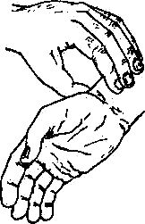
Radial pulse
Place the tips of your index and middle fingers just proximal to the patients wrist on the thumb side, orienting them so that they are both over the length of the vessel.

Slide 35
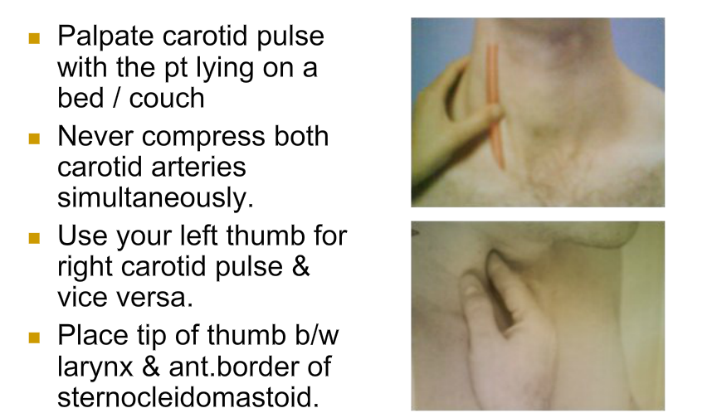
Carotid pulse

Slide 36
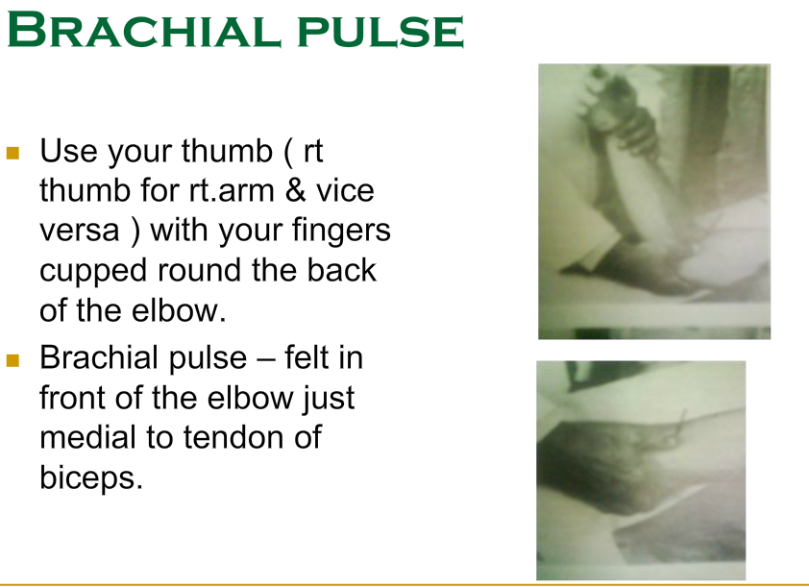
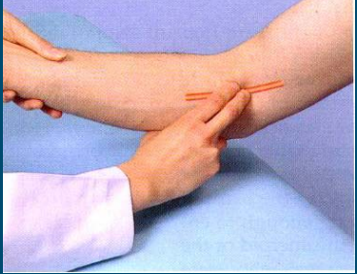
Brachial pulse

Slide 37
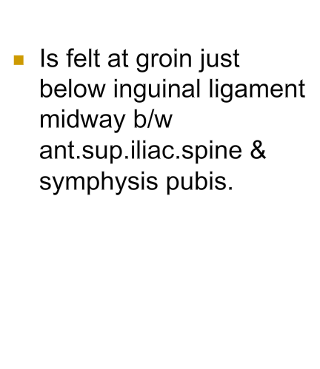
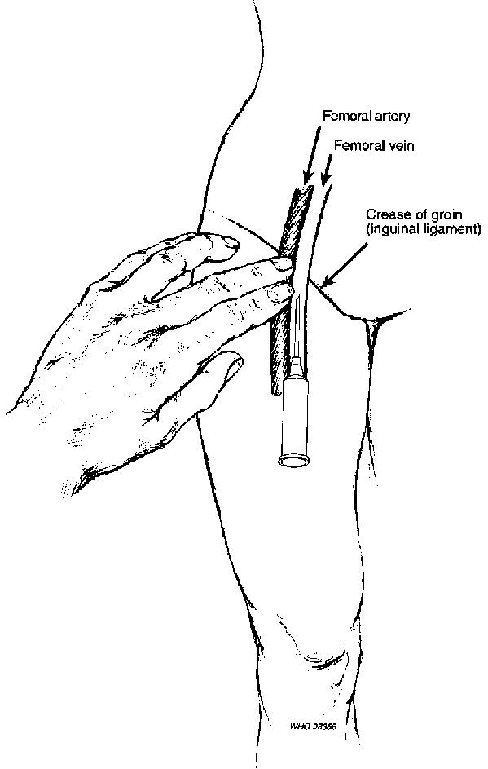
Femoral pulse

Slide 38
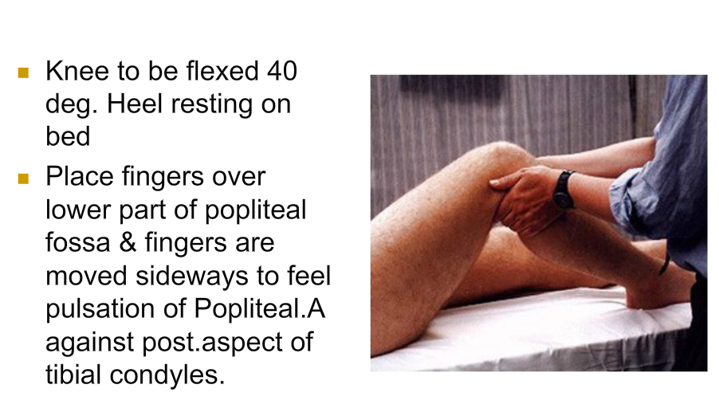
Popliteal pulse

Slide 39
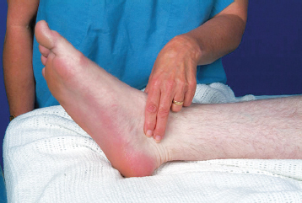
Posterior Tibial pulse
The posterior tibial pulse can be felt behind and below the medial malleolus.

Slide 40
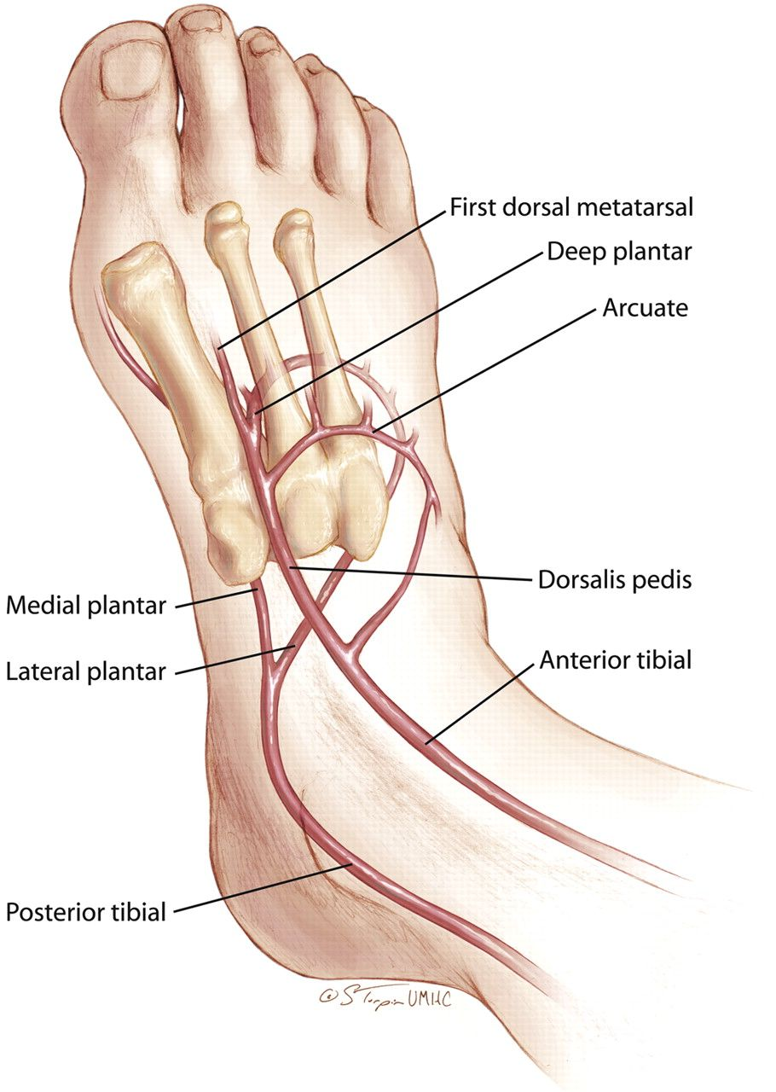
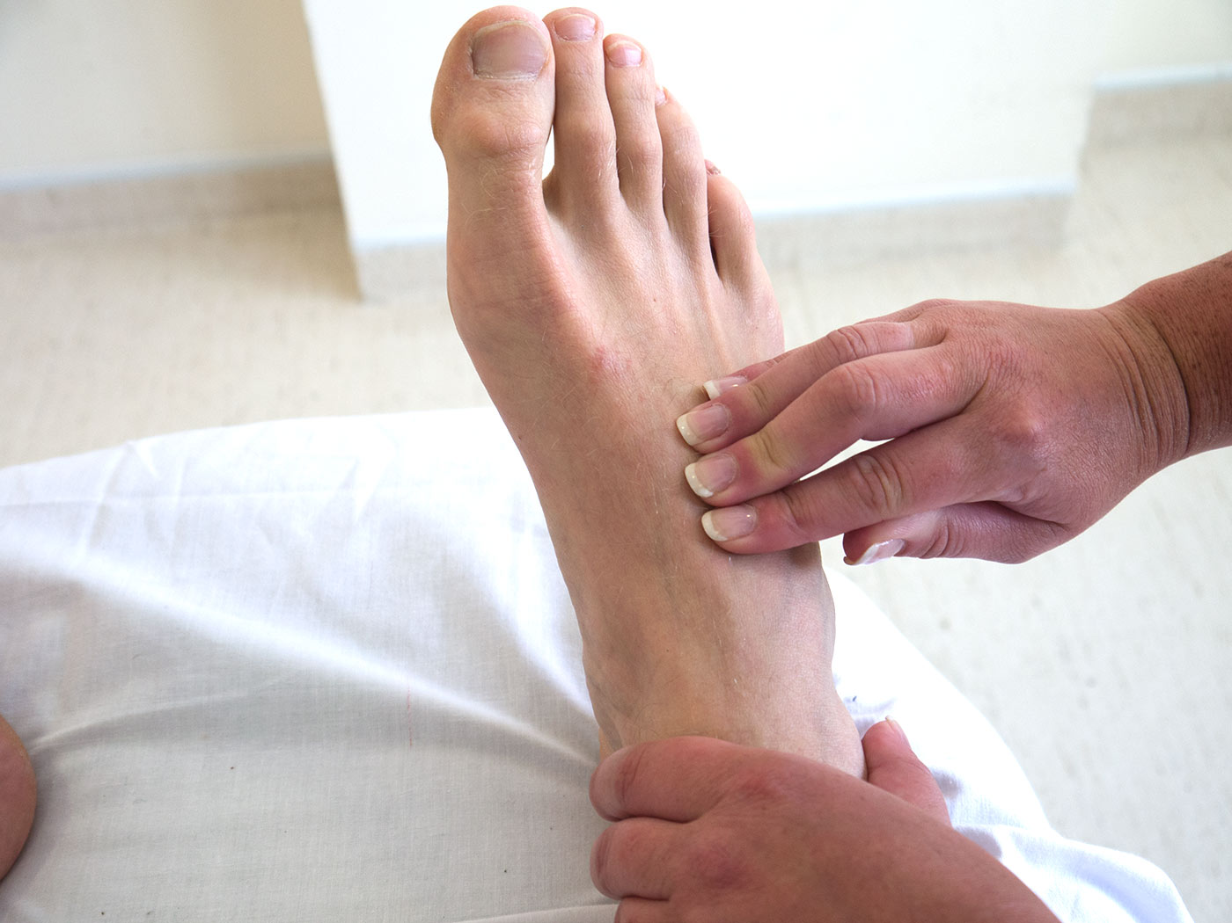
Dorsalis pedis pulse
The dorsalis pedis pulse is palpable on the dorsum of the foot in the first intermetatarsal space just lateral to the extensor tendon of the great toe.

Slide 41
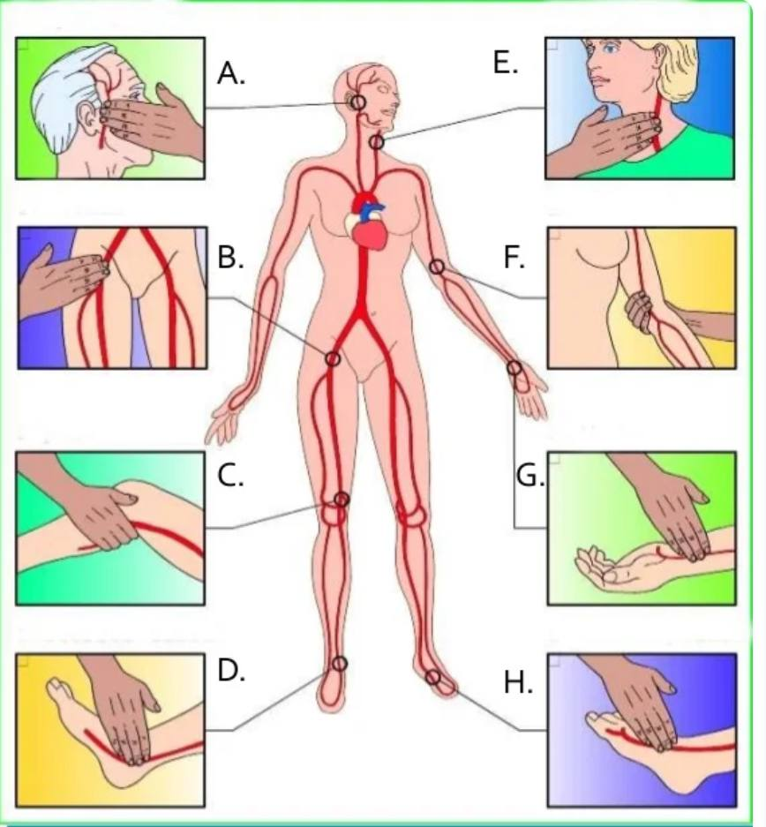

Slide 42
Assessment of pulse
Features the examiner should note :
Rate
Rhythm(regular\irregular)
Volume
Synchronicity
Radio-femoral delay

Slide 43
Rate
Count the pulse for 1 minute
Normal : 60-100/min
Tachycardia : > 100/min
Bradycardia : <60/min

Slide 44
Sinus tachycardia :
Physiological : infants , children , emotion , exertion .
Pathological : anemia , overactive thyroid (hyperthyroidism)
,medication side effects .

Slide 45
Sinus bradycardia :
Physiological : athletes , sleep .
Pathological : severe hypoxia , hypothyroidism, hypothermia , drugs : beta blockers .

Slide 46
Rhythm = Regularity
Is the time between beats constant?. Irregular rhythms, are quite common
Regular pulse
Irregular pulse
Irregular regularity
Irregular irregularity (AF)

Slide 47
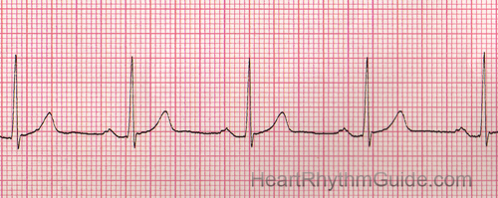
Regular pulse

Slide 48
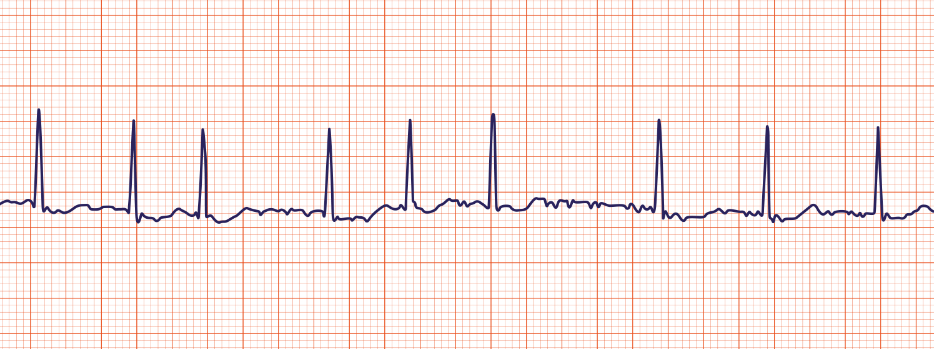
Irregular pulse

Slide 49
Pulse volume
It is the amount of blood pumped with each beat.
Described by words such as high , strong , weak or bounding pulse

Slide 50
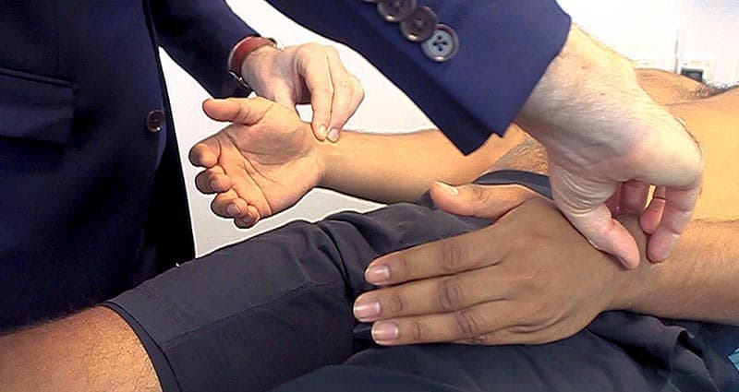
Synchronicity
Comparison between artery on both sides of the body .

Slide 51
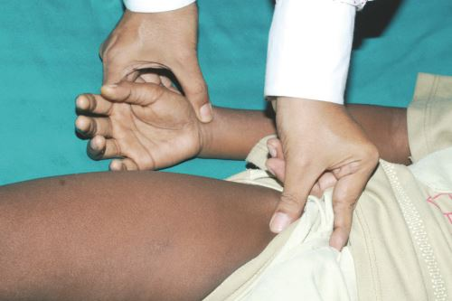
Radio-femoral delay
A delay between the upstroke of the radial pulse and a femoral pulse who presence indicates coarctation of the aorta

Slide 52
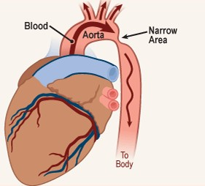

Slide 53
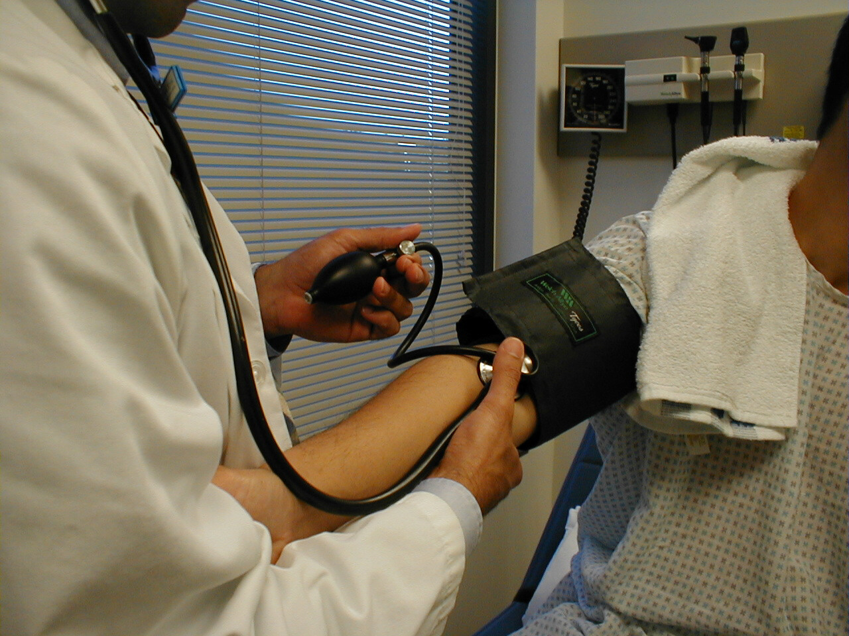
4. Blood pressure

Slide 54
Instructions
Don’t eat or drink anything 30 minutes before you take your blood pressure.
Empty your bladder before your reading.
Sit in a comfortable chair with your back supported for at least 5 minutes before your reading.
Put both feet flat on the ground and keep your legs uncrossed.
Rest your arm with the cuff on a table at chest height.
Make sure the blood pressure cuff is suitable .
The cuff should be against your bare skin, not over clothing.
Do not talk while your blood pressure is being measured.

Slide 55
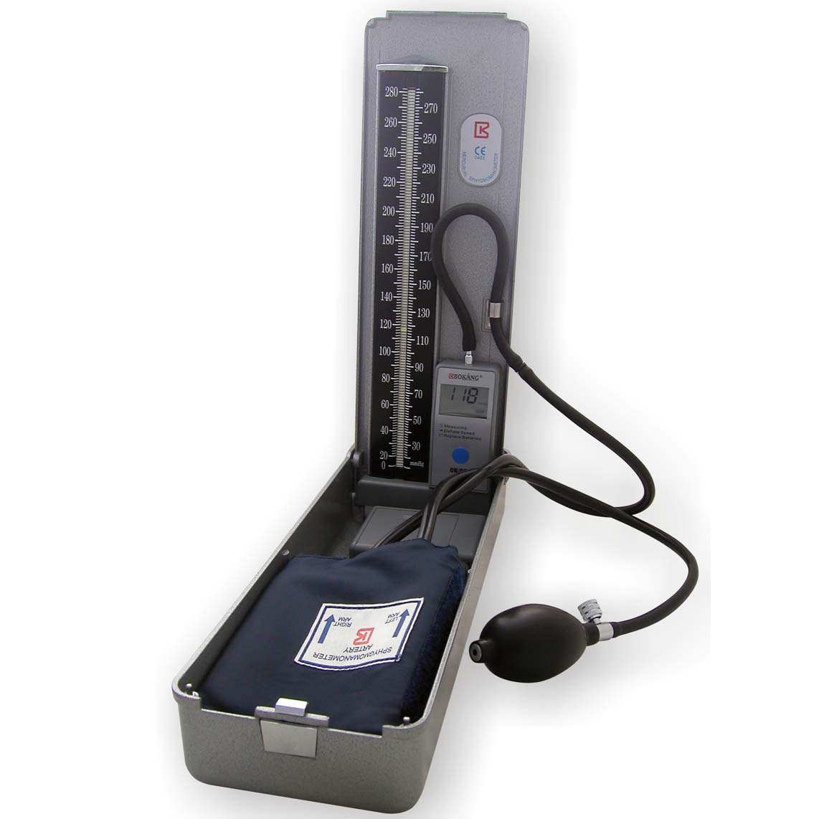
Equipment
Stethoscope
blood pressure cuff of appropriate size
Sphygmomanometer

Slide 56
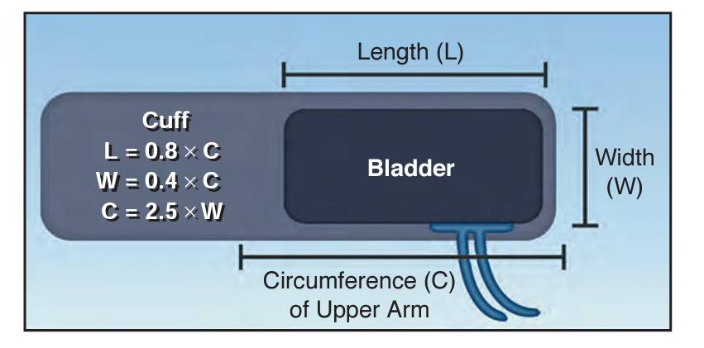

Slide 57
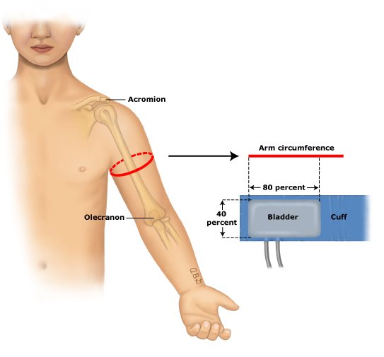

Slide 58
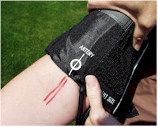
Cuff position :
Cuff applied directly over skin ,
Position lower cuff border 2.5 cm above antecubital fossa .
Center of inflatable bladder over brachial artrey .

Slide 59
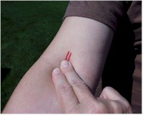
Feel for a pulse from the artery coursing through the inside of the elbow (antecubital fossa).
Wrap the cuff around the patient's upper arm .
With your left hand place the stethoscope head directly over the artery you found. Press in firmly but not so hard that you block the artery.

Slide 60
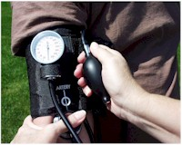
Use your right hand to pump the squeeze bulb several times and Inflate the cuff until you can no longer feel the pulse to level above suspected SBP .
If you immediately hear sound, pump up an additional 20 mmHg and repeat

Slide 61
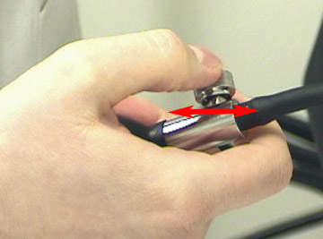
Deflate cuff slowly at a rate of 2-3 mmHg per second until you can again detect the pulse
Listen for auditory vibrations from artery "bump, bump, bump" (Korotkoff sounds)

Slide 62
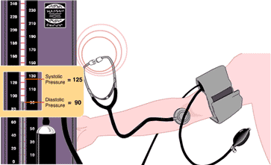
Systolic blood pressure is the pressure at which you can first hear the pulse.
Diastolic blood pressure is the last pressure at which you can still hear the pulse .

Slide 63
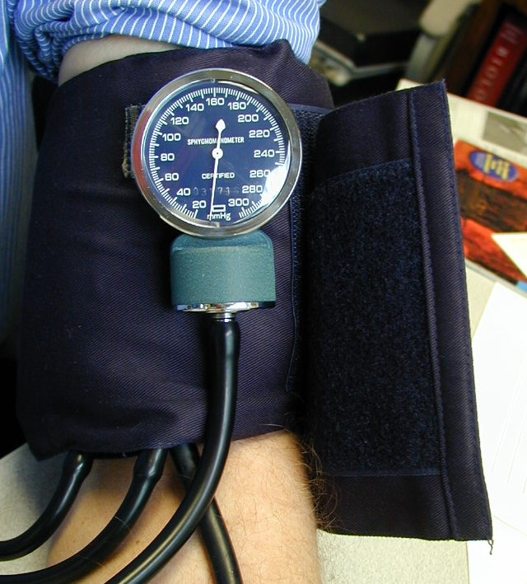
The two arm readings should be within 10-15 mm Hg. Differences greater then 10-15 imply differential blood flow.

Slide 64
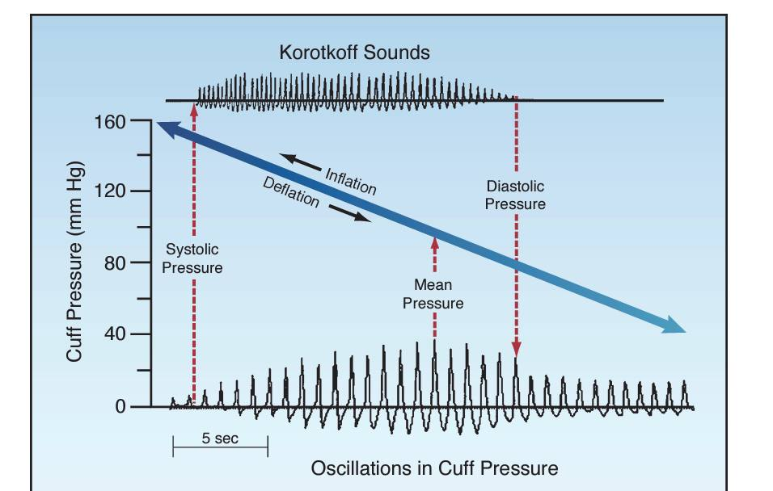

Slide 65
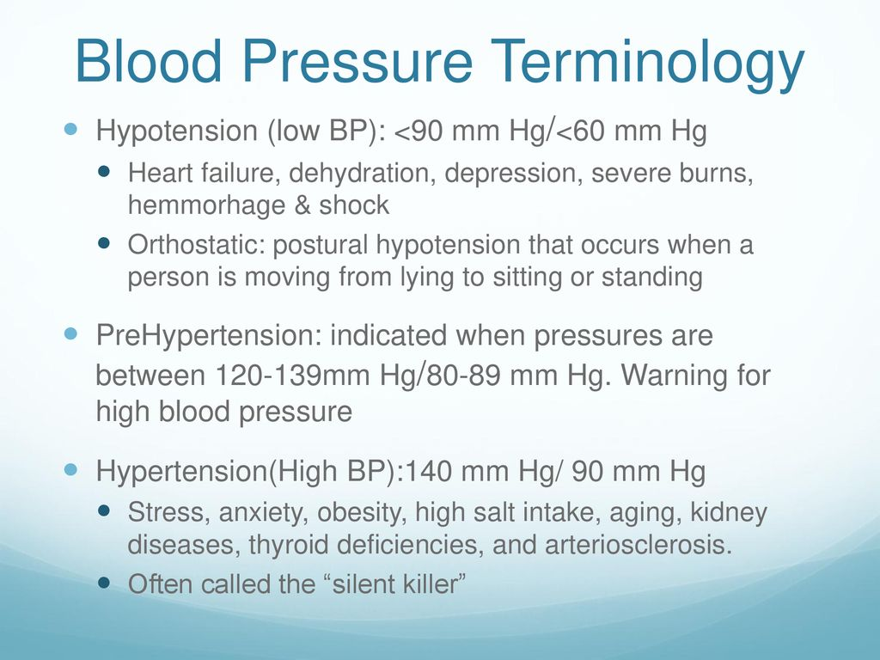

Slide 66
Hypertension
DBP | SBP | Category
<80 | <120 | Normal
<80 | 120-129 | Elevated BP
80-89 | 130-139 | Hypertension-stage 1
>90 | >140 | Hypertension-stage 2

Slide 67
Hypotension : ( BP below normal ) when SBP less than 90 or a pressure 25 mmHg lower than usual .. Causes?
Orthostatic hypotension?
Reduction of 20 mmHg in SBP or reduction of 10 mmHg in DBP

Slide 68
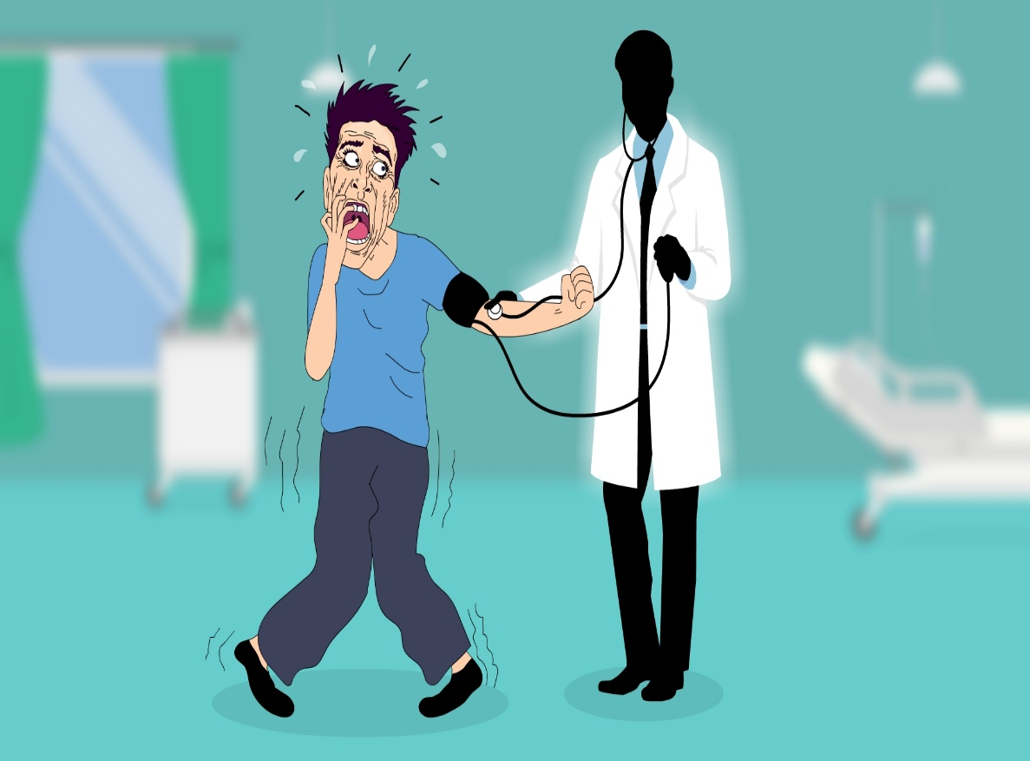
white coat syndrome
White coat syndrome, or white coat hypertension, is the term for when you get a high blood pressure reading in a doctor’s office and a normal reading at home. The anxiety of being around doctors in white coats can make your blood pressure rise. Most people don’t need treatment if their blood pressure is normal at home.

Slide 69
Thank you

