Slide 1
Cardiac cycle
Dr.Dina Haboush

Slide 2
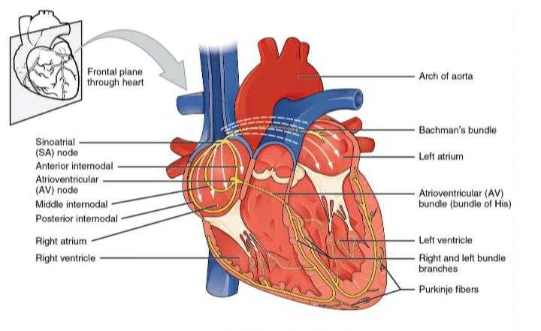

Slide 3
Cardiac cycle is defined as the succession of coordinated events taking place in the heart during each beat
Each heart beat consists of two major periods called systole and diastole
During systole heart contracts and pumps the blood through arteries
During diastole heart relaxes and blood is filled in the heart
All these events are repeated in a cyclic manner

Slide 4
EVENTS OF CARDIAC CYCLE
Atrial Events
Ventricular Events

Slide 5
Ventricular Events
Ventricular Systole = 0.27 (0.3) sec
Ventricular diastole = 0.53 (0.5) sec
Clinical terms
Systole =Ventricular Systole
Diastole = Ventricular Diastole

Slide 6
Atrial systole is also known as last rapid filling phase or presystole.It is usually considered as the last phase of ventricular diastole.
The duration is 0.11 sec.During this period, only a small amount of blood is forced from atria into ventricles.

Slide 7
Cardiac Cycle
1) The heart at rest: atrial and ventricular diastole
The atria are filling with blood from the veins, and the ventricles have just completed a contraction
The AV valves between the atria and ventricles open, Blood flows from the atria into the ventricles.

Slide 8
2) Atrial systole
80% of blood enters the ventricles passively, but the last 20% of filling is accomplished by atrial contraction which push blood into the ventricles
At the end of atrial systole the ventricles contain the largest volume they will holdduring the cycle (End-diastolic volume (EDV)

Slide 9
3) Isovolumic ventricular contraction
When ventricular contraction begins, AV valves closes but does not create enough pressure to open semilunar valves
With both the AV valve and the semilunar valve closed, blood in the ventricle has nowhere to go

Slide 10
4) Ventricular ejection: The heart pumps
As the ventricles contract, they generate enough pressure to open the semilunar valves and push blood into the arteries.
The pressure created by ventricular contraction becomes the driving force for blood flow. High-pressure blood is forced into the arteries
The heart does not empty itself completely of blood each time the ventricle contracts. The volume of blood left in the ventricle at the end of contraction is known as the end systolic volume (ESV).

Slide 11
5) Isovolumic ventricular relaxation
Ventricles relax, pressure in ventricles falls. Blood flows back into cusps of semilunar valves and snaps them closed.
Once the semilunar valves close, the ventricles again become sealed chambers. The AV valves remain closed because ventricular pressure, although falling, is still higher than atrial pressure This period is called isovolumic ventricular relaxation because the volume of blood in the ventricles is not changing.

Slide 12
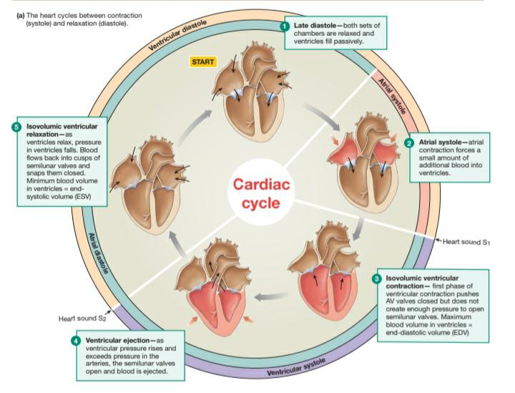

Slide 13
First Heart Sound - closure of atrioventricular valves at the beginning of this phases produces first heart sound
Second Heart Sound: Closure of Semilunar valves during this phase produces second heart sound.

Slide 14
  Stroke Volume
The amount of blood pumped by one ventricle during a contraction.
It is measured in milliliters per beat
Stroke Volume = EDV-ESV (Volume of blood before contraction-volume of blood after contraction)
For the average contraction in a 70-kg person at rest:135 mL-65 mL = 70 mL, the normal stroke volume

Slide 15
Ejection fraction: the percentage of EDV ejected with one contraction (stroke volume/EDV)
For the 70-kg man at rest: if the EDV is 135 mL and the stroke volume is 70 mL,the ejection fraction is 70 ml/135 mL, or 52%. This means the ventricle is ejecting 52% of the blood that was in it at the end of relaxation and filling.

Slide 16
Stroke volume is not constant and will increase as contraction force of the ventricles increases.
For example, if stroke volume increases to 100 ml during exercise, theejection fraction increases to 100 mL/135 mL, or 74%.
Stroke Volume depends on 3 factors: Contractility, Preload, Afterload

Slide 17
The preload refers to the amount of blood already in your ventricles when you’re ready to pump it out, and the afterload refers to the pressure against which your heart has to pump that blood.

Slide 18
Cardiac Output (CO)
A measure of cardiac performance; A way to assess the effectiveness of the heart as a pump
CO (Minute Volume): The volume of blood pumped by one ventricle in a given period of time.Because all blood that leaves the heart flows through the tissues
cardiac output is an indicator of total blood flow through the body.

Slide 19
Cardiac output = heart rate ×stroke volume
For an average resting heart rate of 72 beats per minute and a stroke volume of70 mL per beat, we have
CO = 72 beats/min × 70 mL/beat=5040 mL/min
(or approx. 5 L/min)

Slide 20
Average total blood volume is about 5 liters. This means that, at rest, one side of the heart pumps all the blood in the body through it in only 1 minute
During exercise, cardiac output may increase to 30-35 L/min. Homeostatic changes in cardiac output are accomplished by varying the heart rate, thestroke volume, or both.

Slide 21
Conditions that affect CO
Increased
Excitement & Anxiety (Up to 100%)
Exercise (Up to 700%)
Eating (30%)
Fever
Pregnancy
Decreased
Sitting or standing from lying(30%)
Tachyarrhythmia
Heart diseases

Slide 22
Autonomic Control Of Heart Rate
Parasympathetic Control
The parasympathetic neurotransmitter acetylcholine (ACh) slows heart rate.
Potassium permeability increases, hyperpolarizing the cell so that the pacemaker potential begins at a more negative value. At the same time, • Ca2+ permeability of the pacemaker decreases. Decreased Ca2+ permeability slows the rate at which the pacemaker potential depolarizes.
The combination of the two effects causes the cell to take longer to reach threshold, delaying the onset of the action potential in the pacemaker and slowing the heart rate.

Slide 23
Sympathetic Control
Sympathetic stimulation of pacemaker cells speeds up heart rate. The catecholamines norepinephrine and epinephrine act by binding to and activating b1-adrenergic receptors on the autorhythmic cells increase ion flow through Ca2+ channels.
More rapid cation entry speeds up the rate of the pacemaker depolarization, causing the cell to reach threshold faster and increasing the rate of action potential firing.• When the pacemaker fires action potentials more rapidly, heart rate increases.

Slide 24
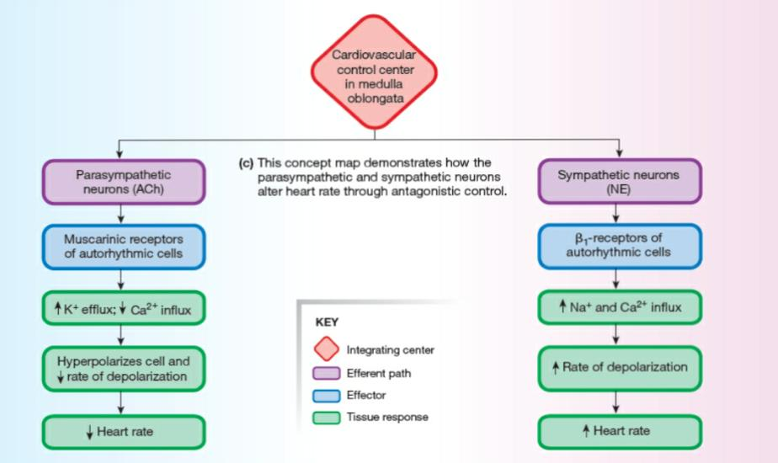

Slide 25
Contractility
The intrinsic ability of a cardiac muscle fiber to contract at any given fiber length and is a function of Ca2+ interaction with the contractile filaments.
Normally, as contraction force increases, stroke volume increases

Slide 26
Inotropy
Any chemical that affects contractility is called an inotropic agent
Positive inotropic effect: If a chemical increases the force of contraction .For example, the catecholamines epinephrine and norepinephrine and drugs such as digitalis enhance contractility and are therefore considered to have a positive inotropic effect.
Chemicals with negative inotropic effects decrease contractility

Slide 27
Preload
The degree of myocardial stretch before contraction begins is called the preload on the heart because this stretch represents the load placed on cardiac muscles before they contract.
The myocardial sarcomere length just prior to contraction. As this is not measurable without removing the heart and cutting it into tiny pieces, clinically it is usually approximated by EDV or, less appropriately, by EDP

Slide 28
In striated muscles, the force created by a muscle fiber is directly related to the length of the sarcomere, as indicated by the initial length of the muscle fiber. The longer the muscle fiber and sarcomere when a contraction begins, the greater the tension developed, up to a maximum
As stretch of the ventricular wall increases, so does the stroke volume. If additional blood flows into the ventricles, the muscle fibers stretch, then contract more forcefully, ejecting more blood.

Slide 29
The Frank-Starling Law of the Heart
This law describes the relationship between stretch and force in the intactheart
It states that the strength of cardiac contraction is dependent on initial fiber length
At a cellular level, additional stretch increases:
The number of myofilament crossbridges that can interact
2. Myofilament Ca2+ sensitivity
• As additional blood enters the heart, the heart contracts more forcefully and ejects more blood. It means that within physiological limits, the heart pumps all the blood that returns to it.

Slide 30
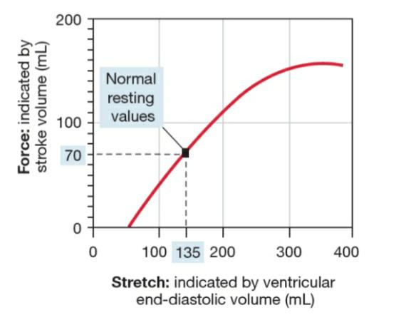

Slide 31
Venous Return Preload depends primarily on venous return; the amount of blood that enters the heart from the venous circulation.
Three factors affect venous return
Contraction or compression of veins returning blood to the heart (the skeletalmuscle pump)
Pressure changes pump)in the abdomen and thorax during breathing (the respiratory
Sympathetic innervation of veins

Slide 32
Skeletal Muscle Pump
Skeletal muscle contractions that squeeze veins (particularly in the legs), compressing them and pushing blood toward the heart.
During exercise that involves the lower extremities, the skeletal muscle pump helps return blood to the heart.
During periods of sitting or standing motionless, the skeletal muscle pump does not assist venous return.

Slide 33
Respiratory pump
Created by movement of the thorax during inspiration. As the chest expands and the diaphragm moves toward the abdomen, the thoracic cavity enlarges and develops a subatmospheric pressure.• This low pressure decreases pressure in the inferior vena cava as it passes through the thorax, which helps draw more blood into the vena cava from veins in the abdomen.

Slide 34
The respiratory pump is aided by the higher pressure placed on the outside of abdominal veins when the abdominal contents are compressed during inspiration.The combination of increased pressure in the abdominal veins and decreased pressure in thoracic veins enhances venous return during inspiration.

Slide 35
Sympathetic innervation of veins
Constriction of veins by sympathetic activity
When the veins constrict, their volume decreases, squeezing more blood out ofthem and into the heart.
With a larger ventricular volume at the beginning of the next contraction, the ventricle contracts more forcefully, sending the blood out into the arterial side of the circulation.In this manner, sympathetic innervation of veins allows the body to redistribute some venous blood to the arterial side of the circulation.

Slide 36
Afterload
The amount of pressure that the heart needs to exert to eject the blood during ventricular contraction• Ventricular force must overcome the resistance created by blood already filling the arterial system. In other words, to eject blood from the ventricle, The combined load of blood in the ventricle (the EDV) and arterial resistance during ventricular contraction is known as afterload.

Slide 37
Increased afterload is found in several pathological situations, including elevated arterial blood pressure and loss of stretchability (compliance) in the aorta. •
To maintain constant stroke volume when afterload increases, the ventricle must increase its force of contraction. This in turn increases the heart muscle's need for oxygen and ATP production.

Slide 38
If increased afterload becomes a chronic situation, the myocardial cells hypertrophy, resulting in increased thickness of the ventricular wall. Clinically, arterial blood pressure is often used as an indirect indicator ofafterload.
•Ventricular function can also be assessed noninvasively by echocardiography

Slide 39
Mean Arterial Pressure (MAP)
The average arterial pressure throughout one cardiac cycle (The driving force for blood flow)• Considered a better indicator of perfusion to vital organs than systolic blood pressure(SBP)
Calculated as: MAP = 1/3 SBP + 2/3 DBP
Mean arterial pressure is closer to diastolic pressure than to systolic pressure because diastole lasts twice as long as systole

Slide 40
Thank you

