Slide 1
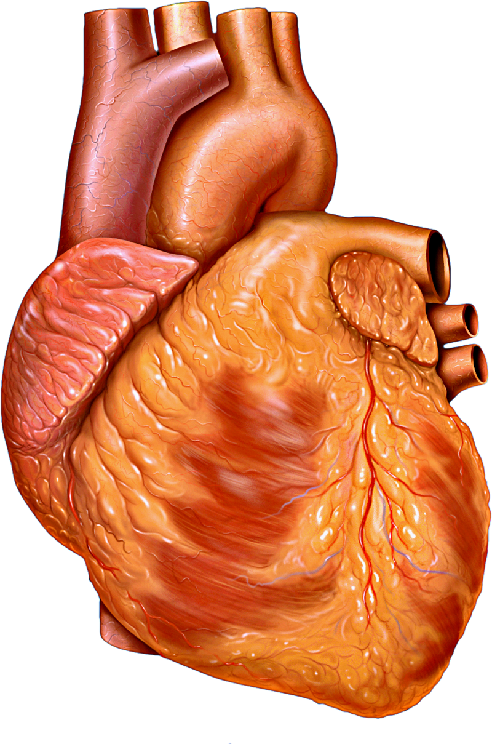

Cardiovascular Anatomy
بسم الله الرحمن الرحيم
Dr. saher abughali
Director of Cardiac surgery department
Al SHIFA HOSPITAL - GAZA

Slide 2
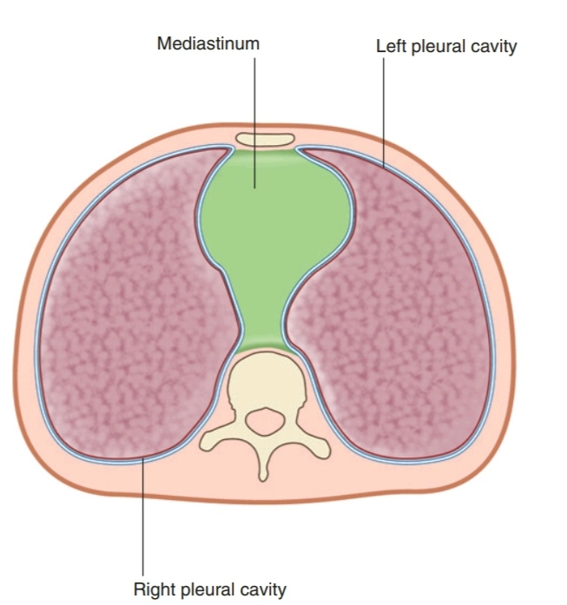
Mediastinum
The mediastinum (from Latin middle septum) :
is the area between the sternum, the two pleural cavities, and the vertebral column

Slide 3
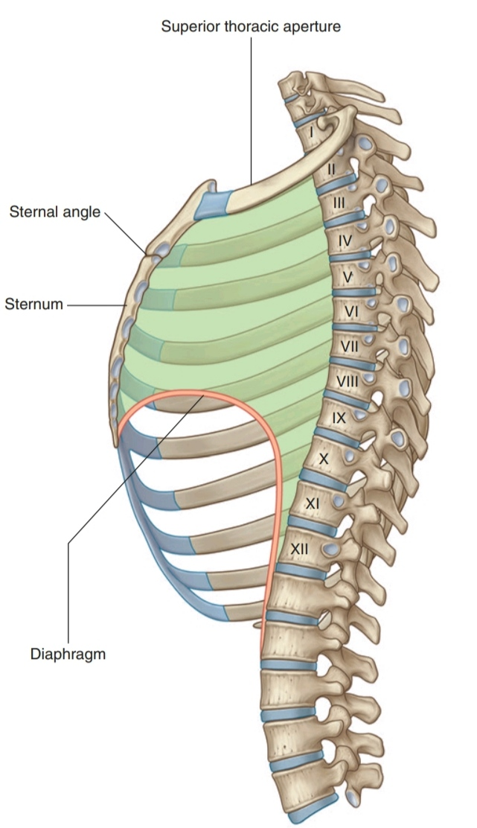
Mediastinum
It extends:
- superiorly to the thoracic outlet and the root of the neck
- inferiorly to the diaphragm
- anteriorly to the sternum
- posteriorly to the vertebral column.

Slide 4
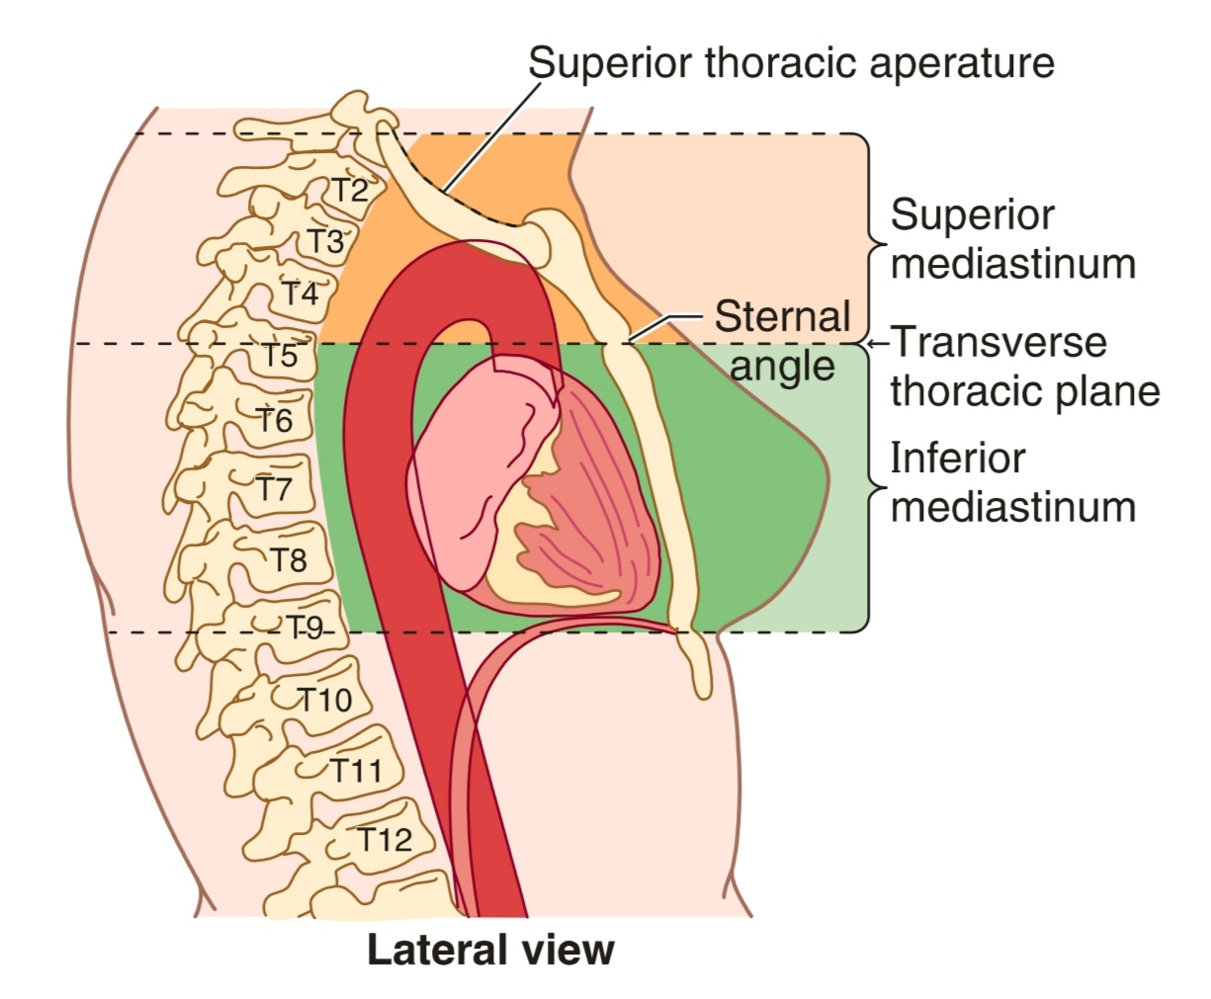
Mediastinum
The mediastinum is divided into superior and Inferior mediastina by an imaginary plane passing from the sternal angle anteriorly to the lower border of the body of the fourth thoracic vertebra posteriorly

Slide 5
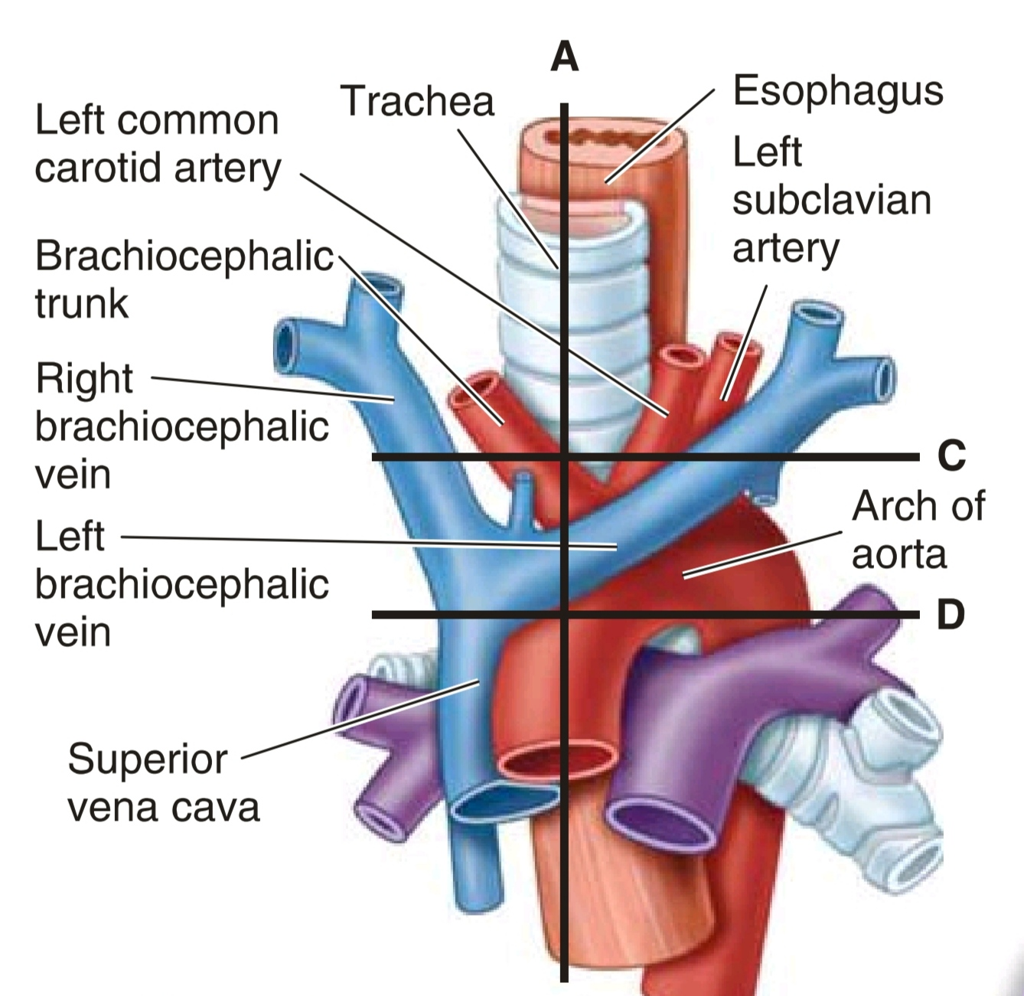
Transverse Thoracic Plane
This plane is a noteworthy landmark in that it marks several key structures. From anterior to posterior, these are the:
• Joint between the manubrium and body of the sternum
• Demarcation between the ascending aorta and the arch of the aorta
• Demarcation between the arch of the aorta and the descending thoracic aorta
• Bifurcation of the trachea

Slide 6
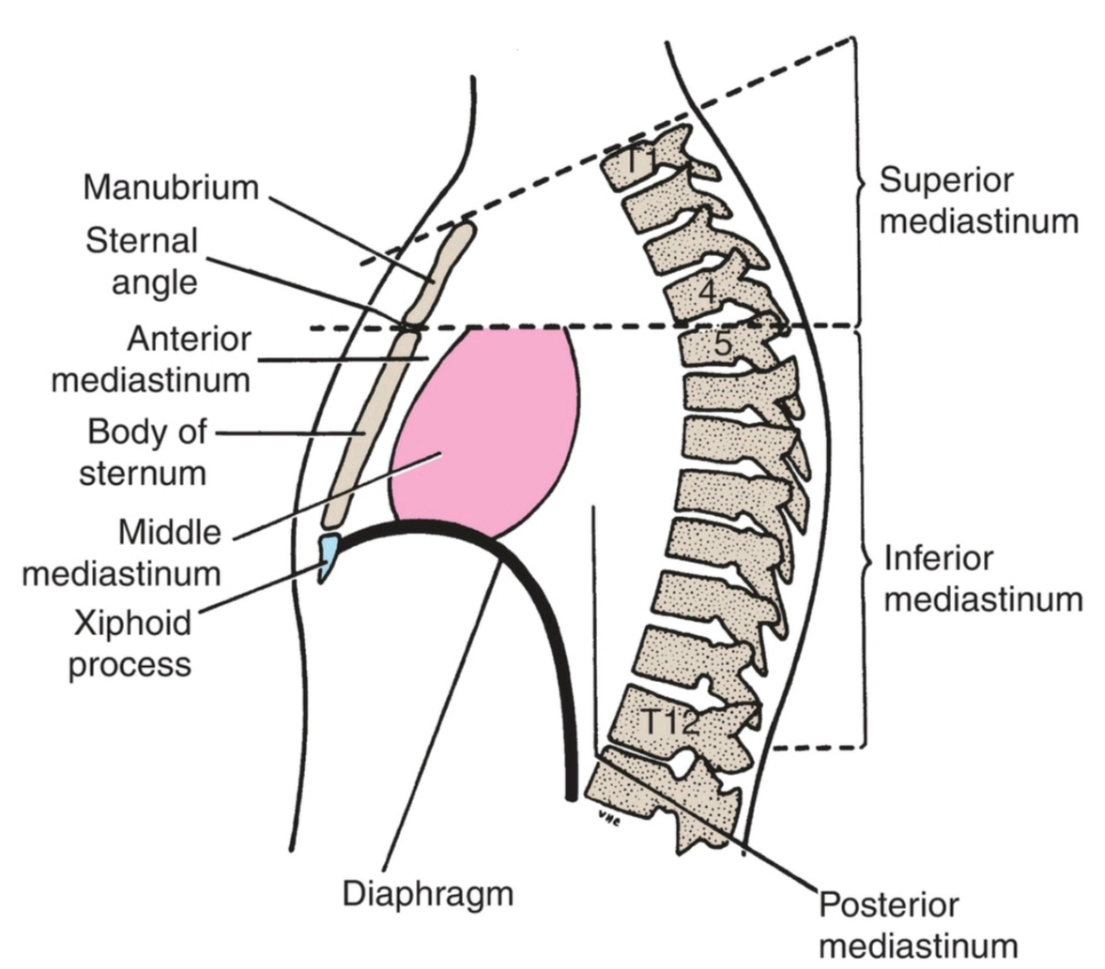
Mediastinum
The inferior mediastinum is further subdivided into the:
- anterior mediastinum, which is a space between the pericardium and the sternum
- middle mediastinum, which consists of the pericardium and heart
- posterior mediastinum, which
lies between the pericardium and the vertebral column.

Slide 7
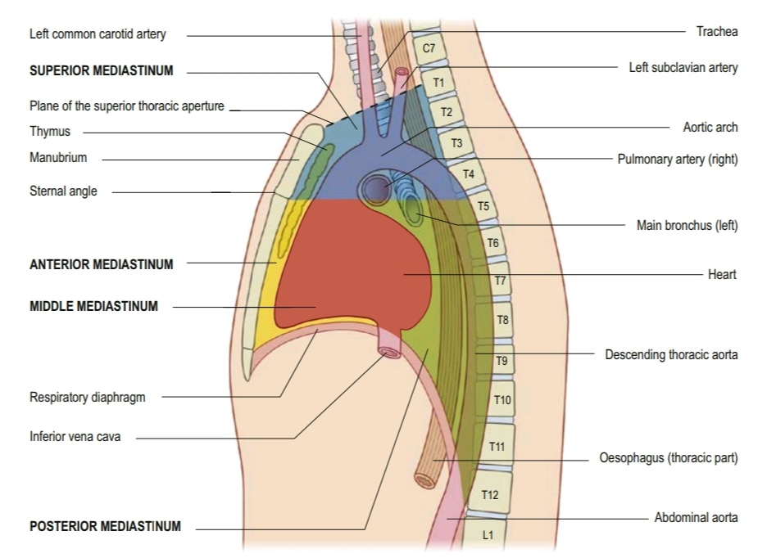

Slide 8
Superior Mediastinum

Slide 9
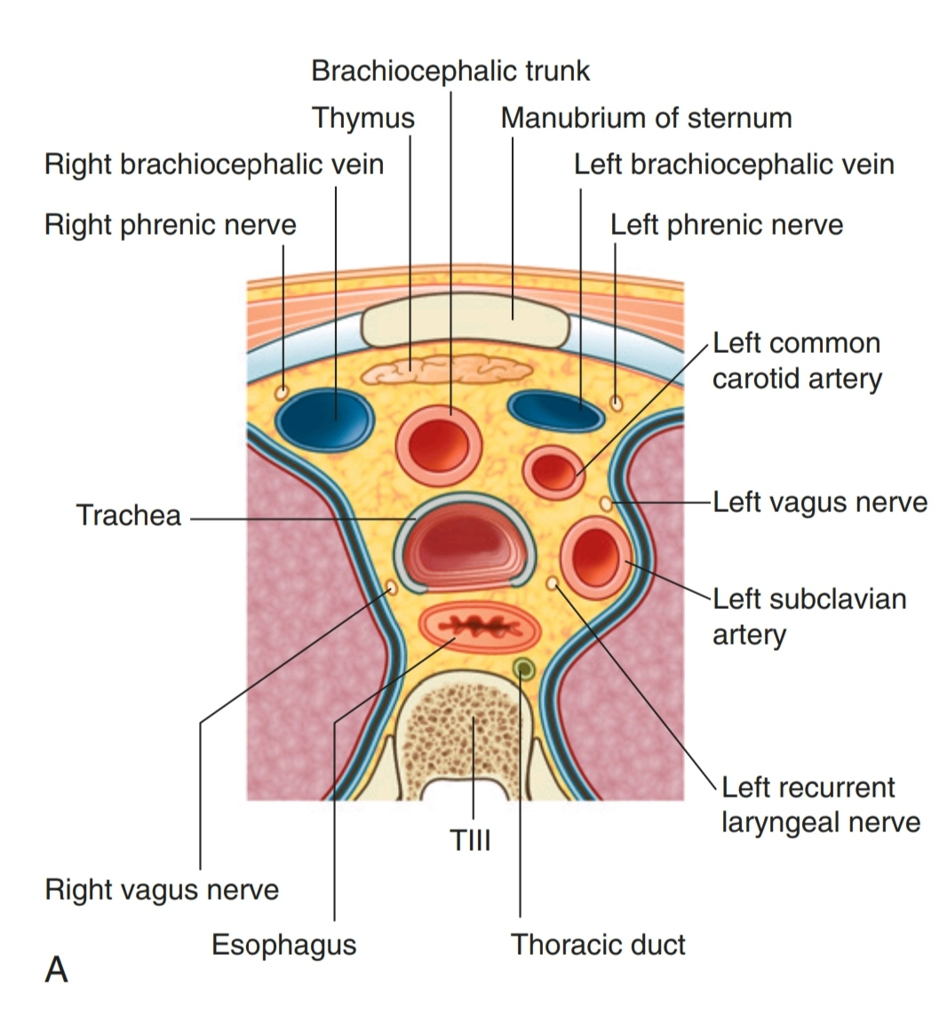
Superior Mediastinum
The superior mediastinum is continuous with the neck above and with the inferior mediastinum below.
From anterior to posterior, the contents of the superior mediastinum are the following:
(1) Thymus
(2) large veins
(3) large arteries
(4) trachea
(5) esophagus and thoracic duct
(6) sympathetic trunks

Slide 10
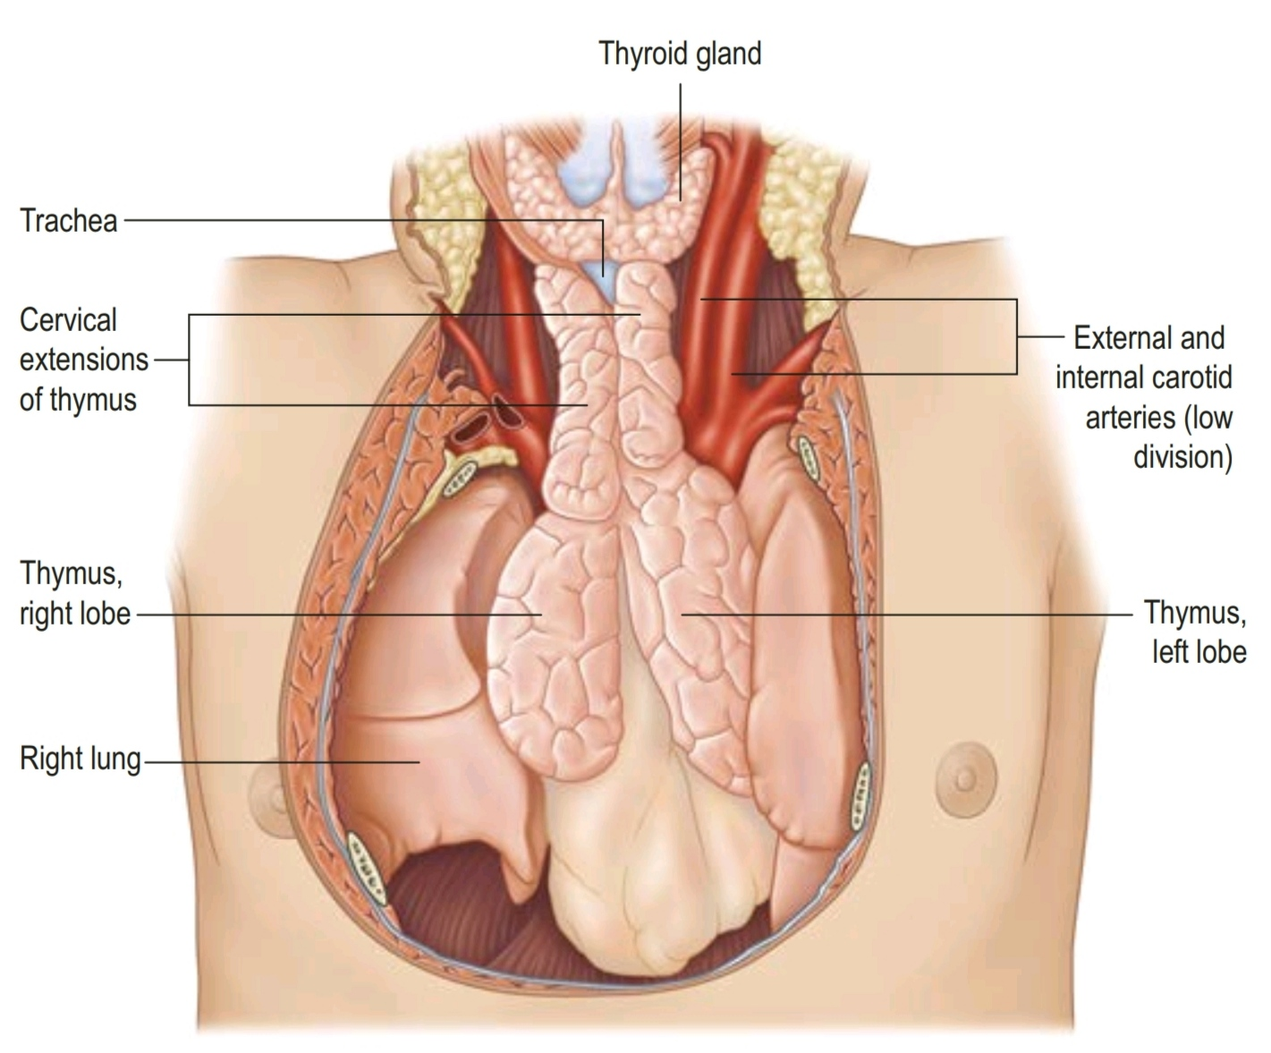
Thymus
The thymus, a primary lymphoid organ, is located in the inferior part of the neck and the anterior part of the superior mediastinum

Slide 11
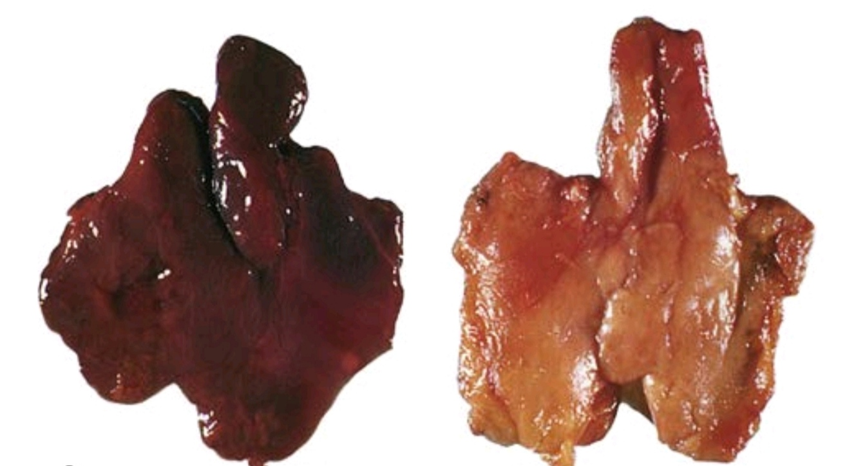
Thymus
The thymus, a primary lymphoid organ, is located in the inferior part of the neck and the anterior part of the superior mediastinum.
It is a flat gland with flassk-shaped lobes (right lobe and left lobe) that lies posterior to the manubrium and extends into the anterior mediastinum, anterior to the fibrous pericardium.
After puberty, the thymus undergoes gradual involution and is largely replaced by fat.

Slide 12
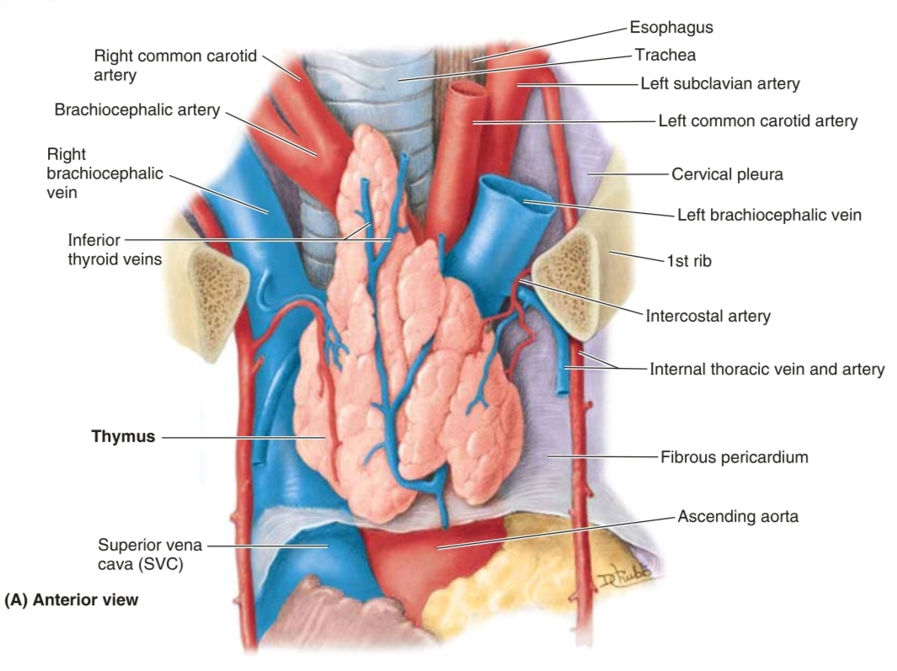
Thymus
Arteries to the thymus consist of small branches originating from the internal thoracic arteries.
Venous drainage
is usually into the left brachiocephalic vein and possibly into the internal thoracic veins.
Lymphatic drainage end in the parasternal, brachiocephalic, and tracheobronchial lymphnodes

Slide 13
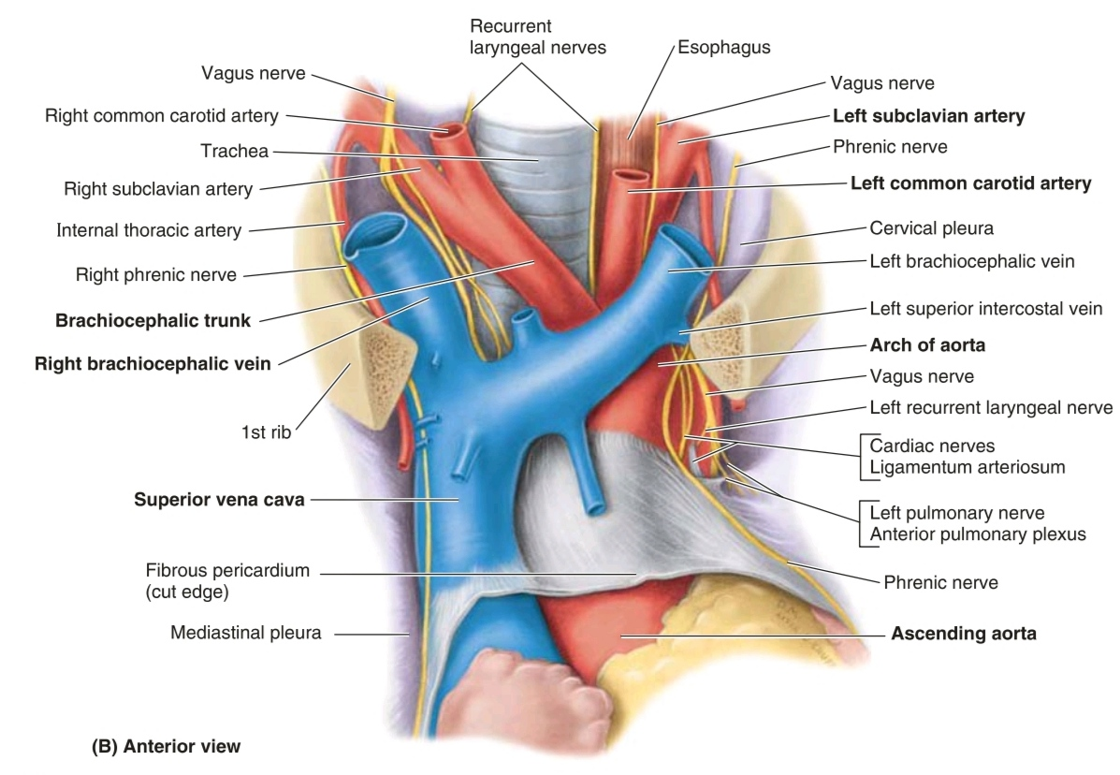
Superior Mediastinum: Great Vessels
the veins: brachiocephalic veins and SVC, anterior to the arteries.
the arteries: arch of aorta and roots of its major branches (the brachiocephalic trunk, left common carotid artery,and left subclavian artery) and related nerves (vagus and phrenic nerves and the cardiac plexus of nerves)

Slide 15
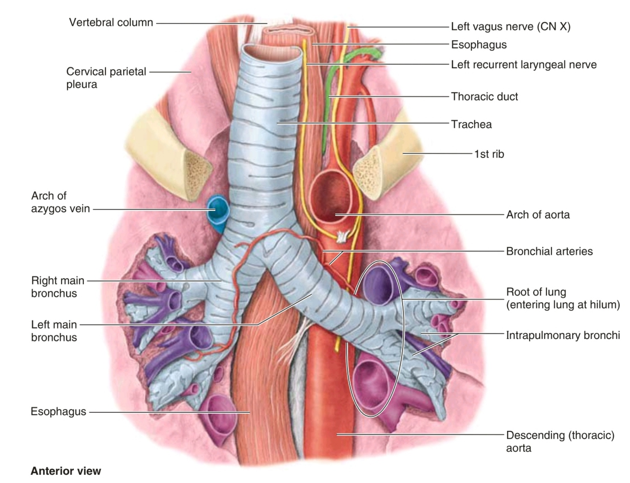
Superior Mediastinum: Trachea
The trachea descends anterior to the esophagus and enters the superior mediastinum, inclining a little to the right of the median plane.
The posterior surface ofthe trachea is flat where it is applied to the esophagus.
The trachea ends at the level of the sternal angle
by dividing into the right and left main bronchi.
The trachea terminates superior to the level of the heart and is not a component of the posterior mediastinum.

Slide 16
Superior Mediastinum: Esophagus & Thoracic Duct
The esophagus is a fibromuscular tube that extends from the phaxynx to the stomach.
The esophagus enters the superior mediastinum between the trachea and vertebral column, where it lies anterior to the bodies of the Tl-T4 vertebrae.
In the superior mediastinum, the thoracic duct usually lies on the left side of the esophagus, deep (medial) to the arch of the aorta

Slide 17
Superior Mediastinum: Trachea, Esophagus & Thoracic Duct

Slide 18
Inferior Mediastinum

Slide 19
Inferior Mediastinum
The inferior mediastinum is further subdivided into the:
- anterior mediastinum, which is a space between the pericardium and the sternum
- middle mediastinum, which consists of the pericardium and heart
- posterior mediastinum, which
lies between the pericardium and the vertebral column.

Slide 20
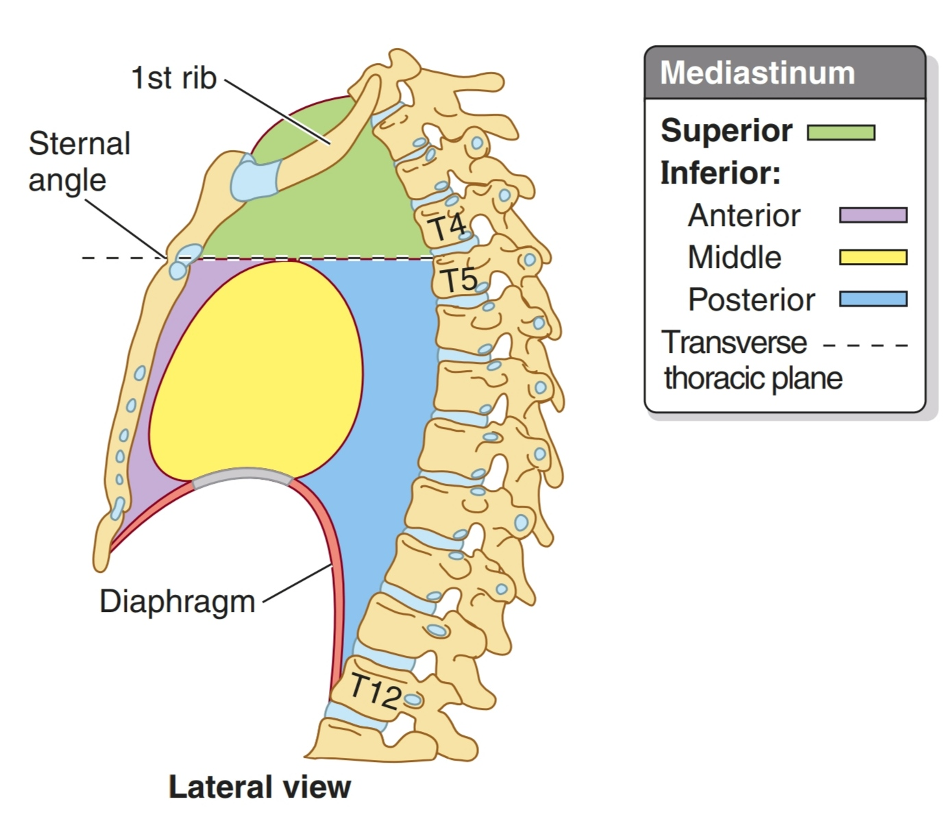
Anterior Mediastinum
The anterior mediastinum lies between the sternal body and fibrous pericardium.
It conntains a variable amount of adipose tissue, loose connective tissue, sternopericardial ligaments, a few lymph nodes, the mediastinal branches of the internal thoracic artery, and sometimes part of the thymus gland or its remnants.

Slide 21
Middle Mediastinum

Slide 22
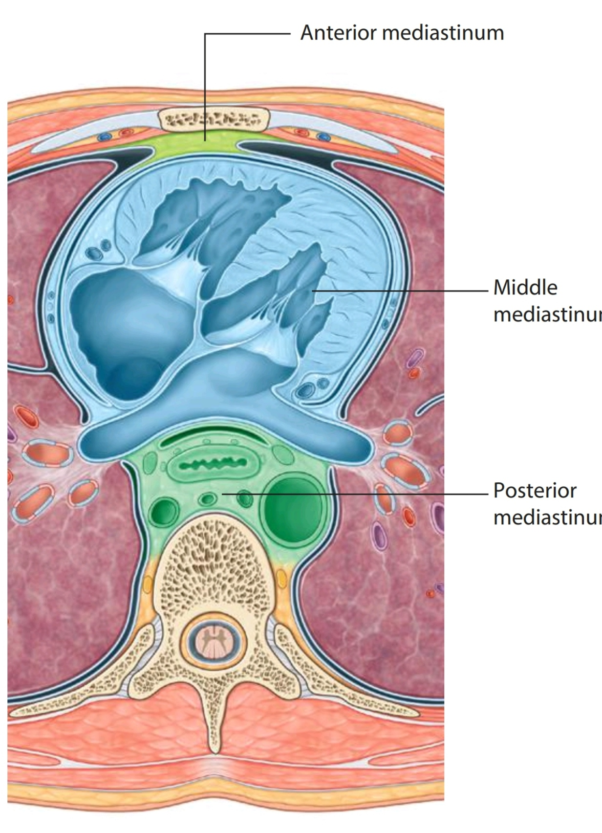
Middle Mediastinum
The middle mediastinum is centrally located in the thoracic cavity.
It contains the pericardium, heart, origins of the great vessels, various nerves, and smaller vessels

Slide 23
Pericardium

Slide 24
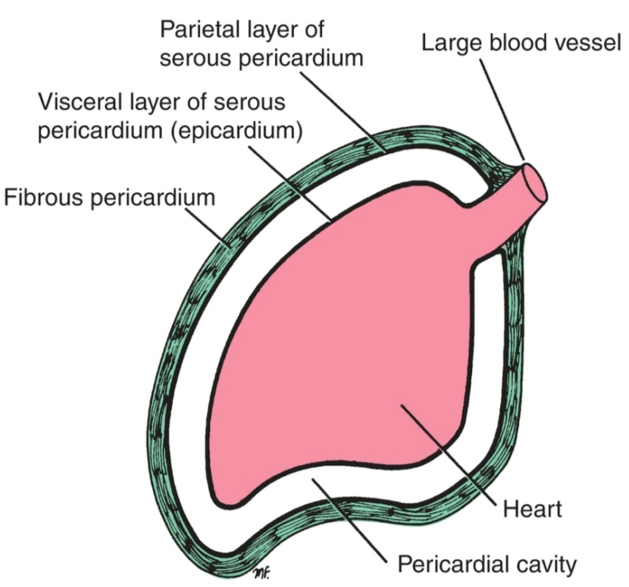
Pericardium
The pericardium is a fibroserous sac surrounding the heart and the roots of the great vessels.
It consists of two components, the fibrous pericardium and the serous pericardium

Slide 25
Fibrous Pericardium
It is the strong, fibrous, outer
layer of the sac. It attaches
firmly below to the central tendon of the diaphragm.
It fuses with the adventitia of the great blood vessels.
It attaches in front of the sternum by fibrous bands called the sternopericardial ligaments.

Slide 26
Serous Pericardium
It is divided into parietal and visceral layers.
The parietal layer lines the inner surface of the fibrous pericardium and reflects around the roots of the great vessels to become continuous with the visceral layer of serous pericardium that closely covers the heart.

Slide 27
Serous Pericardium
The visceral layer is closely applied to the superficial surface of the heart and is often called the epicardium.

Slide 28
Pericardial Cavity
The slitlike space between the parietal and visceral layers is referred to as the pericardial cavity.
Normally, the cavity contains a small amount of tissue fluid (about 50 mL), the pericardial
fluid, which acts as a lubricant to facilitate movements of the heart.

Slide 29
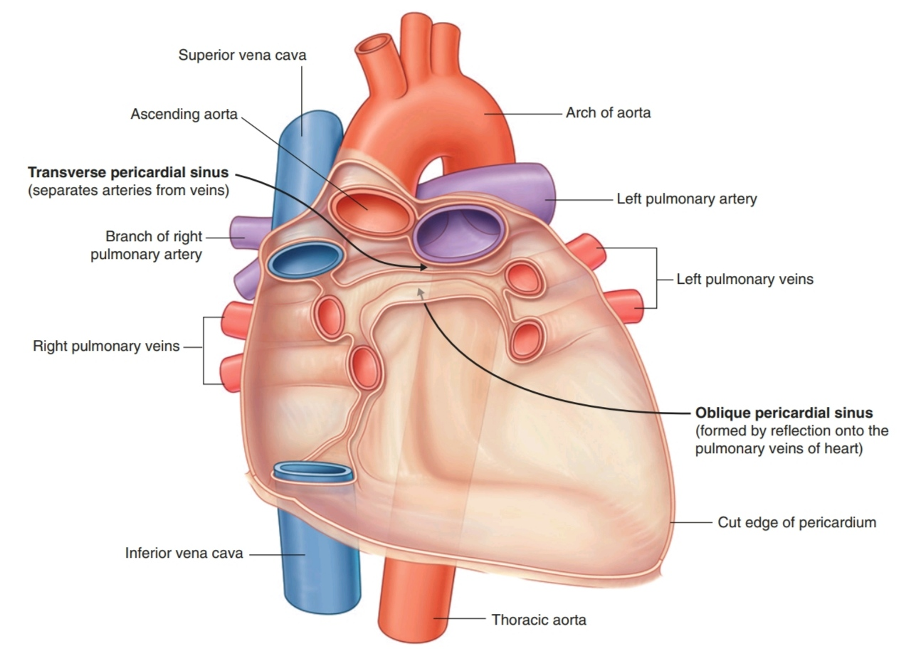
Pericardial Sinuses
These are spaces posterior to the heart, formed by the reflections of the serous pericardium around the great vessels.

Slide 30
Oblique Pericardial Sinus
The reflection around the large veins that forms an inverted U-shaped ccul-de-sac.
It runs along the long axis of the heart, from the apex to the ascending aorta, located posterior to the left atrium and between the left and right superior pulmonary veins.

Slide 32
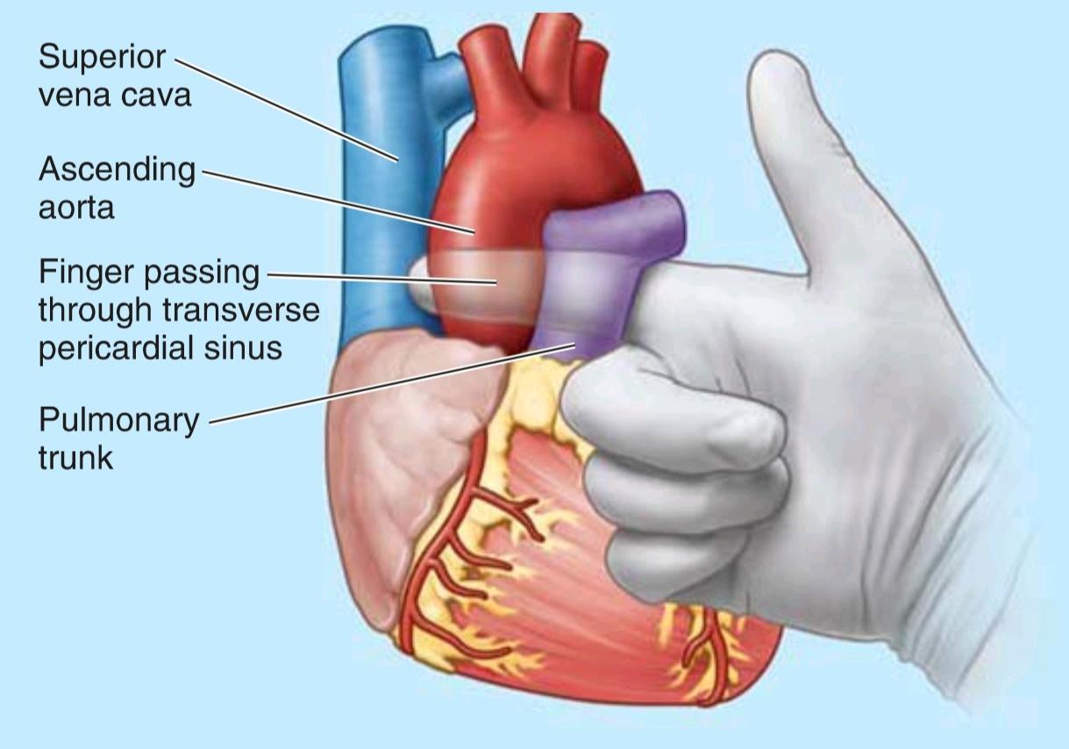
Transverse Pericardial Sinus
It is the passage between the two sites of reflected serous
pericardium. This sinus lies posterior to the ascending aorta and the pulmonary trunk, anterior to the superior vena cava, and superior to the left atrium.

Slide 34
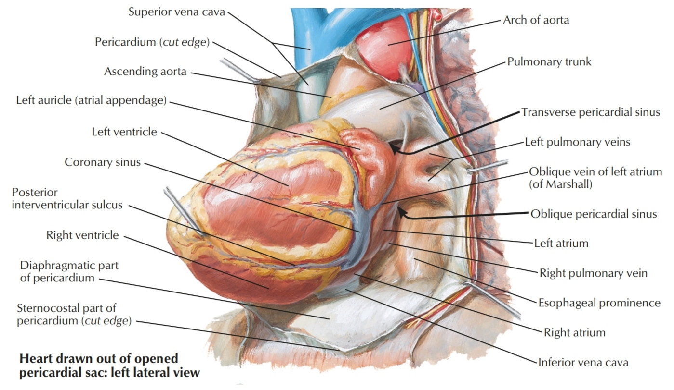

Slide 35
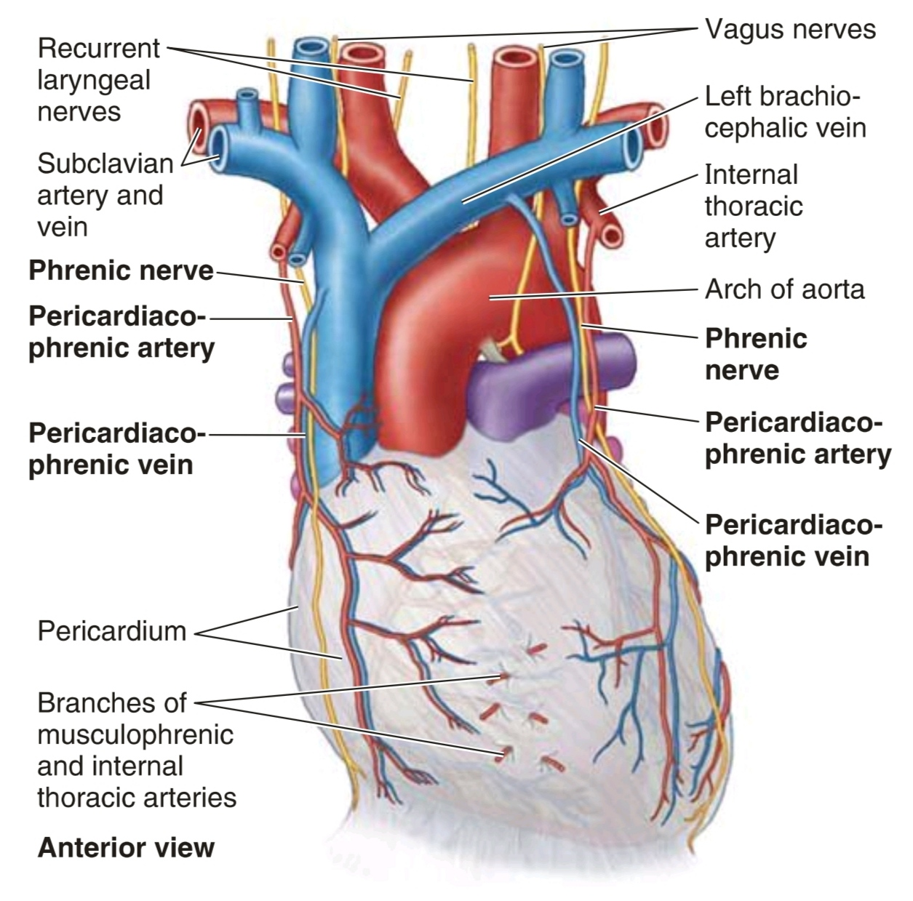
Vessels of the Pericardium
Arterial supply by branches from the internal thoracic, pericardiacophrenic, musculophrenic, and inferior phrenic arteries, and the thoracic aorta.
Veins from the pericardium enter the azygos system of veins and the internal thoracic and superior phrenic veins.

Slide 36
Nerves of the Pericardium
Nerves supplying the pericardium arise from the vagus nerve [X],the sympathetic trunks, and the phrenic
nerves.

Slide 37
HEART

Slide 38
Heart
The heart, slightly larger than one's loosely clenched fist, is a double, self-adjusting suction and pressure pump. The parts of the pump work in unison to propel blood to all parts of the body:
- The right side of the heart (right heart) receives poorly oxygenated (venous) blood from the body through the SVC and IVC and pumps it through the pulmonary trunk and arteries to the lungs for oxygenation.
- The left side of the heart (left heart) receives well-oxygenated (arterial) blood from the lungs through the pulmonary veins and pumps it into the aorta for distribution to the body.

Slide 39
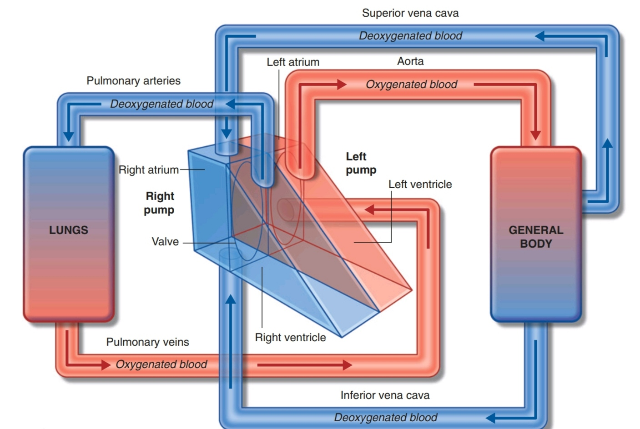

Slide 40
External Configuration of the Heart

Slide 41
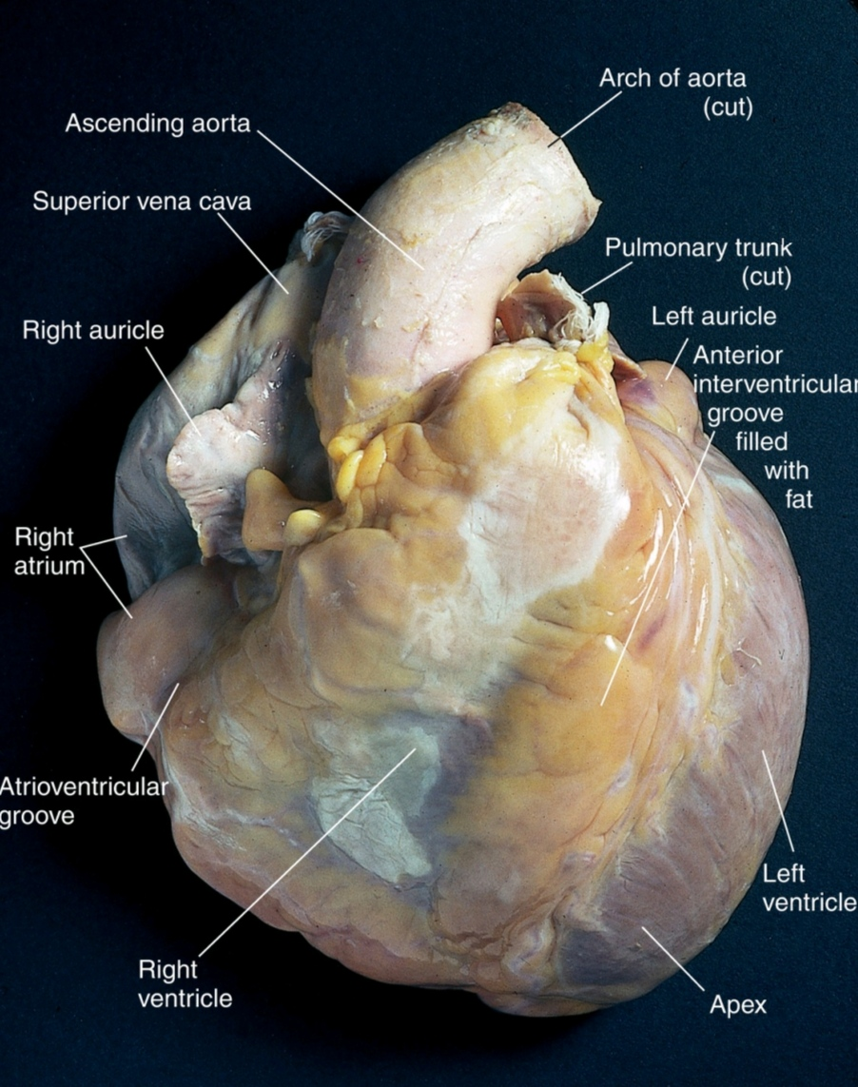
Morphology of the Heart
slightly larger than one's loosely clenched fist
weight : in the adult about 0.45% of body weight (about 300 gr), in the neonate about 0,7% of body weight (about 70 gr)
- diameters : 13 cm longitudinal, 10 cm transversal, 5 cm anteroposterior

Slide 42
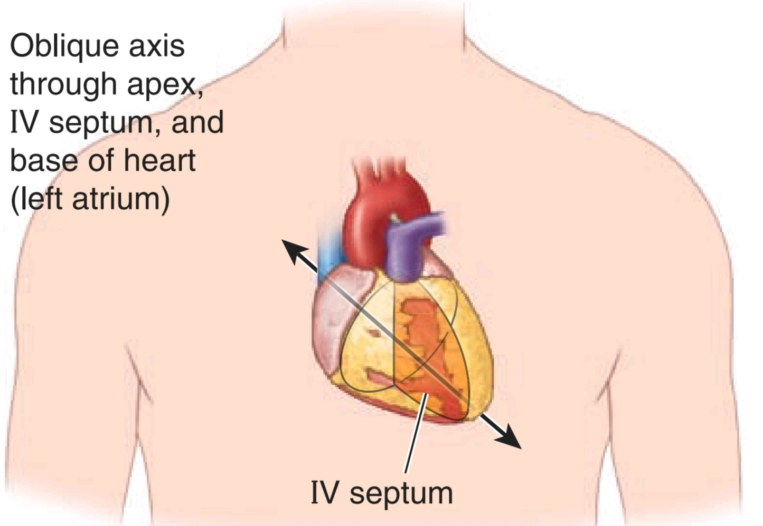
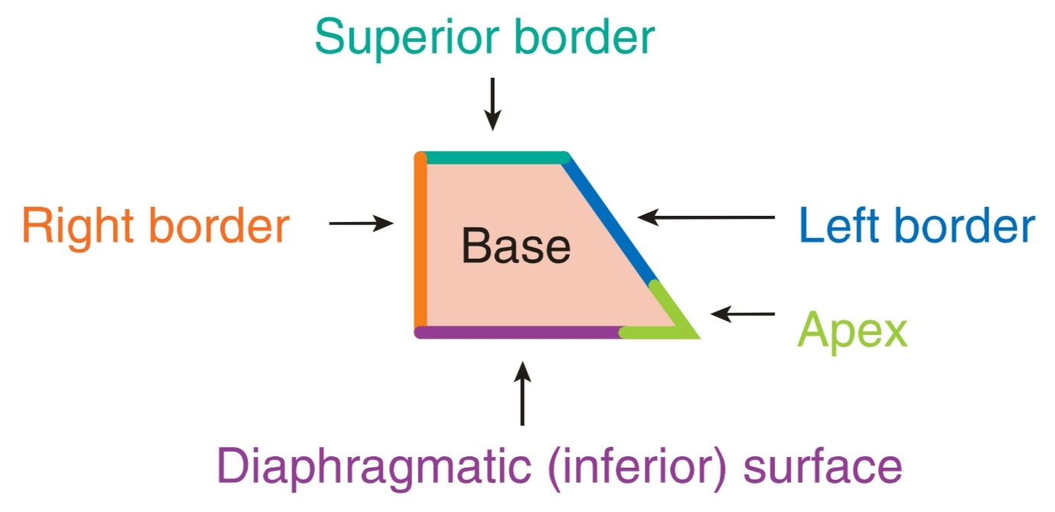
Heart Surface
The general shape and orientation of the heart are that of a pyramid that has fallen over and is resting on one of its sides.
Placed in the thoracic cavity, the apex of this pyramid projects forward, downward, and to the left, whereas the
base is opposite the apex and faces in a posterior direction.
One third of the heart to the right of the midline and 2 thirds to the left.

Slide 43
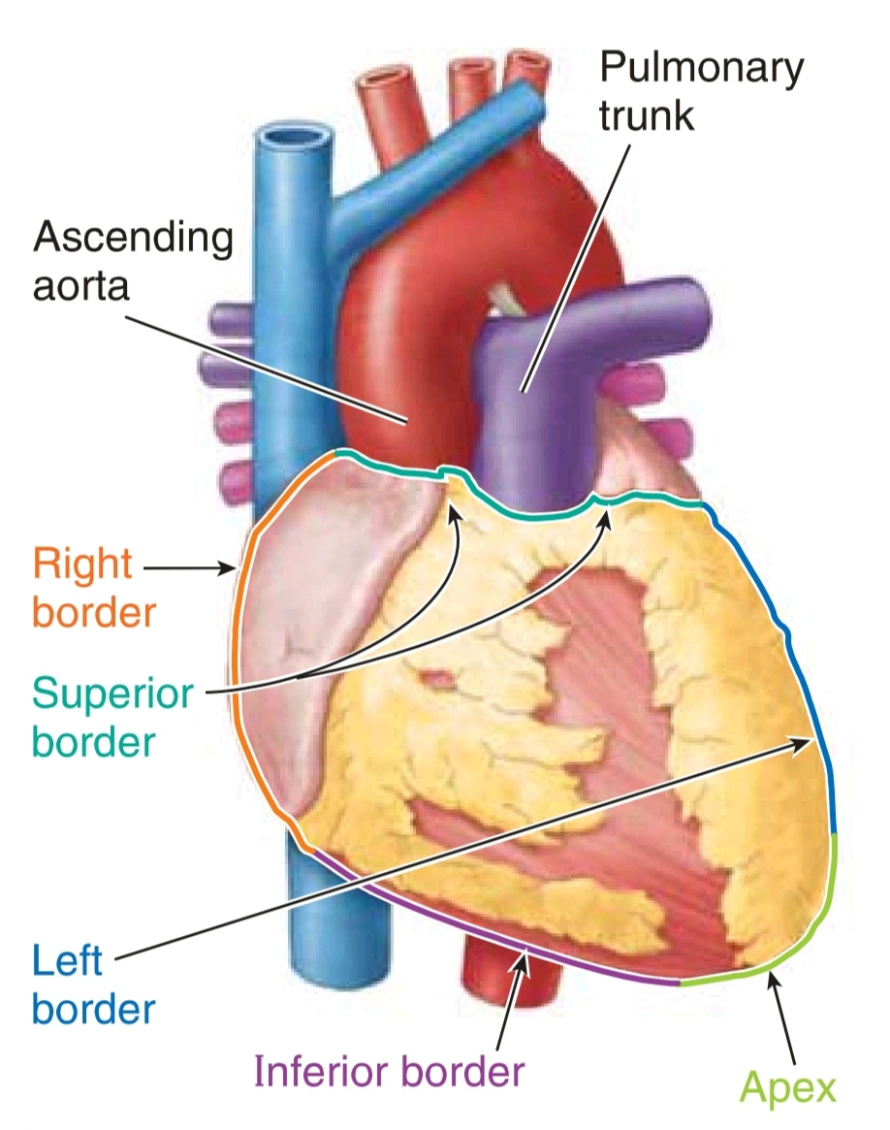
Apex of the Heart
The apex of the heart:
• is formed by the inferolateral part of the left ventricle.
• lies posterior to the left 5th intercostal space in adults, usually approximately 9 cm (a hand's breadth) from the median plane.

Slide 44
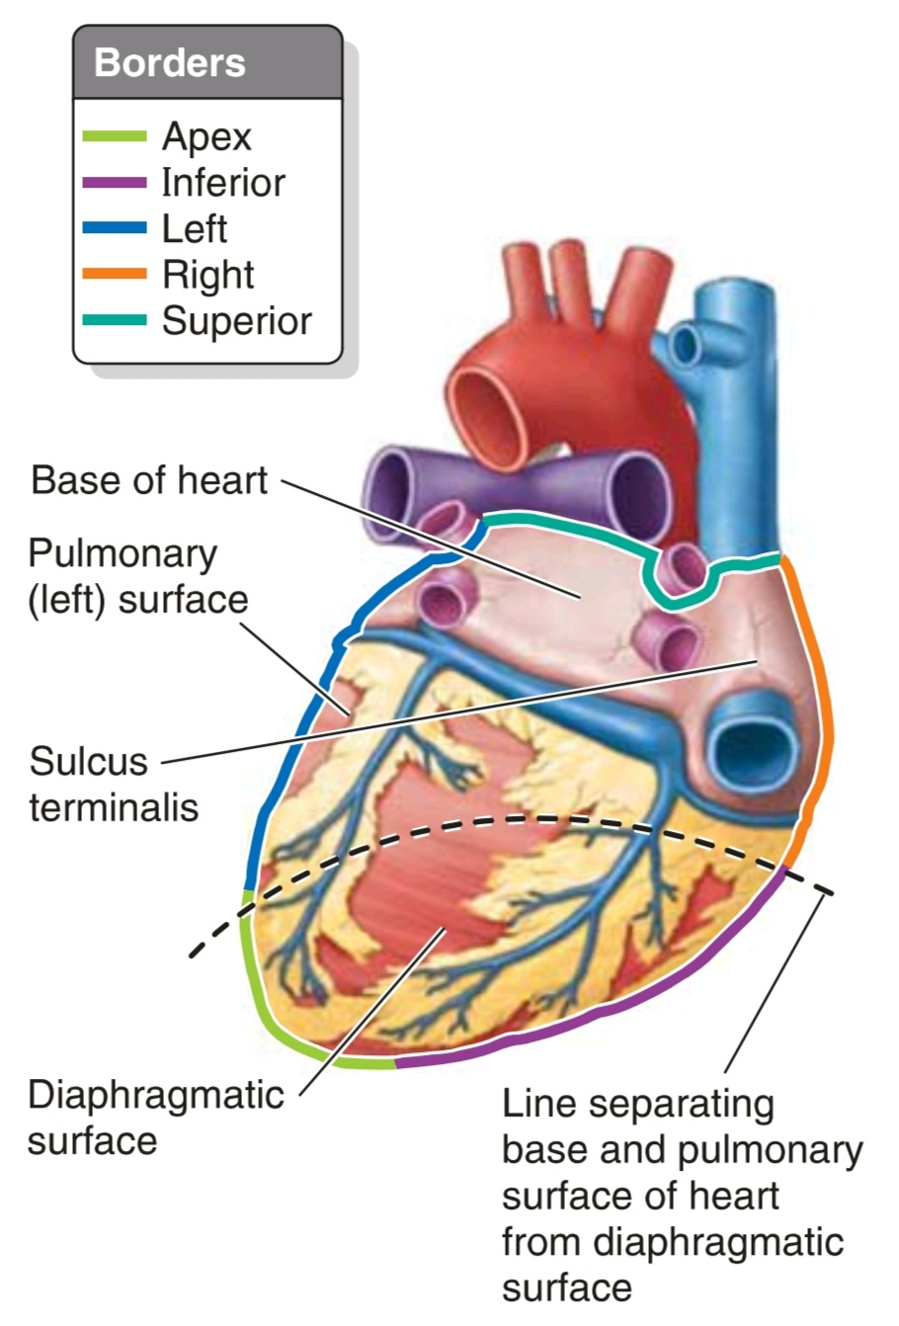
Base of the Heart
The base ofthe heart :
• is the heart's posterior aspect (opposite the apex).
• is formed mainly by the left atrium, with a lesser contribution by the right atrium.
• faces posteriorly toward the bodies of vertebrae T6 - T9 and is separated from them by the pericardium, oblique pericardial sinus, esophagus, and aorta.
• extends superiorly to the bifurcation of the pulmonary
trunk and inferiorly to the coronary sulcus.
• receives the pulmonary veins on the right and left sides of its left atrial portion and the superior and inferior venae cavae at the superior and inferior ends of its right atrial portion.

Slide 45
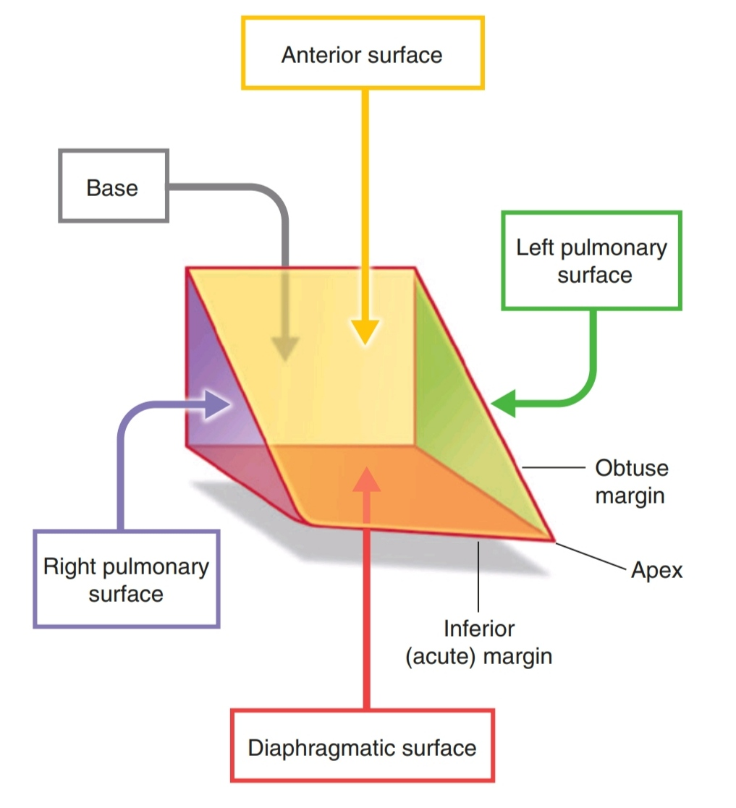
Surfaces of the Heart
The heart has 4 surfaces:
1. anterior (sternocostal) surface: formed mainly by the RV.
2. diaphragmatic (inferior) surface: formed LV and partly by the RV; it is
related mainly to the central tendon of the diaphragm.
3. right pulmonary surface: formed mainly by the RA.
4. left pulmonary surface: formed mainly by the LV; it forms the cardiac impression in the left lung

Slide 46
Borders (margins) of the Heart
The heart has 4 borders:
1. right border (slightly convex), formed by the RA and extending between the SVC and the IVC.
2. inferior border (nearly horizontal, called acute margin), formed mainly by the RV and slightly by the LV.

Slide 47
Borders (margins) of the Heart
3. left border (oblique, nearly vertical, called obtuse margin) formed mainly by the LV and slightly by the left auricle.
4. superior border, formed by the right and left atria and auricles in an anterior view; the ascending aorta and pulmonary trunk emerge from this border and the SVC enters its right side.

Slide 48
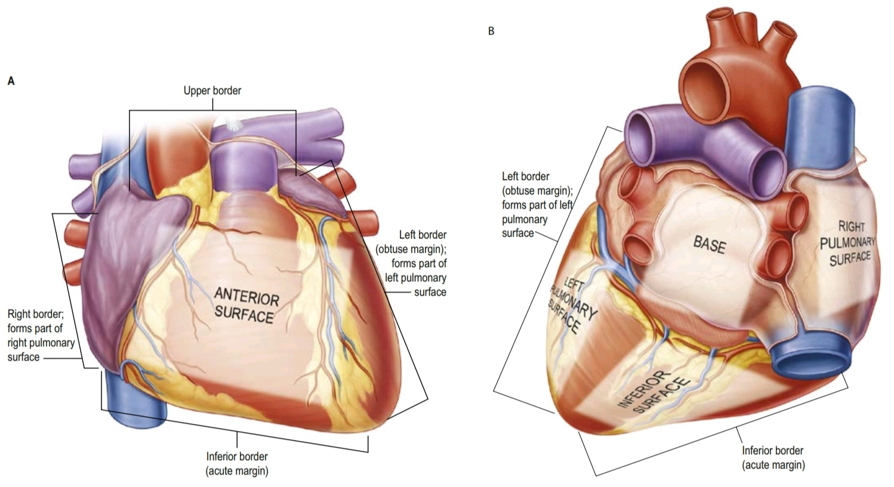
Surfaces and Borders of the Heart

Slide 49
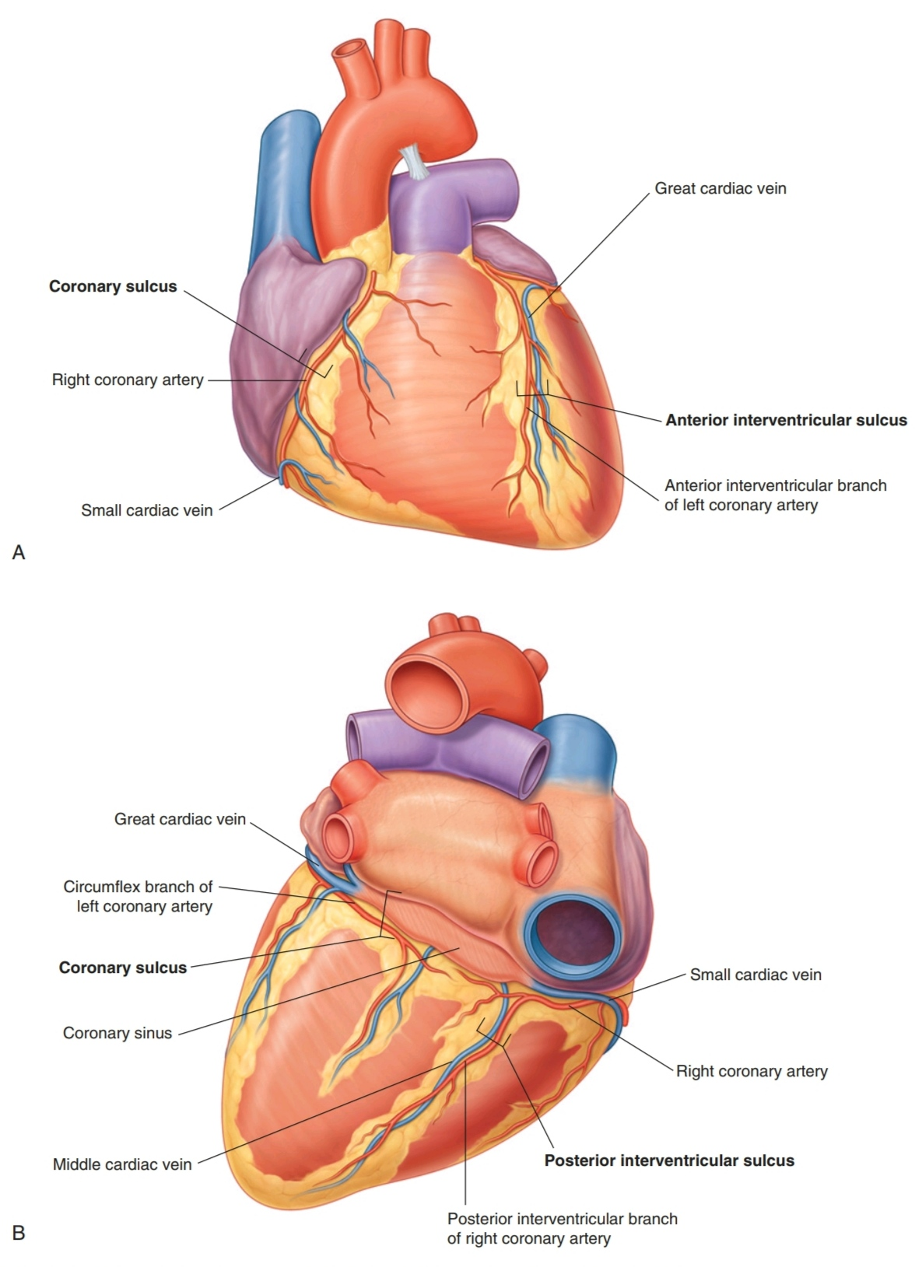
Extenal Sulci of the Heart
The coronary sulcus (artio-ventricular groove) circles the heart, separating the atria from the ventricles.
As it circles the heart, it contains the right coronary artery, the small cardiac vein, the coronary sinus, and the circumflex branch of the left coronary artery.

Slide 50
Extenal Sulci of the Heart
The anterior and posterior interventricular sulci: separate the two ventricles.
- The anterior interventricular sulcus is on the anterior surface of the heart and contains the anterior interventricular artery and the great cardiac vein.
- The posterior interventricular sulcus is on the diaphragmatic surface of the heart and contains the posterior interventricular artery and the middle cardiac vein.

Slide 51
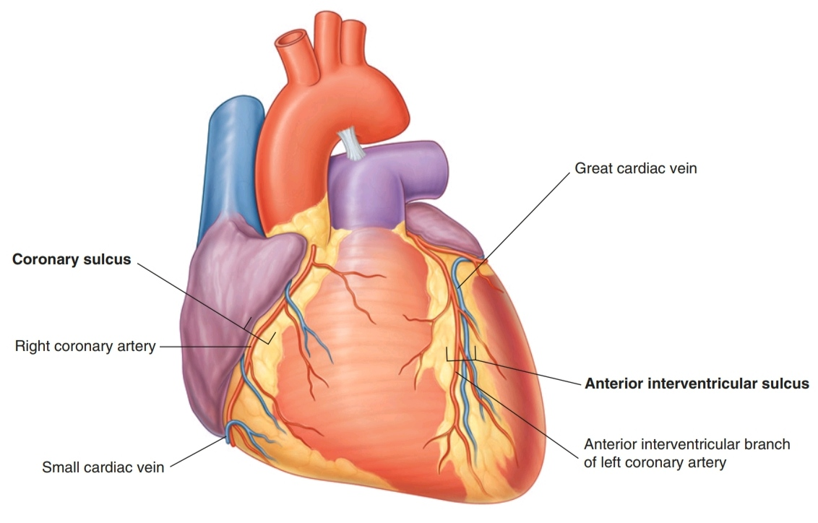
Extenal Sulci of the Heart: anterior view

Slide 52
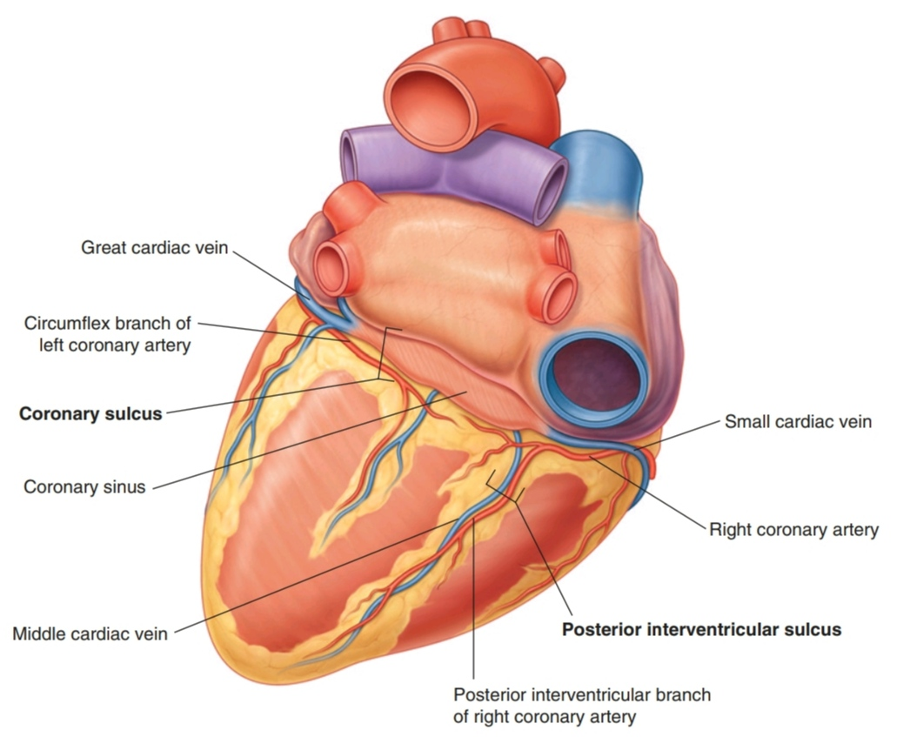
Extenal Sulci of the Heart: posterior view

Slide 53
Internal Configuration of the Heart

Slide 54
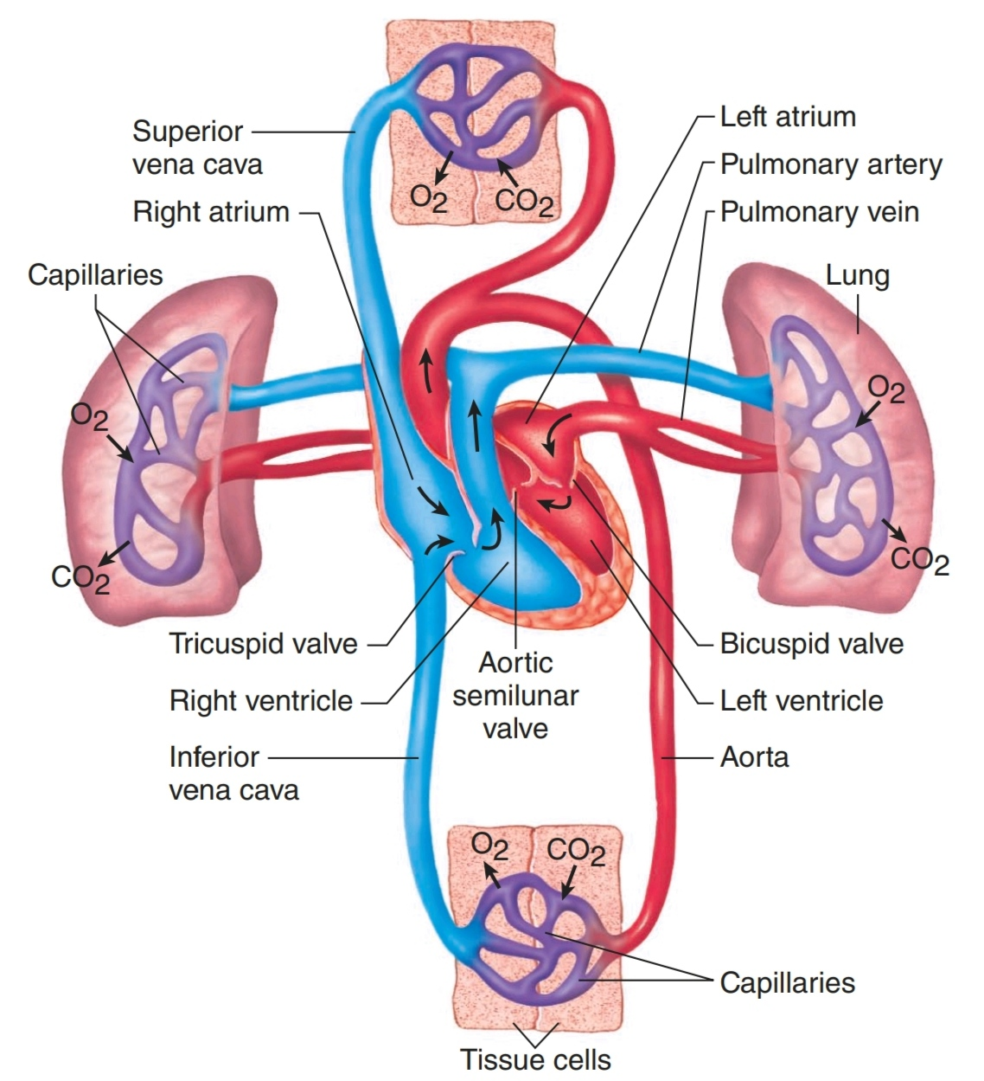
Cardiac Chambers
Functionally 2 separate pumps: right and left.
The Rt pump receives deoxygenated blood from the body and sends it to the lungs.
The Lt pump receives oxygenated blood from the lungs and sends it to the body.
Each pump consists of an atrium and a ventricle separated by a valve.

Slide 55
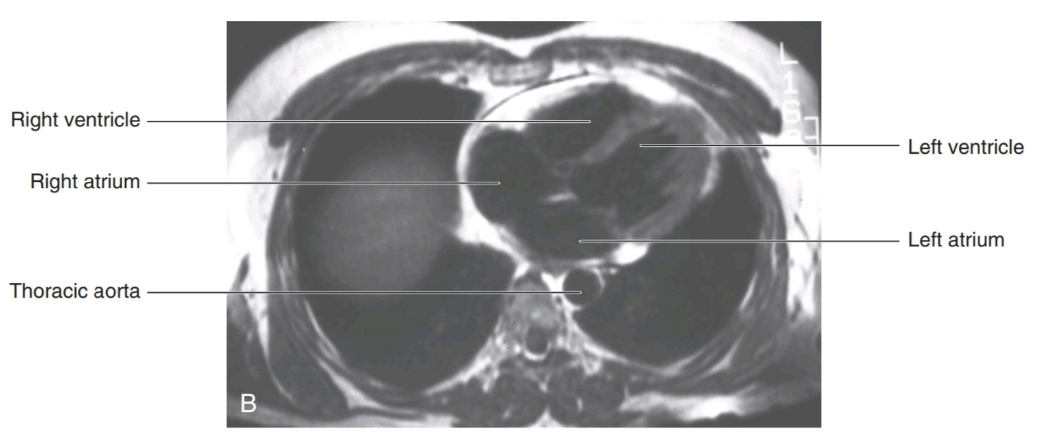
Cardiac Chambers
Interatrial, interventricular, and atrioventricular septa
separate the four chambers of the heart

Slide 56
Right Atrium (RA)

Slide 57
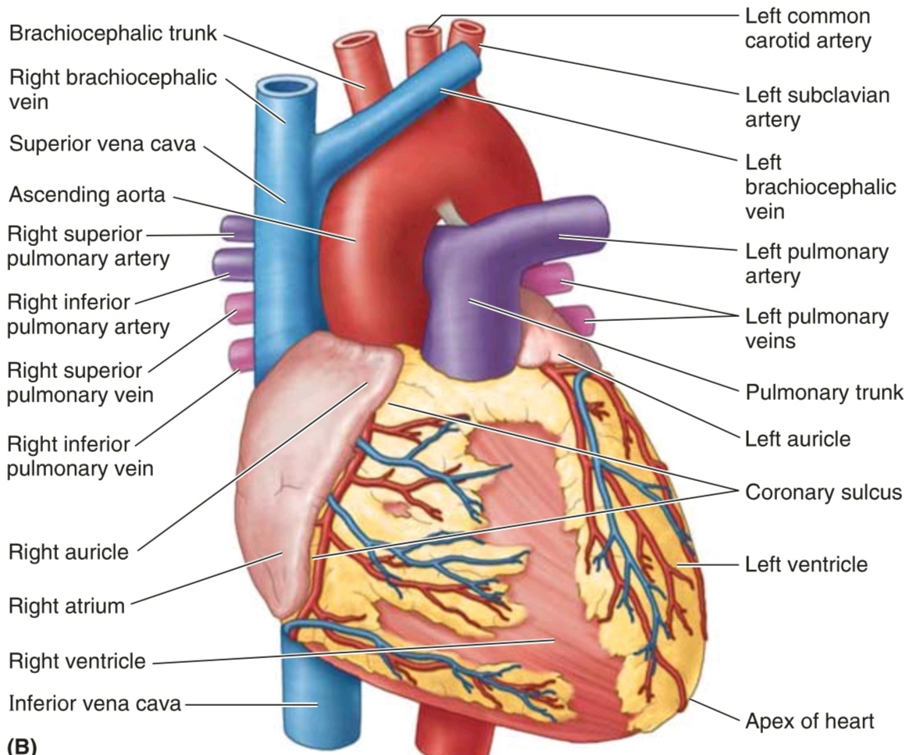
Right Atrium (RA)
It forms the right border of the heart and receives venous blood from the SVC, IVC, and coronary sinus.
The ear-like right auricle is a conical muscular pouch that projects from this chamber like an addon room, increasing the capacity of the atrium as it overlaps the ascending aorta.

Slide 58
Right Atrium (RA)
The interior of the right atrium has a :
• smooth, thin-walled, posterior part (the sinus venarom)
on which the venae cavae (SVC and IVC) and coronary
sinus open, bringing poorly oxygenated blood into the
heart.
• rough, muscular anterior wall composed of pectinate
muscles (L. musculi pectinati).
• right AV orifice through which the right atrium discharges
the poorly oxygenated blood it has received into the RV.

Slide 59
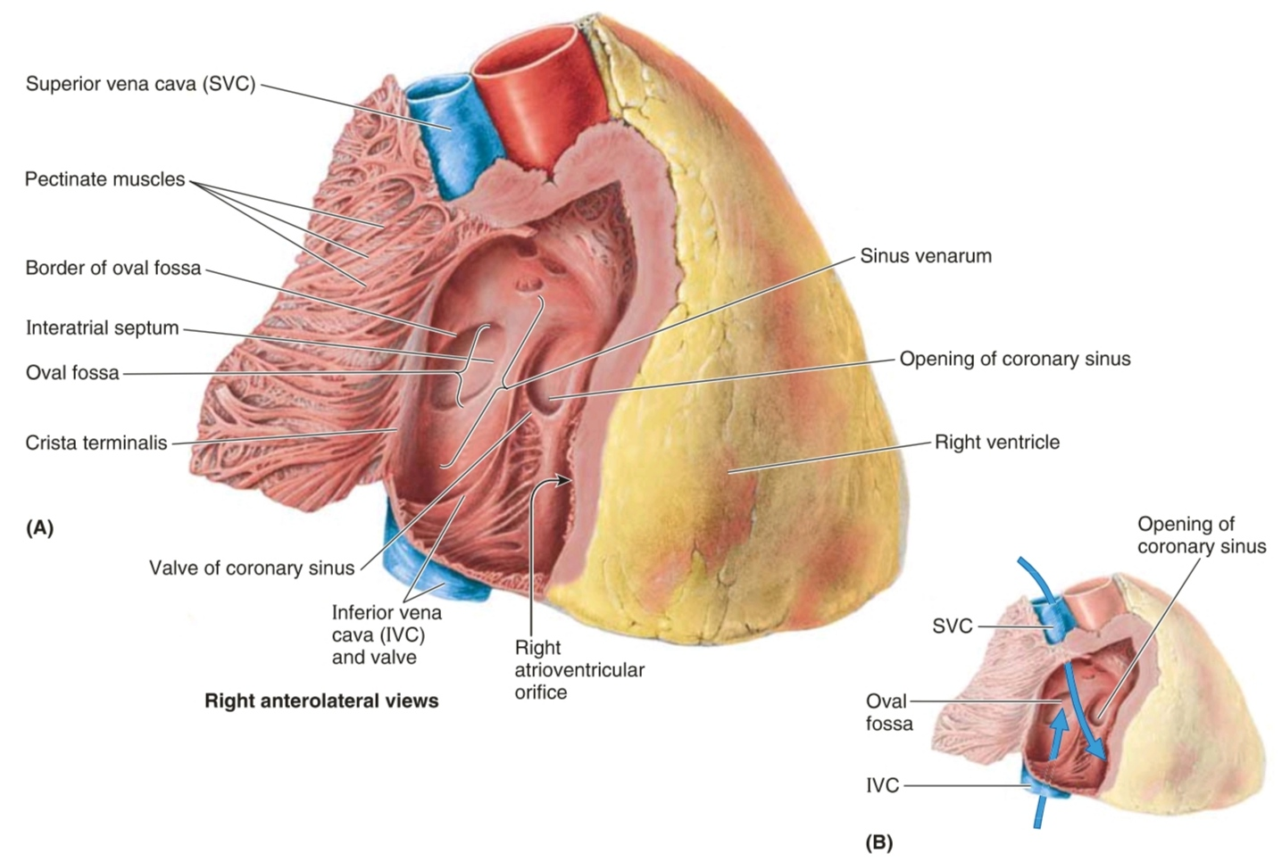

Slide 60
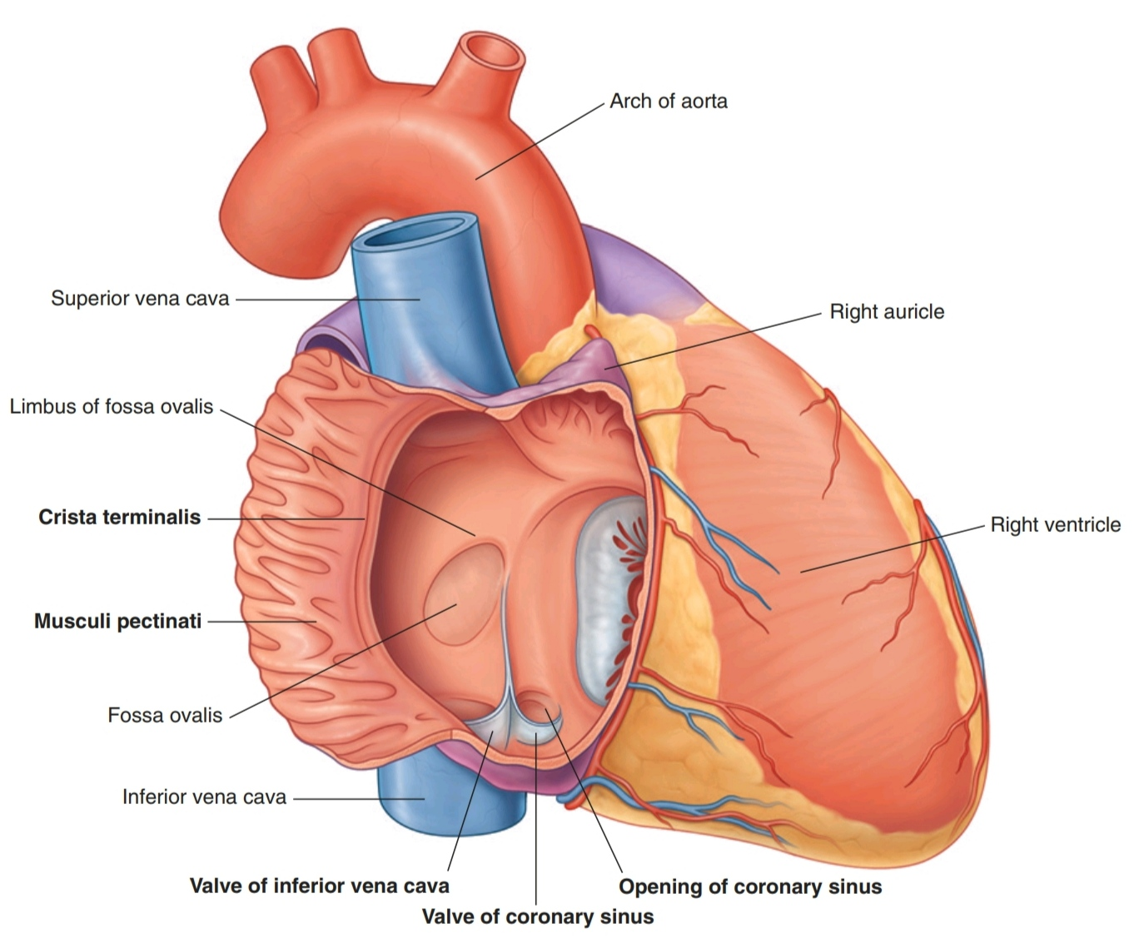
Right Atrium
The smooth and rough parts of the atrial wall are separated externally by a shallow vertical groove, the sulcus terminalis or terminal groove, and internally by a vertical ridge, the crista terminalis or terminal crest

Slide 61
Right Atrium
The opening of the coronary sinus, a short venous trunk receiving most of the cardiac veins, is betweenthe right AV orifice and the IVC orifice.
The interatrial septum separating the atria has an oval, thumbprint-size depression, the oval fossa (L. fossa ovalis), which is a remnant of the oval foramen (L.foramen ovale) and its valve in the fetus.

Slide 62
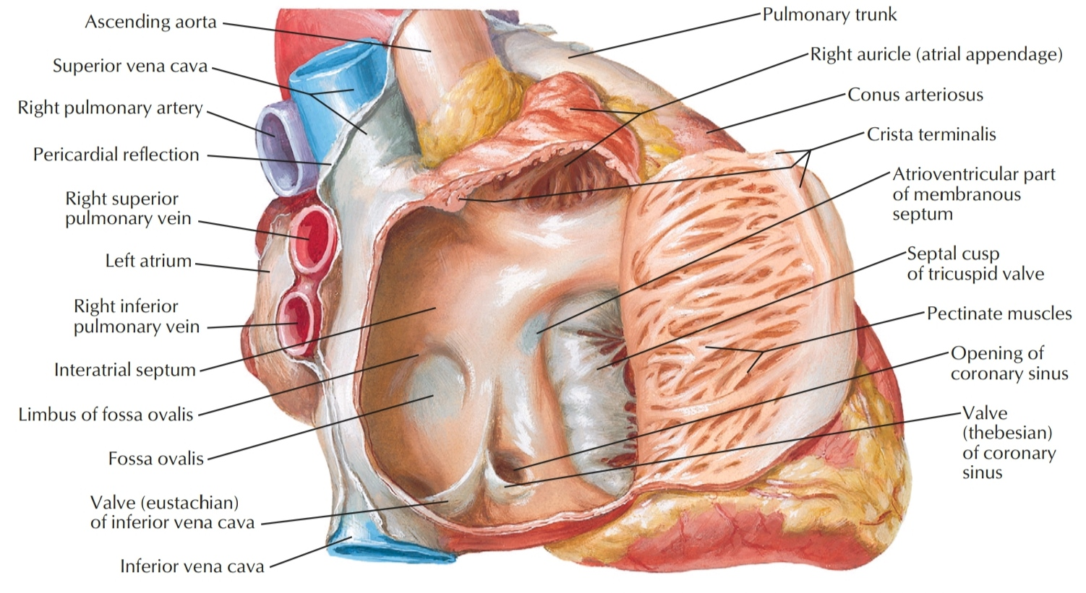

Slide 63
Right Ventricle (RV)

Slide 64
Right Ventricle (RV)
It forms the largest part of the anterior surface of the heart, a small part of the diaphragmatic surface, and almost the entire inferior border of the heart

Slide 65
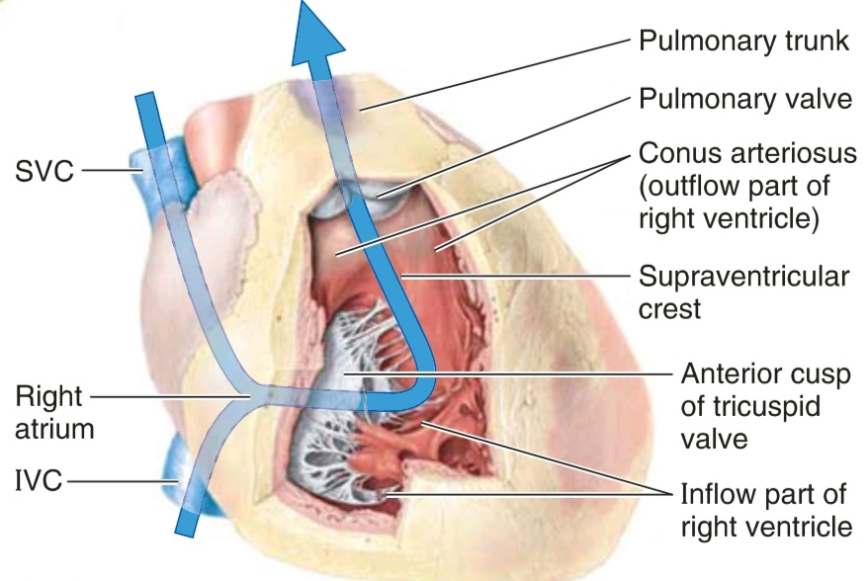
Right Ventricle (RV)
Superiorly, it tapers into an arterial cone, the conus arteriosus (infundibulum), which leads into the pulmonary trunk.

Slide 66
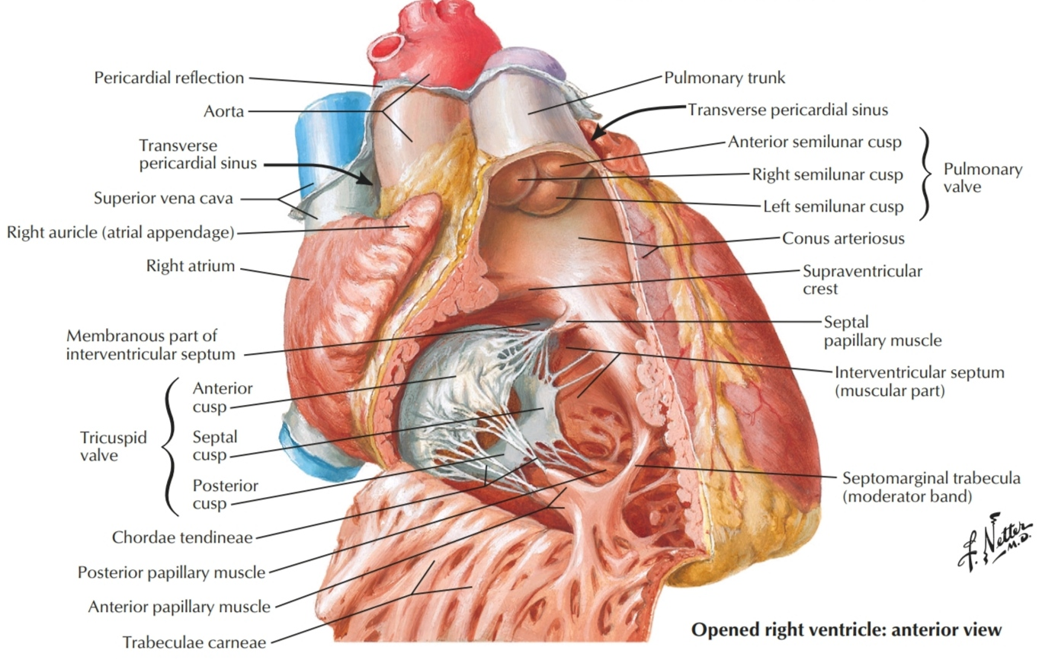
Right Ventricle (RV)
The interior of the RV has irregular muscular elevations (trabeculae carneae).
A thick muscular ridge, the supraventricular crest, separates
the ridged muscular wall of the inflow part of the chamber
from the smooth wall of the conus arteriosus or outflow part.

Slide 68
Right Ventricle (RV)
The inflow part of the RV receives blood from the RA through the right AV (tricuspid) orifice.

Slide 69
Right Ventricle (RV)
The interior of the RV has irregular muscular elevations (trabeculae carneae).
A thick muscular ridge, the supraventricular crest, separates
the ridged muscular wall of the inflow part of the chamber
from the smooth wall of the conus arteriosus or outflow part.

Slide 70
Tricuspid Valve
- It guards the Rt AV orifice. The bases of the valve cusps are attached to the fibrous ring around the orifice.
- Three cusps (leaflets):
anterior (the largest), posterior, septal.
- With corrrisponding papillary muscles.
- Tendinous cords (chordae tendineae) attach to the free edges and ventricular surfaces of the cusps, like a parachute.

Slide 71
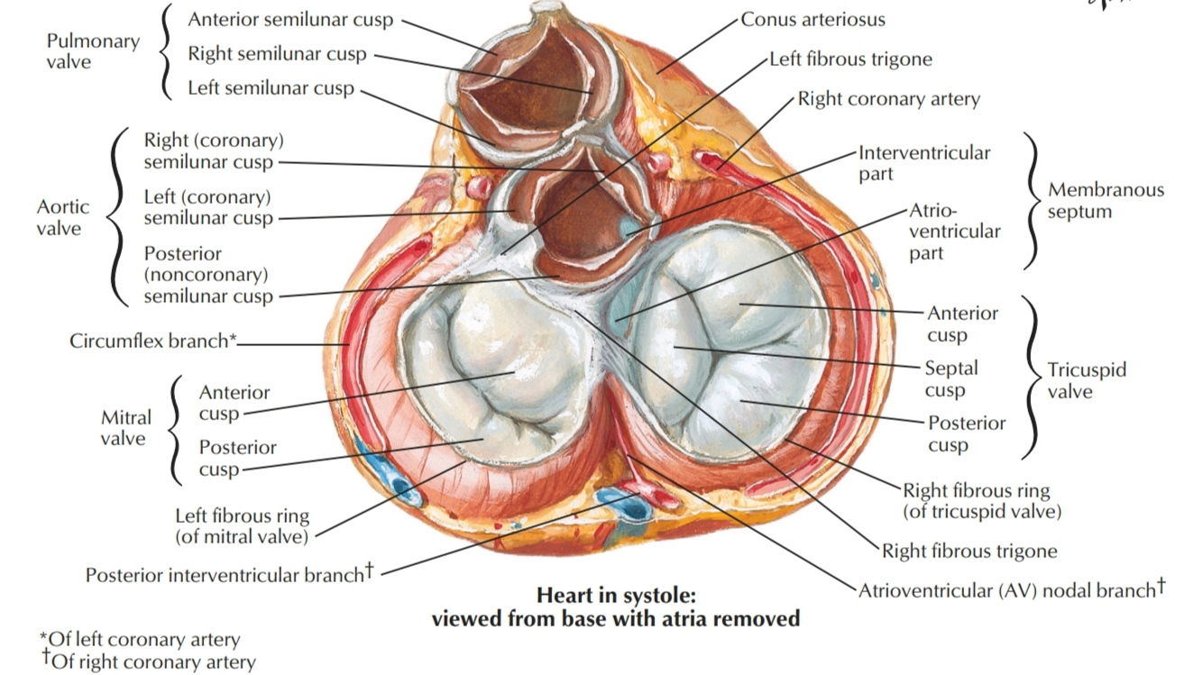

Slide 72
Interventricular Septum (IVS)
It is composed of muscular and membranous parts, is a strong, obliquely placed
partition between the right and left ventricles forming part of the walls of each.

Slide 73
Interventricular Septum (IVS)
The muscular part of the IVS, which forms the majority of the septum, has the thickness of the remainder of the wall of the LV (two to three times as thick as the wall of the right ventricle) and bulges into the cavity of the RV.
Superiorly and posteriorly, a thin membrane, part ofthe fibrous skeleton of the heart, forms
the much smaller membranous part of the IVS.

Slide 74
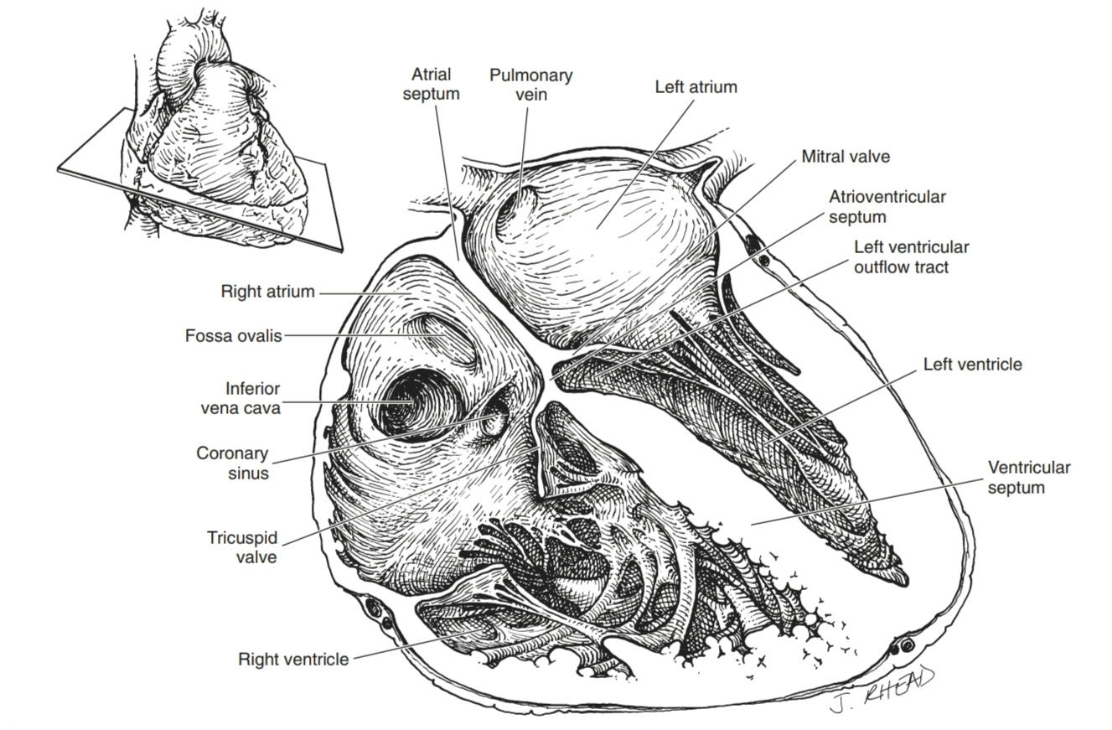
Interventricular Septum (IVS)
On the right side, the septal cusp of the tricuspid valve is attached to the middle of this membranous part of the fibrous skeleton. This means that inferior to the cusp, the
membrane is an interventricular septum, but superior to
the cusp, it is an atrioventricular septum, separating the
right atrium from the left ventricle.

Slide 76
Moderator Band (septomarginal trabecula)
- a curved muscular bundle that traverses the right ventricular
chamber from the inferior part ofthe IVS to the base of the
anterior papillary muscle.
- it carries part of the right branch of the AV bundle
- this "shortcut" across the chamber seems to facilitate conduction time.

Slide 77
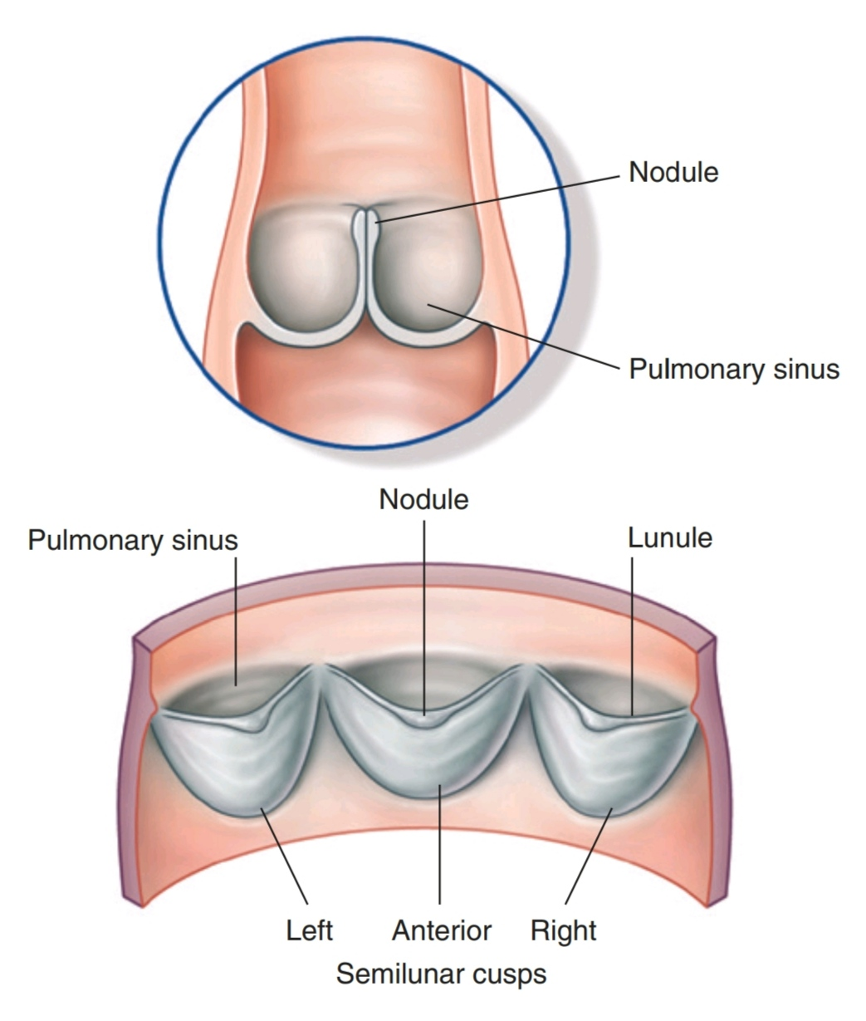
Pulmonary Valve
consists of three semilunar cusps (anterior, right, left) with free edges projecting upward into the lumen of the pulmonary trunk.
The free superior edge of each cusp has a middle, thickened portion, the nodule of the semilunar cusp, and a thin lateral portion, the lunula of the semilunar cusp

Slide 78
Left Atrium (LA)

Slide 79
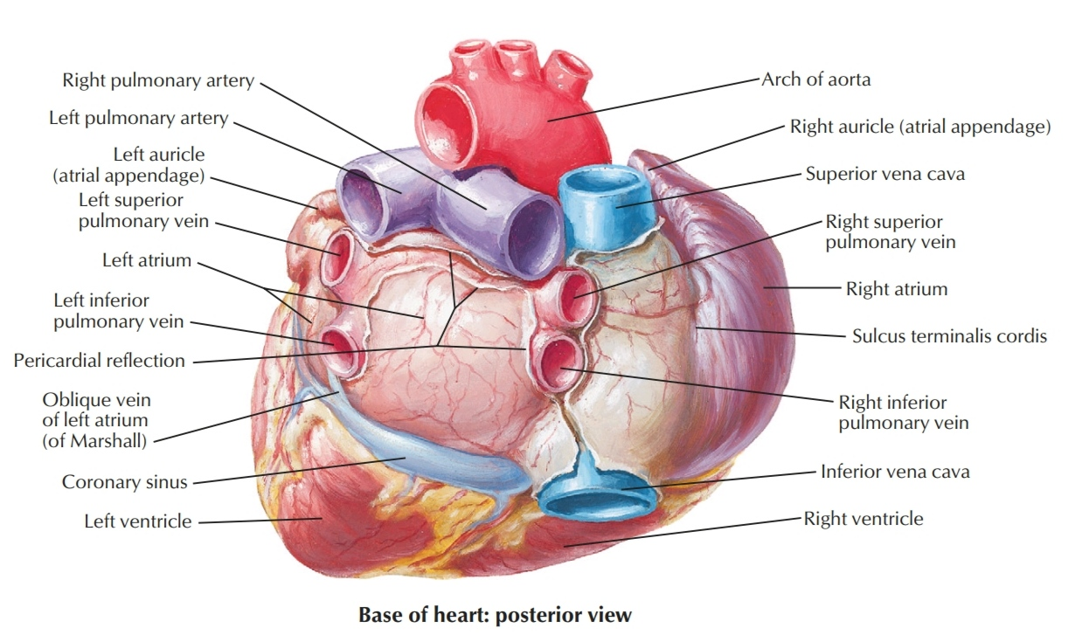
Left Atrium (LA)
LA forms most of the base of the heart. The valveless pairs of right and left pulmonary veins enter the smooth-walled atrium.
The tubular, muscular left auricle, its wall trabeculated with pectinate muscles, forms the superior part of the left border of the heart and overlaps the root of the pulmonary trunk.

Slide 80
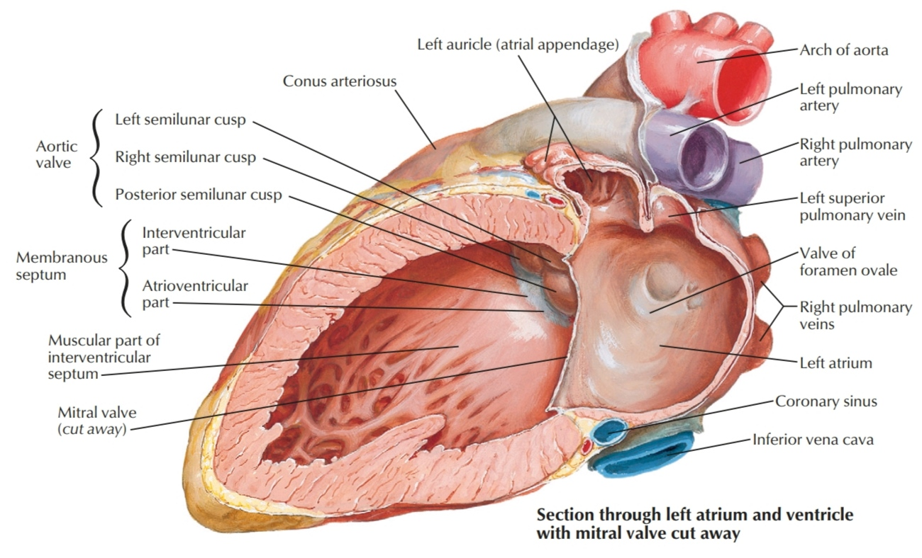
Left Atrium (LA)
A semilunar depression in the interatrial septum indicates the floor of the oval fossa.
The surrounding ridge is the valve of the oval fossa.

Slide 81
Left Atrium (LA)
The interior of the LA has:
• a larger smooth-walled part and a smaller muscular auricle containing pectinate muscles.
• four pulmonary veins (two superior and two inferior)
entering its smooth posterior wall.
• a slightly thicker wall than that of the RA.

Slide 83
Left Ventricle (LV)

Slide 84
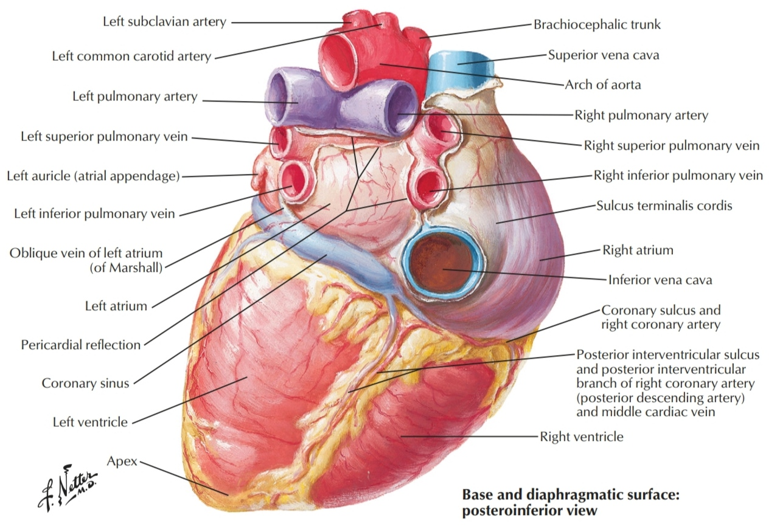
Left Ventricle (LV)
It forms the apex of the heart, nearly all its left (pulmonary) surface and border, and most of the diaphragmatic surface

Slide 85
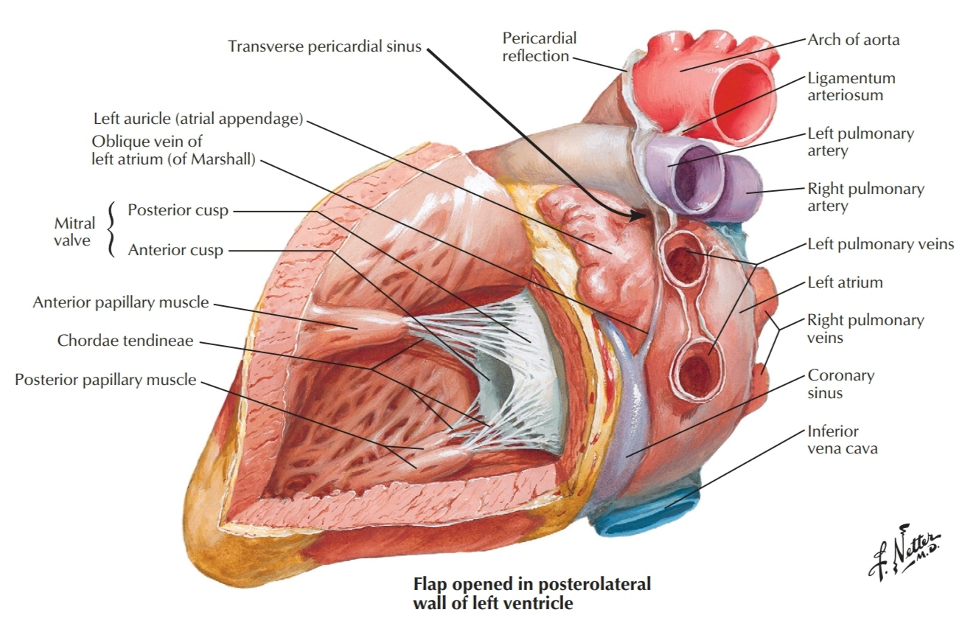
Left Ventricle (LV)
The interior of the LV has:
• walls that are two to three times as thick as those of the RV.
• walls that are mostly covered with a mesh of trabeculaecarnee that are finer and more numerous than those of the RV.
• a conical cavity that is longer than that of the RV.
• Two papillary muscles, the anterior
and posterior papillary muscles, are usually found in the LV and are larger than those of the RV.

Slide 87
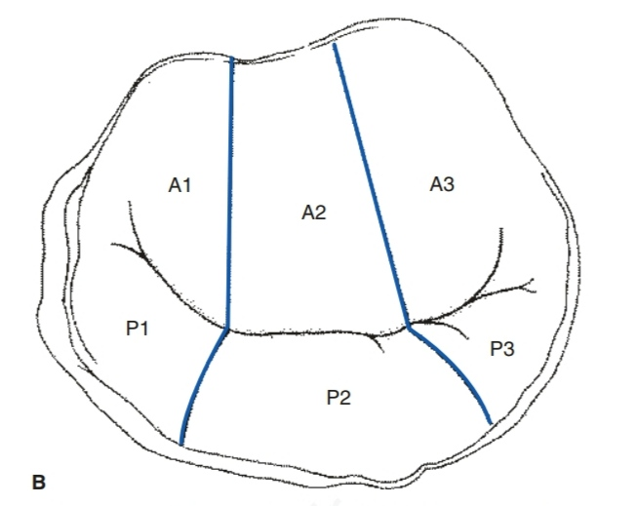
Mitral Valve (Bicuspid Valve)
The mitral valve has two cusps, anterior (aortic or septal) and posterior mural or ventricular).
The anterior leaflet is larger than the posterior leaflet, but the circumference of the posterior leaflet is much larger than the anterior leaflet, hence the smile configuration of mitral valve

Slide 88
Mitral Valve
both the anterior and posterior leaflets are divided into three parts, corresponding to the three scalloped areas of each leaflet (A1, A2, A3 for the anterior leaflet; P1, P2, and P3 for the posterior leaflet)
There are two commissures: anterolateral and posteromedial

Slide 89
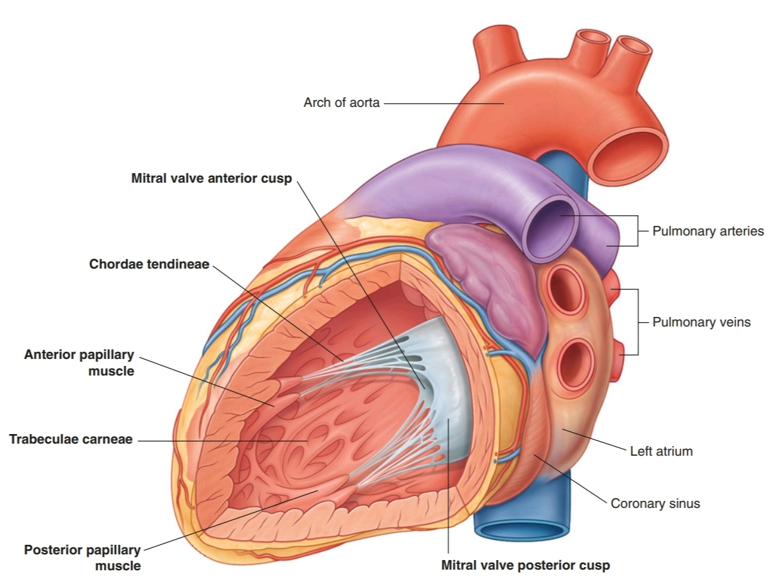
Mitral Valve
The chordae tendineae to the mitral valve originate from the anterolateral and posteromedial papillary muscles.
Each leaflet receives chordae
from both muscles with the majority inserting on the free leaflet edge.

Slide 90
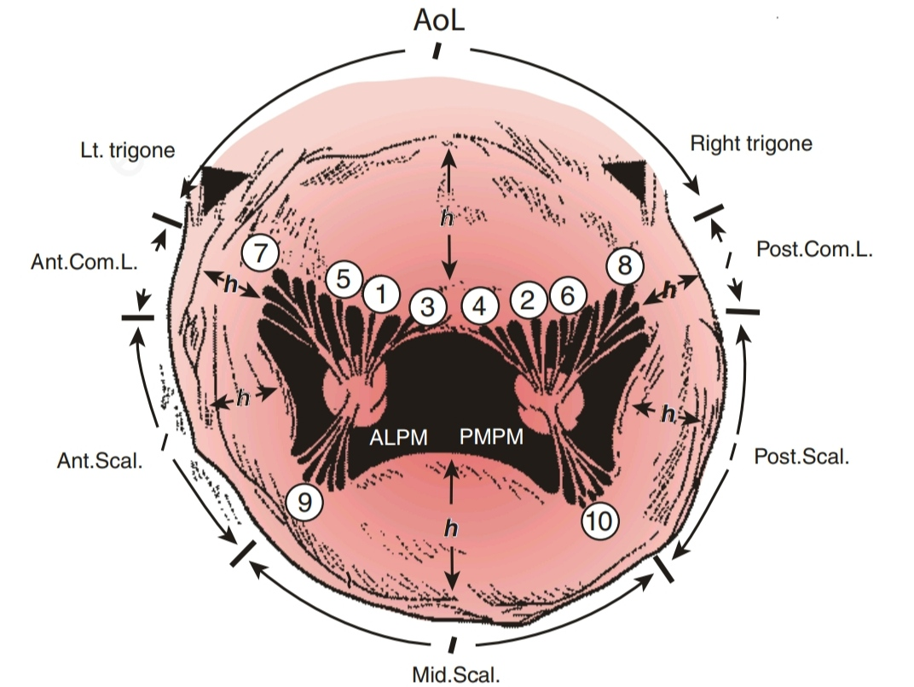
Mitral Valve
There are three orders of chordae:
- the first order insert on the free margin of the leaflet;
- the second order chordae insert several millimeters back from the free edge;
- the third order chordae insert at the base of the leaflet.
Third order chordae exist only on the posterior leaflet

Slide 91
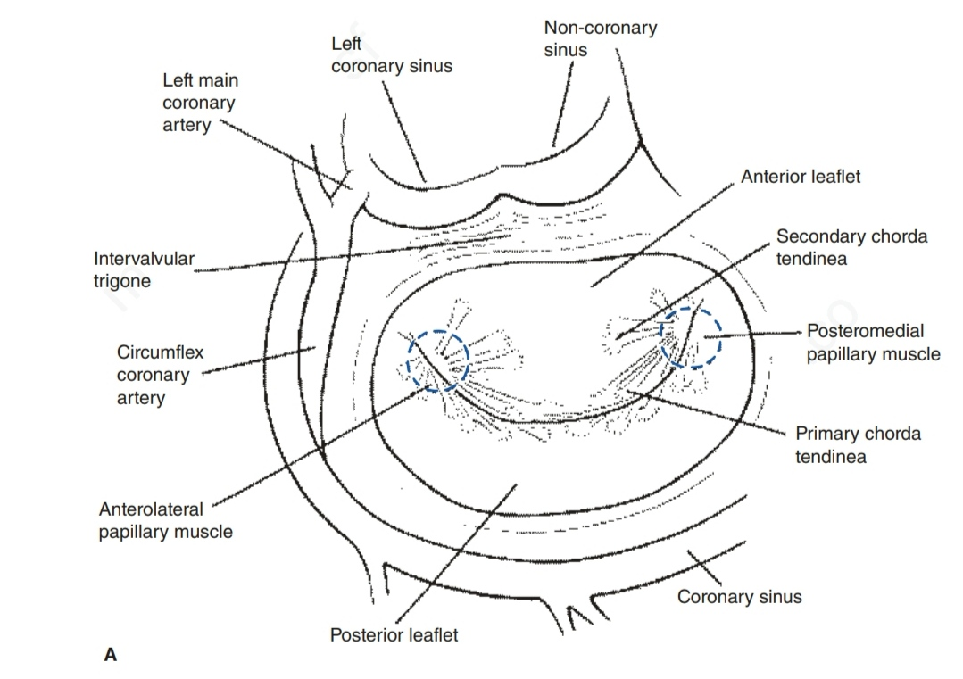
Mitral Valve

Slide 92

Aortic Valve
similar in structure to the pulmonary valve. It consists of three semilunar cusps with the free edge of each projecting upward into the lumen of the ascending aorta.

Slide 93

Aortic Valve
Between the semilunar cusps and the wall of the ascending aorta are pocket-like sinuses—the right, left, and posterior aortic sinuses.
The right and left coronary arteries originate from the right and left aortic sinuses. Because of this, the posterior aortic sinus and cusp are sometimes referred to as the noncoronary sinus and cusp.

Slide 94

Aortic Valve
The aortic valve is in fibrous continuity with the anterior leaflet of the mitral valve and the membranous septum

Slide 95
Cardiac Valves All Together

Slide 96


