Slide 1
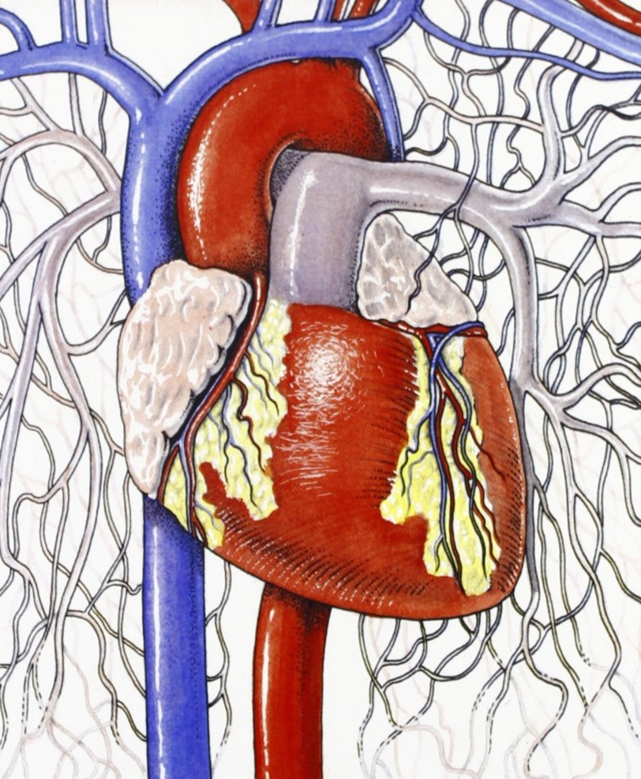

Cardiovascular Anatomy
Part II
بسم الله الرحمن الرحيم
DR. SAHER ABUGHALI
DIRECTOR OF CARDIAC SURGERY DEPARTMENT
AL SHIFA HOSPITAL

Slide 2
Fibrous Skeleton of the Heart

Slide 3
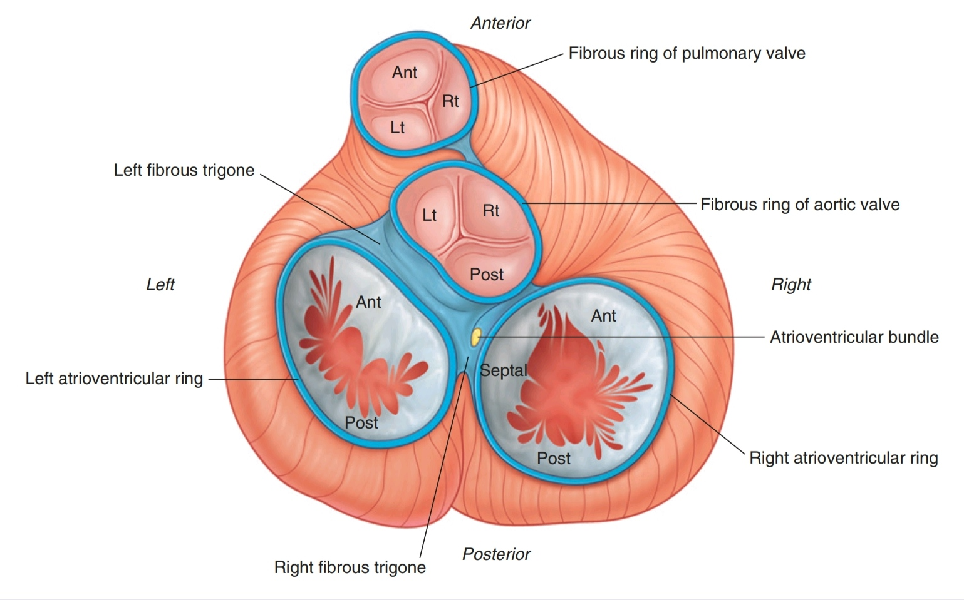
Fibrous Skeleton of the Heart
The cardiac skeleton is a collection of dense, fibrous connective tissue in the form of four rings with interconnecting areas in a plane between the atria and the ventricles.
The four rings of the cardiac skeleton surround the two atrioventricular orifices, the aortic orifice and opening of the pulmonary trunks. They are the anulus fibrosus.

Slide 5
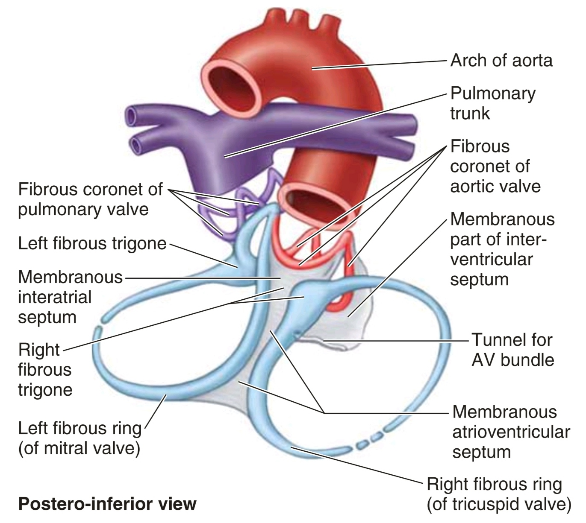
Fibrous Skeleton of the Heart
The interconnecting areas include:
■ the right fibrous trigone, which is a thickened area of connective tissue between the aortic ring and right atrioventricular ring
■ the left fibrous trigone, which is a thickened area of connective tissue between the aortic ring and the left atrioventricular ring

Slide 6
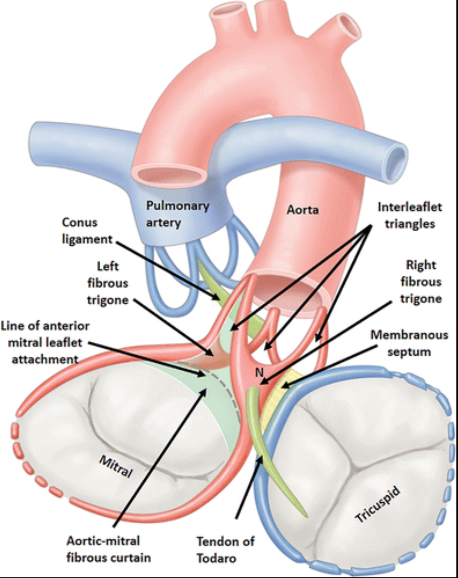

Slide 7
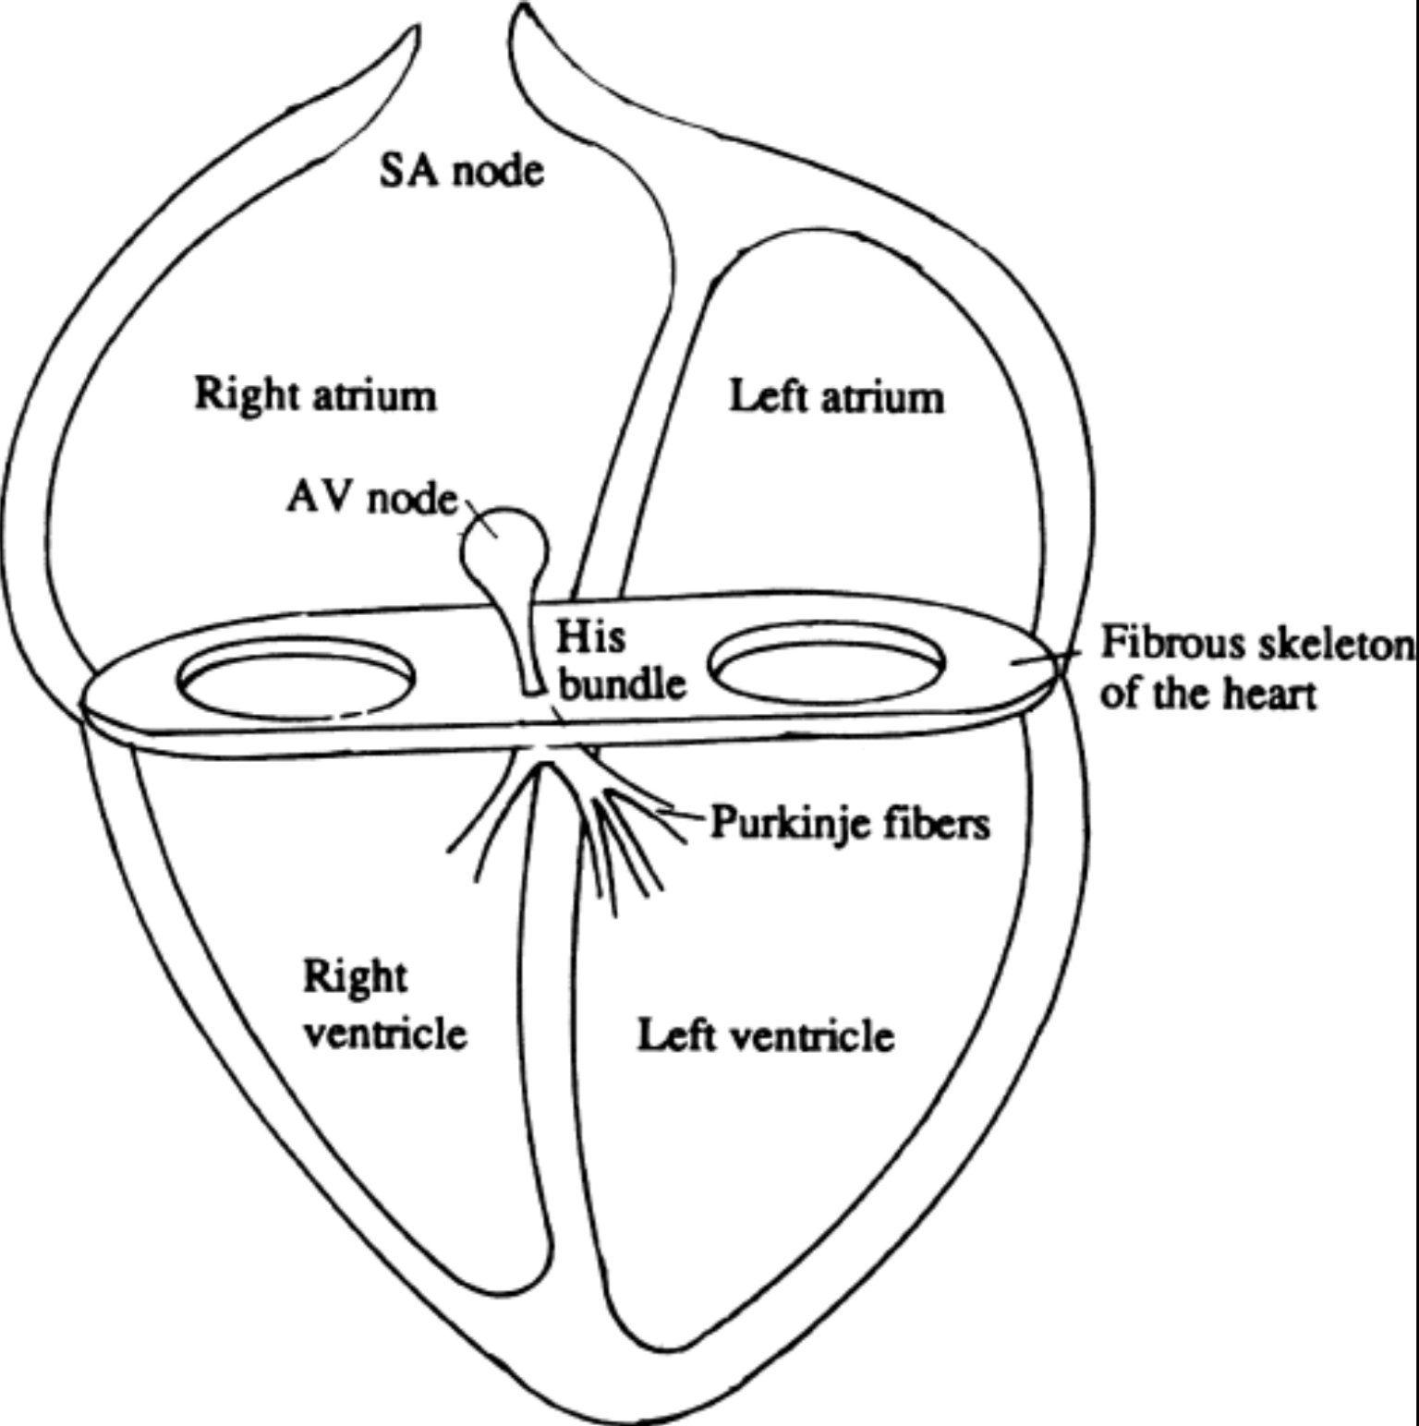
Importance of The Cardiac Skeleton
• it helps maintain the integrity of the openings it surrounds and provides points of attachment for the cusps.
• it separates the atrial musculature from the ventricular musculature: the atrial myocardium originates from the upper border of the rings, whereas the ventricular myocardium originates from the lower border of the rings.
• it is a dense connective tissue partition that electrically isolates the atria from the ventricles: the atrioventricular bundle, which passes through the anulus, is the single connection between these two groups of myocardium.

Slide 8
Conduction System of The Heart

Slide 9
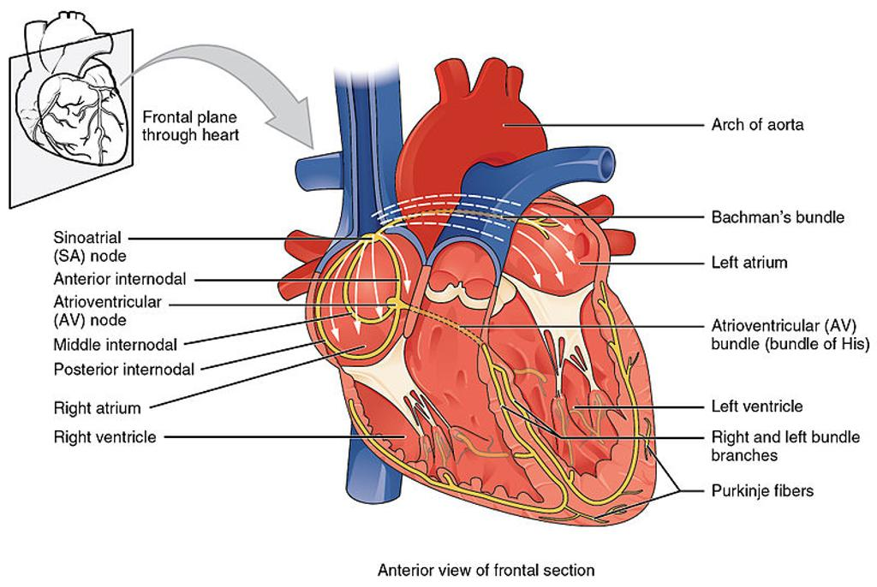
Conduction System of The Heart
The musculature of the atria and ventricles is capable of contracting spontaneously. The cardiac conduction system initiates and coordinates contraction.

Slide 10
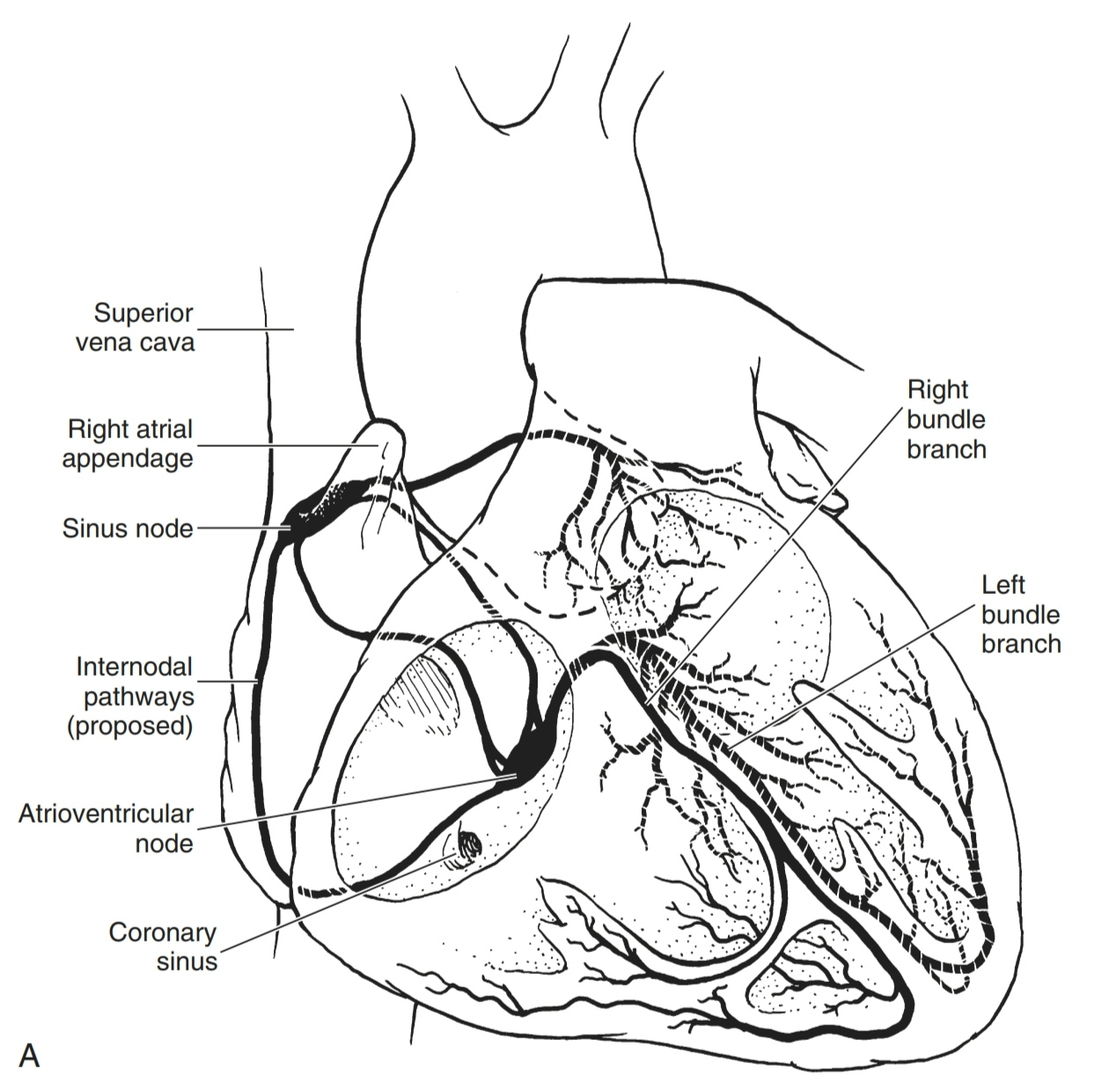
Conduction System of The Heart
The conduction system consists of nodes and networks of specialized
cardiac muscle cells organized into four basic components:
■ the sinu-atrial (SA) node
■ the atrioventricular (AV) node
■ the atrioventricular bundle with its right and left bundle branches
■ the subendocardial plexus of conduction cells (the Purkinje fibers).

Slide 11
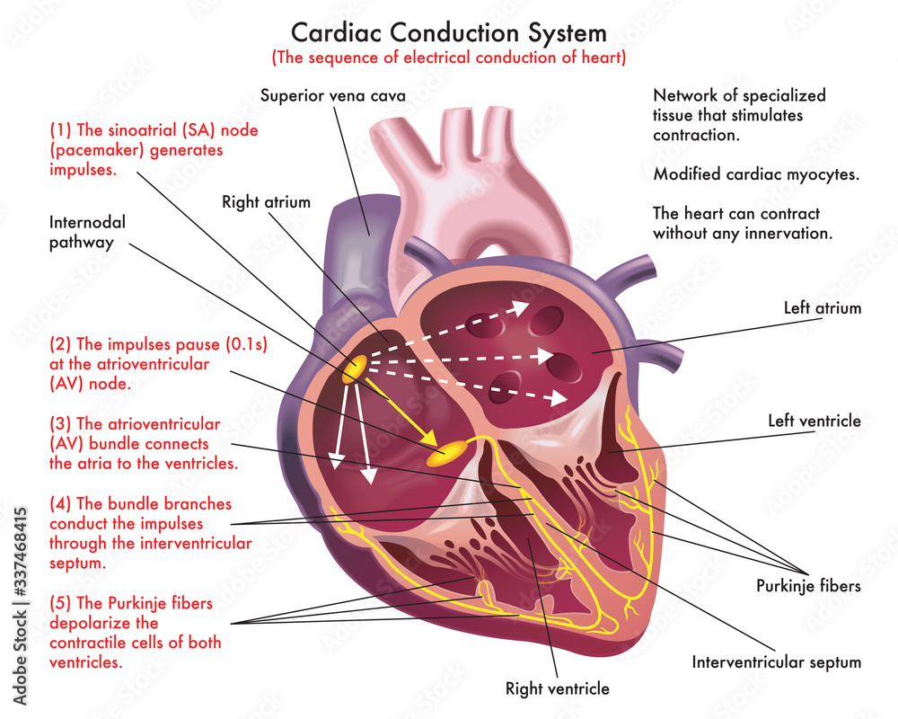

Slide 12
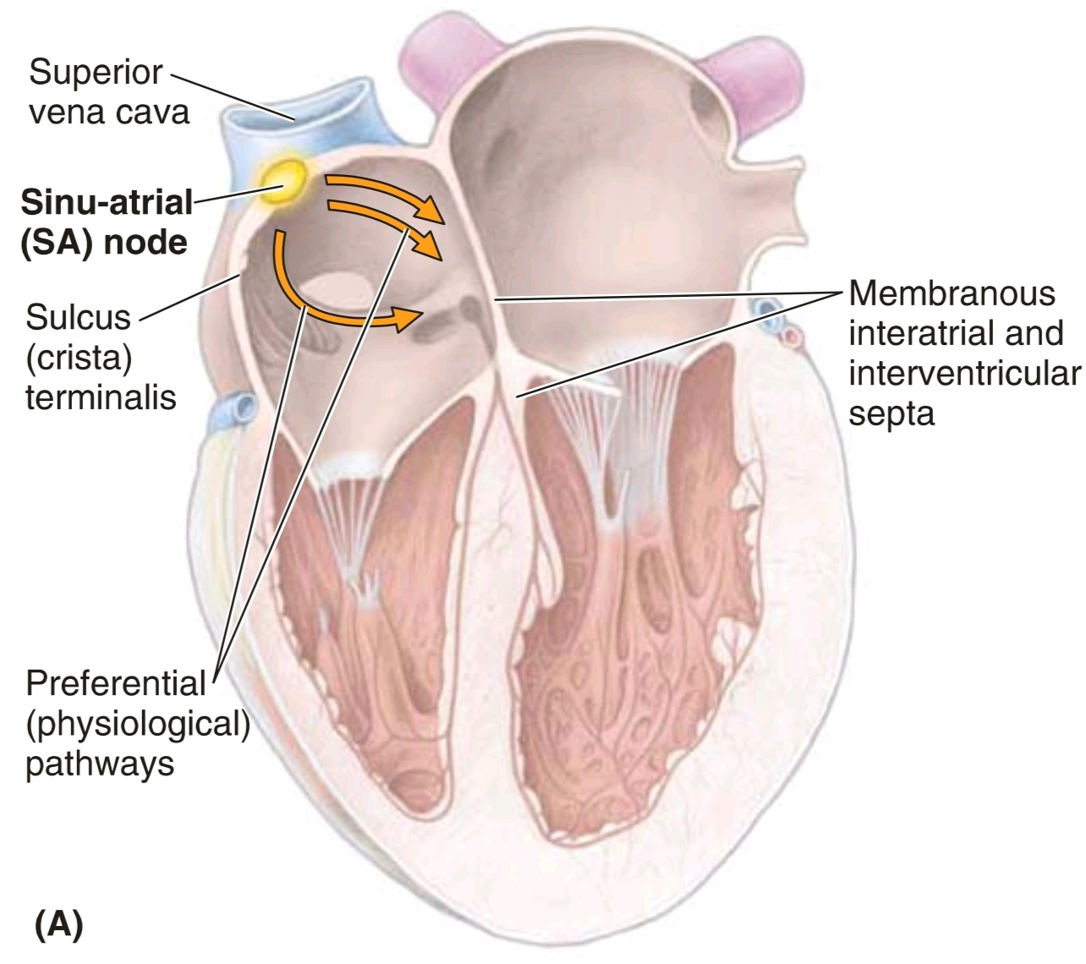
The sinu-atrial (SA) node [of Keith-Flack]
- Impulses begin at the sinu-atrial node, the cardiac pacemaker.
- cigar-shaped structure, 8–25 mm long
- This collection of cells is located at the superior end of the crista terminalis at the junction of the SVC and the RA.
- The excitation signals generated by the sinu-atrial node spread across the atria, causing the muscle to contract.

Slide 13
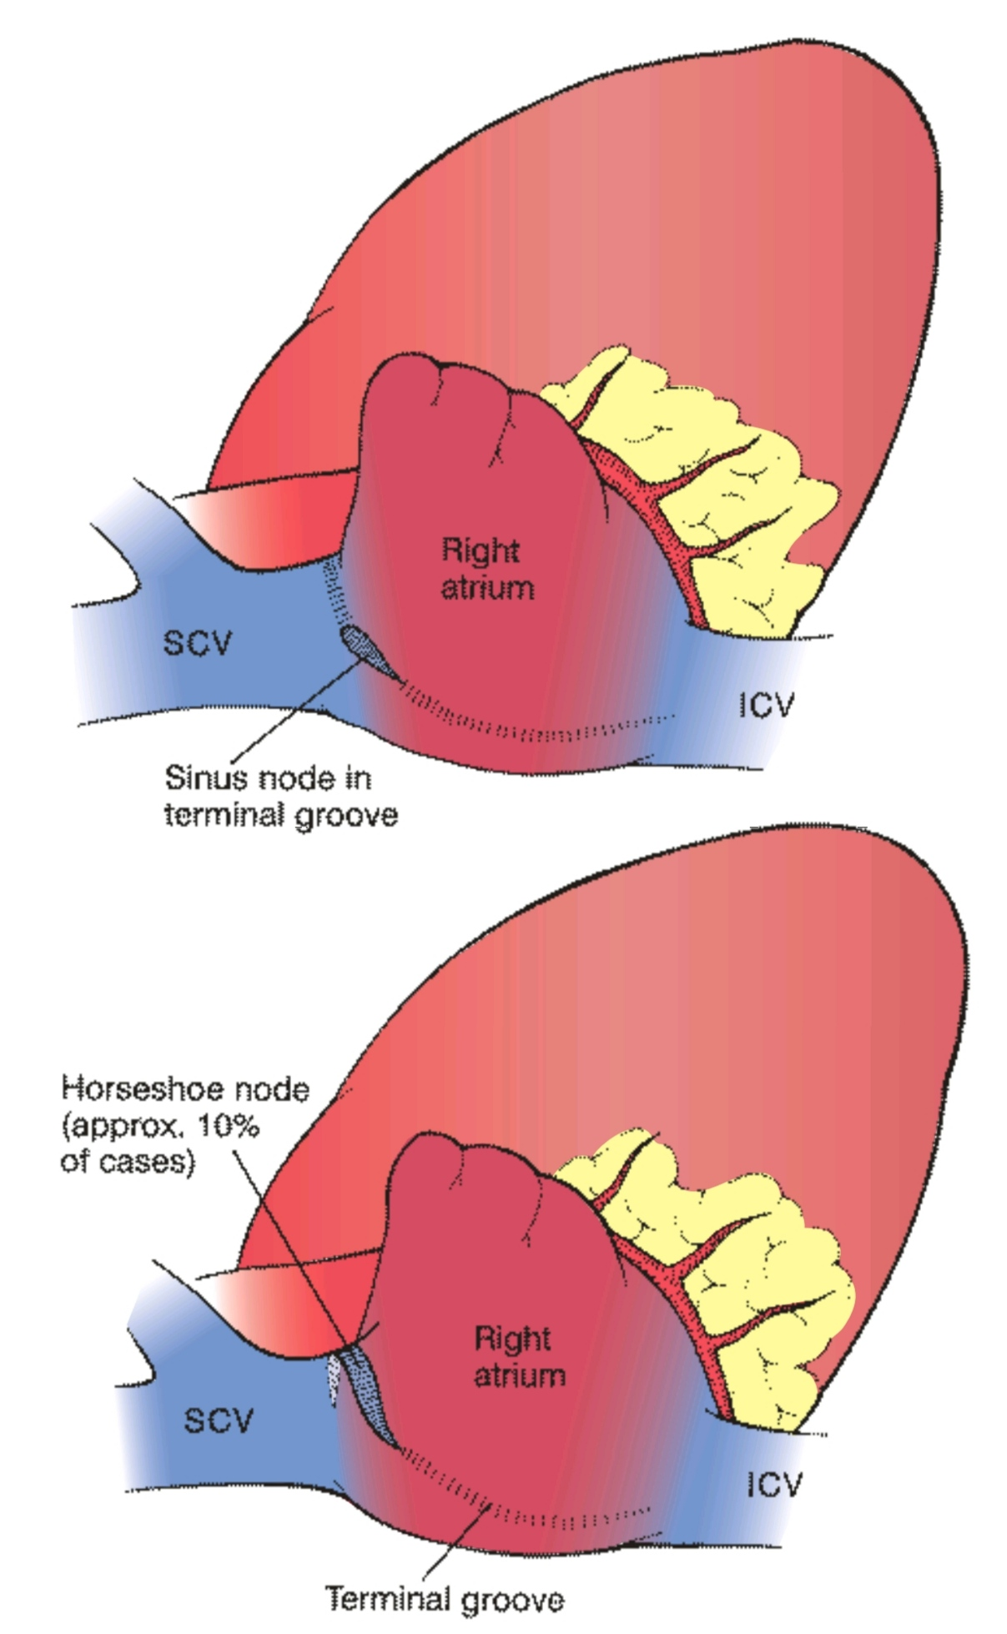

Slide 14
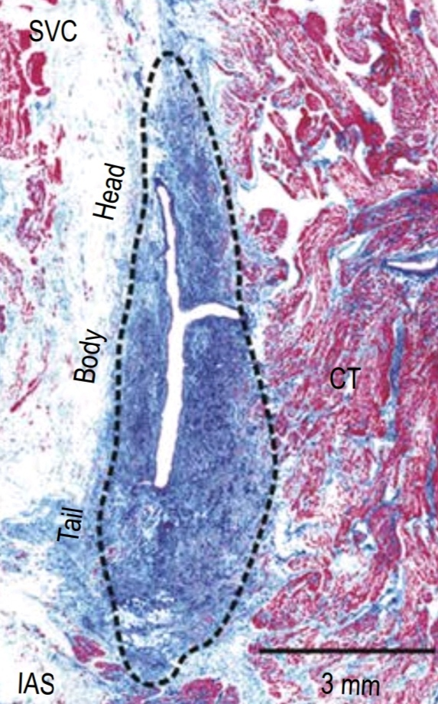
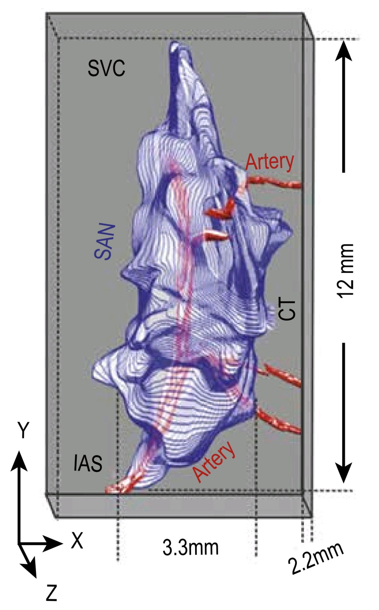
The sinu-atrial (SA) node
- The sinu-atrial (SA) node is located anterolaterally just deep to the epicardium at the junction ofthe SVC and RA, near the superior end of the sulcus terminalis.
- it is a small collection of nodal tissue, specialized cardiac muscle fibers, and associated fibro-elastic connective tissue. It is the pacemaker of the heart.
- it initiates and regulates the impulses for the contractions of the heart, giving off an impulse approximately 70 times per minute.
- The contraction signal from the SA node spreads myogenically (through the musculature) of both atria.

Slide 15
The sinu-atrial (SA) node
- The SA node is supplied by the sino-atrial nodal artery,which usually arises as an atrial branch ofthe RCA (in 60% of people) but it often arises from the LCA (in 40%)
- The SA node is stimulated by the sympathetic division of the autonomic nervous system to accelerate the heart rate and is inhibited by the parasympathetic division to return to or approach its basal rate.

Slide 16
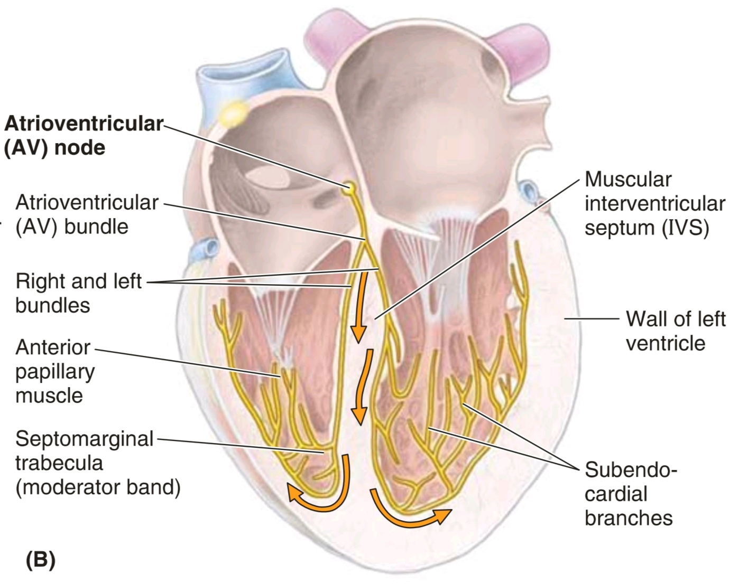
The Atrioventricular (AV) node
[of Aschoff-Tawara]
Concurrently, the wave of excitation in the atria stimulates the atrioventricular node, which is located near the opening of the coronary sinus, close to the attachment of the septal cusp of the tricuspid valve, and within the atrioventricular septum.
The atrioventricular node is a collection of specialized cells that forms the beginning of an elaborate system of conducting tissue, the atrioventricular bundle, which extends the excitatory impulse to all ventricular
musculature.

Slide 17
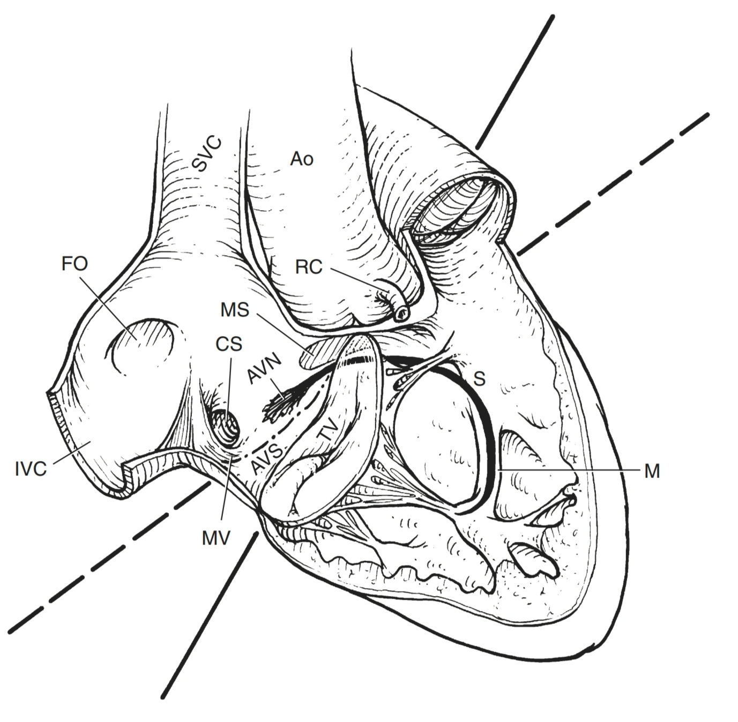
The Atrioventricular (AV) node
- The AV node lies directly on the right atrial side of the central
fibrous body (right trigone) in the muscular portion of the
AV septum, just anterosuperior to the ostium of the coronary
sinus. At times, its posterior margin has been found to lie
directly against the coronary sinus ostium.
- It has a flattened oblong shape and an average dimension in adults of 1 × 3 × 6 mm. Its left surface lies against the mitral anulus.
- Viewed from the RA, the AV node can be localized within
a triangle—described by Koch —formed by the:
tricuspid anulus, tendon of Todaro (continuation of eustachian valve that runs to the central fibrous body), and
coronary sinus ostium.

Slide 18
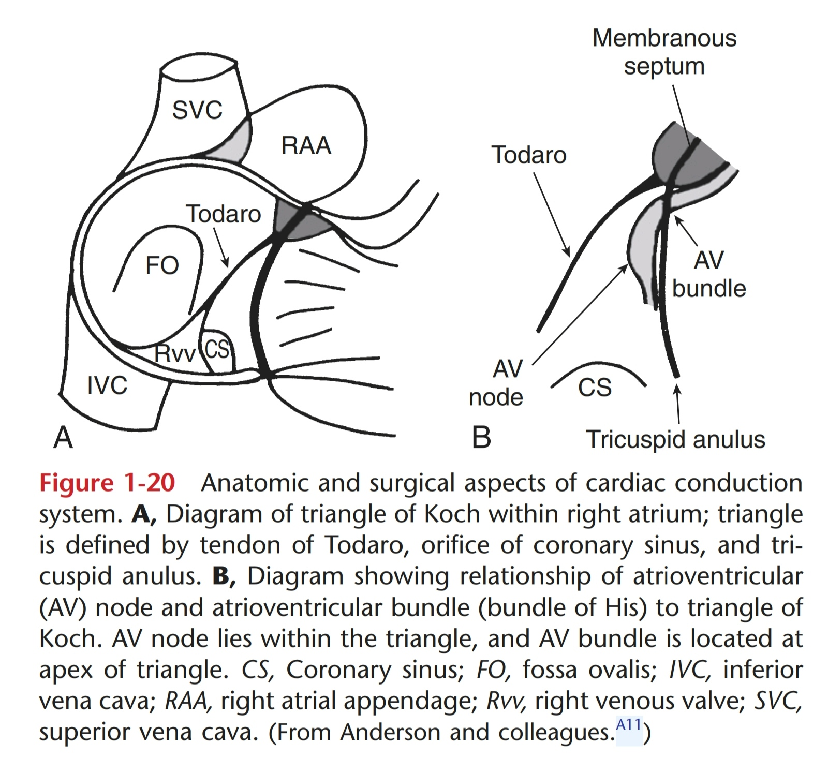
Triangle of Koch

Slide 19
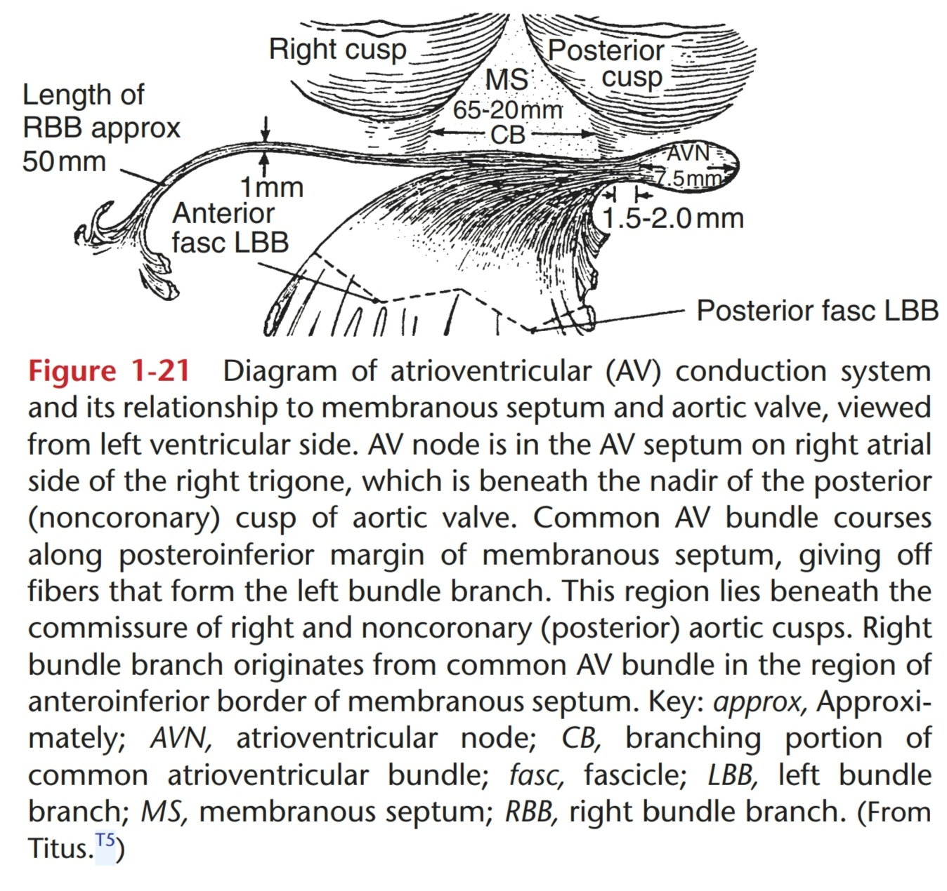

Slide 20
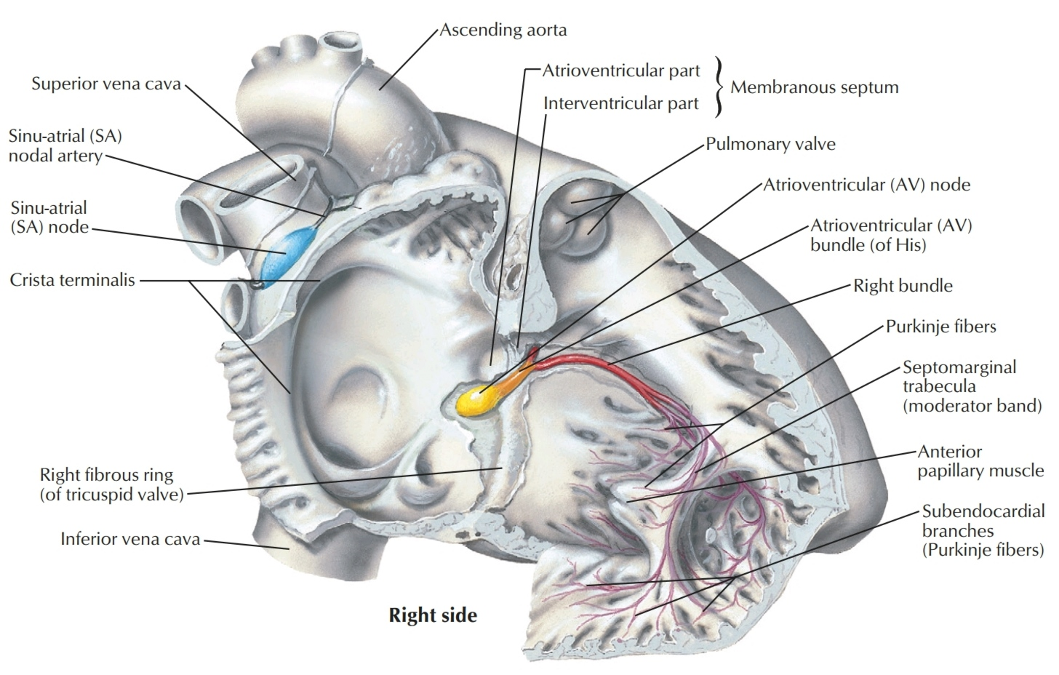
Atrioventricular bundle (of His)
The atrioventricular bundle is a direct continuation of the atrioventricular node.
It follows along the lower border of the membranous part of the IV septum before splitting into right and left
bundles.

Slide 21
The Right Bundle Branch (RBB)
- The RBB continues on the right side of the interventricular septum toward the apex of the RV.
- From the septum it enters the septomarginal
trabecula (moderator band) to reach the base of the anterior papillary muscle.
- At this point, it divides and is continuous with the final component of the cardiac conduction system, the subendocardial plexus of ventricular conduction cells or Purkinje fibers. This network of specialized cells spreads throughout the ventricle to supply the ventricular musculature, including the papillary muscles.

Slide 22
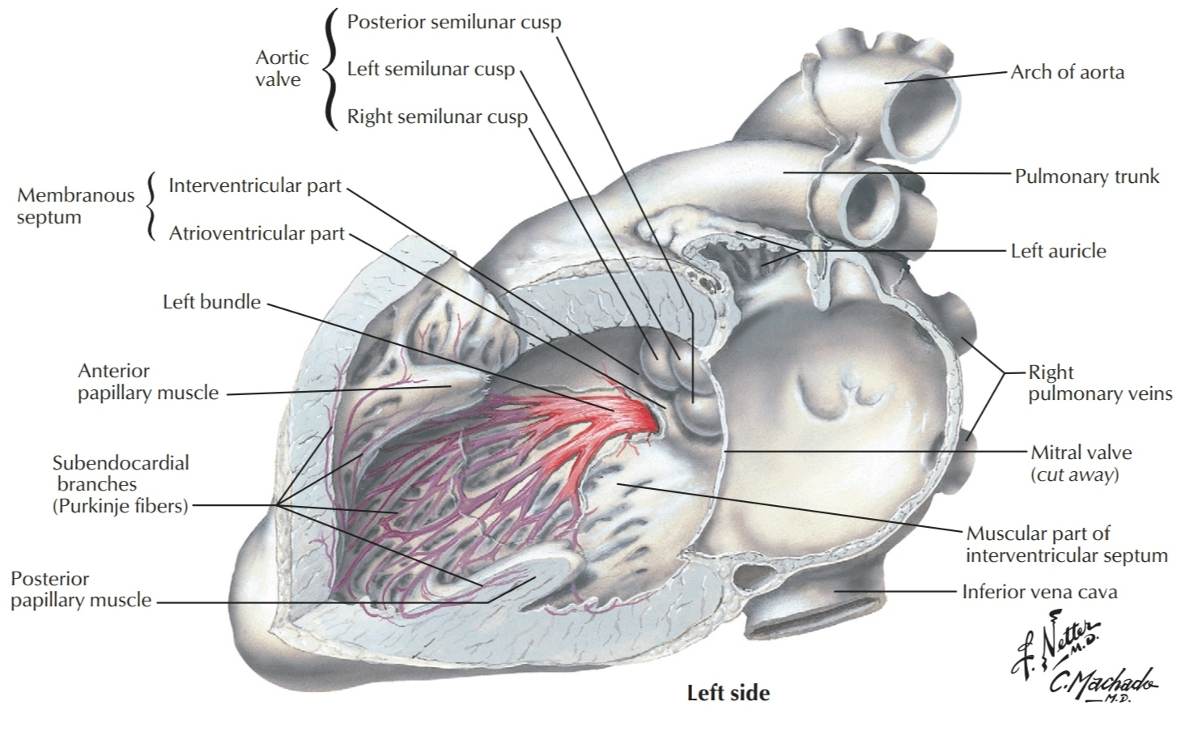
The Left Bundle Branch (LBB)
- The LBB passes to the left side of the
muscular interventricular septum and descends to the apex of the left ventricle.
- Along its course it gives off branches that eventually become continuous
with the subendocardial plexus of conduction cells (Purkinje fibers).
- As with the right side, this network of
specialized cells spreads the excitation impulses throughout the left ventricle.
- Commonly (although not always) the LBB trifurcates into anterior, septal and posterior divisions.

Slide 23
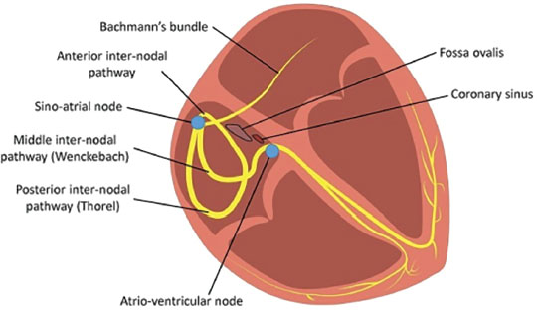
Internodal Pathways
The spread of activation between SA node and AV node occurs preferentially through the muscle bundles delimited by orifices of the RA .
Investigators have not found discrete internodal tracts composed of homogeneous cells or fibers, although some have identified Purkinje-like cells in the major muscle bundles of adult hearts.

Slide 25
Vasculature of The Heart

Slide 26
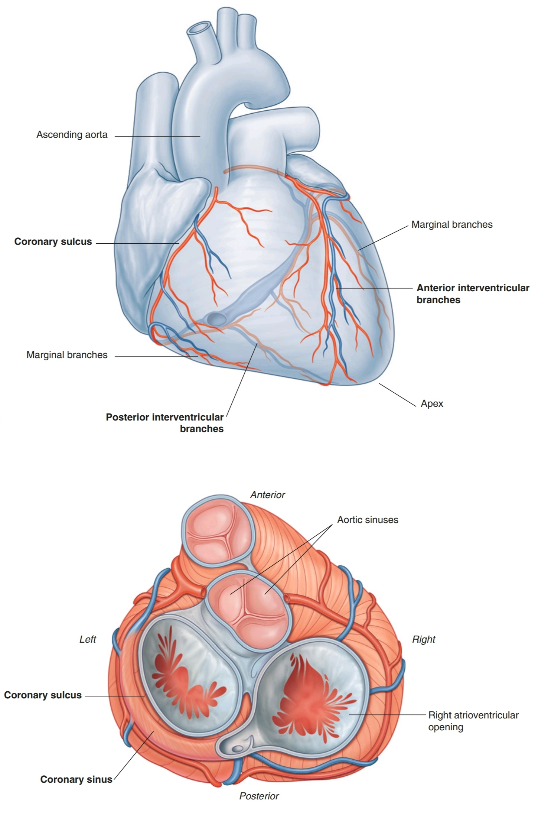
Vasculature of The Heart
- The blood vessels of the heart comprise the coronary arteries and cardiac veins, which carry blood to and from the myocardium.
- The endocardium and some subendocardial tissue receive oxygen and nutrients by diffusion or microvasculature directly from the chambers of the heart.

Slide 27
Vasculature of The Heart
- The blood vessels of the heart, normally embedded in fat, course across the surface of the heart just deep to the epicardium.
- Occasionally, parts of the vessels become embedded within the myocardium (intramyocardial vessels).
- The blood vessels of the heart are affected by both sympathetic and parasympathetic nerves.

Slide 28
Coronary Arteries

Slide 29
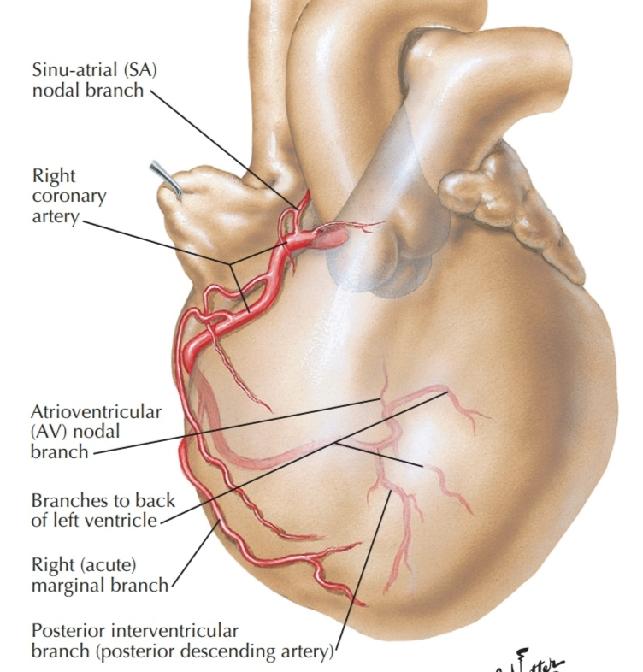
Right Coronary Artery (RCA)
- The RCA originates from the right aortic sinus of the ascending aorta.
- It passes anteriorly and then descends vertically in the coronary sulcus, between the RA and the RV.
- On reaching the inferior margin of the heart, it turns posteriorly and continues in the sulcus onto the diaphragmatic surface and base of the heart.

Slide 30
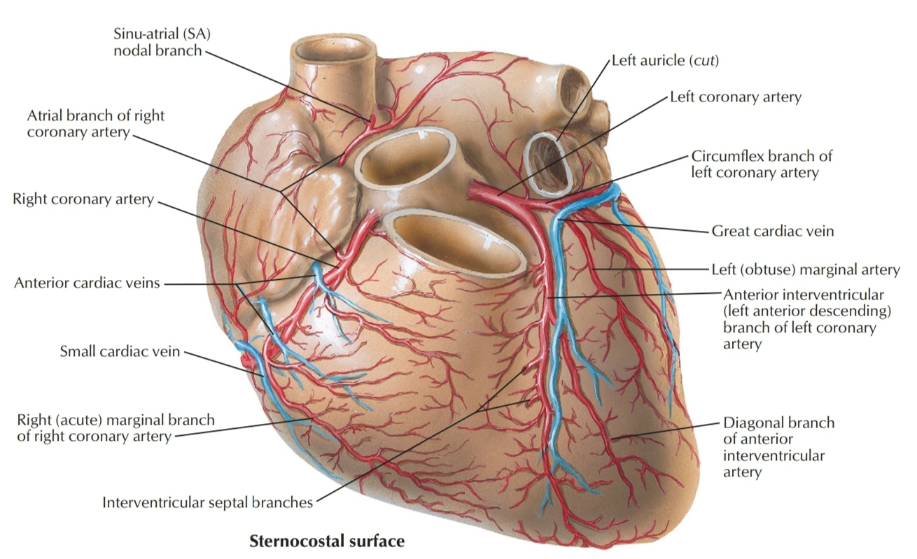
Branches of the RCA
■ An early atrial branch passes in the groove between the right auricle and ascending aorta, and gives off the sinu-atrial nodal branch , which passes posteriorly around the superior vena cava to supply the sinu-atrial node.
■ A right marginal branch is given off as the RCA approaches the inferior (acute) margin of the heart and continues along this border toward the apex of the heart.

Slide 31
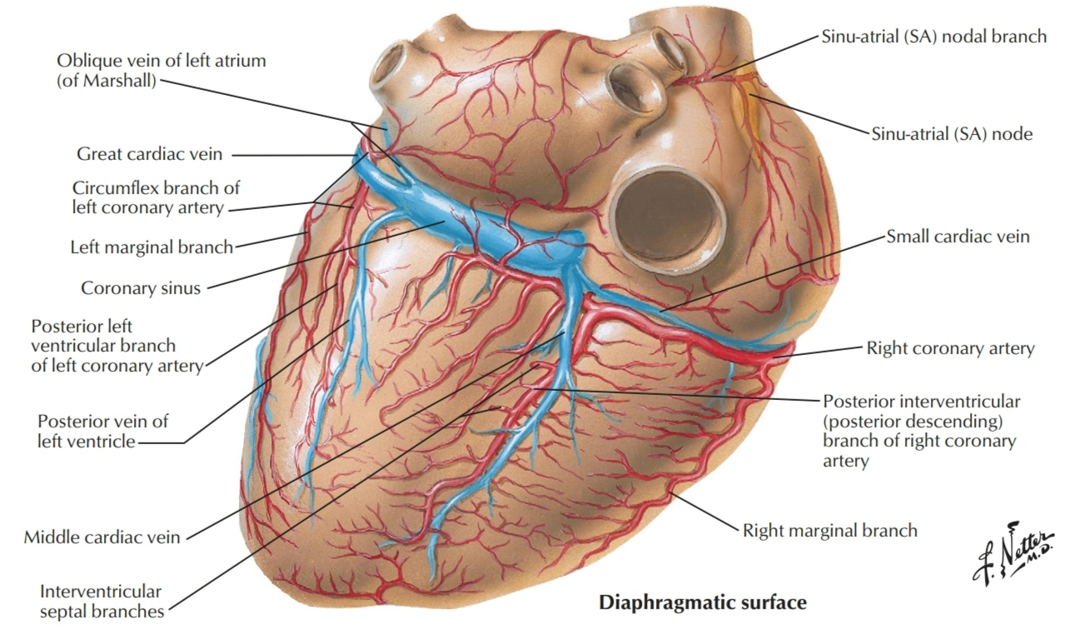
Branches of the RCA
■ As the RCA continues on the diaphragmatic surface of the heart, it supplies a small branch to the AV node before giving off its final major branch, the posterior interventricular branch (PDA) which lies in the posterior interventricular sulcus.

Slide 32
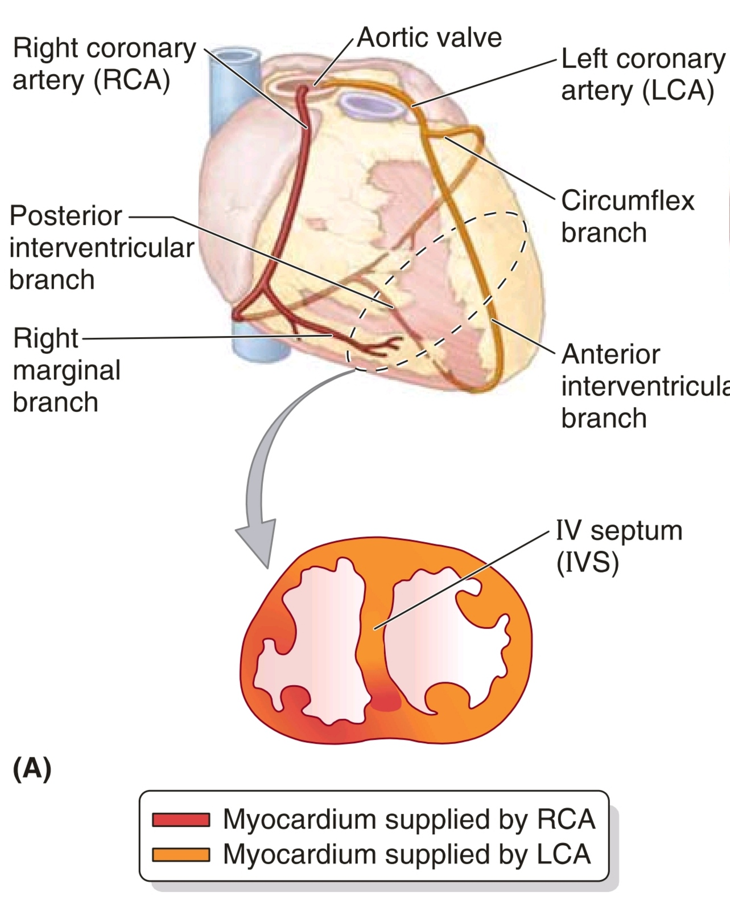
RCA
It supplies:
- RA and RV
- SA and AV nodes
- the interatrial septum
- a portion of the left atrium
- the posteroinferior one third of the IV septum,
-'a portion of the posterior part of the left ventricle.

Slide 33
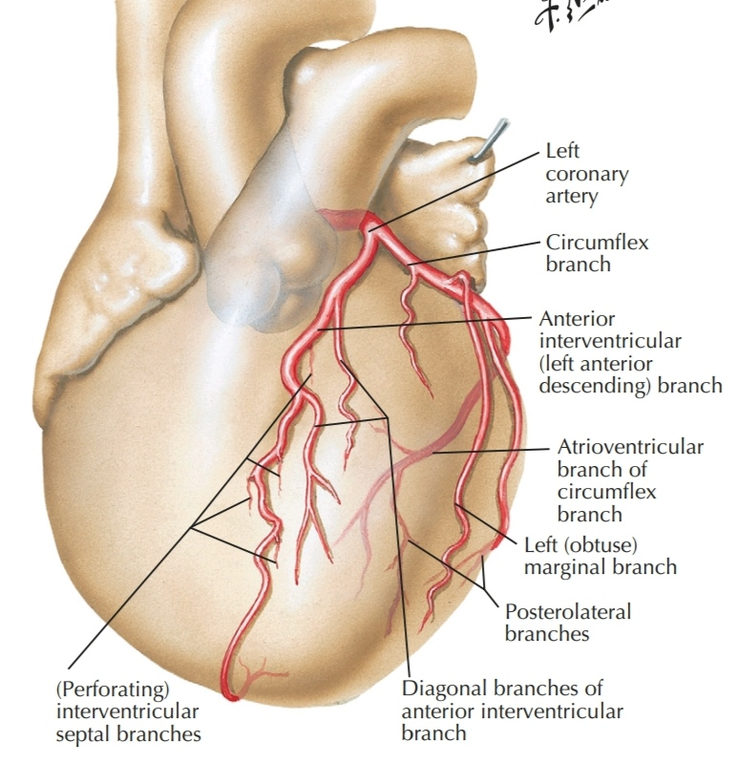
Left Coronary Artery (LCA)
- It originates from the left aortic sinus of the ascending aorta as a left main coronary artery (LM).
- It passes between the pulmonary trunk and the left auricle before entering the coronary sulcus.
- Emerging from behind the pulmonary trunk, the artery divides into its two terminal branches, the anterior interventricular (LAD) and the circumflex (LCX)

Slide 34
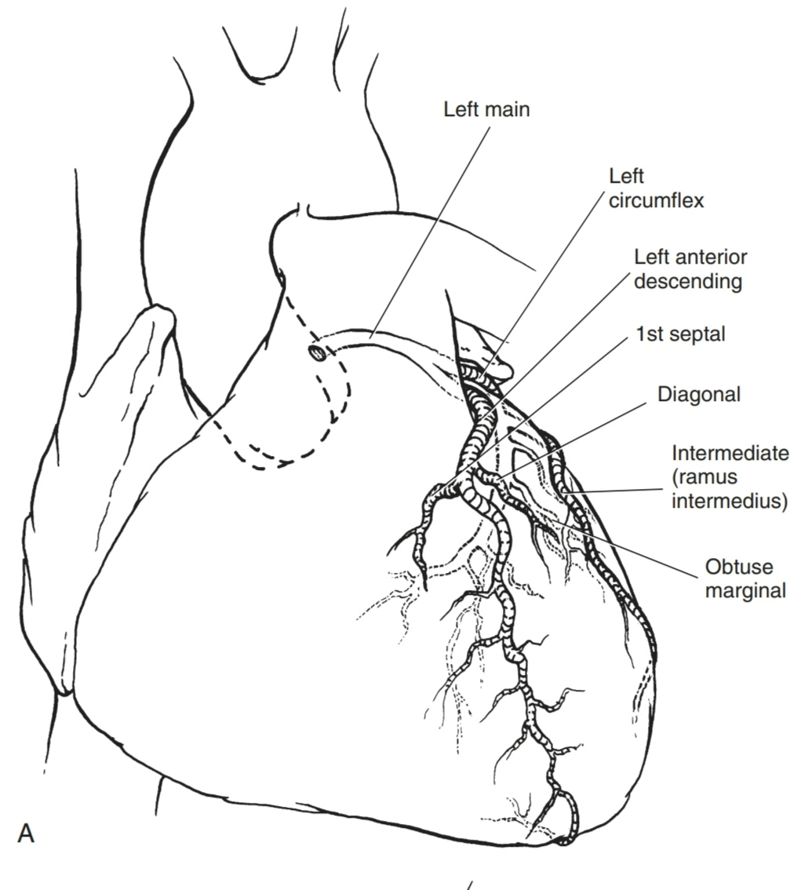
LAD
- The anterior interventricular branch (left anterior descending artery—LAD) continues around the left side of the pulmonary trunk and descends obliquely toward the apex of the heart in the anterior interventricular sulcus.
- During its course, one or two large diagonal branches (DG) may arise and descend diagonally across the anterior surface of the left ventricle.

Slide 35
LCX
- The circumflex branch courses toward
the left, in the coronary sulcus and onto the diaphragmatic surface of the heart, and usually ends
before reaching the posterior interventricular sulcus.
- A large branch, the obtuse marginal artery (OM) usually arises from it and continues across the rounded obtuse margin of the heart.

Slide 36
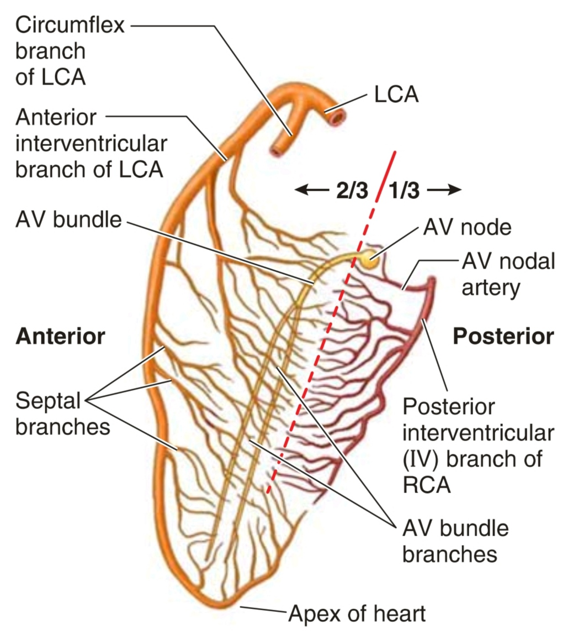
LCA
The distribution pattern of the left coronary artery
enables it to supply most of the:
- LA and LV
- most of the IV septum
- AV bundle and its branches

Slide 37
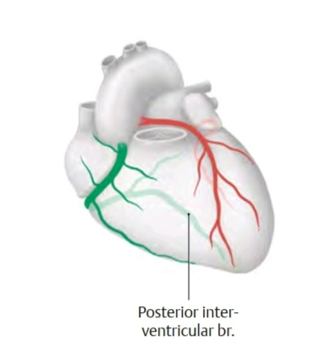
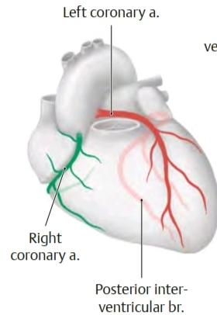
Variations in the distribution patterns of coronary arteries
- right dominant coronary artery: the PDA arises from the RC.
The right coronary artery therefore supplies a large portion of the posterior wall of the LV and the circumflex branch of the left coronary artery is relatively small.
- left dominant coronary artery: the PDA arises from an enlarged LCX and supplies most of the posterior wall of the LV

Slide 38
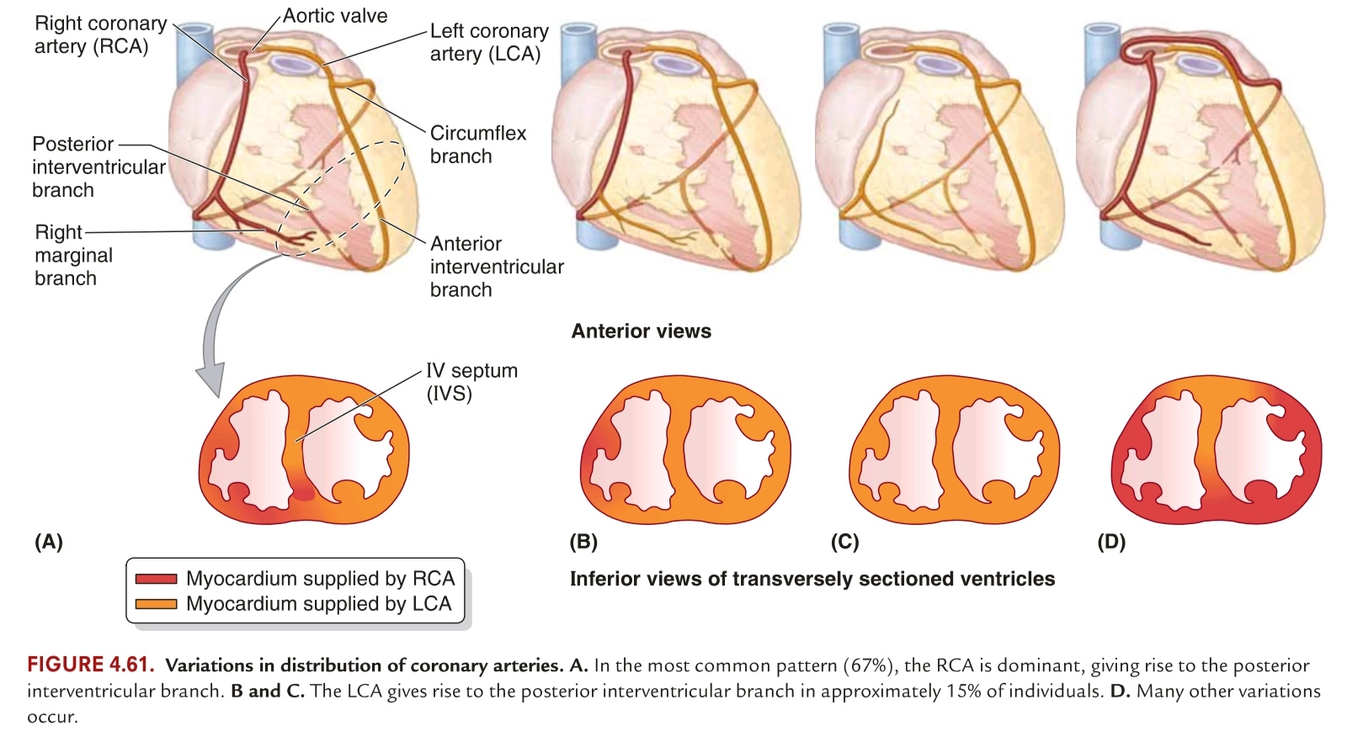

Slide 39
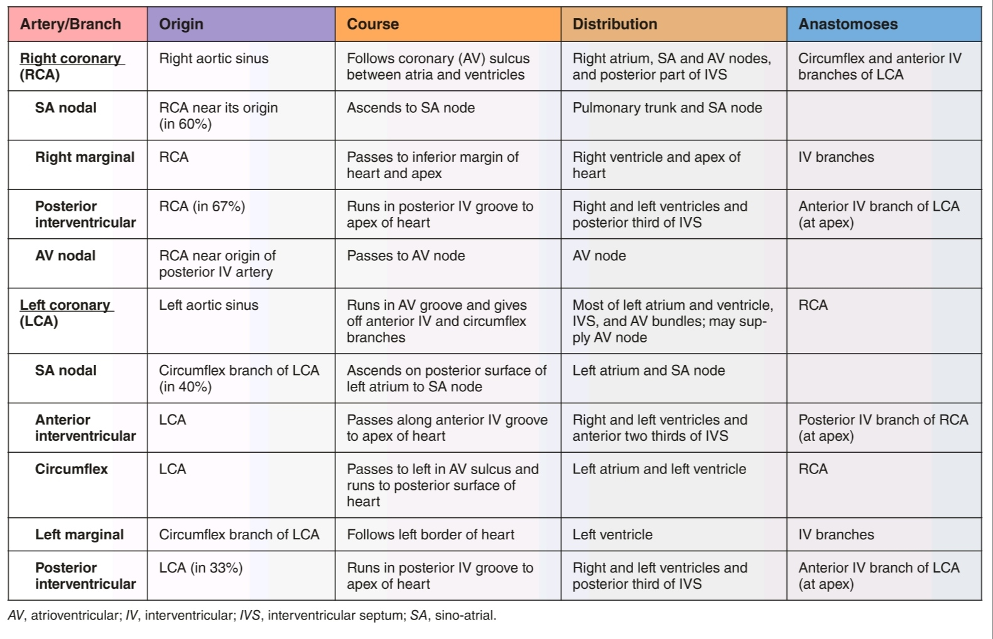

Slide 40
Coronary Arterial Supply to Specialized Areas of the Heart
- The SA node artery is a single artery in 89% and double in 11% of hearts.
- Its origin is from the RCA in 55% to 65% of cases and from the LCX or the LM coronary artery in the remainder.
- When it arises from the RCA, it courses posteriorly and superiorly over the anterior wall of the right atrium beneath the right atrial appendage to the base of the SVC.
- If the sinus node artery arises from the LCX artery, it courses over the left atrial
wall, and ascends to the base of the superior vena cava.
- It then encircles the cava clockwise or counterclockwise, or bifurcates and
encircles it in both directions.

Slide 41
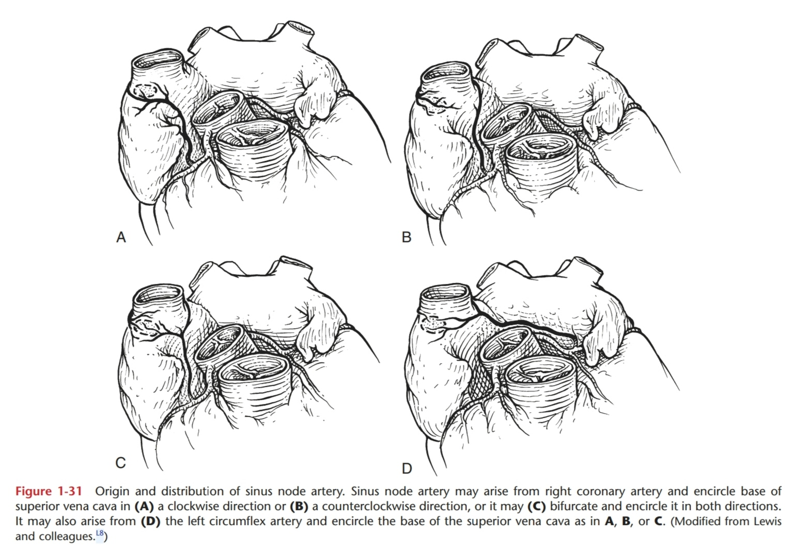

Slide 42
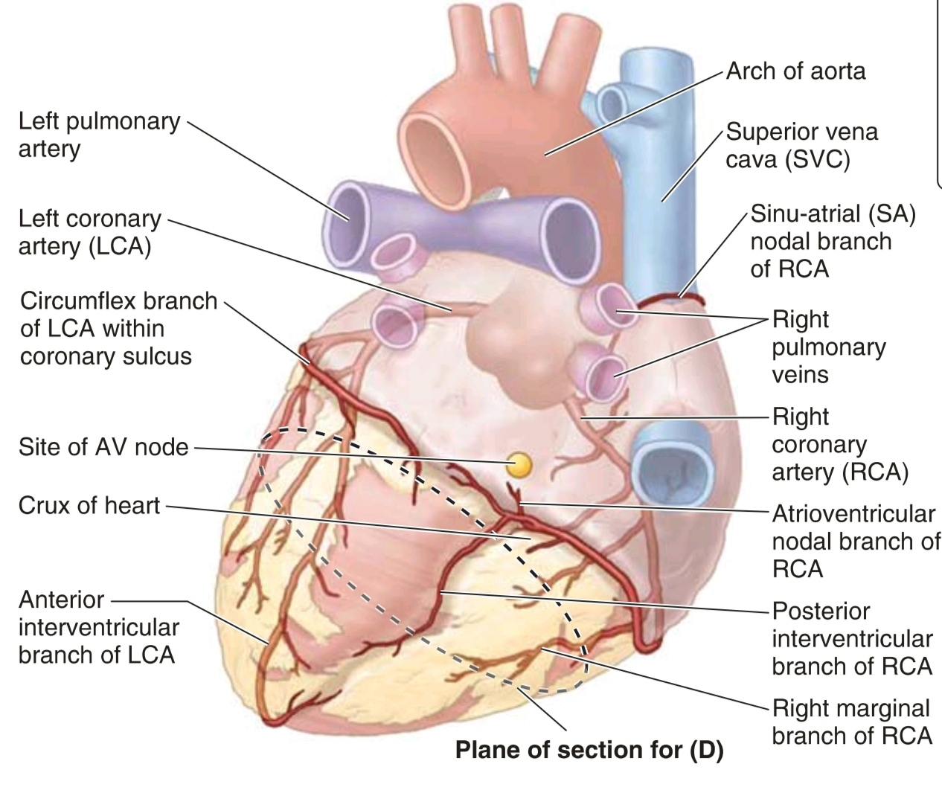
Coronary Arterial Supply to Specialized Areas of the Heart
Th e AV node artery arises from the characteristic U-turn
of the RCA as it crosses the crux of the heart.
The AV node is usually supplied by the dominant coronary artery.
The AV node artery courses superiorly and anteriorly and terminates with a distinctive angulation.
An important accessory blood supply to the AV node is Kugel artery.

Slide 43
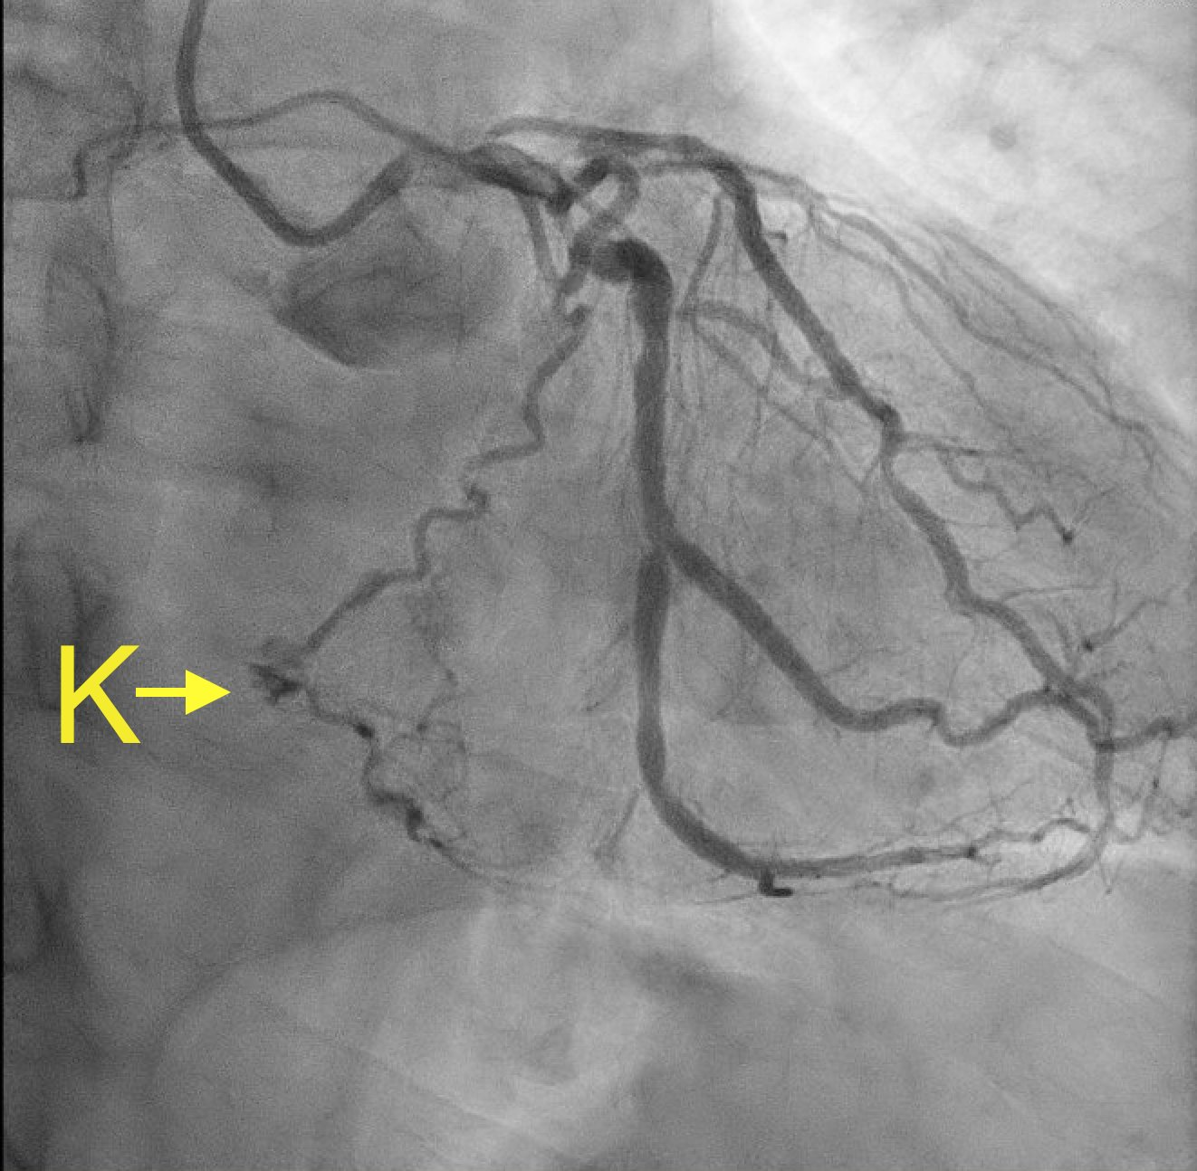
Coronary Arterial Supply to Specialized Areas of the Heart
Kugel’s artery is an anastomotic vessel between the
proximal RCA and the LCX that also can provide a branch that runs through the base of the atrial septum to the crux of the heart where it supplies collateral circulation to the AV node.
Kugel artery is the source of blood supply to the AV node in 40% of normal hearts

Slide 44
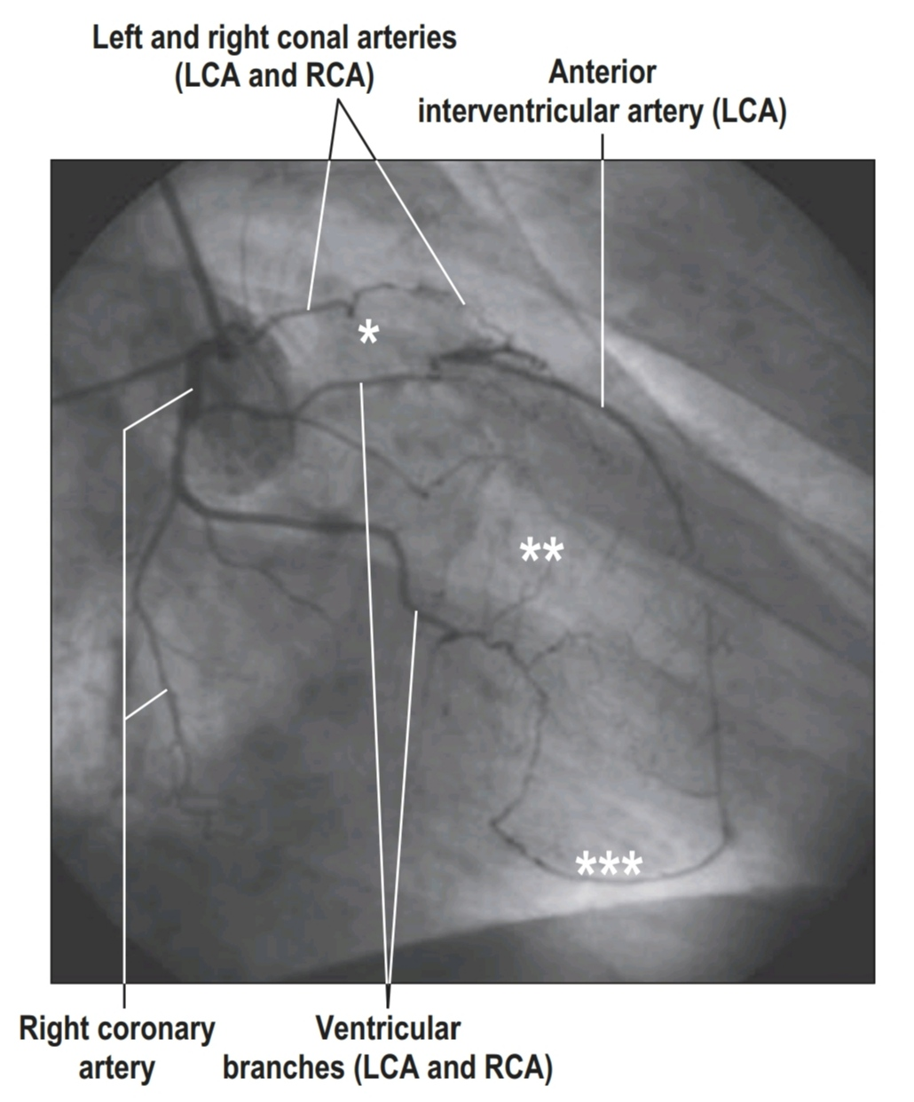
Coronary Arterial Supply to Specialized Areas of the Heart
Arterial ring of Vieussens:
the right conal artery (a branch of the RCA) anastomoses with the left conal artery (a branch of the LAD) to form the arterial ring of (arterial circle or anulus) of Vieussens

Slide 45
coronary collateral circulation
The branches of the coronary arteries are generally considered to be functional end arteries (arteries that supply regions of the
myocardium lacking sufficient anastomoses from other large
branches to maintain viability of the tissue should occlusion
occur). However, anastomoses do exist between branches
of the coronary arteries, subepicardial or myocardial, and
between these arteries and extracardiac vessels such as thoracic vessels.
Anastomoses exist between the terminations of the RCA and the LCA in the coronary sulcus and between the IV branches around the apex of the heart in approximately 10% of apparently normal hearts. The potential for development of collateral circulation probably exists in most if not all hearts.

Slide 46
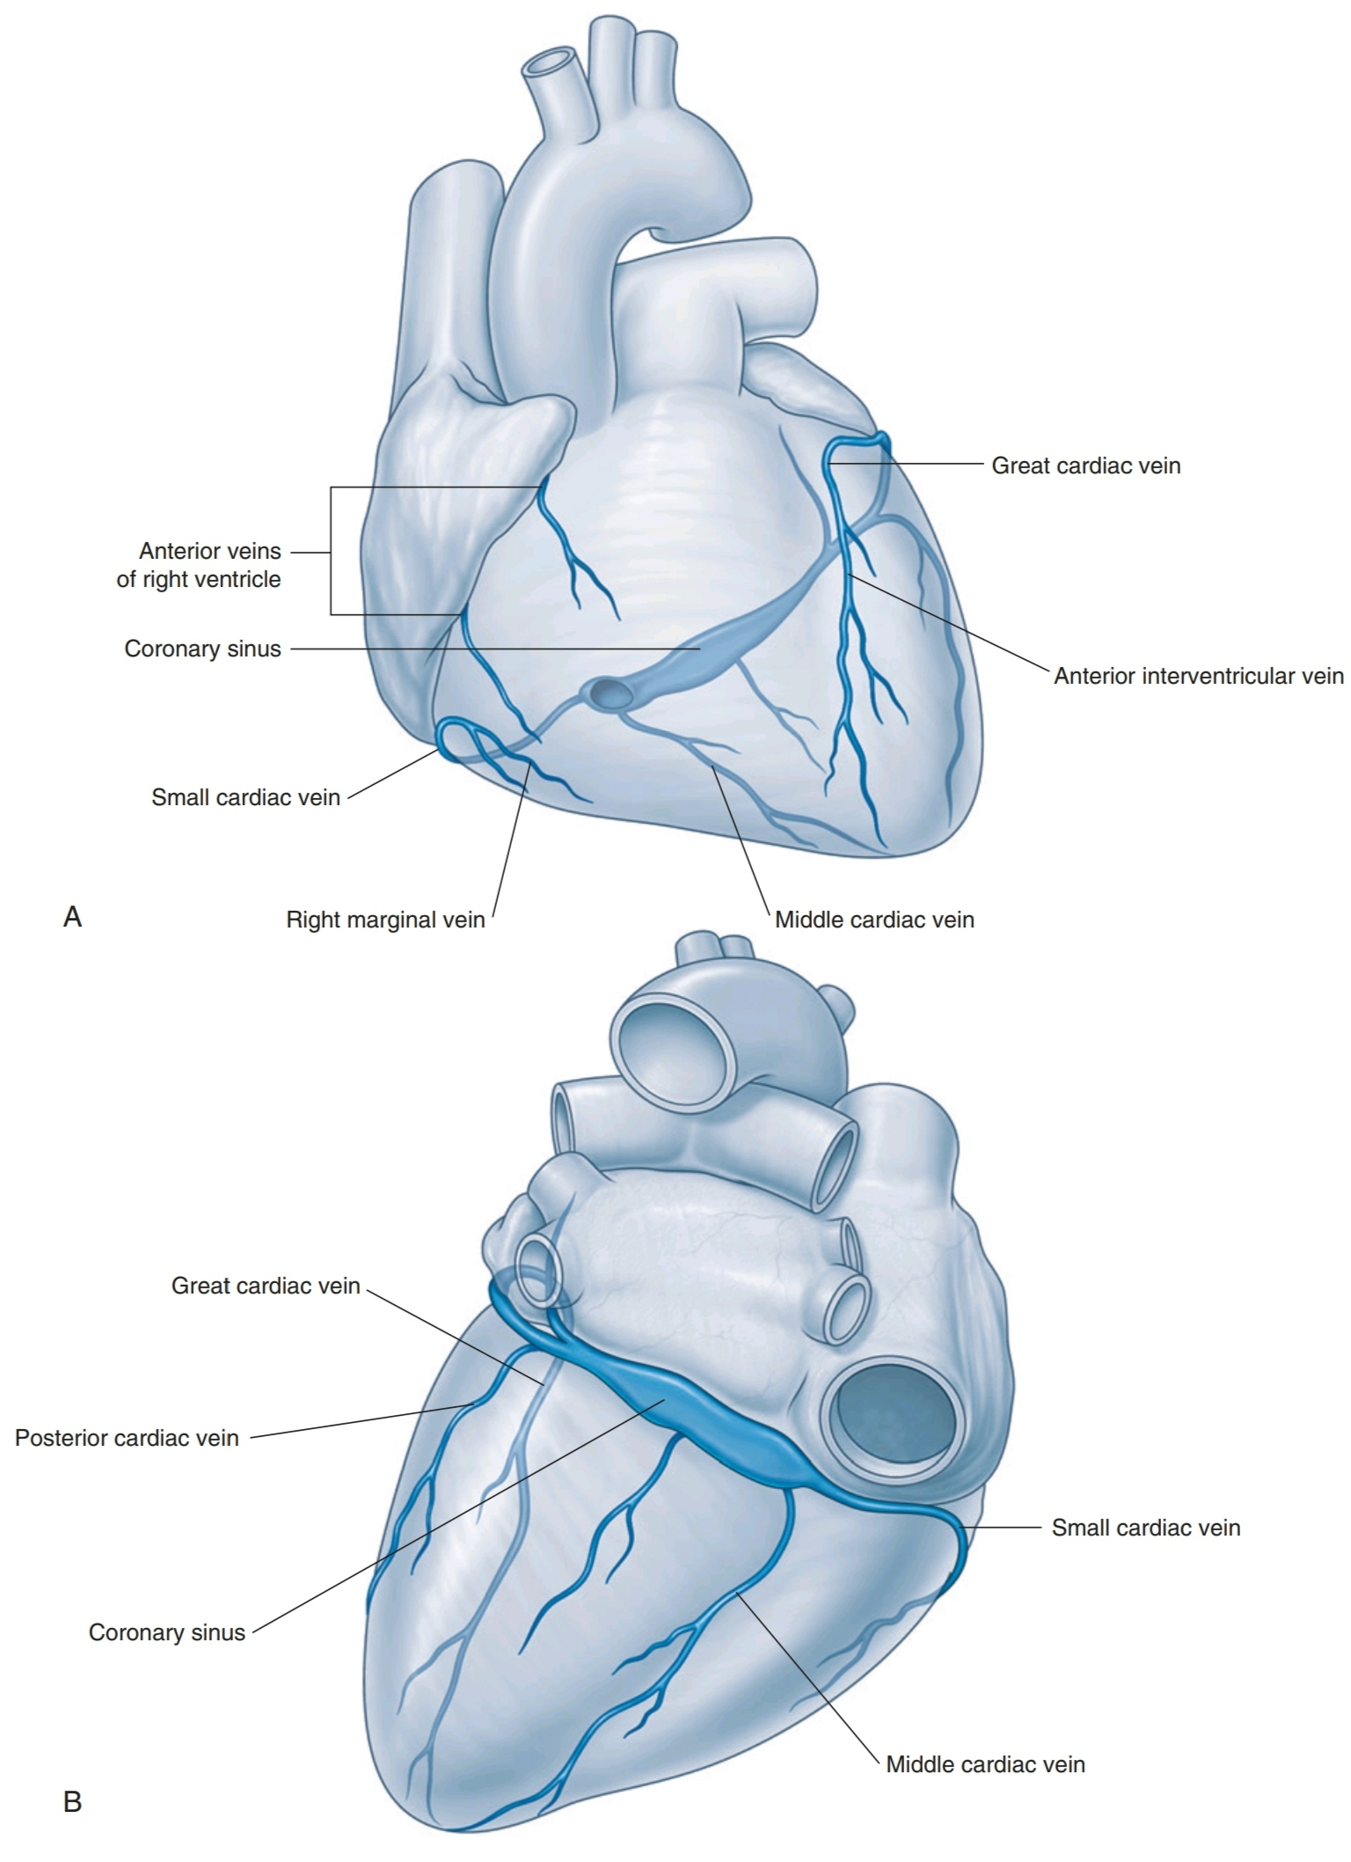
Venous Drainage of the Heart
The coronary sinus receives four major tributaries:
- great
- middle
- small
- posterior cardiac veins

Slide 47
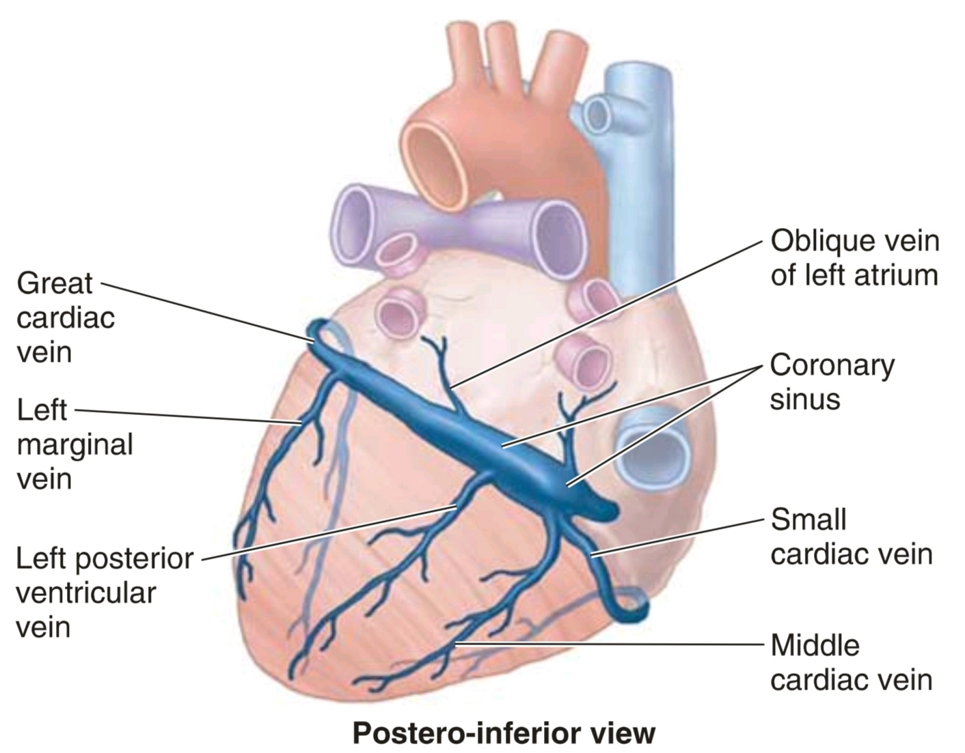
The Coronary Sinus
The heart is drained mainly by veins that empty into the coronary sinus and partly by small veins that empty in to the right atrium.
The coronary sinus, the main vein ofthe heart, is a wide venous channel that runs from left to right in the posterior part of the coronary sulcus.
The coronary sinus receives:
- the great cardiac vein at its left end
- and the middle cardiac vein and small cardiac veins at its right end.
The left posterior ventricular vein
and left marginal vein also open into the coronary sinus.

Slide 48
Great Cardiac Vein
- It is the main tributary of the coronary sinus.
- Its first part, the anterior interventricular vein, begins near the apex of the heart and ascends with the anterior IV branch (LAD) of the LCA.
- At the coronary sulcus, it turns left, and its second part runs around the left side of the heart with the circumflex branch (LCX) of the LCA to reach the coronary sinus.
- An unsual situation is occurring here:
blood is flowing in the same direction within a paired artery and vein!
- The great cardiac vein drains the areas ofthe heart supplied by the LCA

Slide 51
Middle cardiac vein (Posterior IV vein)
- it begins near the apex of the heart and ascends in the posterior interventricular sulcus toward the coronary sinus.
- It is associated with the posterior interventricular branch (PDA) of the right or left coronary artery throughout its course.

Slide 52
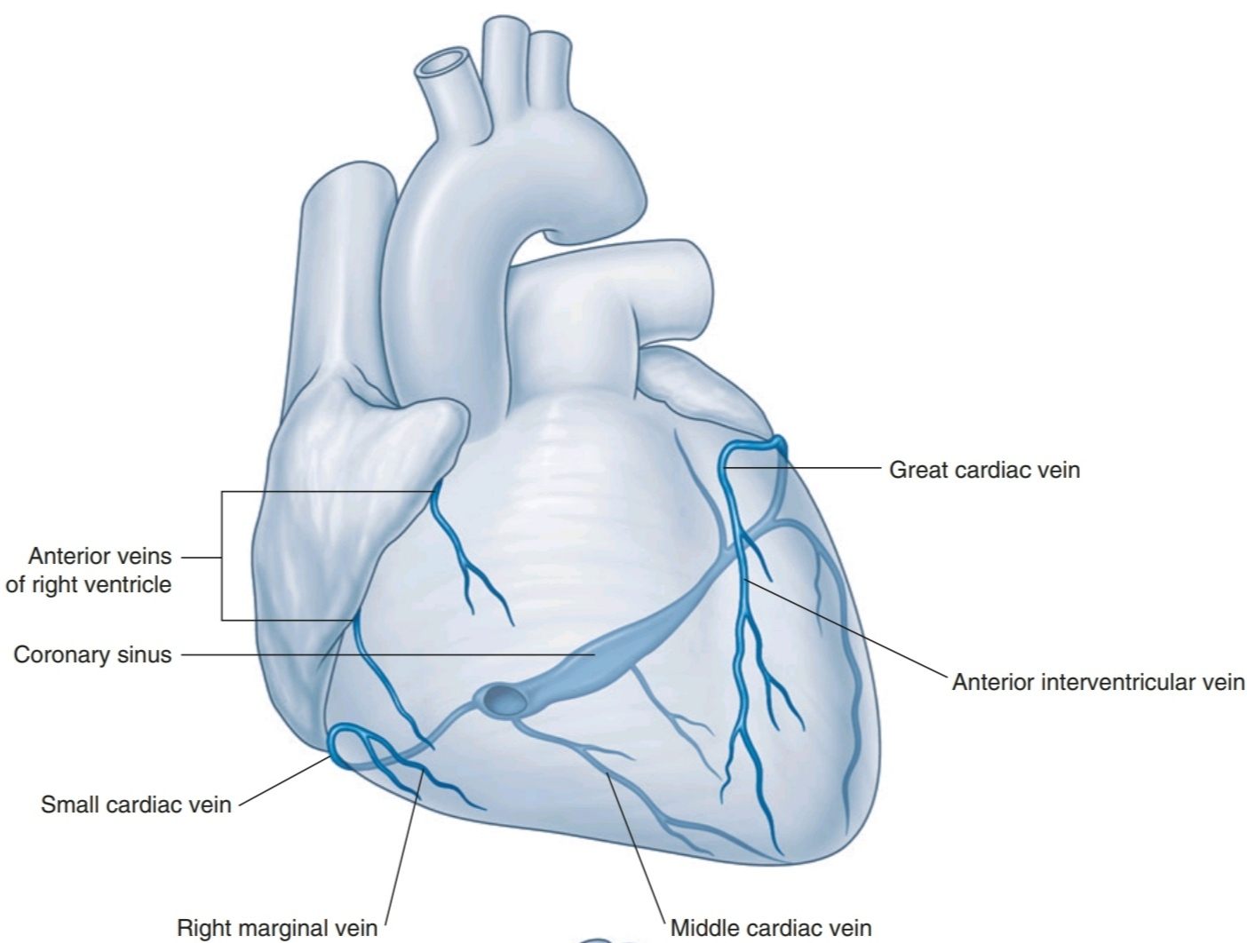
Small cardiac vein
- it begins in the lower anterior section of the coronary sulcus between the RA and RV.
- It continues in this groove onto the diaphragmatic surface of the heart where it enters the coronary sinus at its atrial end.
- It is a companion of the RCA throughout its course and may receive the right marginal vein. This small vein accompanies the marginal branch of the RCA along the acute margin of the heart.
- If the right marginal vein does not join the small cardiac vein, it enters the RA directly.

Slide 53
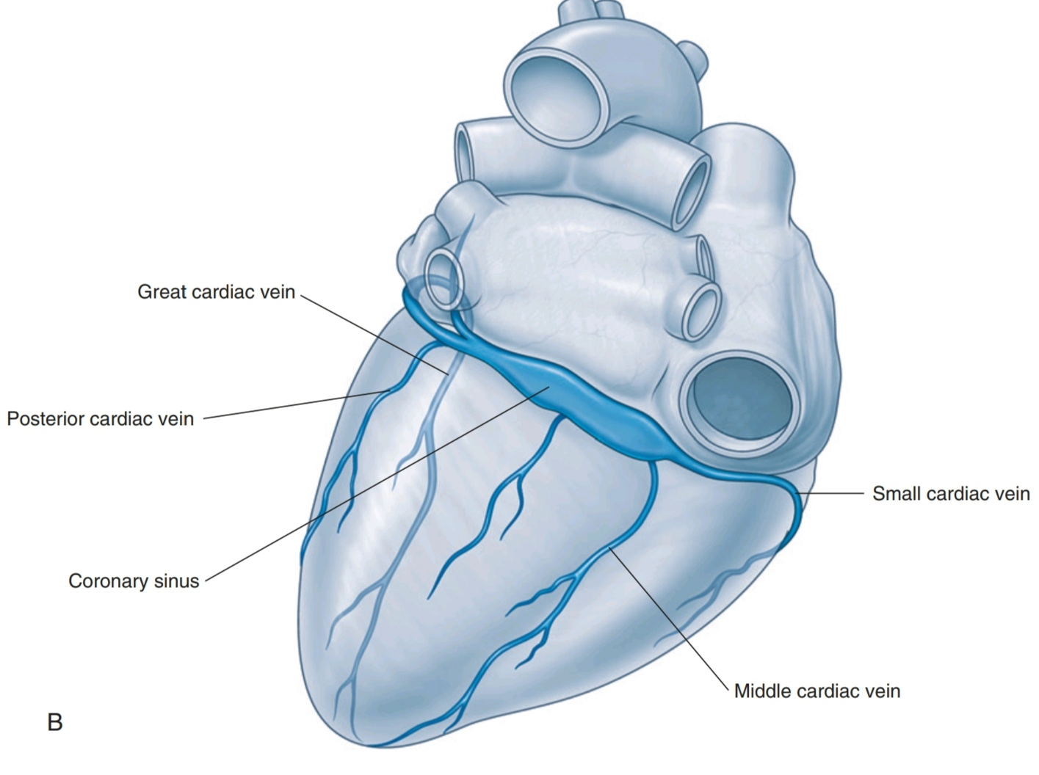
Posterior cardiac vein
- it lies on the posterior surface of the LV just to the left of the middle cardiac vein.
- It either enters the coronary sinus directly or joins the great cardiac vein.

Slide 54
Oblique vein of Marshall
- it is a small vessel, relatively unimportant postnatally, that descends obliquely on the posterior aspect of the LA to join the coronary sinus.
- its junction with the great cardiac vein marks the start of the coronary sinus and, often, the location of the valve of Vieussens.
- The oblique vein is the remnant of the embryonic left SVC, which usually atrophies during the fetal period; it occasionally persists in adults, replacing or augmenting the right SVC.

Slide 55
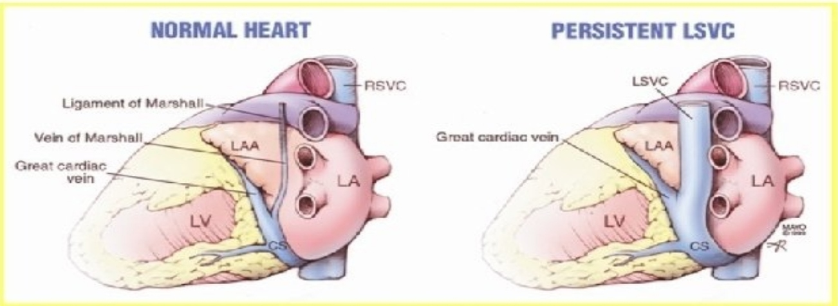

Slide 56
Other cardiac veins
- Some cardiac veins do not drain via the coronary sinus.
- The smallest cardiac veins (venae cordis minimae) or veins of Thebesius are minute vessels that begin in the capillary beds of the myocardium and open directly into the chambers of the heart, chiefly the atria.
Although called veins, they are valveless communications with the capillary beds of the myocardium and may carry blood from the heart chambers to the myocardium.

Slide 57
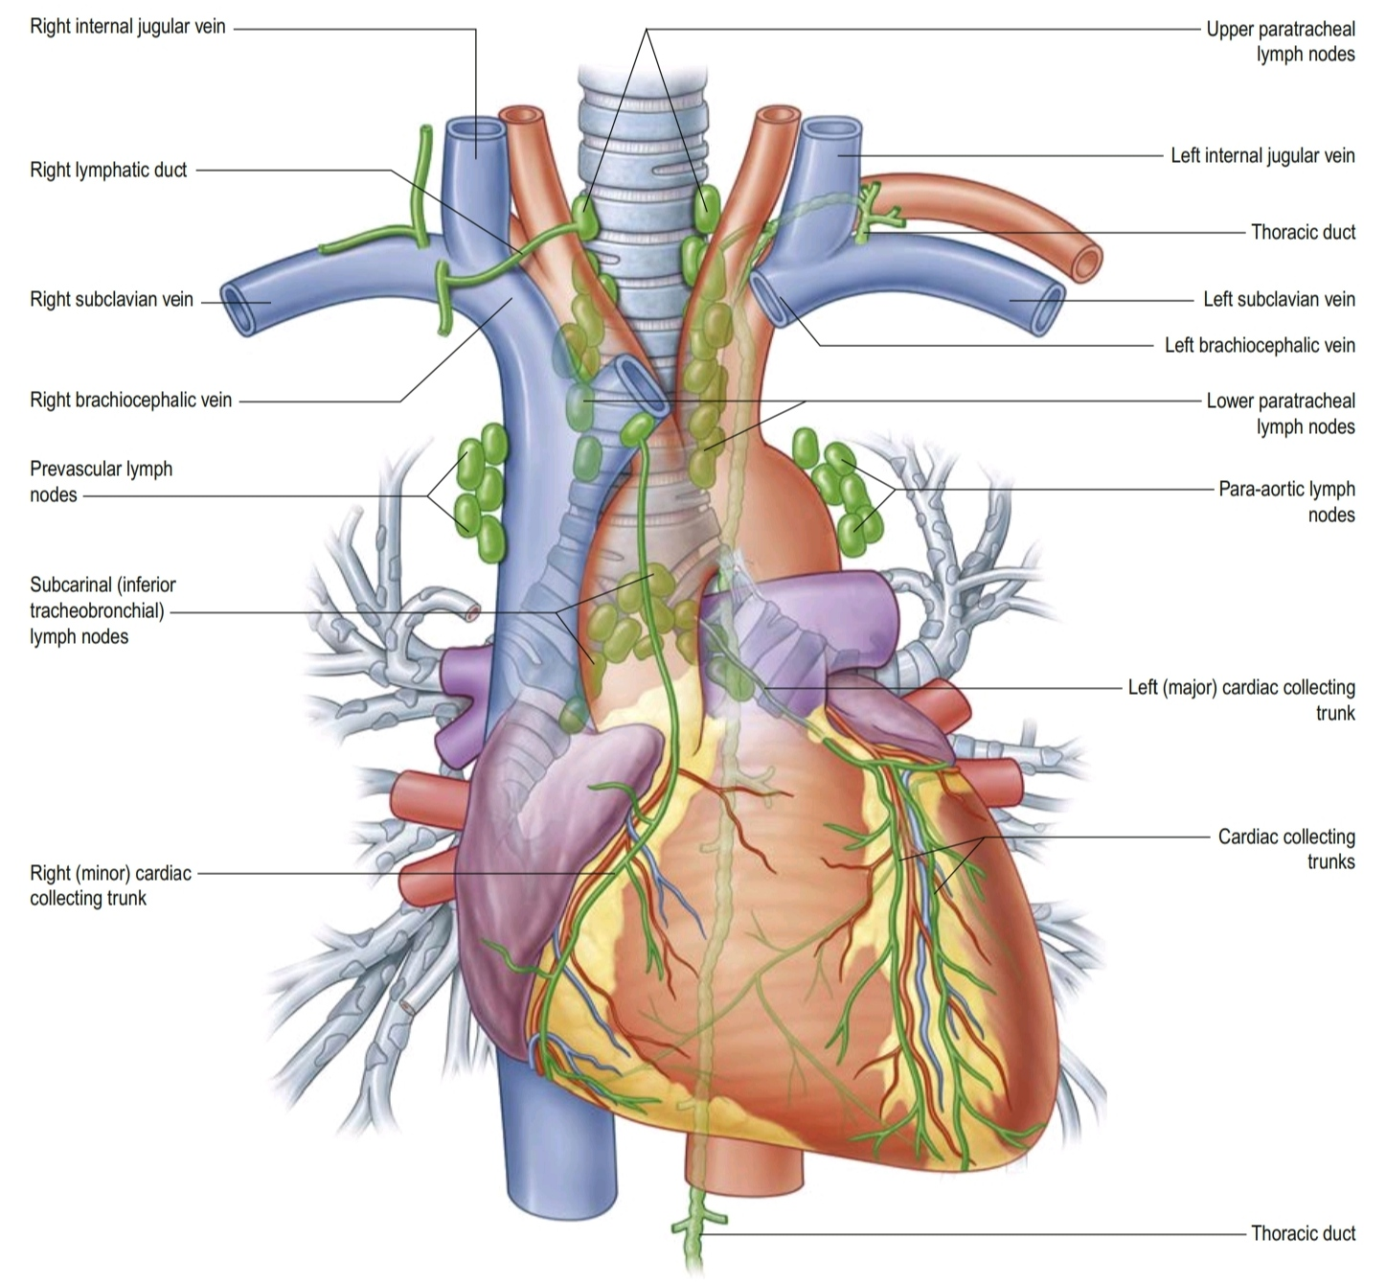
Coronary lymphatics
The lymphatic vessels of the heart follow the coronary arteries and drain mainly into:
■ brachiocephalic nodes, anterior to the brachiocephalic veins
■ tracheobronchial nodes, at the inferior end of the trachea

Slide 58
Cardiac Innervation
The autonomic division of the peripheral nervous system is directly responsible for regulating:
■ heart rate
■ force of each contraction
■ cardiac output
Branches from both the parasympathetic and sympathetic systems contribute to the formation of the cardiac plexus.

Slide 59
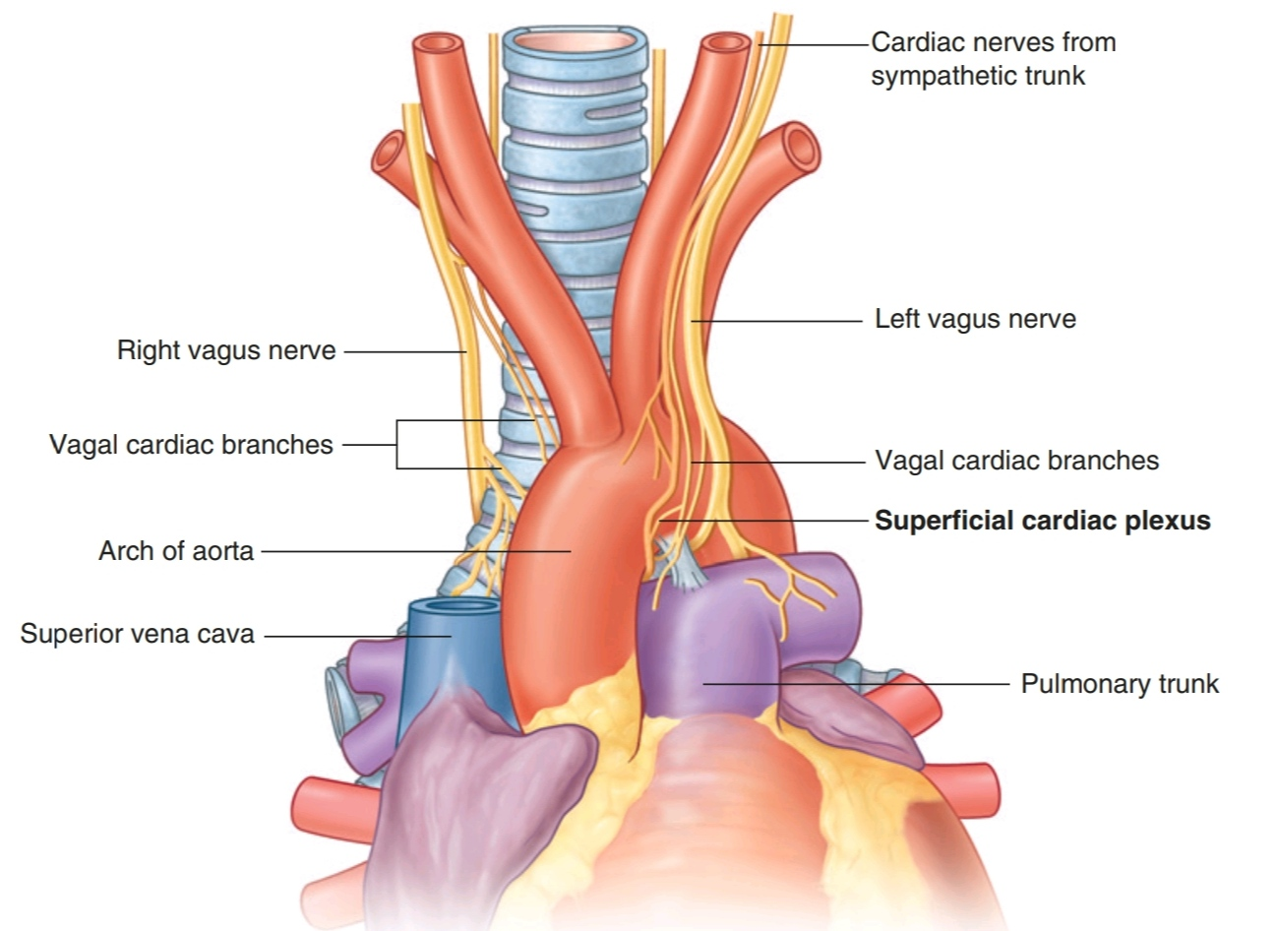
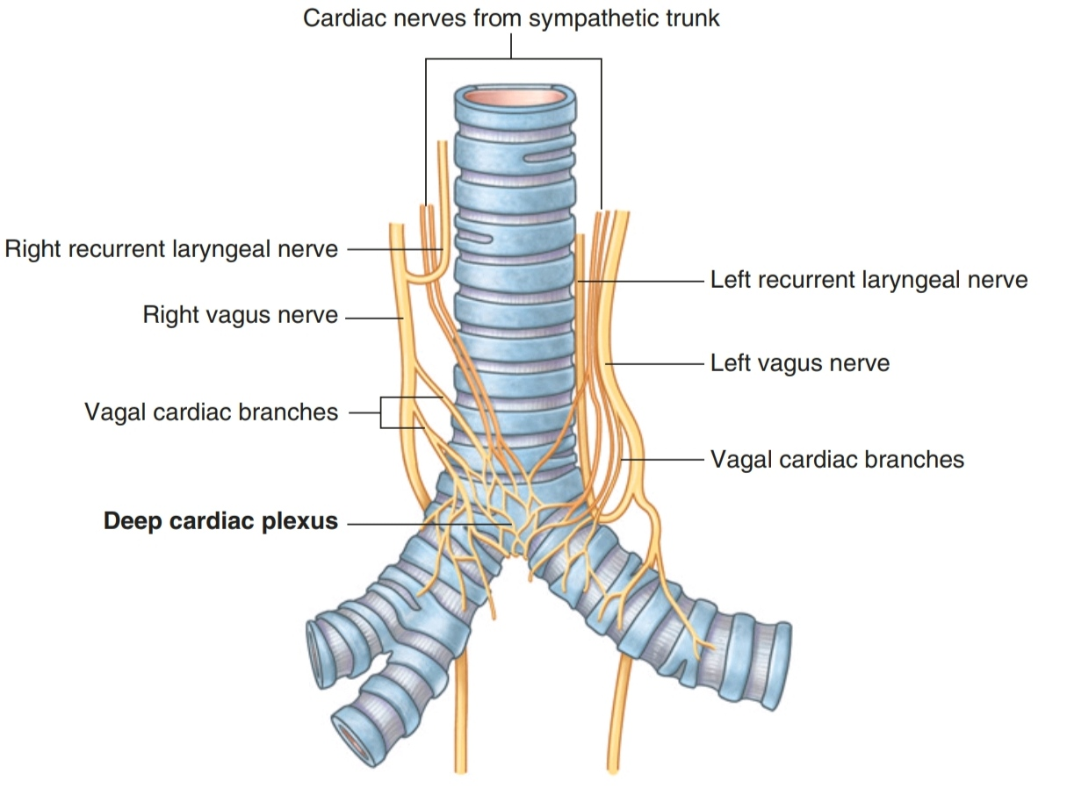
Cardiac Plexus
It consists of a :
- superficial part, inferior to the aortic arch and between it and the pulmonary trunk
- deep part, between the aortic arch and the tracheal bifurcation

Slide 60
Cardiac Innervation
From the cardiac plexus, small branches that are
mixed nerves containing both sympathetic and parasympathetic fibers supply the heart.
These branches affect nodal tissue and other components of the conduction system, coronary blood vessels, and atrial and ventricular musculature.

Slide 61
Parasympathetic innervation
Stimulation of the parasympathetic system:
■ decreases heart rate
■ reduces force of contraction
■ constricts the coronary arteries
The preganglionic parasympathetic fibers reach the heart as cardiac branches from the right and left vagus nerves. They enter the cardiac plexus and synapse in ganglia located either within the plexus or in the walls of the atria.

Slide 62
Sympathetic innervation
Stimulation of the sympathetic system:
■ increases heart rate, and
■ increases the force of contraction.
Sympathetic fibers reach the cardiac plexus through the cardiac nerves from the sympathetic trunk.
Preganglionic sympathetic fibers from the upper four or five segments of the thoracic spinal cord enter and move through the sympathetic trunk. They synapse in cervical and upper thoracic sympathetic ganglia.
Postganglionic fibers (that originate in the cervicothoracic (stellate) ganglion, with contributions from the cervical, vertebral and upper thoracic ganglia) proceed as bilateral branches from the sympathetic trunk to the cardiac plexus.

Slide 63
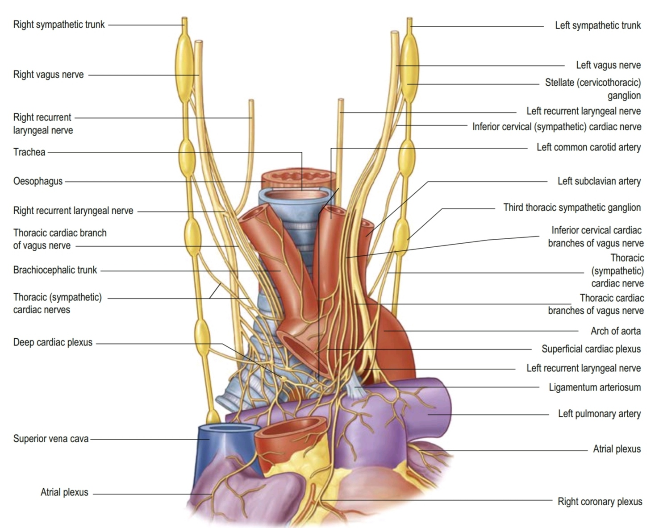

Slide 64
Visceral Afferents from the Heart
- these are also a component of the cardiac plexus.
- these fibers pass through the cardiac plexus and return to the central nervous system in the cardiac nerves from the sympathetic trunk and in the vagal
cardiac branches.

Slide 65
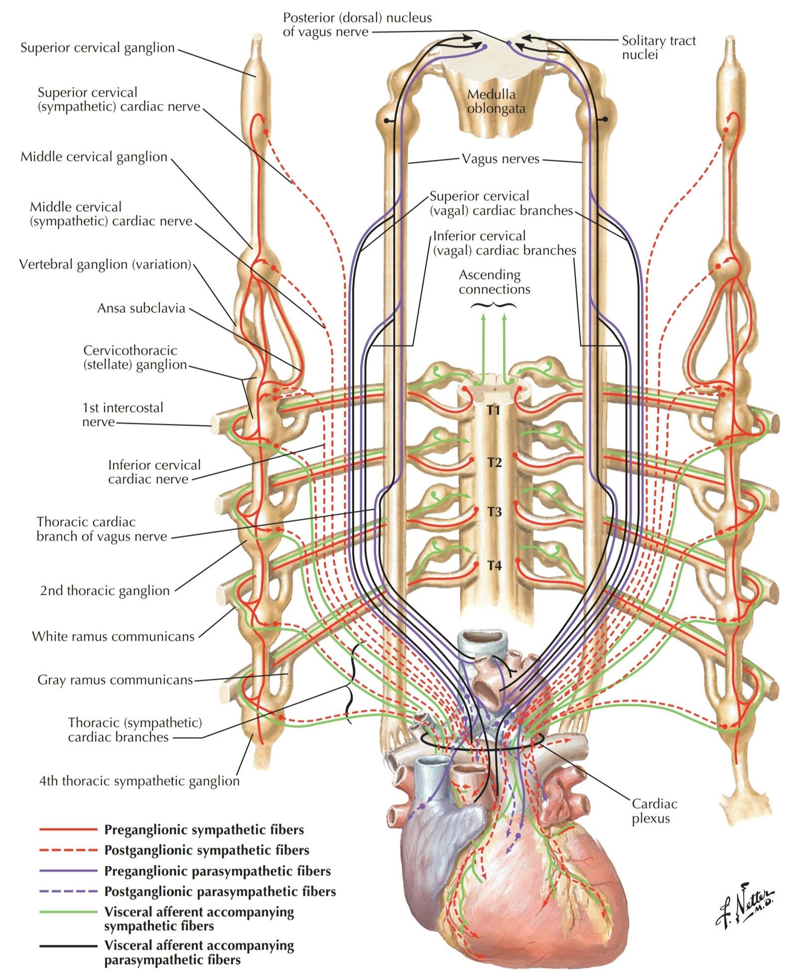

Slide 66
Visceral Afferents from the Heart
The afferents associated with the vagal cardiac nerves return to the vagus nerve [X]. They sense alterations in blood pressure and blood chemistry and are therefore primarily concerned with cardiac reflexes.

Slide 67
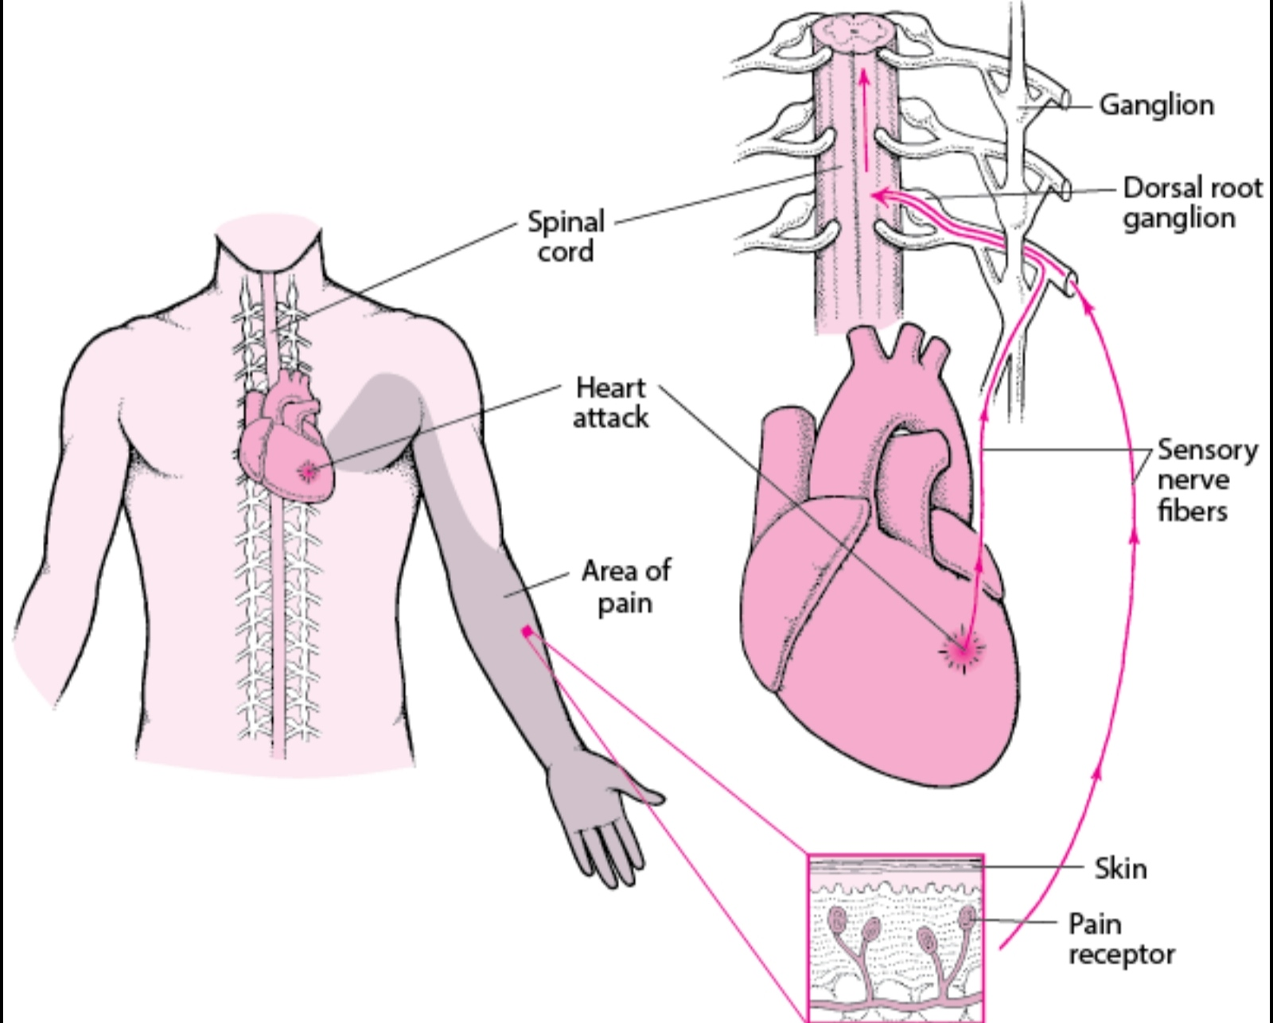
Visceral Afferents from the Heart
The afferents associated with the cardiac nerves from the sympathetic trunks conduct pain sensation from the heart, which is detected at the cellular level as tissue-damaging events (i.e., cardiac ischemia).
This pain is often “referred” to cutaneous regions supplied by the same spinal cord levels (referred pain)

