Slide 1

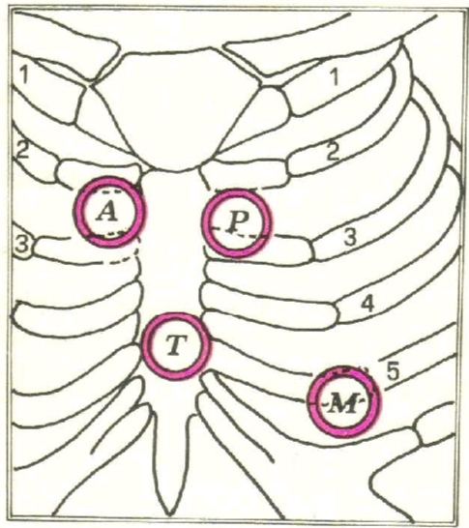
Cardiovascular Anatomy
Part III
بسم الله الرحمن الرحيم
Dr. SAHER ABUGHALI
Director of Cardiac Surgery Department
European Gaza Hospital

Slide 2
Posterior Mediastinum

Slide 3
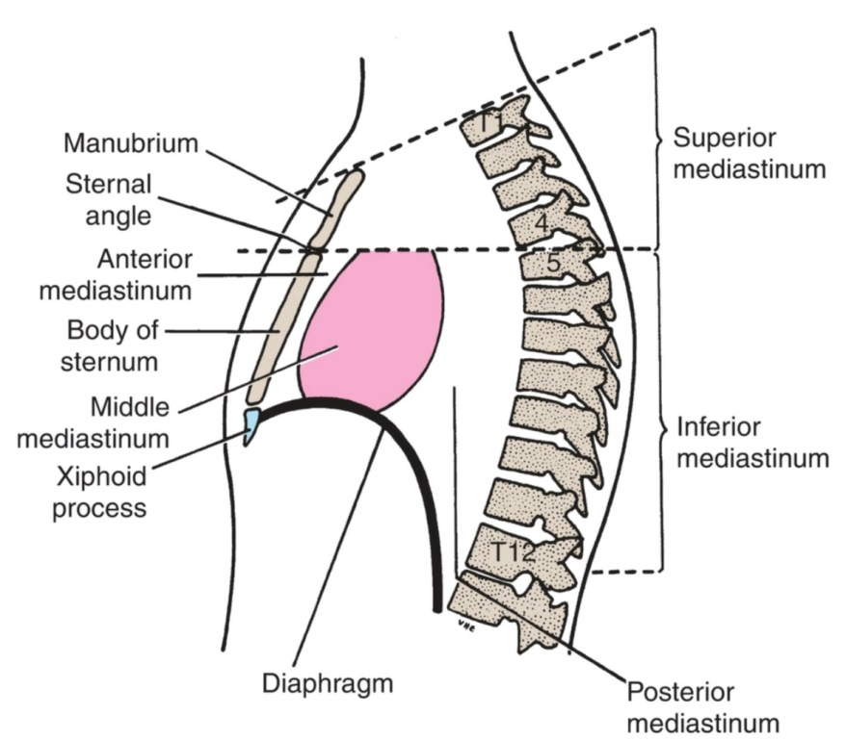
Posterior Mediastinum
The posterior mediastinum (the posterior part of the inferior mediastinum) is located:
inferior to the transverse thoracic plane
anterior to the T5-T12 vertebrae
posterior to the pericardium and diaphragm, and between the parietal pleura of the two lungs

Slide 4
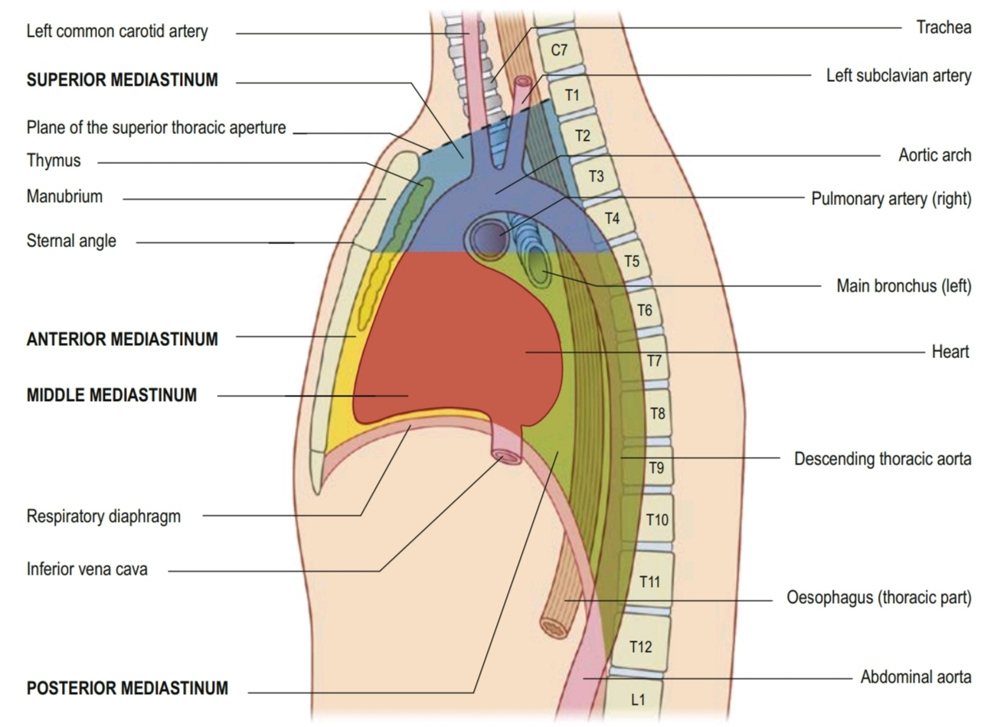
Posterior Mediastinum

Slide 5
Major Structures in the Posterior Mediastinum
esophagus and its associated nerve plexus
descending thoracic aorta and its branches
azygos system of veins
thoracic duct and associated lymph nodes
sympathetic trunks
thoracic splanchnic nerves

Slide 6
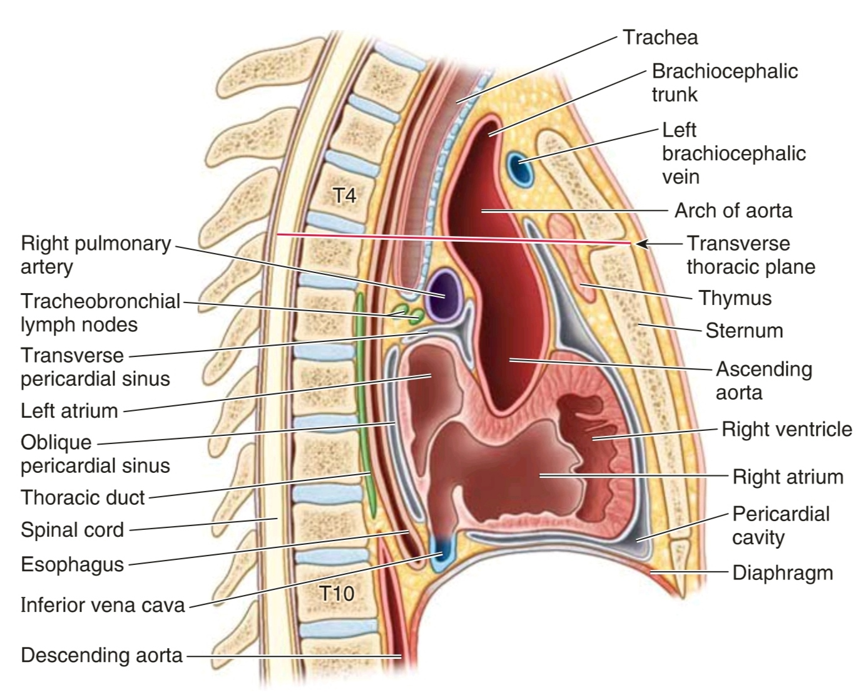

Slide 7
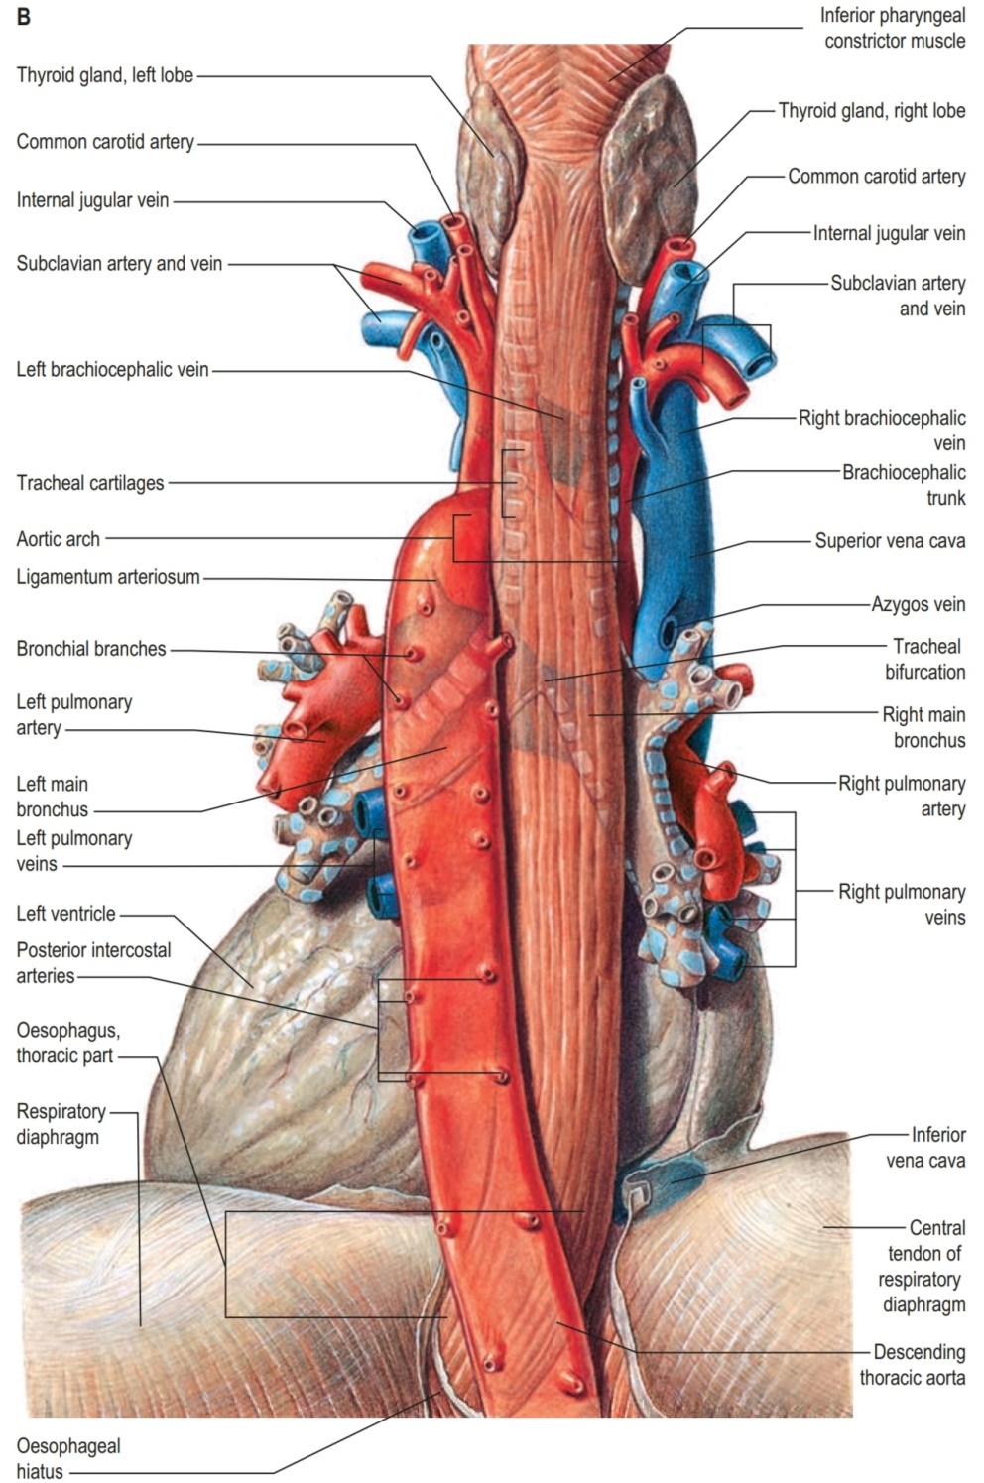

Slide 8
Surface Anatomy of the Heart

Slide 9
How to count Ribs
palpate the jugular notch at the superior extent of the manubrium of the sternum.
Move down the sternum until a ridge is felt.
This ridge is the sternal angle of Louis, which identifies the articulation between the manubrium of the sternum and the body of the sternum.
The costal cartilage of rib II articulates with the sternum at this location.
Identify rib II. Then continue counting the ribs, moving in a downward and lateral direction

Slide 10
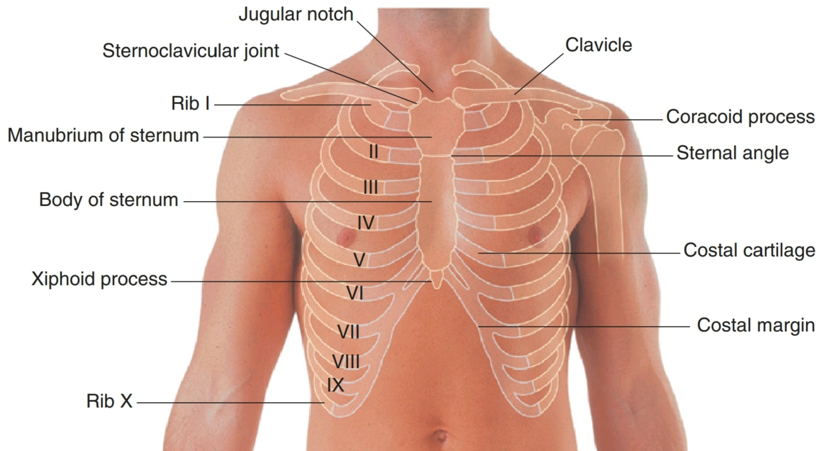

Slide 11
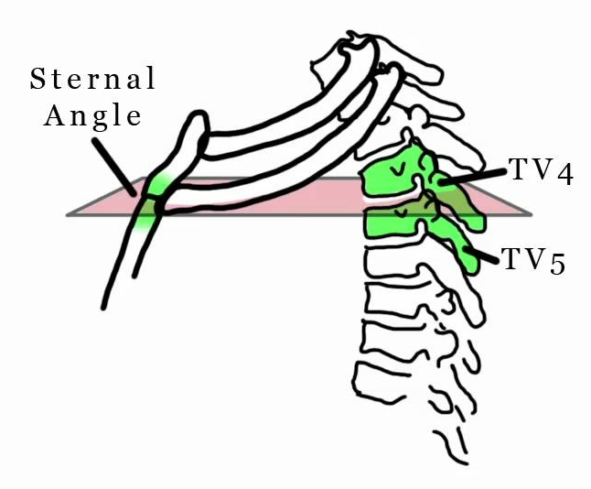
Transverse Thoracic Plane
is a transverse plane that passes through the sternal angle on the anterior chest wall and the intervertebral disc between T4 and T5 vertebrae posteriorly

Slide 12
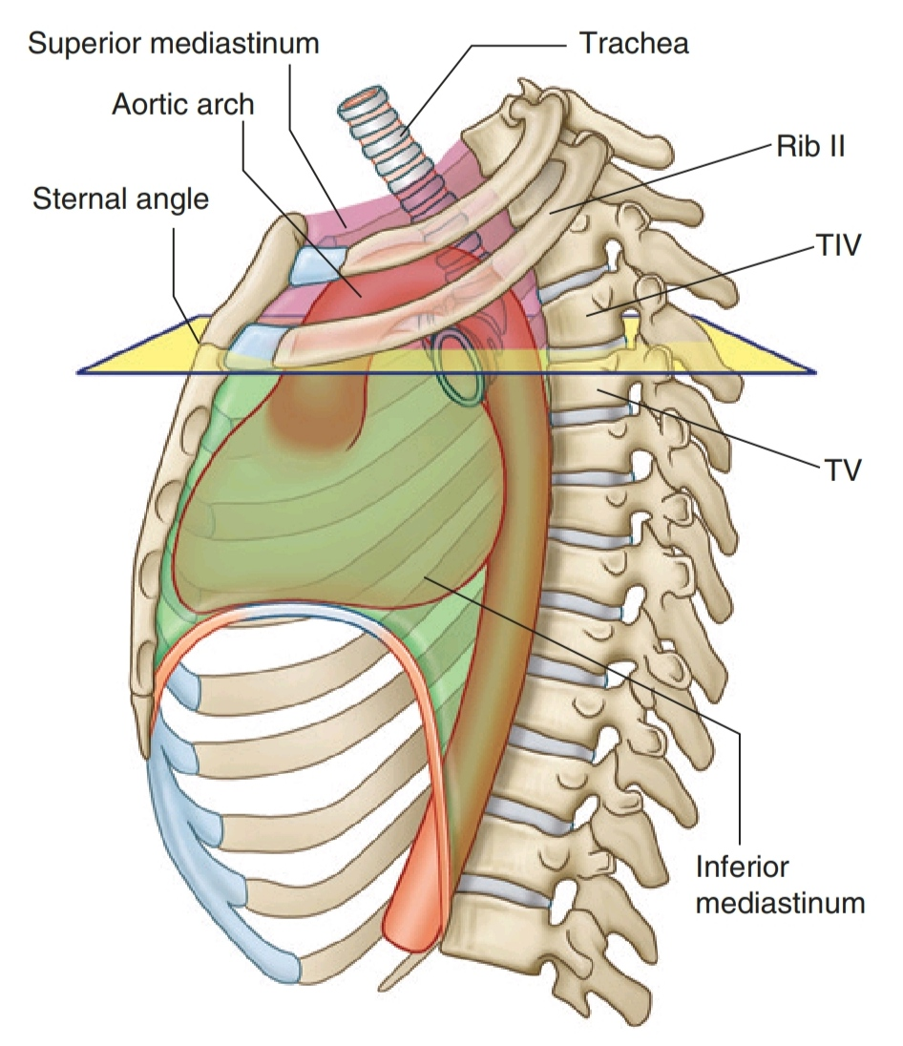

Slide 13
At the level of the Transverse Thoracic Plane:
■ The costal cartilage of rib II articulates with the sternum
■ The superior mediastinum is separated from the inferior mediastinum
■ The ascending aorta ends and the arch of the aorta begins
■ The arch of the aorta ends and the thoracic aorta begins
■ The trachea bifurcates

Slide 14
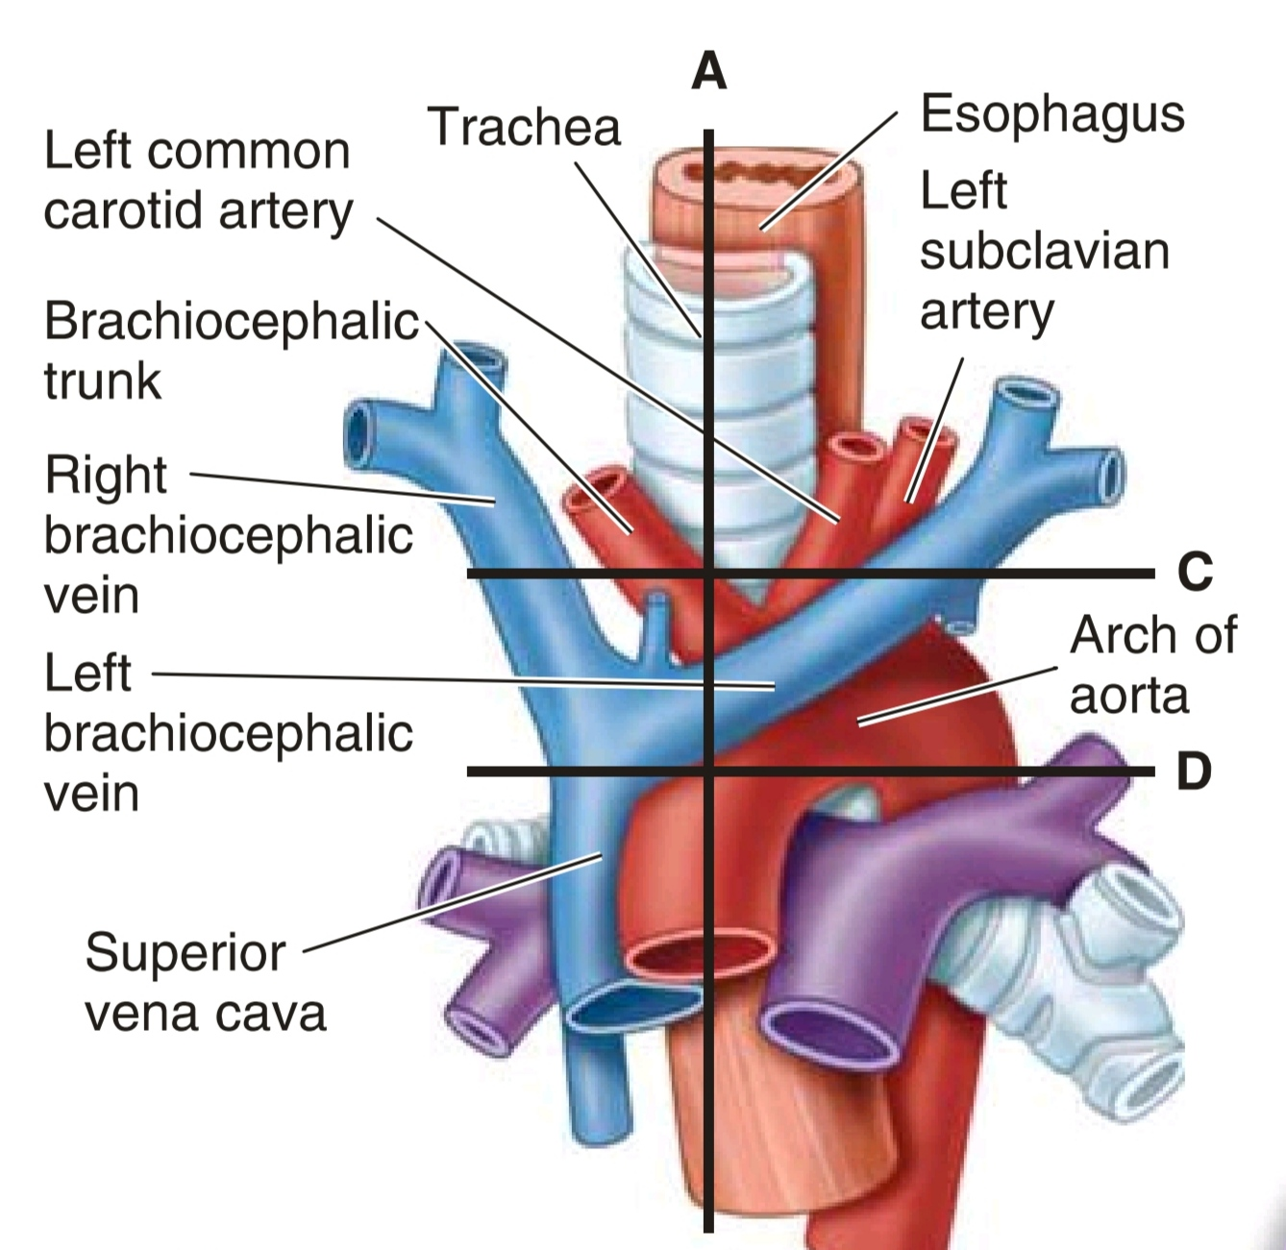

Slide 15
Visualizing Structures in the Superior Mediastinum

Slide 16
(1) Thymus
(2) large veins
(3) large arteries
(4) trachea
(5) esophagus and thoracic duct
(6) sympathetic trunks

Slide 17
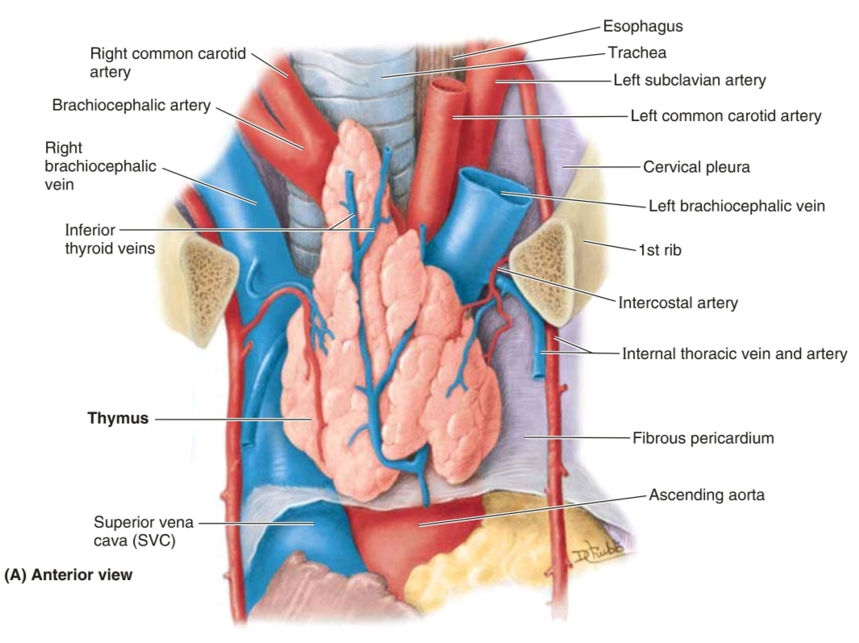

Slide 18
Visualizing Structures in the Superior Mediastinum
On each side, the internal jugular and subclavian veins join to form the brachiocephalic veins behind the sternal ends of the clavicles near the sternoclavicular joints
The left brachiocephalic vein crosses from left to right behind the manubrium of the sternum
The brachiocephalic veins unite to form the superior vena cava behind the lower border of the costal cartilage of the right 1st rib

Slide 19
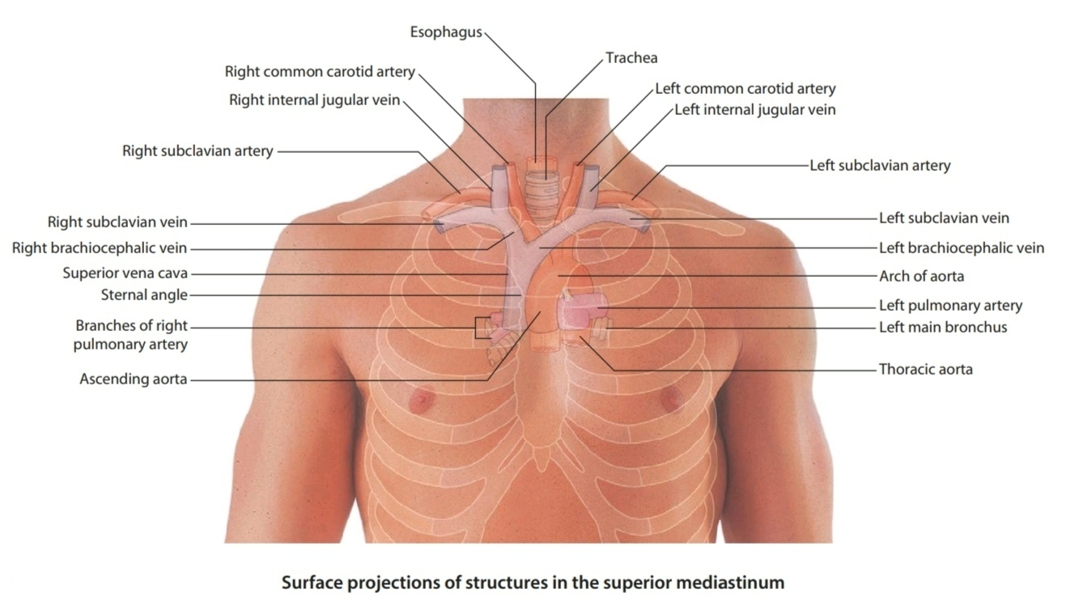

Slide 20
Visualizing Structures in the Superior Mediastinum
The arch of the aorta begins and ends at the transverse plane between the sternal angle anteriorly and vertebral level TIV/V posteriorly.
The arch may reach as high as the midlevel of the manubrium of the sternum.

Slide 21
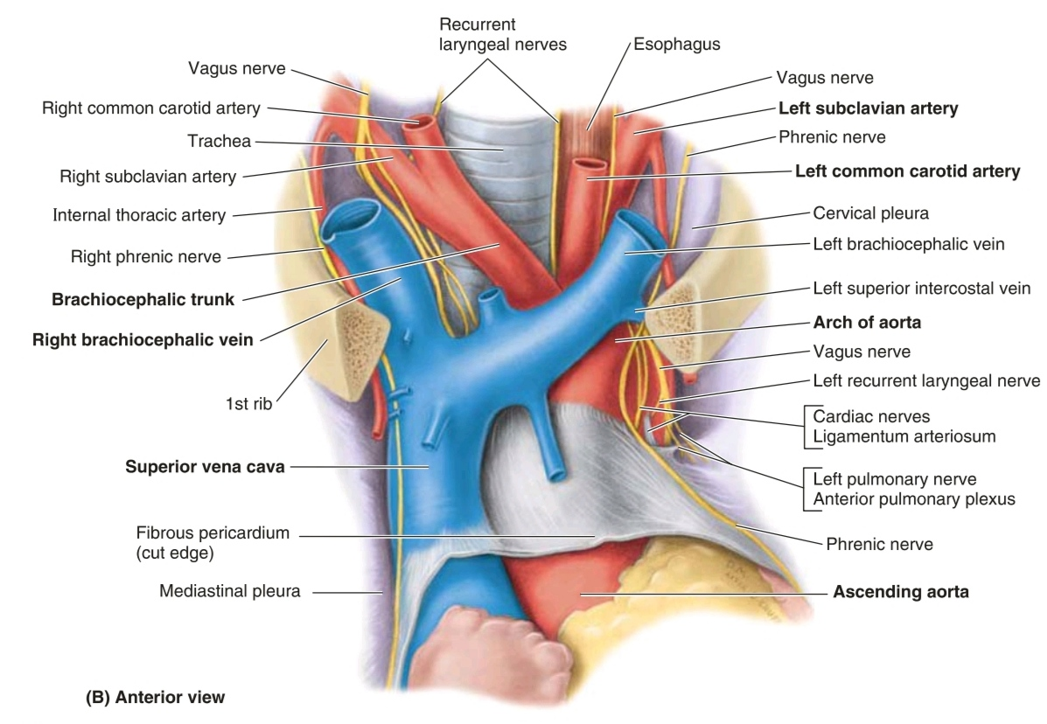

Slide 22
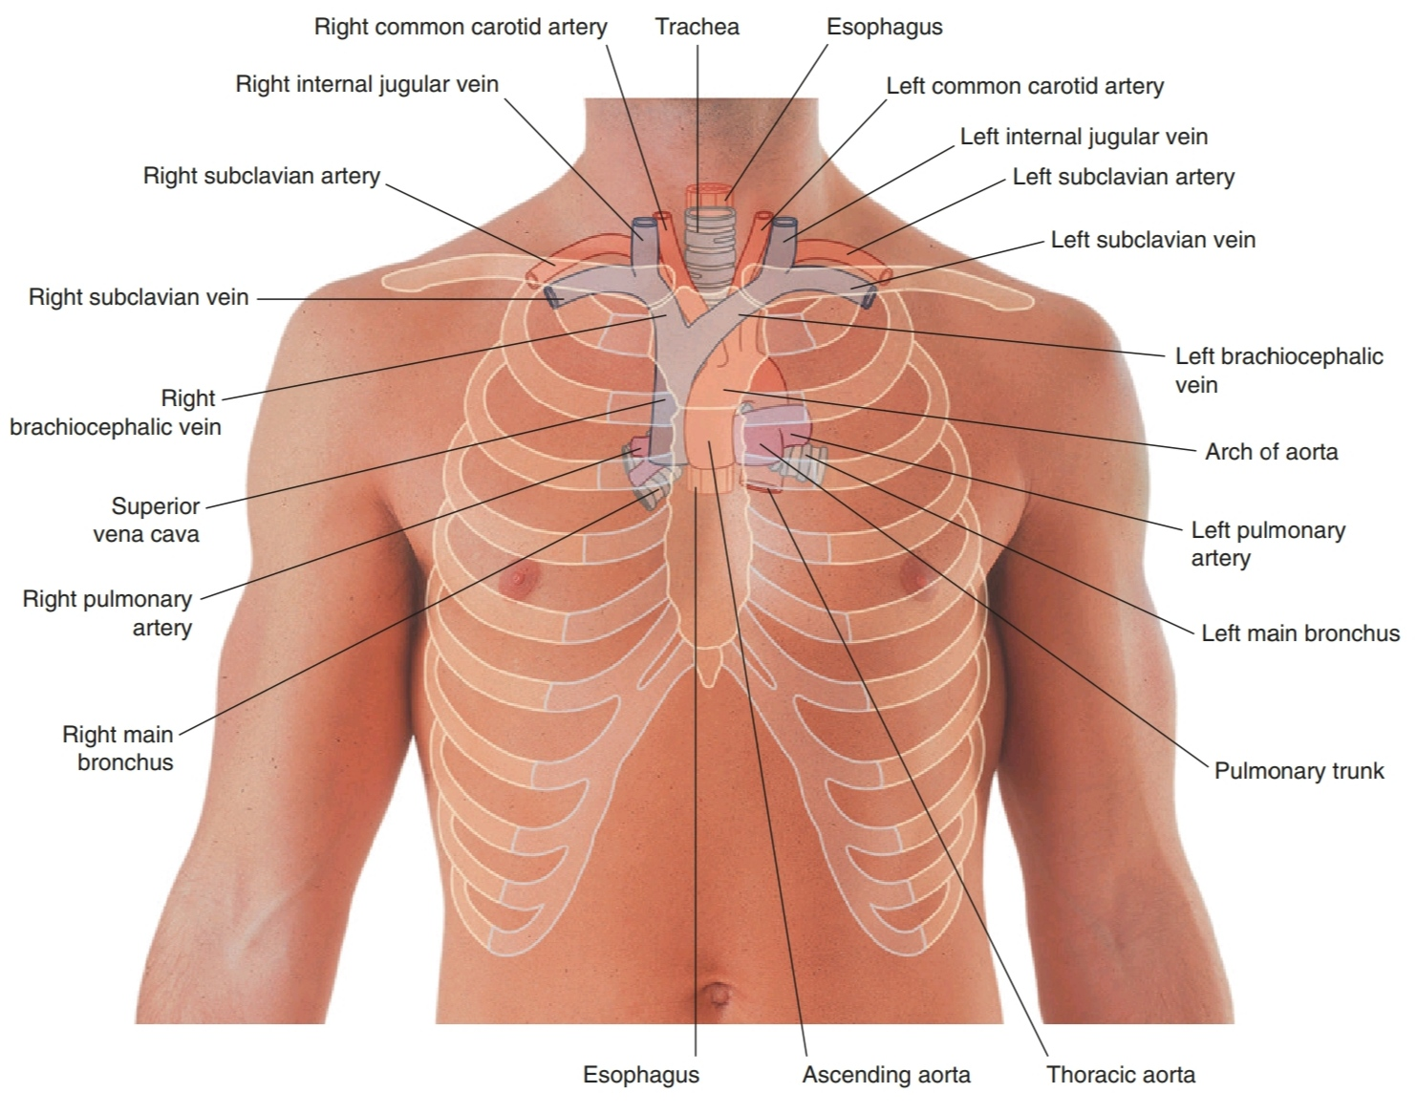

Slide 23
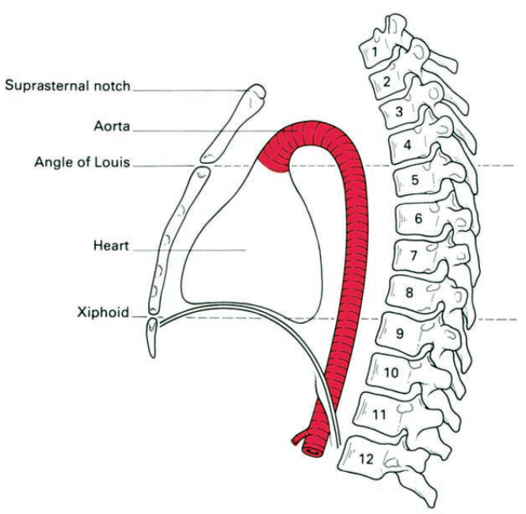
The position of Heart with respect to our vertebral column
It extends from T5 - T8
(cardiac vertebrae of Giacomini)

Slide 24
Visualizing the margins of the Heart

Slide 25
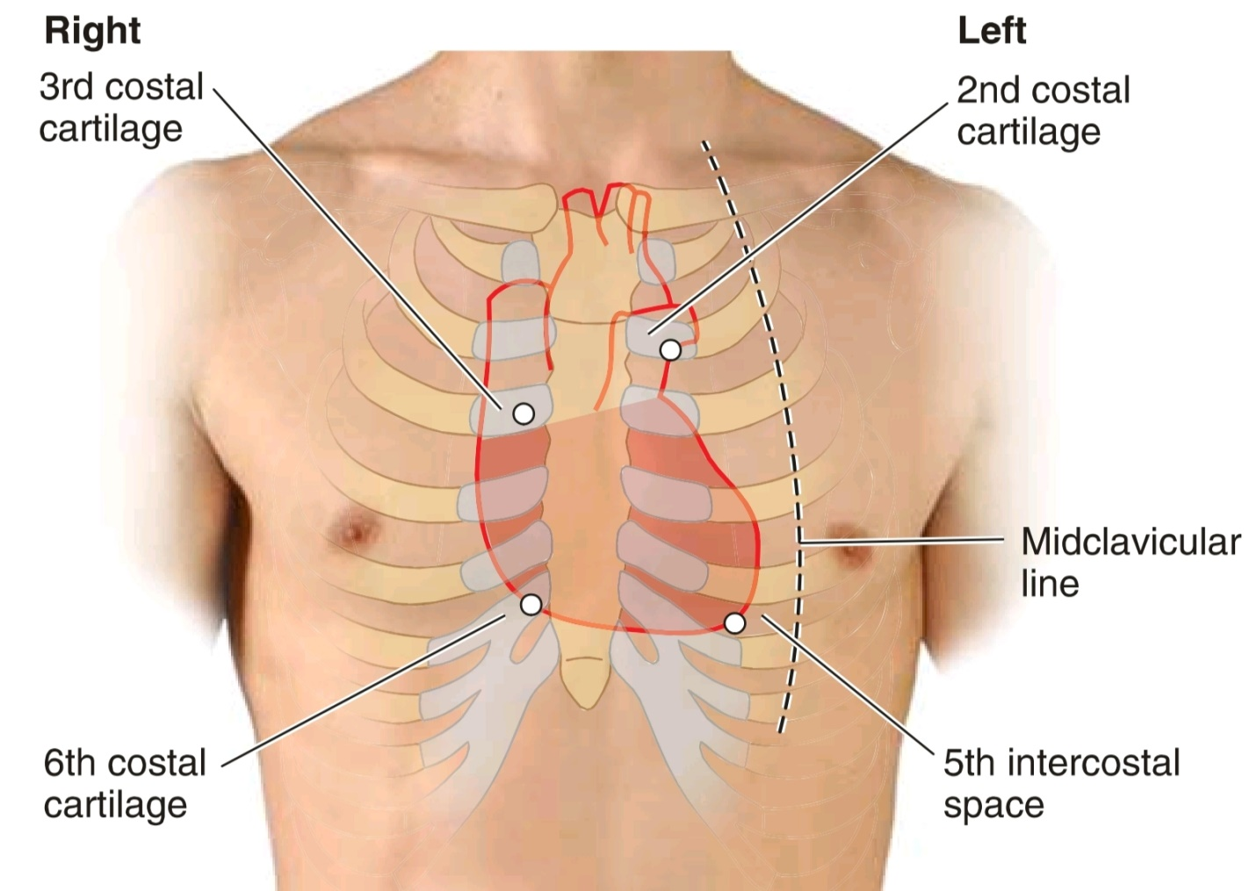
Projection Of the Heart Borders On The Chest Wall
Borders :
2
3
6
5.5

Slide 26

The upper border of the heart
(2 - 3)
reaches as high as the 2nd intercostal space on the left side of the sternum and the 3rd costal cartilage on the right side

Slide 27

The right border of the heart
(3 - 6)
extends from the right 3rd costal cartilage to near the right 6th costal cartilage

Slide 28

The lower border of the heart
(6 - 5.5)
extends from the sternal end of the right 6th costal cartilage to the apex in the 5th intercostal space near the midclavicular line

Slide 29

The left border of the heart
(2 - 5.5)
descends laterally from the 2nd intercostal space to the apex located near the midclavicular line in the 5th intercostal space

Slide 30


Slide 31
The Apex Beat (5.5)
is the impulse that results from the apex of the heart being forced against the anterior thoracic wall when the left ventricle contracts.
lies posterior to the left 5th intercostal space in adults, usually approximately 9 cm (a hand's breadth) from the median plane.

Slide 32
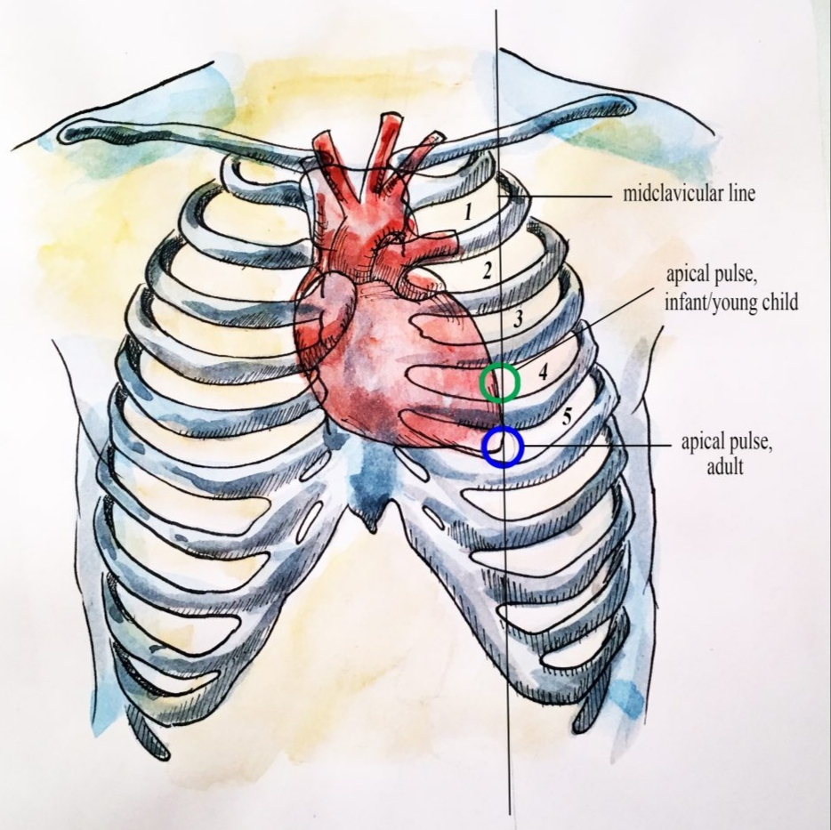

Slide 33

Where To Listen For Heart Sounds

Slide 34
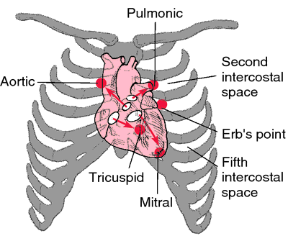
Listening areas on the chest wall
To listen for valve sounds, position the stethoscope downstream from the flow of blood through the valves

Slide 35
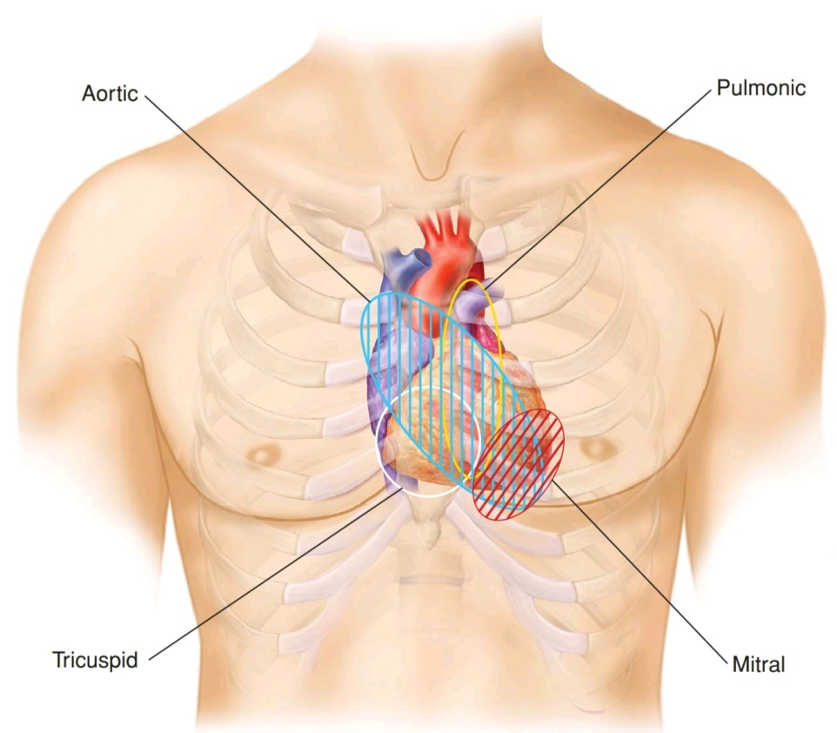
auscultation points
auscultation areas

Slide 36
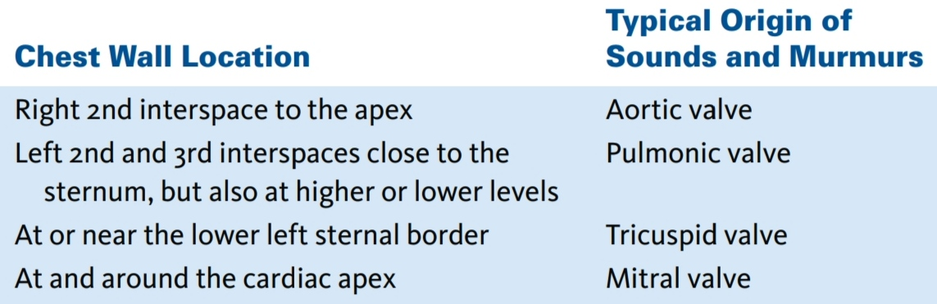
Listening areas on the chest wall

Slide 37
Auscultation Position of
The Tricuspid Valve
The tricuspid valve is heard just to the left of the lower part of the sternum near the 5th intercostal space

Slide 38
Auscultation Position of
The Pulmonary Valve
The pulmonary valve is heard over the medial end of the left 2nd intercostal space

Slide 39
Auscultation Position of
The Mitral Valve
The mitral valve is heard over the apex of the heart in the left 5th intercostal space at the midclavicular line

Slide 40
Auscultation Position of
The Aortic Valve
The aortic valve is heard over the medial end of the right 2nd intercostal space

Slide 41
Erb's Point
it is the fifth point of auscultation of the heart , located in the 3rd left intercostal space close to the sternum
for auscultation of cardiac murmers due to aortic valve disease

Slide 42
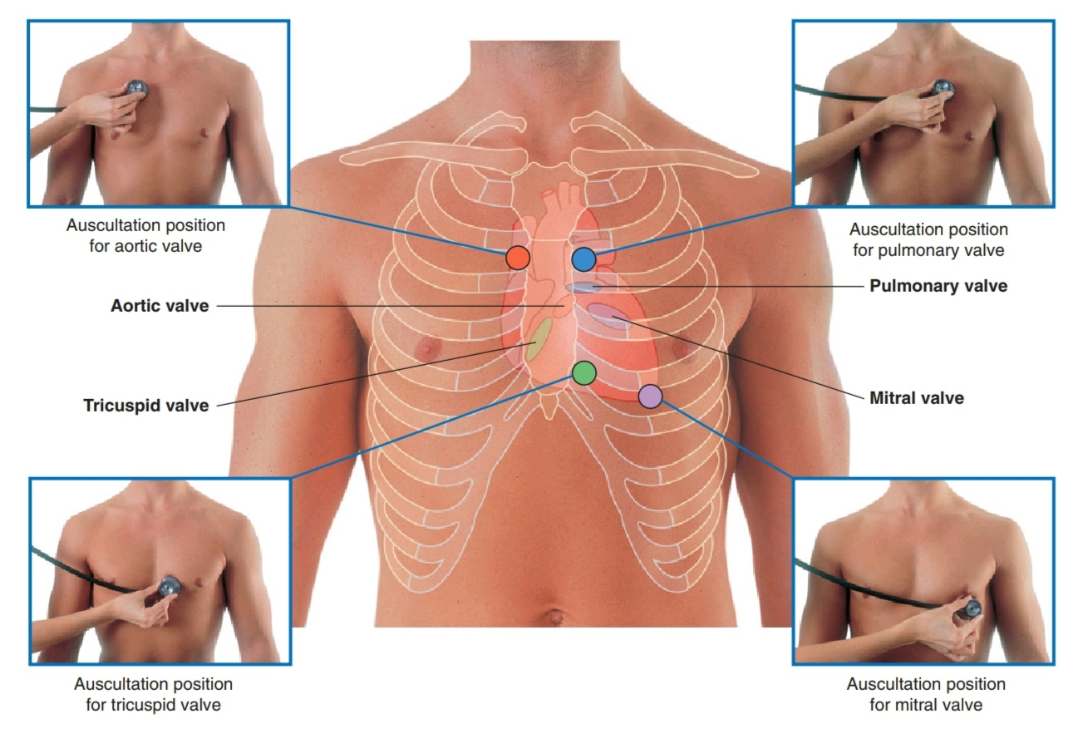

Slide 43
Clinical Anatomy of the Heart

Slide 44
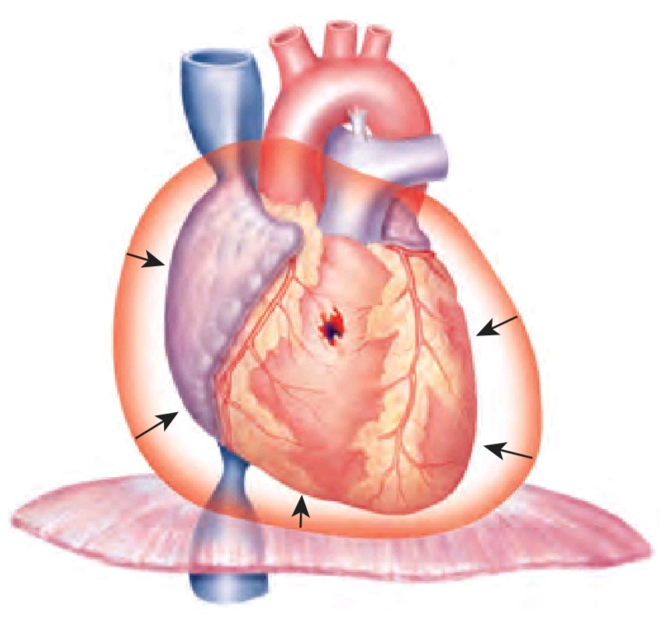
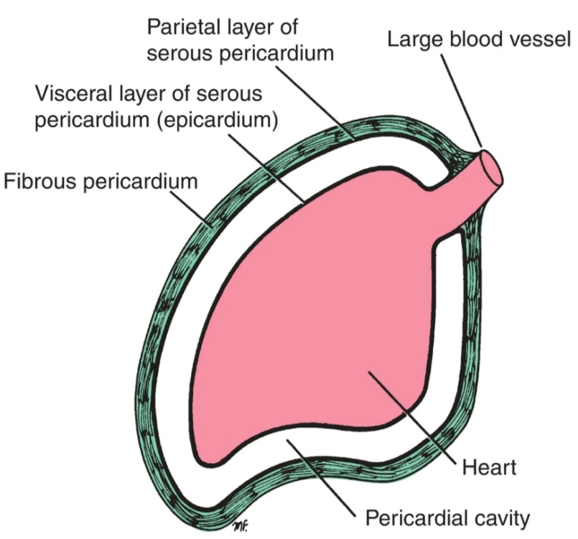
Cardiac Tamponade
Excessive accumulation of fluids in the pericardial space

Slide 45
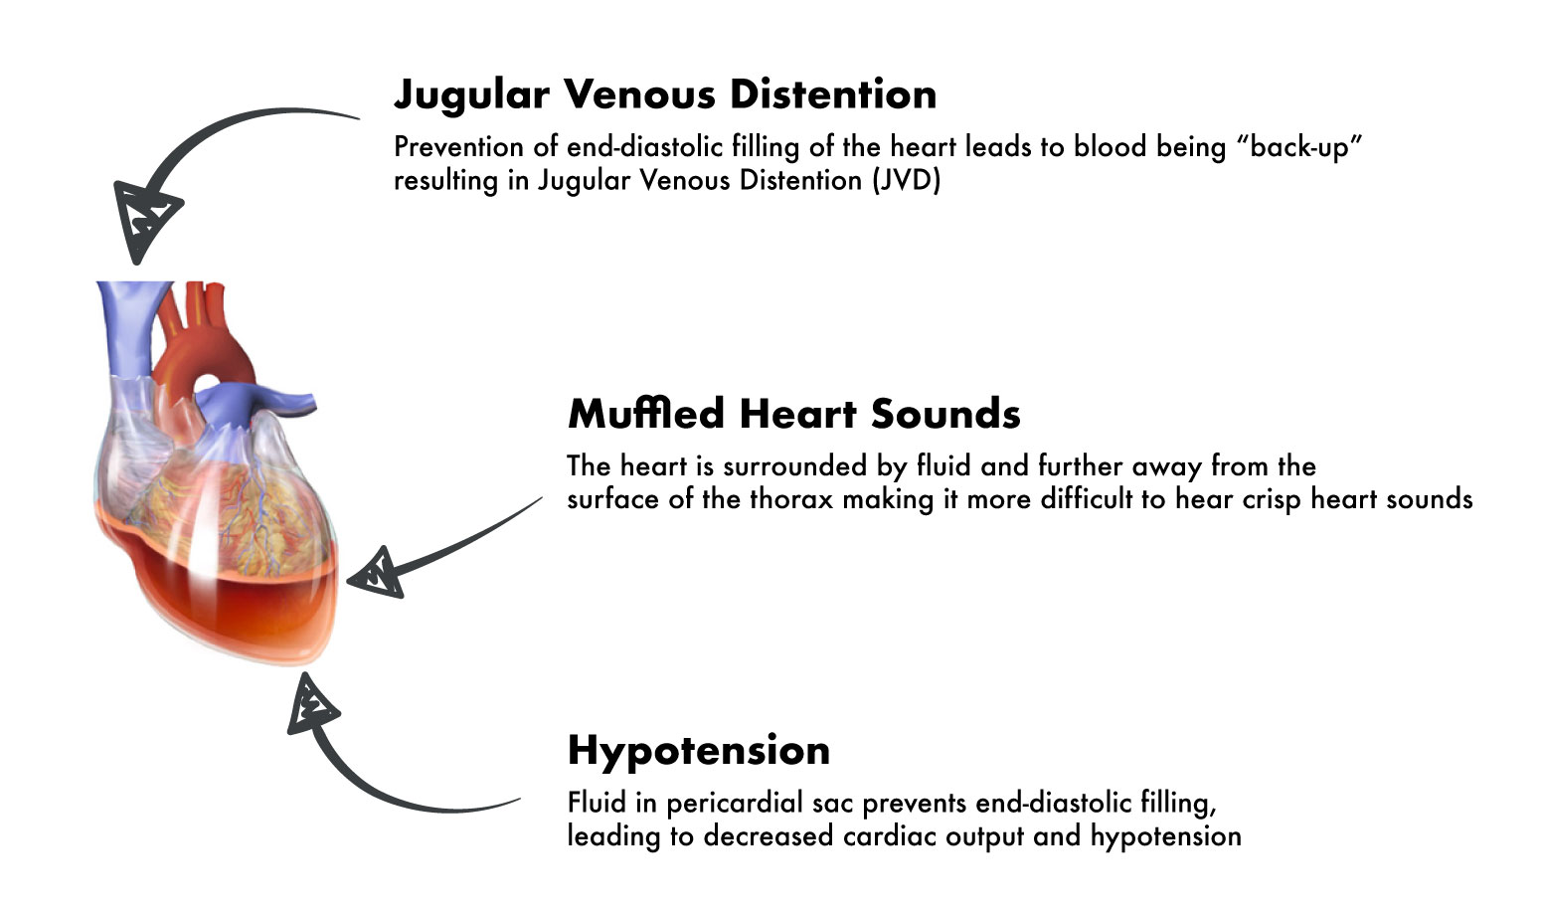
Beck's Triade

Slide 46
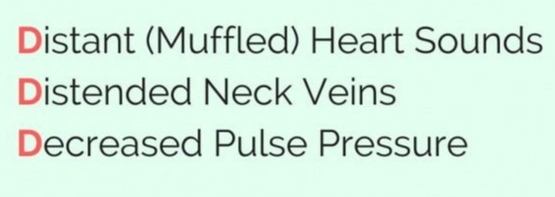
Beck's Triade (3D)

Slide 47
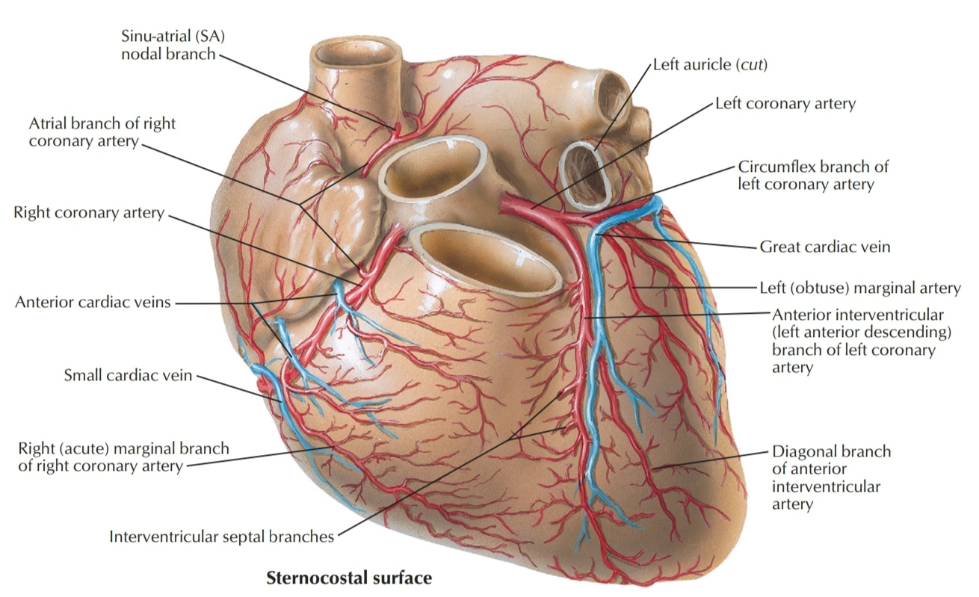
Ischemic Heart Disease (IHD)

Slide 48
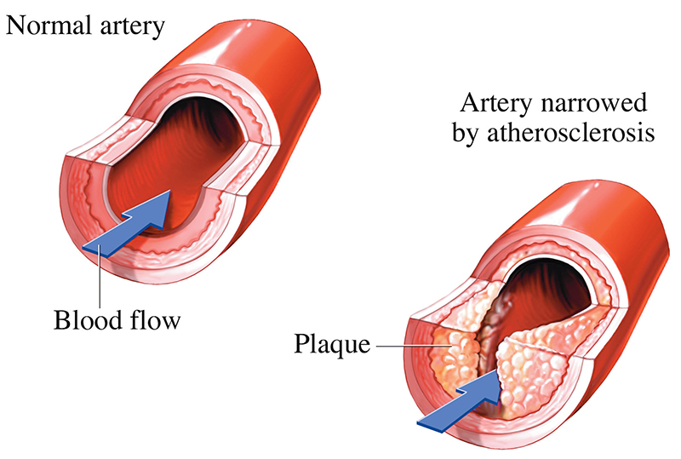
Ischemic Heart Disease (IHD)
Myocardial ischaemia occurs when there is an imbalance between the supply of oxygen (and other essential myocardial nutrients) and the myocardial demand for these substances.
most common cause is Atherosclerosis

Slide 49
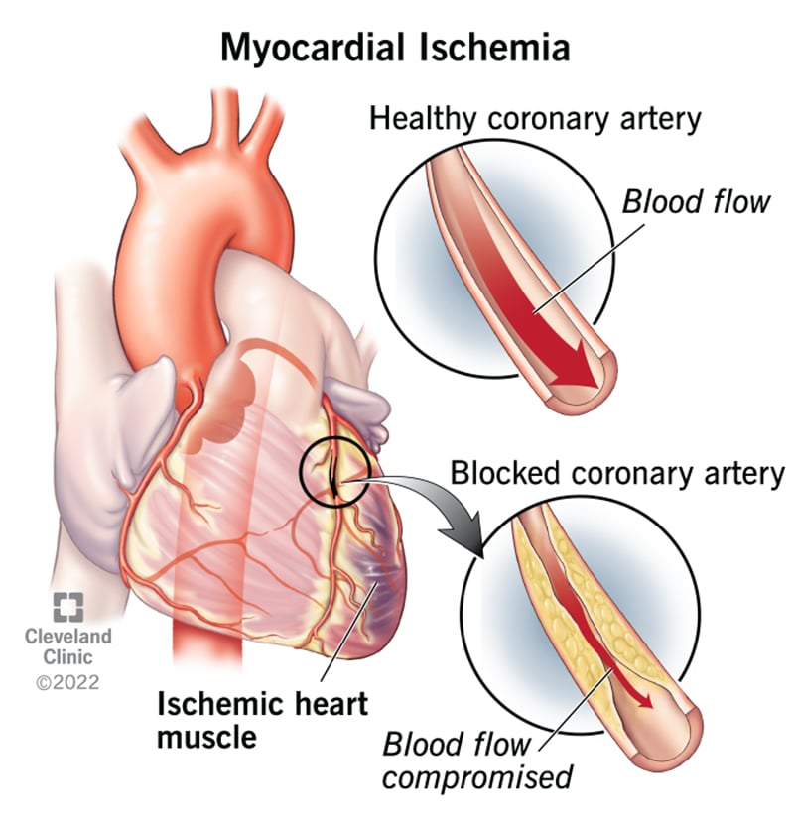

Slide 50
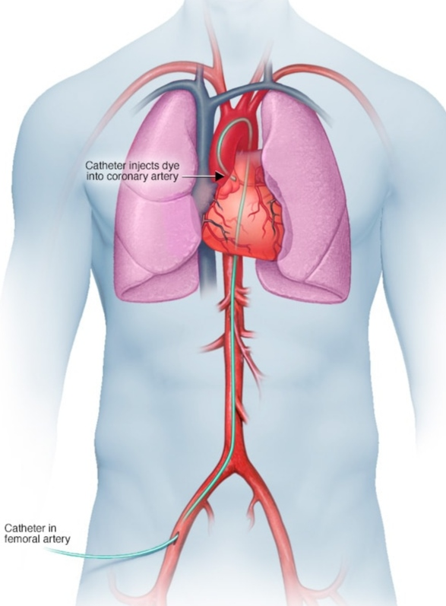
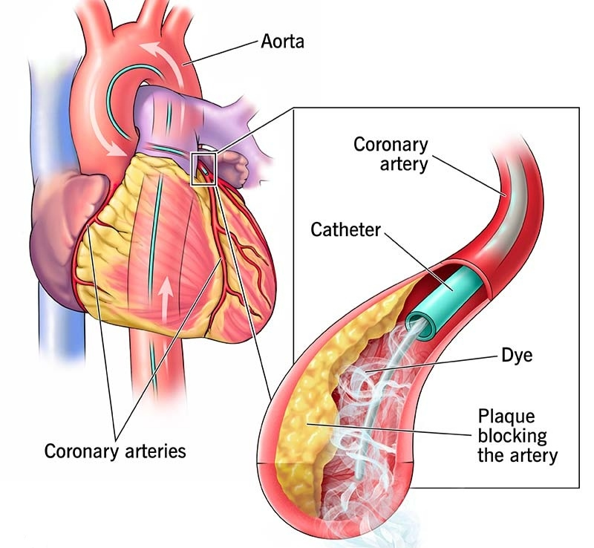
Coronary Angiography

Slide 51
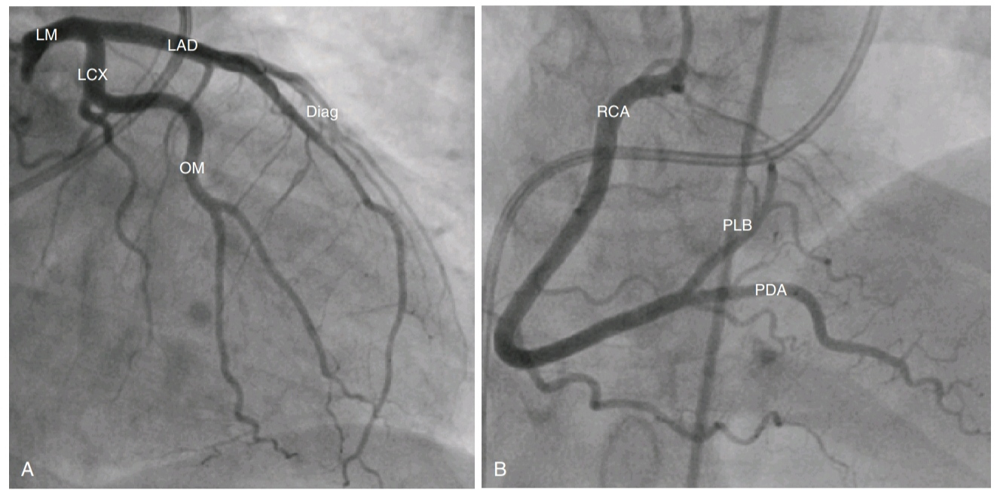
Coronary Angiography

Slide 52
Percutaneous Coronary Intervention (PCI)
1- A guidewire is advanced from the radial (or femoral) artery to the coronary artery under radiographic control
2- A balloon catheter is then advanced over the guidewire to the stenotic coronary artery and the balloon is infated to dilate the stenosis
3- When this has been achieved, a stent is usually placed at the site of the stenosis to maintain patency of the artery

Slide 53
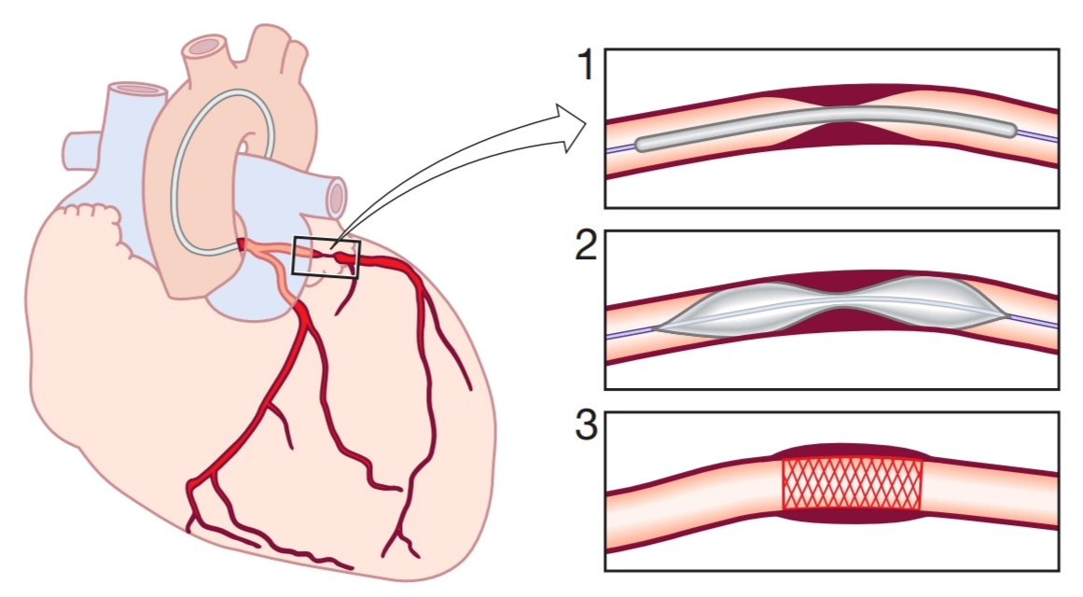
PCI

Slide 54
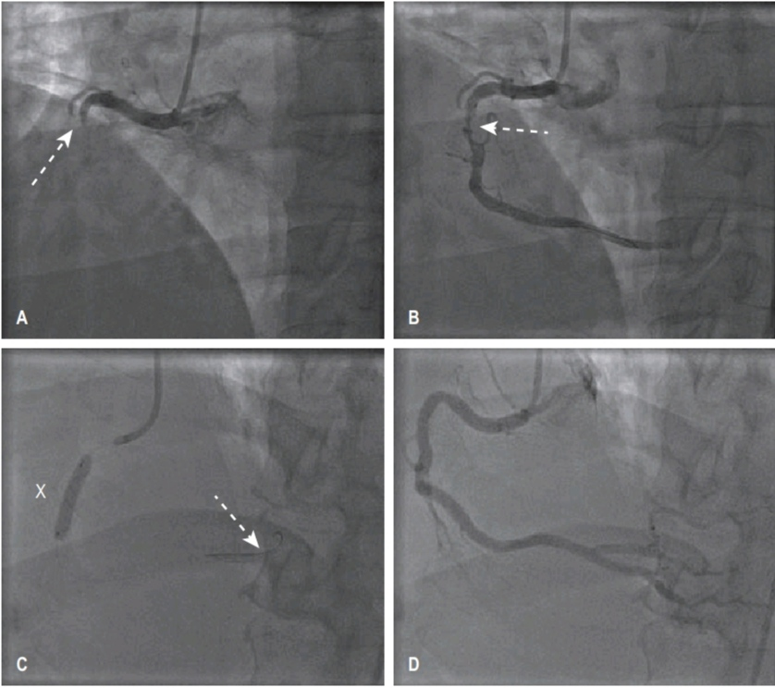
PCI

Slide 55
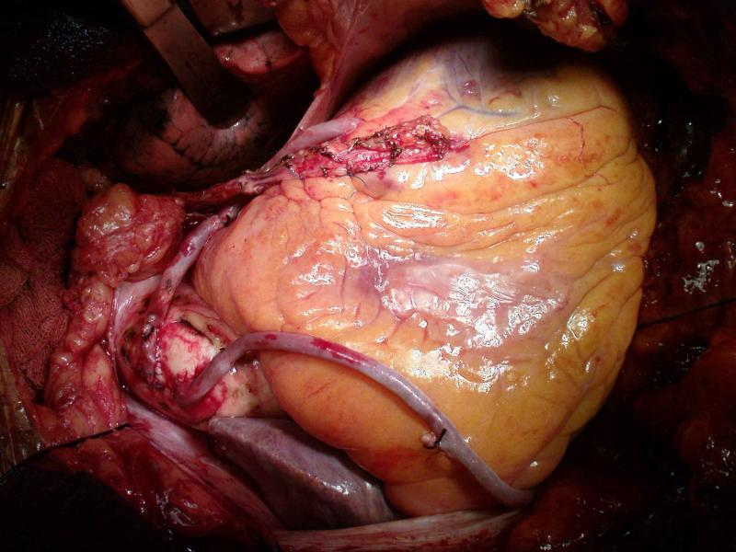
Coronary Artery Bypass Grafting
(CABG)
With CABG, autologous veins or arteries are anastomosed to the ascending aorta and to the native coronary arteries distal to the area of stenosis

Slide 56
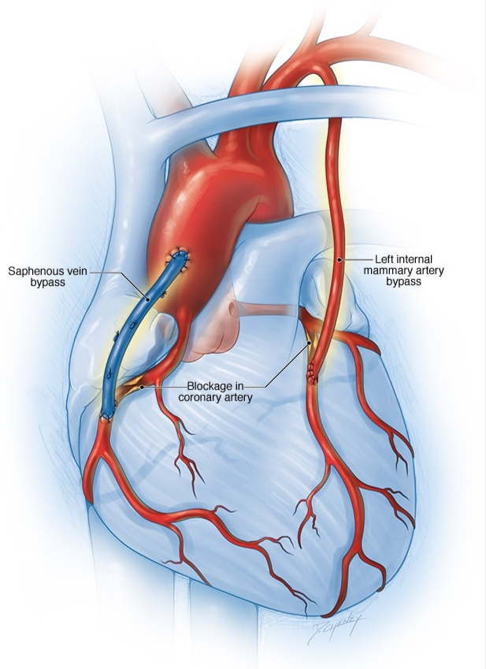
Coronary Artery Bypass Grafting
(CABG)
Mostly used grafts are:
Internal Mammary Arteries (LIMA & RIMA)
and Great Saphenous Vein

Slide 57
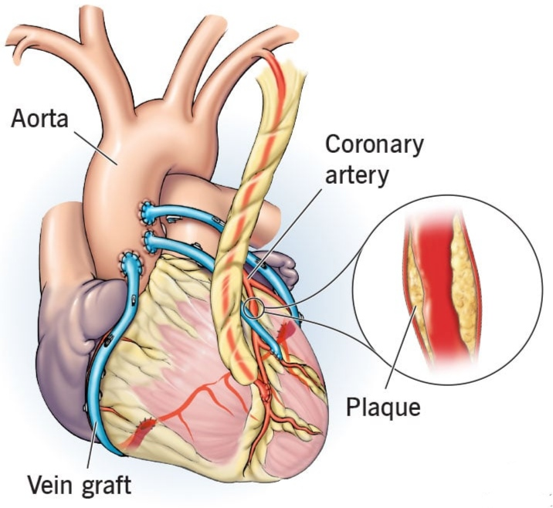
Coronary Artery Bypass Grafting
(CABG)
Indicated for multiple vessel disease (including Left Main coronary artery stenosis)
Long-term survival and quality of life in CABG is better than PCI

Slide 58
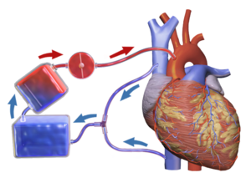
Heart-Lung Machine
(Cardio-pulmonary Bypass, CPB)
it performs the function of heart and lung
venous blood is drained from the Right Atrium, oxygenated in the Oxygenator, and pumped into the Ascending Aorta

Slide 59
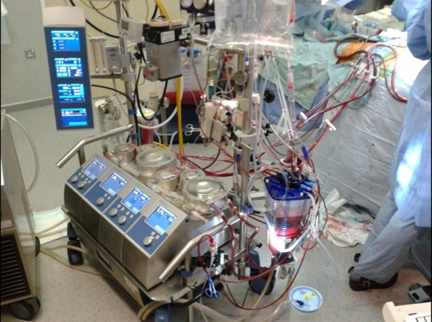
CPB

Slide 60
Valvular Heart Disease
the heart valves should open and close well
valve STENOSIS: if the valve doesn't open well
valve REGURGITATION (or insufficiency): if the valve doesn't close well

Slide 61
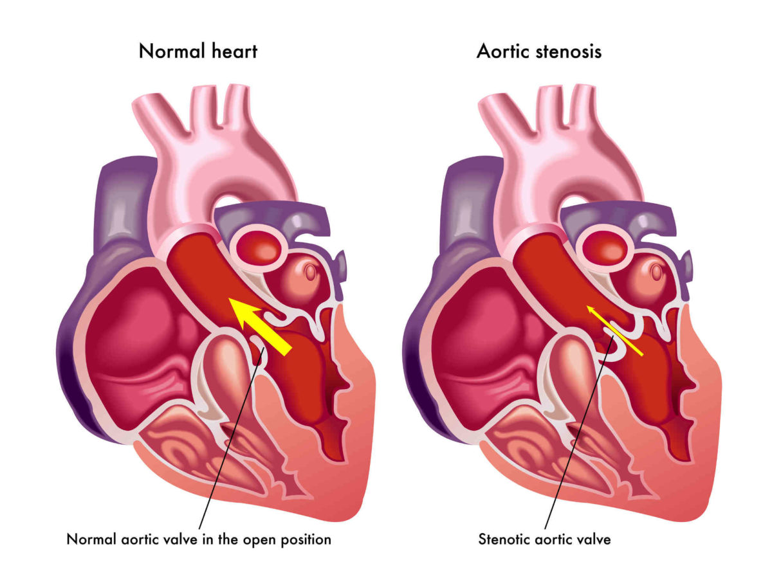
Valve Stenosis

Slide 62
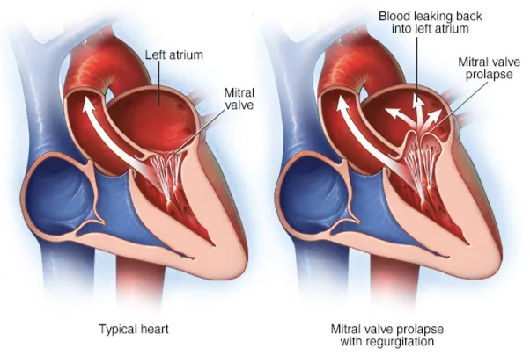
Valve Regurgitation

Slide 63
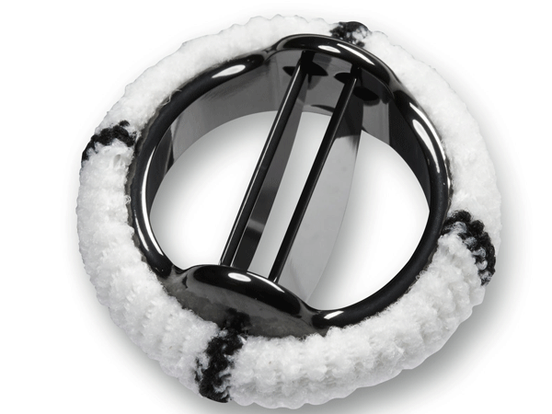
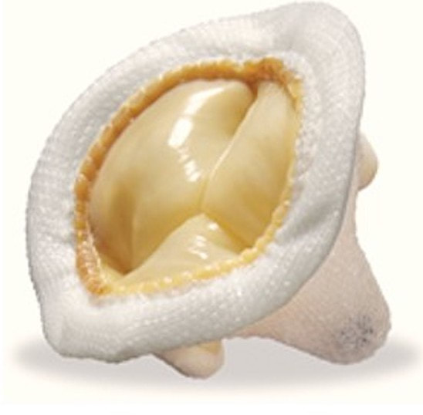
Valve Replacement
excision of the native valve
implantation of prosthetic valve : mechanical or biological valves

Slide 64
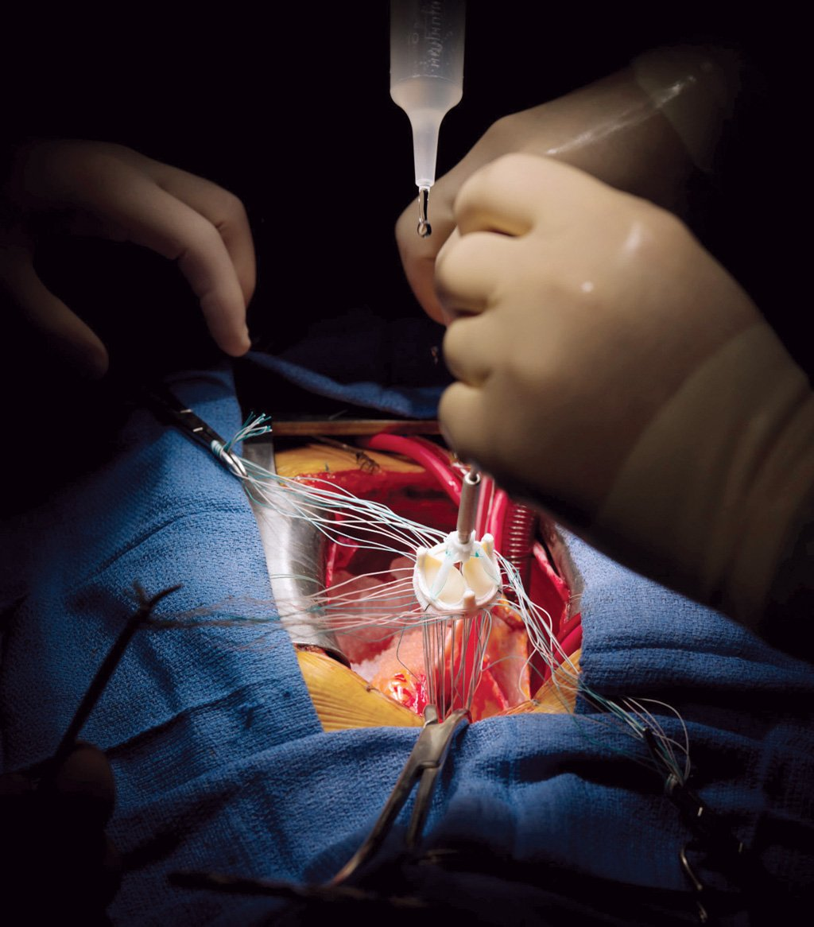
Valve Replacement

Slide 65
Valve Repair
maintenance of the native valve
use of prosthetic rings, resection of segments of valve and use of special surgical techniques to restore its normal function

Slide 66
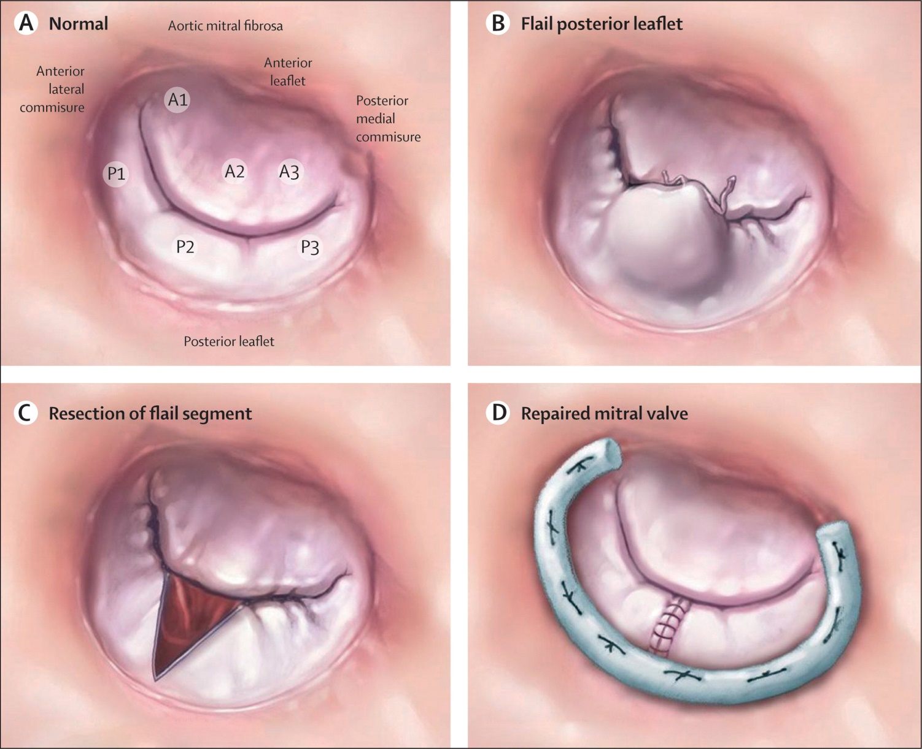
Valve Repair

Slide 67
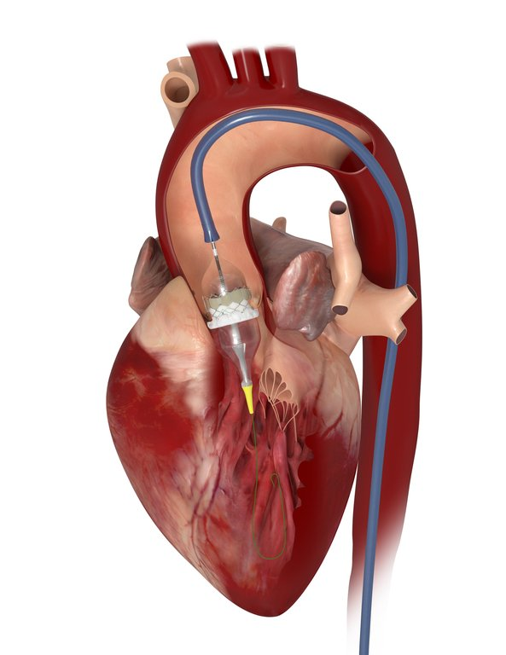
Trans-catheter Aortic Valve Implantation (TAVI)
for the treatment of severe aortic valve stenosis
implantation of biological valve into the native aortic valve by catheterization

Slide 68
Percutaneous Mitral Balloon Valvuloplasty (PMBV)
to treat mitral stenosis
a guidewire is introduced into the right atrium (RA) from the femoral vein and the inferior vena cava (IVC)
the inter-atrial septum is punctured, providing access to the left atrium (LA) and mitral valve
a balloon catheter is then advanced over the guidewire across the mitral valve and the balloon dilated to stretch the valve and reduce the degree of stenosis

Slide 69
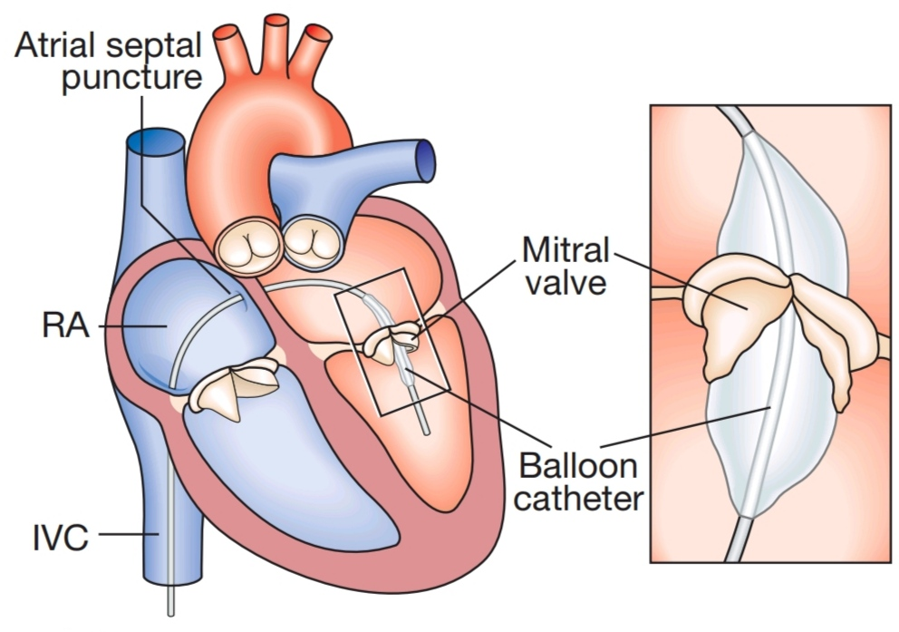
Percutaneous Mitral Balloon Valvuloplasty (PMBV)

Slide 70
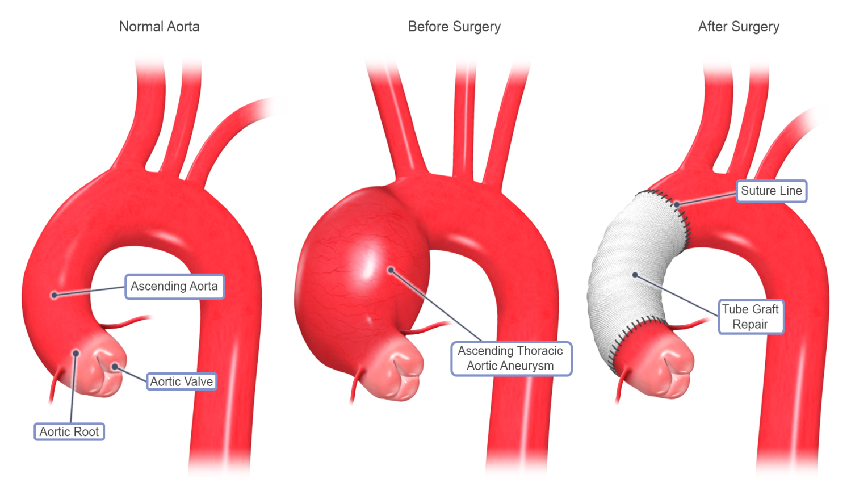
Asceding Aortic Aneurysm
abnormal bulging and dilatation of the ascending aorta
treated by replacing the ascending aorta with prosthetic Tube Graft

Slide 71
Acute Ascending Aortic Dissection
is an acute process in which a tear in the intima of the aorta leads to dissection through the laminas and formation of a new lumen (false lumen) and acute drop in systemic blood pressure, potentially leading to death
is an absolute EMERGENCY and life-threatening condition that should be operated immediately, with HIGH MORTALITY post-operatively

Slide 72
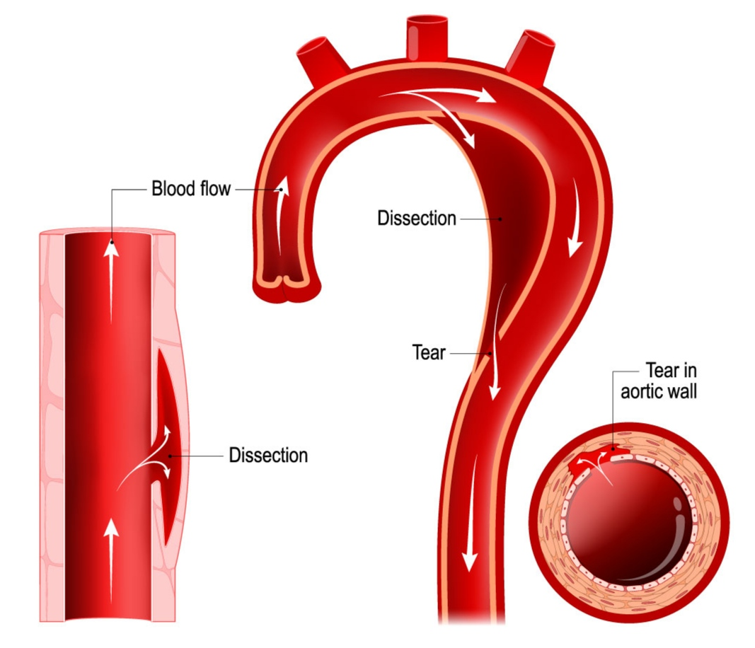

Slide 73
Surgical Treatment of Acute Ascending Aortic Dissection
complex surgery
use of Deep Hypothermic Circulatory Arrest
may need to replace aortic root, aortic valve, ascending aorta and re-implantation of coronary ostia (Bentall procedure)
high rate of complications and mortality post-operatively

Slide 74
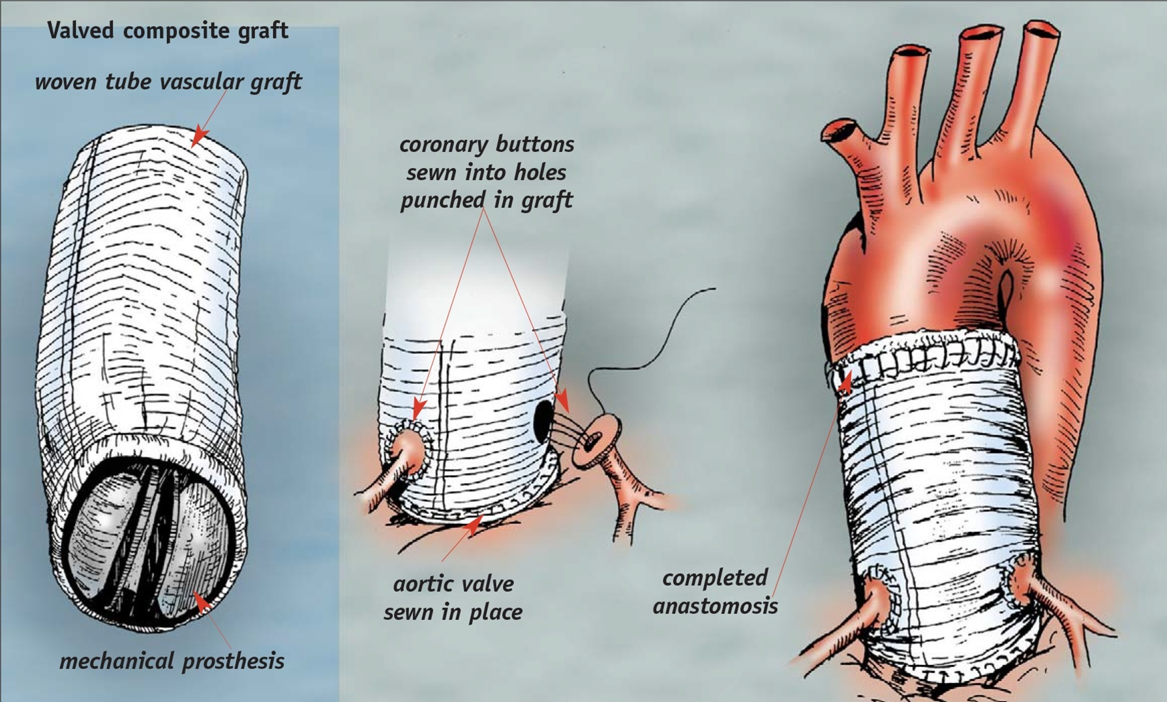
Bentall Procedure

Slide 75

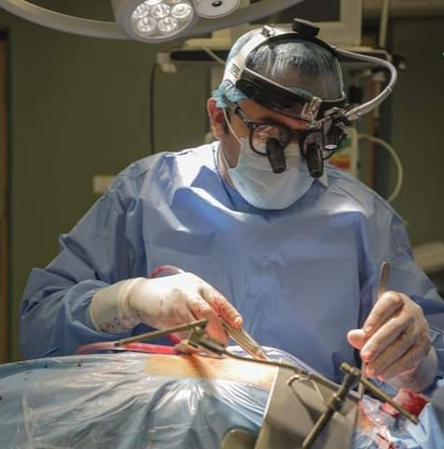
تمنيات لكم جميعاً بالتوفيق و النجاح في حياتكم العلمية و العملية
مع تحياتي:
د. ساهر خضر أبو غالي
و كل عام و أنتم بخير

