Slide 1
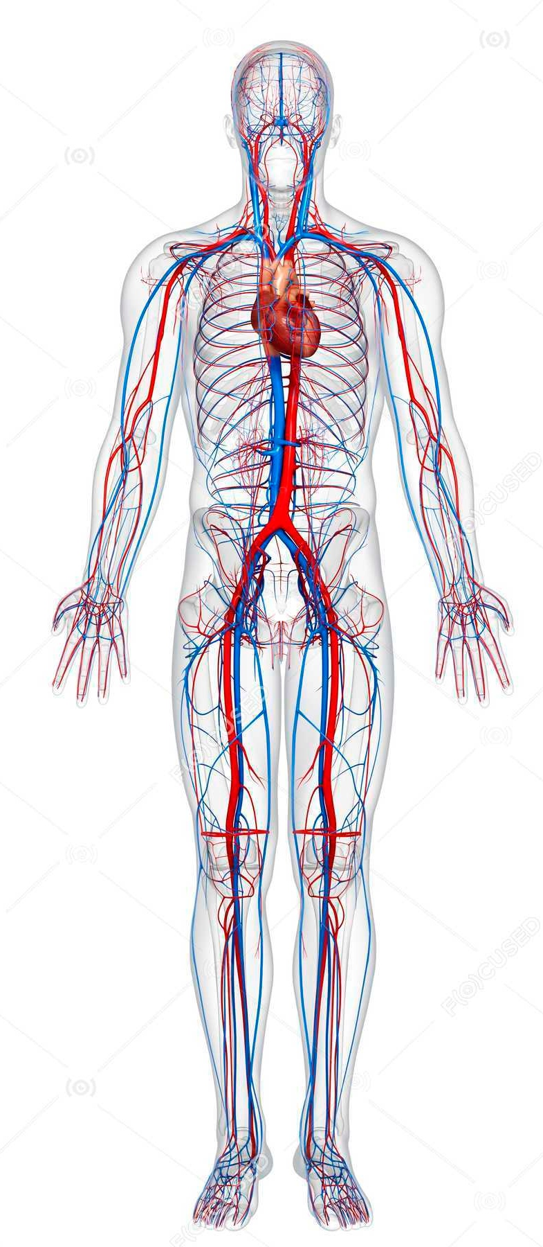

Cardiovascular Anatomy
Part III
بسم الله الرحمن الرحيم
Dr. SAHER ABUGHALI
Director of Cardiac Surgery Department,
Al Shifa Hospital.

Slide 2
Posterior Mediastinum

Slide 3
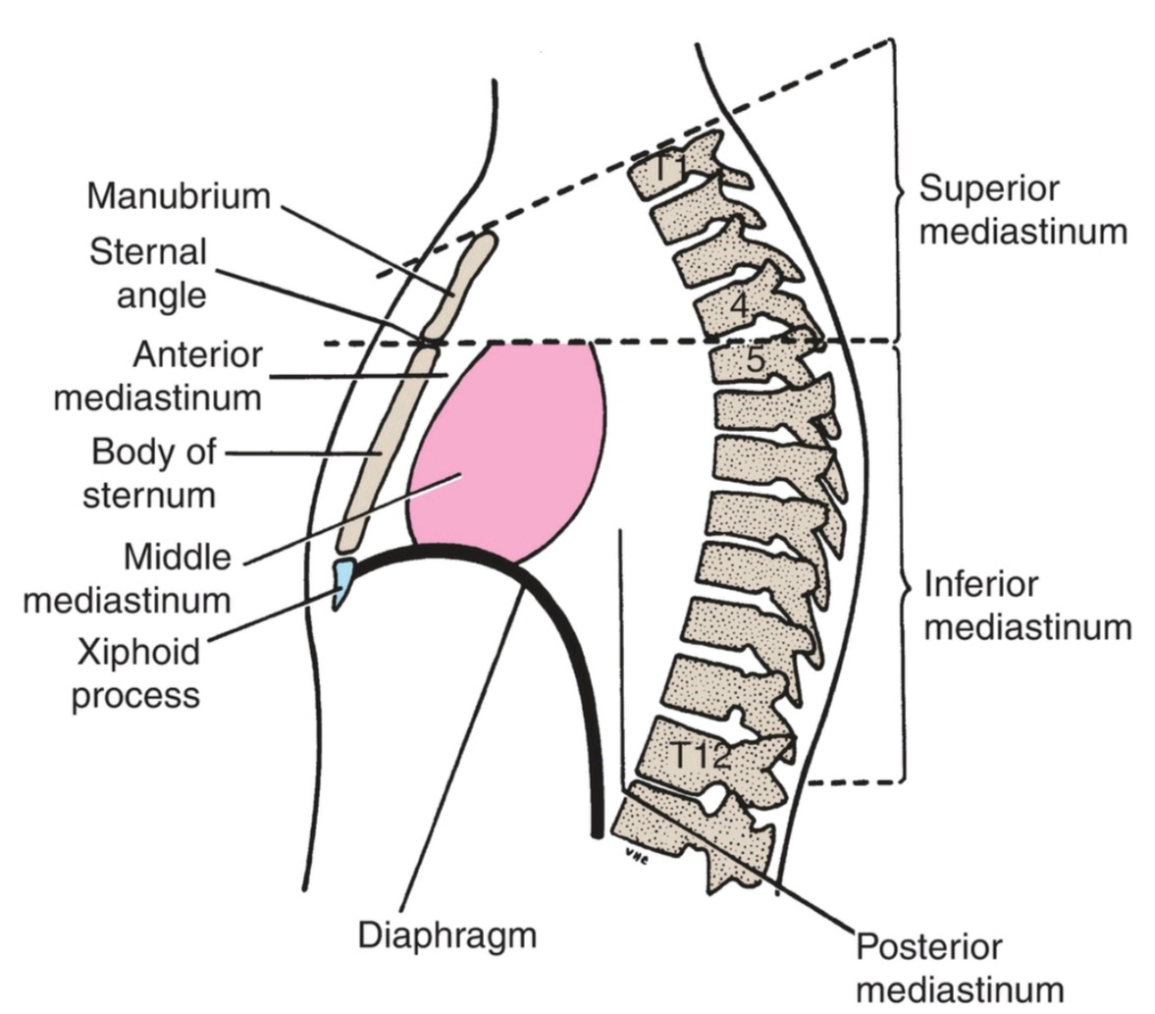
Posterior Mediastinum
The posterior mediastinum (the posterior part of the inferior mediastinum) is located:
inferior to the transverse thoracic plane
anterior to the T5-T12 vertebrae
posterior to the pericardium and diaphragm, and between the parietal pleura of the two lungs

Slide 4
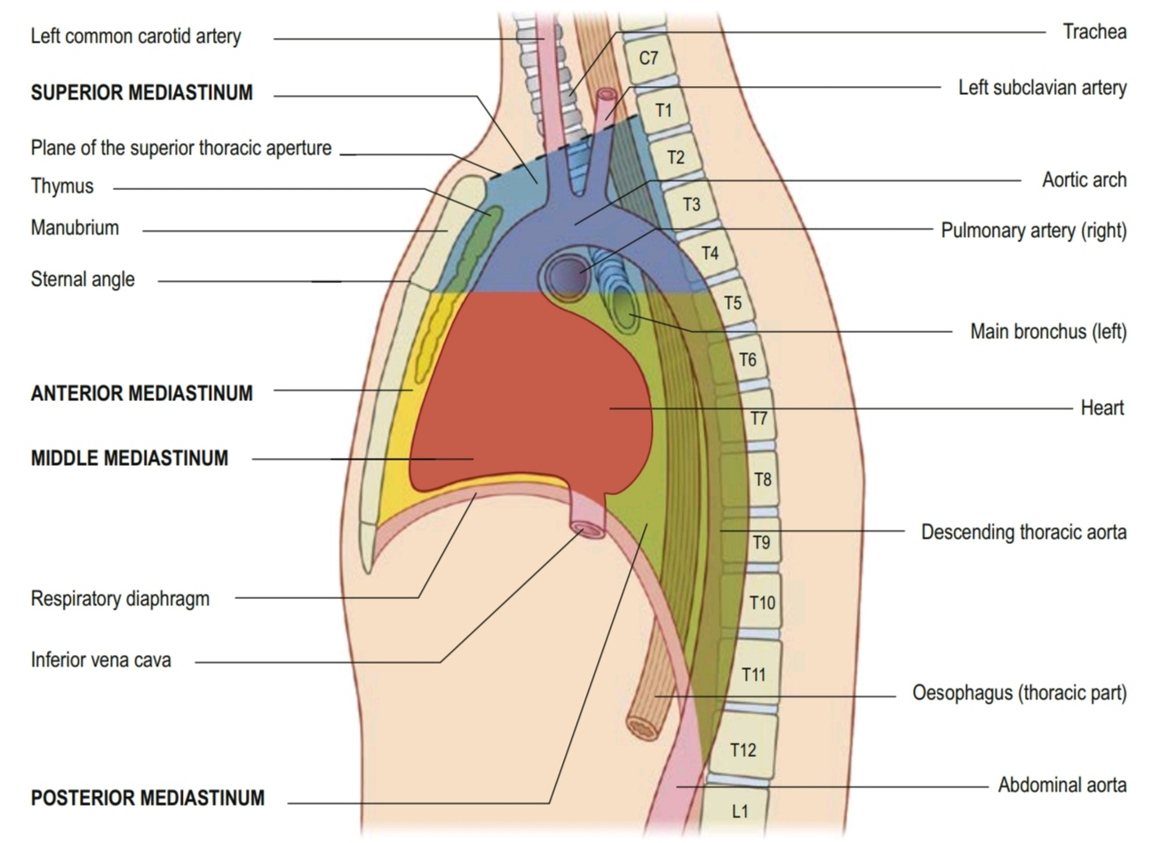
Posterior Mediastinum

Slide 5
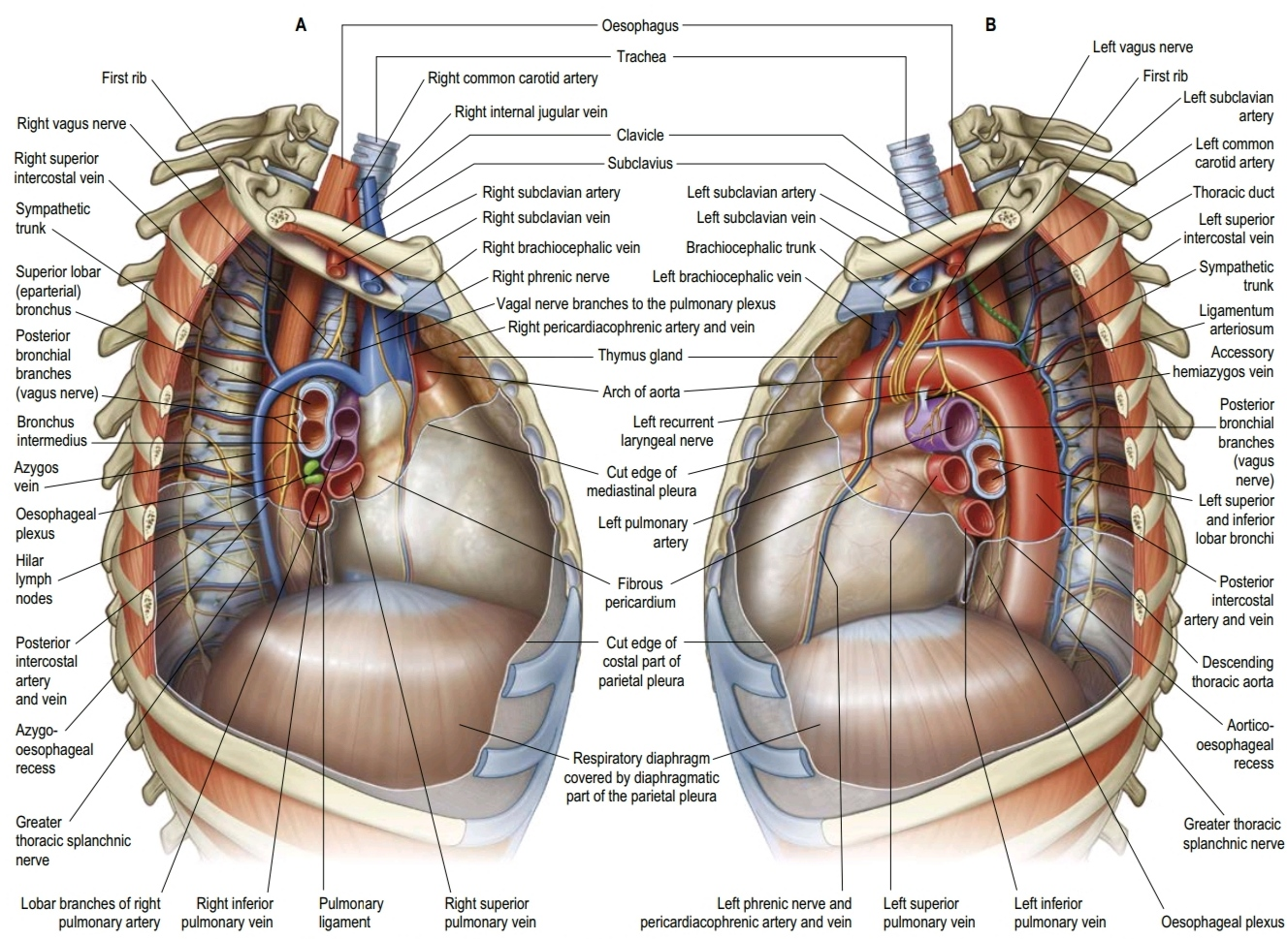

Slide 6
Major Structures in the Posterior Mediastinum
■ esophagus and its associated nerve plexus
■ descending thoracic aorta and its branches
■ azygos system of veins
■ thoracic duct and associated lymph nodes
■ sympathetic trunks
■ thoracic splanchnic nerves

Slide 7
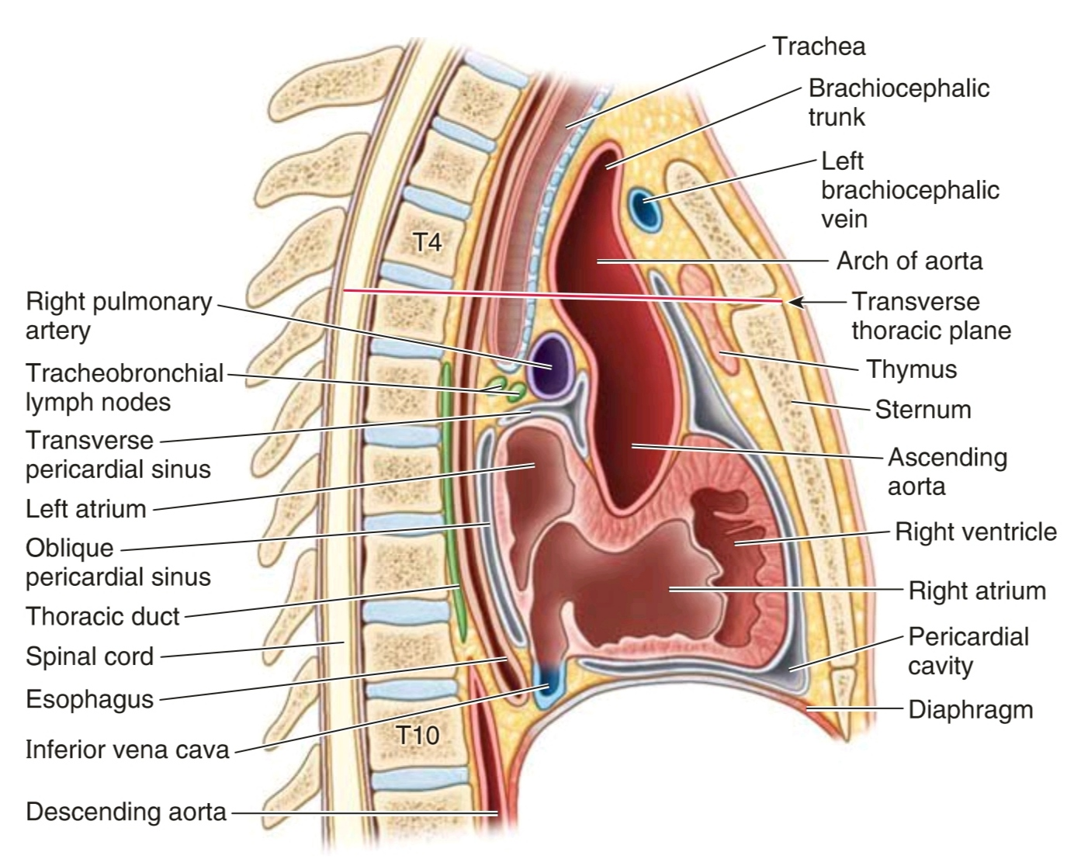

Slide 8
Esophagus
The esophagus is a muscular tube (between 20 and 25 cm long in the adult) passing between the pharynx in the neck and the stomach in the abdomen.
It begins at the inferior border of the cricoid cartilage, opposite vertebra C4, and ends at the cardiac opening of the stomach (cardias), opposite vertebra T11.

Slide 9
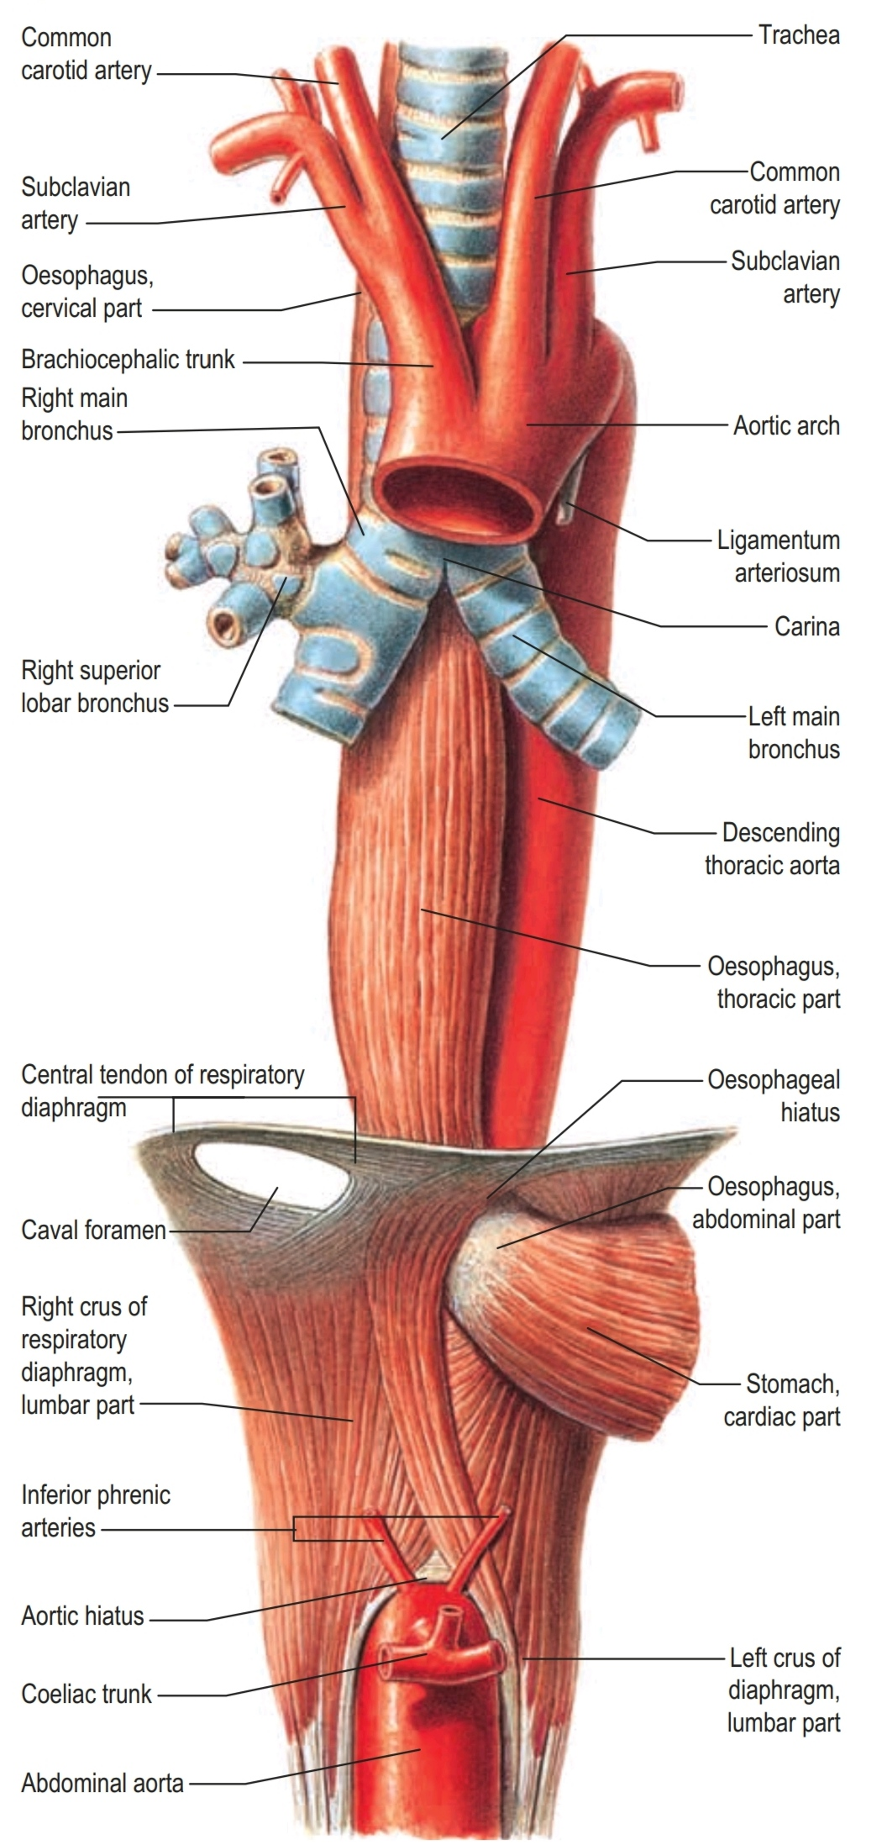
Esophagus
The esophagus descends into the posterior mediastinum from the superior mediastinum, passing posterior to and to the right of the arch of the aorta and posterior to the pericardium and LA.
The esophagus constitutes the primary posterior relationship of the base of the heart.
It then deviates to the left and passes through the esophageal hiatus in the diaphragm at the level of the T10 vertebra, anterior to the aorta.

Slide 10
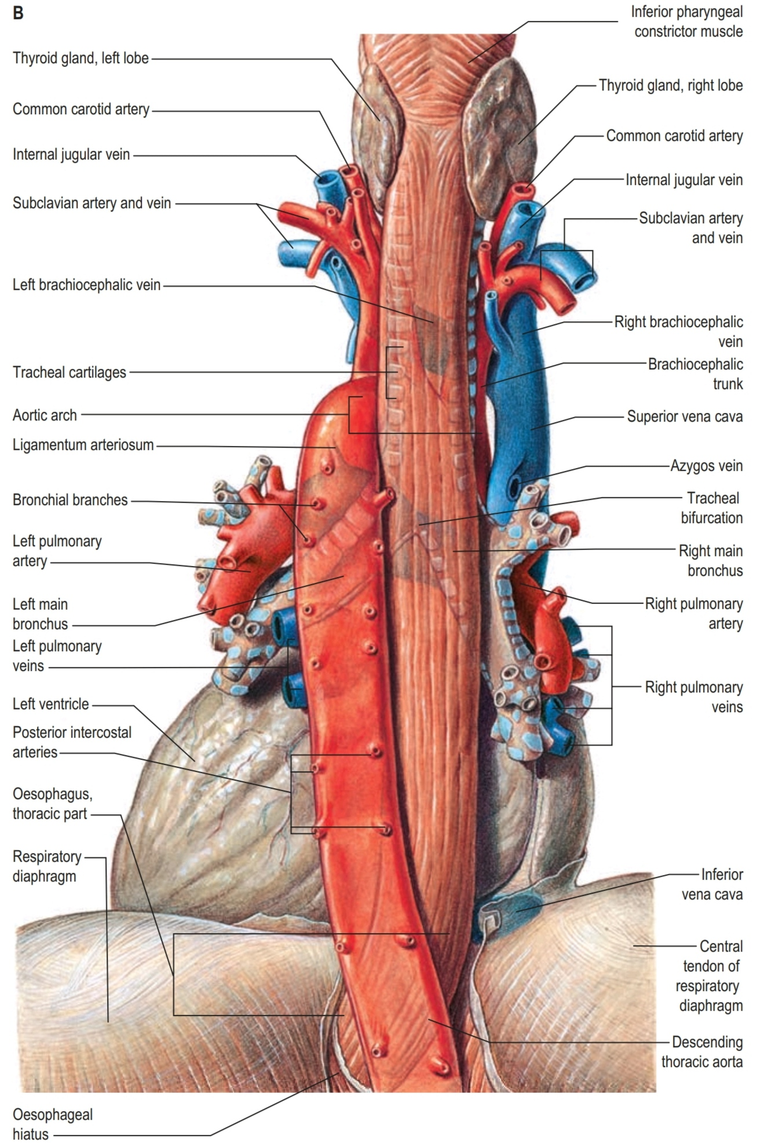

Slide 11
Relationships to important structures in the posterior mediastinum:
The right side is covered by the mediastinal part of the parietal pleura.
Anterior to the esophagus, below the level of the tracheal bifurcation, are the right PA and the left main bronchus.
The esophagus then passes immediately posteriorly to the LA, separated from it only by pericardium.
Inferior to the LA, the esophagus is related to the diaphragm.

Slide 12
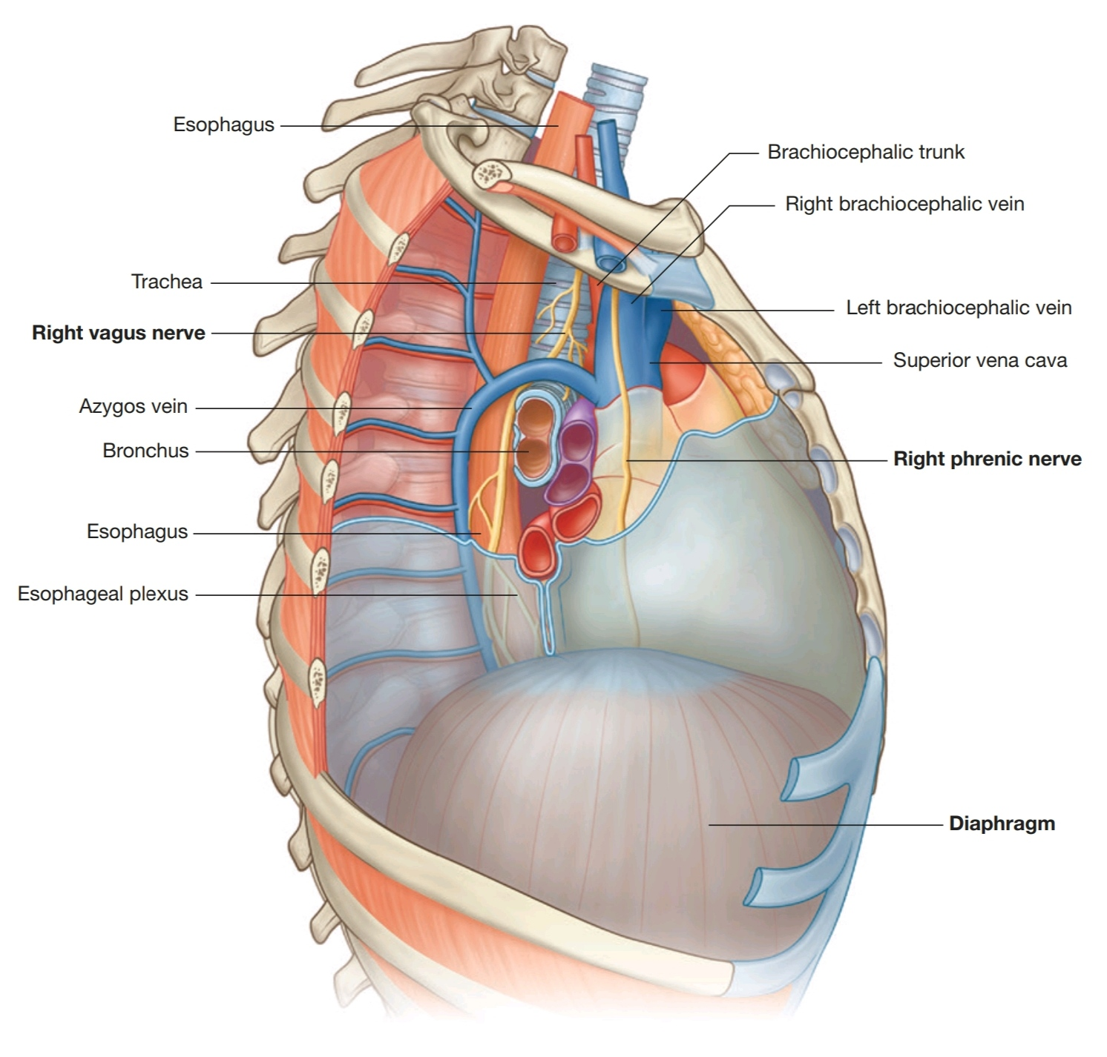
Relationships to important structures in the posterior mediastinum
Structures other than the thoracic duct posterior to the esophagus include portions of the hemiazygos veins, the right posterior intercostal vessels, and, near the diaphragm, the thoracic aorta.

Slide 13
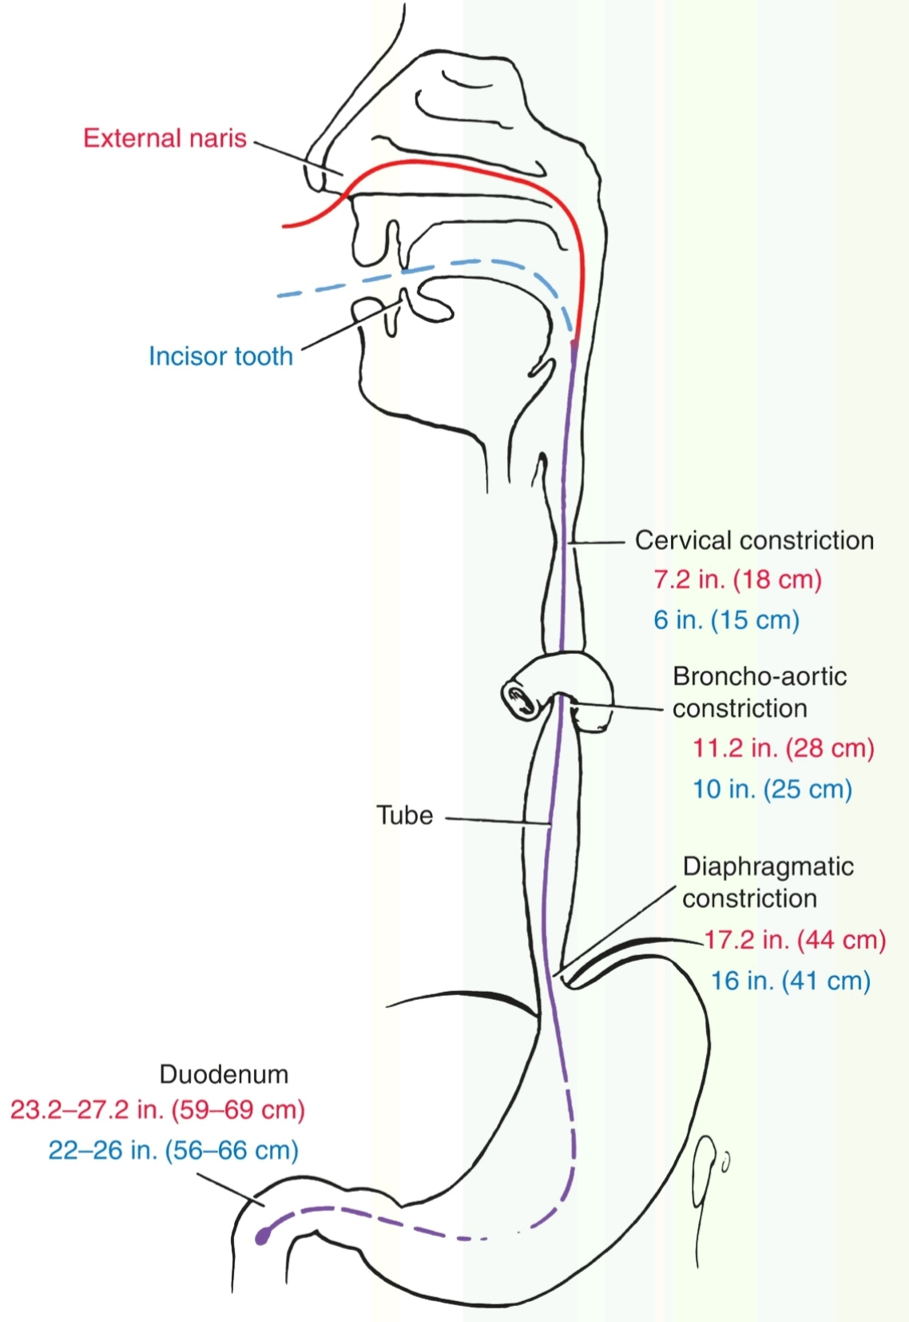
Esophageal Constrictions
The esophagus is compressed by 3 structures:
(1) the arch ofthe aorta
(2) the left main bronchus
(3) the diaphragm
The first two impressions occur in close proximity (broncho-aortic constriction).

Slide 14
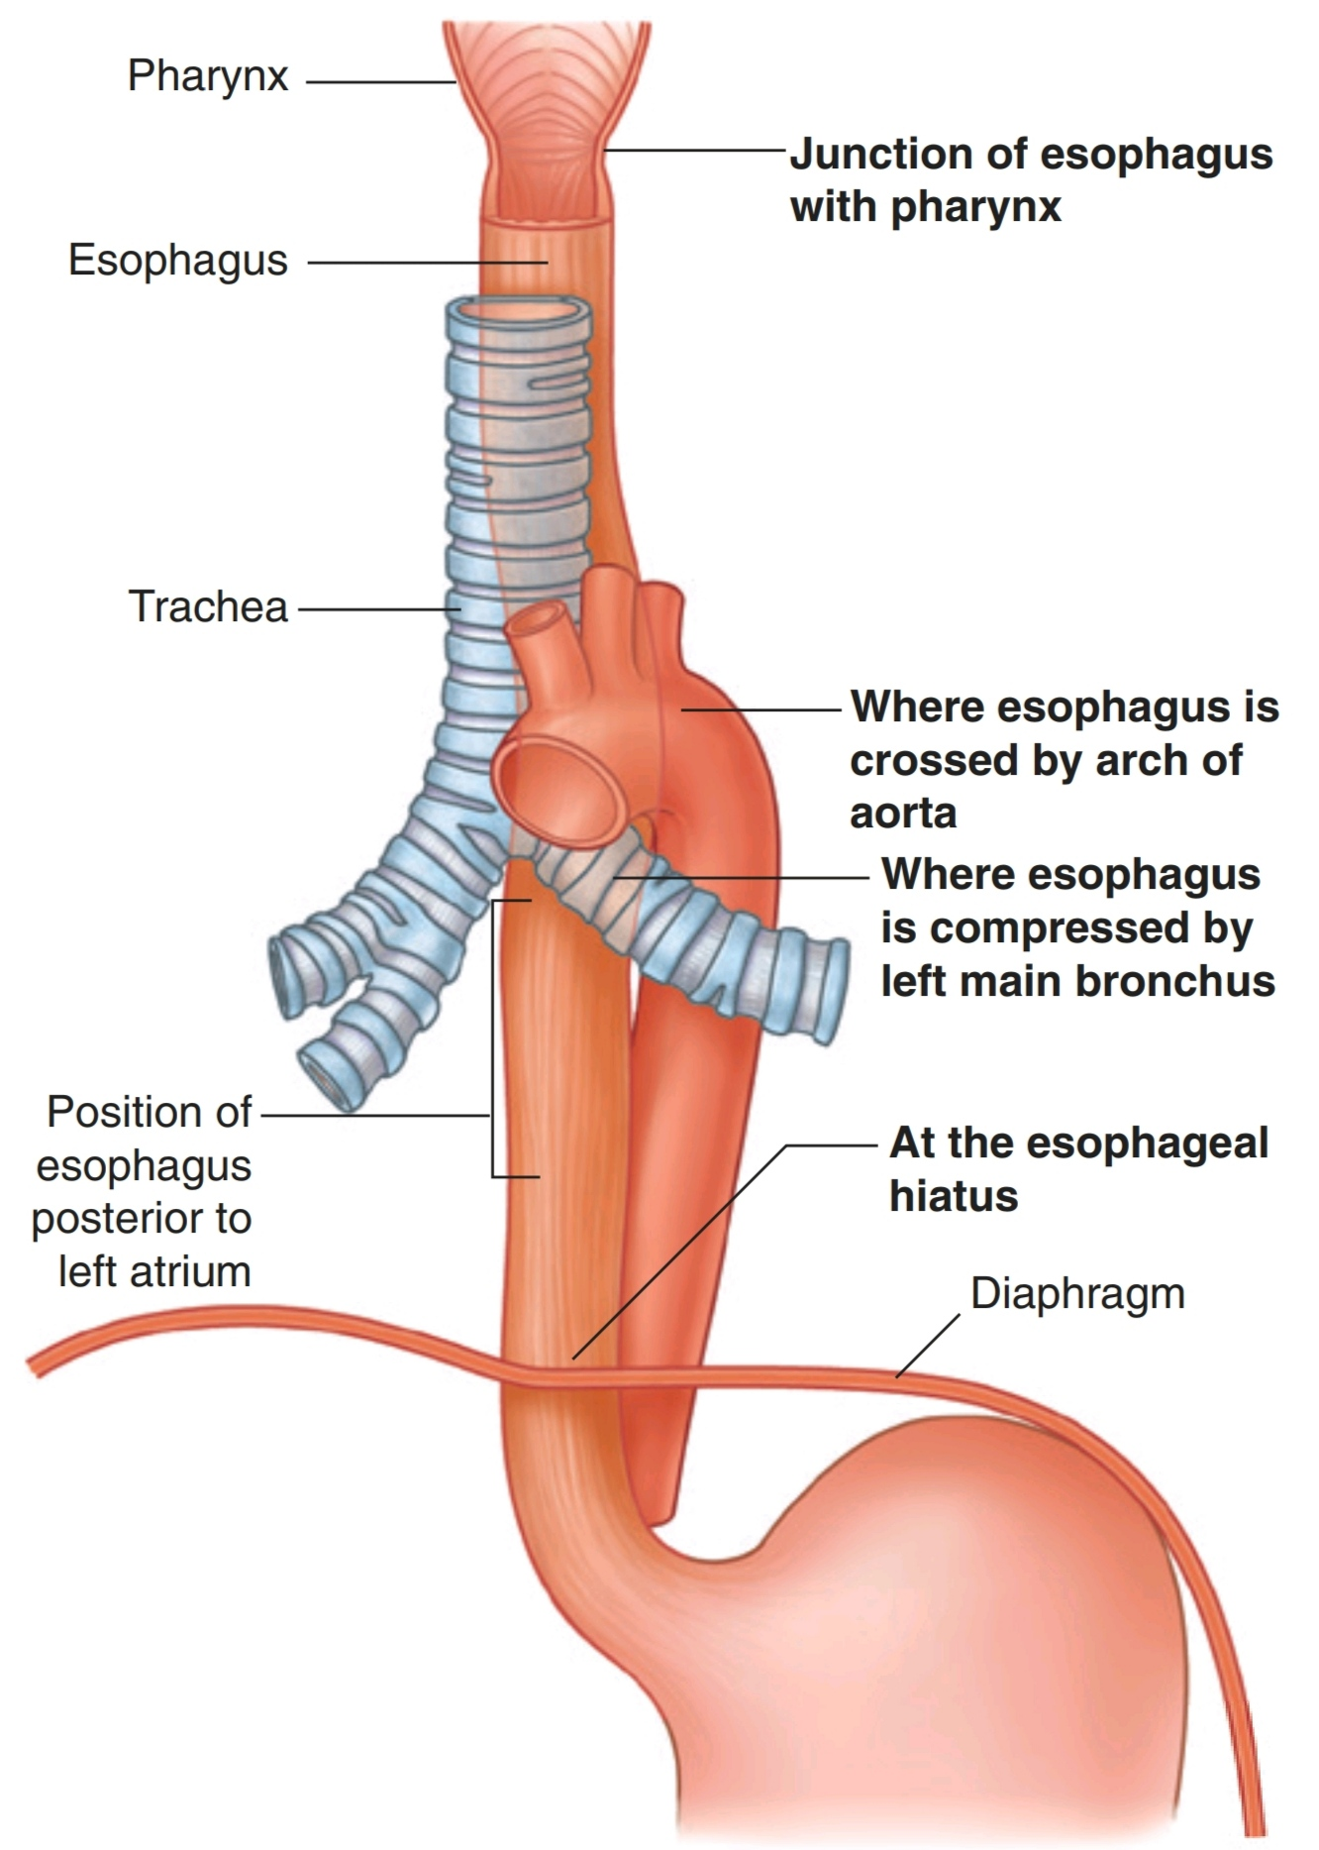
Esophageal Constrictions

Slide 15
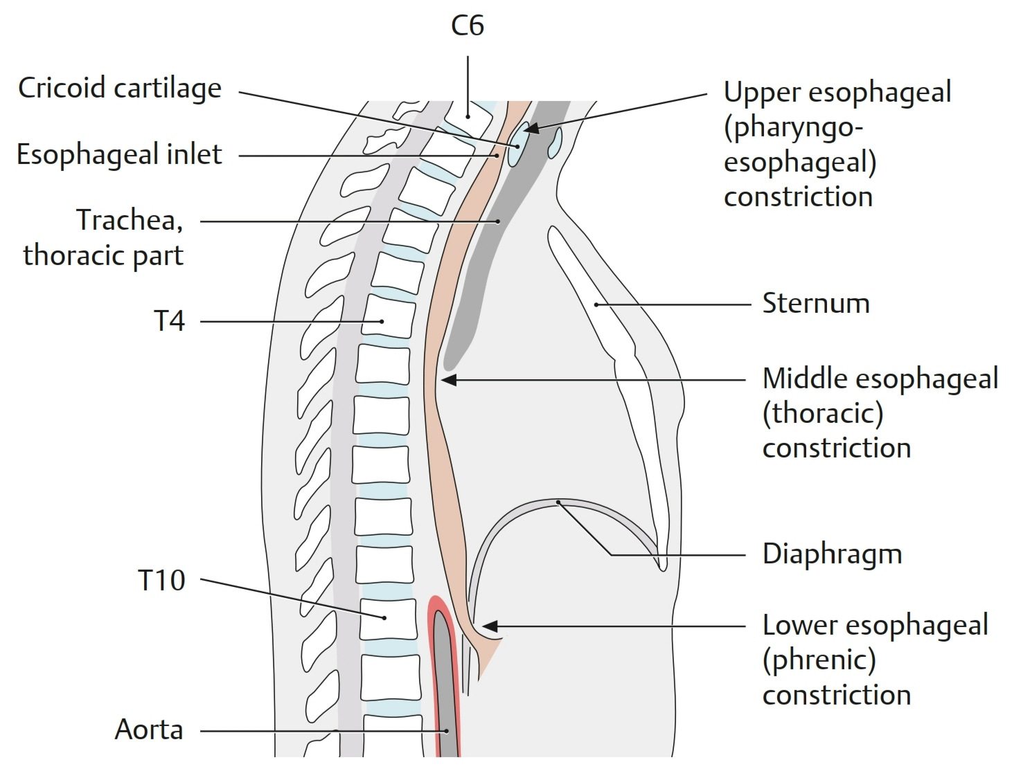
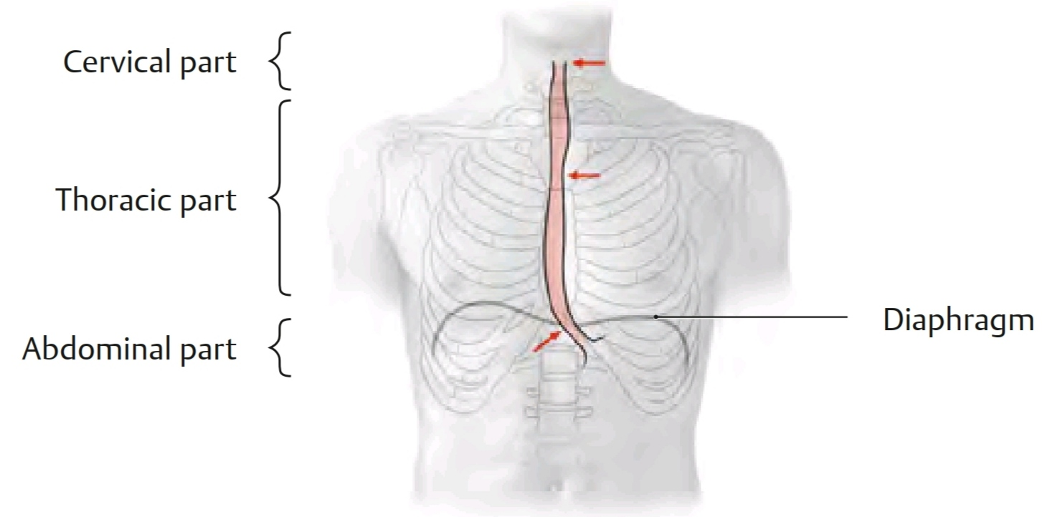
Esophageal Constrictions

Slide 16
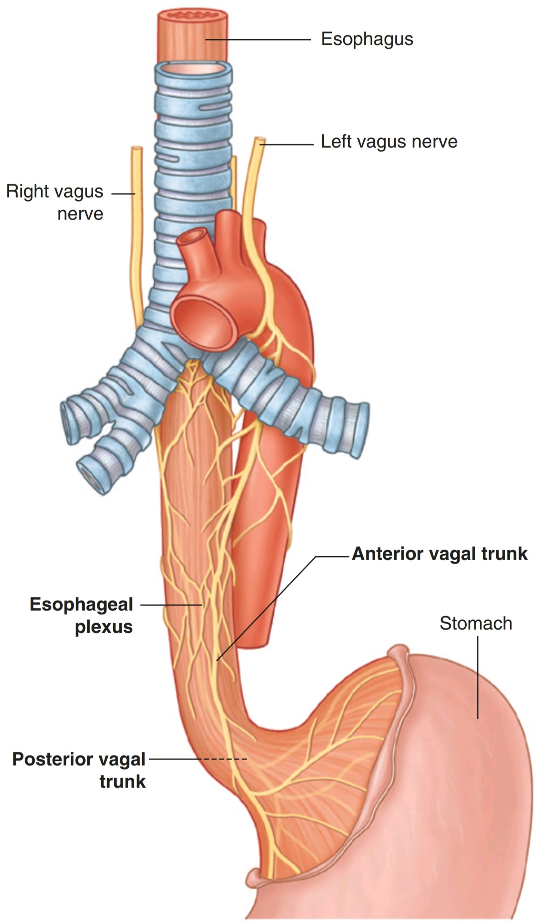
Innervation of the Esophagus
It is supplied by parasympathetic and sympathetic fibers via the vagi and sympathetic trunks respectively.
In the lower part of lts thoracic course, the esophagus ls surrounded by the esophageal nerve plexus.
The left vagus lies anterior to the esophagus, and the right vagus lies posterior.

Slide 17
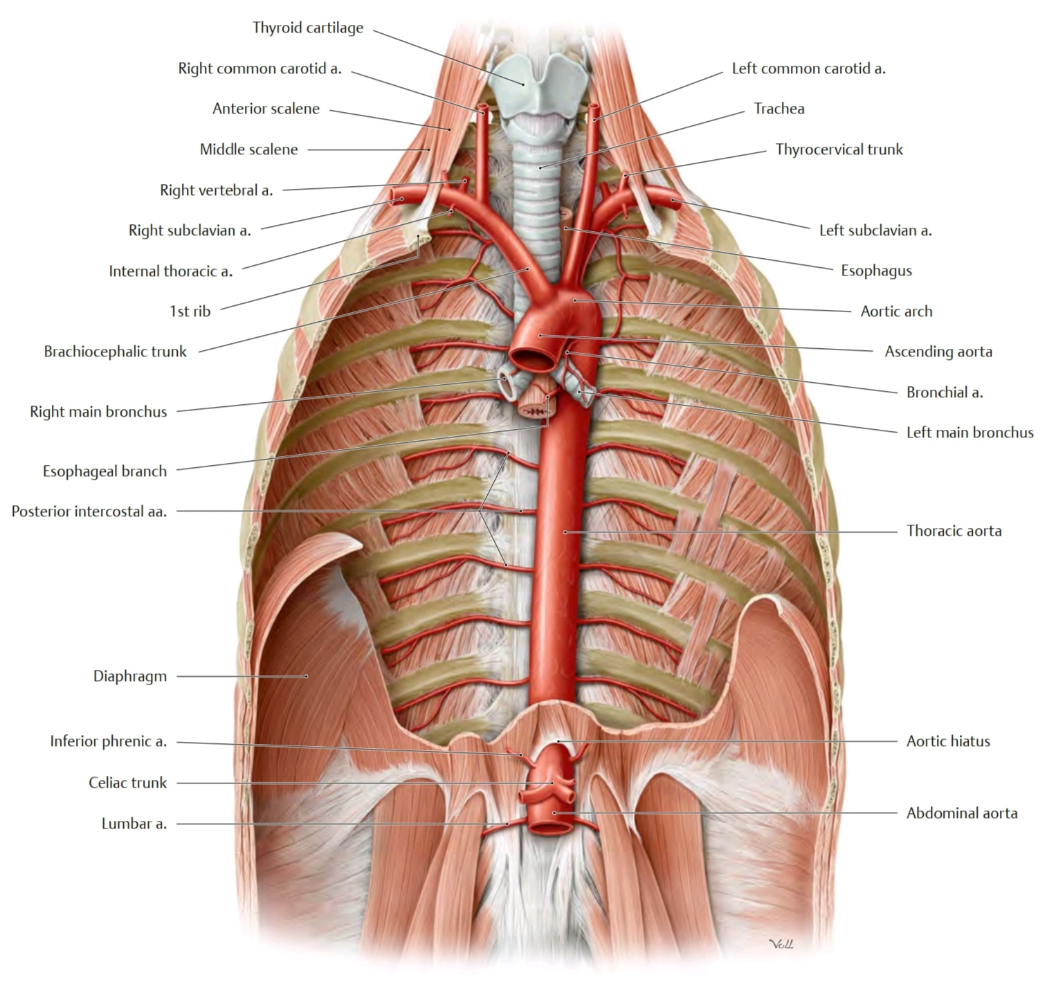
Thoracic Aorta
It is devided into:
ascending: in the middle mediastinum
arch: in the superior mediastinum
descending: in the posterior mediastinum

Slide 18
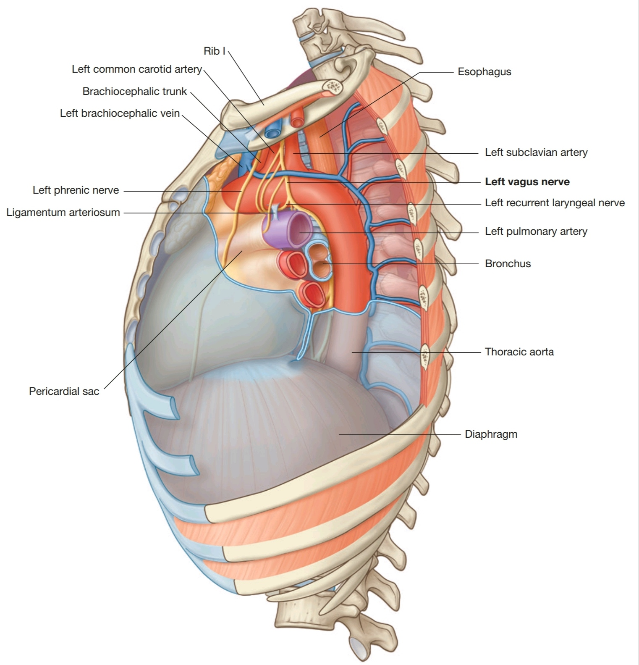
Descending Thoracic Aorta
It is the continuation of the arch of the aorta.
It begins on the left side of the inferior border of the body of the T4 vertebra and descends in the posterior mediastinum on the left sides of the T5-T12 vertebrae

Slide 19
Descending Thoracic Aorta
As it descends, the thoracic aorta approaches the median plane and displaces the esophagus to the right.
The thoracic aortic plexus, an autonomic nerve network, surrounds it.
The thoracic aorta lies posterior to the root of the left lung, pericardium, and esophagus.

Slide 20
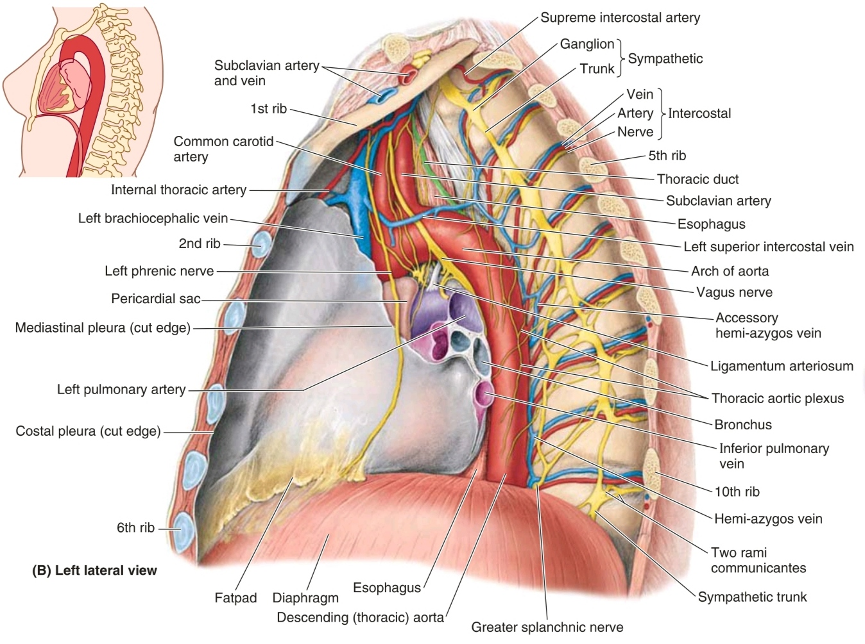

Slide 21
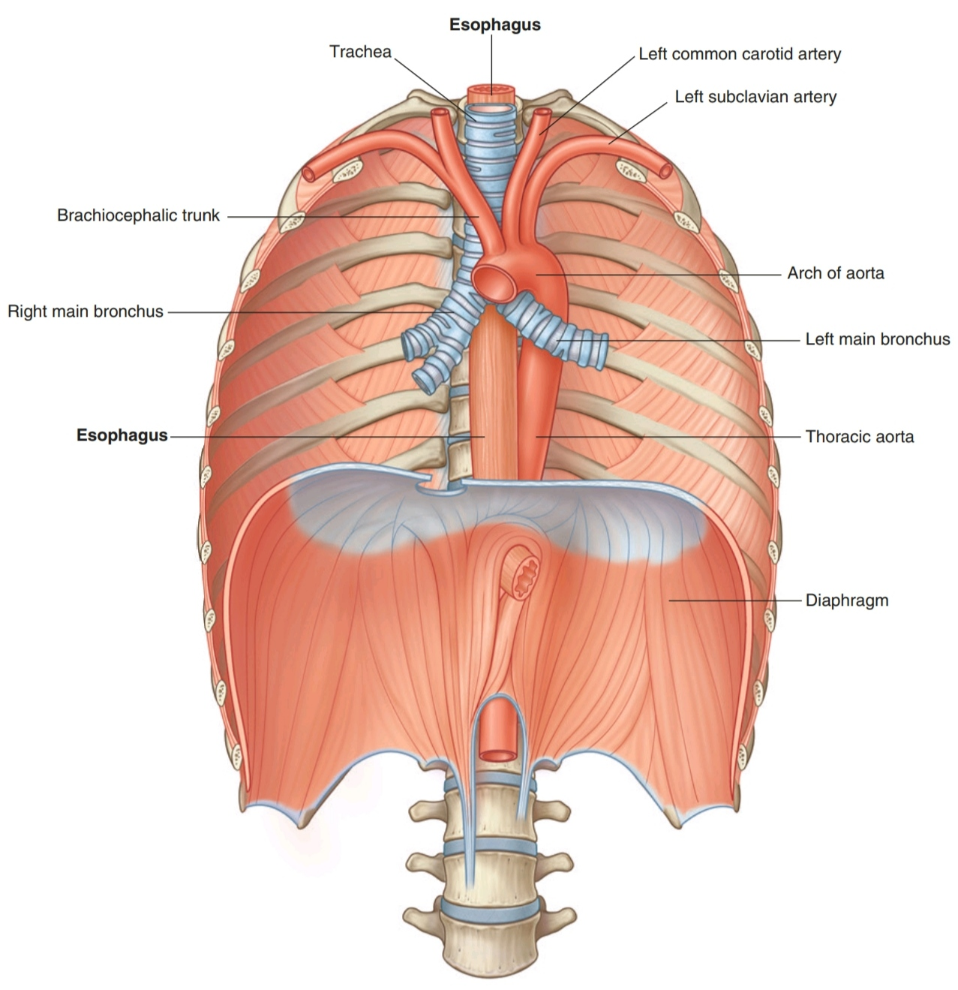
Descending Thoracic Aorta
It terminates (with a name change to abdominal aorta) anterior to the inferior border of the T12 vertebra and enters the abdomen through the aortic hiatus in the diaphragm.
The thoracic duct and azygos vein ascend on its right side and accompany it through this hiatus.

Slide 22
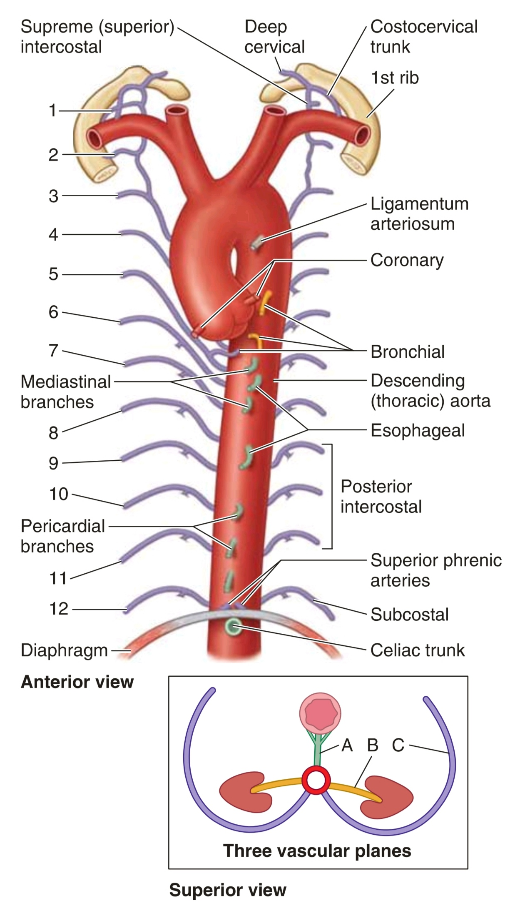
Descending Thoracic Aorta
The branches of the descending thoracic aorta arise and course within 3 "vascular planes" :
A. An anterior midline plane of unpaired visceral branches to the gut (embryonic digestive tube) and its derivatives .
B. Lateral planes of paired visceral branches serving viscera other than the gut and its derivatives.
C. Posterolateral planes of paired (segmental) parietal branches to the bodywall.

Slide 23
Descending Thoracic Aorta
A. An anterior midline plane of unpaired visceral branches:
the esophageal arteries-usually 2, but there may be as many as 5.

Slide 24
Descending Thoracic Aorta
B. Lateral planes of paired visceral branches serving viscera other than the gut and its derivatives: the bronchial arteries.
the right bronchial arteries arise indirectly as branches of a right posterior intercostal artery (usually the 3rd).

Slide 25
Descending Thoracic Aorta
C. Posterolateral planes of paired (segmental) parietal branches to the bodywall: nine posterior intercostal arteries that supply all but the upper two intercostal spaces and the subcostal arteries.
The latter vessels arise from the thoracic aorta but course below the diaphragm.

Slide 26
Descending Thoracic Aorta
Exceptions to thi spattern include the following:
• Superior phrenic arteries, paired parietal branches that pass anterolaterally to the superior surface of the diaphragm (which is actually facing posteriorly at this level owing to the convexity of the diaphragm), where they anastomose with the musculophrenic and pericardiacophrenic branches of the internal thoracic artery.
• Pericardial branches, unpaired branches that arise anteriorly but, instead of passing to the gut, send twigs to the pericardium. The same is true for the small mediastinal arteries that supply the lymph nodes and other tissues of the posterior mediastinum.

Slide 27
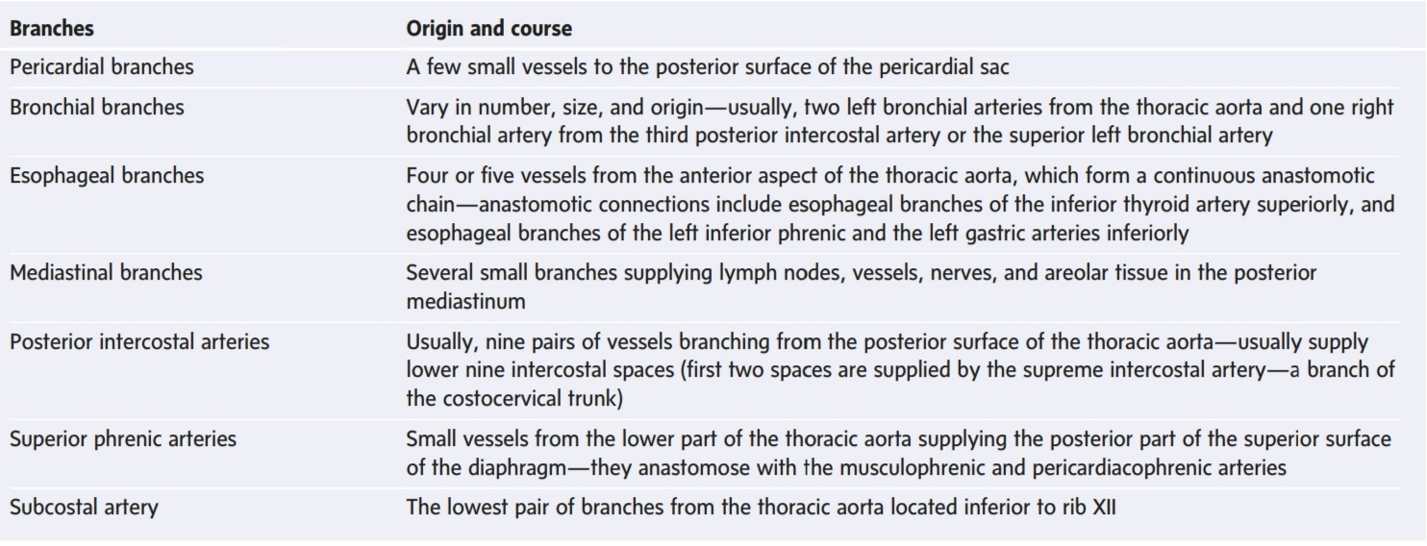
Branches of the Descending Thoracic Aorta

Slide 28
Azygos system of veins
it consists of a series of longitudinal vessels on each side of the body that drain blood from the body wall and move it superiorly to empty into the SVC.
Blood from some of the thoracic viscera may also enter the system, and there are anastomotic connections with abdominal veins.
The azygos system of veins serves as an important anastomotic pathway capable of returning venous blood from the lower part of the body to the heart if the IVC is blocked.

Slide 29
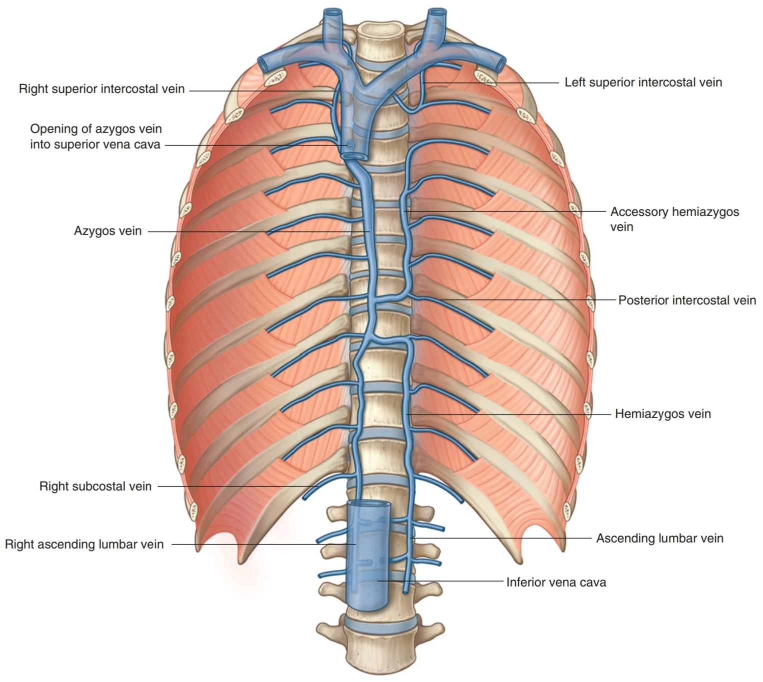
Azygos system of veins

Slide 30
Azygos system of veins
The major veins in the system are:
■ the azygos vein, on the right
■ the hemiazygos vein and the accessory hemiazygos vein, on the left

Slide 31
The Azygos Vein
(azygos= unpaired)
forms a collateral pathway between the SVC and IVC and drains blood from the posterior walls of the thorax and abdomen.
The union of t he right ascending lumbar vein and the right subcostal vein in the abdomen often forms it.
It ascends in the posterior mediastinum, passing close to the right sides of the bodies of the inferior 8 thoracic vertebrae.
It arches over the superior aspect of the root of the right lung to join the SVC, similar to the way the arch of the aorta passes over the root of the left lung.

Slide 32
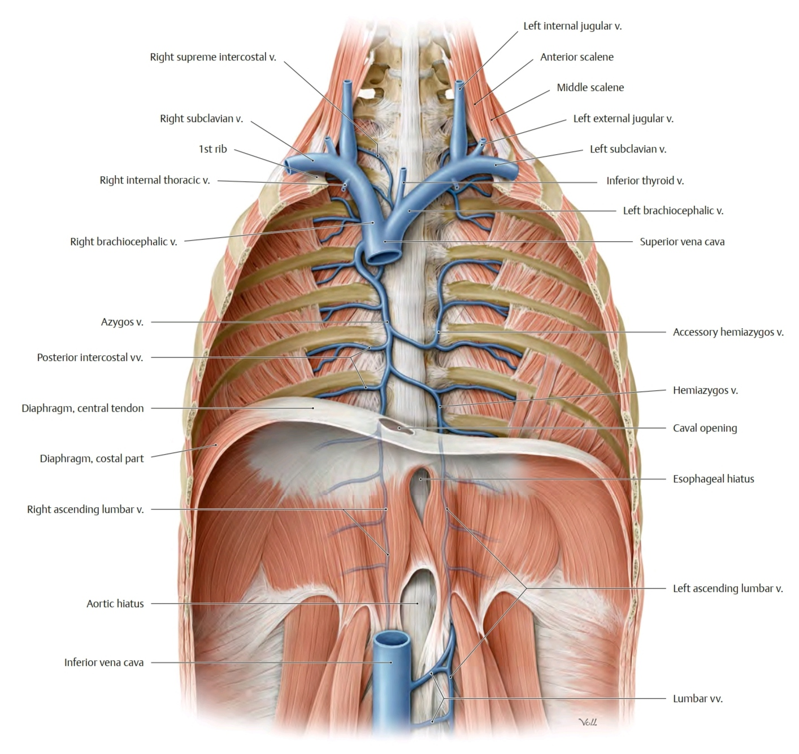

Slide 33
Hemiazygos Vein
it usually enters the thorax through the left crus of the diaphragm, but may enter through the aortic hiatus.
It ascends through the posterior mediastinum, on the left side, to approximately vertebral level T12.
At this point, it crosses the vertebral column, posterior to the thoracic aorta, esophagus, and thoracic duct, to enter the azygos vein.

Slide 34
The Azygos Vein
it enters the thorax through the aortic hiatus of the diaphragm, or it enters through or posterior to the right crus of the diaphragm.
It ascends through the posterior mediastinum, usually to the right of the thoracic duct.
At approximately vertebral level T4, it arches anteriorly, over the root of the right lung, to join the SVC before it enters the pericardial sac.

Slide 35
Hemiazygos Vein
The hemiazygos vein (inferior hemiazygos vein) usually arises at the junction between the left ascending lumbar vein and the left subcostal vein.

Slide 36
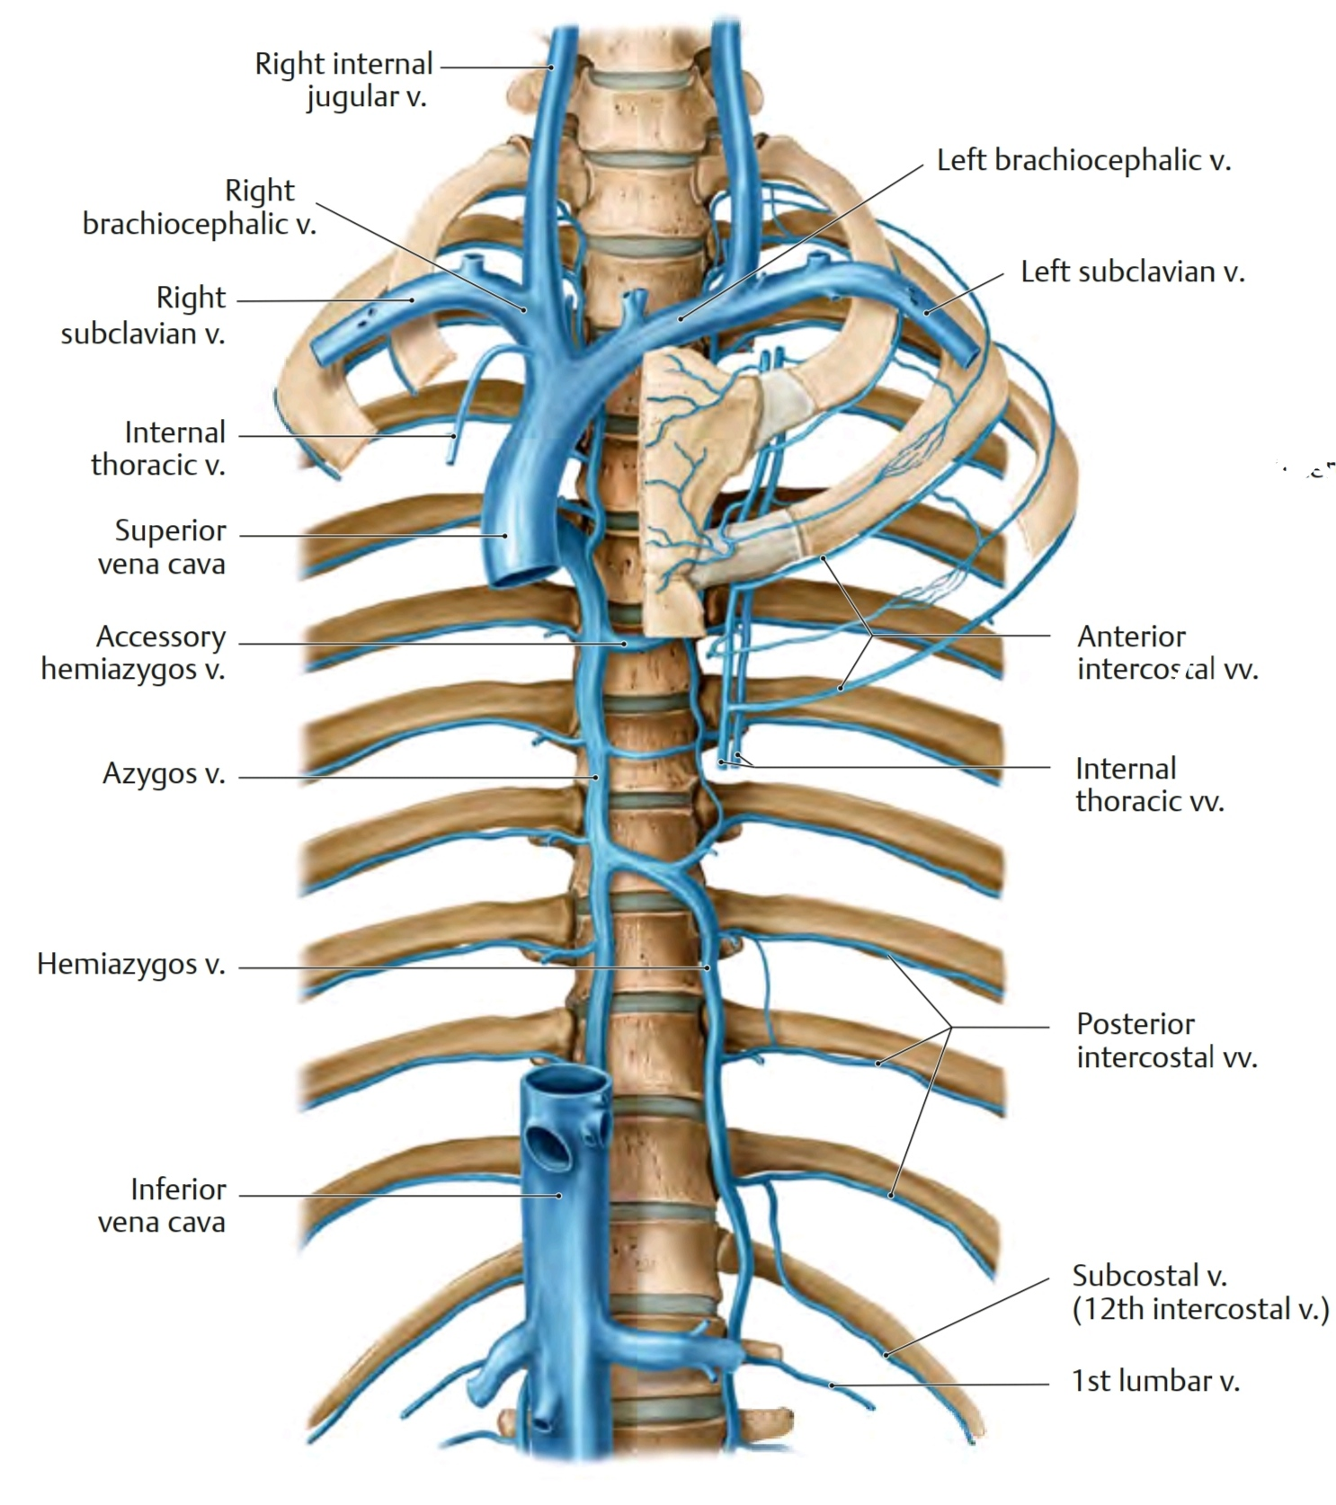

Slide 37
Hemiazygos Vein
Tributaries joining the hemiazygos vein include:
■ the lowest 4 or 5 left posterior intercostal veins
■ esophageal veins
■ mediastinal vein

Slide 38
Accessory Hemiazygos Vein
it descends on the left side from the superior portion o the posterior mediastinum to approximately vertebral level T8.
at this point, it crosses the vertebral column to join the azygos vein, or ends in the hemiazygos vein, or has a connection to both veins.
usually, it also has a connection superiorly to the left superior intercostal vein.

Slide 40
Accessory Hemiazygos Vein
Vessels that drain into the accessory hemiazygos vein include:
■ the 4th to 8th left posterior intercostal veins
■ sometimes, the left bronchial veins

Slide 41
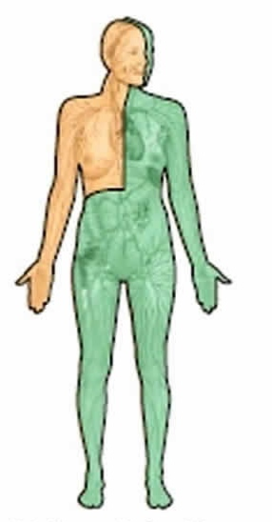
Thoracic Duct
The thoracic duct is the largest lymphatic channel in the body, is commonly 35–45 cm in length.
In the posterior mediastinum, it lies on the anterior aspect of the bodies of the inferior 7 thoracic vertebrae.
The thoracic duct conveys most lymph of the body to the venous system: that from the lower limbs, pelvic cavity, abdominal cavity, left upper limb, and left side of the thorax, head, and neck-that is, all lymph except that from the right superior quadrant.

Slide 42
Thoracic Duct
it is the principal channel through which lymph from most of the body is returned to the venous system.
it begins as a confluence of lymph trunks in the abdomen, sometimes forming a saccular dilation referred to as the cisterna chyli (chyle cistern) which drains the abdominal viscera and walls, pelvis, perineum, and lower limbs.
it extends from vertebra L2 to the root of the neck

Slide 43
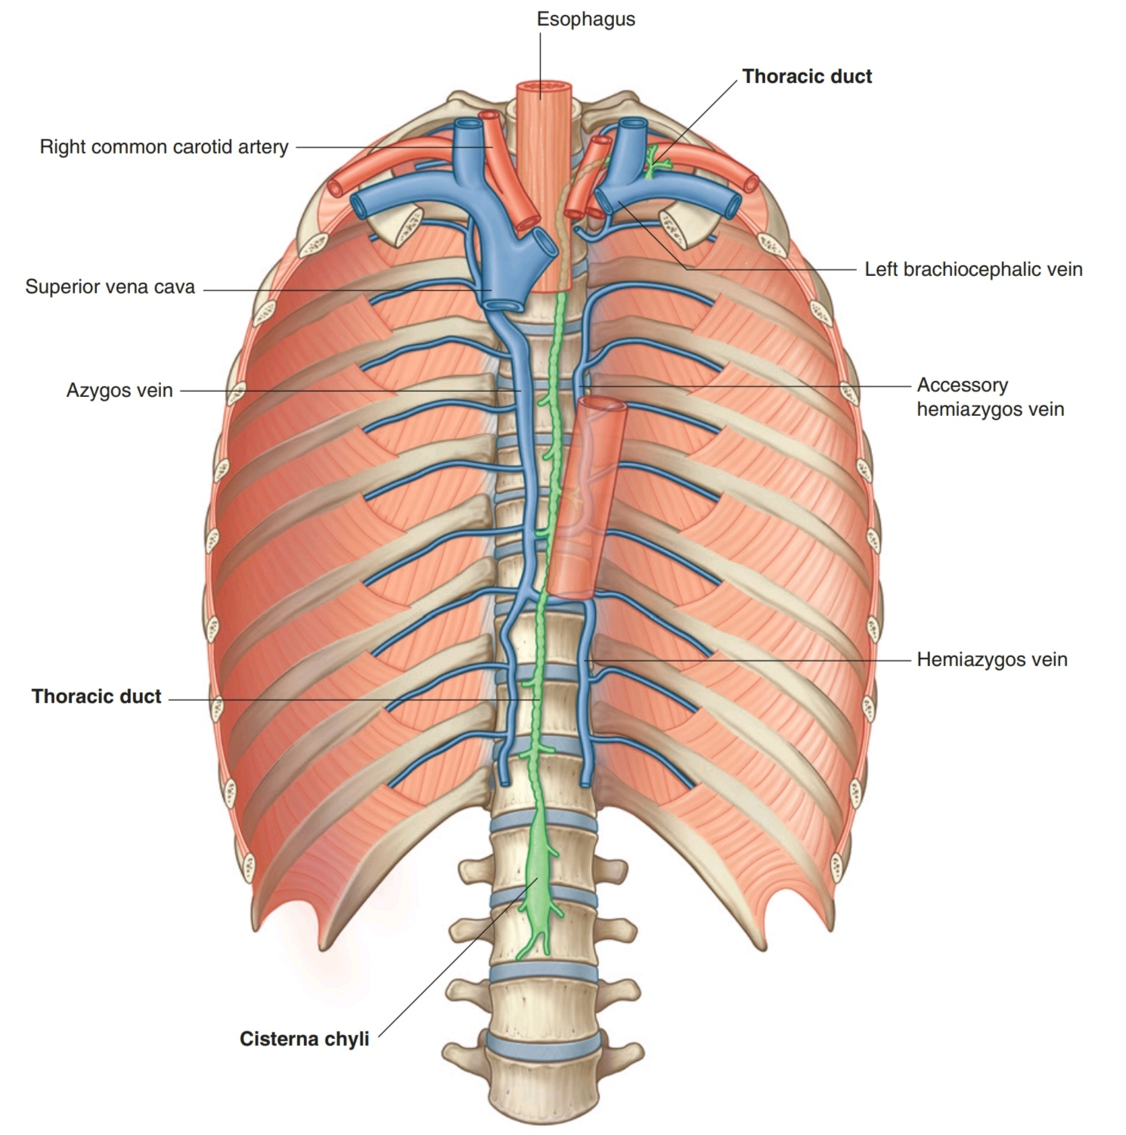

Slide 44
Thoracic Duct
The duct is usually thin walled and dullwhite. Often, it is beaded because of its numerous valves. It ascends in the posterior mediastinum among:
the thoracic aorta on its left
the azygos vein on its right
the esophagus anteriorly
the vertebral bodies posteriorly

Slide 45
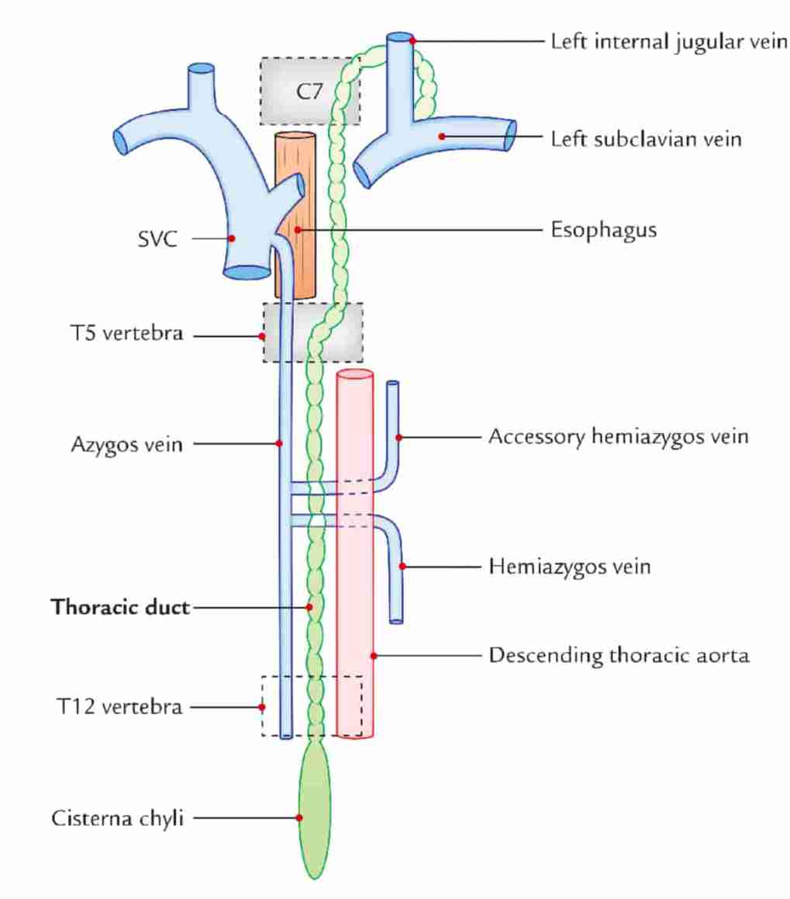

Slide 46
Thoracic Duct
At the level of the transverse thoracic plane, the thoracic duct crosses to the left, posterior to the esophagus, and ascends into the superior mediastinum.
it receives branches from posterior mediastinal structures. Near its termination, it often receives the jugular, subclavian, and bronchomediastinal lymphatic trunks.
it usually empties into the venous system near the union of the left internal jugular and subclavian veins (the left venous angle or origin of the left brachiocephalic vein) but it may open into the left subclavian vein.

Slide 47
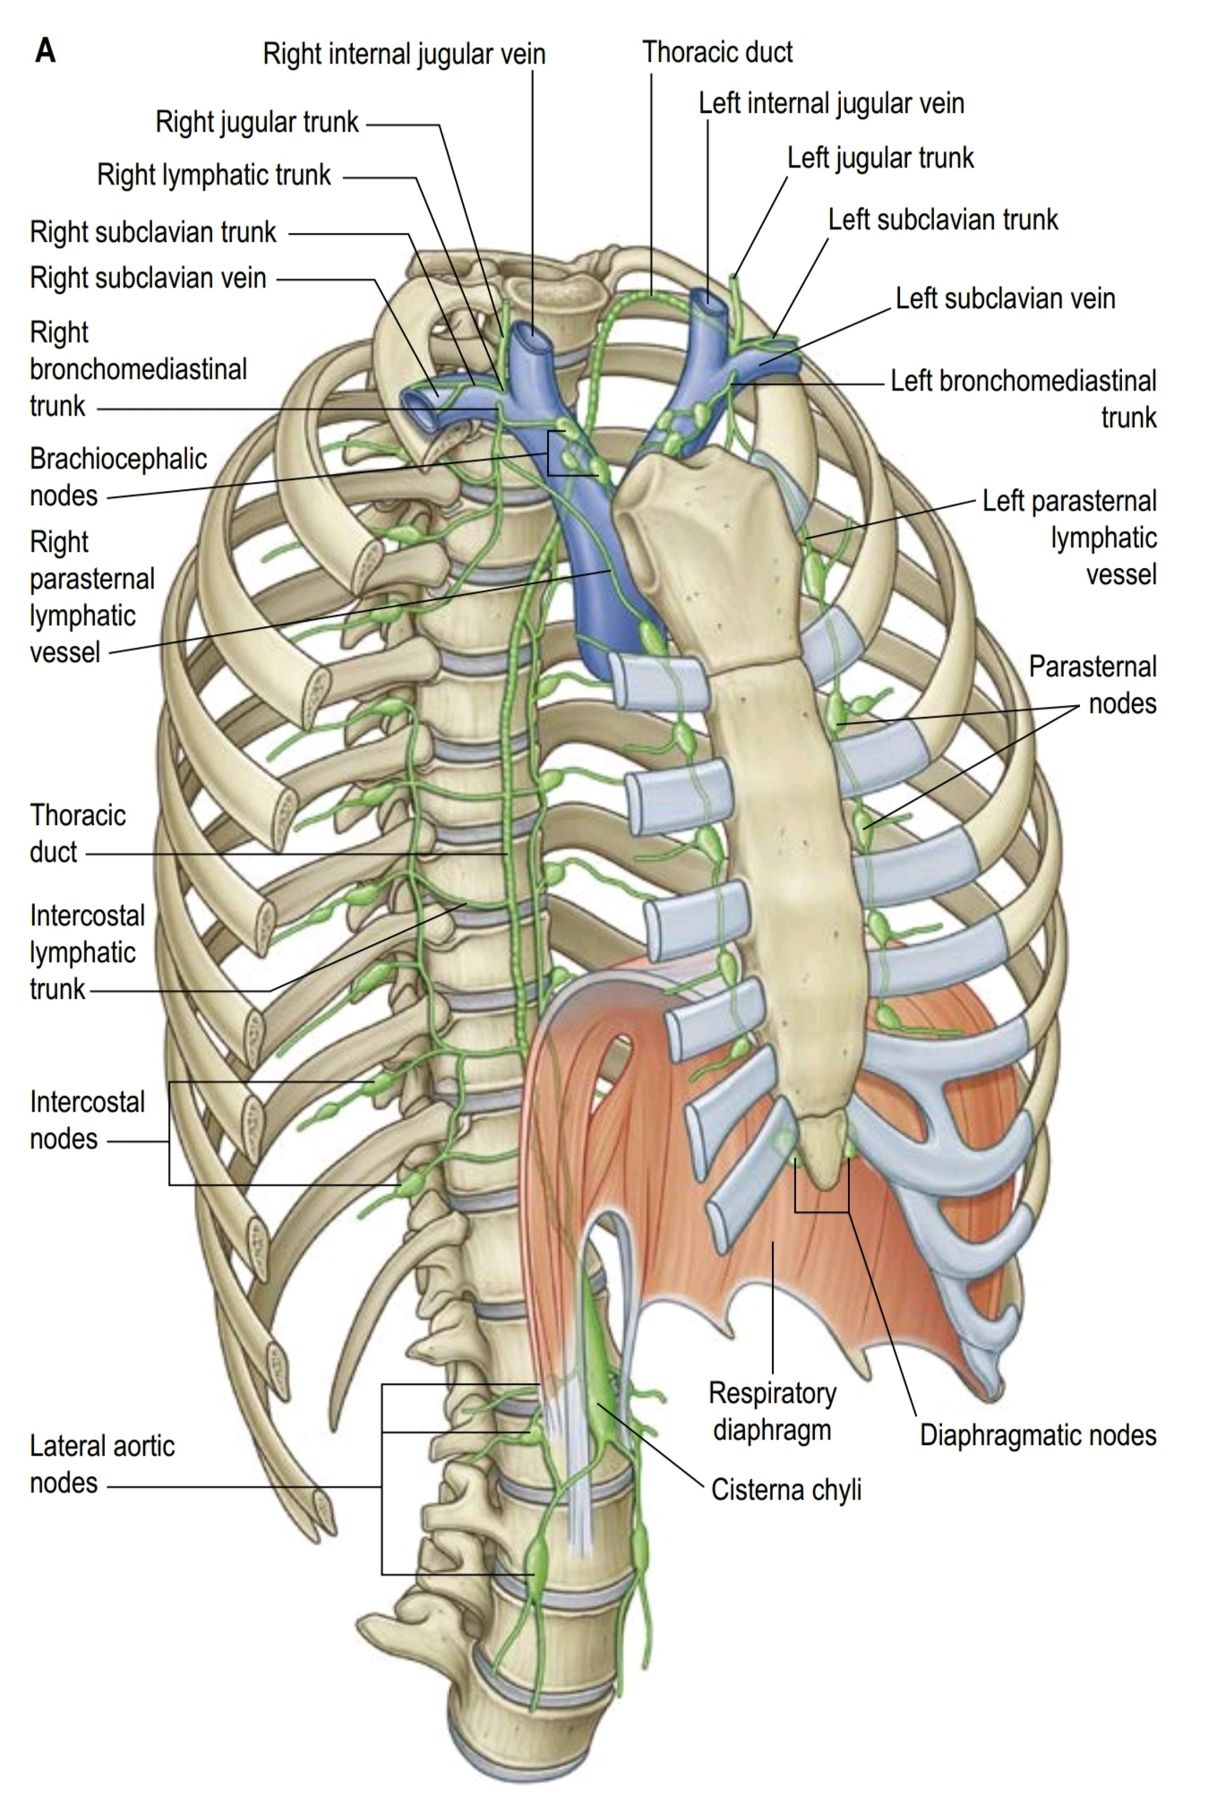

Slide 48
Right Lymphatic Trunk
it has a variable anatomy.
it has 3 main tributaries: the right jugular, subclavian and bronchomediastinal trunks
they often empty separately into either the right internal jugular and/or subclavian veins.
In up to 20% of individuals, they may aggregate to form the right lymphatic trunk that is usually 5–10 mm in length.
it usually empties into the venous system near the union of the right internal jugular and subclavian veins (the right venous angle)

Slide 49
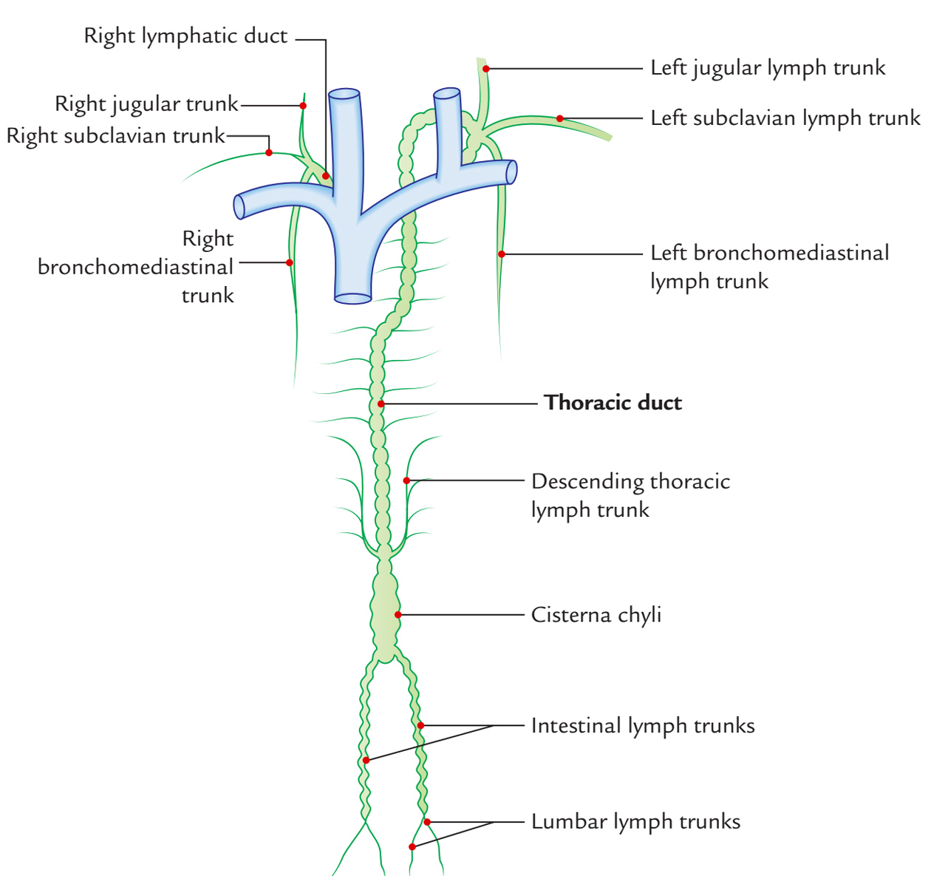

Slide 50
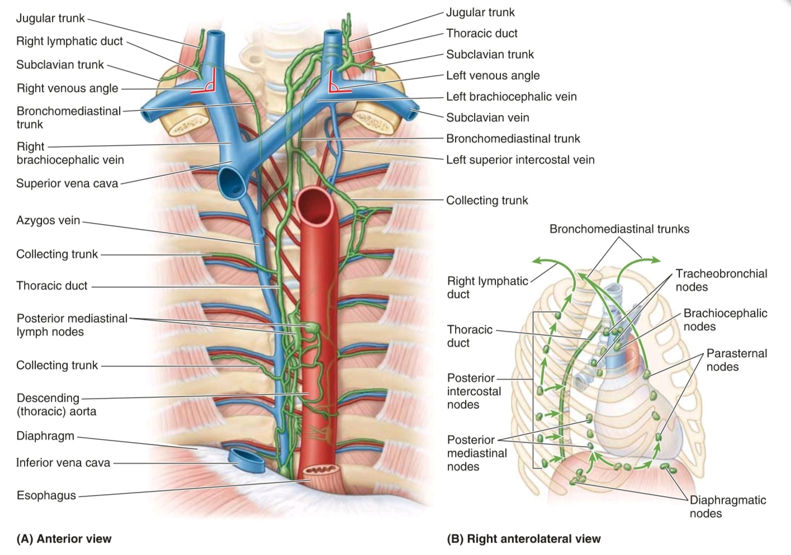

Slide 51
Thoracic Sympathetic Trunks
two parallel cords punctuated by 11 or 12 ganglia.
The ganglia are connected to adjacent thoracic spinal nerves by white and gray rami communicantes.
In the superior portion of the posterior mediastinum the trunks are anterior to the neck of the ribs.
Inferiorly, they become more medial in position until they lie on the lateral aspect of the vertebral bodies

Slide 52
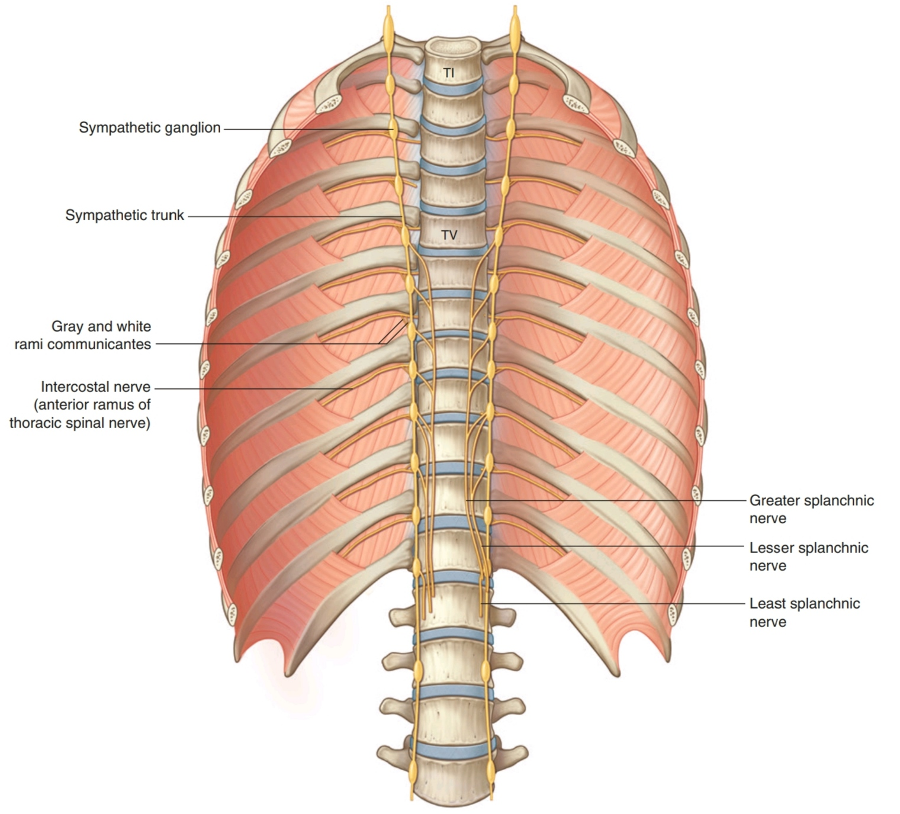

Slide 53
Branches from the ganglia
Two types of medial branches are given off by the ganglia:
■ The first type includes branches from the upper 5 ganglia: supply the various thoracic viscera. These branches are relatively small, and also contain visceral afferent fibers.
■ The second type includes branches from the lower 7 ganglia: supply the various abdominal and pelvic viscera. These branches are large, also carry visceral afferent fibers, and form the 3 thoracic splanchnic nerves.

Slide 54
Thoracic Splancnic Nerves
■ The greater splanchnic nerve on each side usually arises from the 5th to 9th or 10th thoracic ganglia. It descends across the vertebral bodies moving in a medial direction, passes into the abdomen through the crus of the diaphragm, and ends in the celiac ganglion.
■ The lesser splanchnic nerve usually arises from the 9th + 10h (or 10th + 11th) thoracic ganglia. It descends across the vertebral bodies moving in a medial direction, and passes into the abdomen through the crus of the diaphragm to end in the aorticorenal ganglion.
■ The least splanchnic nerve (lowest splanchnic nerve) usually arises from the 12th thoracic ganglion. It descends and passes into the abdomen through the crus of the diaphragm to end in the renal plexus.

Slide 56
Mediastinum: all together

Slide 57
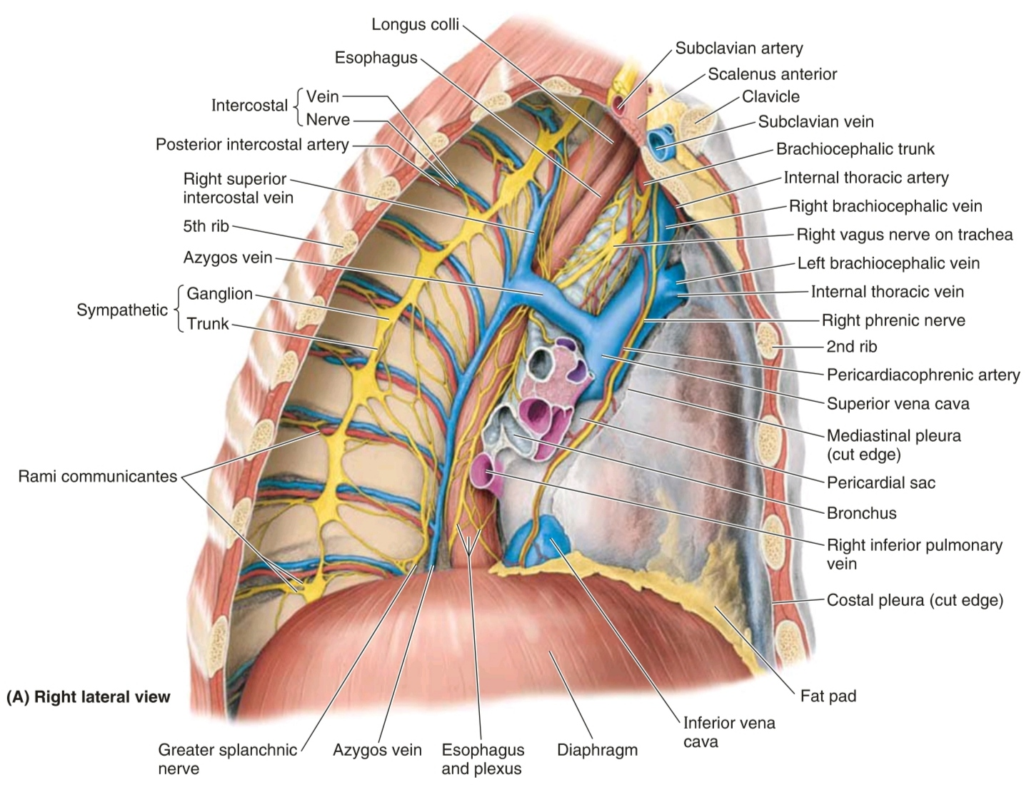

Slide 59
Vascular Anatomy

Slide 60
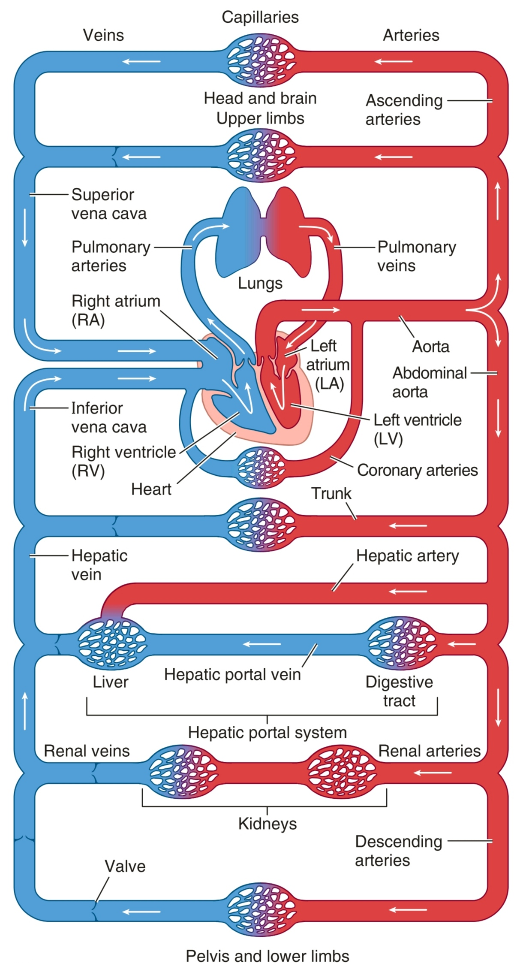
Major Blood Vessels

Slide 61
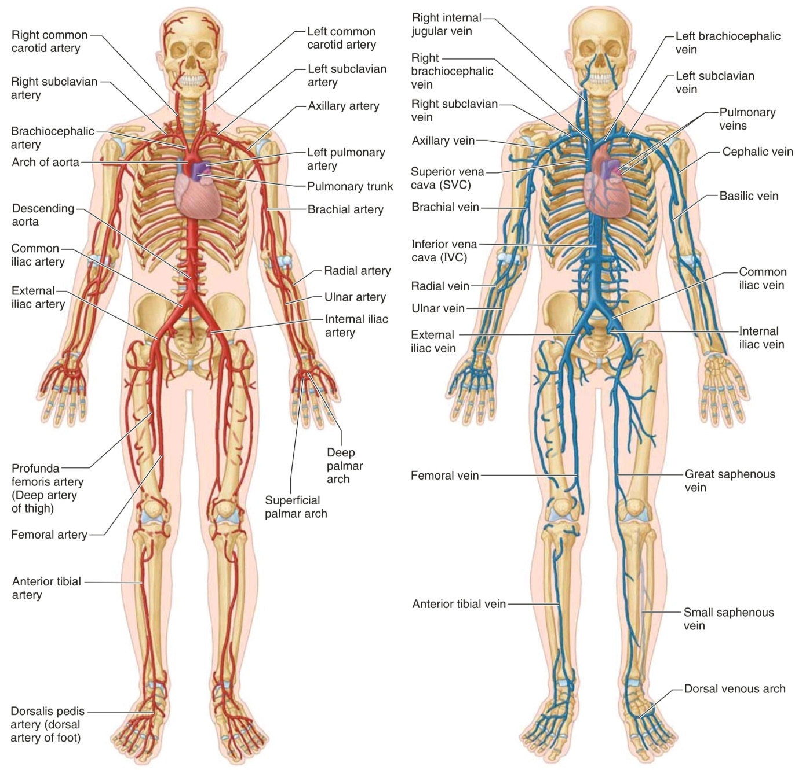

Slide 62
Great Vessels of the Chest

Slide 63
Great Vessels of the Chest
Arteries and their branches:
pulmonary trunk
thoracic aorta
Veins and their tributaries:
SVC
IVC

Slide 64
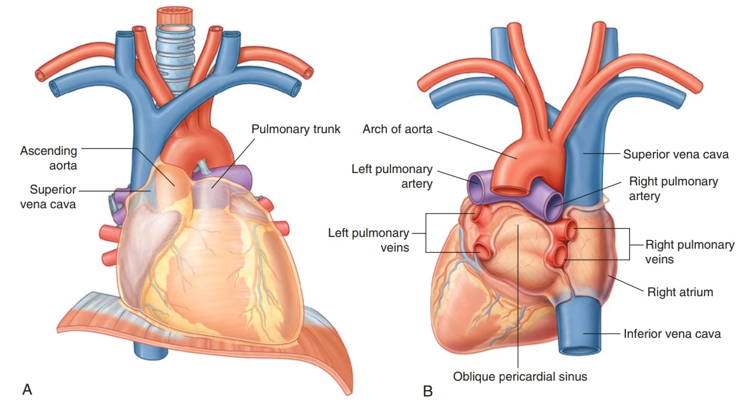
Great Vessels of the Chest

Slide 65
Pulmonary Trunk
it conveys deoxygenated blood from the RV to the lungs.
about 5 cm in length and 3 cm in diameter.
it is the most anterior of the cardiac vessels.
it arises from the pulmonary anulus surrounding the subpulmonary conus arteriosus (infundibulum) at the base of the RV superior and to the left of the supraventricular crest.

Slide 66
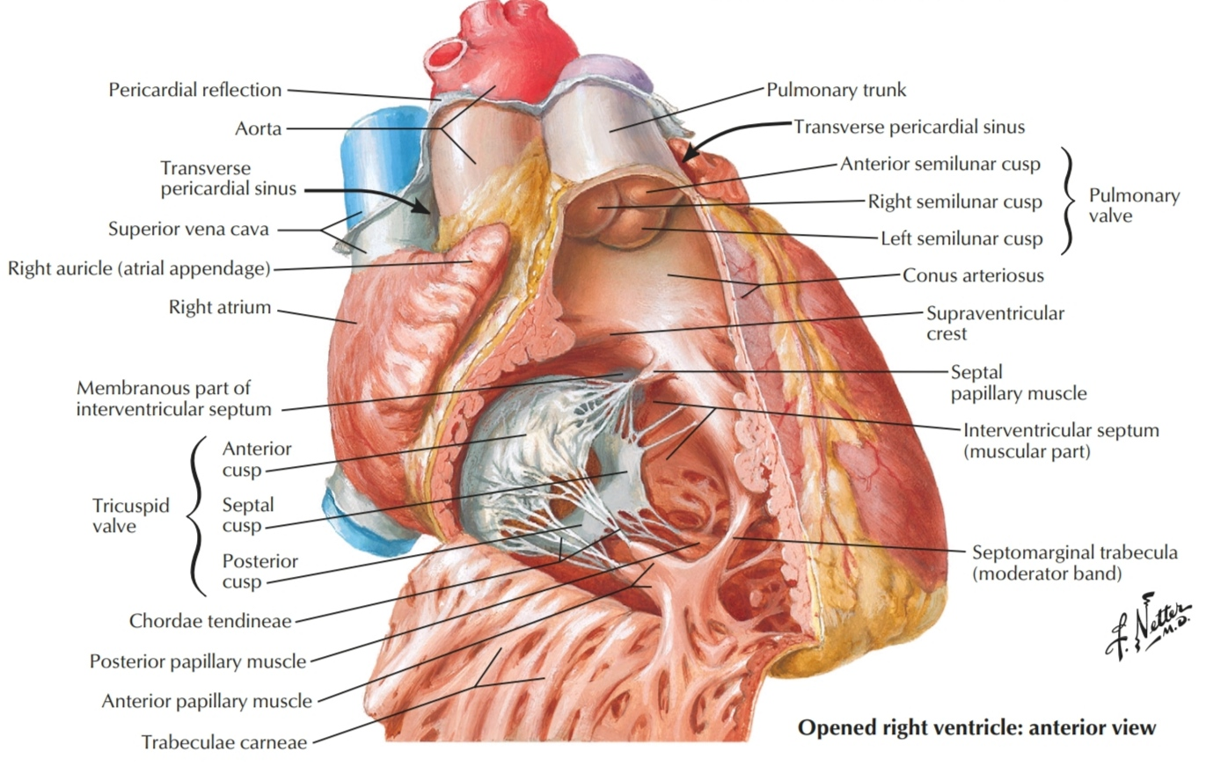
Pulmonary Trunk

Slide 67
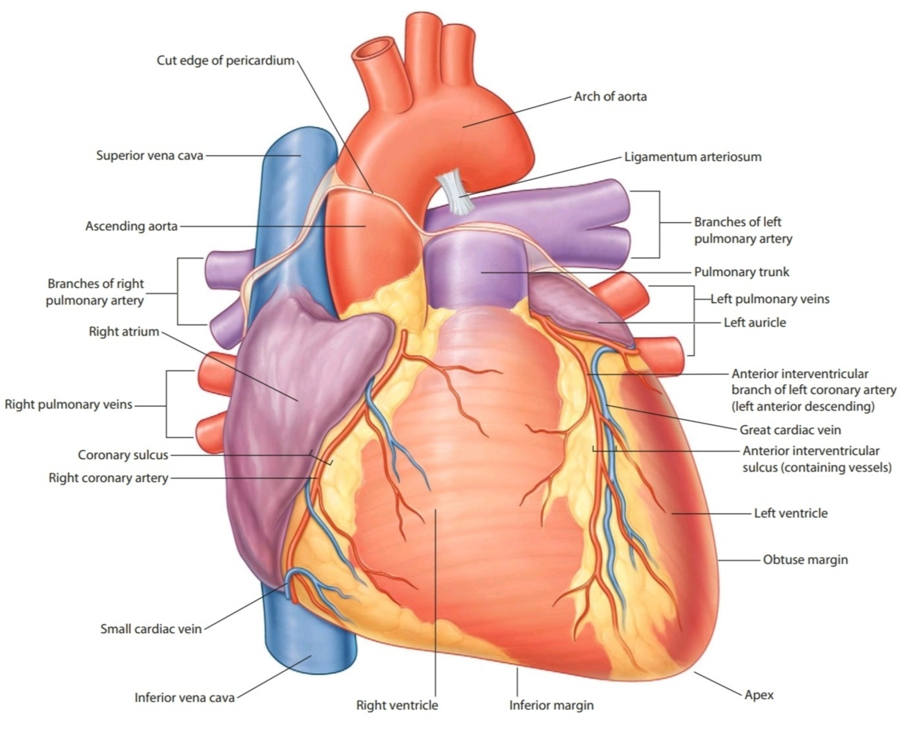
Pulmonary Trunk
It lies in the middle mediastinum, together with the ascending aorta, enclosed in the fibrous pericardium and a sheath of serous pericardium.

Slide 68
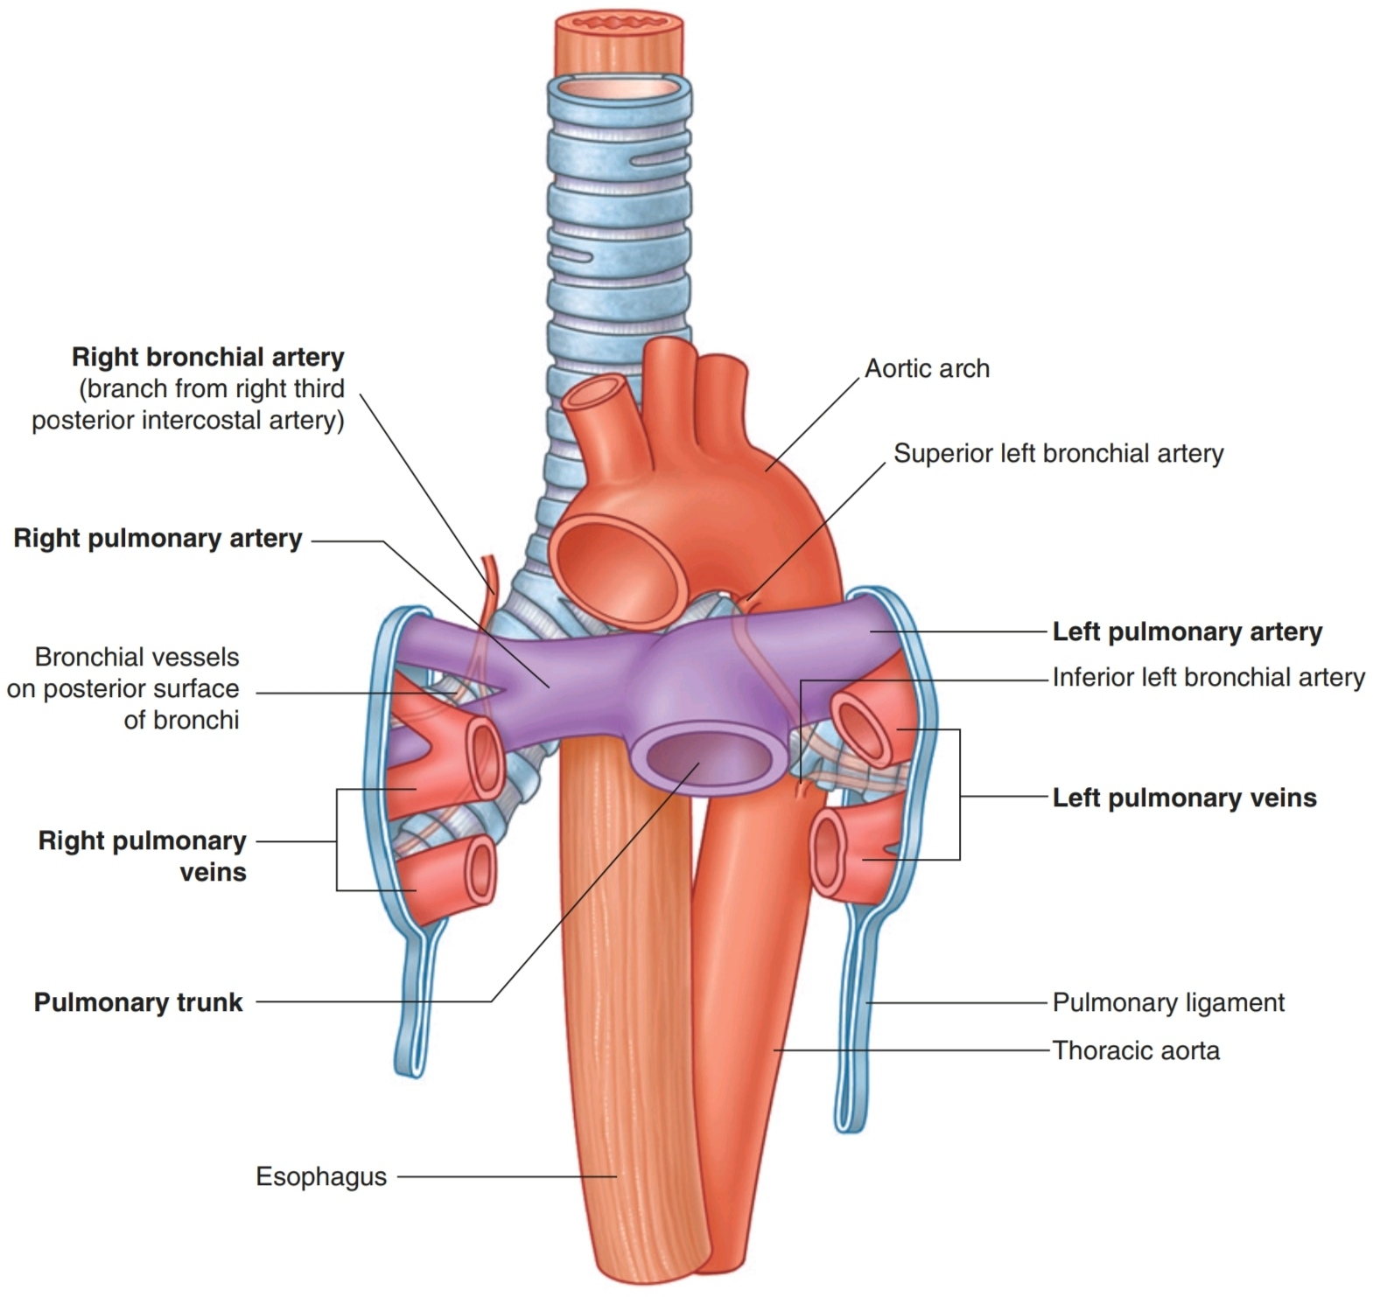
Pulmonary Trunk
it inclines posterosuperiorly and divides into right and left pulmonary arteries, of almost equal size, at the level of:
the body of the 6th thoracic vertebra
2–3 cm inferior to the transverse thoracic plane
inferior to the aortic arch
to the left of the midline.

Slide 69
Pulmonary Arteries
The bifurcation of the pulmonary trunk commonly lies anteroinferior and to the left of the tracheal bifurcation.
it bifurcates into right and left pulmonary arteries.
each pulmonary artery enters the hilum of the lung and is devided into branches for the lobes and segments of the corrisponding lung.

Slide 70
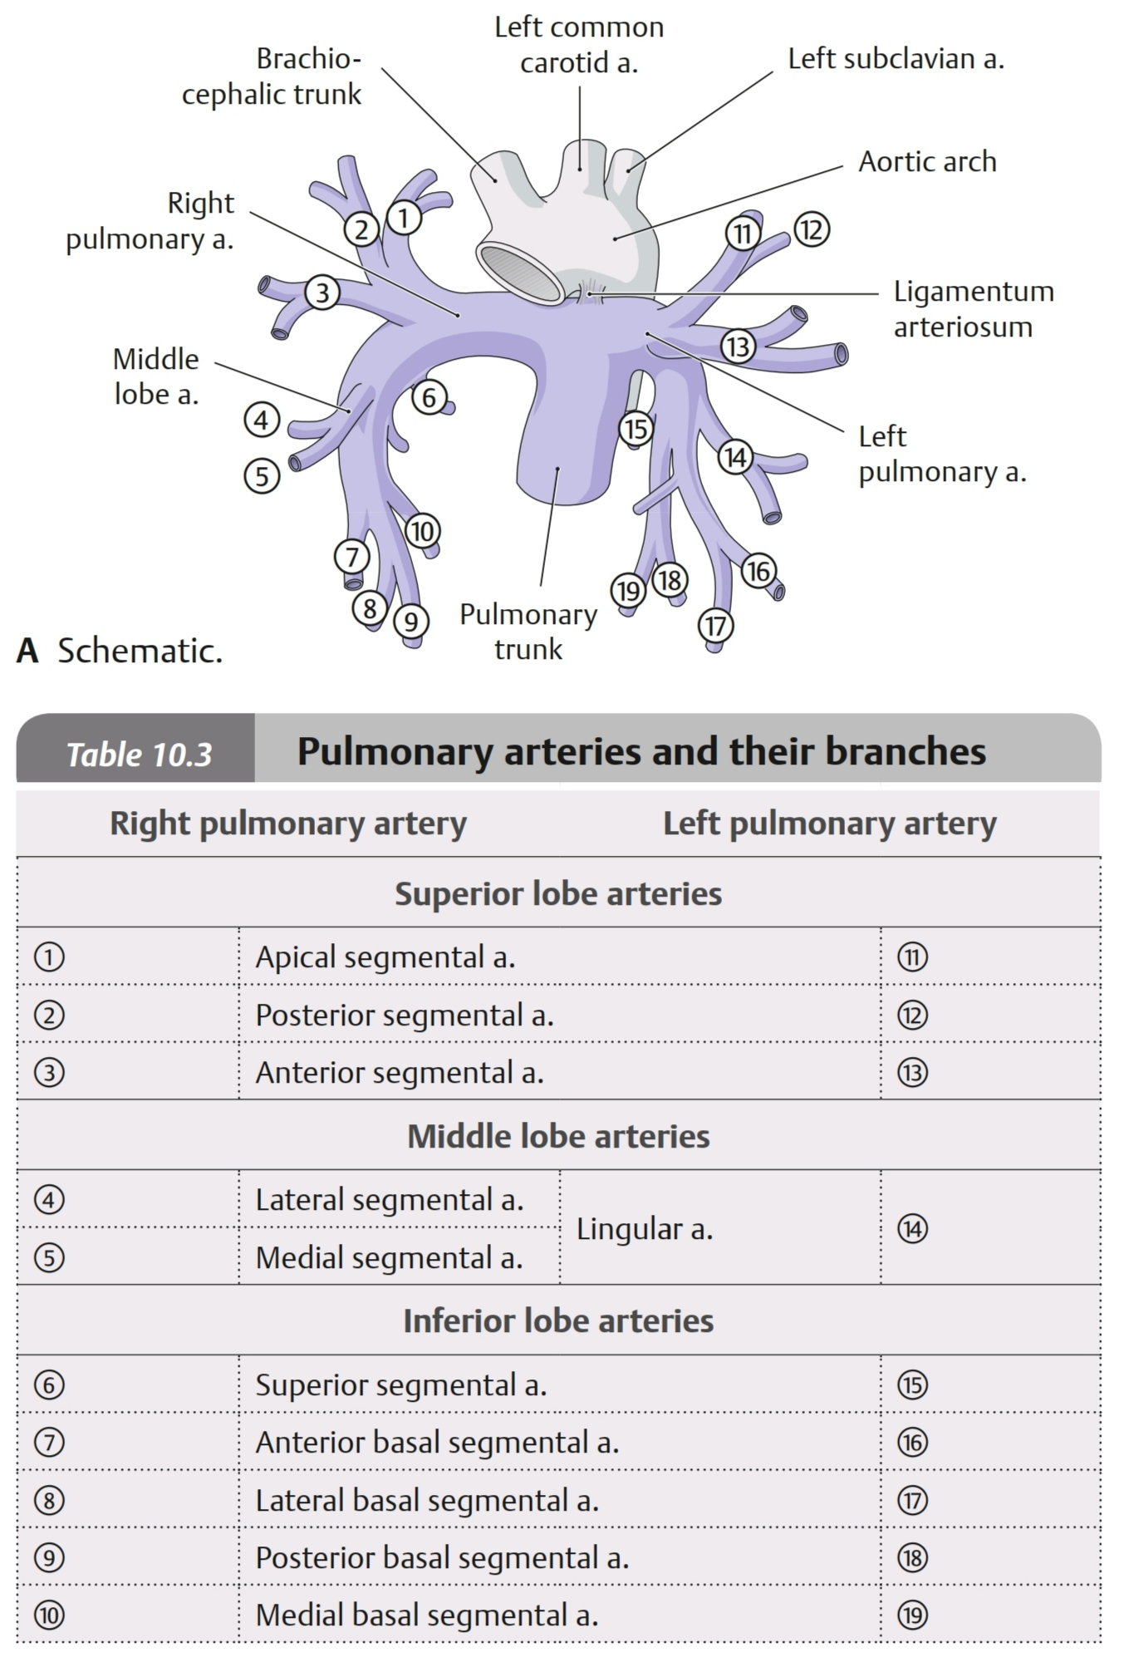

Slide 72
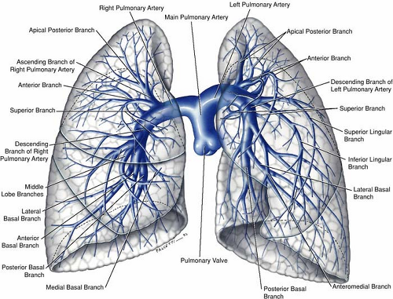
Pulmonary Arteries
The right pulmonary artery, is longer than the left, runs to the right behind the ascending aorta and superior vena cava to enter the root of the right lung.
The left pulmonary artery runs to the left in front of the descending aorta to enter the root of the left lung.

Slide 73
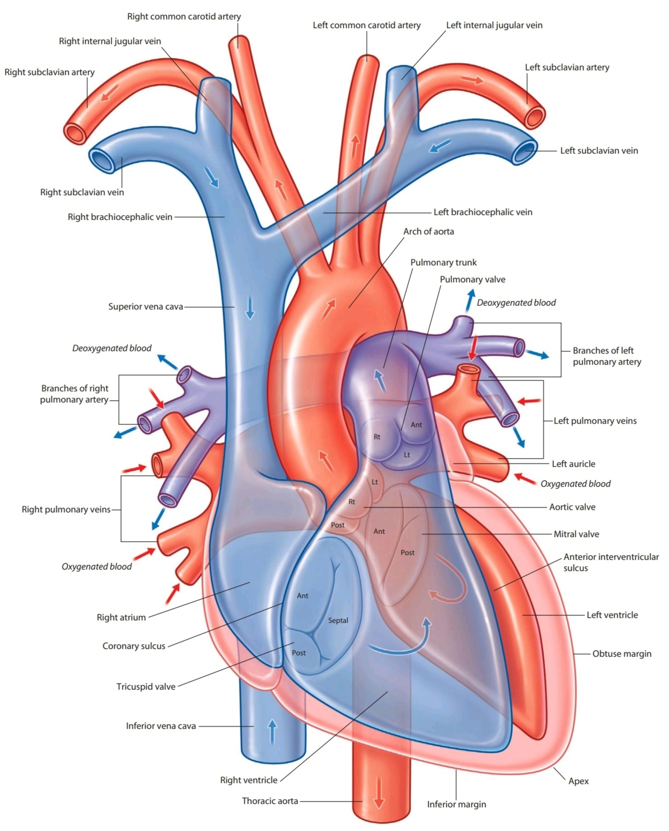

Slide 74
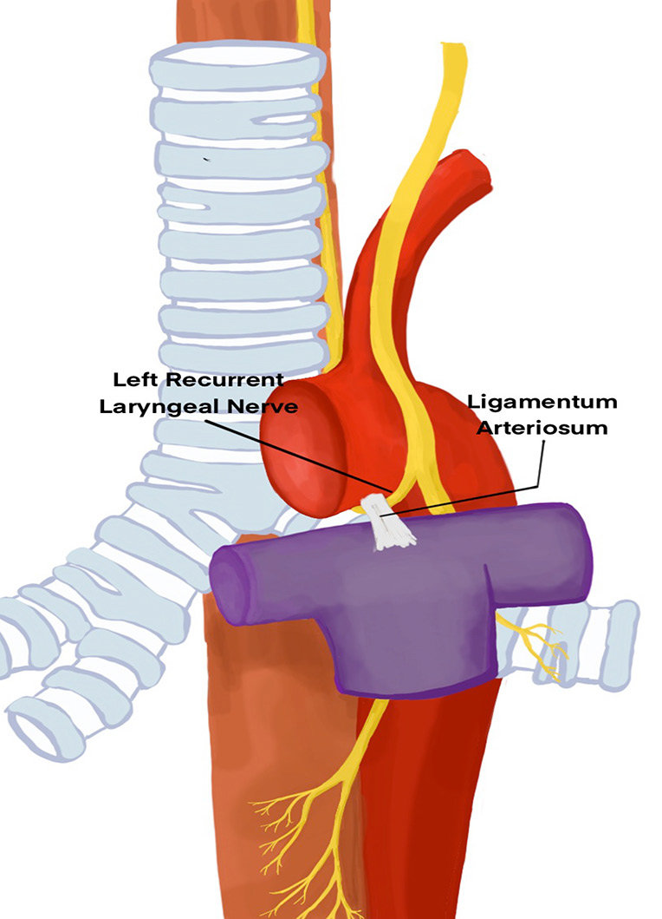
Ligamentum Arteriosum
it is a fibrous band that connects the bifurcation of the pulmonary trunk to the lower concave surface of the aortic arch.
it is the remnant of the ductus arteriosus which in the fetus conducts blood from the pulmonary trunk to the aorta, thus bypassing the lungs.
the left recurrent laryngeal nerve hooks around the lower border of the ductus, which closes after birth.

Slide 75
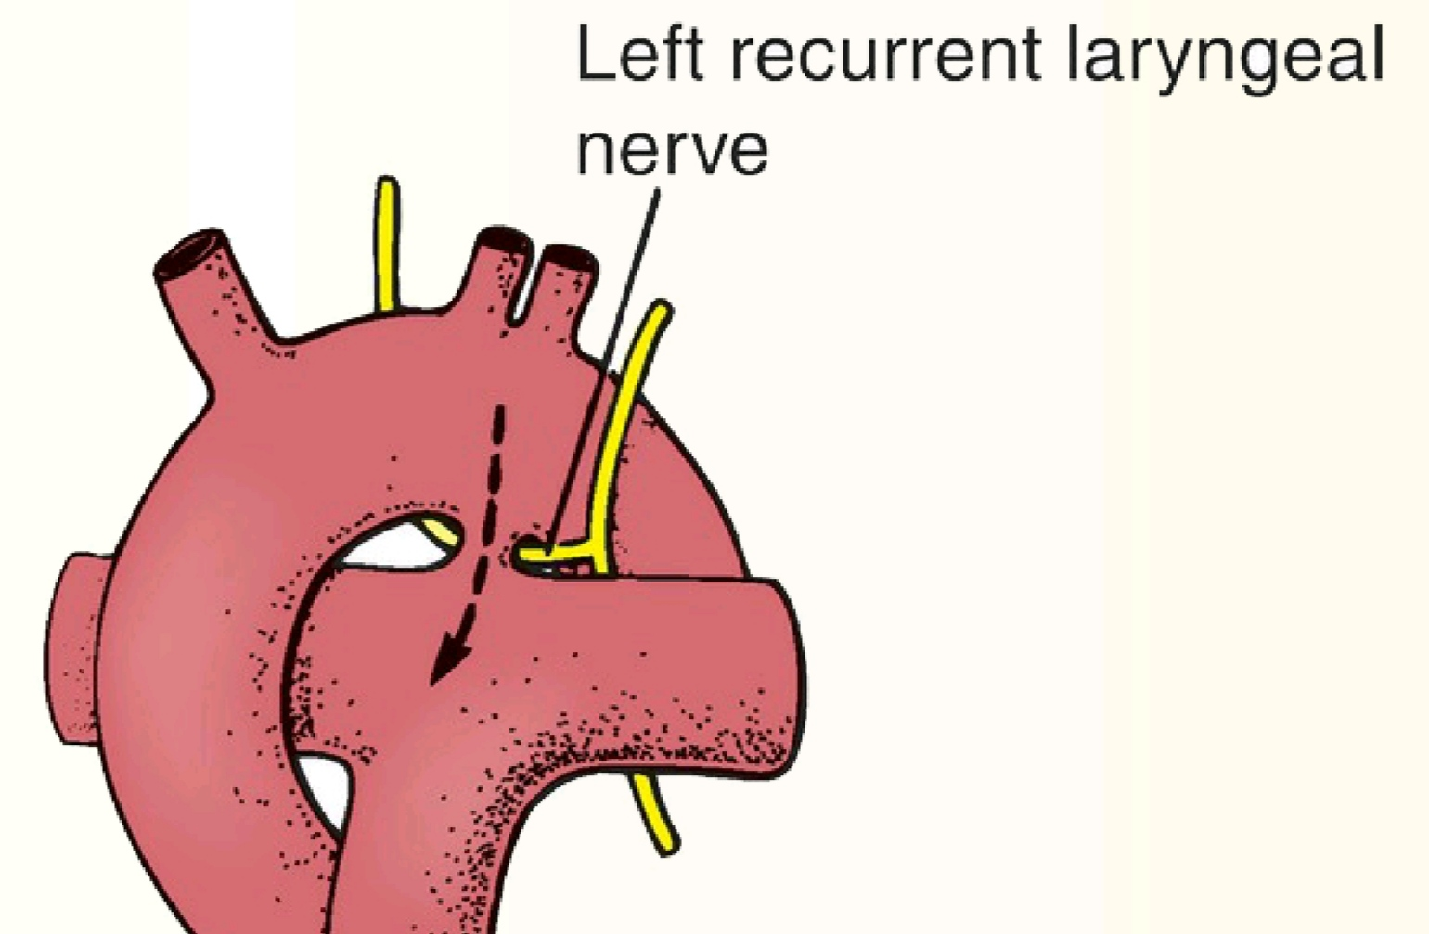
Patent Ductus Arteriosus
Should it remain patent, aortic blood will enter the pulmonary circulation: Patent Ductus Arteriosus
Surgical ligation of the ductus Is then necessary, and the surgeon must take care to preserve the left recurrent laryngeal nerve.

Slide 76
The Aorta
The aorta is the main arterial trunk that delivers oxygenated blood from the LV of the heart to the tissues of the body.
It consists of 2 main parts:
thoracic aorta:
- ascending aorta
- arch of the aorta
- descending thoracic aorta
abdominal aorta

Slide 77
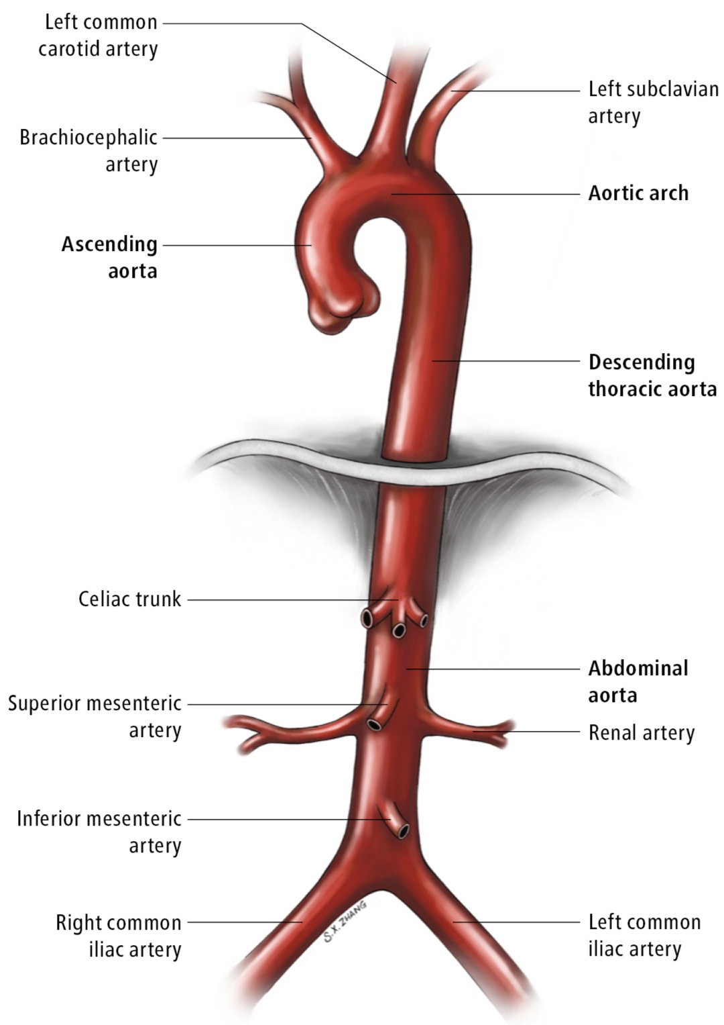
Aorta

Slide 78
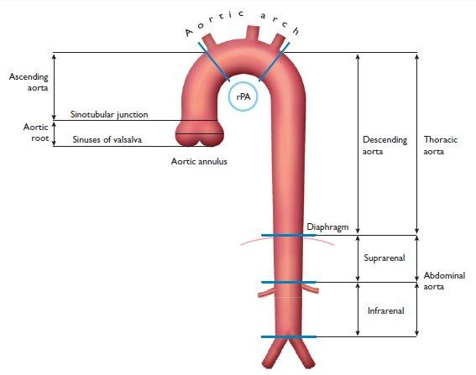
Aorta: schematic division

Slide 79
Thoracic Aorta
it is divided into 3 parts:
ascending aorta (in the middle mediastinum)
arch of the aorta (in the superior mediastinum)
descending thoracic aorta (in the posterior mediastinum)

Slide 80
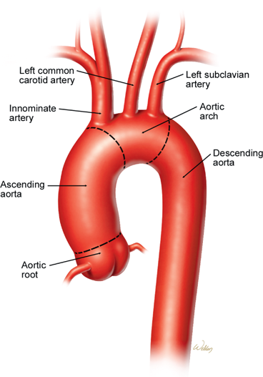
Ascending Aorta
it can be further divided into:
aortic root
(tubular) ascending aorta

Slide 81
Aortic Root
refers to the aortic valve from its origin at the left ventricular outlet to its junction with the ascending portion of the aorta.
it comprises of the semilunar leaflets with attachments (or hinge lines) to ventricular and aortic walls and to the “anterior” mitral leaflet, the aortic sinuses (of Valsalva), the interleaflet triangles, and the sinutubular junction.

Slide 82
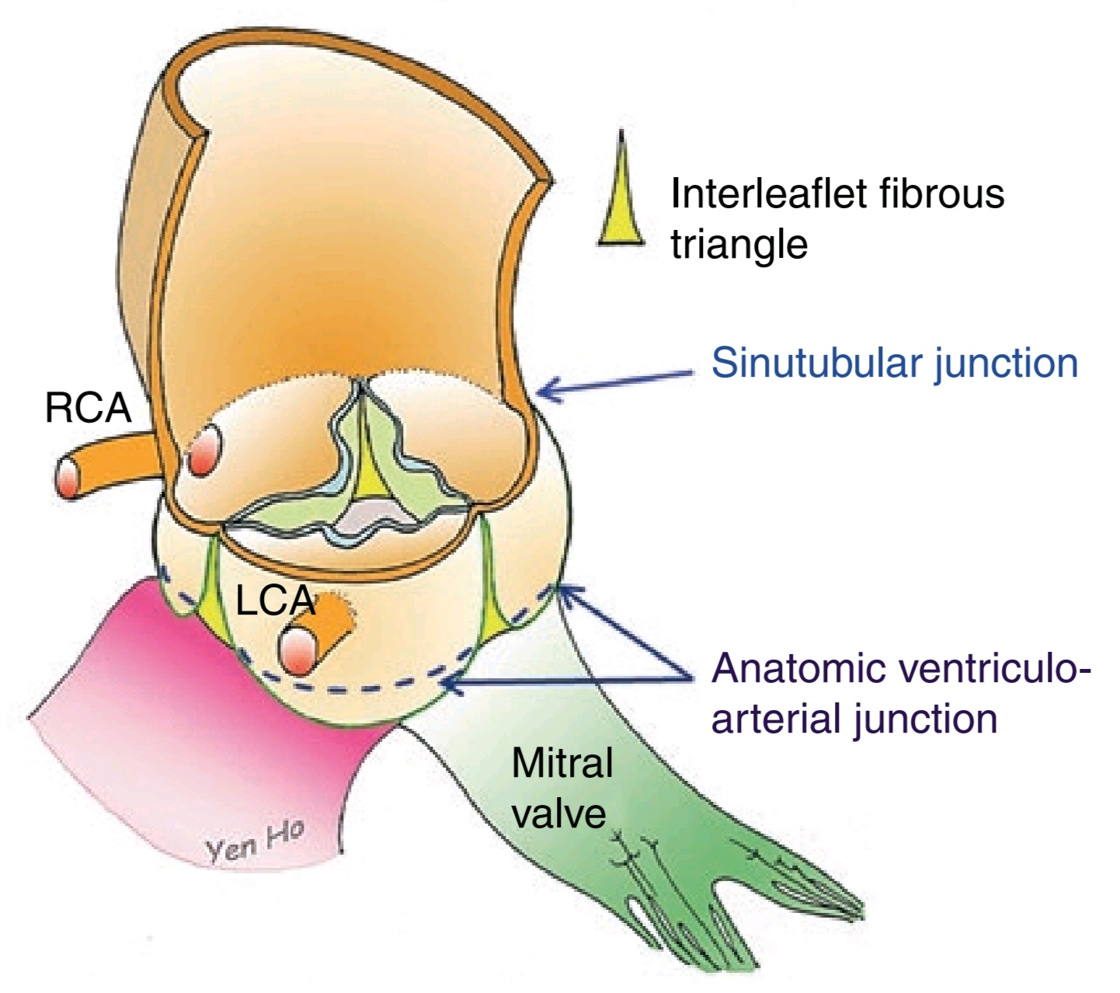
Aortic Root

Slide 83
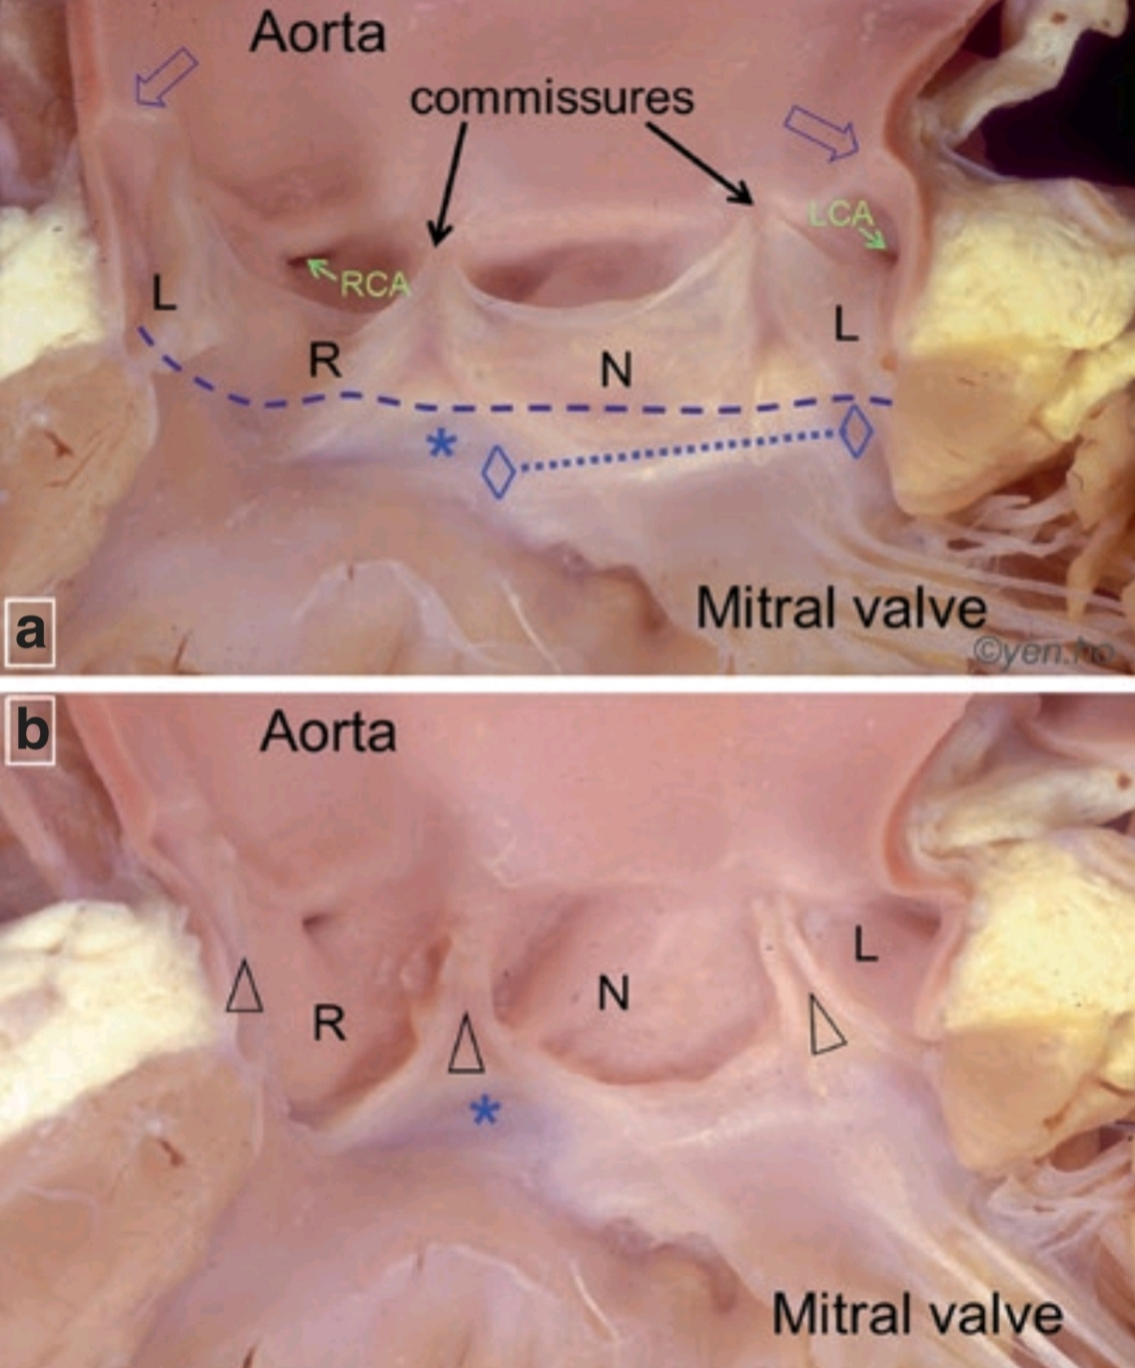
(a) The open arrows indicate the thickening of the aortic wall at the sinutubular junction. The highest points of attachments of the leaflets are at the commissures. The anatomic ventriculo-arterial junction is traced by the broken line. The right and left fibrous trigones (diamonds) are at each end of the area of aortic-mitral fibrous continuity (dotted line). The membranous septum is the pale area marked by the asterisk.
(b) The three aortic sinuses (R, N, L) are visible after removing the leaflets. The triangles mark the sites of the interleaflet fibrous triangles.

Slide 84
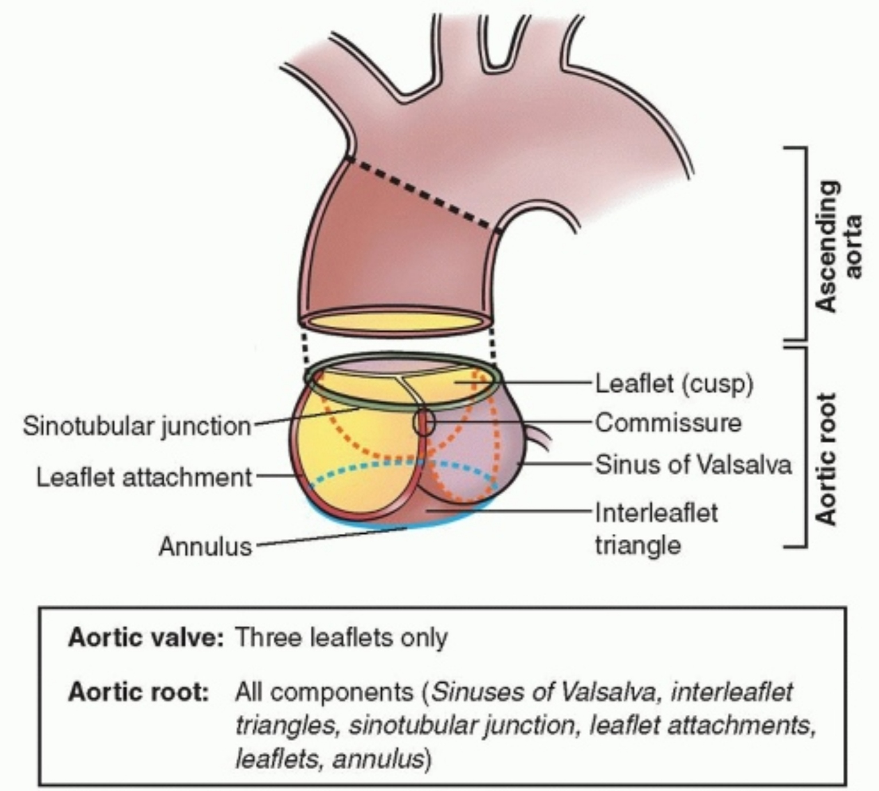

Slide 85
Ascending Aorta
it is typically about 5 cm in length and 2.5 cm in diameter.
it begins at the base of the LV, at the sinu-tubular junction.
it runs upward and forward to come to lie behind the right half of the sternum at the level of the sternal angle
at the level of the sternal angle it becomes continuous with the arch of the aorta.
it lies within the fibrous pericardium in the middle mediastinum and is enclosed with the pulmonary trunk in a sheath of serous pericardium.
its only branches are the coronary arteries, arising from the aortic sinuses.

Slide 86
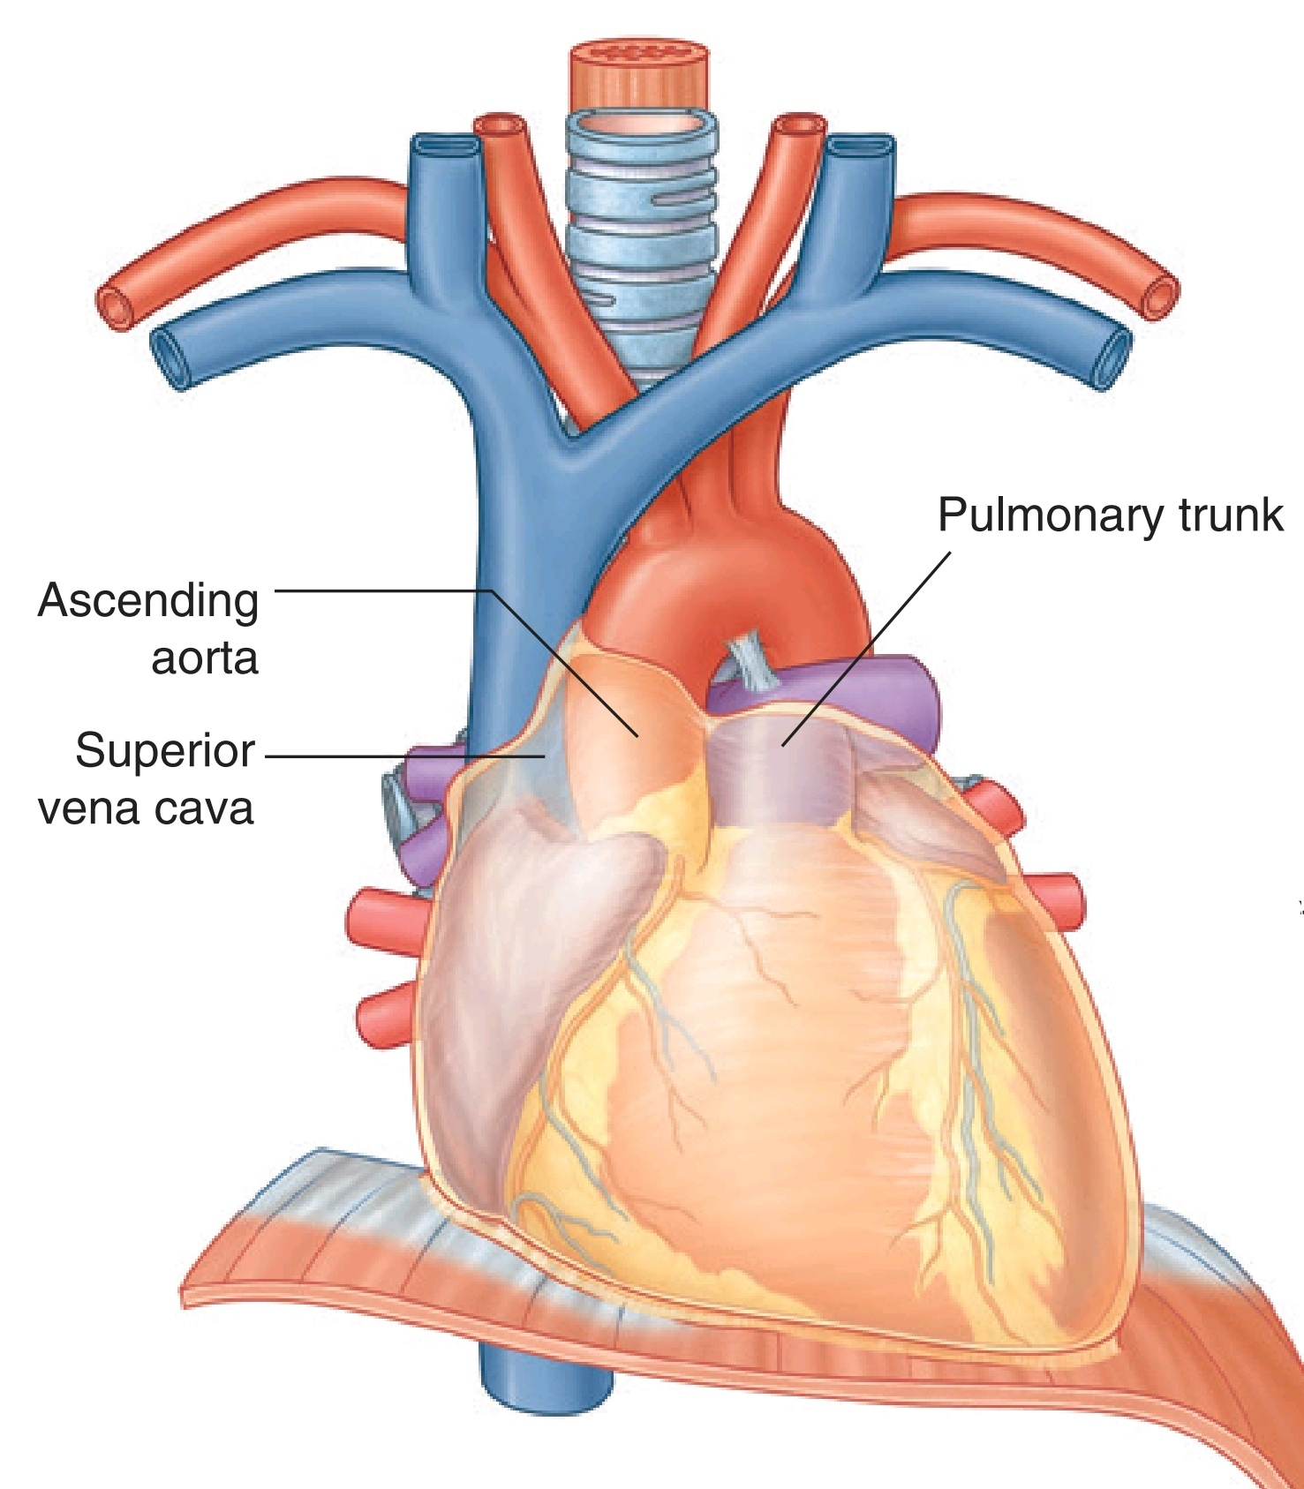

Slide 87
Aortic Arch
it is the continuation of the ascending aorta.
It lies In the superior mediastinum, behind the manubrium sterni, and arches upward, backward, and to the left In front of the trachea (lts main direction is backward).
It then passes downward to the left of the trachea and, at the level of the sternal angle, becomes continuous with the descending aorta.

Slide 88
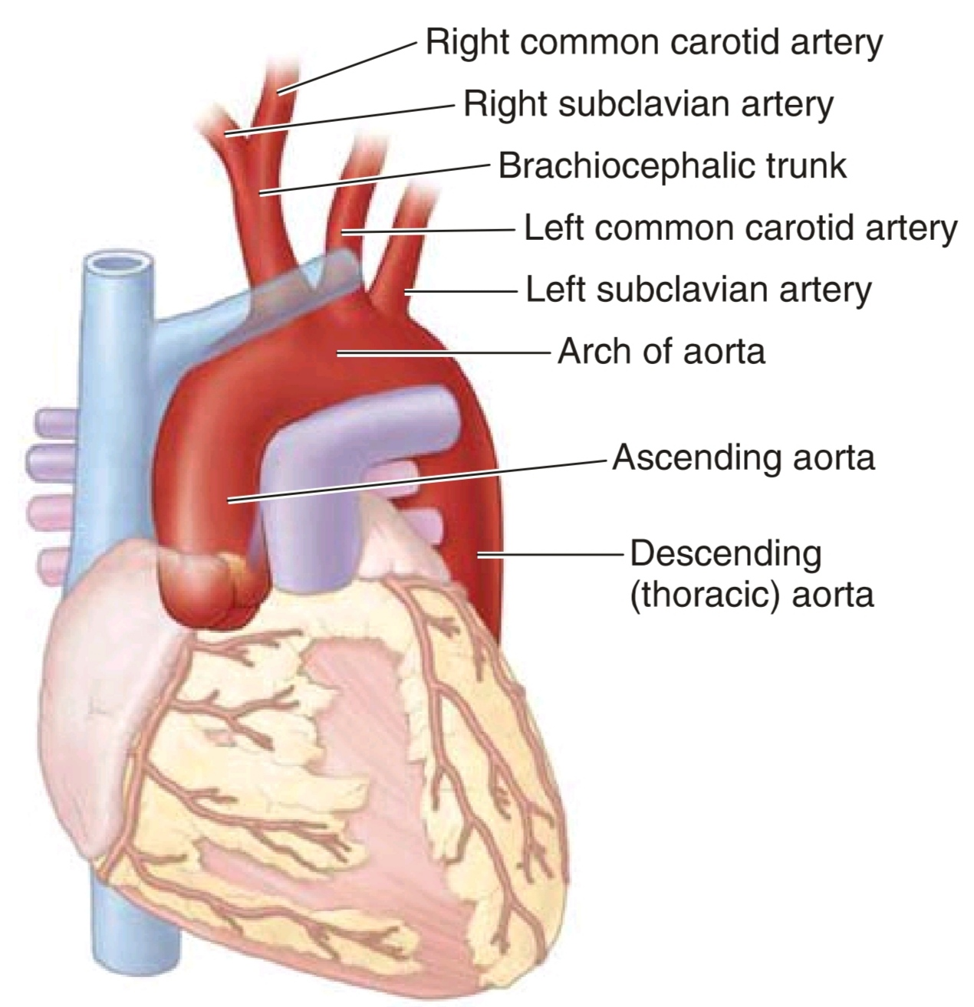
Branches of the Aortic Arch
Three branches arise from the superior border of the arch of the aorta; at their origins, all three are crossed anteriorly by the left brachiocephalic vein.
first branch: brachiocephalic trunk
second branch: left common carotid artery
third branch: left subclavian artery

Slide 89
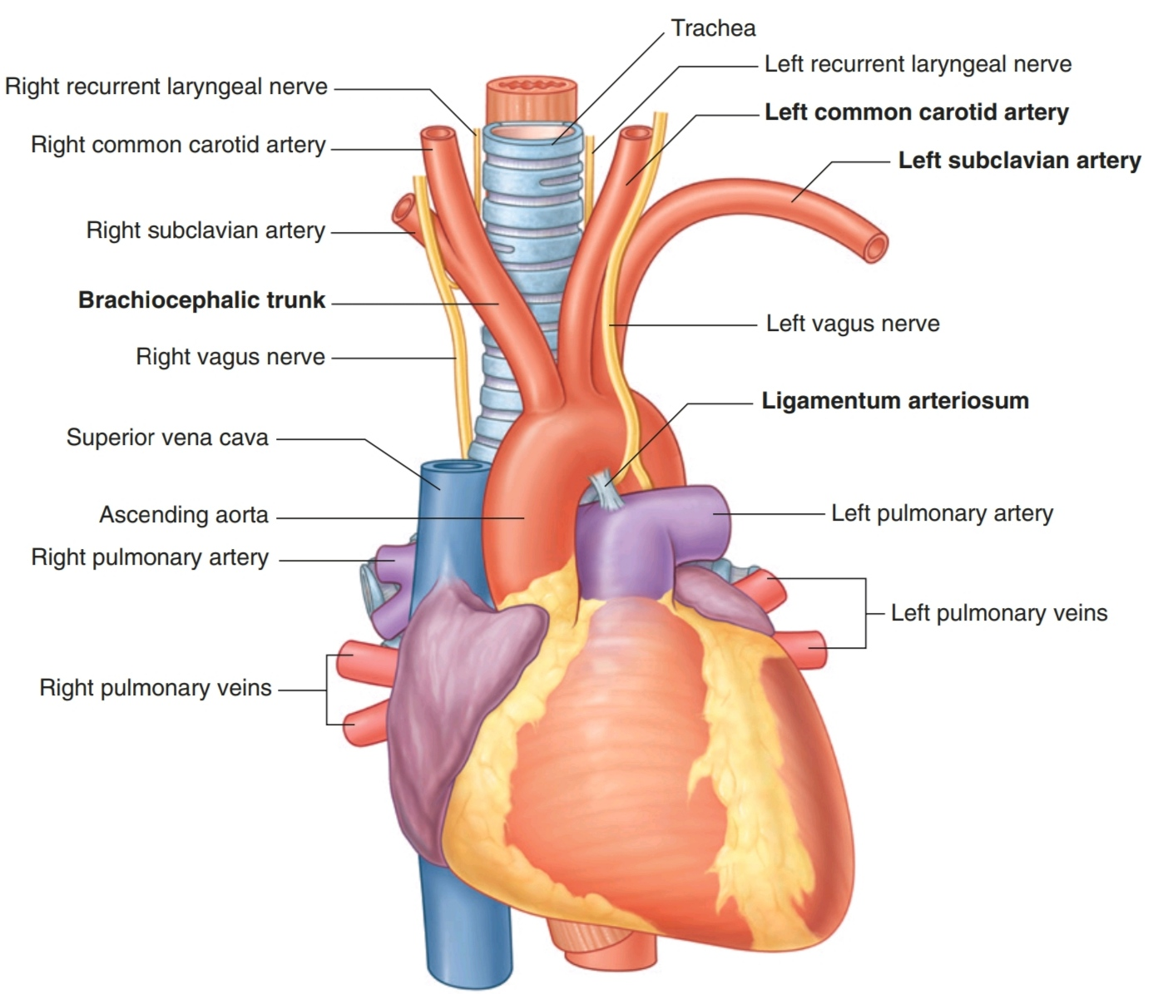

Slide 90
First Branch:
Brachiocephalic Trunk (innominate artery)
It is the largest of the three branches, is 4–5 cm in length, and, at its point of origin behind the manubrium of the sternum, is slightly anterior to the other two branches.
It ascends slightly posteriorly and to the right.
At the level of the upper edge of the right sternoclavicular joint, the brachiocephalic trunk divides into:
■ the right common carotid artery
■ the right subclavian artery
The arteries mainly supply the right side of the head and neck and the right upper limb, respectively.
Occasionally, the brachiocephalic trunk has a small branch, the thyroid ima (lowest) artery, which contributes to the vascular supply of the thyroid gland.

Slide 91


Slide 92
Second Branch:
Left Common Carotid Artery
it arises from the arch immediately to the left and slightly posterior to the brachiocephalic trunk and ascends through the superior mediastinum along the left side of the trachea.
it supplies the left side of the head and neck.

Slide 93
Third Branch:
Left Subclavian Artery
it arises from the arch of the aorta immediately to the left of, and slightly posterior to, the left common carotid artery and ascends through the superior mediastinum along the left side of the trachea.
it is the major blood supply to the left upper limb.

Slide 94


Slide 95
Ligamentum Arteriosum
it is important in embryonic circulation, when it is a patent vessel (the ductus arteriosus).
it connects the pulmonary trunk with the arch of the aorta and allows blood to bypass the lungs during development.
it closes soon after birth and forms the ligamentous connection observed in the adult.
the left recurrent laryngeal nerve hooks around the lower border of the ductus

Slide 96


Slide 97

Descending Thoracic Aorta
Branches of the descending thoracic aorta :

Slide 98


Slide 99
Large Thoracic Veins
pulmonary veins
brachiocephalic veins
azygos veins
SVC
IVS

Slide 100
Pulmonary Veins (PVs)
These are 4 pulmonary veins, two leave each lung carrying oxygenated blood to the left atrium of the heart:
2 right (R) and 2 left (L)
2 superior (S) and 2 inferior (I)
So, we have:
RSPV
RIPV
LSPV
LIPV

Slide 101


Slide 102
Brachiocephalic Veins
the right and left brachiocephalic veins form at the root of the neck on each side by the union of the respective subclavian and internal jugular veins.
the left brachiocephalic vein (innominate vein) passes obliquely downward and to the right behind the manubrium sterni and in front of the large branches of the aortic arch.
the right brachiocephalic vein is relatively short and descends almost vertically.
they shunt blood from the head, neck, and upper limbs and join to form the superior vena cava, posterior to the lower edge of the right first costal cartilage

Slide 103


Slide 104
Superior Vena Cava (SVC)
it is formed by the union of Rt and Lt brachiocephalic veins.
the vertically oriented SVC begins posterior to the lower edge of the right 1st costal cartilage, and terminates at the lower edge of the right 3rd costal cartilage, where it joins the right atrium.
the lower half of the superior vena cava is within the pericardial sac and is therefore contained in the middle mediastinum.
it conveys all the venous blood from the head and neck and both upper limbs.
it passes downward to end in the right atrium.
the azygos vein joins the posterior aspect of the SVC just before it enters the pericardium.

Slide 105


Slide 106
Inferior Vena Cava (IVC)
the IVC pierces the central tendon of the diaphragm opposite the 8th thoracic vertebra and almost immediately enters the lowest part of the RA.
it receives blood mainly from the body below the diaphragm and has only a brief appearance in the thorax.

Slide 107
Major Nerves of the Thorax

Slide 108
Vagus Nerves [X]
The vagus nerves [X] pass through the superior and posterior divisions of the mediastinum on their way to the abdominal cavity.
As they pass through the thorax, they provide parasympathetic innervation to the thoracic viscera and carry visceral afferents from the thoracic viscera.
Visceral afferents in the vagus nerves relay information to the central nervous system about normal physiological processes and reflex activities. They do not transmit pain sensation.

Slide 109
Right Vagus Nerve
it enters the superior mediastinum and lies between the right brachiocephalic vein and the brachiocephalic trunk.
it descends in a posterior direction toward the trachea, crosses the lateral surface of the trachea, and passes posteriorly to the root of the right lung to reach the esophagus.
just before the esophagus, it is crossed by the arch of the azygos vein.
it gives branches to the esophagus, cardiac plexus, and pulmonary plexus.
The right recurrent laryngeal nerve arises from the right vagus in the neck, hooks around the right subclavian artery,and ascends between the trachea and esophagus.

Slide 110


Slide 111


Slide 112
Left Vagus Nerve
it enters the superior mediastinum posterior to the left brachiocephalic vein and between the left common carotid and left subclavian arteries.
it lies just deep to the mediastinal part of the parietal pleura and crosses the left side of the arch of the aorta.
it passes posterior to the root of the left lung to reach the esophagus in the posterior mediastinum.
it gives branches to the esophagus, the cardiac plexus, and the pulmonary plexus.

Slide 113


Slide 114
Left Recurrent Laryngeal Nerve
The left vagus nerve also gives rise to the left recurrent laryngeal nerve, which arises from it at the inferior margin of the arch of the aorta just lateral to the ligamentum arteriosum.
it passes inferior to the arch of the aorta before ascending on its medial surface.
Entering a groove between the trachea and esophagus, the left recurrent laryngeal nerve continues superiorly to enter the neck and terminate in the larynx.

Slide 115


Slide 116
Phrenic Nerves
they arise in the cervical region mainly from the 4th, but also from the 3rd and 5th, cervical spinal nerves.
the phrenic nerves descend through the thorax to supply motor and sensory innervation to the diaphragm.
As they pass through the thorax, they provide innervation through somatic afferent fibers to the mediastinal pleura, fibrous pericardium, and parietal layer of serous pericardium.

Slide 117


Slide 118
Right Phrenic Nerve
it descends in the thorax along the right side of the right brachiocephalic vein and the SVC.
it passes in front of the root of the right lung and runs along the right side of the pericardium, which separates the nerve from the right atrium.
it then descends on the right side of the IVC to the diaphragm.
the pericardiacophrenic vessels accompany it through most of its course in the thorax.
its terminal branches pass through the caval opening in the diaphragm.

Slide 119


Slide 120
Left Phrenic Nerve
it descends in the thorax along the left side of the left subclavian artery.
it crosses the left side of the aortic arch and here crosses over the left vagus nerve.
it passes in front of the root of the left lung and then descends over the left surface of the pericardium, which separates the nerve from the left ventricle.
the pericardiacophrenic vessels accompany it through most of its course in the thorax.
it leaves the thorax by piercing the diaphragm near the apex of the heart.

Slide 121


