Slide 1

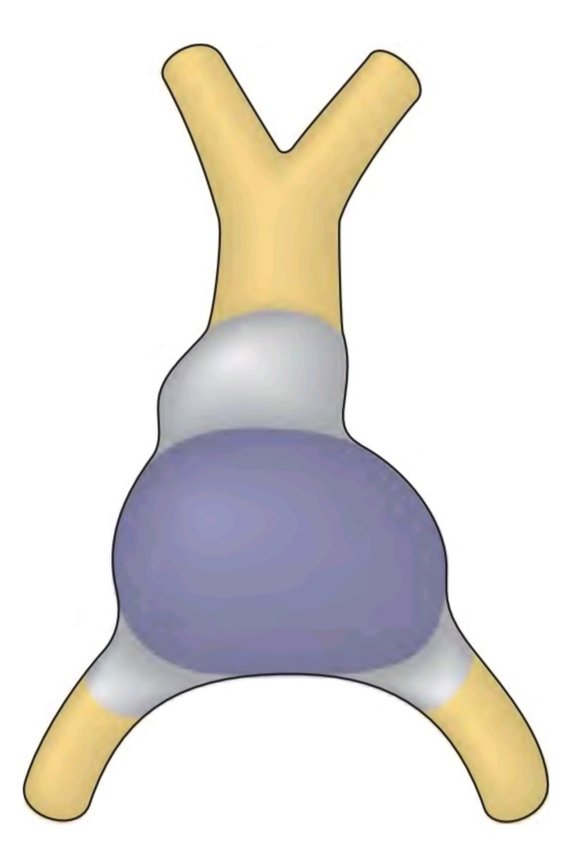
Cardiovascular Anatomy
Part 5
بسم الله الرحمن الرحيم
Dr. SAHER ABUGHALI
Director of Cardiac Surgery Department,
Al Shifa Hospital.

Slide 2
Cardiovascular Embryology

Slide 3
Development of the CVS
The cardiovascular system (CVS) is the first major system to function in the embryo.
The primordial heart and vascular system appear in the middle of the 3rd week.
This precocious cardiac development occurs because the rapidly growing embryo can no longer satisfy its nutritional and oxygen requirements by diffusion alone.
Consequently, there is a need for an efficient method of acquiring oxygen and nutrients from the maternal blood and disposing of carbon dioxide and waste products.

Slide 4
Development of the Cardiovascular System
Fetal Development
Cardiogenesis
Arch Formation
Fetal Circulation

Slide 5

Fetal Development
Cardiogenesis
Arch Formation
Fetal Circulation

Slide 6
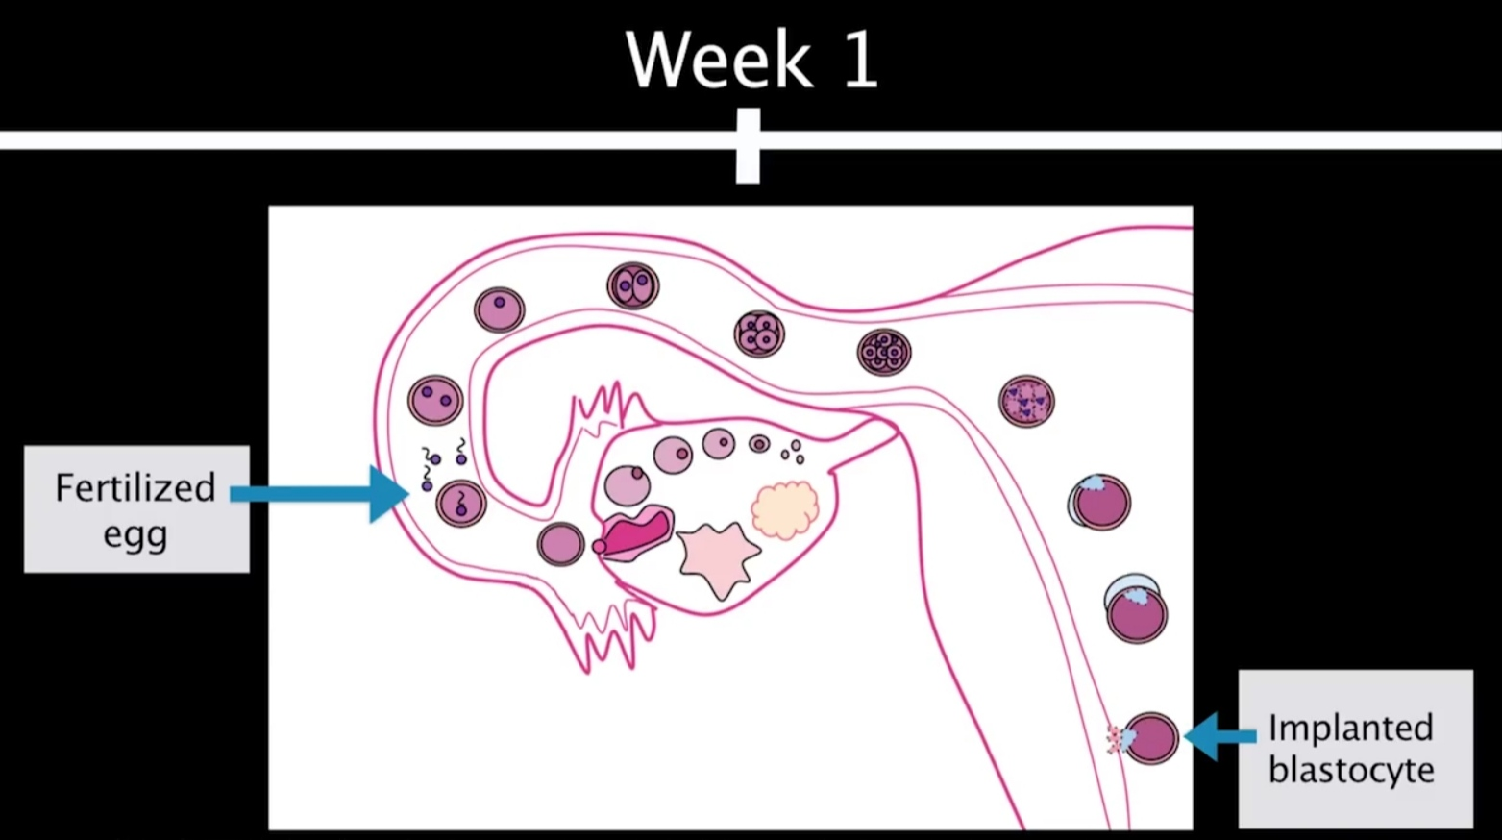
Fetal Development: 1st week
During the first week of fetal life, the fertilized egg develops into a blastocyte and in plants in the mother's uterus.

Slide 7
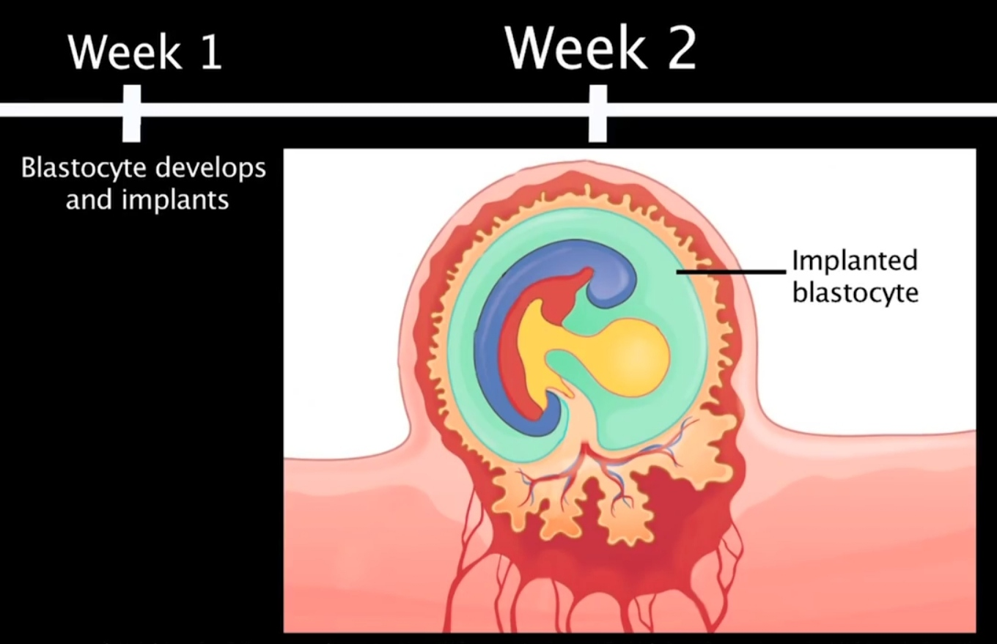
Fetal Development: 2nd week
During the second week of fetal life, the blastocyte implants deeper into the uterine wall and a primitive placenta begins to form.

Slide 8
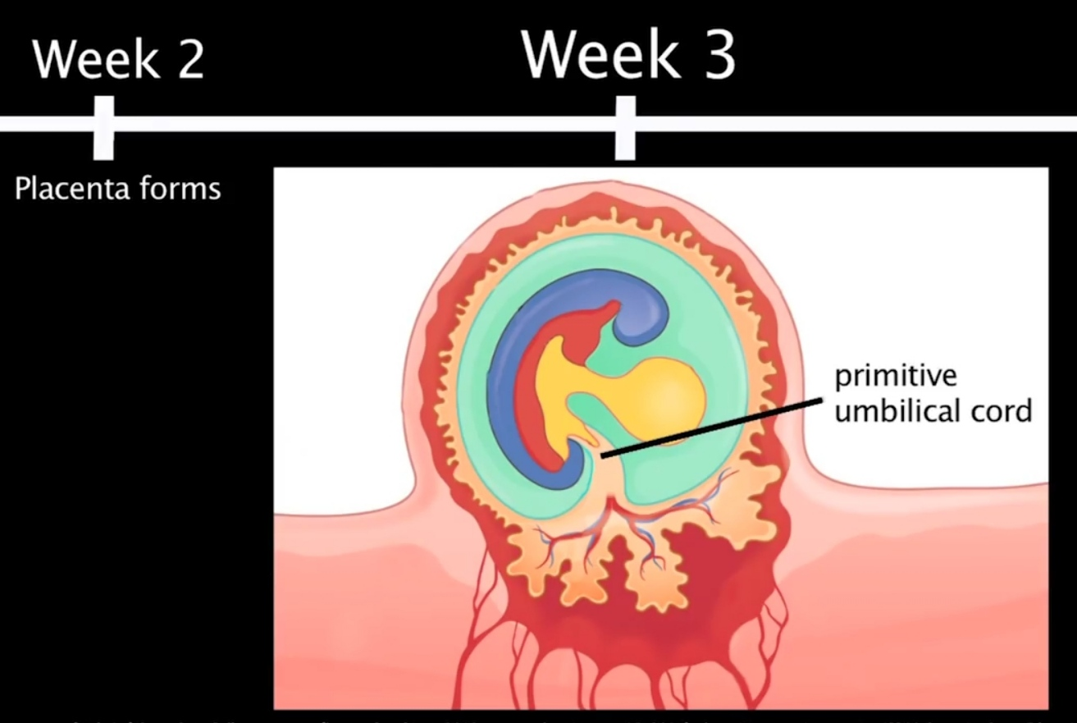
Fetal Development: 3rd week
during the third week of fetal life, the primitive umbilical cord developes.

Slide 9
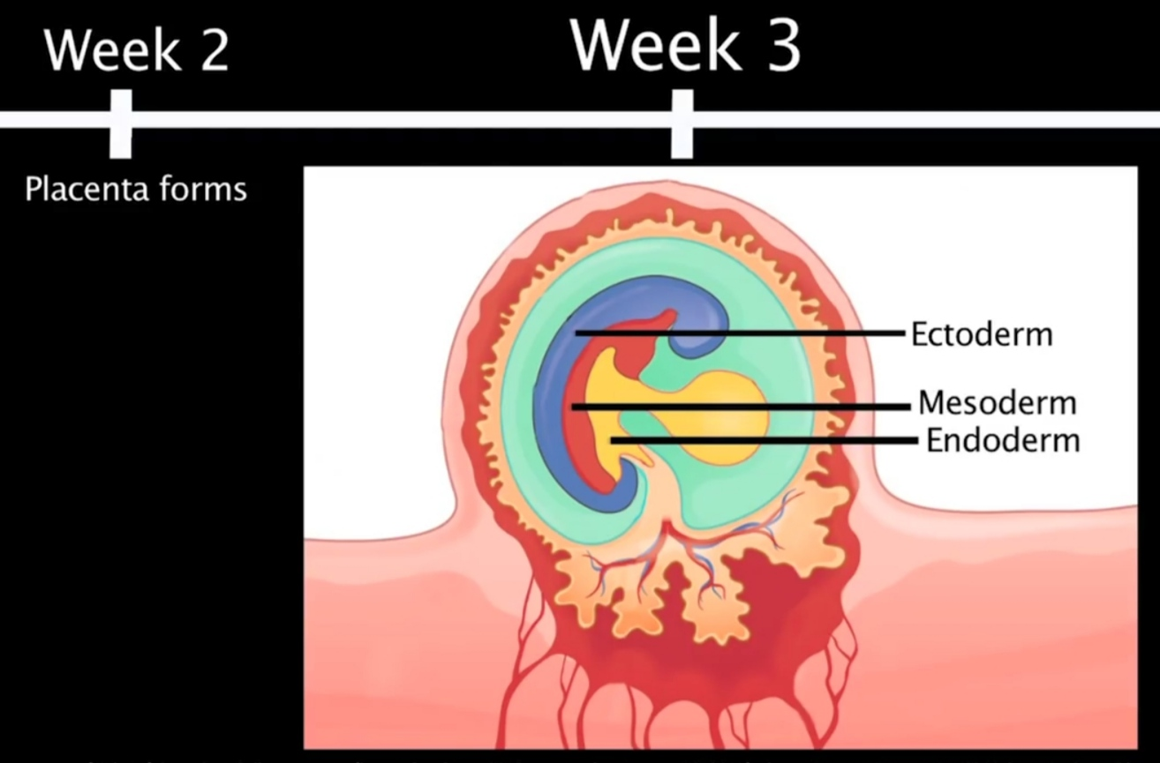
Also at this time the blastocyte develops into a three-layer disc: endoderm, mesoderm and ectoderm

Slide 10
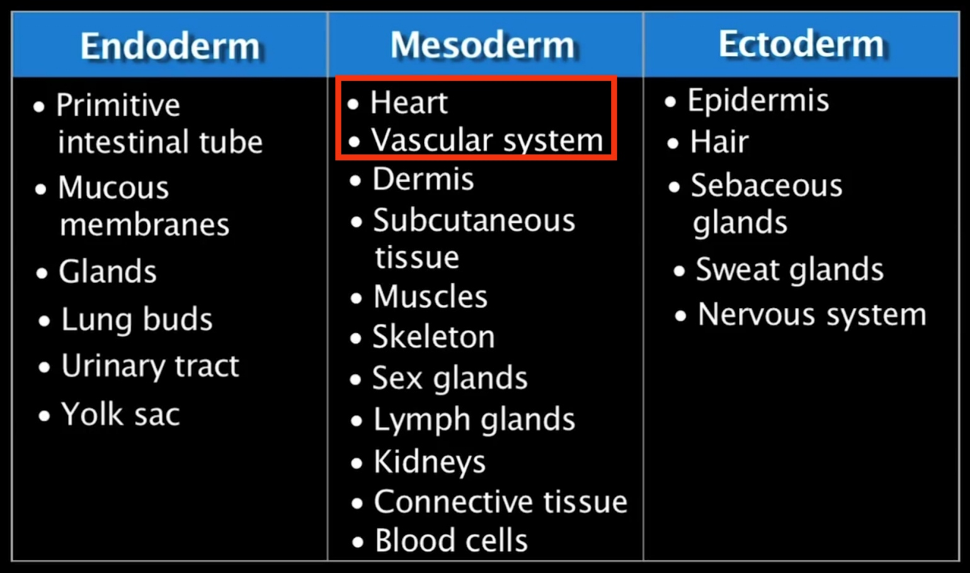
Specific body systems will develop from each layer

Slide 11
Fetal Development
Cardiogenesis
Arch Formation
Fetal Circulation

Slide 12
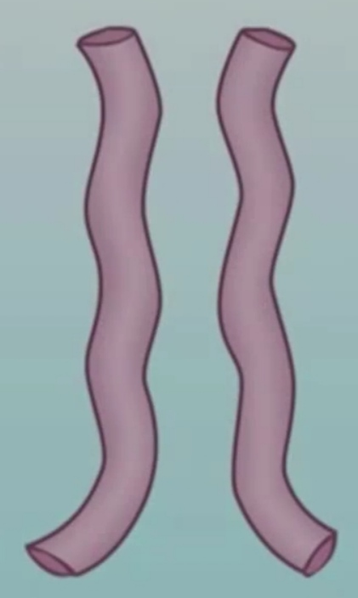
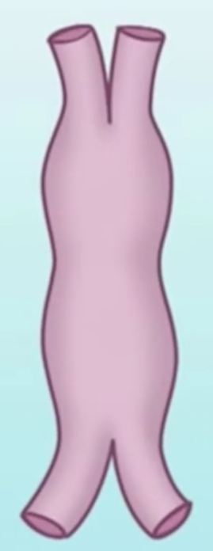
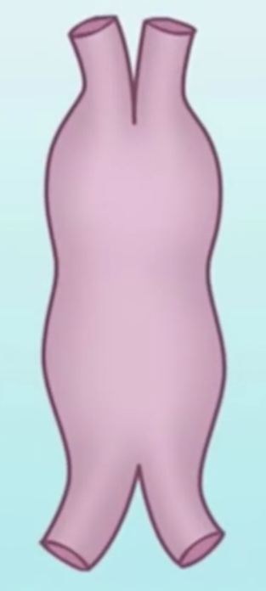
Primitive Heart Tube
Early in the development, the primitive heart develops as two tubes that merge into one tube. The single tube begins to swell and develop into various anatomic features of the heart. The heart begins to beat by week 3.

Slide 13
Primitive Heart Tube Dilations
Five dilations appear along the length of the tube:
truncus arteriosus
bulbus cordis
primitive ventricle
primitive atrium
sinus venosus.
These five dilations undergo dextral looping (rightward twisting or D-looping) and develop into the adult structures of the heart.

Slide 14
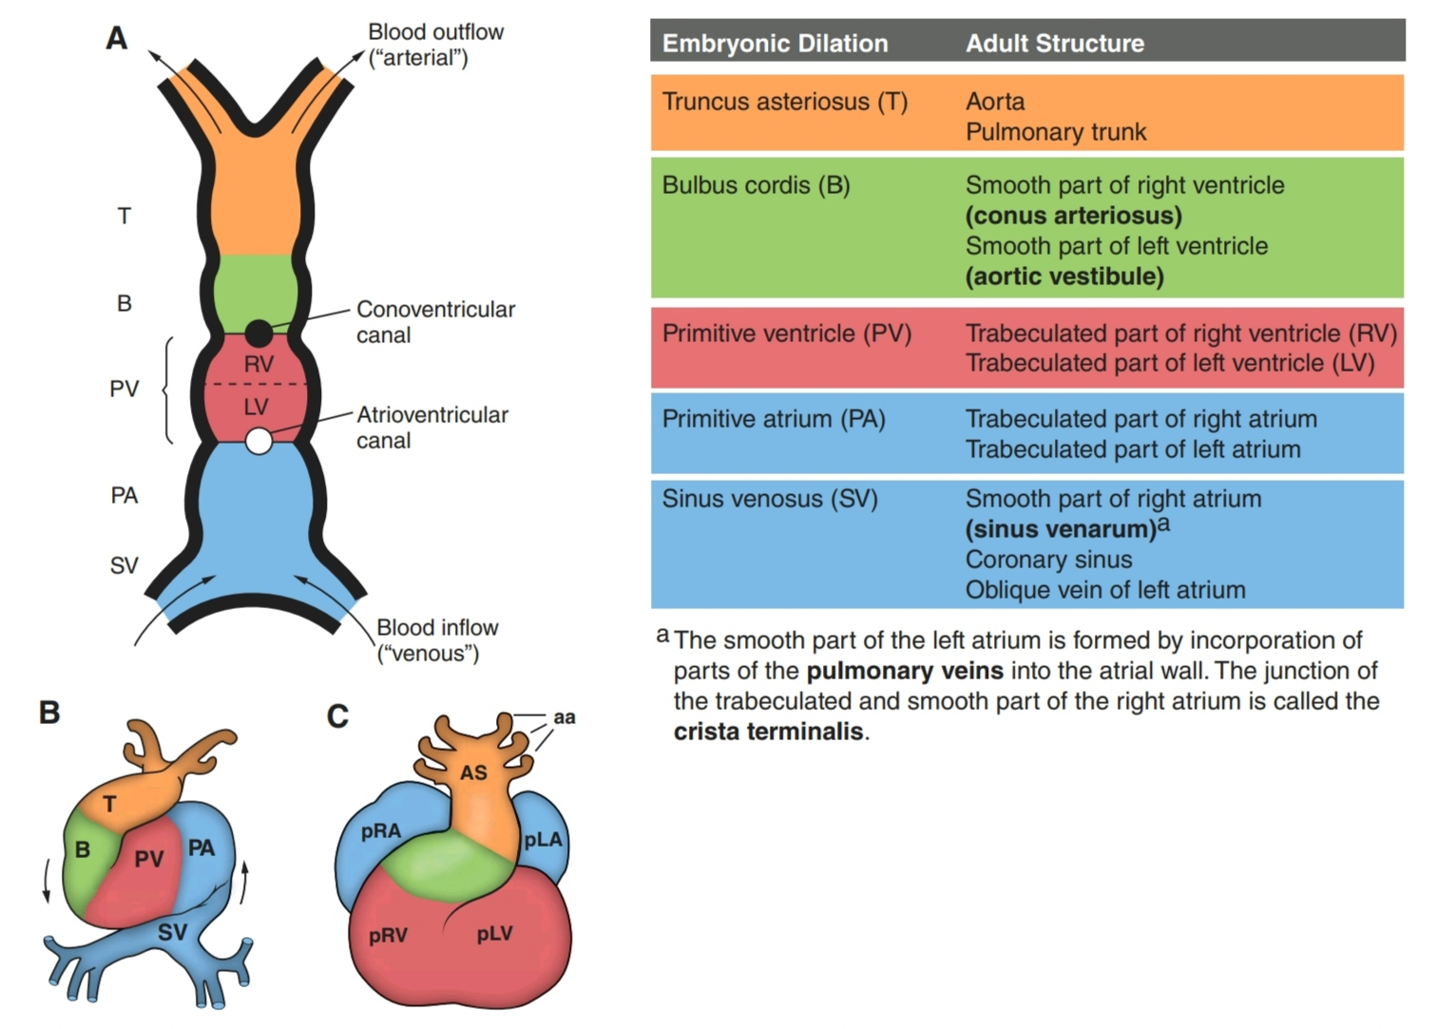

Slide 15
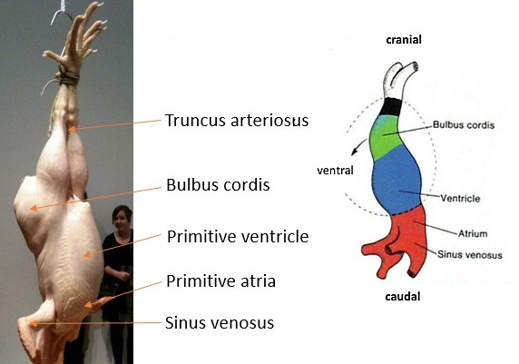

Slide 16
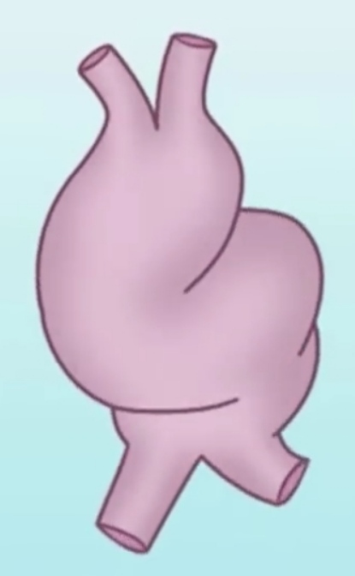
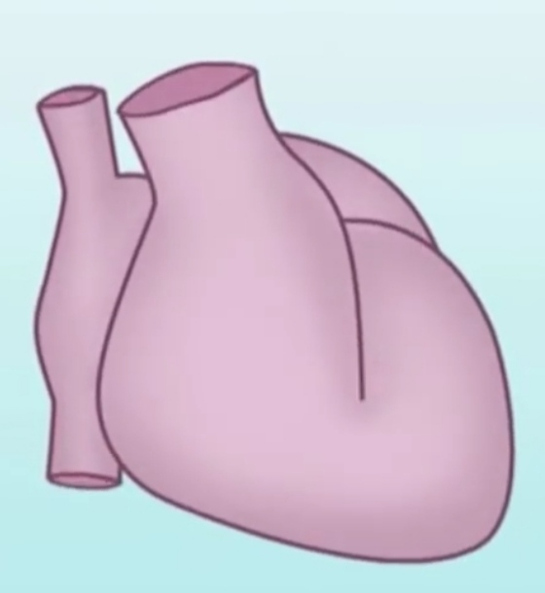
Dextral Looping
In normal cardiac development, the cardiac tube will twist and turn on itself in a rightward direction. this is called dextral looping which results in the RV developing on the right side of the heart and the LV developing on the left side of the heart.

Slide 17
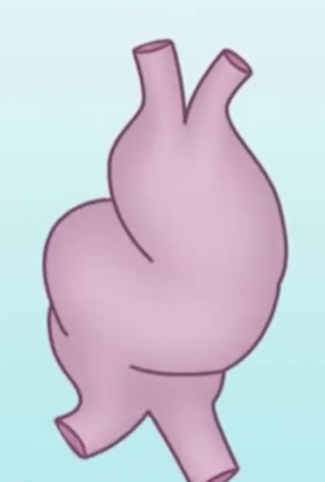
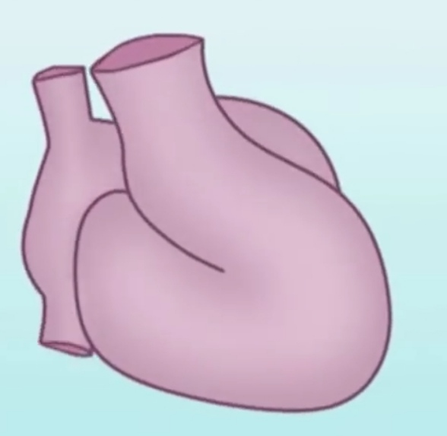
Levo Looping
Abnormal looping in a leftward direction is called levo looping o this results in the RV developing on the left side of the heart and the LV developing on the right side of the heart.

Slide 18
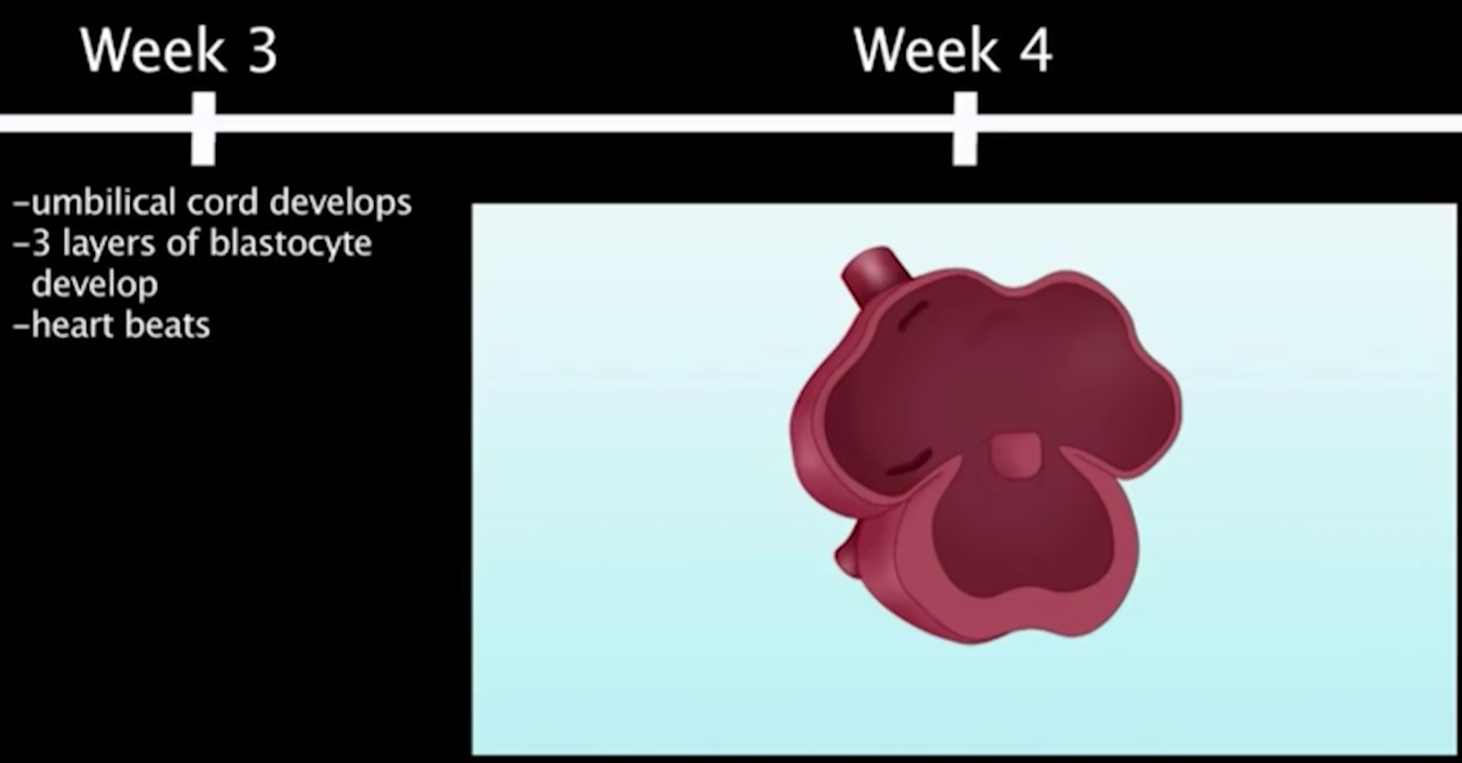
Fetal Development: 4th week
The atrial septum and ventricular septum begins to form.
The atrial septum grows in layers and includes the tissues of septum primum, septum secundum and endocardial cushion tissue.

Slide 19
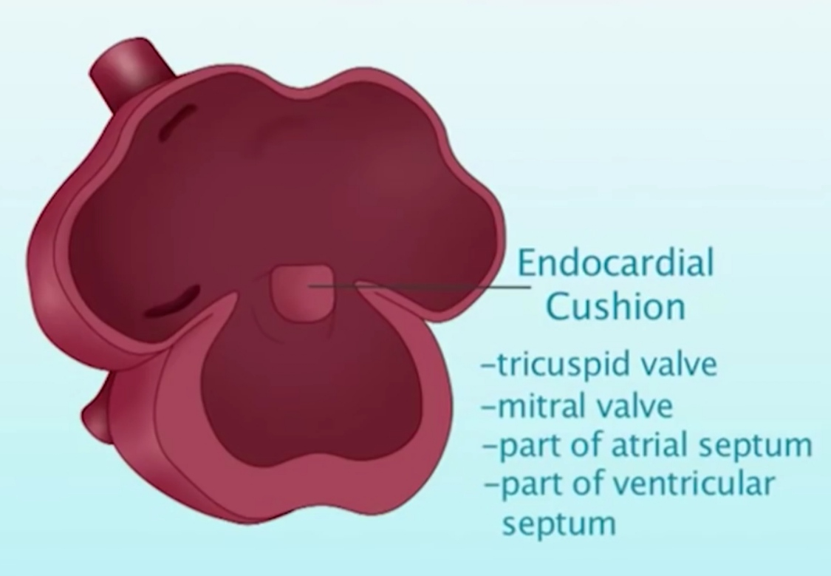
Endocardial Cushion (AV Cushions)
it is located in the middle of the heart. From this tissue arises the tricuspid valve, mitral valve, part of the atrial septum and part of the ventricular septum.

Slide 20
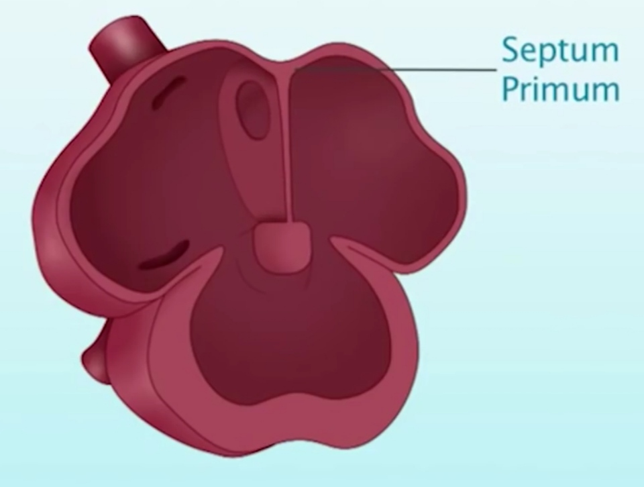
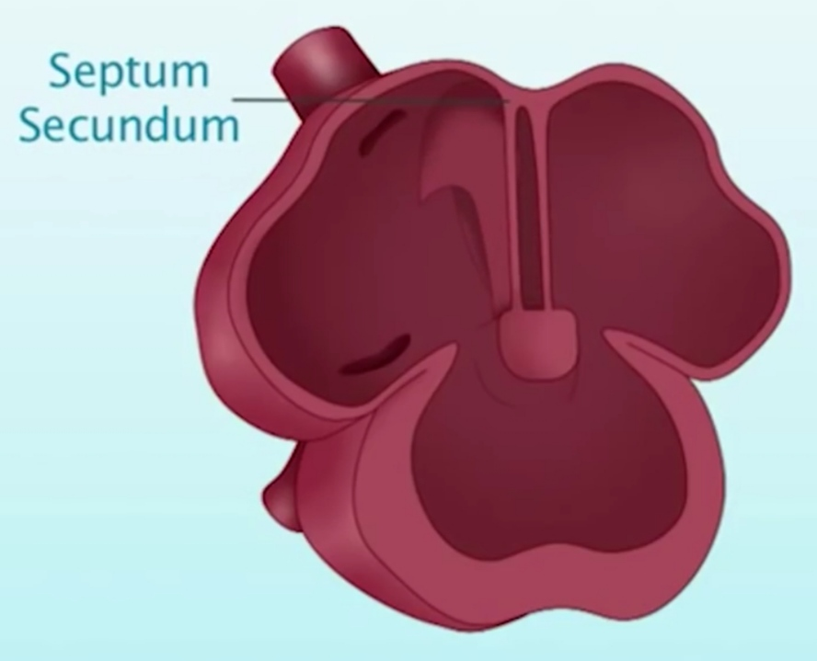
Atrial Septum Development
the septum primum grows downward between the right and left atrium and eventually fuses with the endocardial tissues
the septum secundum grows parallel to the septum primum.

Slide 21
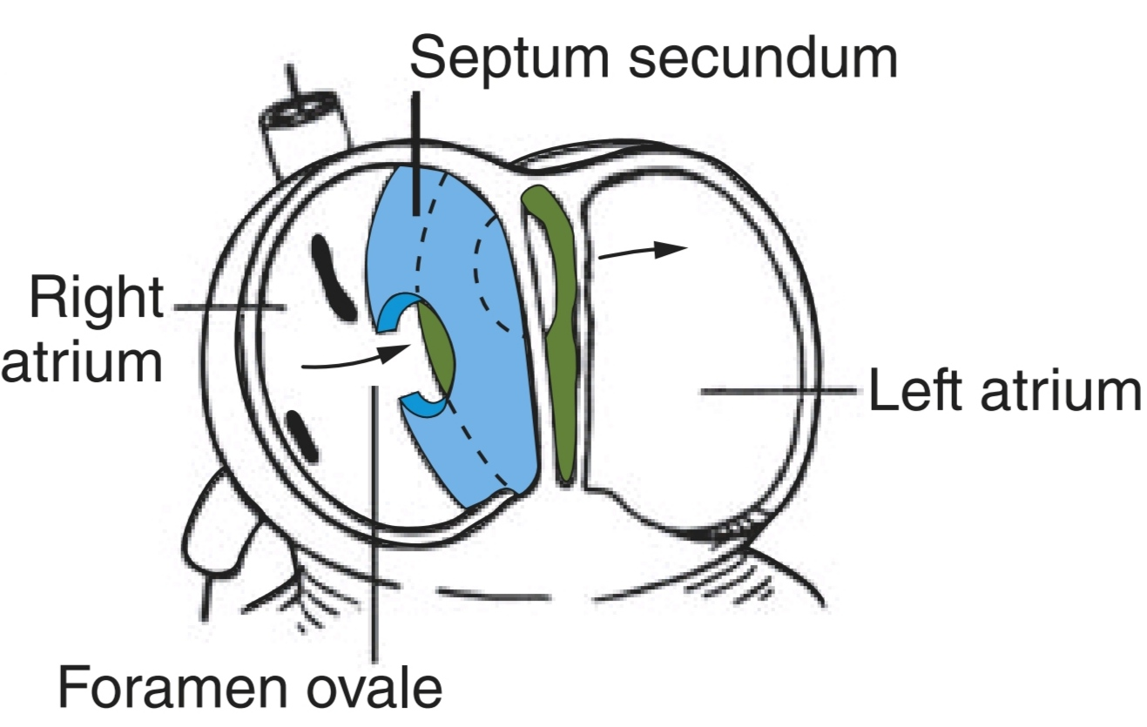
Both septum primum and septum secundum develope with holes in them to create a passageway for blood to flow from RA to LA through the foramen ovale
As long as the pressures in the RA are higher than pressures in the LA, the passage will stay open to allow the blood to flow from right to left.

Slide 22
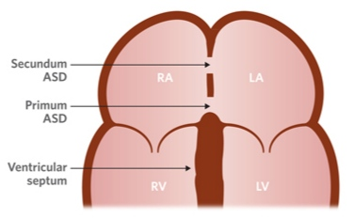
Defects of Atrial Septation
A secundum atrial septal defect (ASD II) is an opening in the middle of the atrial septum produced when the tissue of septum primum does not reach septum secundum adequately to completely close the wall or when a tiny hole is left in the septum primum as the tissues grow.

Slide 23
Defects of Atrial Septation
A primum atrial septal defect (ASD I) is an opening in the lower part of the atrial septum near the tricuspid and mitral valves. It results from problems in the growth of the tissues of endocardial cushion and is often associated with a defect in the mitral valve as well as tricuspid valve.

Slide 24
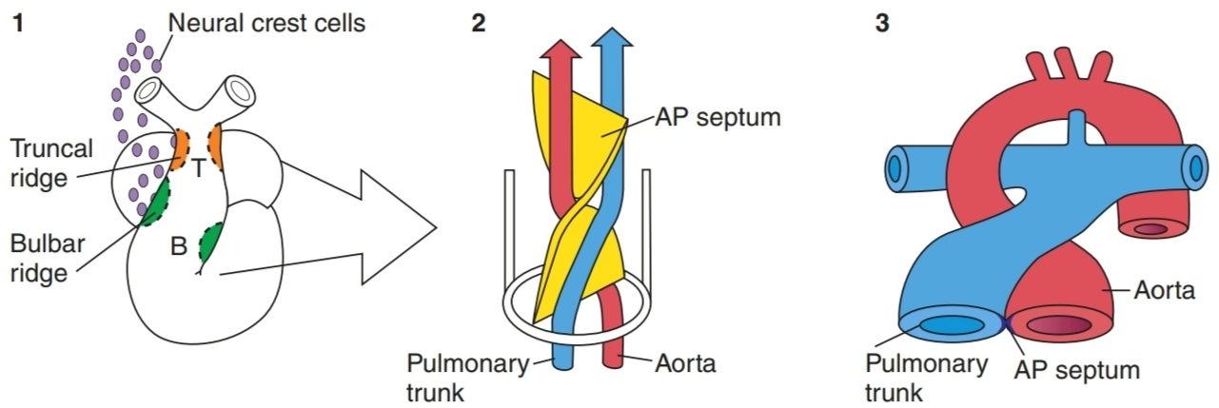
Development of Aorta and Pulmonary Artery
The aorta and pulmonary artery develop from a single tubular structure: the truncus arteriosus .
Two areas of thickened tissue project in the lumen of this tube on the right and left side.
As they continue to grow in size, these ridges meet and fuse to form a septum which takes a spiral course toward the end of this tube.
This septum devides the tube into two vessels: the aorta and the pulmonary artery.
The conal tissue involved in the septation of the truncus arteriosus also directs placement of the aorta and pulmonary artery over their related ventricles.

Slide 25
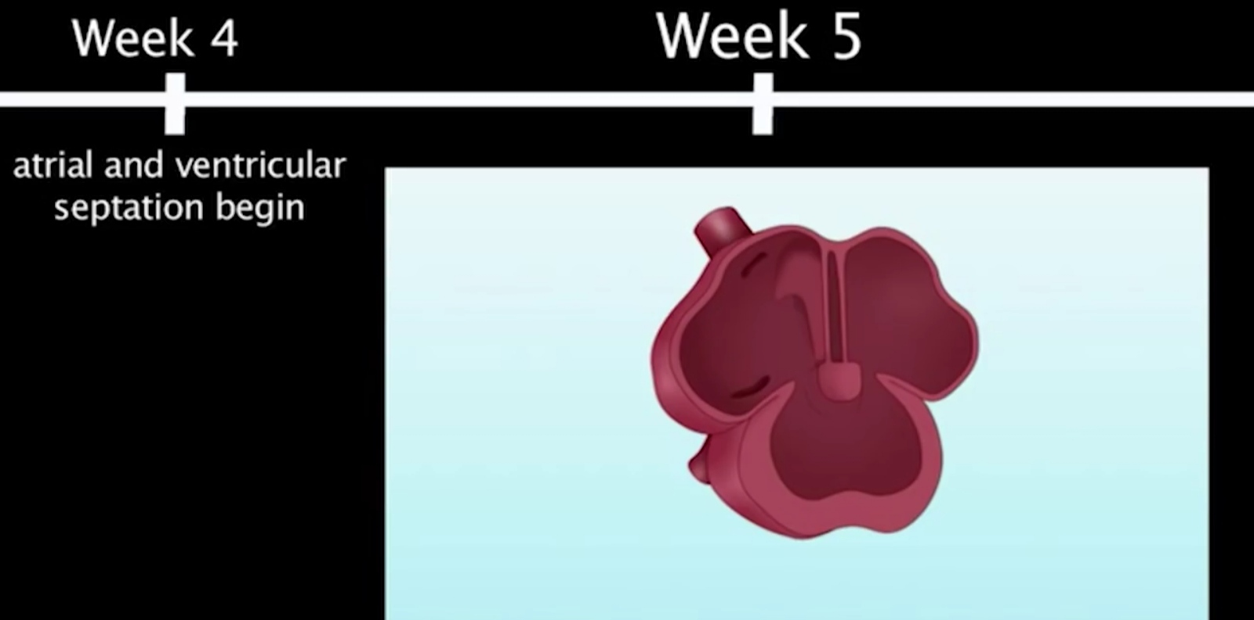
Development of the Interventriclar Septum (IVS)
by the 5th week of fetal life, the atria completely separate into the RA and LA.
also in this time, the ventricular septum continues to grow in size.

Slide 26
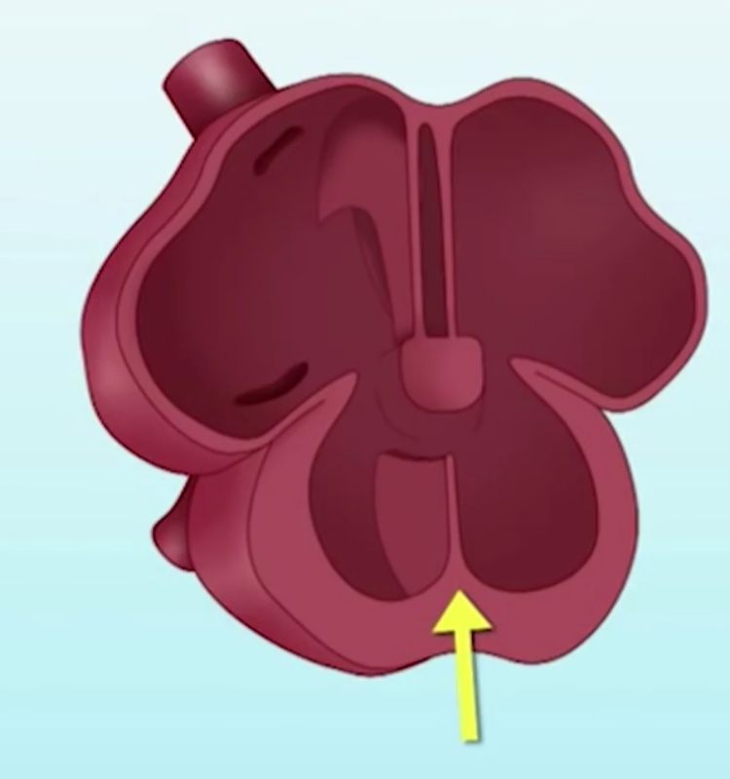
Development of the Interventriclar Septum (IVS)
the muscular portion of the ventricular septum develops from the apex of the common ventricle.

Slide 27
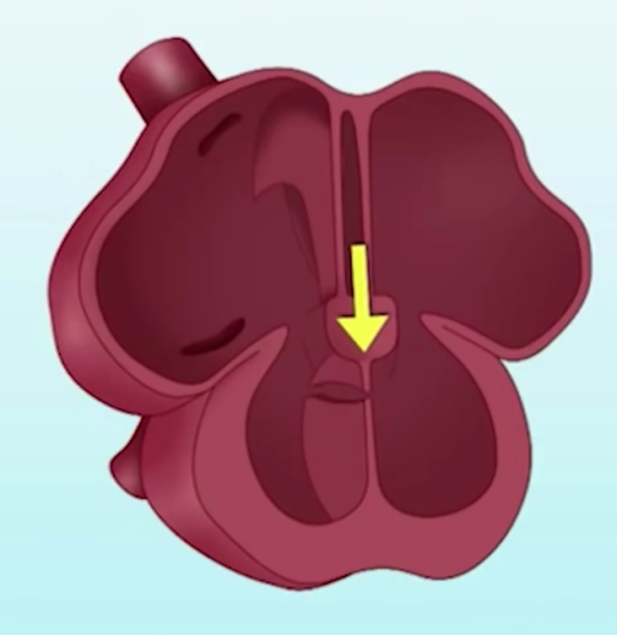
Development of the Interventriclar Septum (IVS)
the membranous septum develops from the endocardial cushion .

Slide 28
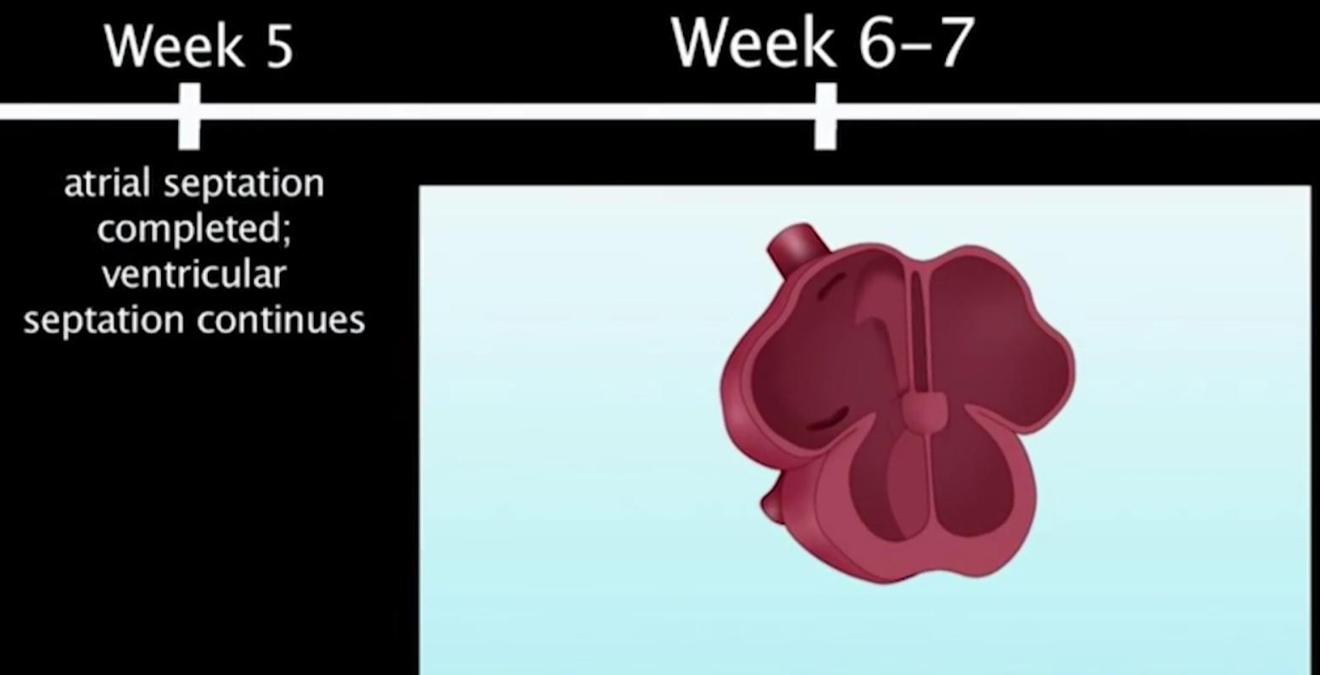
Development of the Interventriclar Septum (IVS)
conal tissue contributes to the complete closure of the septum between the aortic and pulmonary valves.
by the 6th and 7th week of the life, the ventricular septum completely separates into the RV and LV.

Slide 29
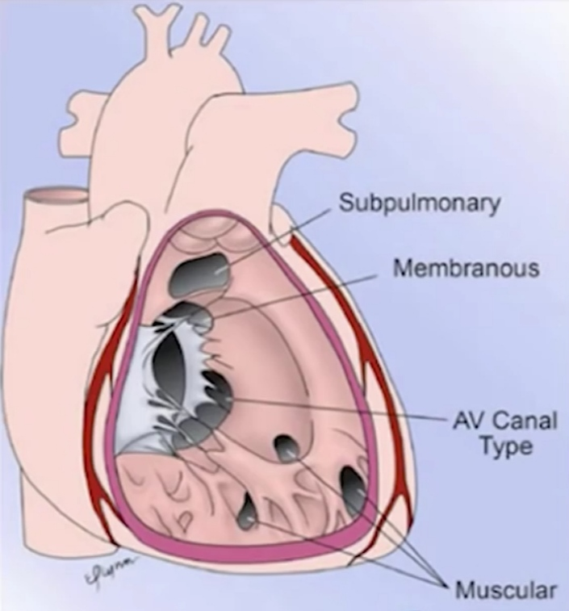
Defects of the Interventricular Septum (IVS)
Defects may occur during ventricular septation:
muscular defects can occur in any portion of the muscular septum
membraneous defects behind septal leaflet of tricuspid valve
sub-pulmonary defects are caused by deficiency of the coronal septum
atrioventricular canal type defects (AV canal) are caused by defects in the endocardial cushion tissues of the intraventricular septum.

Slide 30
Fetal Development
Cardiogenesis
Arch Formation
Fetal Circulation

Slide 31
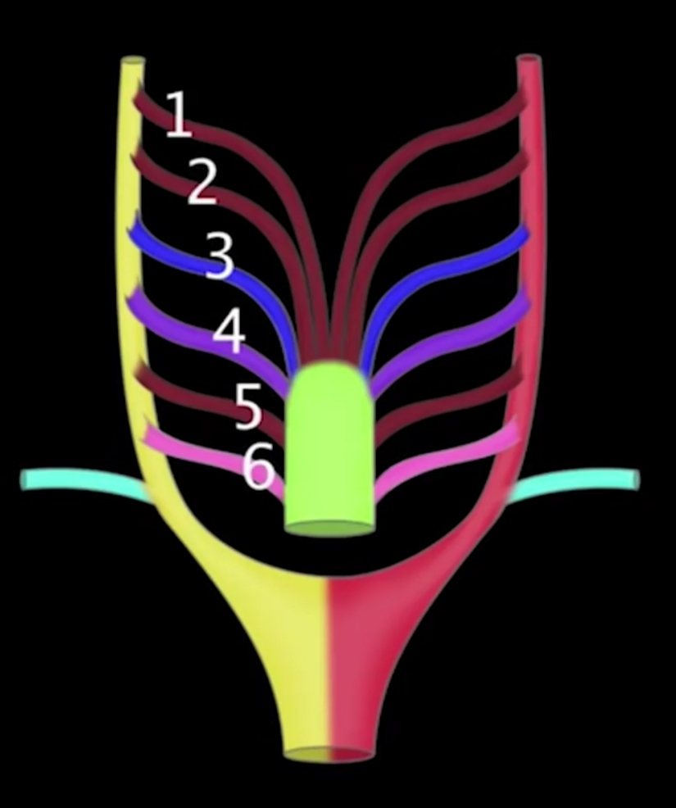
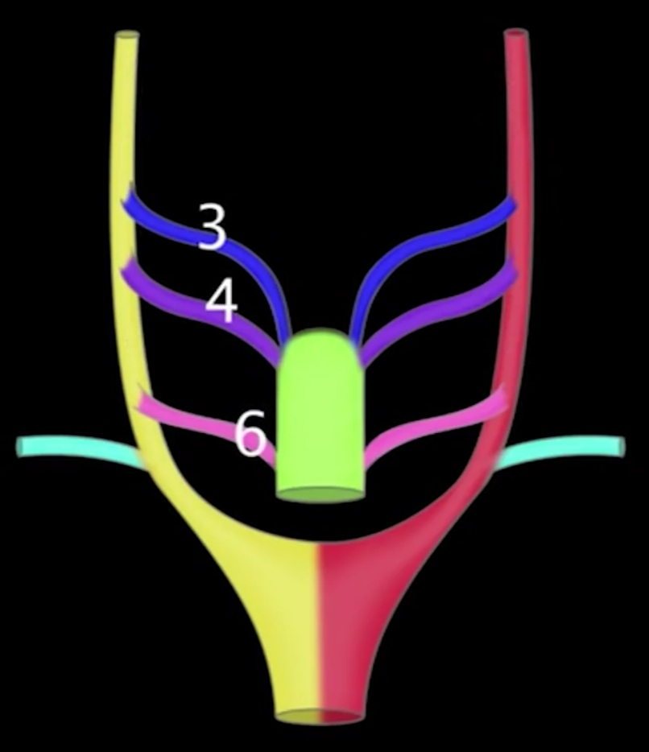
Arch Formation
The aorta and pulmonary artery and their branching vessels are formed from the pharyngeal (branchial) arch arteries.
initially there are six pairs of branchial arteries
the 1st, 2nd, and 5th pairs disappear

Slide 32
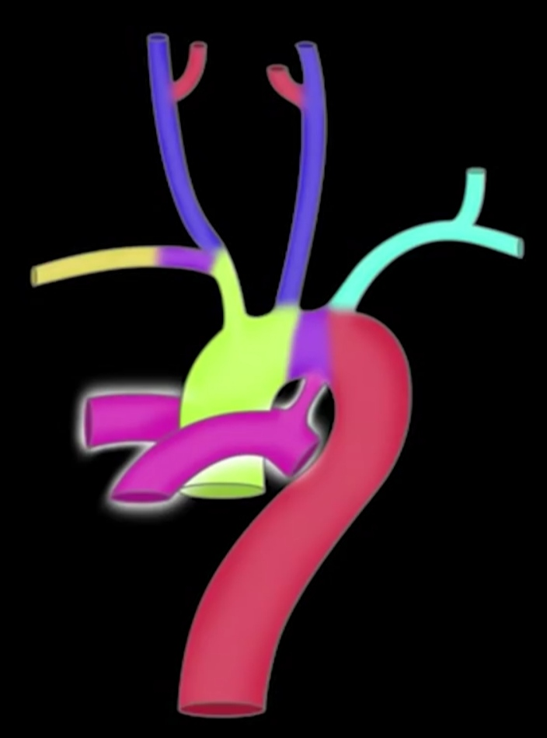
Arch Formation
the 3rd aortic arch forms the common carotid artery and internal carotid artery
the 4th aortic arch forms part of the final aortic arch as well as the proximal portion of the right subclavian artery
the 6th aortic arch produces the proximal segment of the branch pulmonary arteries, the ductus arteriosus and provides pulmonary blood flow via the branch that develops lung buds.

Slide 33
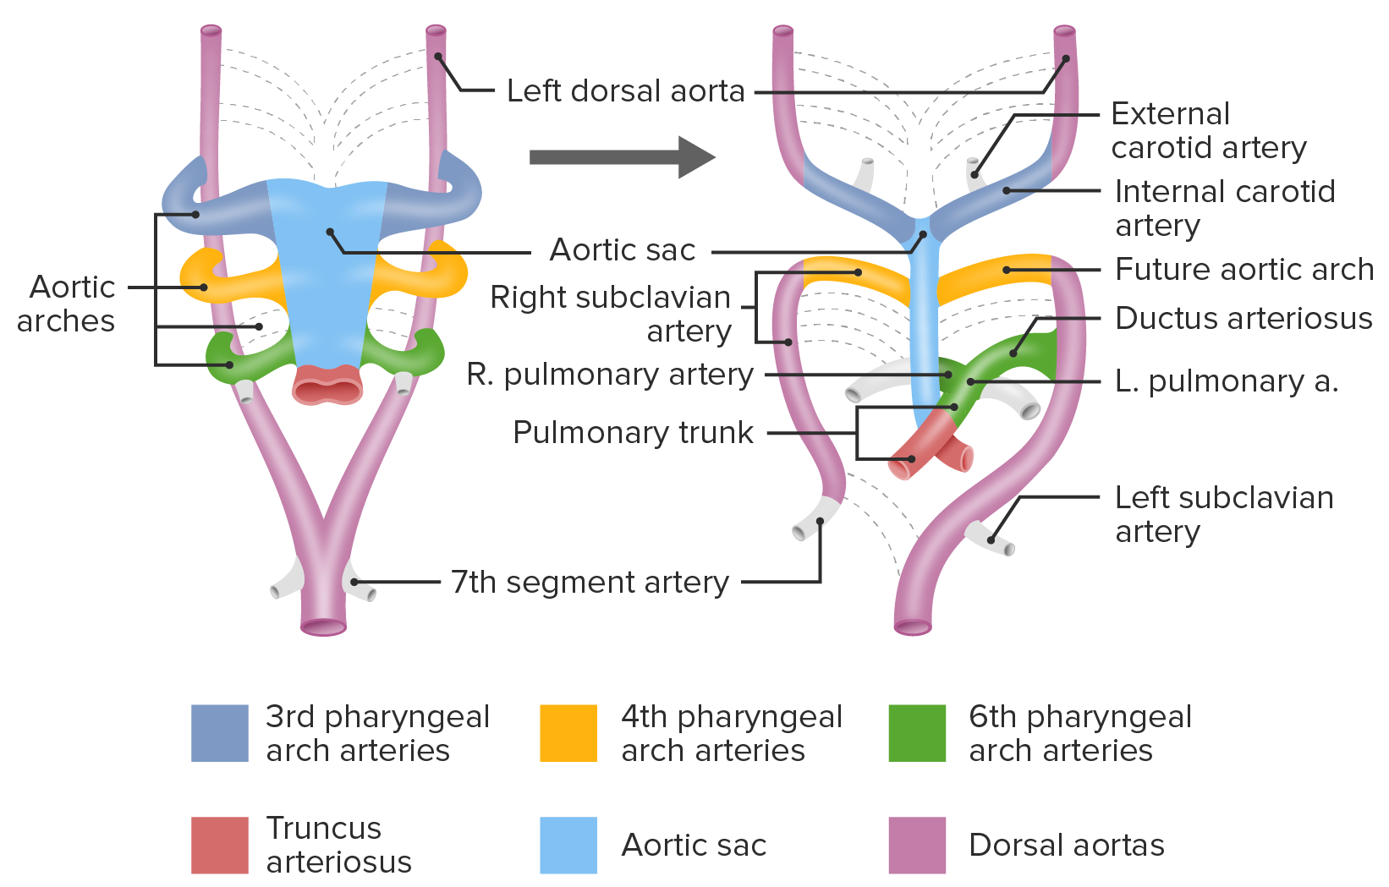
In the rest of the body, the arterial patterns develop mainly from the right and left dorsal aortae

Slide 34
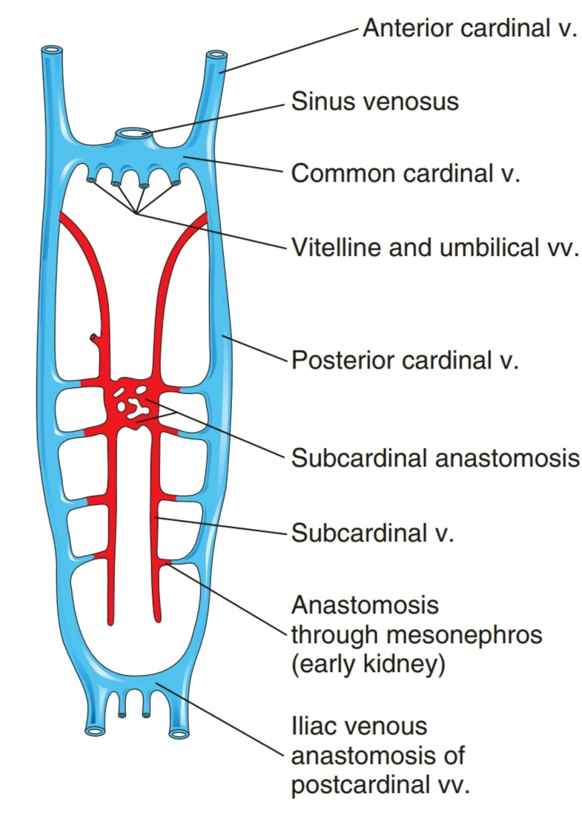
Development of the Venous System
The general pattern develops mainly from three pairs of veins:
the vitelline veins
umbilical veins
cardinal veins
that empty blood into the sinus venosus. These veins undergo remodeling during fetal life.

Slide 35
Fetal Development
Cardiogenesis
Arch Formation
Fetal Circulation

Slide 36
Fetal Circulation
The specific structures associated with fetal circulation include :
the placenta
the umbilical vein
the ductus venosus (of Aranzio)
the foramen ovale
the ductus arteriosus (of Botallo)
the umbelical arteries

Slide 37
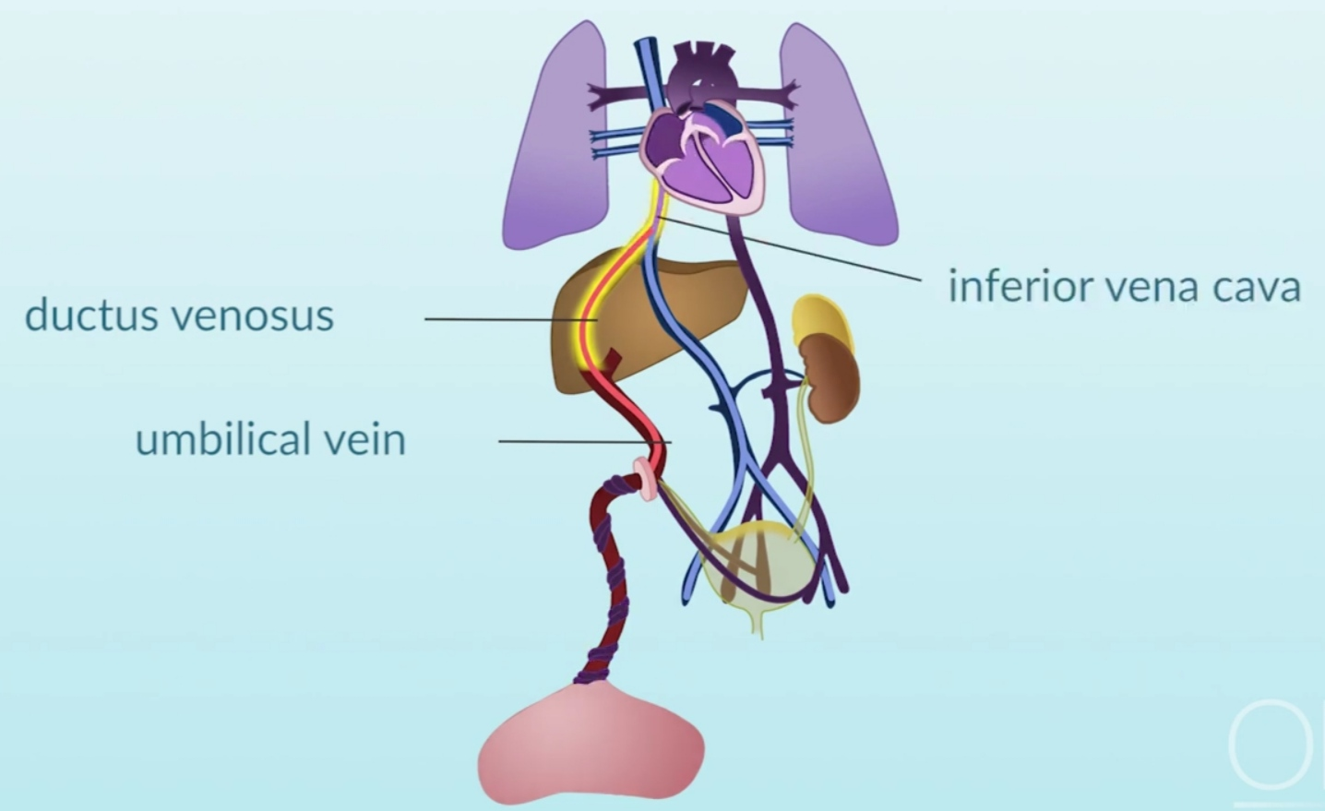
blood rich in nutrients and oxygen supplied by the placenta flows through the umbilical vein to the ductus venosus.
then, blood flows into the IVC up to the RA.
this blood mixes with blood returning to the heart from the upper body by the SVC and from the lower body via the IVC

Slide 38
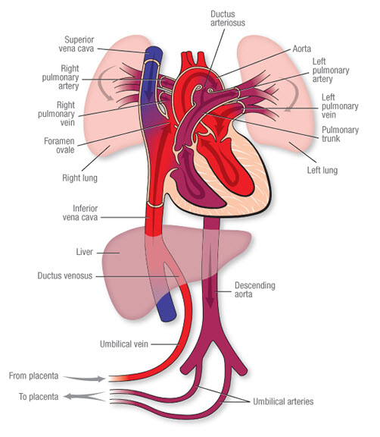
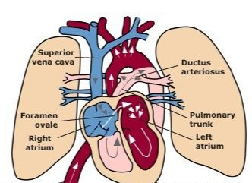
once in the RA, some of the blood flows to the RV and some of the blood flows through the foramen ovale to the LA and into the LV where it is then pumped out into the aorta to the body.

Slide 39
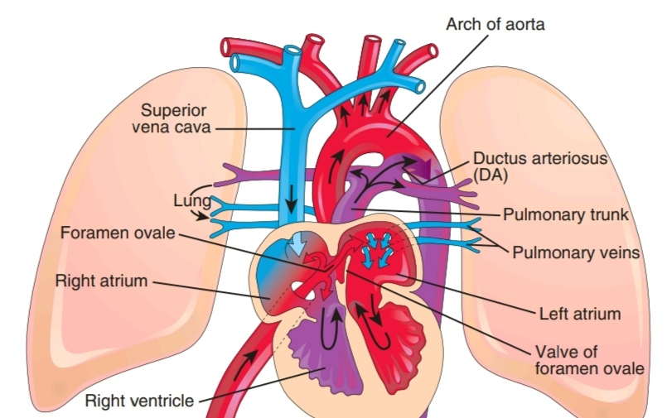
Blood that flows into the RV is then pumped into the pulmonary artery.
because the lungs are fluid-filled instead of airfield, the vessels in the lungs are narrow creating higher resistance to blood flow into the lungs.
due to this high resistance to blood flow in the pulmonary circulation and the low resistance to blood flow in the systemic circulation, blood pumped into the pulmonary artery by the RV is more likely to flow into the ductus arteriosus and then into the aorta (only 8% of right ventricular output flows into the lungs providing nutrients for the developing lung tissues).

Slide 40
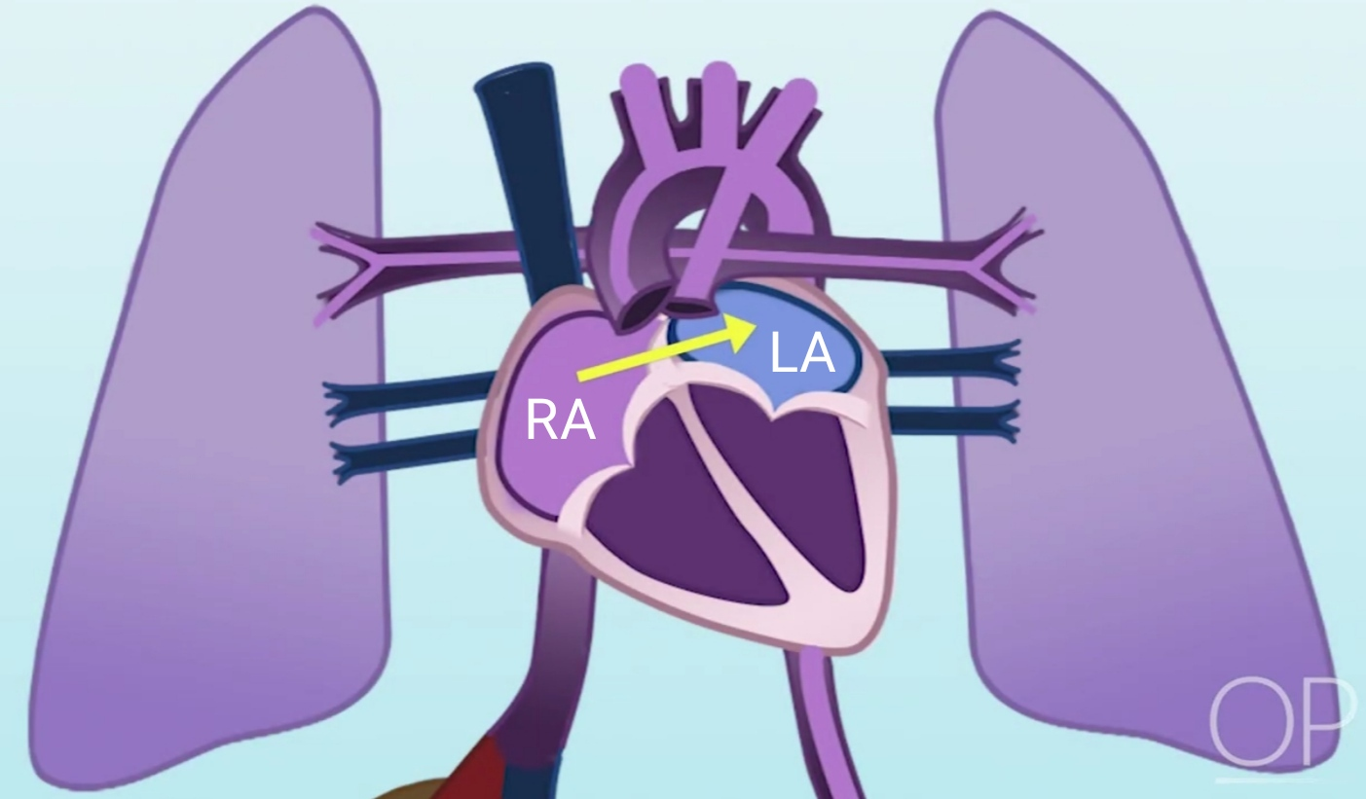
due to the high blood flow from the SVC and the IVC up to the RA, pressures in the RA are higher than in the LA.
this promotes blood flow through the foramen ovale from RA to LA.

Slide 41
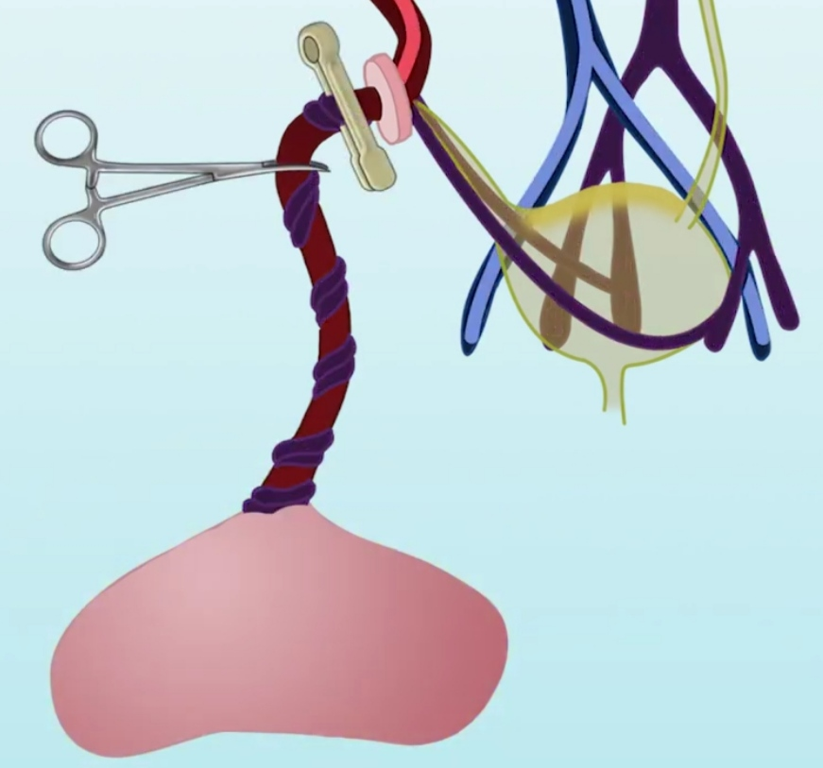
Transition from Fetal to Post-natal Circulation
the umbilical arteries allow blood to flow from the body back to the placenta to be enriched with oxygen and nutrients.
once the baby is born and takes a breath, the umbilical cord is clamped and the placenta is removed from the systemic circulation.
immediately the transition from fetal to postnatal circulation begins.
with the elimination of the placenta from the circulation, systemic vascular resistance begins to rise.

Slide 42
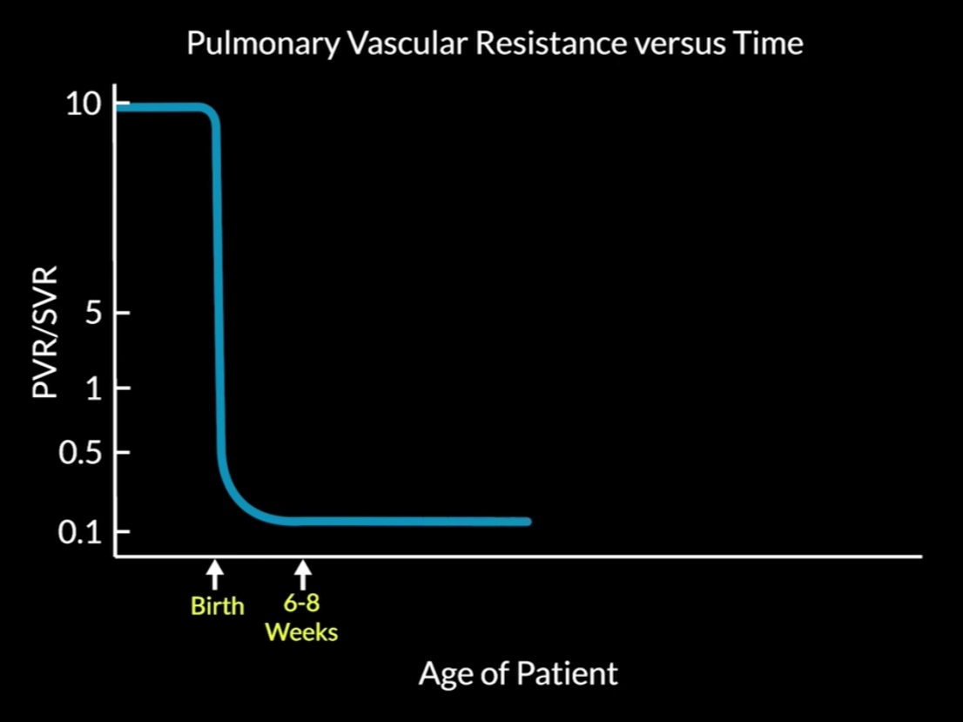
Transition from Fetal to Post-natal Circulation
with each breath more alveoli in the lungs expand and the vessels surrounding them dilate in response to the presence of oxygen.
pulmonary pressures begin to decrease and become lower than systemic pressures within minutes after birth.
it takes 6 to 8 weeks before pulmonary vascular resistance decreases to normal.

Slide 43
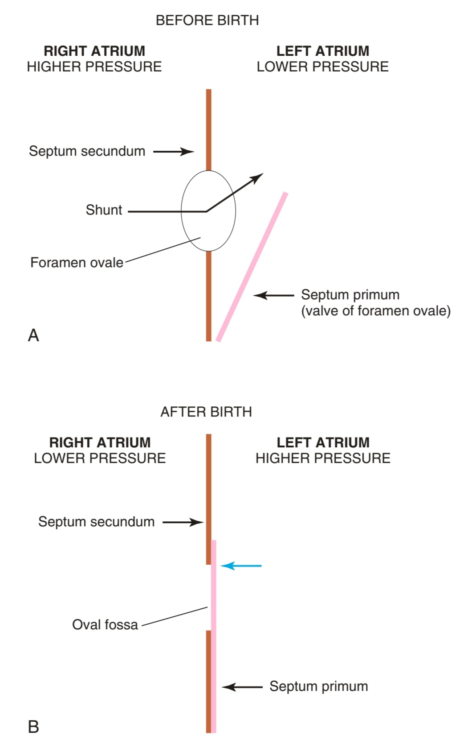
Closure of Foramen Ovale
the increase in LA pressure after birth forces the septum primum against the septum secundum, functionally closing the foramen ovale.
within 3 months the foramen ovale permanently closes as fibrin deposits fuse the layers of septal wall together.

Slide 44
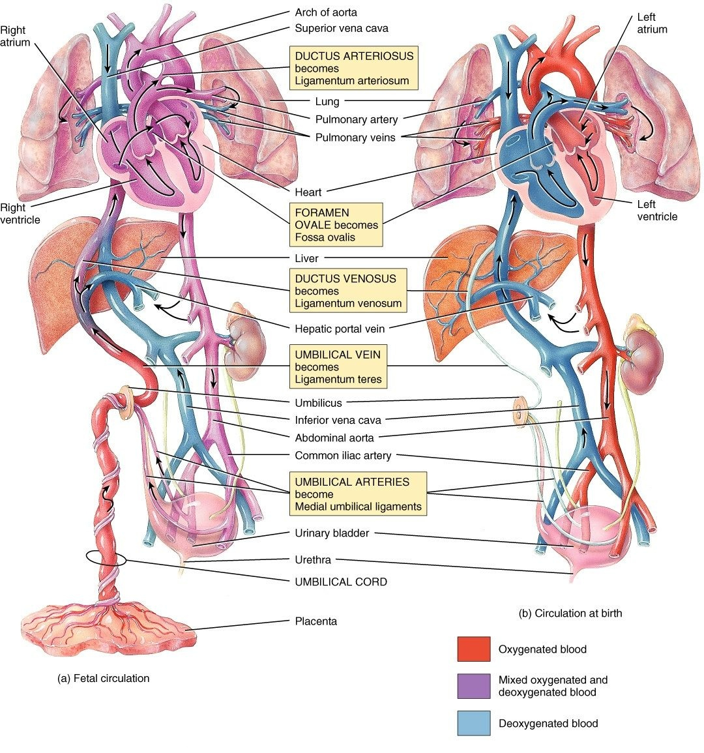

Slide 45
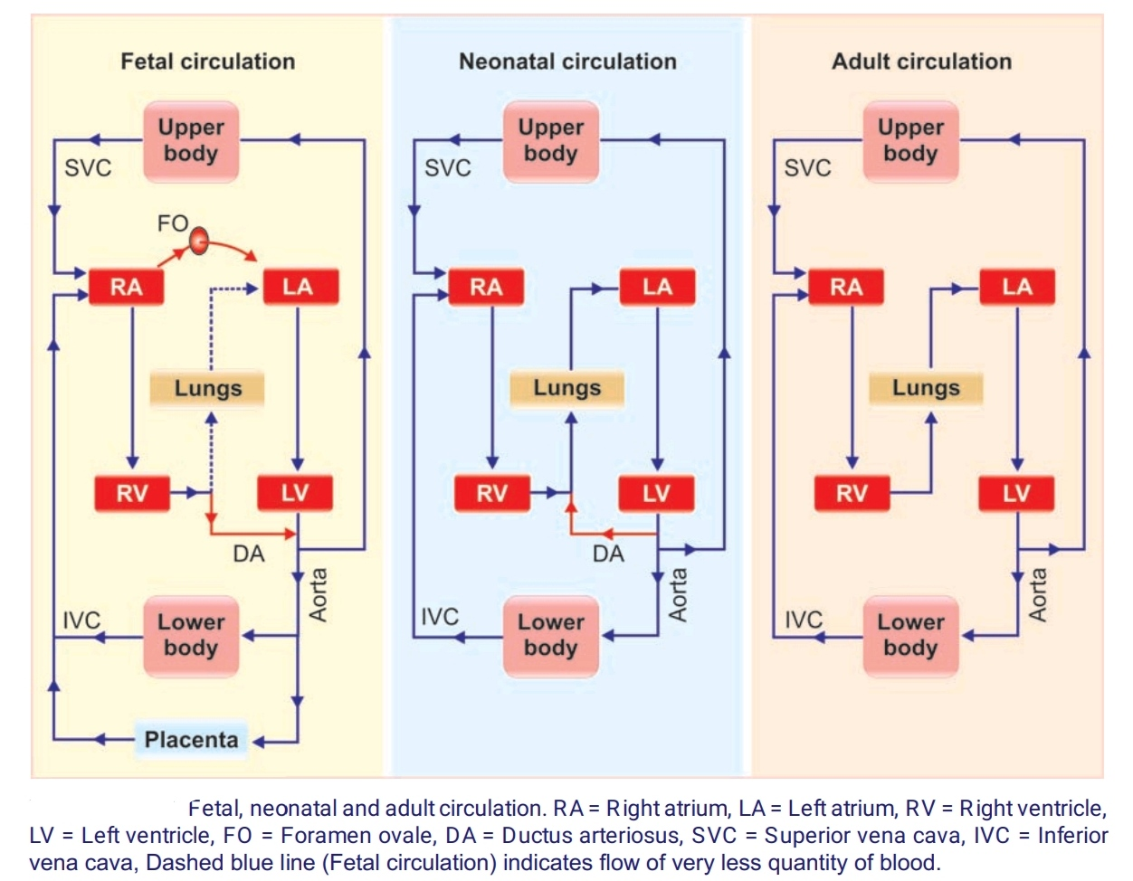

Slide 46
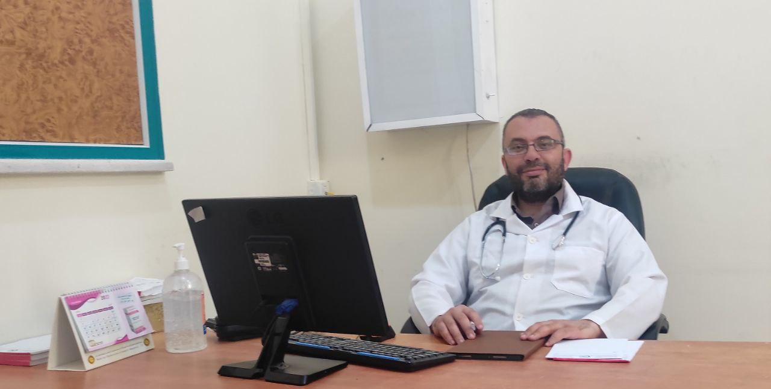
تمنياتي لكم جميعاً بالتوفيق و النجاح
د. ساهر خضر أبو غالي

