Slide 1
ANATOMY LAB 1
Cardiovascular System
Prepared By:
Dr. Ayah Mahmoud Almzayyen
MD , T.A in AUG

Slide 2
Thoracic Cavity
Boundaries:
demarcated by the rib cage, and separated from the abdominal cavity by the diaphragm
Divisions
  The centrally located mediastinum
  Two laterally located pleural cavities
Contents
  Organs: heart, lungs, esophagus, thymus
  Nerves: sympathetic trunk
  Vessels (e.g., aorta, thoracic trunk)

Slide 3
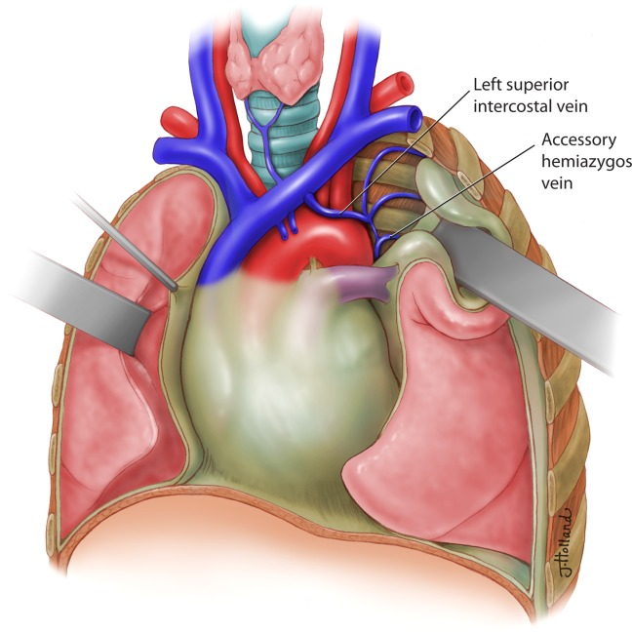

Slide 4
The Mediastinum
Definition:
The mediastinum is the central space of the thoracic cavity located behind the sternum and between the two lungs and their respective pleura.
Boundaries
  Anterior: sternum and transversus thoracis muscles
  Posterior: vertebral column
  Superior: thoracic inlet
  Inferior: diaphragm
  Lateral: pleura of the lung

Slide 5
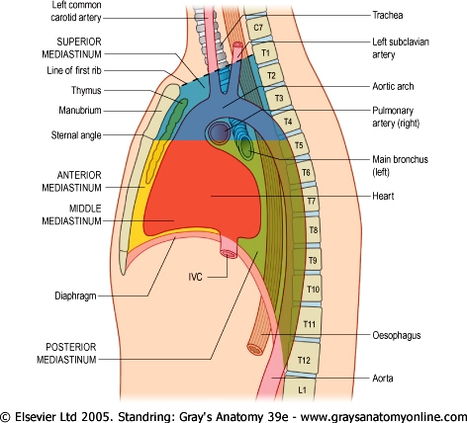

Slide 6
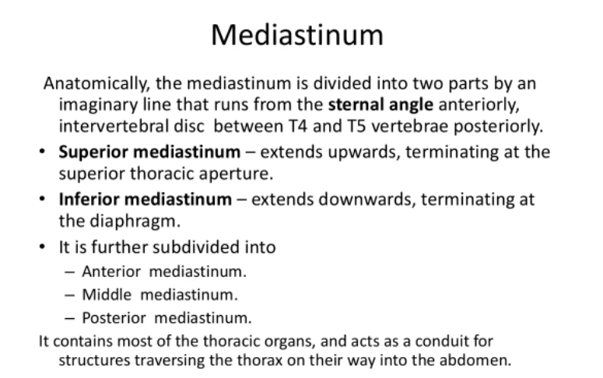

Slide 7
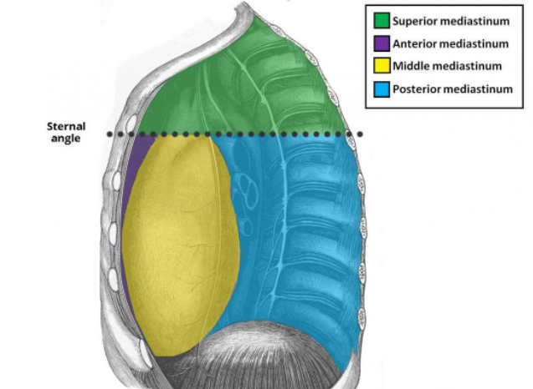

Slide 8
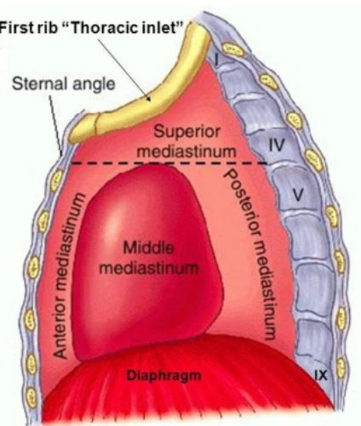
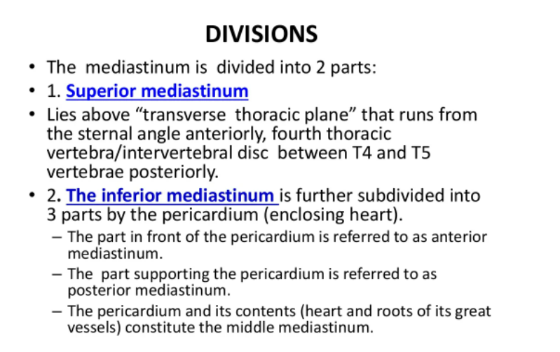
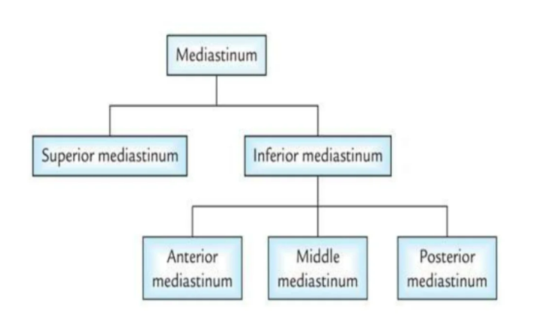

Slide 9
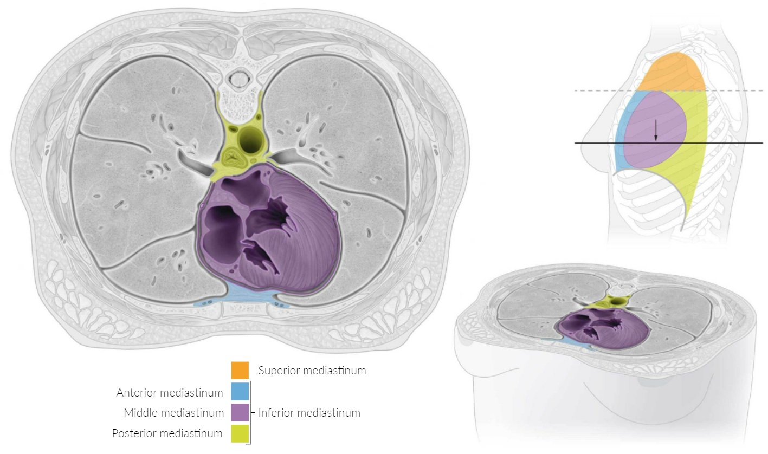

Slide 10
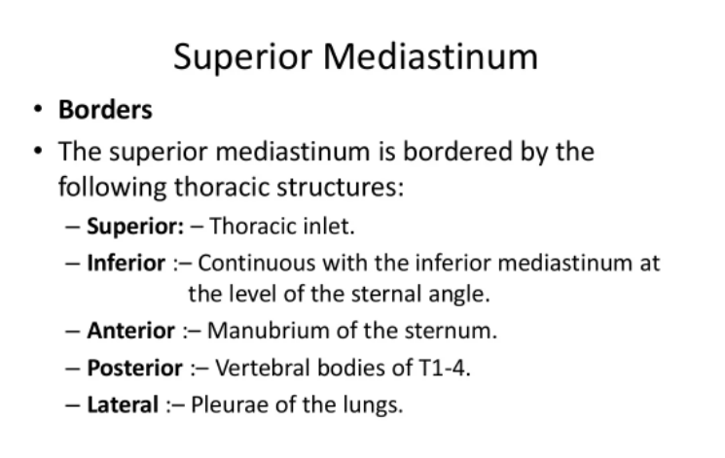

Slide 11
    Contents:
    A)Retromanubrial structures: (fatty lymphatic & venous layers)
These are structures lies immediately behind the manubrium sterni and arranged from anterior to posterior as follows:
Remains of thymus gland: After puberty it undergoes gradual involution and replaced by fibro-fatty tisuues.
Fat and anterior mediastinal lymph nodes.
Right braciocephalic vein: descends vertically behind the right margin of the manubrium.
Left braciocephalic vein: runs obliquely from left to right above the arch of the aorta, crossing the origins of its 3 branches

Slide 12
      5) Left superior intercostal vein: ends in the left brachiocephalic vein.
  6) Upper ½ of SVC: formed by the union of the right and left brachiocephalic veins, descends vertically behind the right margin of the manubrium and its posterior aspect receives the arch of the azygos vein.
  7) Right phrenic nerve on the right side of right brachio-cephalic vein & superior vena cava.

Slide 13
          B) Intermediate structures:( 2 arches & 4 nerves)
Arterial layer: Arch of aorta and its 3 branches. (brachiocephalic, left common carotid and left subclavian arteries).
Left phrenic & left vagus nerves: descend between left subclavian and left common carotid arteries then on the left side of aortic arch.
Left recurrent laryngeal nerve: it arises from the left vagus nerve and curves around the lower aspect of the arch of the aorta.
Superficial cardiac plexus below arch of aorta.
Arch of azygos.

Slide 14
          Prevertebral structures:(3 tubes, 2 nerve)
Trachea with its right vagus on its right side. It descends behind the arch of aorta and its branches.
Oesophagus : It descends posterior to the trachea .
Thoracic duct: ascends on the left border of oesophagus.
Left recurrent laryngeal nerve ascends in between the
trachea and oesophagus.

Slide 16
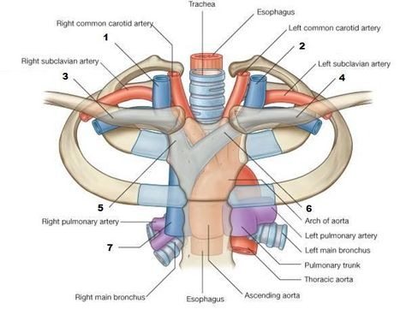

Slide 17
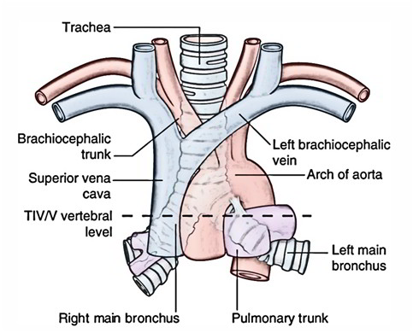

Slide 18
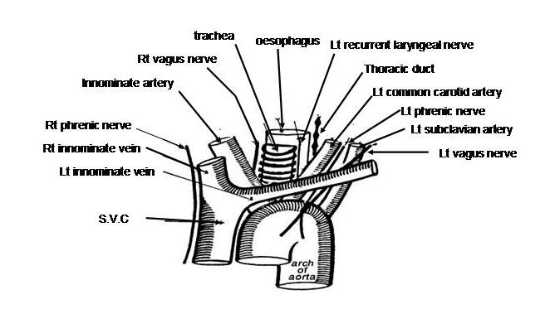

Slide 19
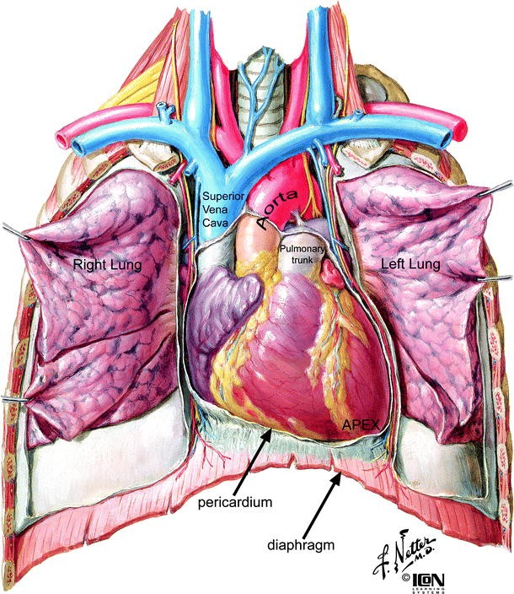

Slide 20
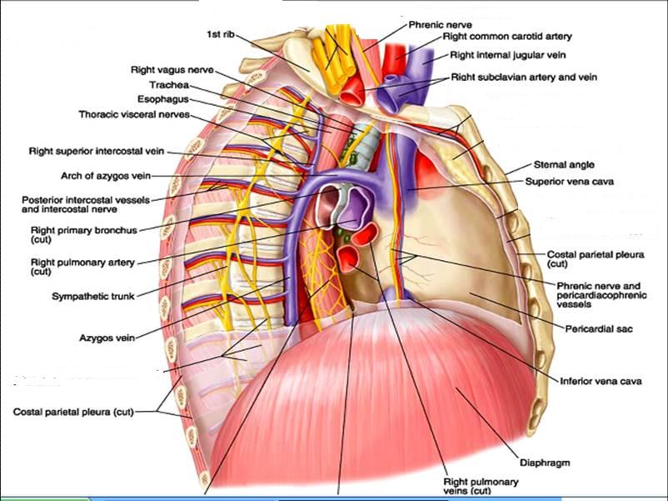
Mediastinum (right lateral view)

Slide 21
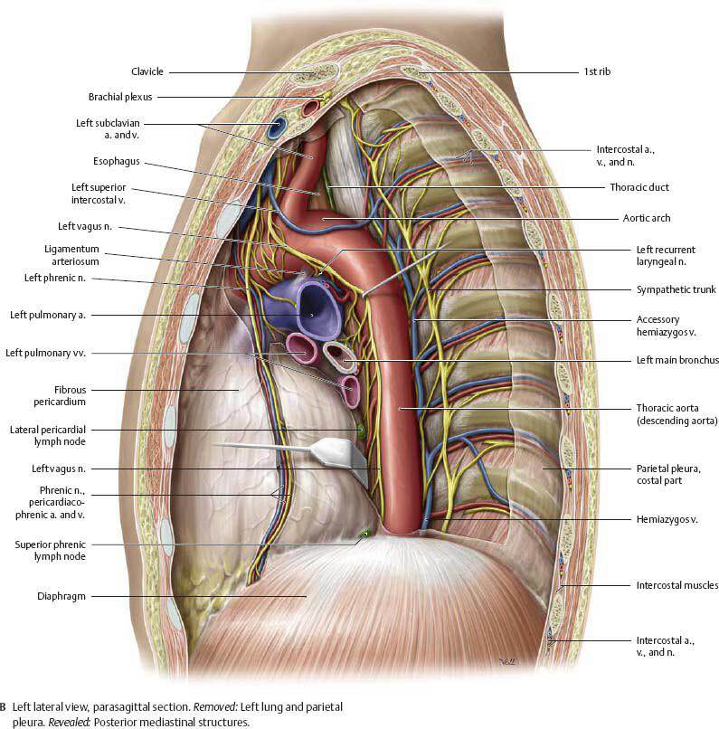
Mediastinum (left lateral view)

Slide 22
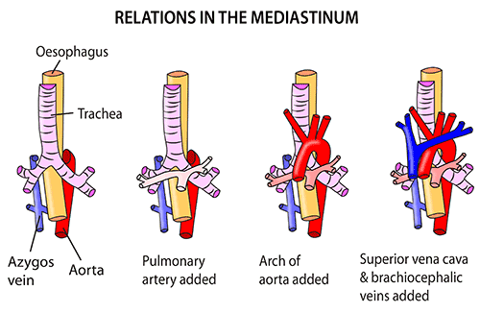
Structures of superior mediastinum can be classified from anterior to posterior into fatty lymphatic layer , venous layer , arterial layer , tubular layer.

Slide 23
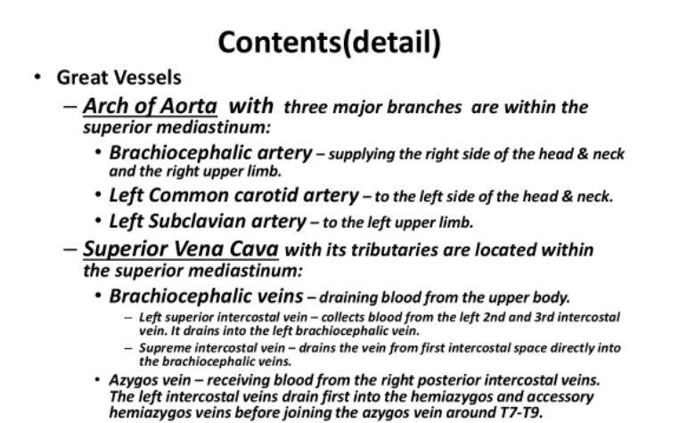

Slide 24
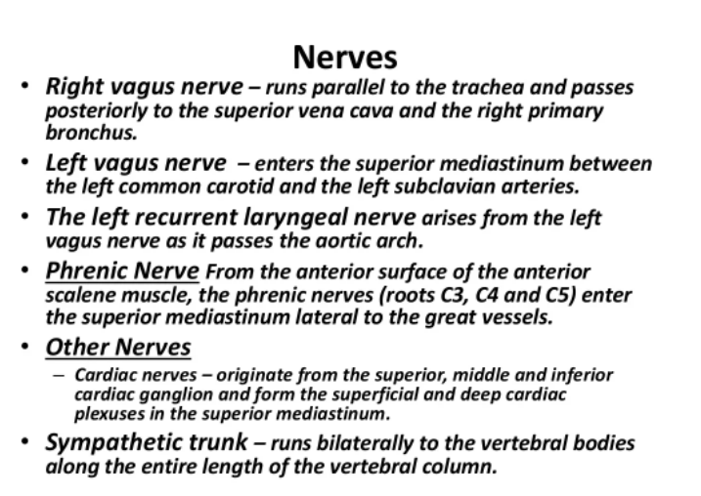

Slide 25
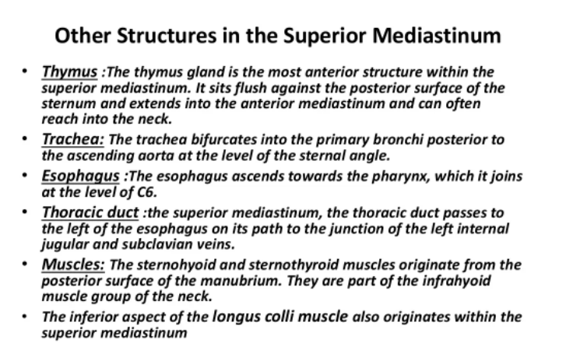

Slide 26
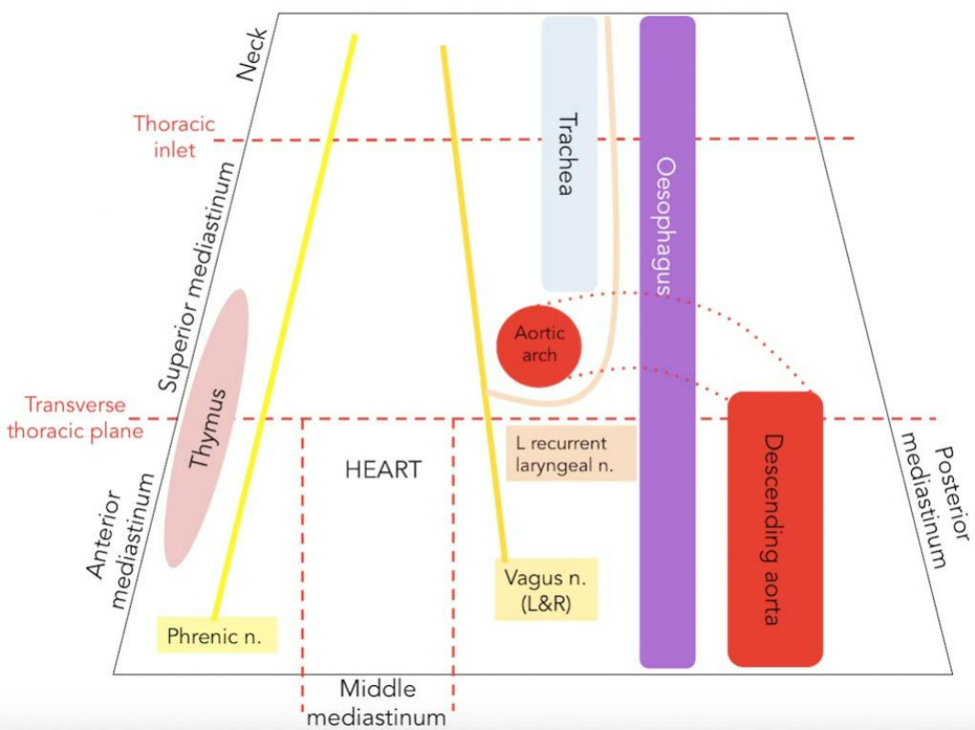
The left recurrent laryngeal nerve arises from the left vagus nerve as it passes the aortic arch. It loops under the arch, to the left of ligamentum arteriosum, before continuing its journey to the larynx in the tracheal-esophageal groove.

Slide 27
II) Inferior mediastinum:
Lies below a line drawn from the angle of Louis to the disc between T4 and T5 vertebrae.
It is divided into:
Anterior mediastinum:
    It is a narrow space between body of sternum and pericardium.
    It contains: (2 lymphatic tissues & 2 ligaments)
Fat, lymph nodes, lower part of thymus gland
Superior and inferior sternopericardial ligaments.

Slide 28
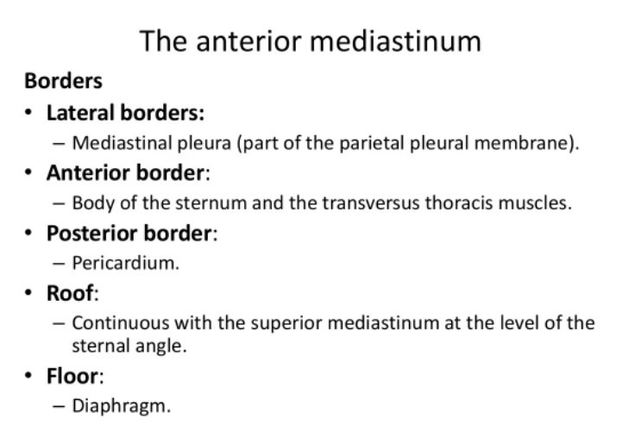

Slide 30
  b)Middle mediastinum:
It lies between anterior and posterior mediastinum.
Contents:
1) Pericardium and structure inside it: heart, ascending aorta, pulmonary trunk, lower 1/2 of SVC, terminal parts of IVC and 4 pulmonary veins.
2) Structures outside pericardium:
Bifurcation of trachea into two bronchi.
Deep cardiac plexus in front of tracheal bifurcation
Tracheobroncheal lymph nodes around tracheal bifurcation.
Arteries: right and left pulmonary arteries.
Veins: 2 right and 2 left pulmonary veins.
Phrenic nerves & pericardiophrenic vessels on each side of pericardium.

Slide 31
The Middle Mediastinum
Borders
The middle mediastinum is bordered by the following thoracic structures:
Anterior: Anterior margin of the pericardium.
Posterior: Posterior border of the pericardium.
Laterally: Mediastinal pleura of the lungs.
Superiorly: Imaginary line extending between the sternal angle (the angle formed by the junction of the sternal body and manubrium) and the T4 vertebrae.
Inferiorly: Superior surface of the diaphragm.

Slide 33
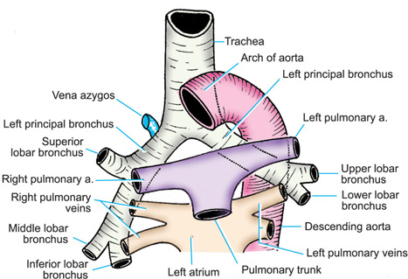
Middle mediastinum

Slide 34
  Posterior mediastinum:
Lies between pericardium and vertical part of diaphragm anteriorly, and lower 8 thoracic vertebrae posteriorly.
Contents:
1) Oesophagus: on right side of descending thoracic aorta till the level of T₇ vertebra where it crosses in front of descending thoracic aorta.
2) 2 vagi forming oesophageal nerve plexuses .
3) Descending thoracic aorta and its branches:
It descends on left side of esophagus till the level of T₇ vertebra then crosses behind it) 4)Azygos vein and 2 hemiazygos veins cross from left to right.
5)Thoracic duct: Passes behind the right border of oesophagus till the level of T₅ vertebra
6)Posterior mediastinal lymph nodes.

Slide 35
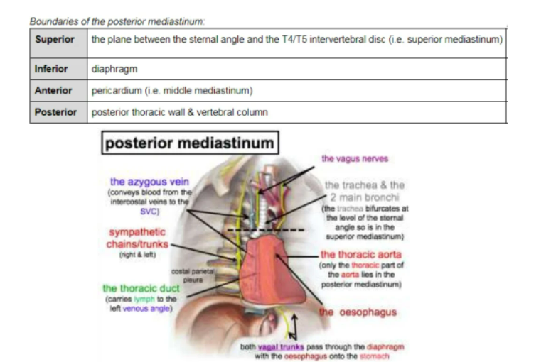

Slide 36
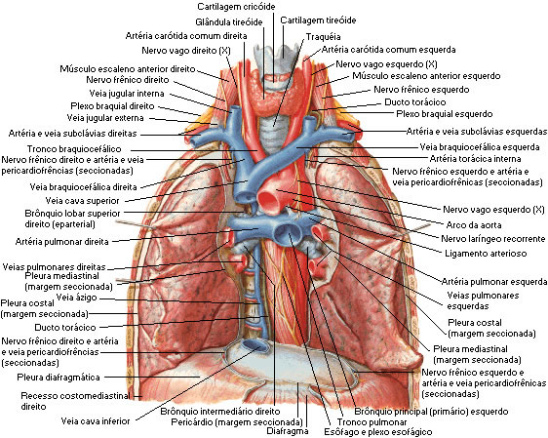
Posterior mediastinum

Slide 37
Mediastinum (right lateral view)
Mediastinum (left lateral view)

Slide 38
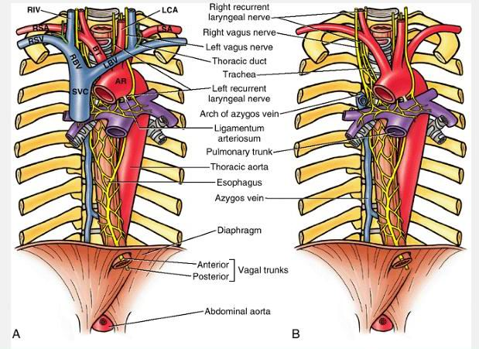
Superior & Posterior mediastinum

Slide 39
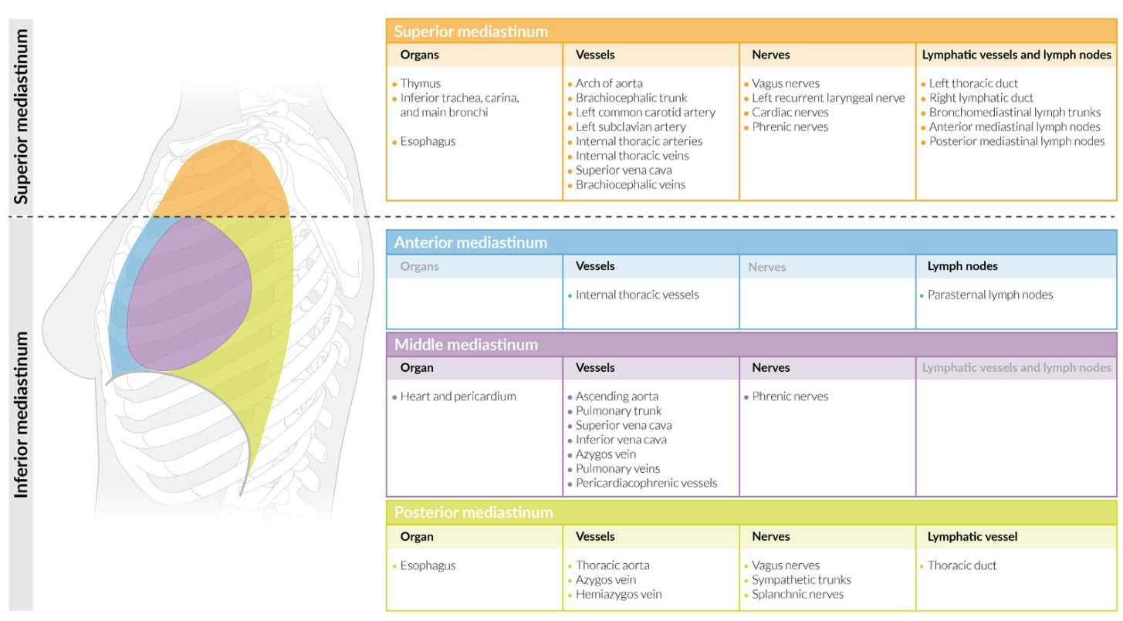

Slide 40
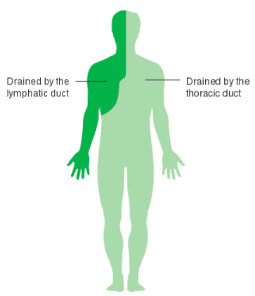
Thoracic Duct
The thoracic duct (also known as van Hoorne’s canal) is the largest lymphatic vessel in the body, It is approximately 40 cm in length in adults, and approximately 5 mm in width at its abdominal origin.
The thoracic duct drains the lymph from 75% of the body, aside from the right upper right limb, right breast, right lung and right side of the head and neck (which are drained by the right lymphatic duct) into the venous system.
The thoracic duct is formed from the abdominal confluence of the left and right lumbar lymph trunks, as well as the left and right intestinal lymph trunks between T12 and L2. If the confluence of lymph trunks is saccular, it is referred to as cisterna chyli. The action of breathing helps chyle flow up the thoracic duct. The duct also contains smooth muscle within its walls, as well as interval valves (much like large veins), which prevent backflow of lymph.

Slide 41
The duct enters the mediastinum via the aortic hiatus. It ascends to lie directly anterior to the T6-T12 vertebrae, before deviating left as it ascends into the superior mediastinum. While located in the posterior mediastinum, the thoracic duct receives lymphatic drainage from the intercostal spaces and neighboring anatomical structures through a number of branches.
Within the thoracic duct, there is a milky white fluid containing both emulsified fats, and the lymph fluid found in the rest of the lymphatic system. This fluid is called chyle
The lymph drains at the level of the venous angle (Pirogoff’s angle) between the left subclavian vein and the left internal jugular vein, where it reenters the systemic venous circulation

Slide 42
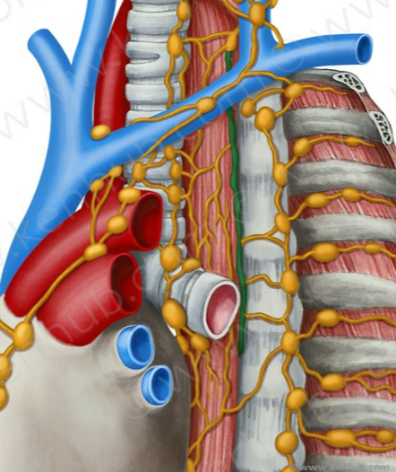
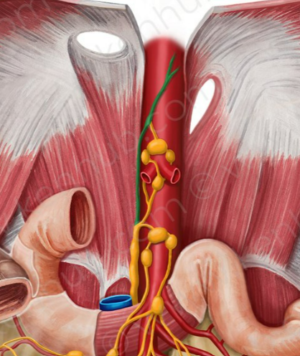
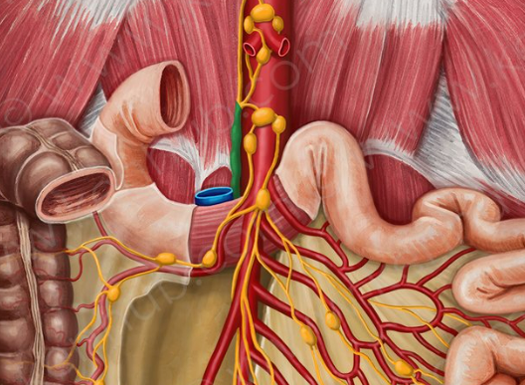

Slide 43
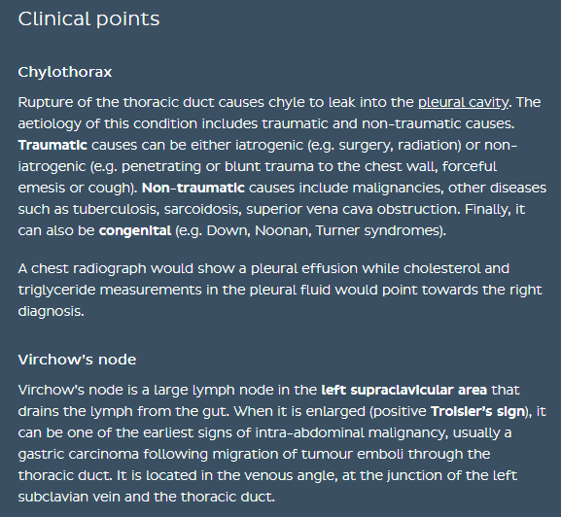

Slide 44
Applied Anatomy :
Mediastinal syndrome:
Any space occupying lesion in the mediastineum (tumour, lymph nodes enlargement, aneurysm….. etc ) cause compression of mediastinal structures leading to :
Compression of superior vena cava and brachiocephalic veins leading to congested oedematous face with congested neck veins.
  Compression of trachea leading to dyspnea.
  Compression of esophagus leading to dysphagia.
  Compression of recurrent laryngeal nerves leading to changes of voice.

Slide 45
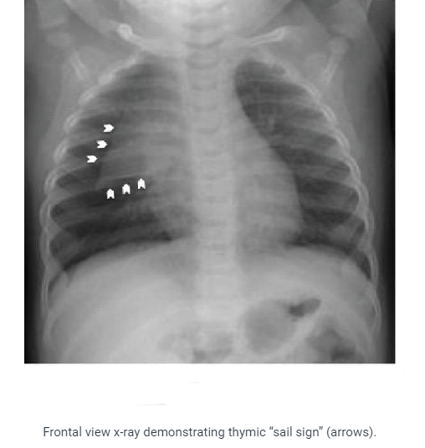

Slide 46


