Slide 1
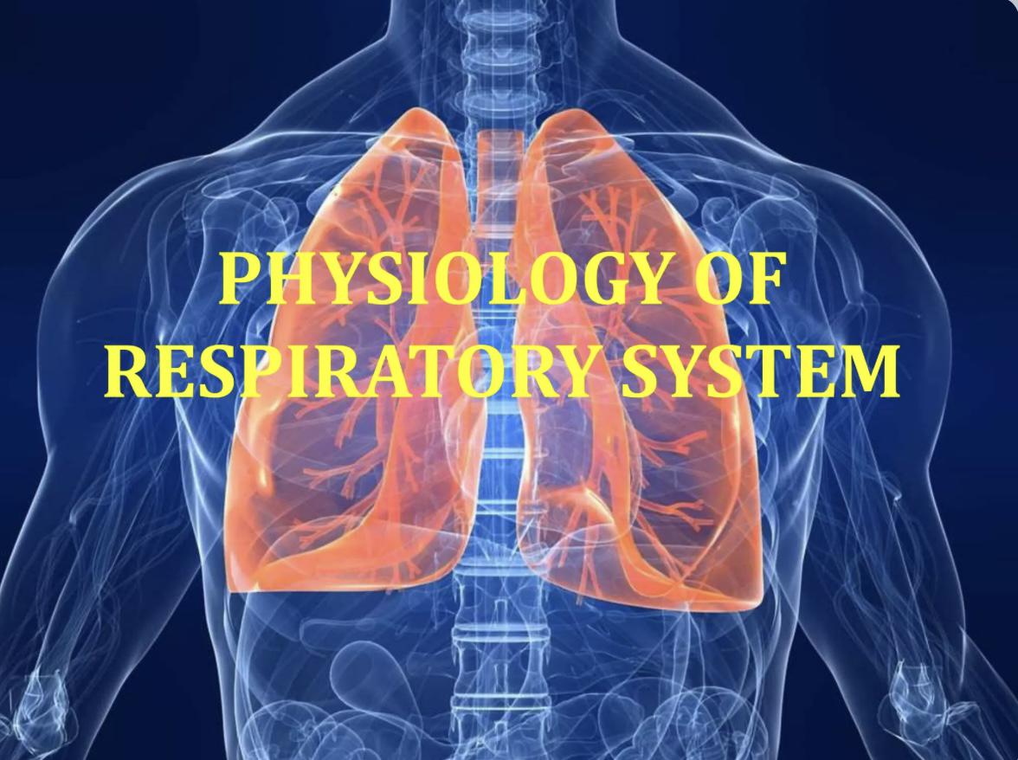
Dr. Mahmoud AbuMettleq

Slide 2
Objectives:
Respiration and it’s types
Mechanics of breathing
Lung volumes and capacities
Lung compliance
Work of breathing

Slide 3
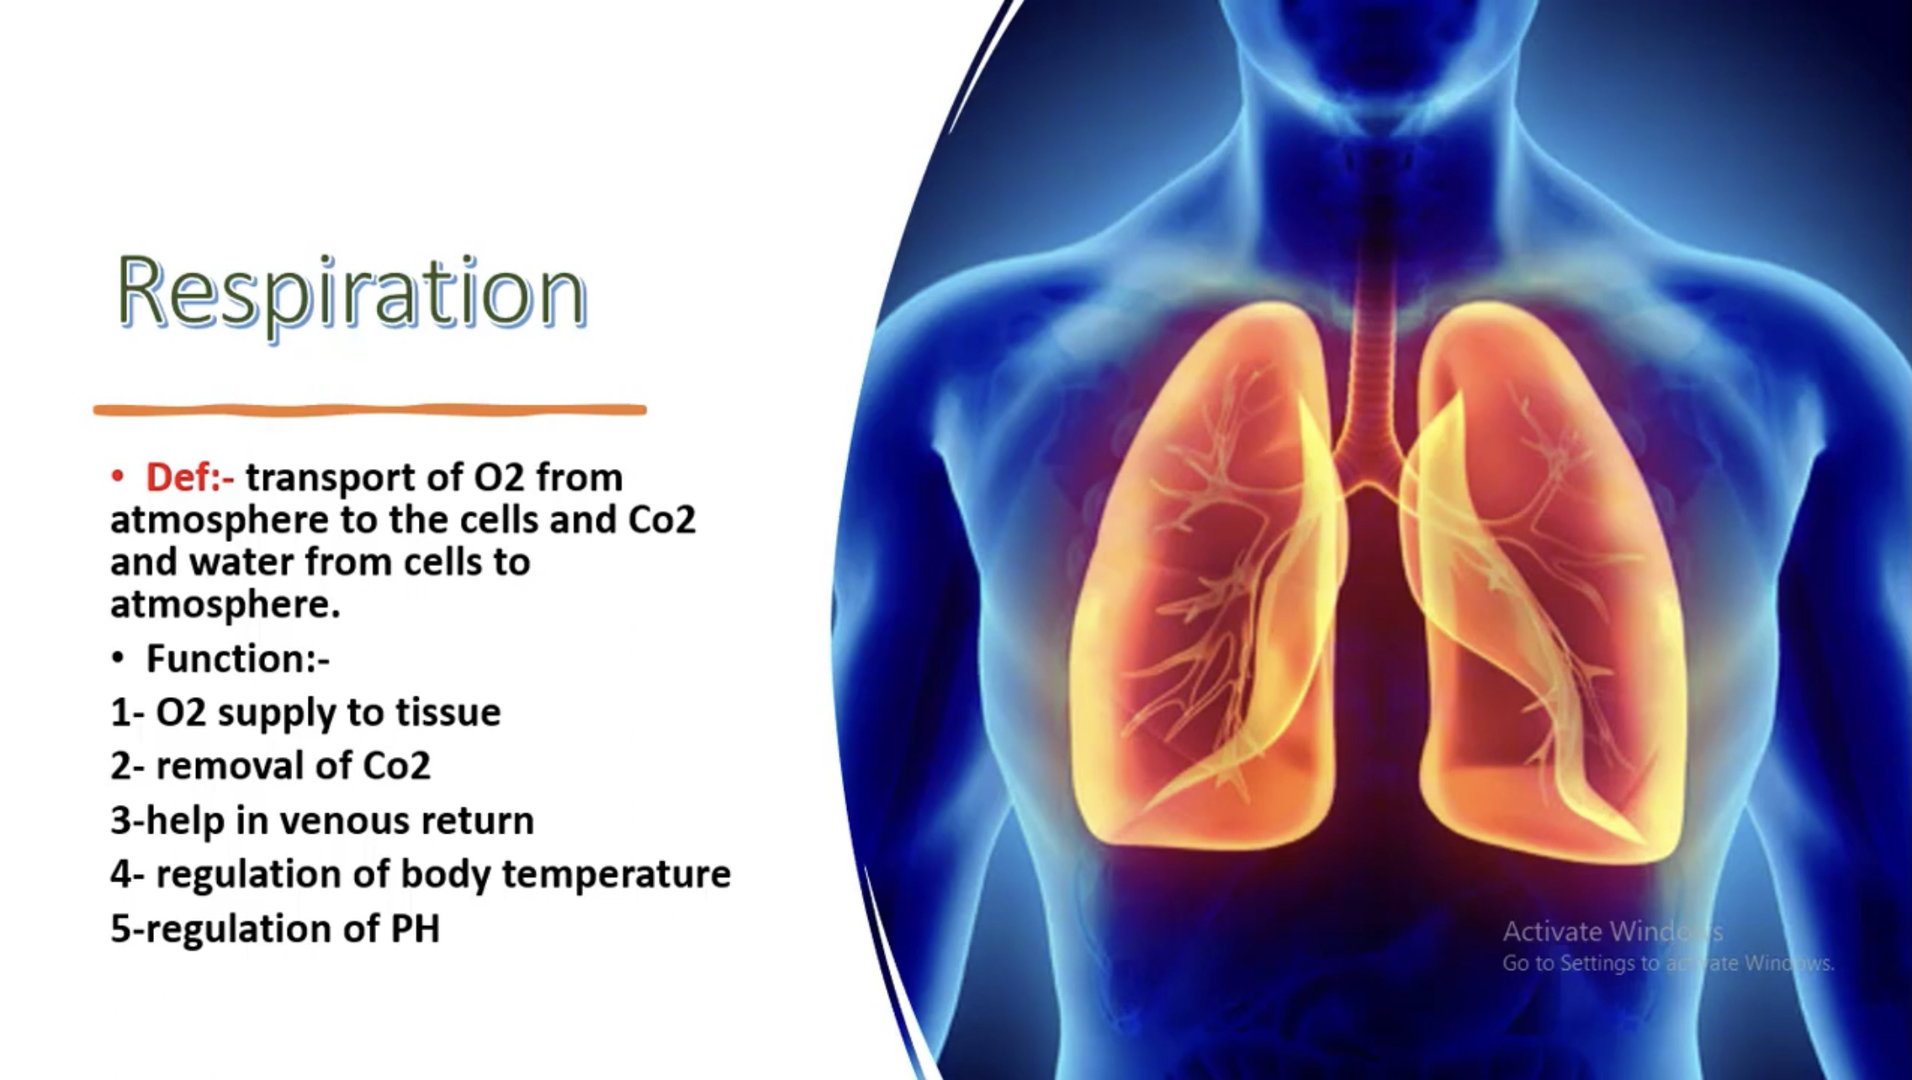

Slide 4
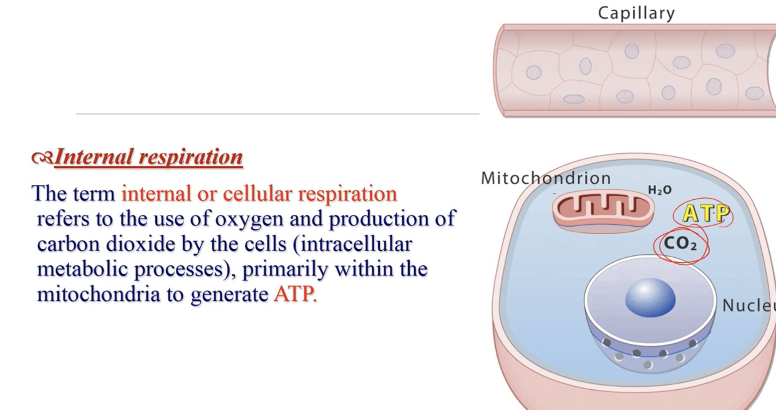

Slide 5
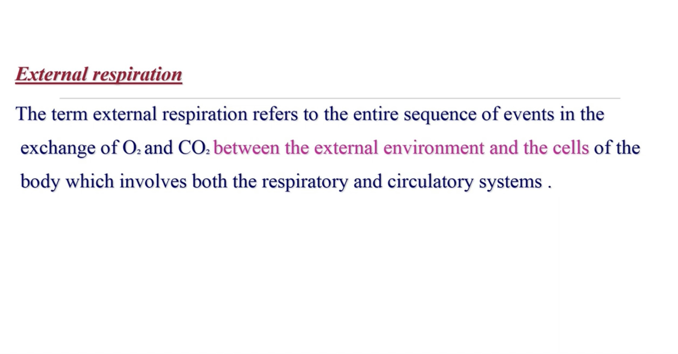

Slide 6
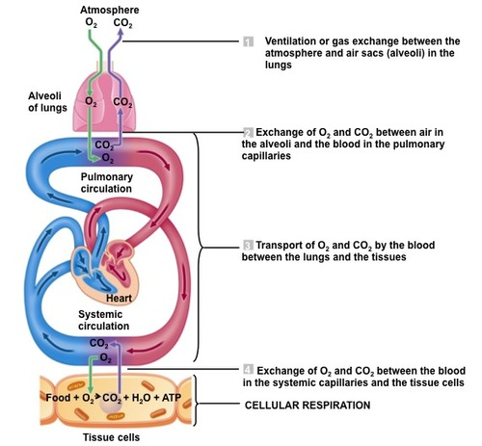

Slide 7
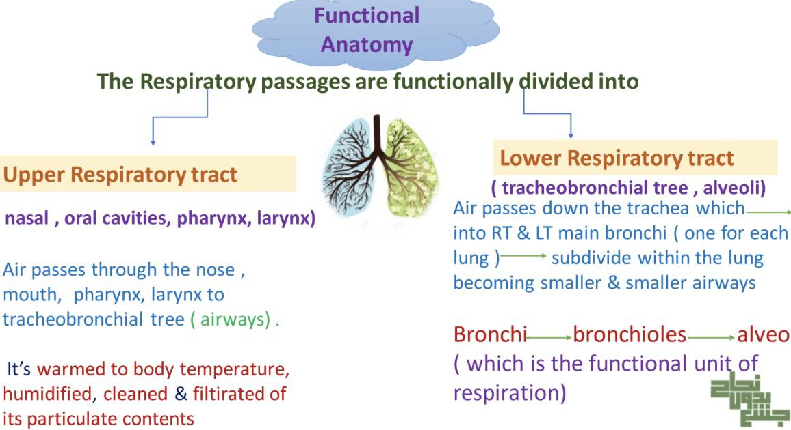

Slide 8
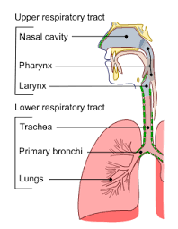
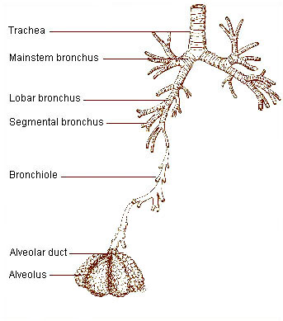

Slide 9
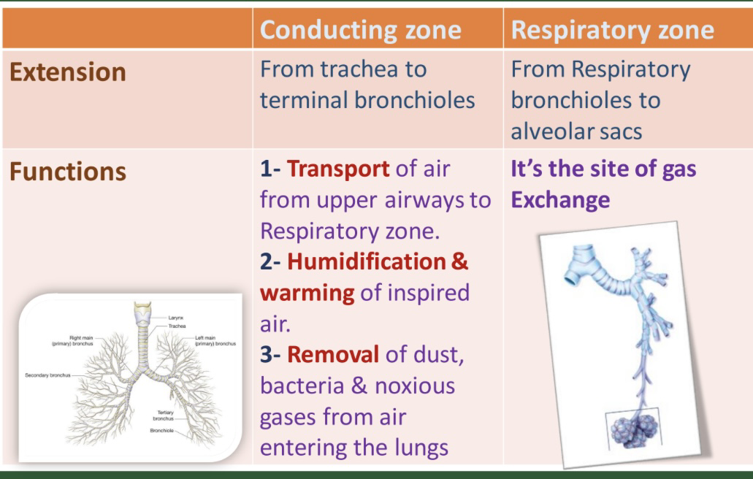

Slide 10
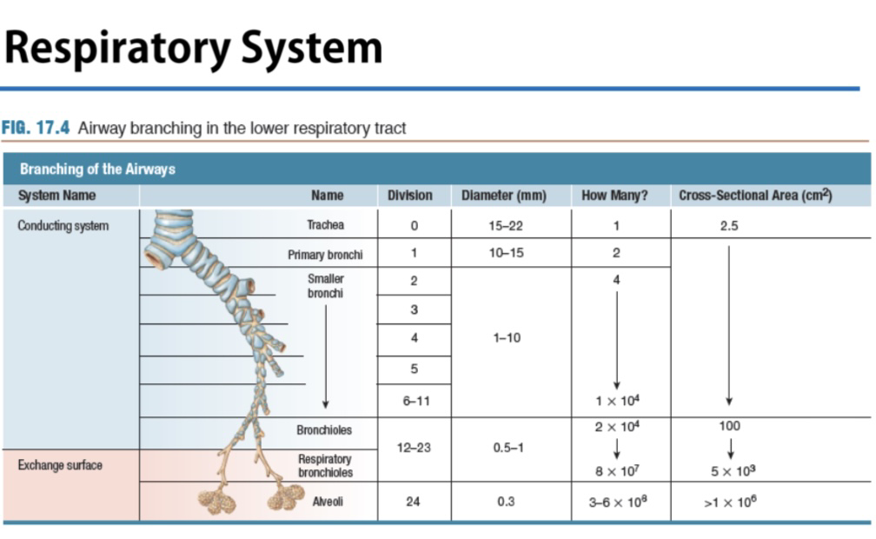

Slide 11
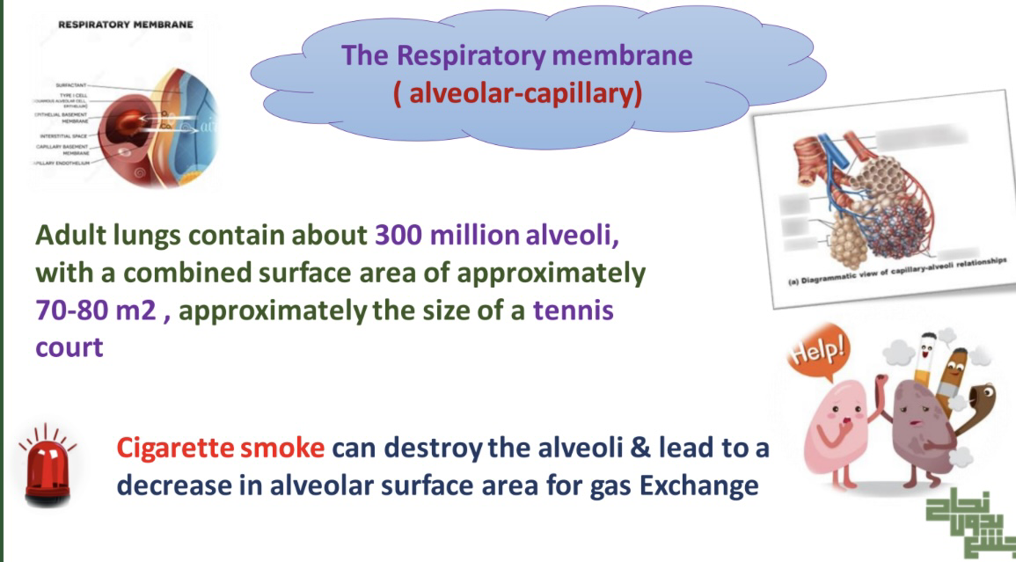

Slide 12
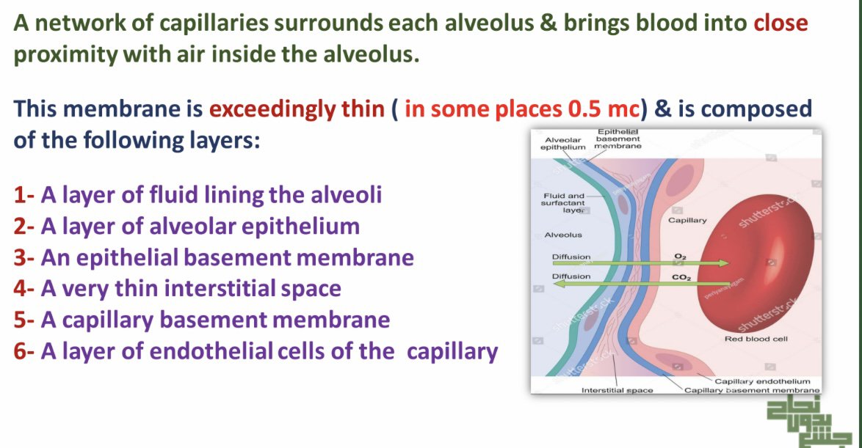

Slide 13
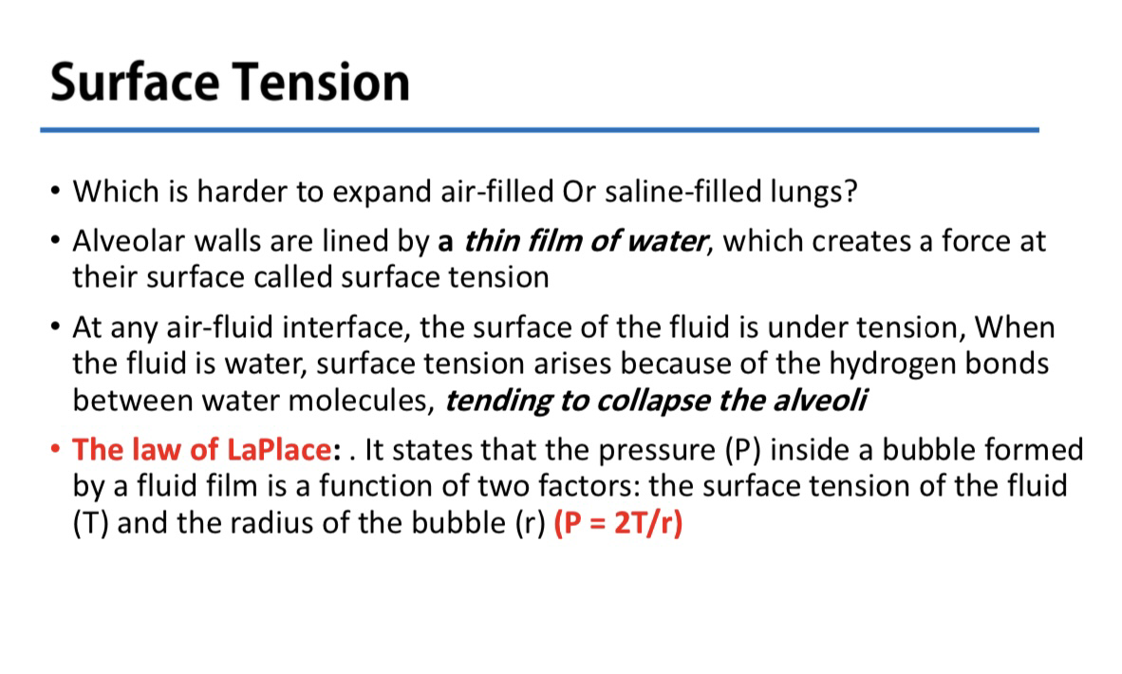

Slide 14
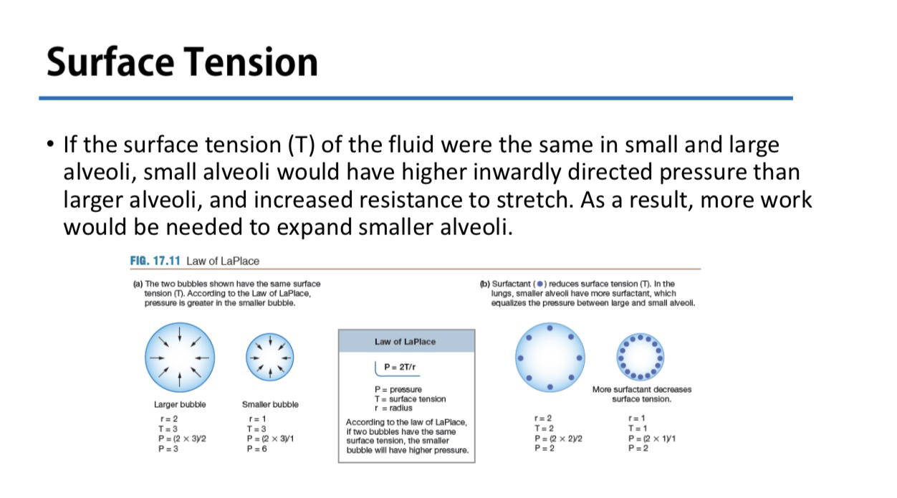

Slide 15
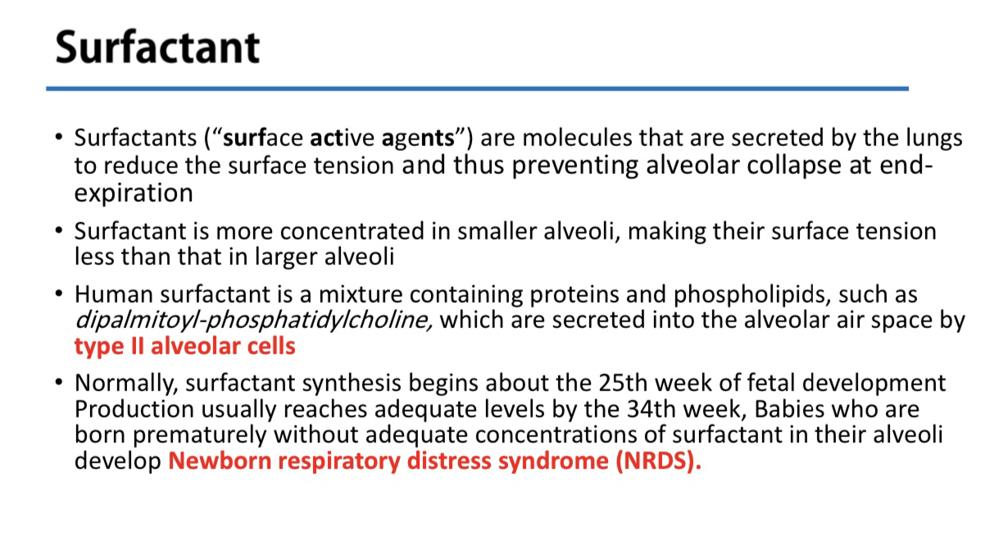

Slide 16
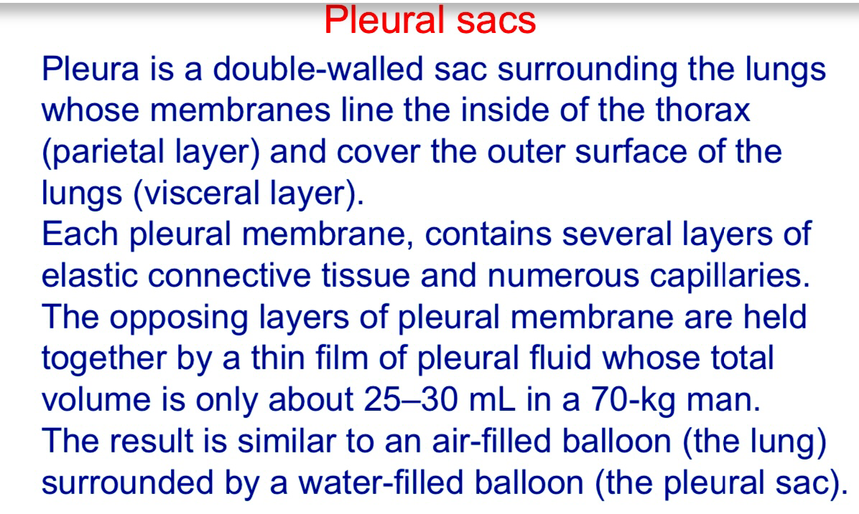
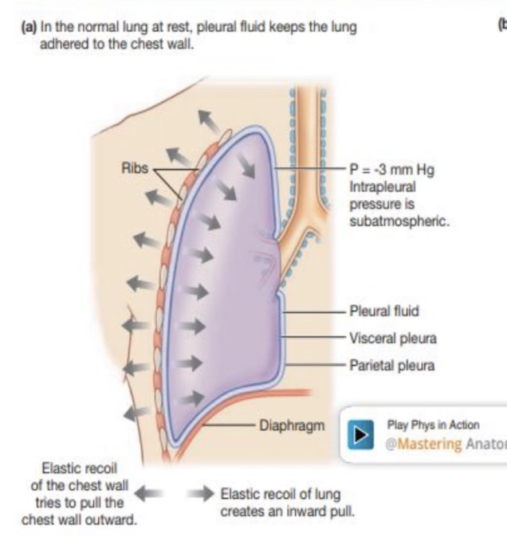

Slide 17
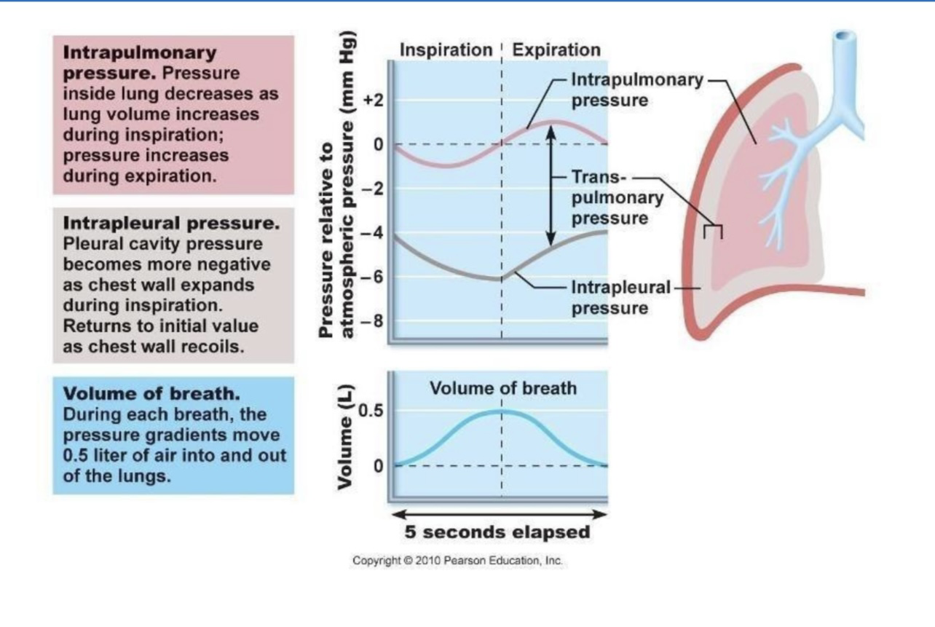

Slide 18
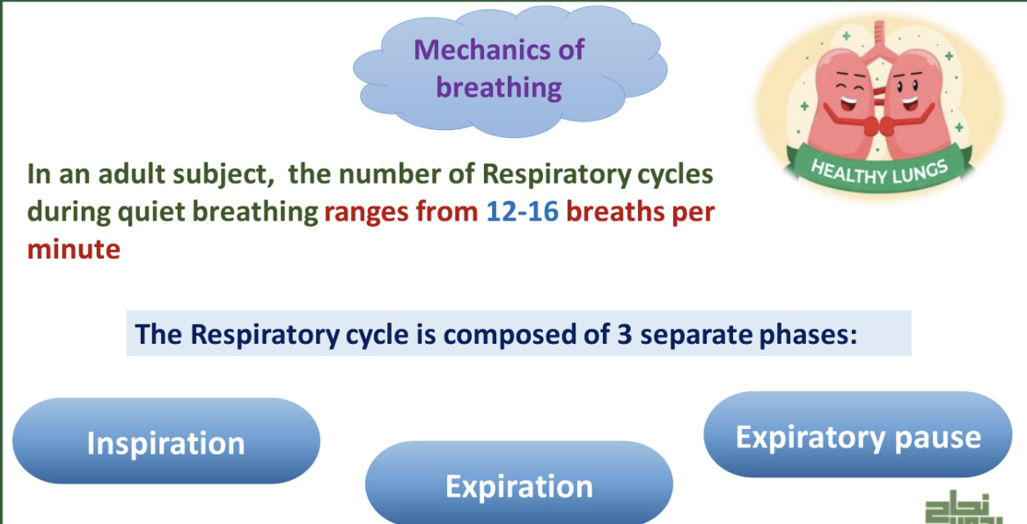

Slide 19
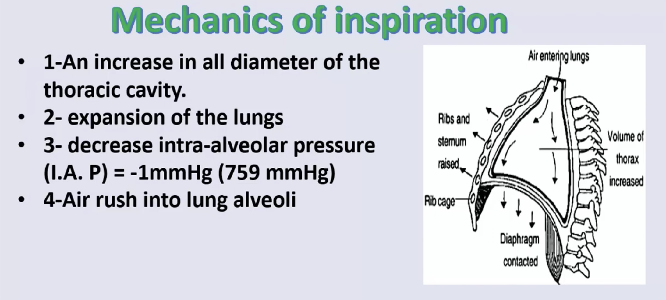

Slide 20
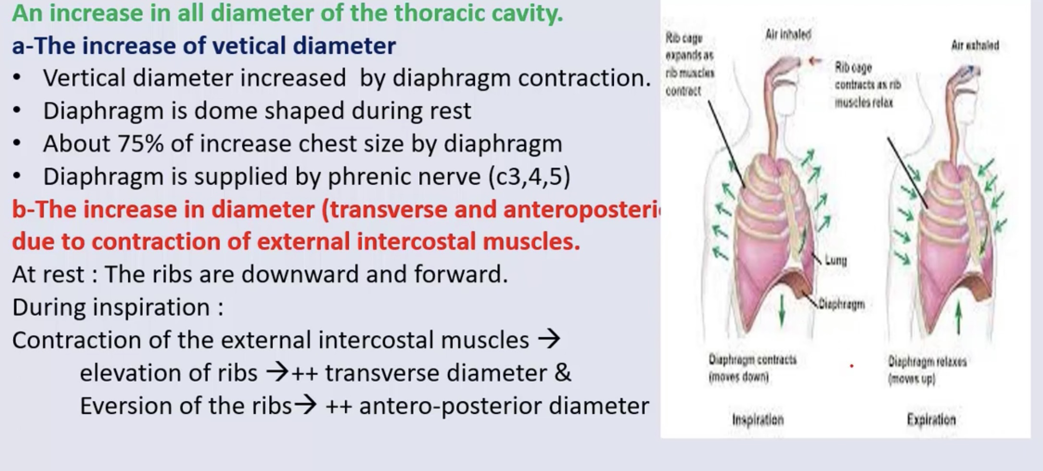

Slide 21
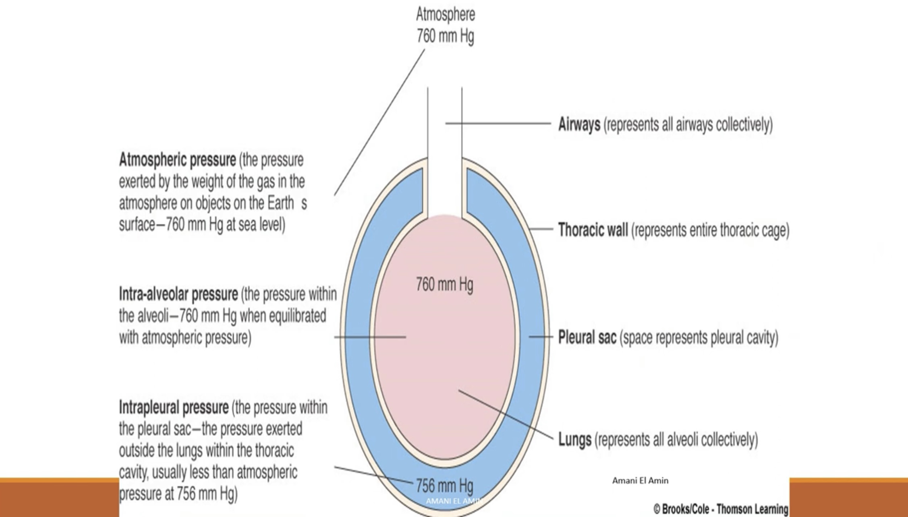

Slide 22
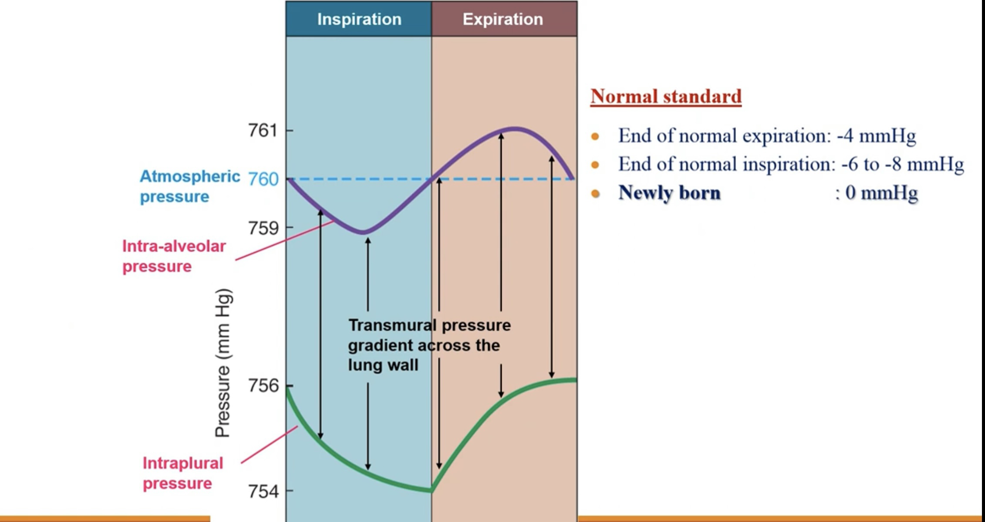

Slide 23
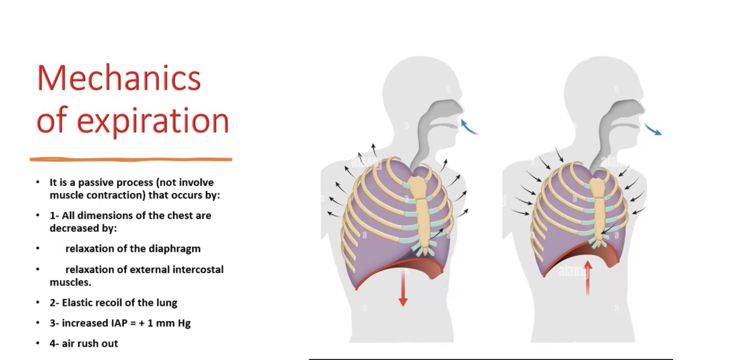

Slide 24
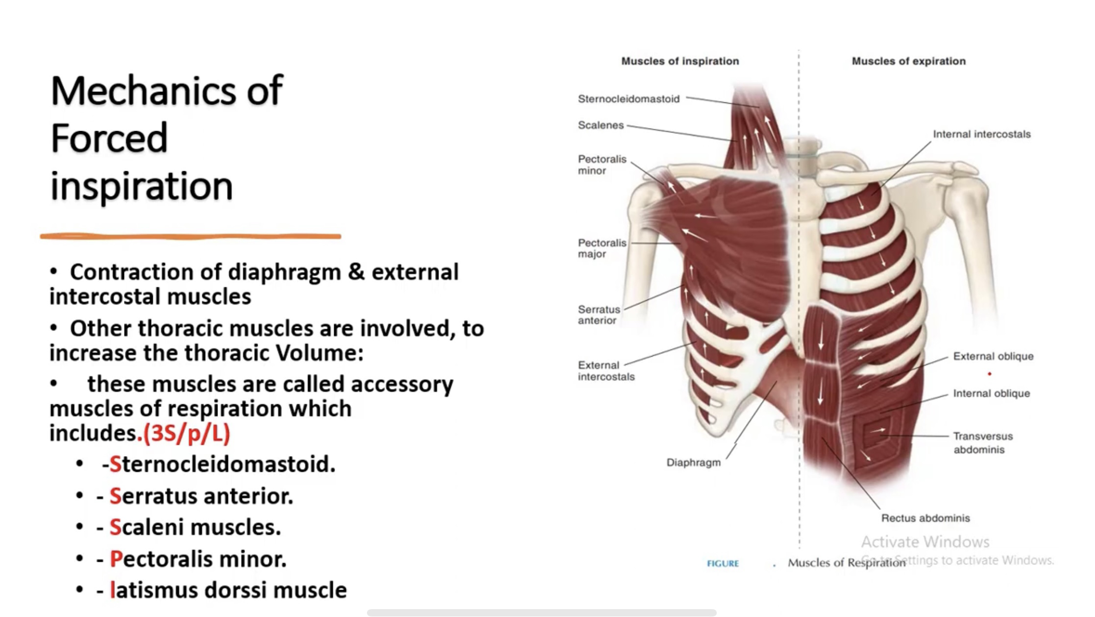

Slide 25
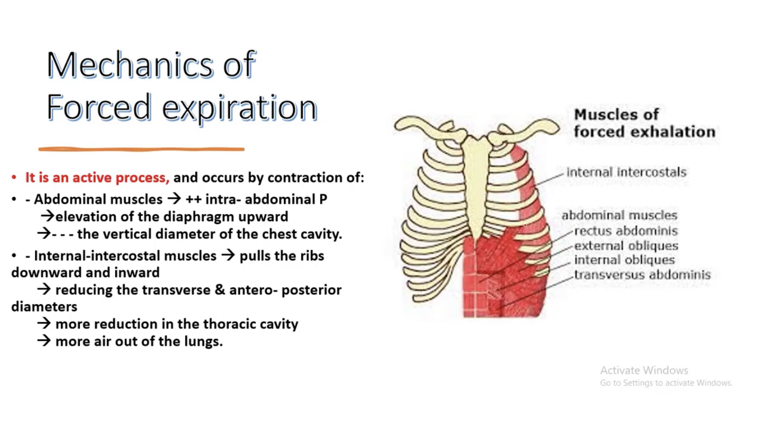

Slide 26
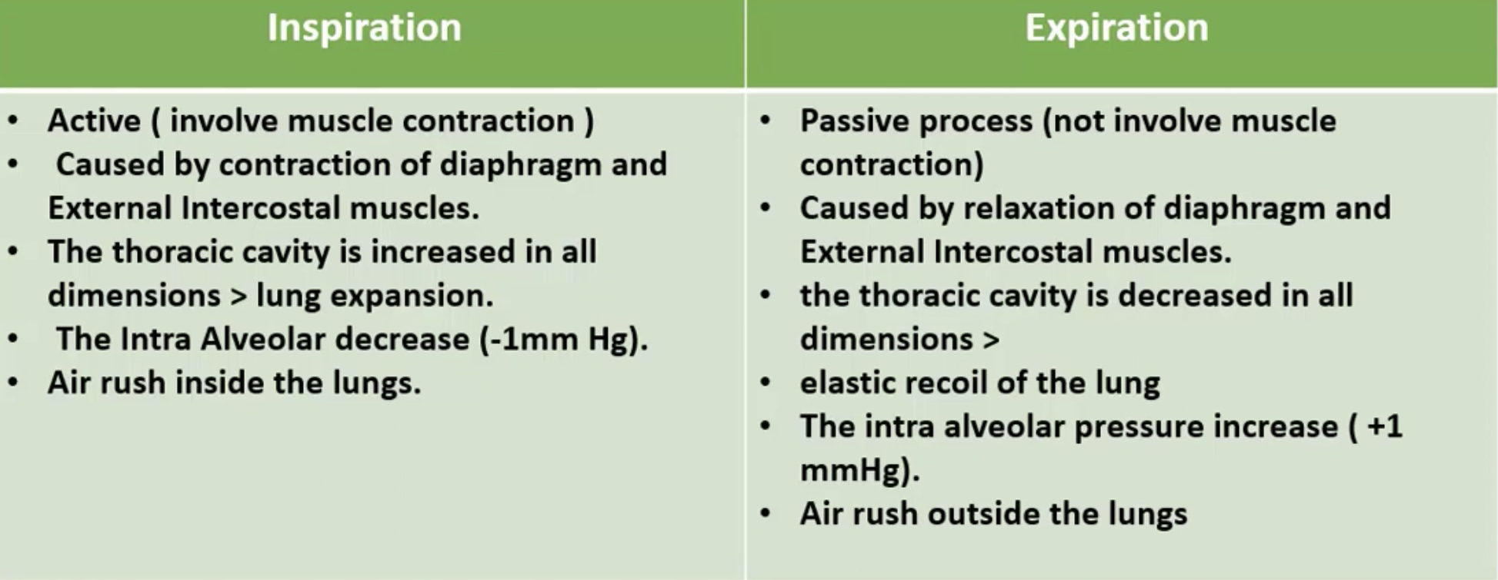
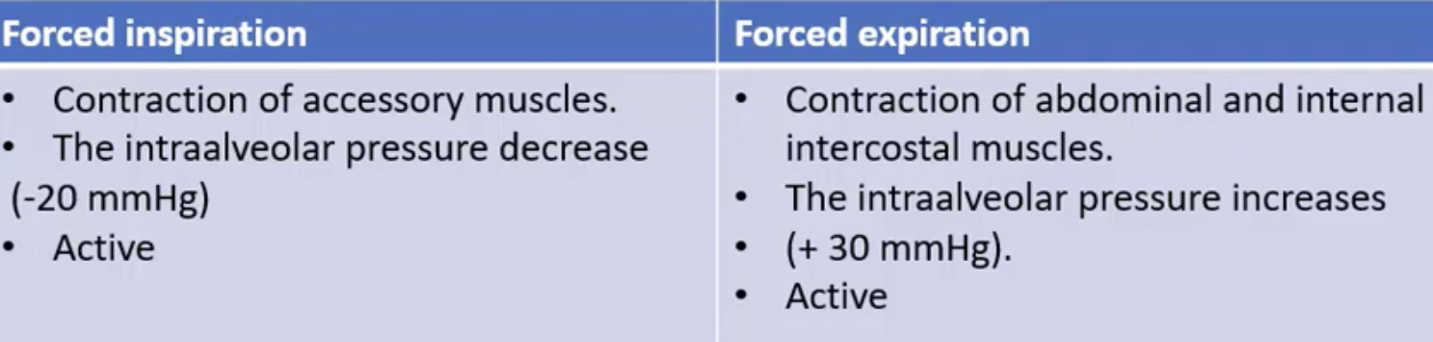

Slide 27
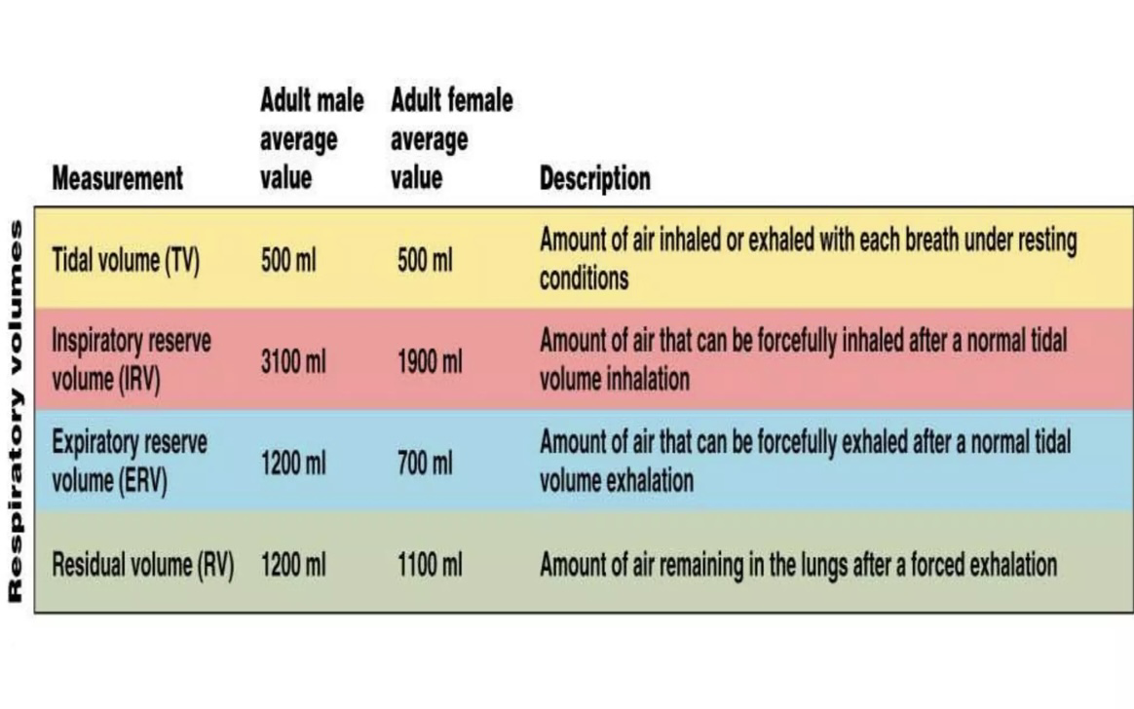

Slide 28
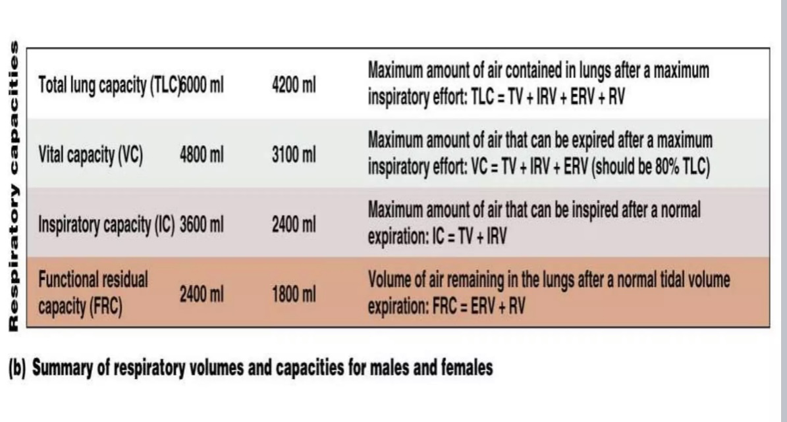

Slide 29
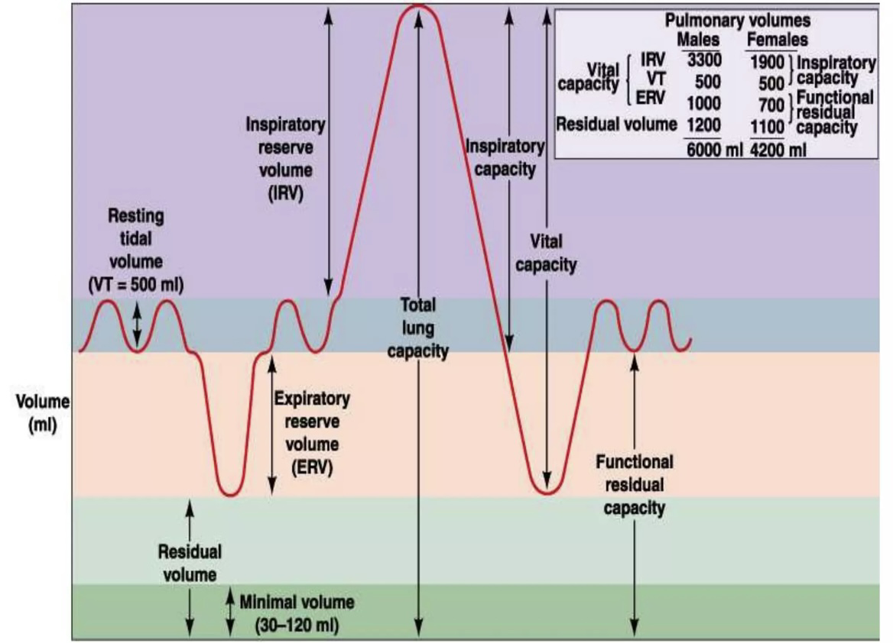

Slide 30
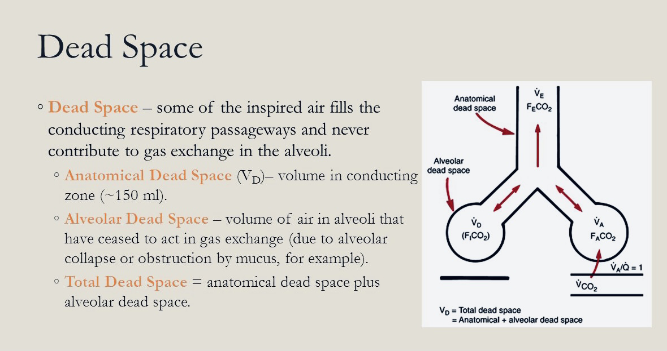

Slide 31
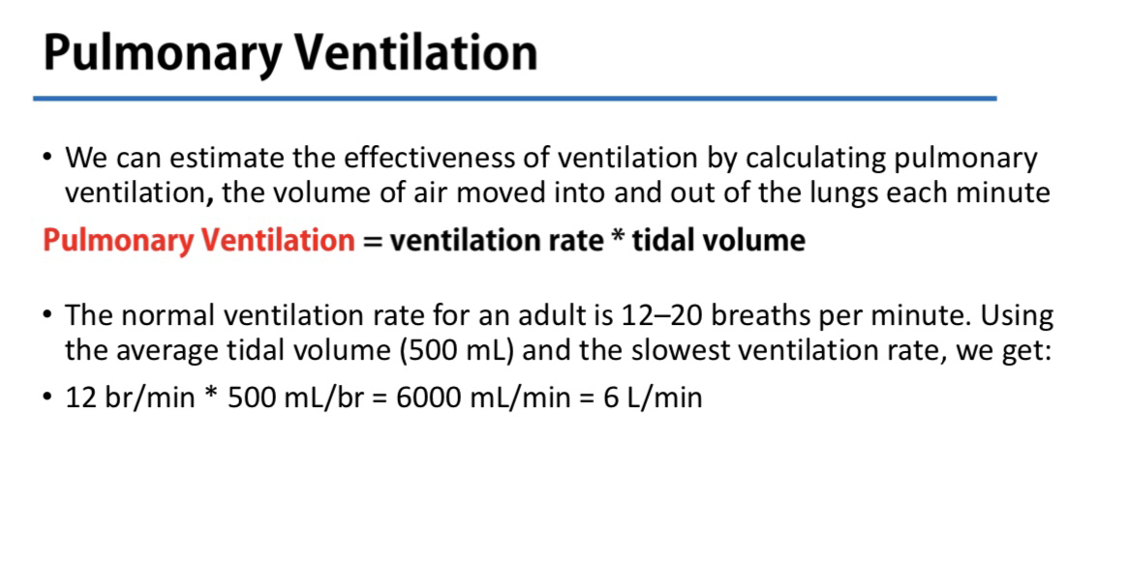

Slide 32
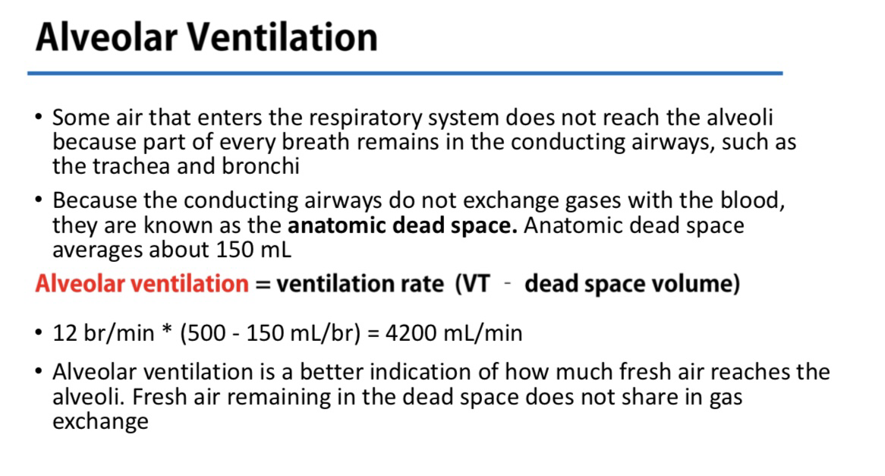

Slide 33
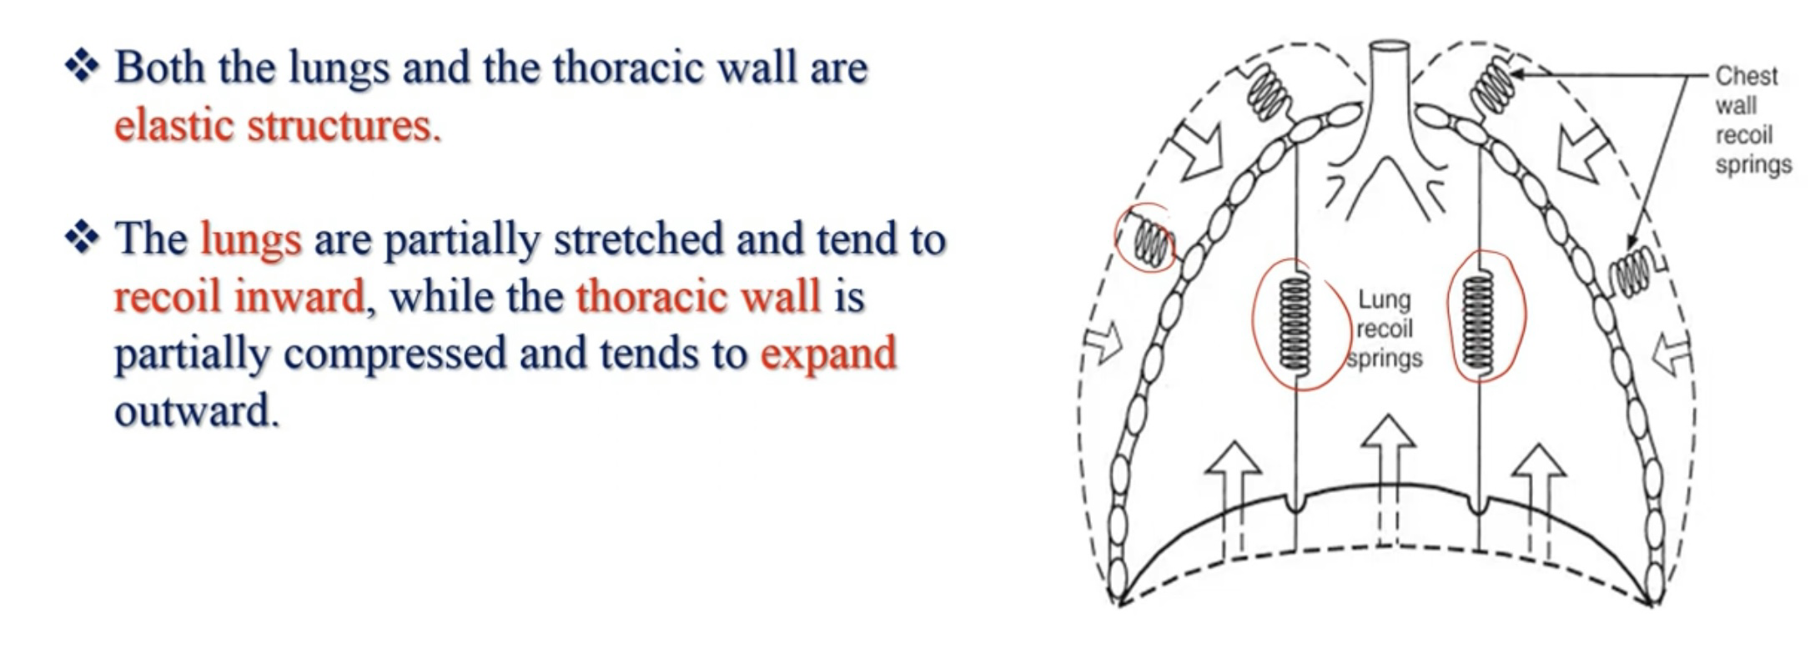

Slide 34
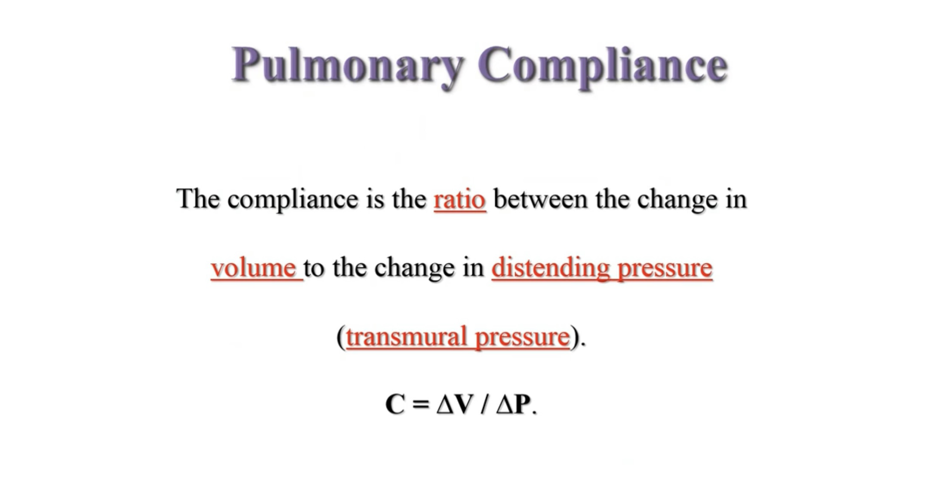

Slide 35
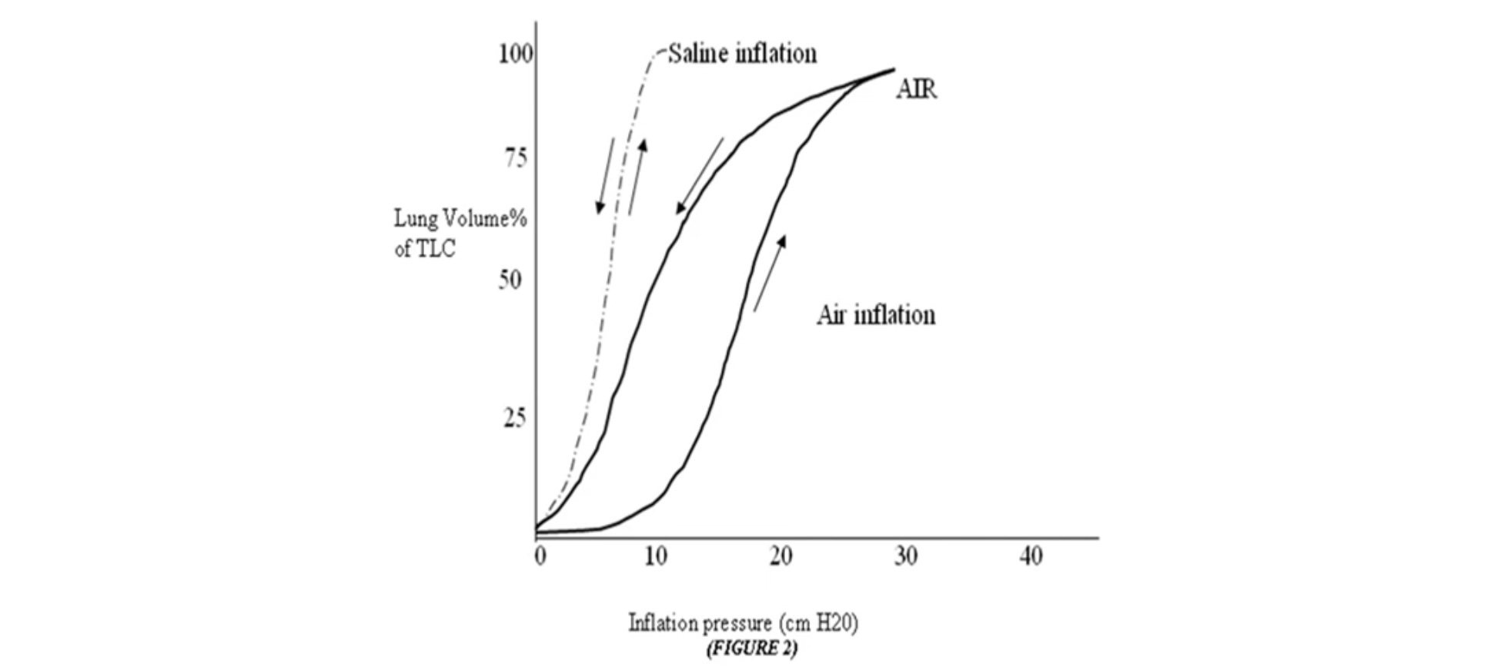

Slide 36
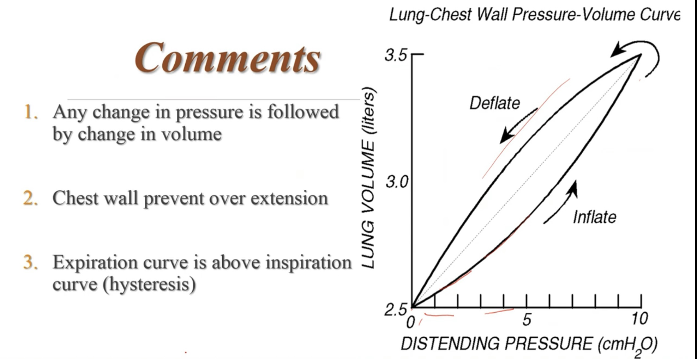

Slide 37
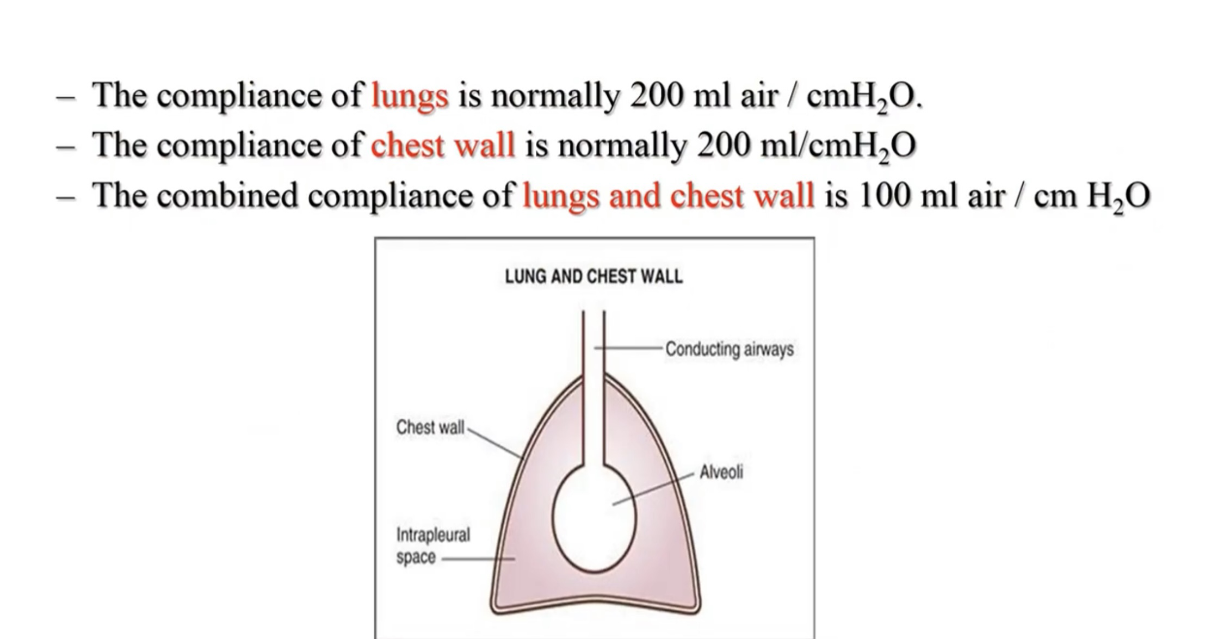

Slide 38
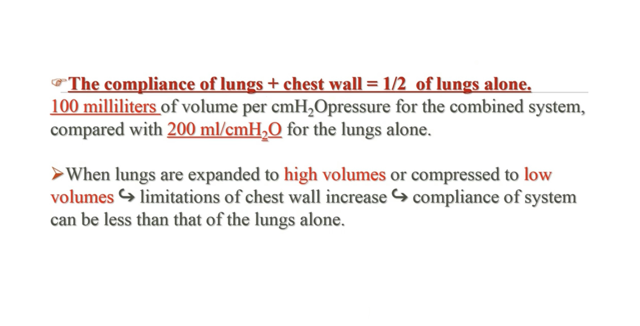

Slide 39
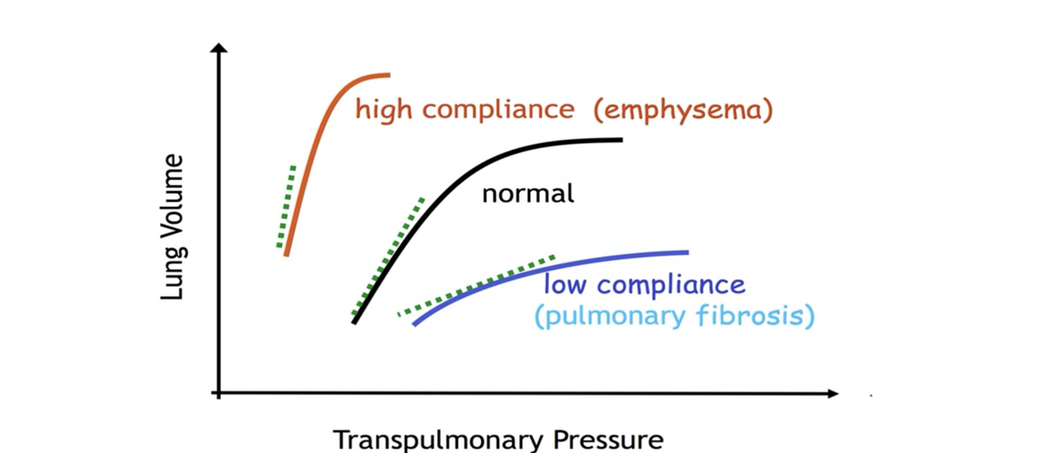

Slide 40
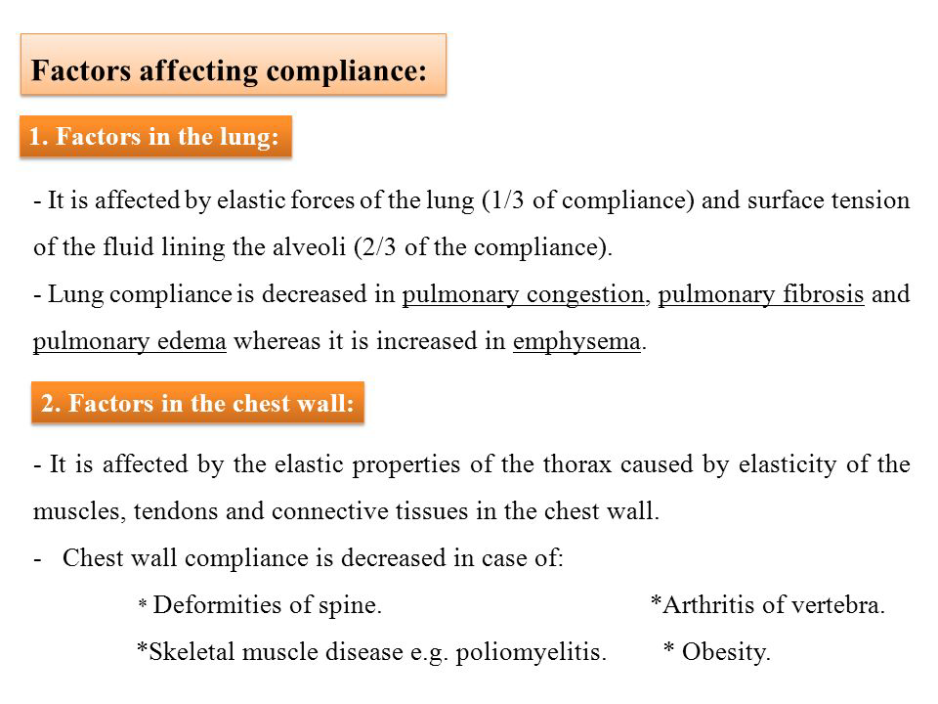

Slide 41
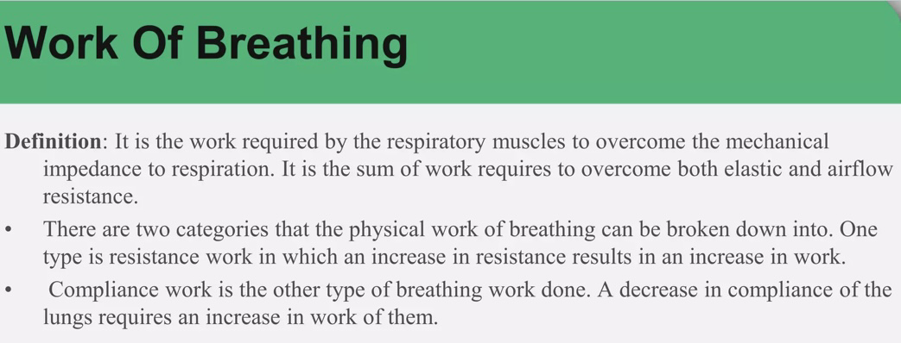
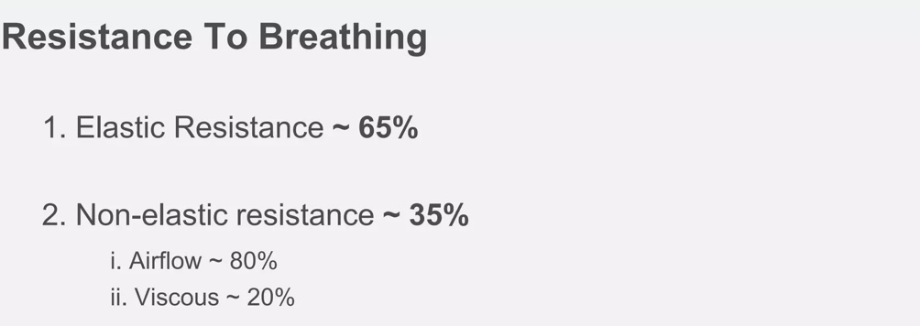

Slide 42
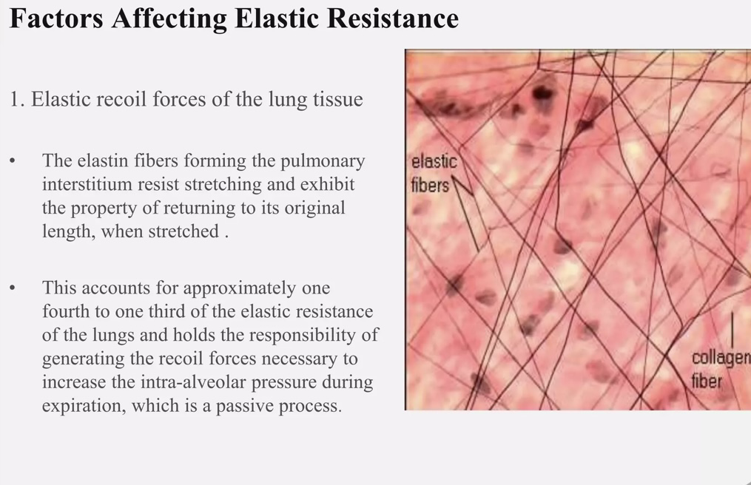

Slide 43
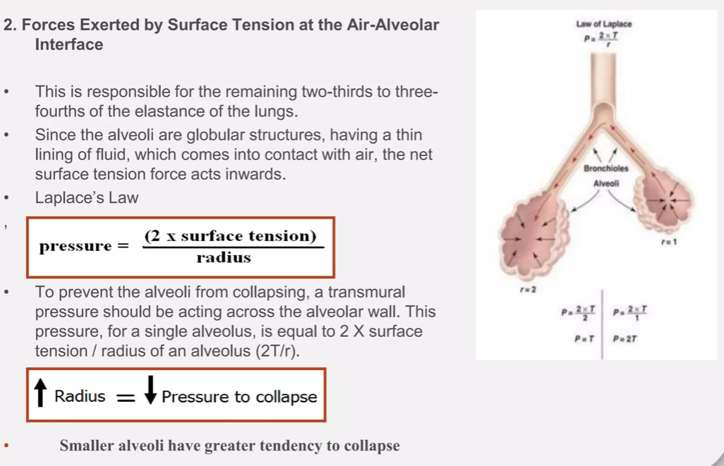

Slide 44
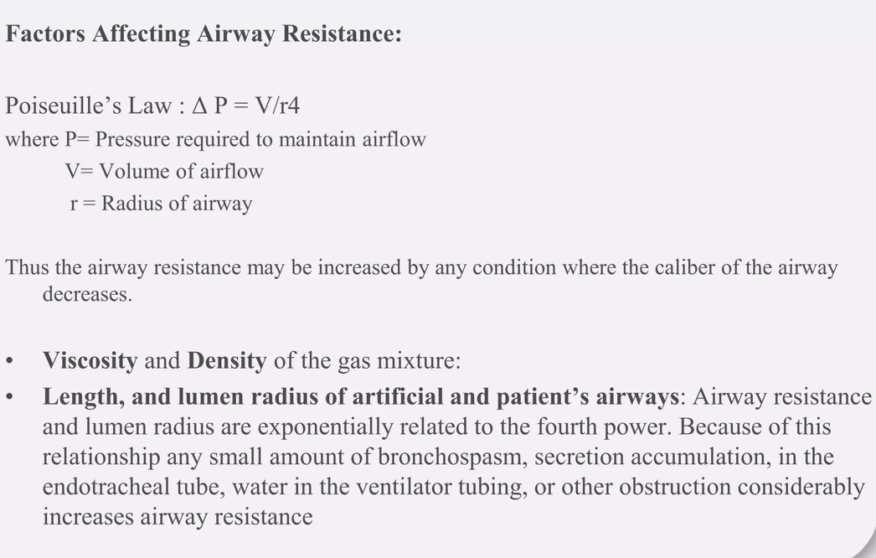

Slide 45
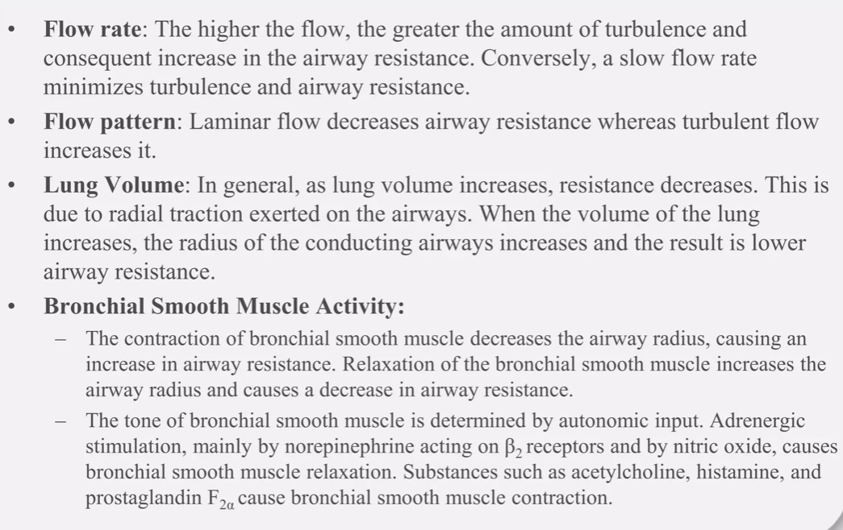

Slide 46
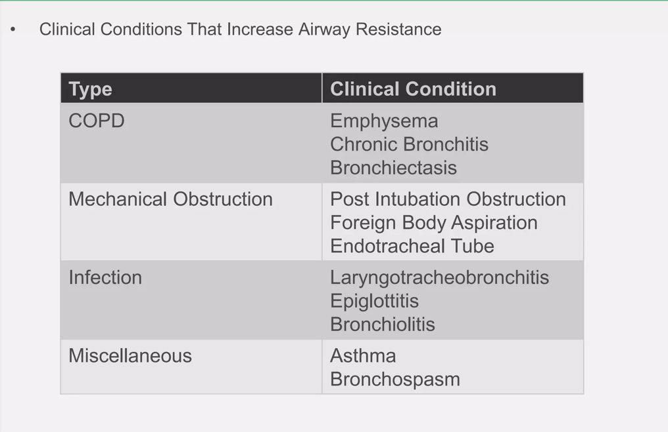

Slide 47
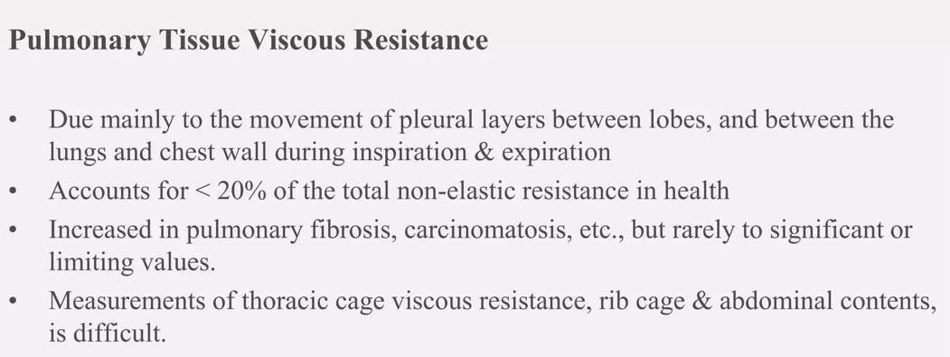

Slide 48


Slide 49
Questions:
Surfactant
a) It increases surface tension
b) Is increased in cigarette smoking
c) Surface tension is proportional to their concentration
d) Is produced by type I alveolar cells
e) Prevents pulmonary oedema

Slide 50
During respiration
a) Transverse diameter is increased by diaphragm contraction during inspiration
b) At normal resting expiration, contraction of internal intercostals is the main cause of air outflow
c) Sternomastoid and scaleni helps only in the process of forced expiration
d) External intercostals contraction helps in the generation of negative intra-pulmonary pressure
e) External intercostals contraction helps in the inspiration only during exercise

Slide 51
The volume of air expired forcefully after normal inspiration
1. TV+ IRV
2.TV+ERV
3.TV
4. None of these

Slide 52
Which of the following represents the pressure difference that acts to distend lungs
a) Airway opening pressure
b) Transpulmonary pressure
c) Alveolar pressure
d) Transthoracic pressure
e) All of the above

Slide 53
Compliance of the lung is reduced by all of the following EXCEPT
a) High expanding pressures
b) Alveolar oedema
c) Emphysema
d) Consolidation
e) Lung fibrosis

Slide 54


