Slide 1
Gas Exchange and Transport
Dr. Mahmoud AbuMettleq

Slide 2
Pulmonary circulation

Slide 3
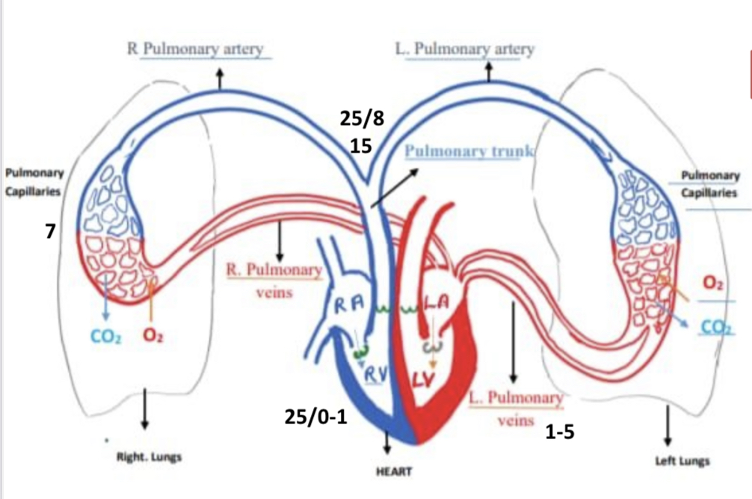

Slide 4
Blood Volume of the Lungs
At any given moment, the pulmonary circulation contains about 0.5 liter of blood, or 10% of total blood volume.
About 75 mL of this amount is found in the capillaries, where gas exchange takes place, with the remainder in pulmonary arteries and veins. The rate of blood flow through the lungs is much higher than the rate in other tissues because the lungs receive the entire cardiac output of the right ventricle: 5 L/min.
Pulmonary transit time is 0.8 sec and when cardiac output increases as in exercise transit time is decreased to 0.3 sec.
During exercise blood flow increases in all regions of blood, near base increased by 2-3 time, and near apex increased by 8 times.
﻿﻿It occurs due to Recruitment of capillaries &Distension of capillaries.

Slide 5
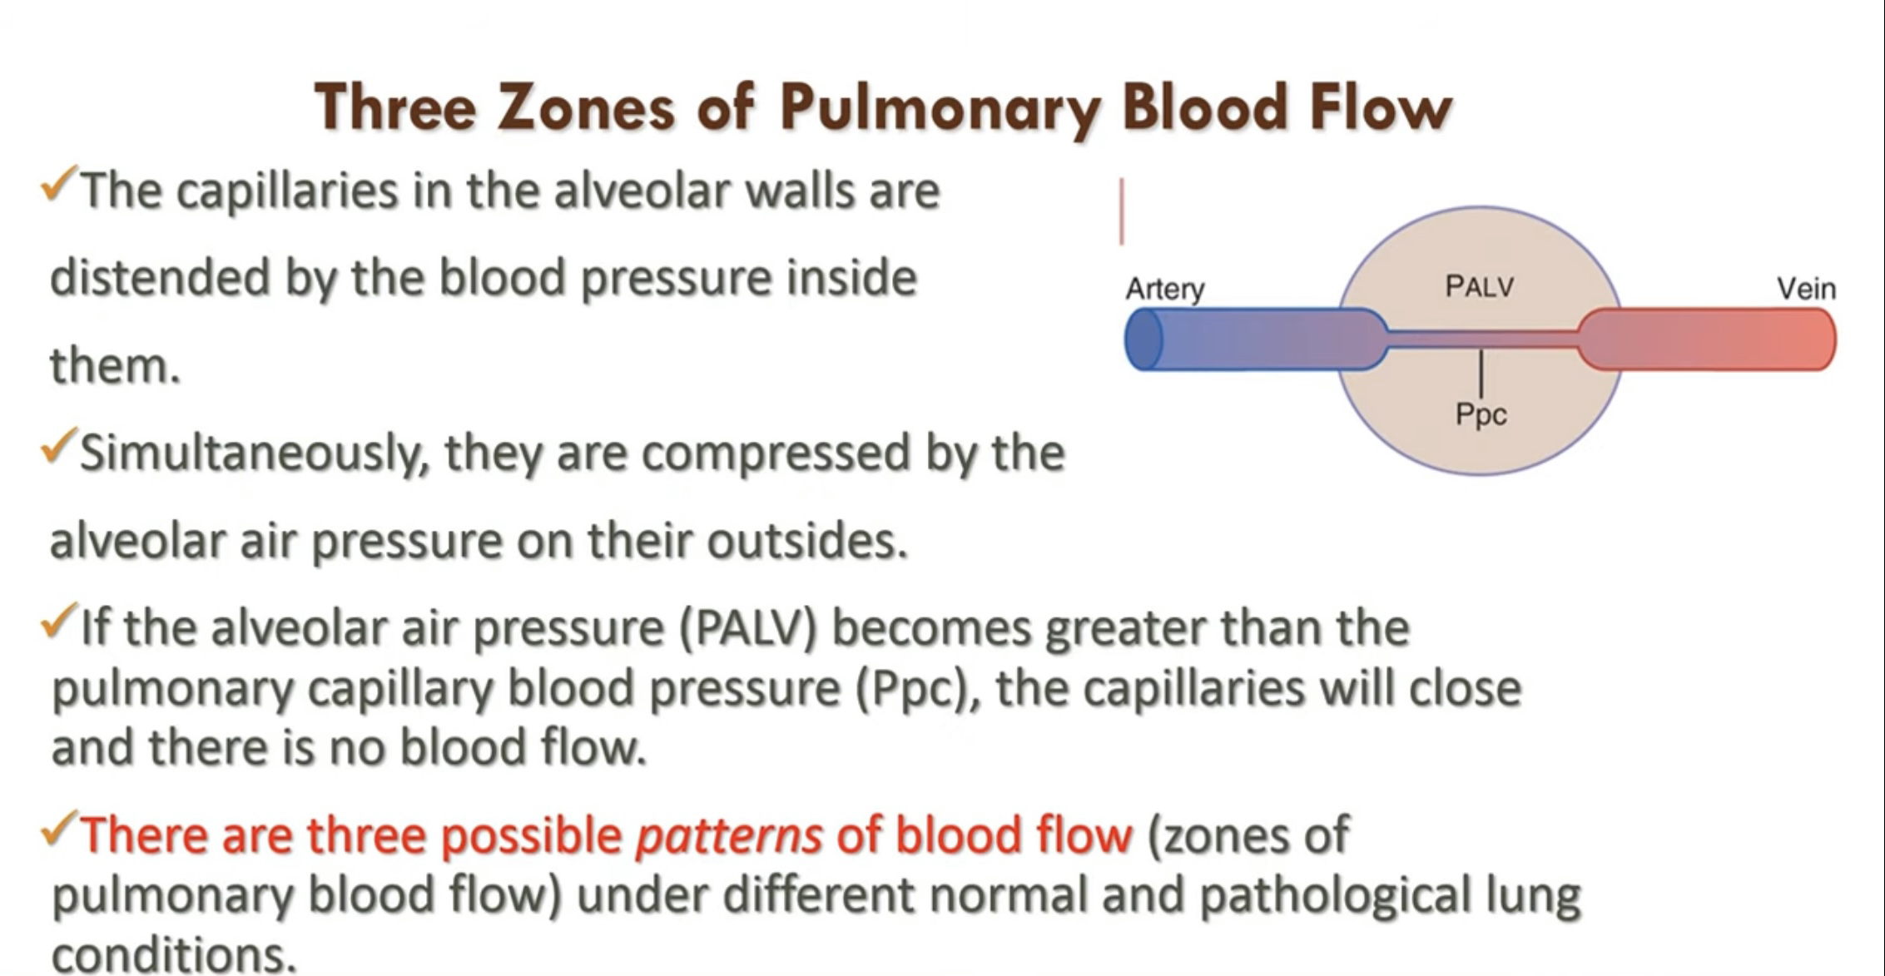

Slide 6
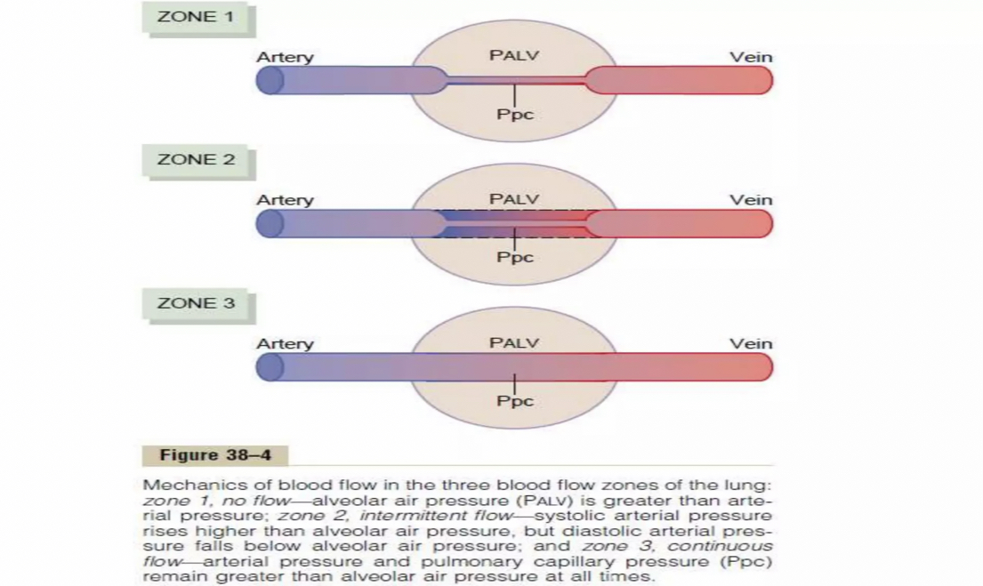

Slide 7
Zone 1: No blood flow during all portions of the cardiac cycle because the local alveolar capillary pressure in that area of the lung never rises higher than the alveolar air pressure during any part of the cardiac cycle
Zone 2: Intermittent blood flow only during the pulmonary arterial pressure peaks because the systolic pressure is then greater than the alveolar air pressure, but the diastolic pressure is less than the alveolar air pressure
Zone 3: Continuous blood flow because the alveolar capillary pressure remains greater than alveolar air pressure during the entire cardiac cycle

Slide 8
Normally, the lungs have only zones 2 and 3 blood flow, zone 2 (intermittent flow) in the apices, and zone 3 (continuous flow) in all the lower areas.
blood flow through the apical part of the lung is intermittent, with flow during systole but cessation of flow during diastole; this is called zone 2 blood
Zone1 Blood Flow Occurs Only Under Abnormal Conditions.
Seen in positive pressure ventilation and in severe blood loss.
Also, when a person is lying down, no part of the lung is more than a few centimetres above the level of the heart.
In this case, blood flow in a normal person is entirely zone 3 blood flow, including
the lung apices.

Slide 9
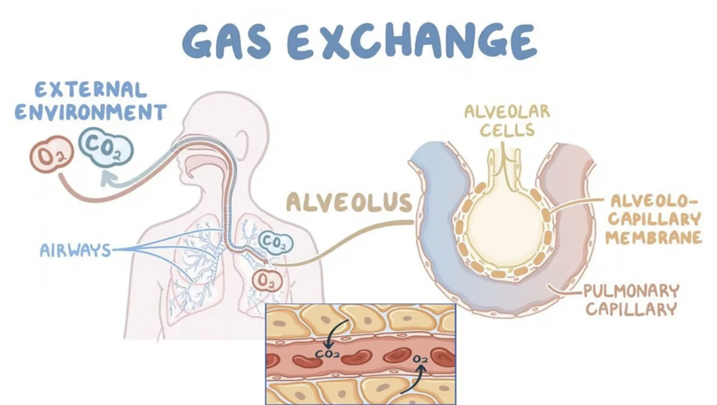

Slide 10
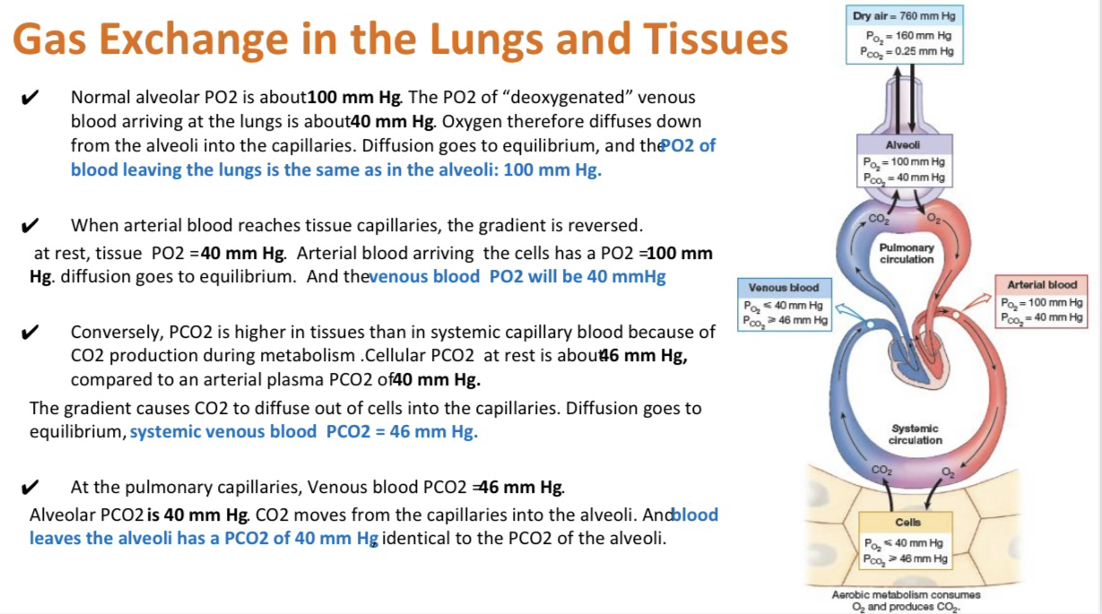

Slide 11
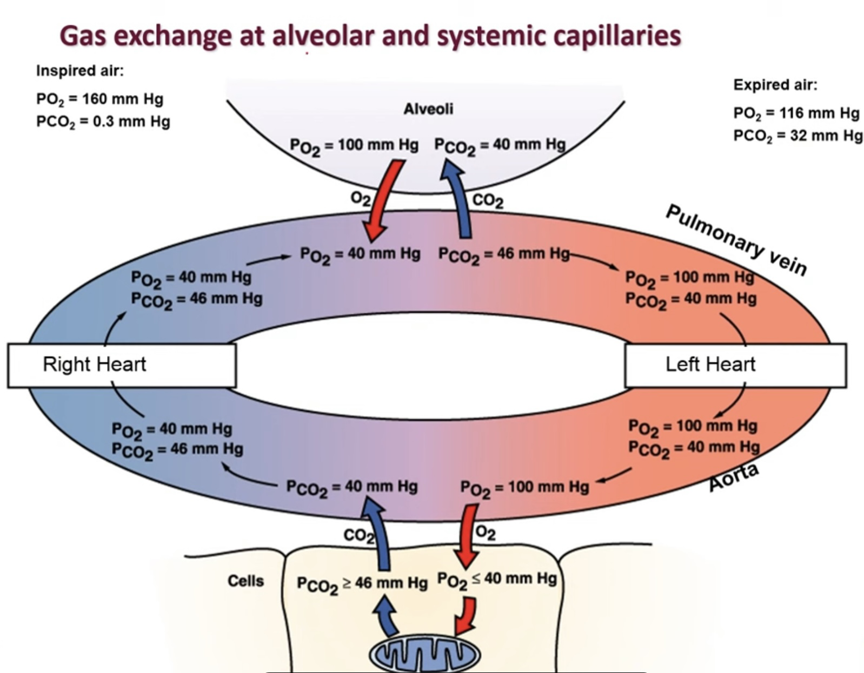

Slide 12
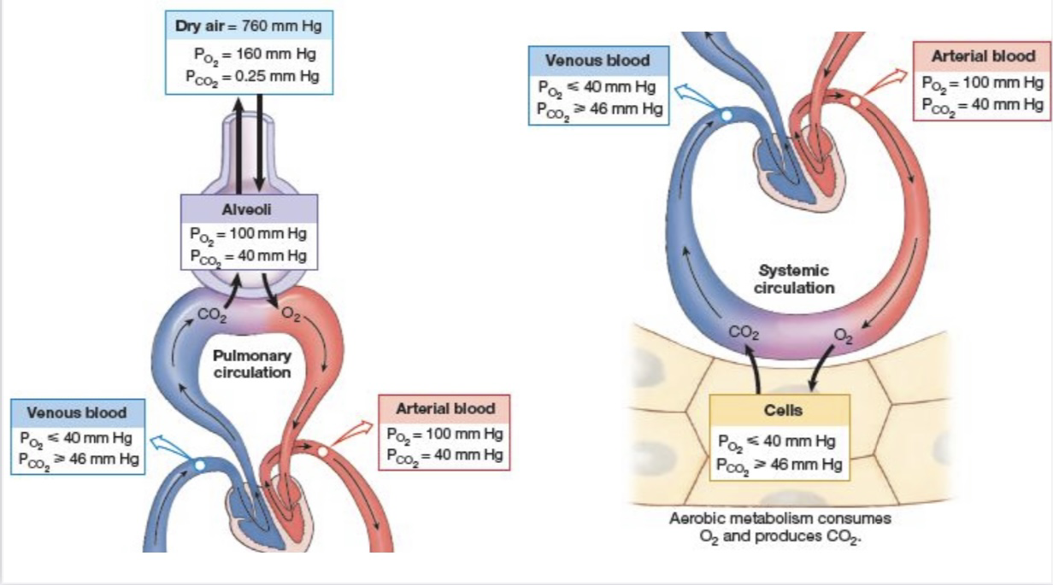

Slide 13
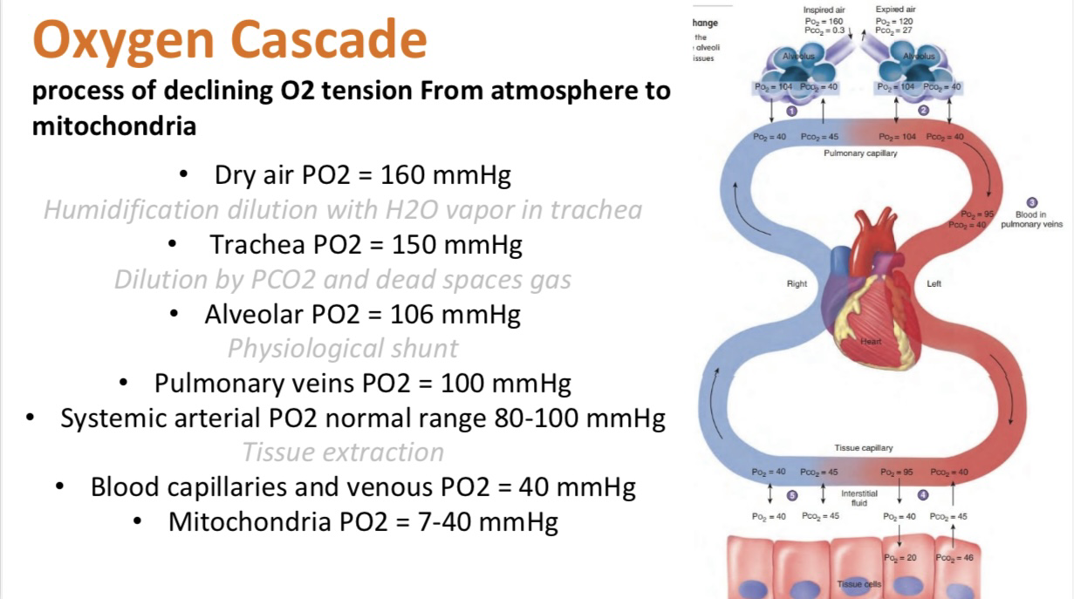

Slide 14
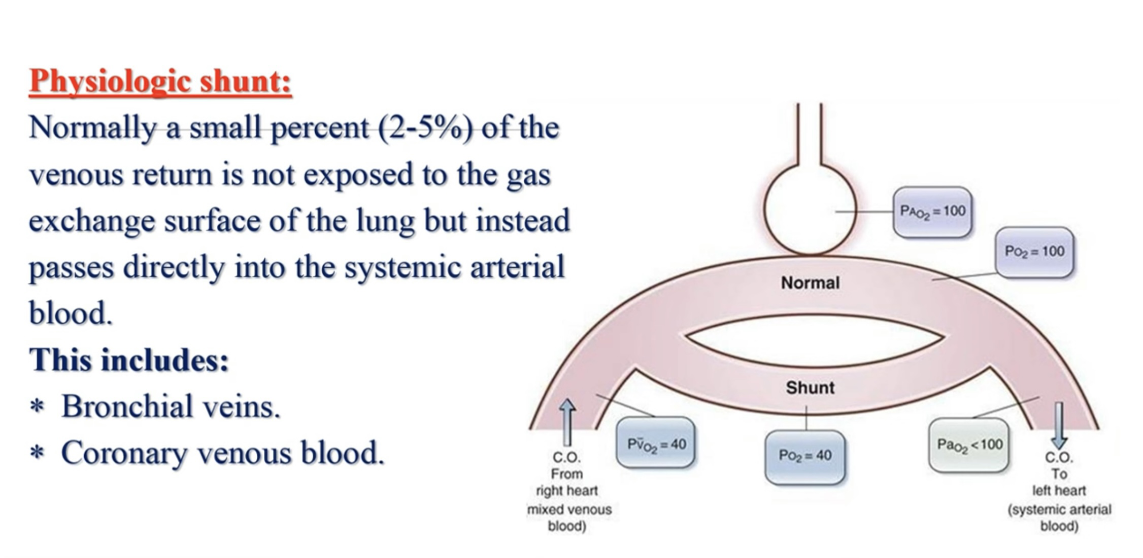

Slide 15
Gas diffusion across the pulmonary membrane affected by the following :
1. Pressure gradient of gases across the pulmonary membrane
2. Surface area of the pulmonary membrane.
3. Lipid solubility of gases.
4. Thickness of pulmonary membrane.
5. Ventilation perfusion ratio.
6. Temperature
7. Molecular weight of the gas

Slide 16
Partial pressure gradient
The greater the pressure gradient, the greater will be its rate of diffusion
O2 In alveolar air has a partial pressure of 100 mmHg , and also in arterial blood is 100mmHg ,but it is 40 mmHg in venous blood So O2 diffuse from alveoli into the capillaries.
Co2 partial pressure on the alveoli & arterial blood pressure is 40 mmHg , but it’s 46 mmHg in venous blood, so it’s diffuse from the capillary to the alveoli

Slide 17
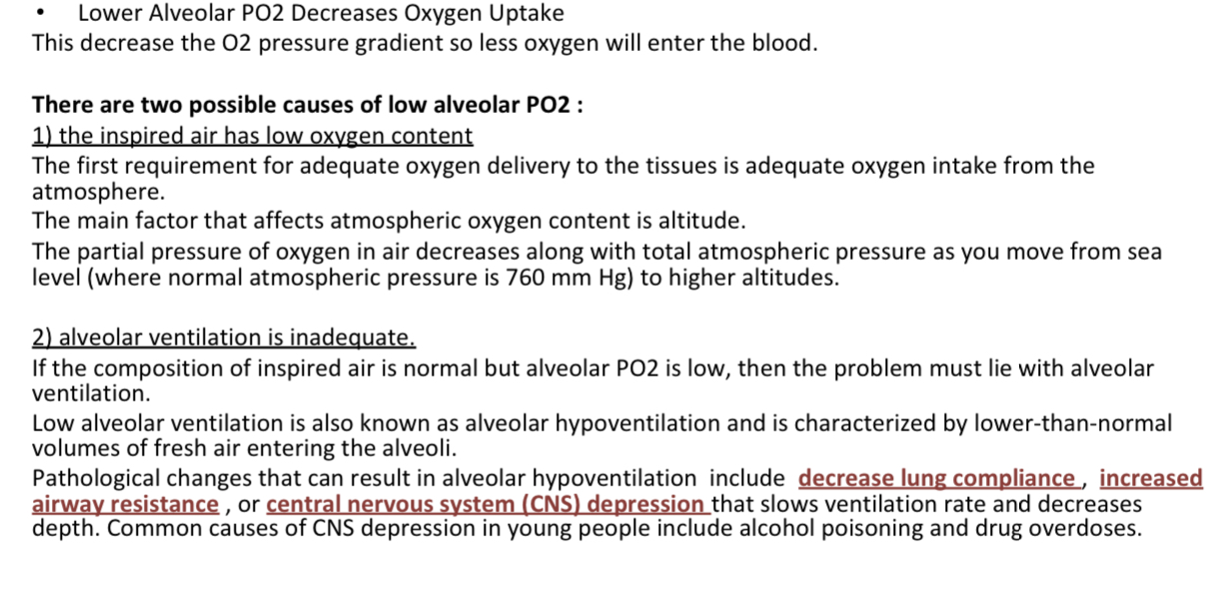

Slide 18
Surface area of the pulmonary membrane:
The air in the alveoli is separated from the blood in the capillary by a thin respiratory membrane , which consist of :
A) Layer of fluid lining the alveolus.
B) Single layer of alveolar epithelial cells.
C) An epithelial basement membrane.
D) Thininterstitialspacebetweenthealveolarepithelium&the capillary membrane.
E) Capillary basement membrane.
F) Capillary endothelium membrane.

Slide 19
As regarded the surface area, the greater the surface area ,the more will be the rate of gas diffusion .
• The total surface area of respiratory membrane is approximately 70 m*2.
The surface area increased in muscular exercise due to :
a) dilation of already opened capillaries.
b) Opening of the closed capillaries.
c) More expansion of the alveoli.
It’s reduced in :
old age due to reduced number of capillaries.
lung collapse due to obstruction of bronchus .
emphysema
removal of entire lung

Slide 20
Lipid solubility of the gases:
As regard lipid solubility, all respiratory gases are lipid soluble , so the rate of diffusion is directly proportional to lipid solubility.
The solubility of co2 is 24 time greater than that of O2 , so the rate of co2 diffusion is higher than that of O2.

Slide 21
Thickness of the pulmonary membrane:
The thickness of the pulmonary membrane is .5 microns.
The rate of diffusion of gases across the pulmonary membrane is inversely proportional to the thickness of the membrane.
Thickness of the pulmonary membrane is increased in pulmonary fibrosis and pulmonary edema

Slide 22
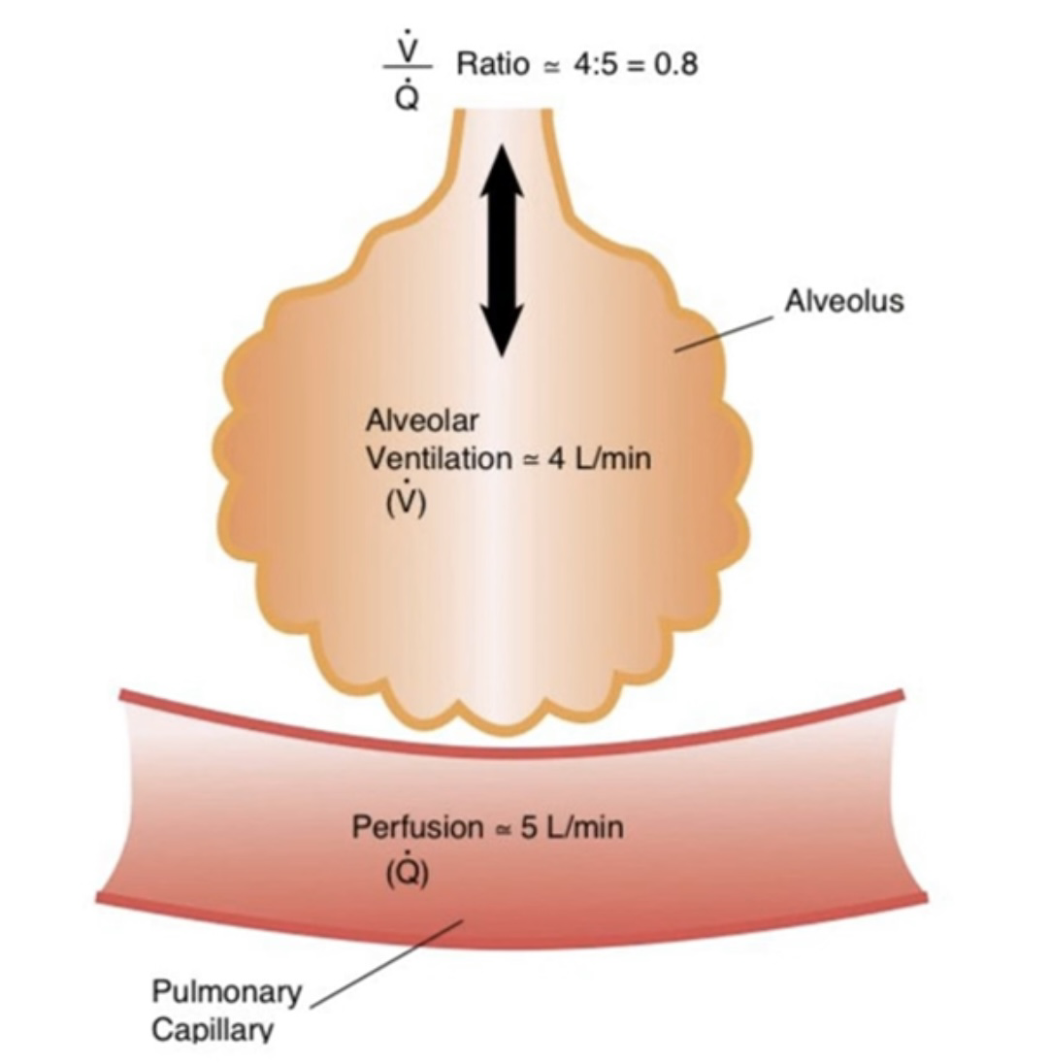
Ventilation perfusion ratio:
The adequate gas exchange in the lungs, requires that alveolar ventilation and alveolar blood flow (perfusion) be matched to each other.
Alveoli at apex are under-perfused (over-ventilated)
-Ventilation decreased.
-Perfusion is markedly decrease by gravity
-VA/O Ratio increase to become 3
Alveoli at the base are under-ventilated (over-perfused)
-Perfusion increases by gravity
-Ratio decrease to become 0.6

Slide 23
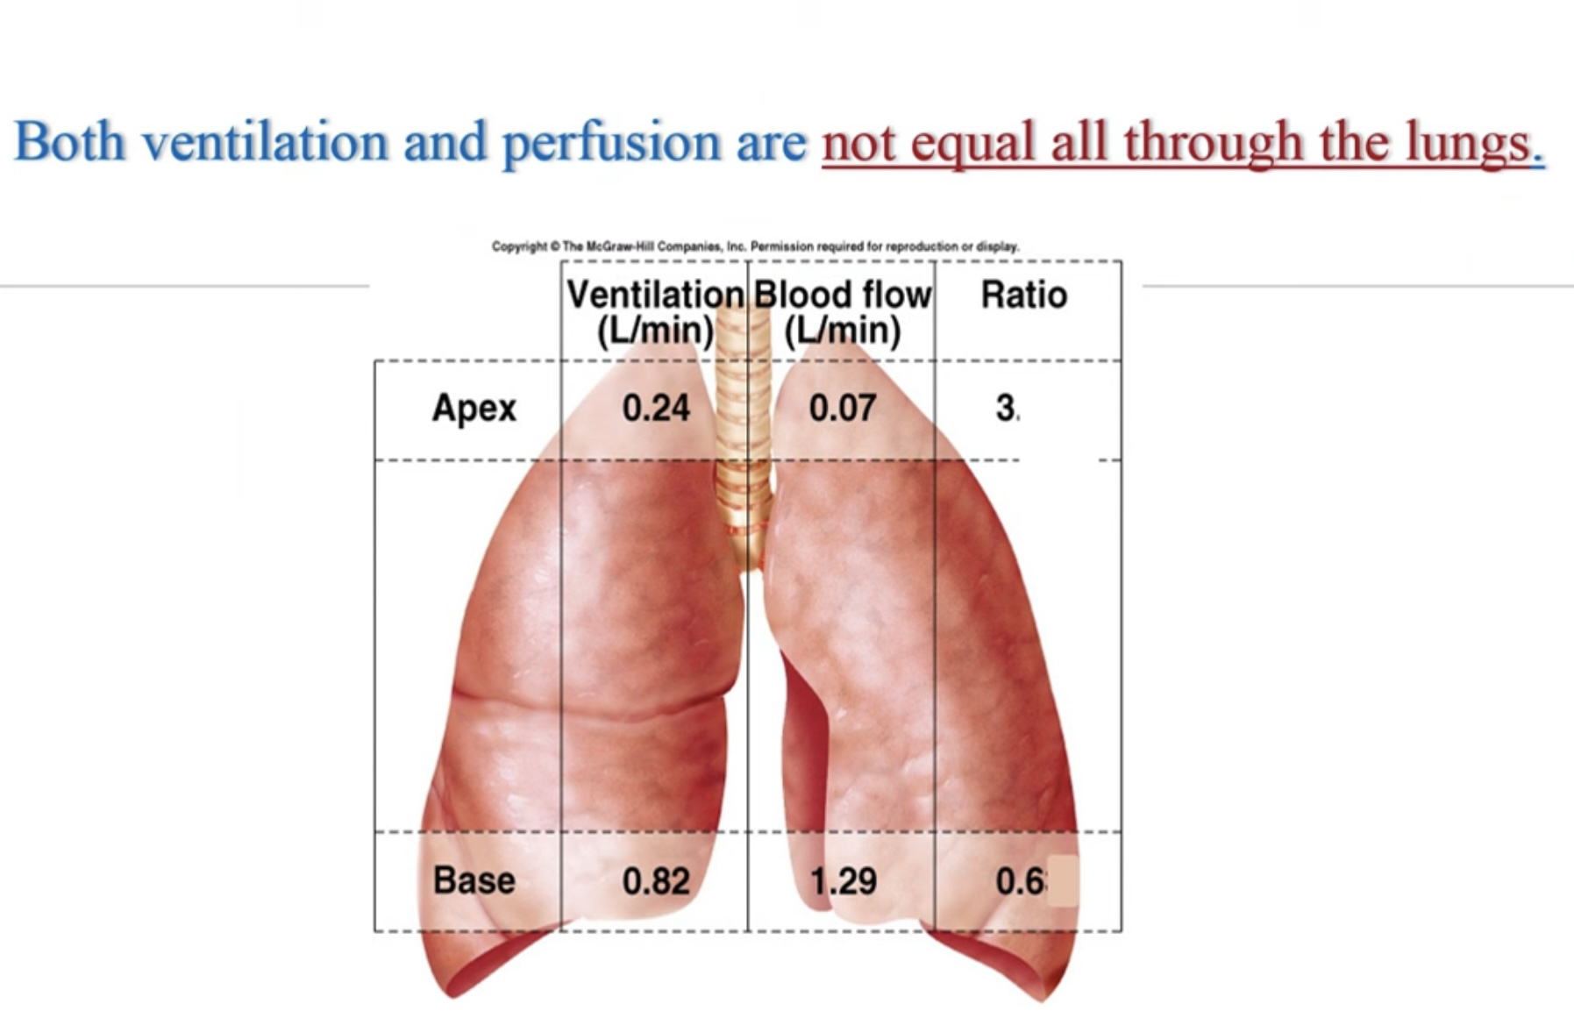
So, the apex is more ventilated than perfused, and the base is more perfused than ventilated.

Slide 24
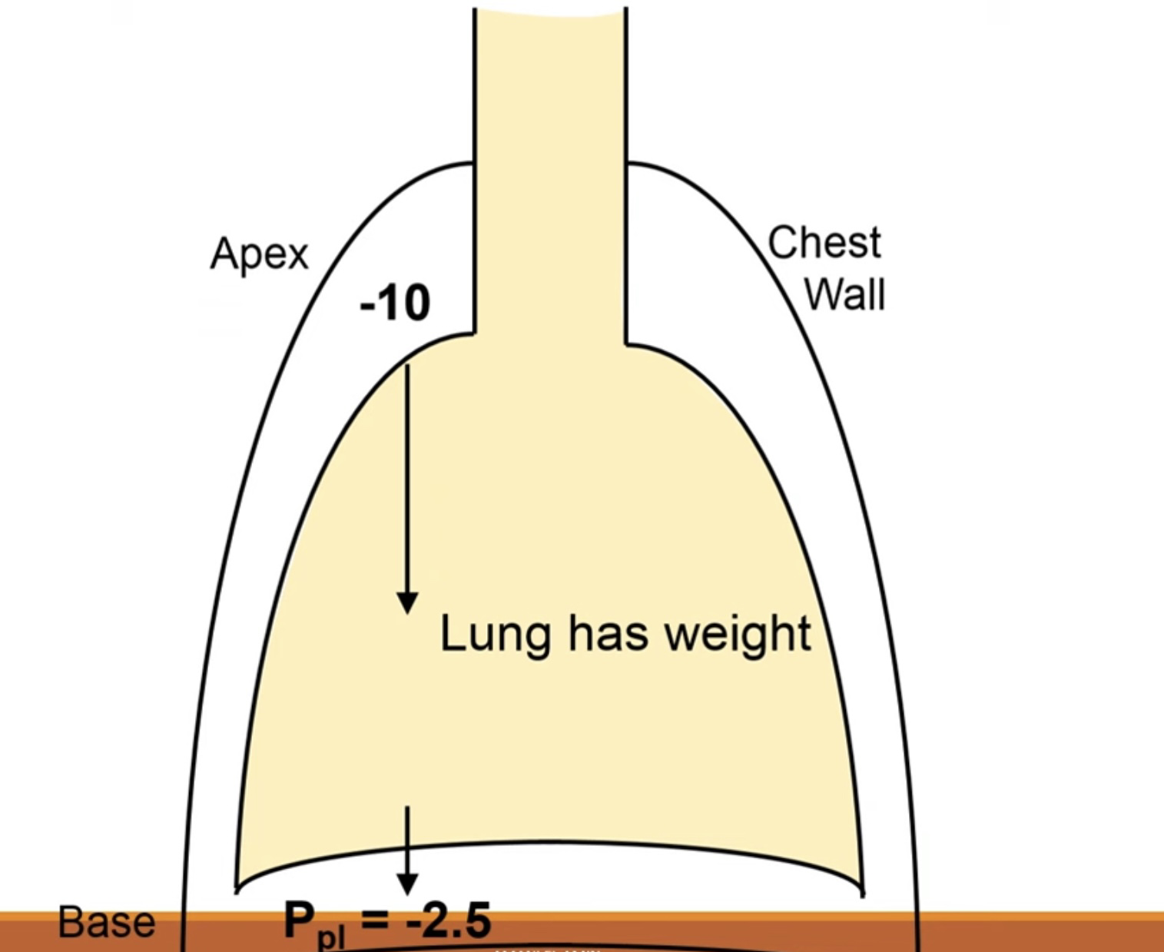
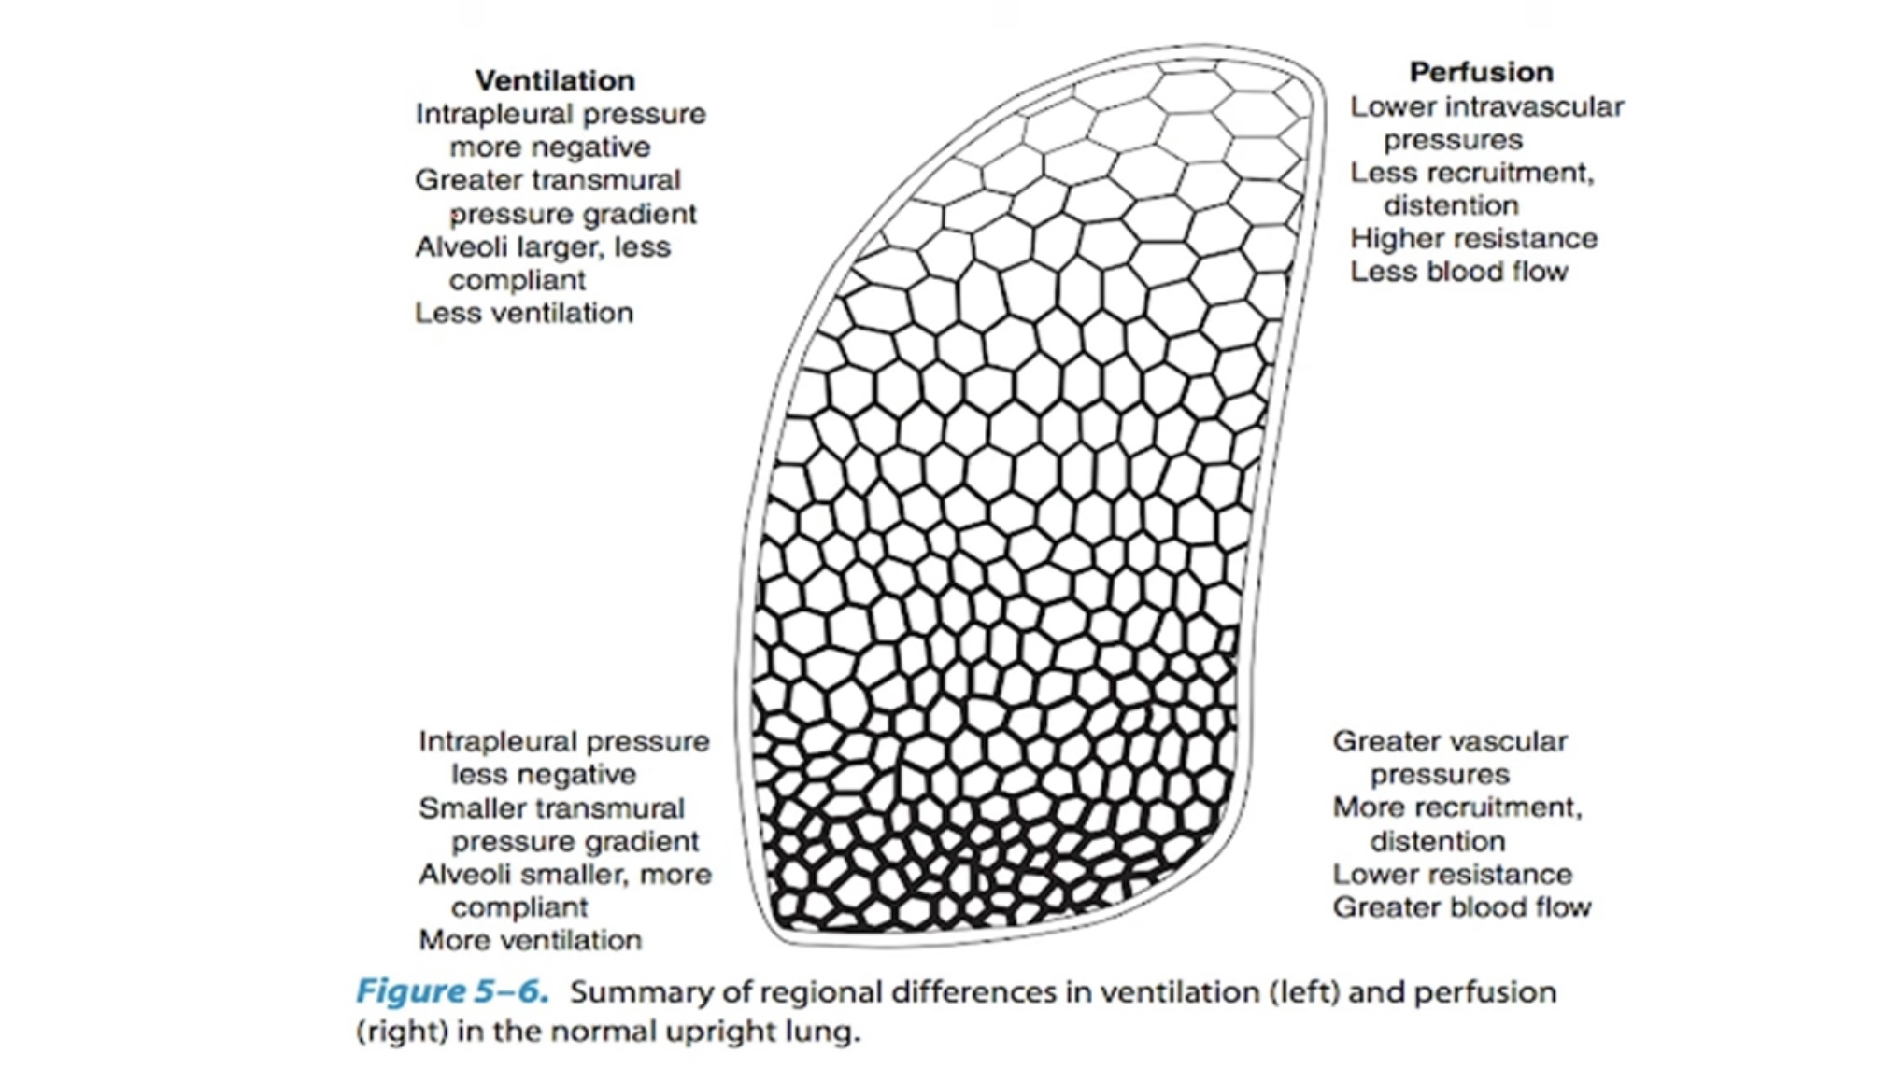

Slide 25
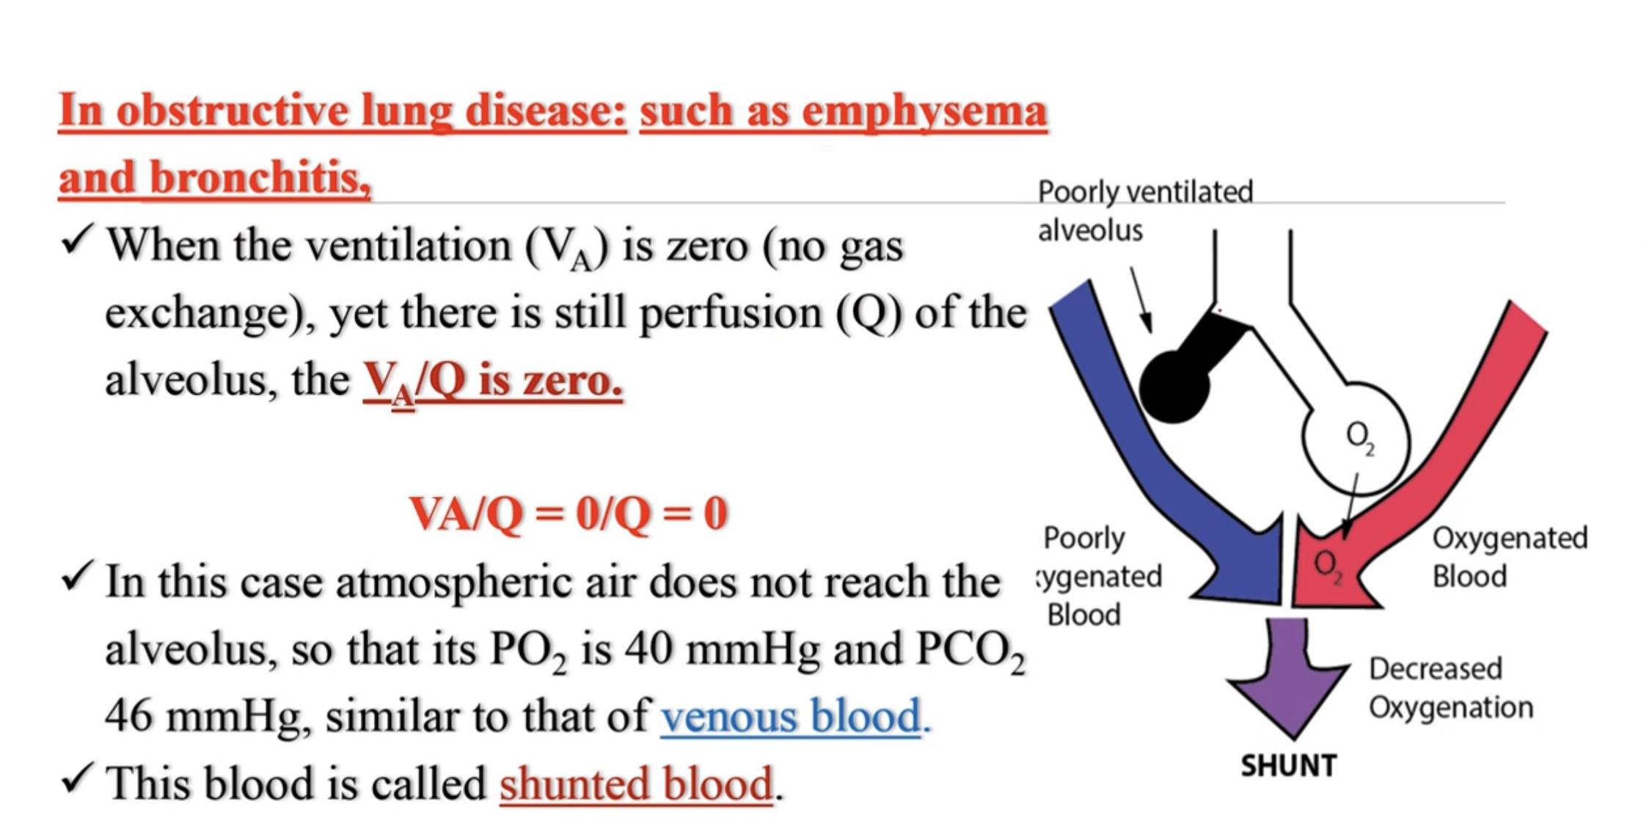

Slide 26
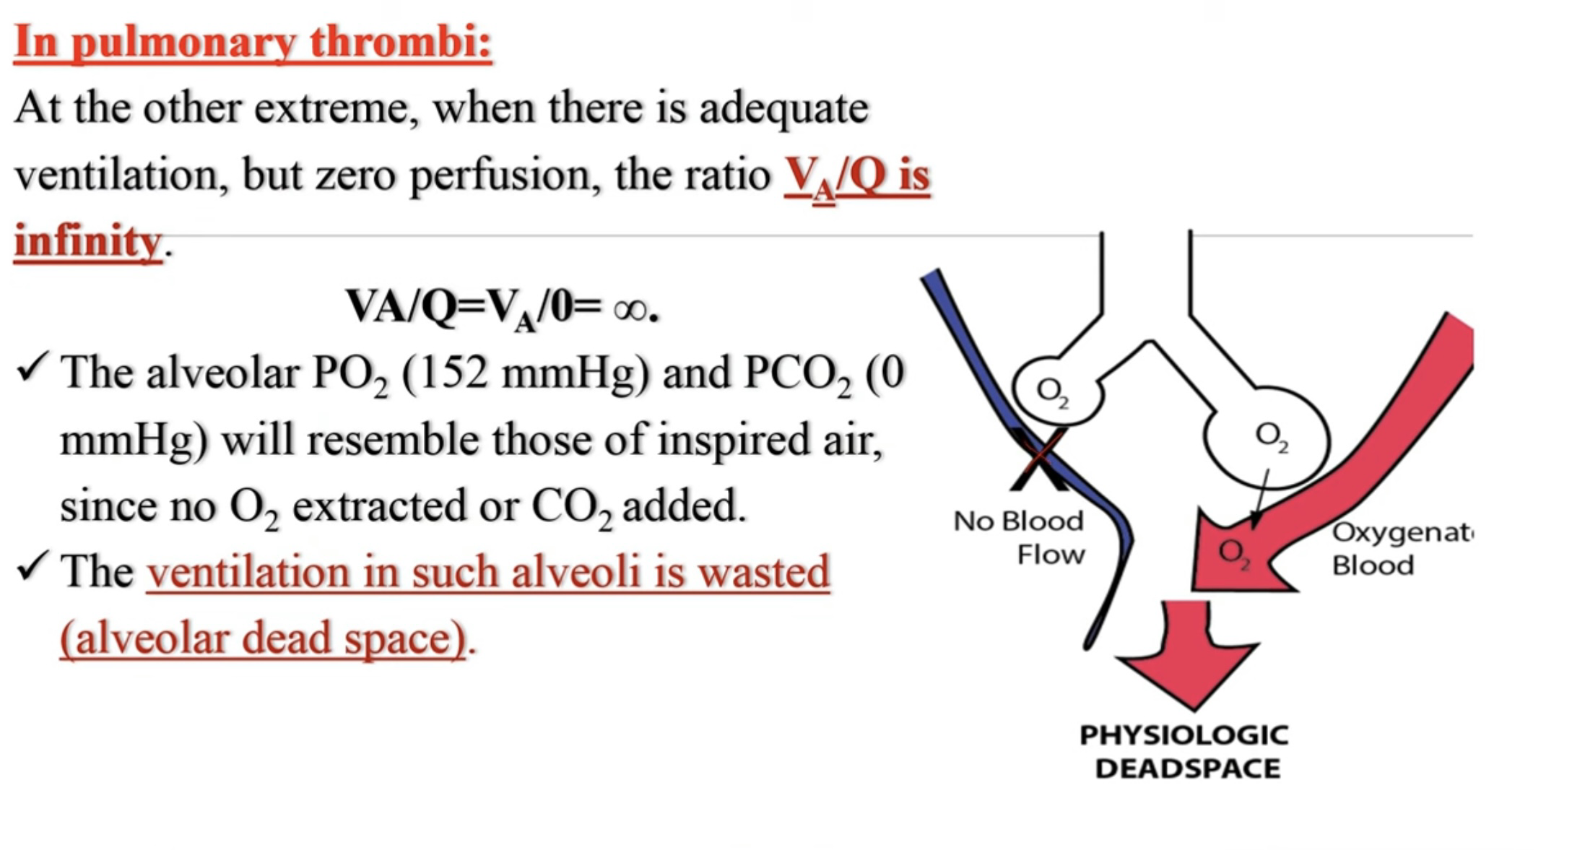

Slide 27
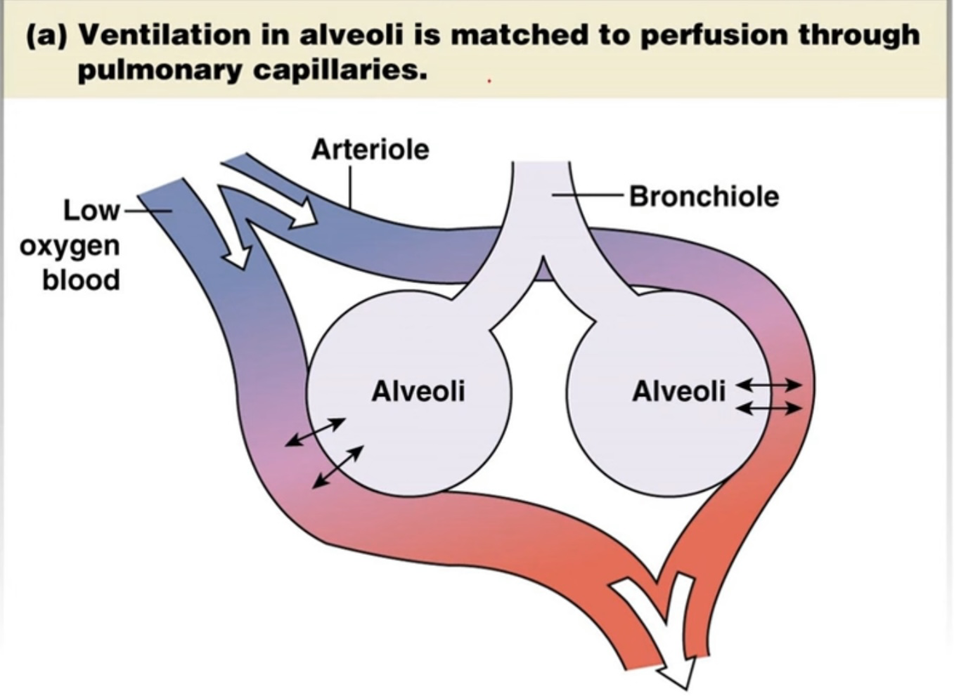
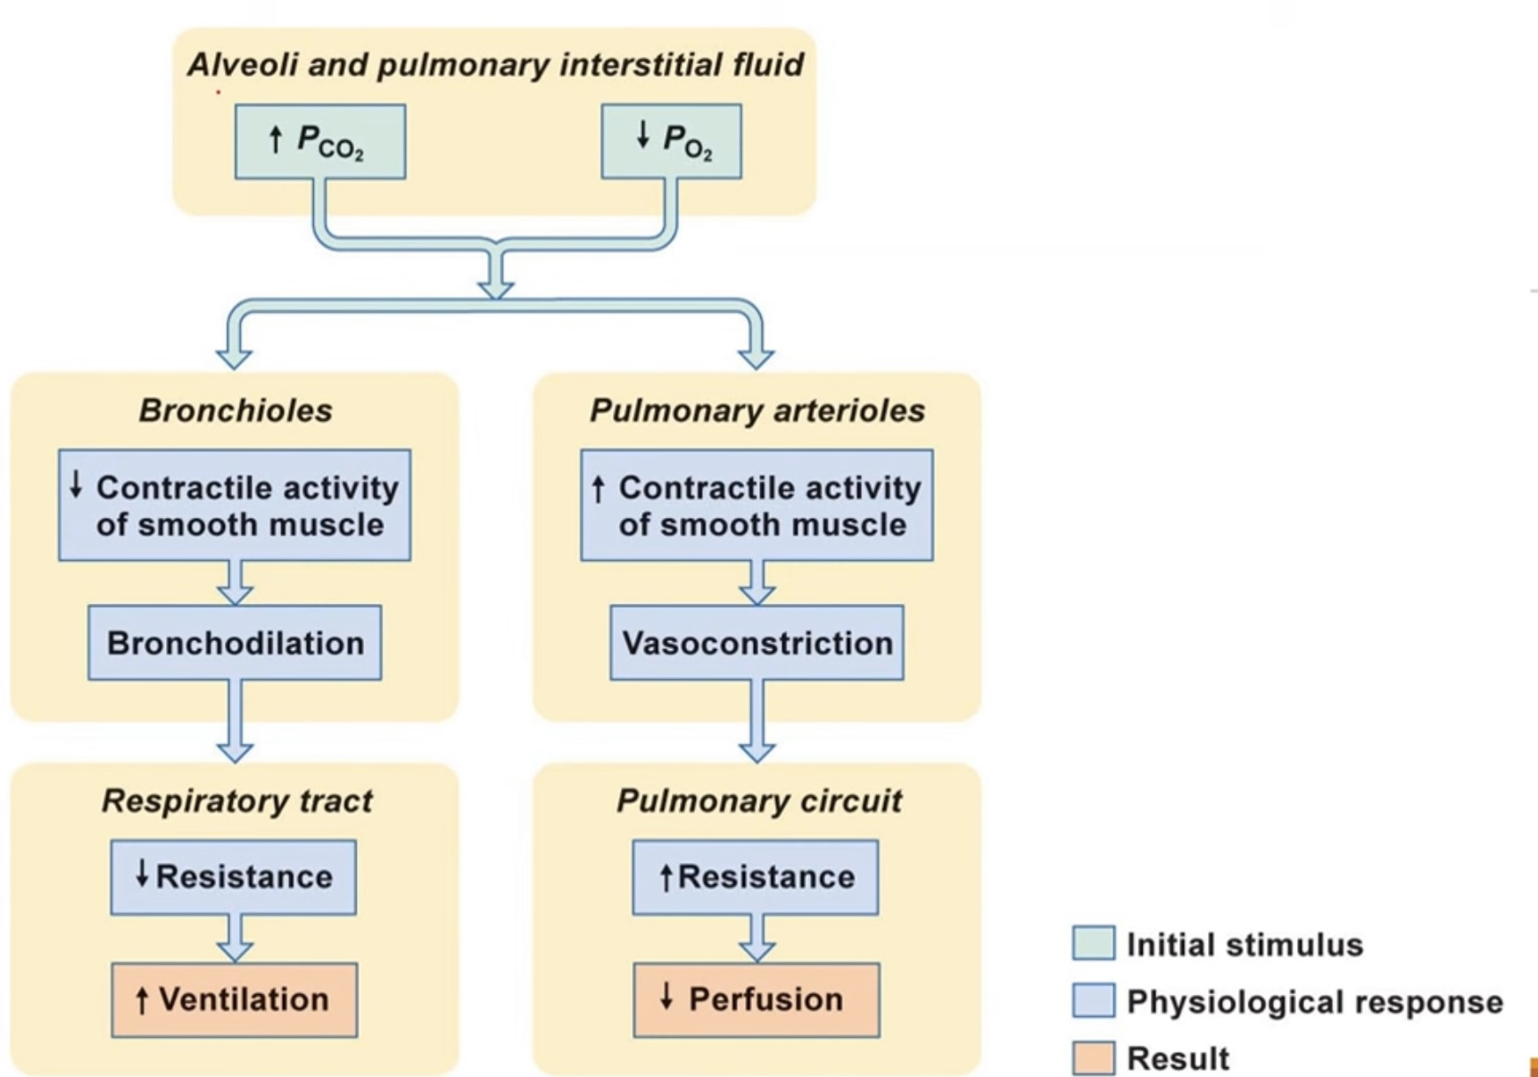
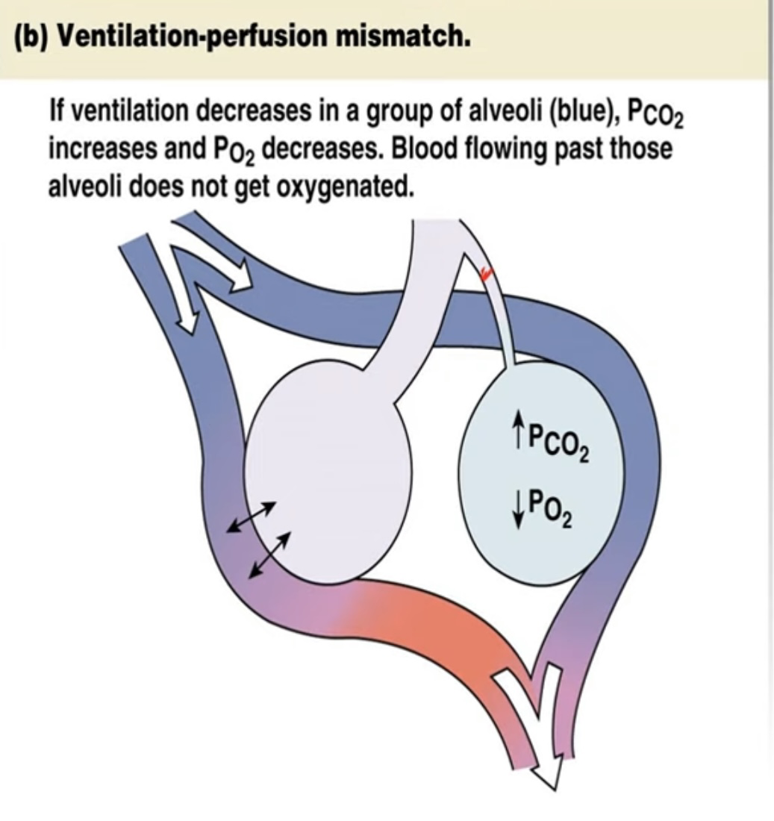

Slide 28
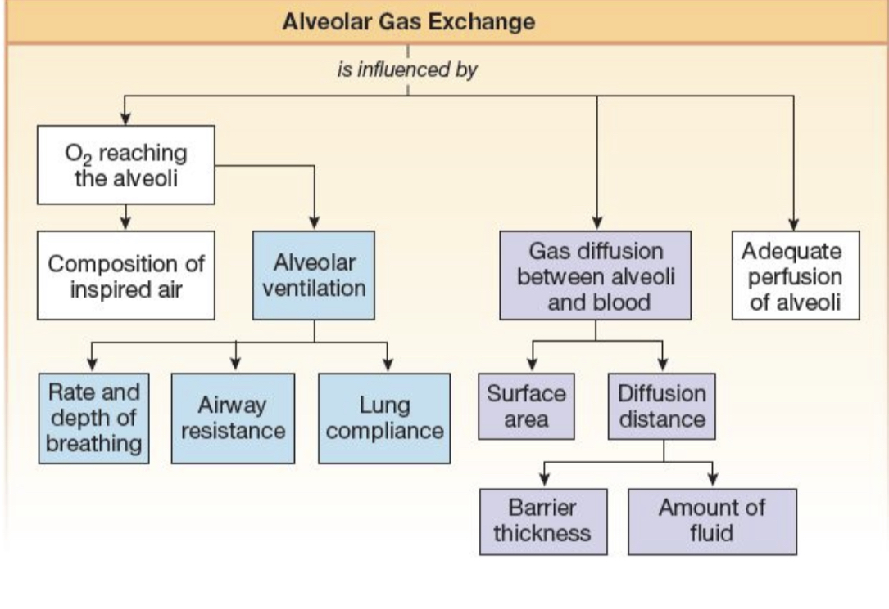

Slide 29
Gas Transport in the Blood

Slide 30
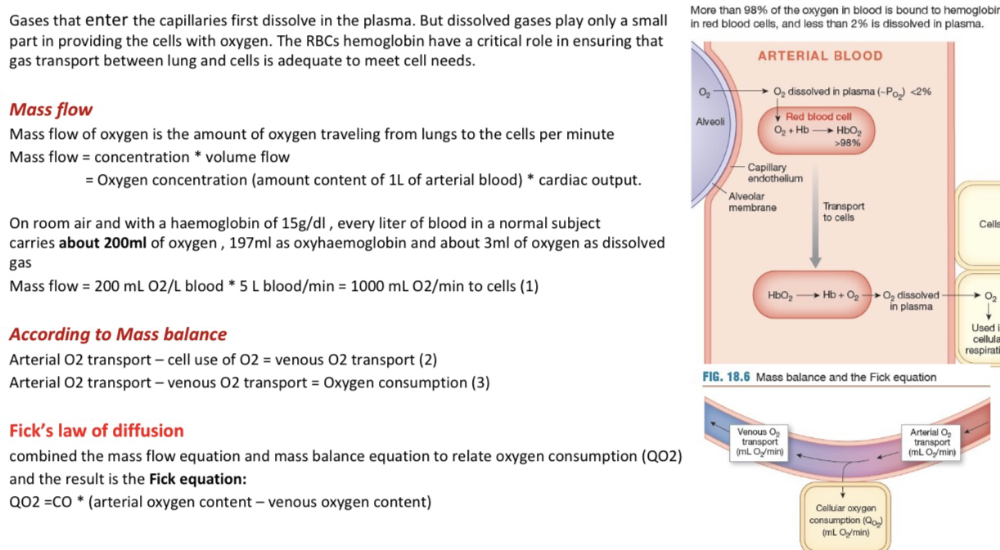

Slide 31
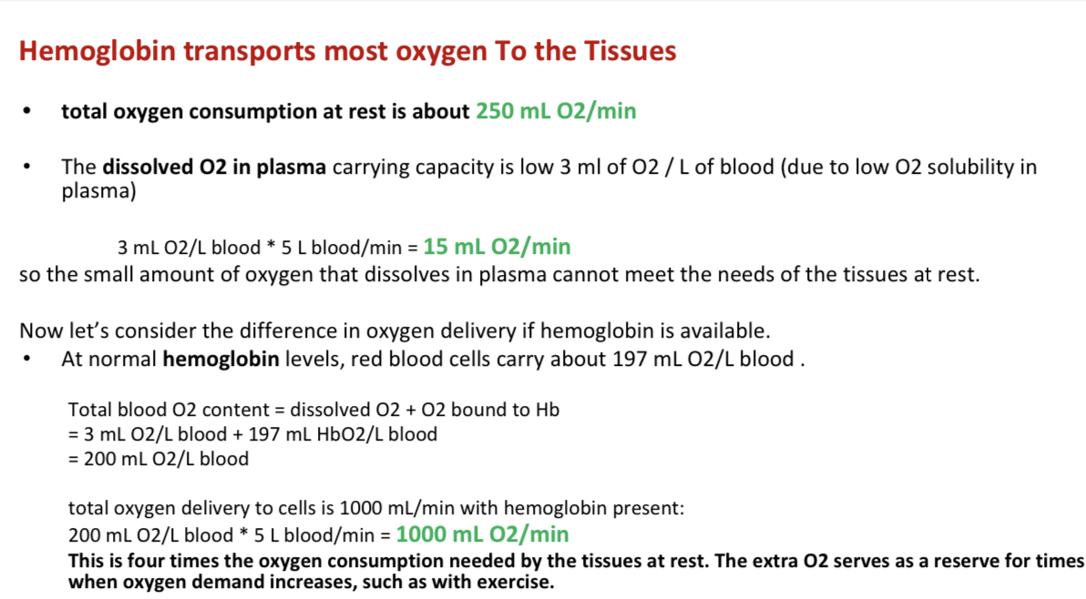

Slide 32
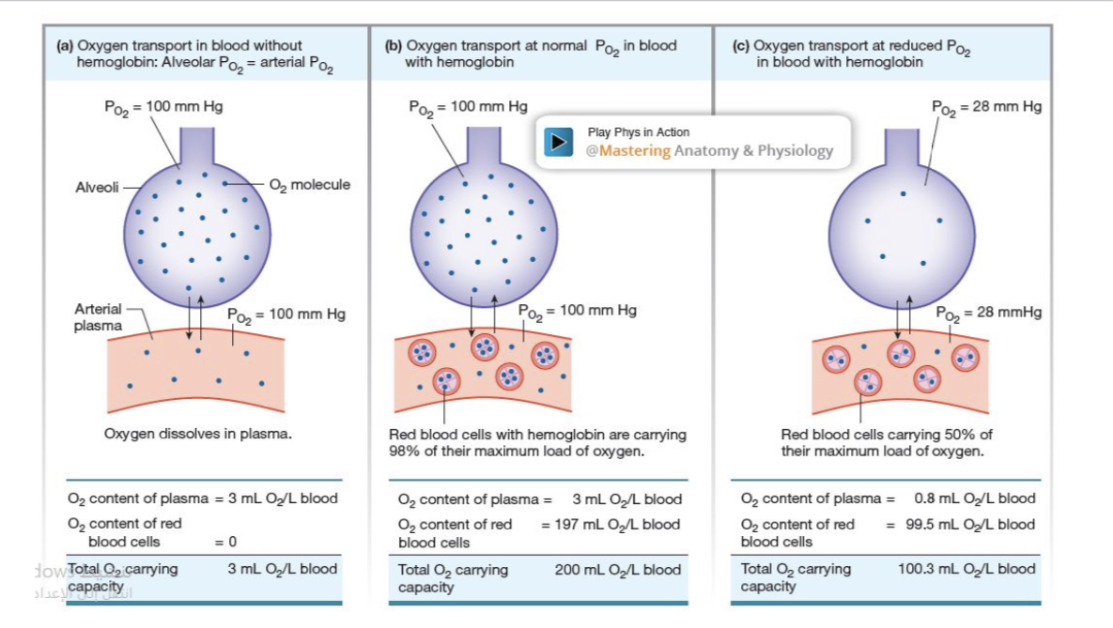

Slide 33
O2 content: It is the volume of O2 carried by blood combined with haemoglobin
O2 capacity of blood: Is the maximum volume of O2 that can be carried by haemoglobin
The percent haemoglobin (%Hb) saturation: A measure of the extent to which the Hb present is combined with O2
The Нb% saturation does not vary with Hb content) (as in anemia) because both O2 content and capacity are affected to the same extend.
The most important factor determining the % Hb saturation is the Po2 of the blood.

Slide 34
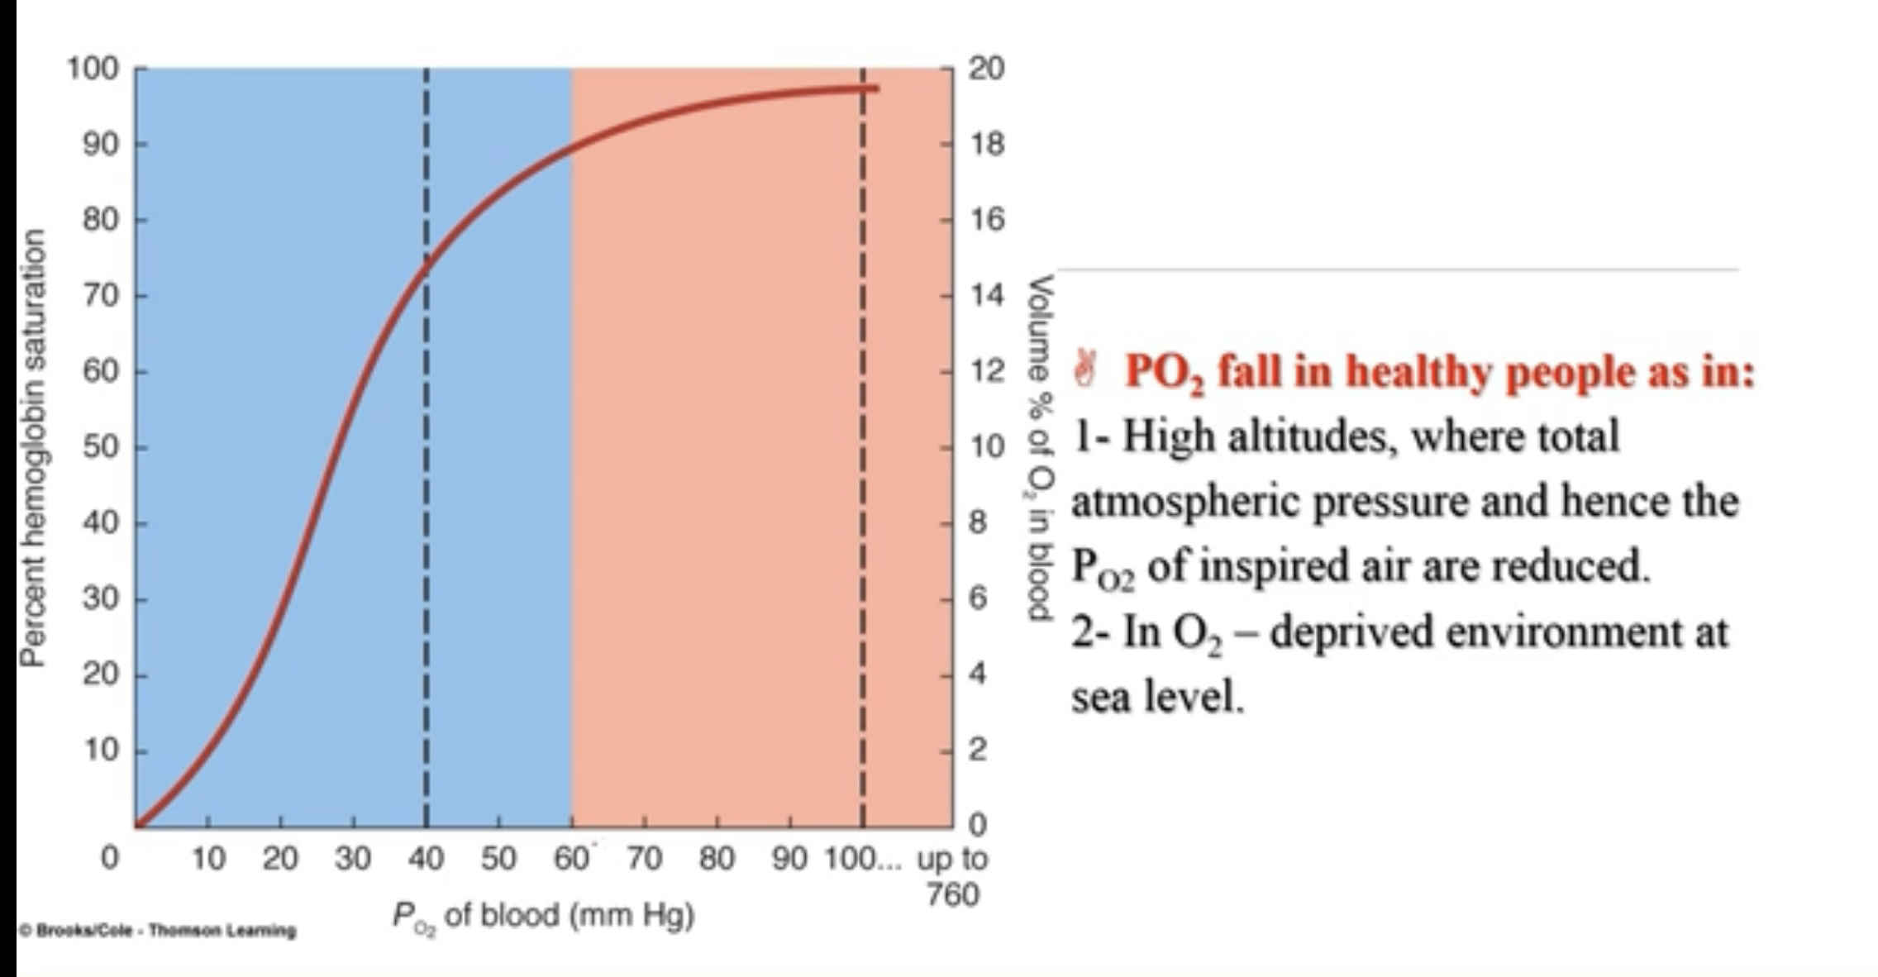

Slide 35
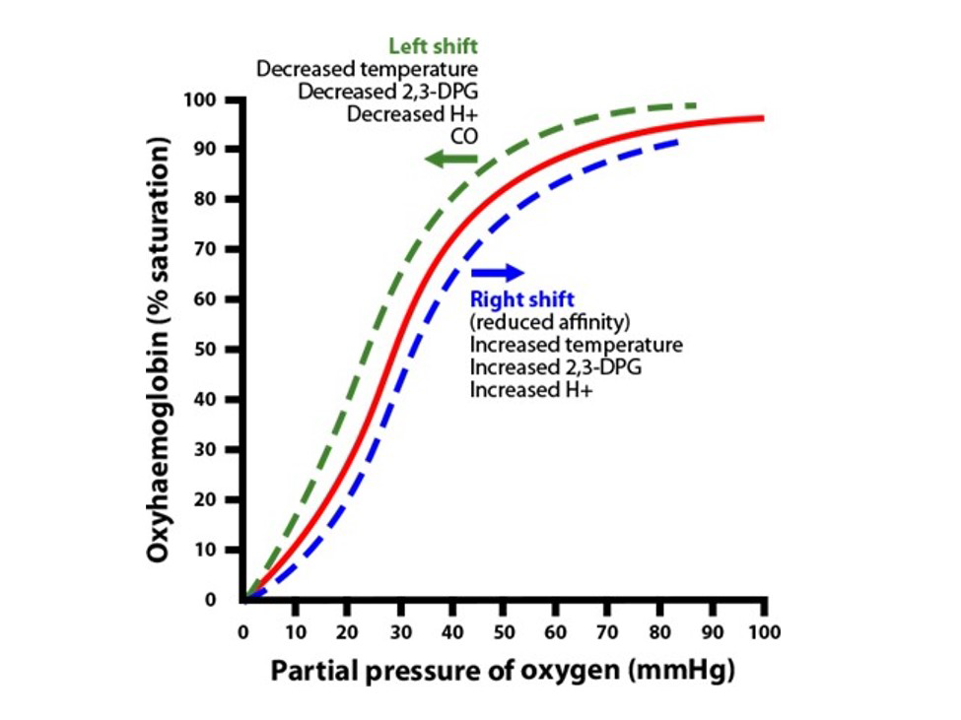

Slide 36
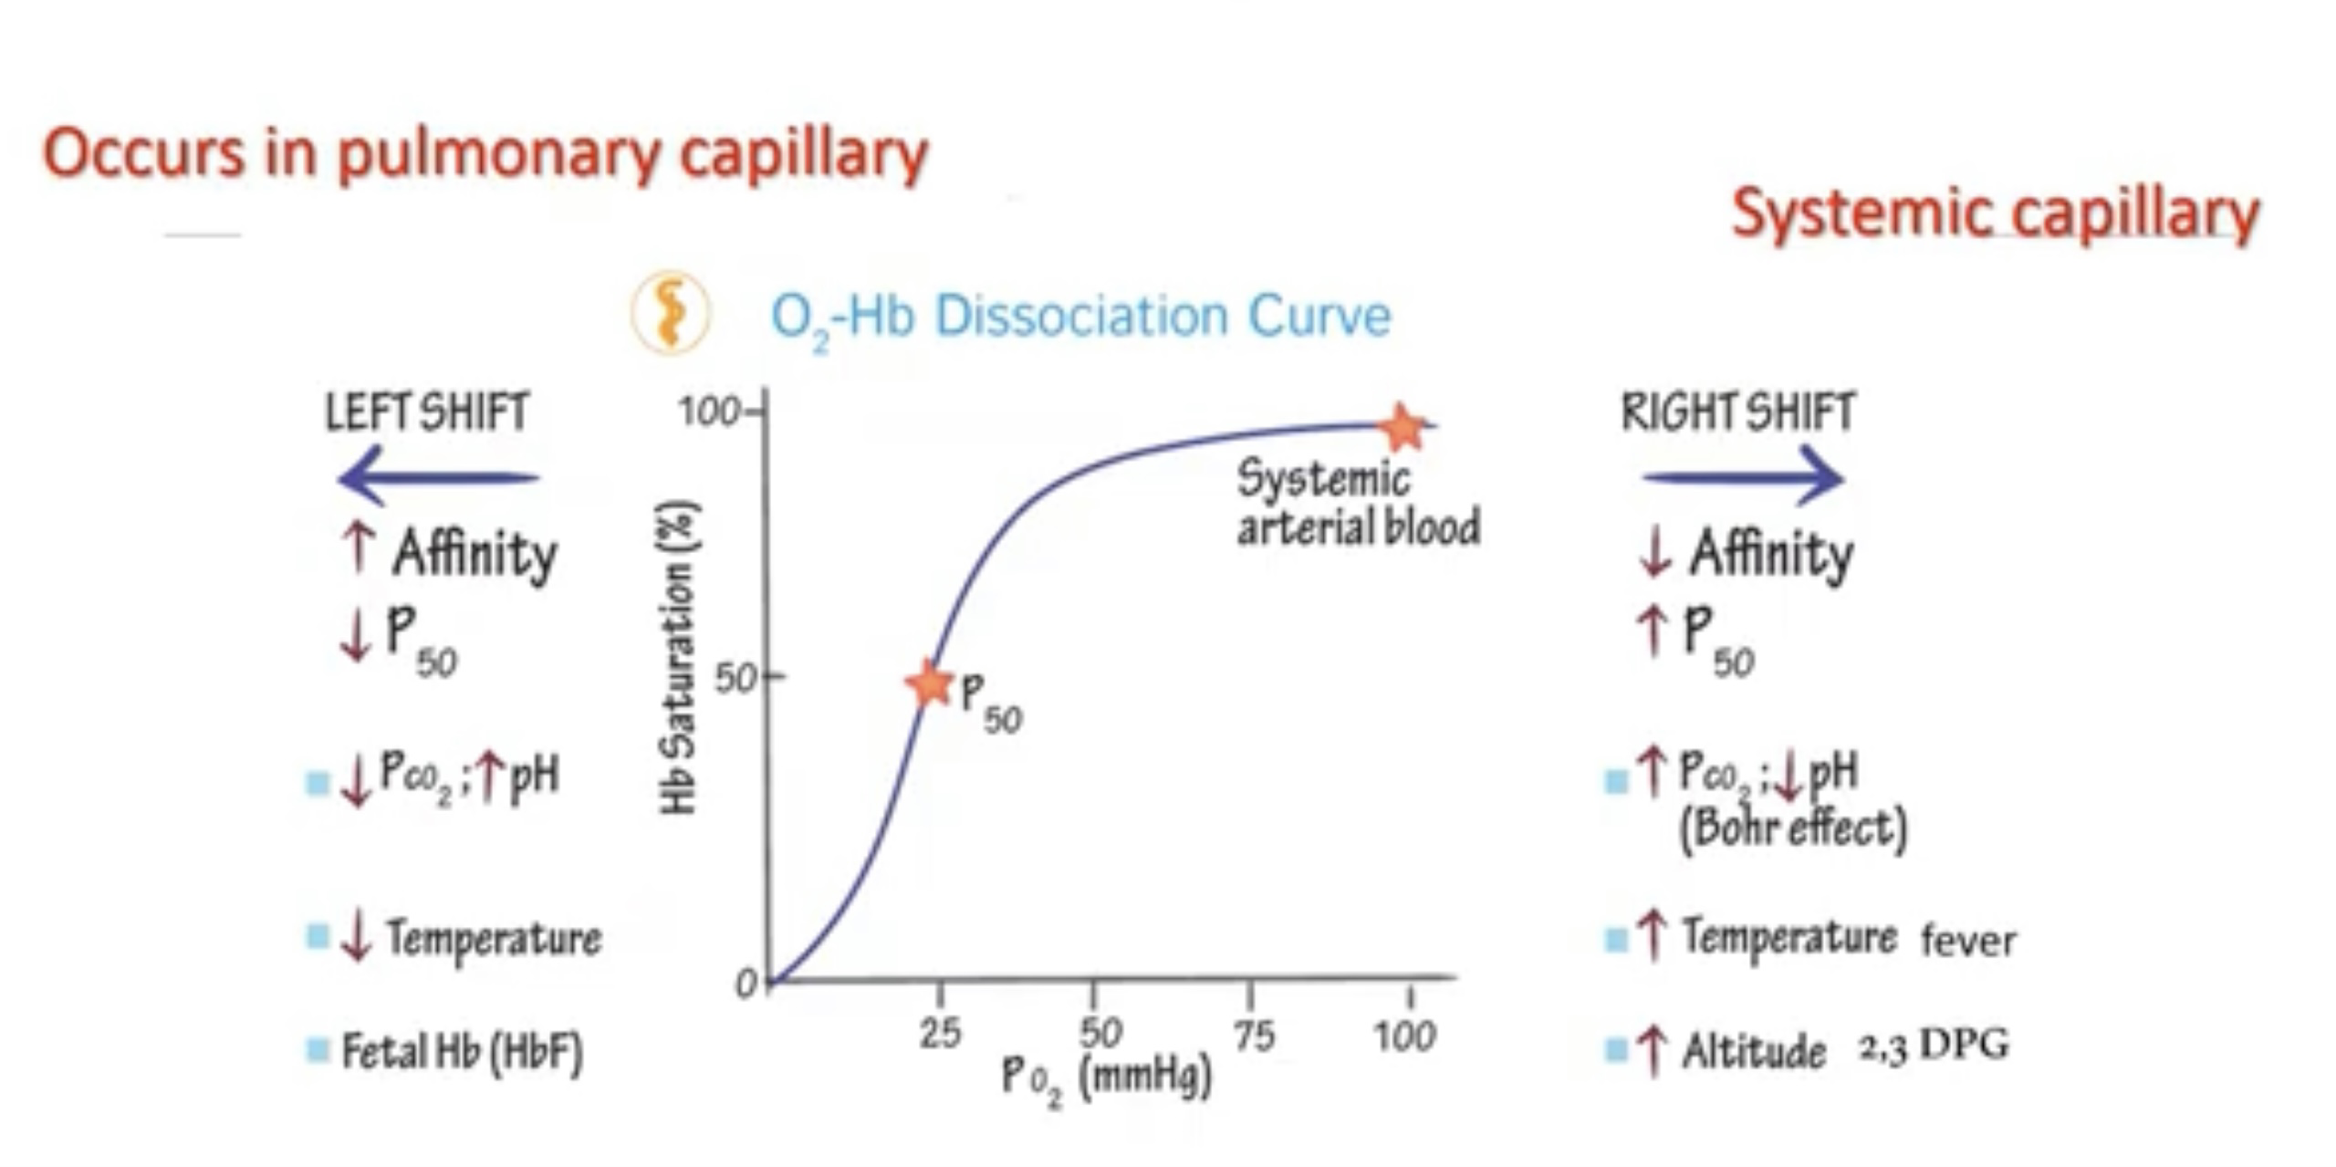

Slide 37
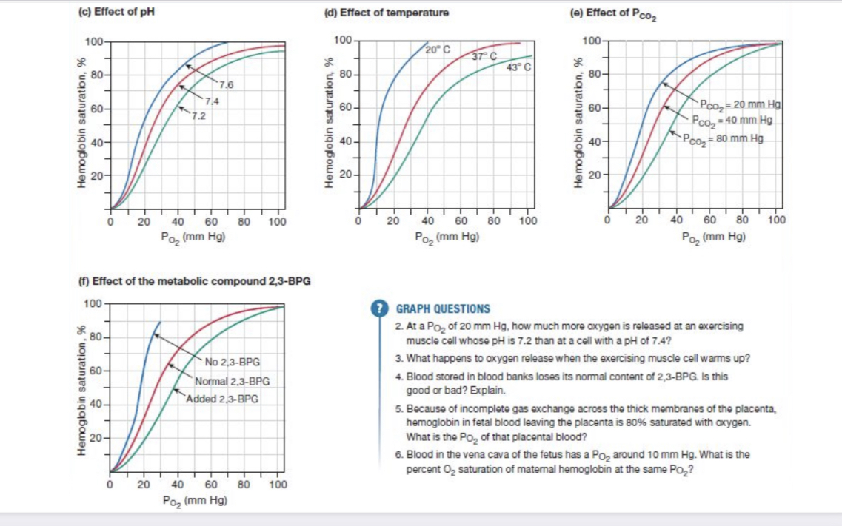

Slide 38
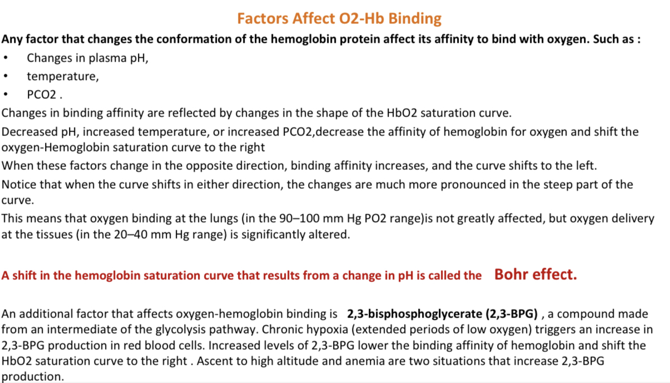

Slide 39
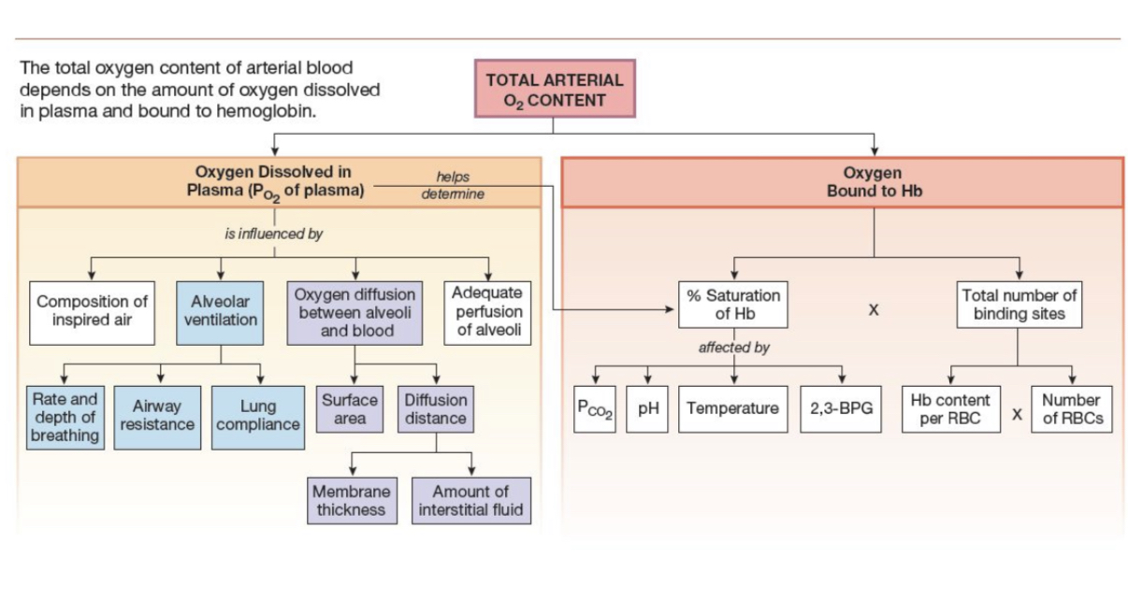

Slide 40
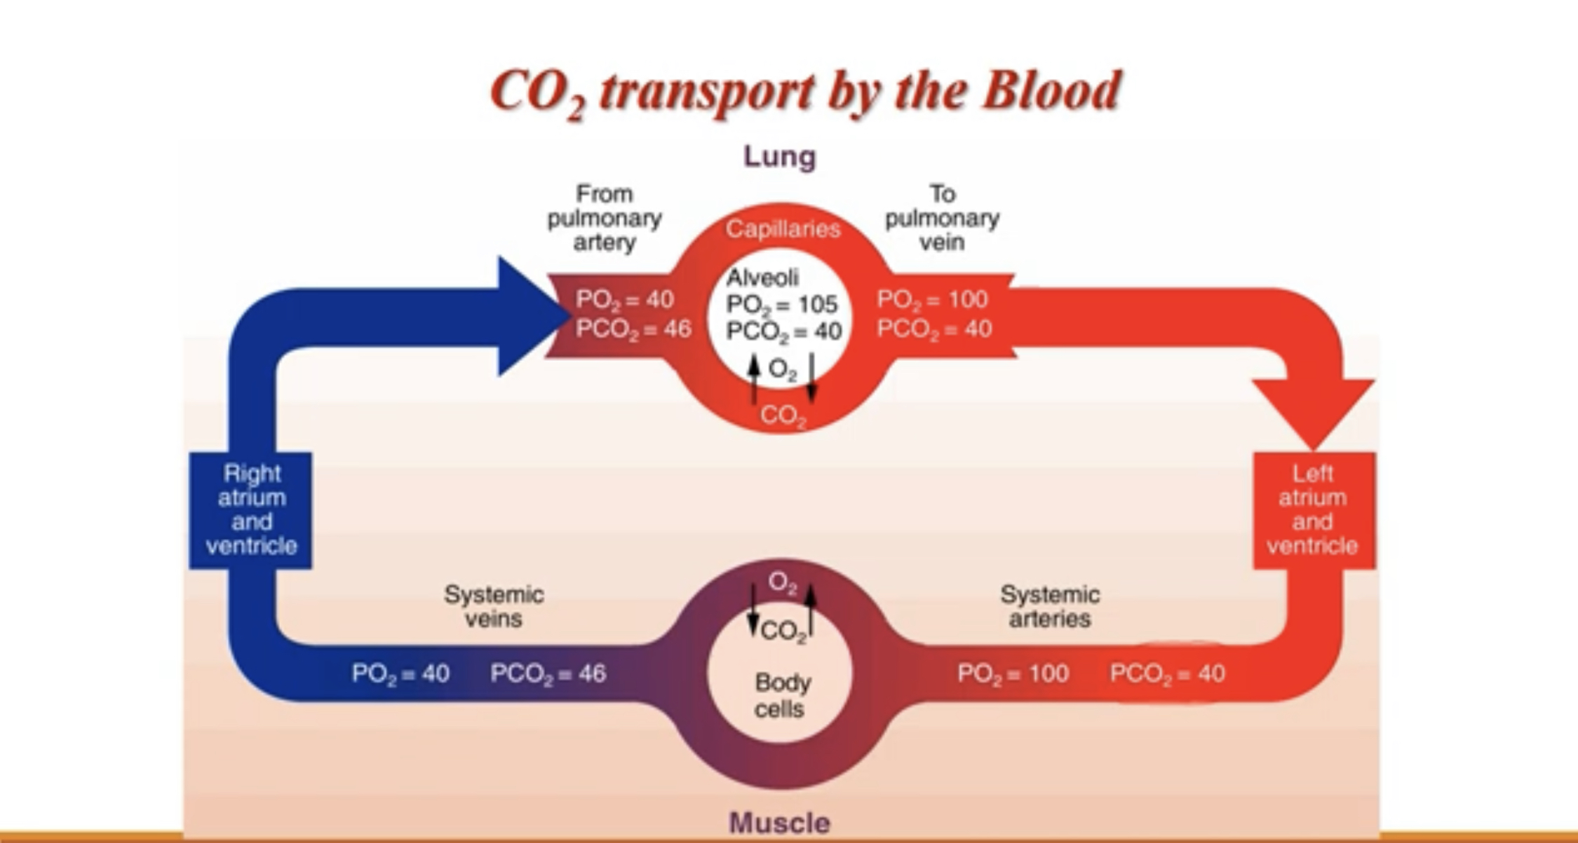
CO2 released from tissue to blood = 4ml (tidal CO2)
CO2 content = 52 ml / 100 ml venous blood
CO2 content = 48 ml / 100 ml arterial blood

Slide 41
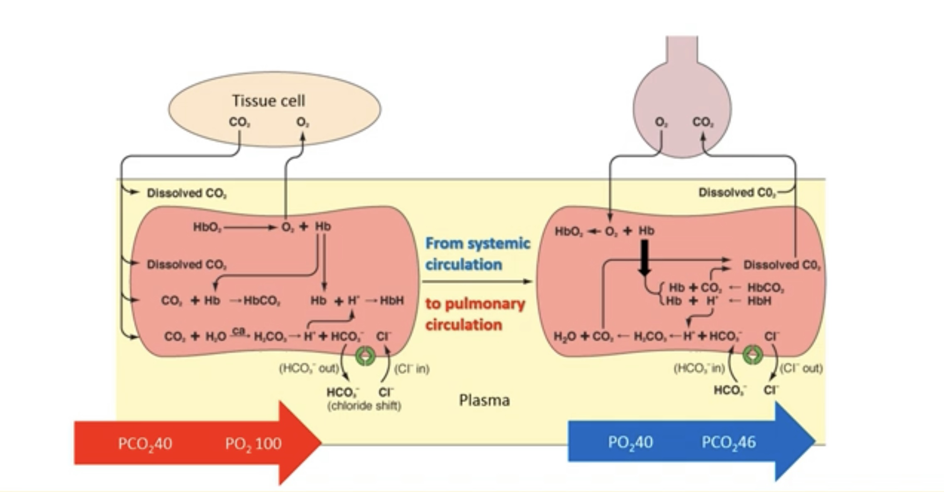
Alveolus
CO2 transported as:
CO2= 7%
Hgb-CO2 = 23%
HCO;= 70%

Slide 42
CO2 transport in 3 forms:
7% CO2 dissolved in plasma
CO2 binds to hemoglobin (HbCO2): 23% of the CO2 in venous blood binds directly to Hb.At the tissues, when O2 leaves its binding sites on the Hb molecule, CO2 binds with free Hb at exposed amino groups (-NH2), forming carbaminohemoglobin:CO2 + Hb ↔ HbCO2 (carbaminohemoglobin).The presence of CO2 and H+ facilitates formation of HbCO2 because both of these factors decrease hemoglobin’s binding affinity for oxygen .

Slide 43
CO2 transport in the form of Bicarbonate Ions (70%):
Most of the CO2 that enters the blood is transported to the lungs as bicarbonate ions (HCO3-) dissolved in the plasma. The conversion of CO2 to HCO3- serves two purposes:(1) it provides an additional way to transport CO2 from cells to lungs, and(2) HCO3- is available to act as a buffer for metabolic acids, thereby helping stabilize the body’s pH.The rapid production of HCO3- depends on the presence of carbonic anhydrase (CA). Dissolved CO2 in the plasma diffuses into RBCs, where it can react with water in the presence of carbonic anhydrase to form H ion and HCO3 ion:
CO2 + H2O ↔ H+ + HCO3-

Slide 44
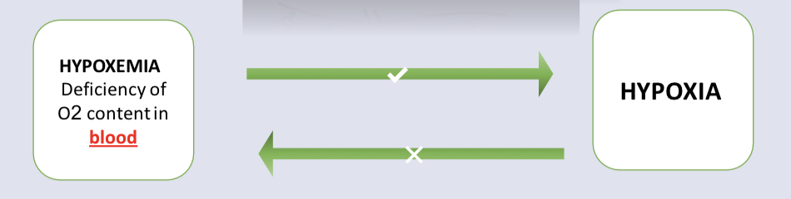
Hypoxia vs Hypoxemia
  • Normal arterial PO2 80-100 mmHg
  • Hypoxemia = low O2 tension in the arterial blood- arterial PO2 < 75- 80 mmHg
  • Hypoxia = low O2 tension at the tissue level
  • when arterial PO2 < 60 mmHg = Respiratory failure

Slide 45
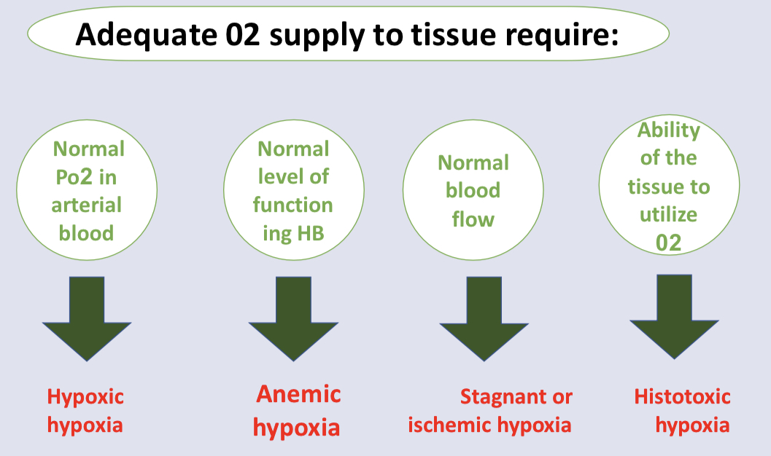

Slide 46
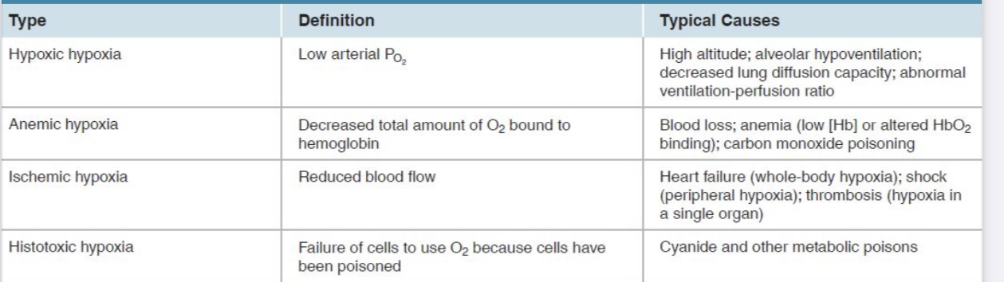

Slide 47
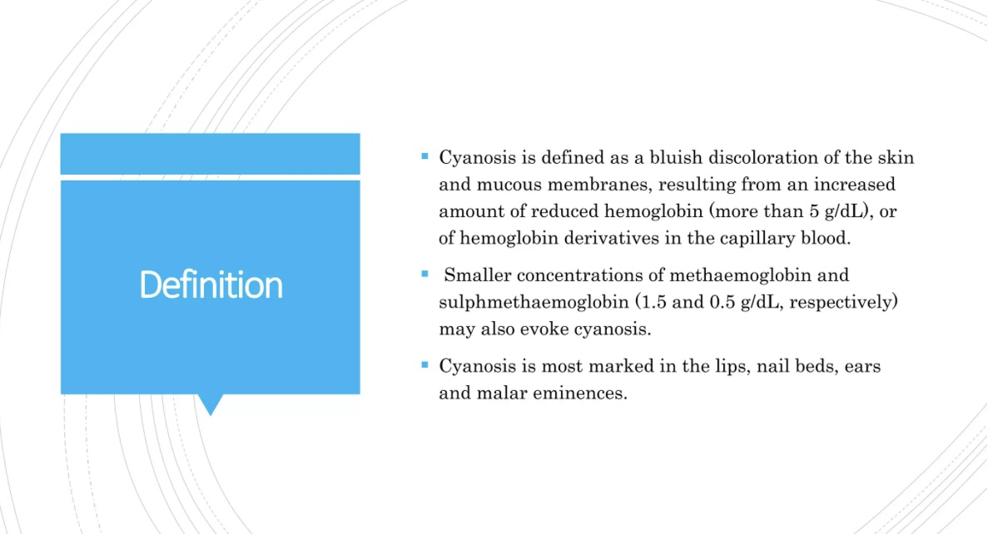
Cyanosis

Slide 48
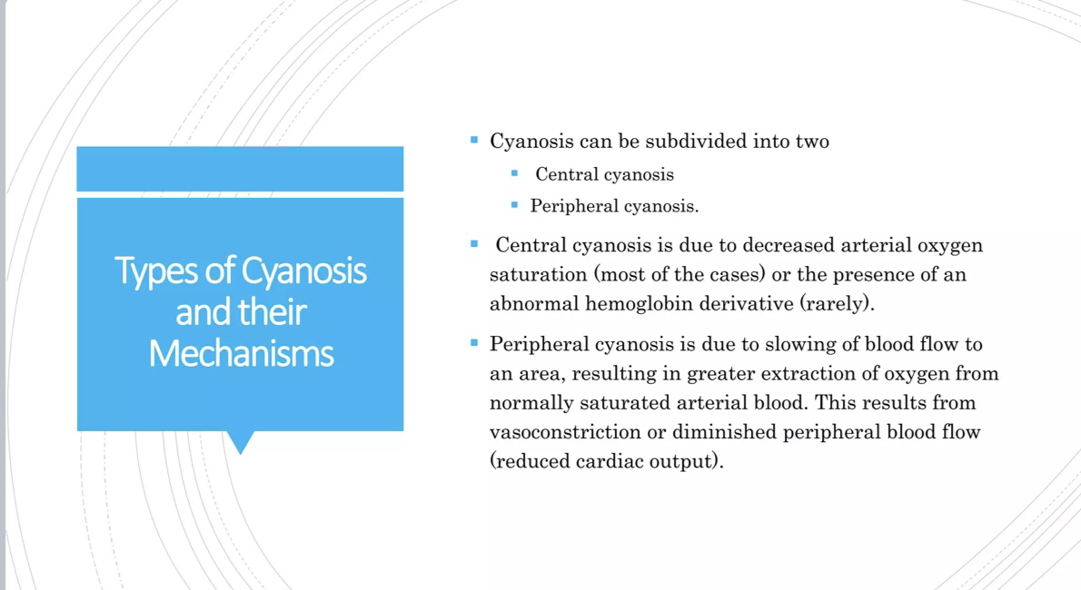
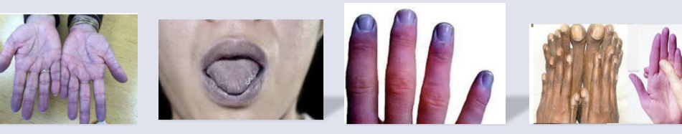

Slide 49
With regard to the distribution of pulmonary blood flow
Hypoxia leads to pulmonary vasodilation
Typically there is a zone at the apex that is not perfused
The mean pulmonary arterial pressure is 8 mmHg
Flow is determined by the arterial/alveolar pressure difference

Slide 50
Concerning O2 transport, oxygen capacity of the blood is determined by
Plasma volume
Amount of O2 dissolved in the blood
Amount of Hb in the blood
Affinity of Hb for oxygen
All of the above

Slide 51
All the following shift the oxygen dissociation curve to the right EXCEPT
Increased temperature
Carbon monoxide poisoning
Increased CO2
Increased hydrogen ion
Increased biphosphoglycerate

Slide 52
With respect to gas transport in the blood
Normal arterial blood with a pO2 of 100mHg contains 3ml of dissolved oxygen per liter
The great bulk of carbon dioxide in blood is found as dissolved carbon dioxide and carbamino compounds
Oxygen capacity is the total amount of oxygen that can be carried in 100ml of blood
Haldane effect refers to the shift of Chloride ions into the RBC to maintain electrical neutrality after carbon dioxide diffuses out of cells
Arterial pO2 measures the amount of oxygen bound to hemoglobin

Slide 53
Which of the following is Cause of hypoxic hypoxia
Increase PO2 in inspired air
Hyperventilation
Normal gas exchange
Arteriovenous shunt

Slide 54


