Slide 1
Pulmonary functions tests prepared by : dr. alaa abushahla teaching assistant, AUG

Slide 2
Purposes Pulmonary Function Testing
diagnosis of symptomatic
screening for early, asymptomatic disease
prognostic of known disease
monitoring response to treatment
as a diagnostic tool, PFTs help classify diffuse lung disease into three categories
1- obstructive lung disease
2- restrictive lung disease
3- pulmonary vascular disease
Group of procedures that measure the function of the lungs

Slide 3
functions of pulmonary systems tested by PFTs
provide information about every component of respiration
including :
patency of the airways (large and small)
parenchyma (alveoli and interstitium )
pulmonary vasculature
bellows/pumps mechanism resposible for the changes of intrathoracic pressure (diaphragm and chest wall )
neural control of ventillation

Slide 4
PULMONARY FUNCTION TESTS:
Spirometry.
lung volumes.
diffusing capacity for carbon monoxide(Dlco)
ABG
maximum respiratory pressures measurment
peak flow
exercise oxymetry
6 minute walk test

Slide 5
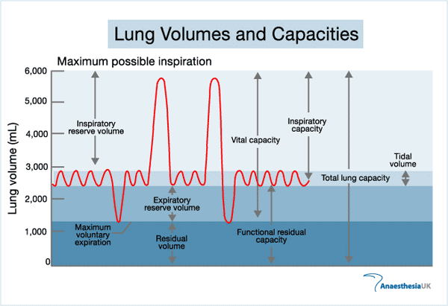

Slide 6
Tidal volume (TV) is the volume of air moved in and out of the respiratory tract (breathed) duringeach ventilatory cycle.
Inspiratory reserve volume (IRV) is the additional volume of air that can be forcibly inhaled following a normal inspiration. It can be accessed simply by inspiring maximally, to the maximal inspiratory level.
Expiratory reserve volume (ERV) is the additional volume of air that can be forcibly exhaled following a normal expiration. It can be accessed simply by expiring maximally to the maximal expiratory level.
Residual volume (RV) is that volume of air remaining in the lungs after a maximal expiration. It cannot be expired no matter how vigorous or long the effort. RV = FRC - ERV.
Functional residual capacity (FRC) is the volume of air remaining in the lungs at the end of a normal expiration. FRC = RV + ERV.
inpiratory capacity(IC) the volume of air that can be maximally forcefully inhaled .
Vital capacity (VC) is the maximal volume of air that can be forcibly exhaled after a maximal inspiration. VC = TV + IRV + ERV.
Total lung capacity (TLC) is the volume of air in the lungs at the end of a maximal inspiration. TLC = FRC + TV + IRV = VC + RV

Slide 7
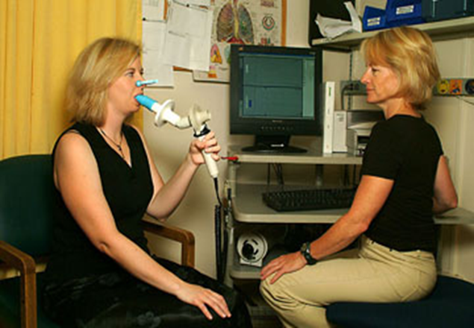
Spirometry

Slide 8
Indications of Spirometry:
Spirometry is a key diagnostic test for asthma and chronic obstructive pulmonary disease (COPD; when performed before and after bronchodilator) and is useful to assess for asthma or other causes of airflow obstruction in the evaluation of chronic cough.
It is also used to monitor a broad spectrum of respiratory diseases, including asthma, COPD, interstitial lung disease, and neuromuscular diseases affecting respiratory muscles.

Slide 9
Spirometry
Proper technique consists of the patient sitting upright with the head erect and the mouthpiece held tightly between the lips.
patient is instructed to inhale maximally then exhale as fast as possible and continue exhaling for at least 6 secounds
the maneuver should be repeatedat least three time ; the two largest values within 150 mL of each other should be used even if at different attempts. Normal reference values for spirometry are dependent on age, gender, height, and race.

Slide 10
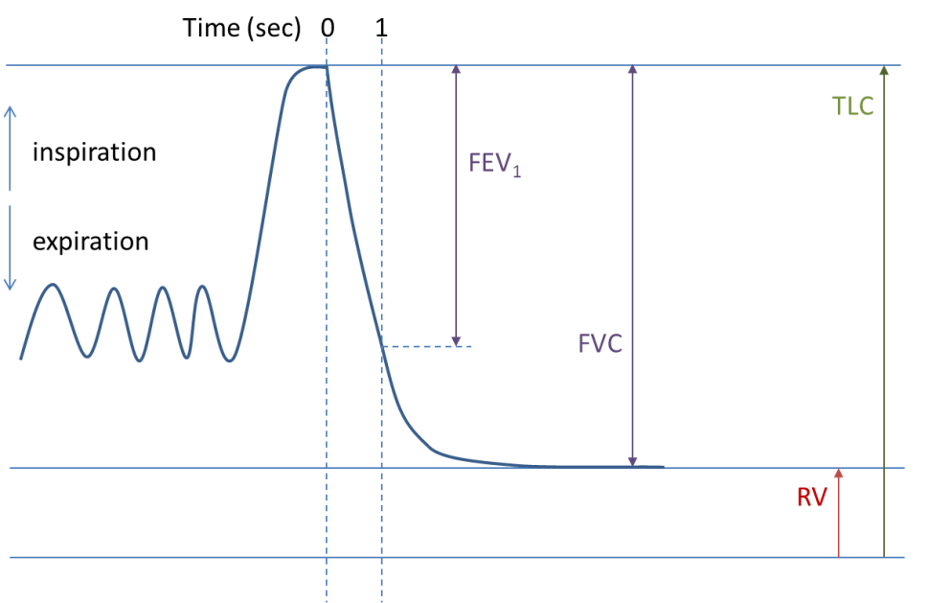

Slide 11
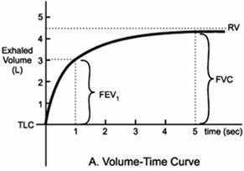
Volume Time Graph
The volume is plotted against the time, it displays the expiration.

Slide 12
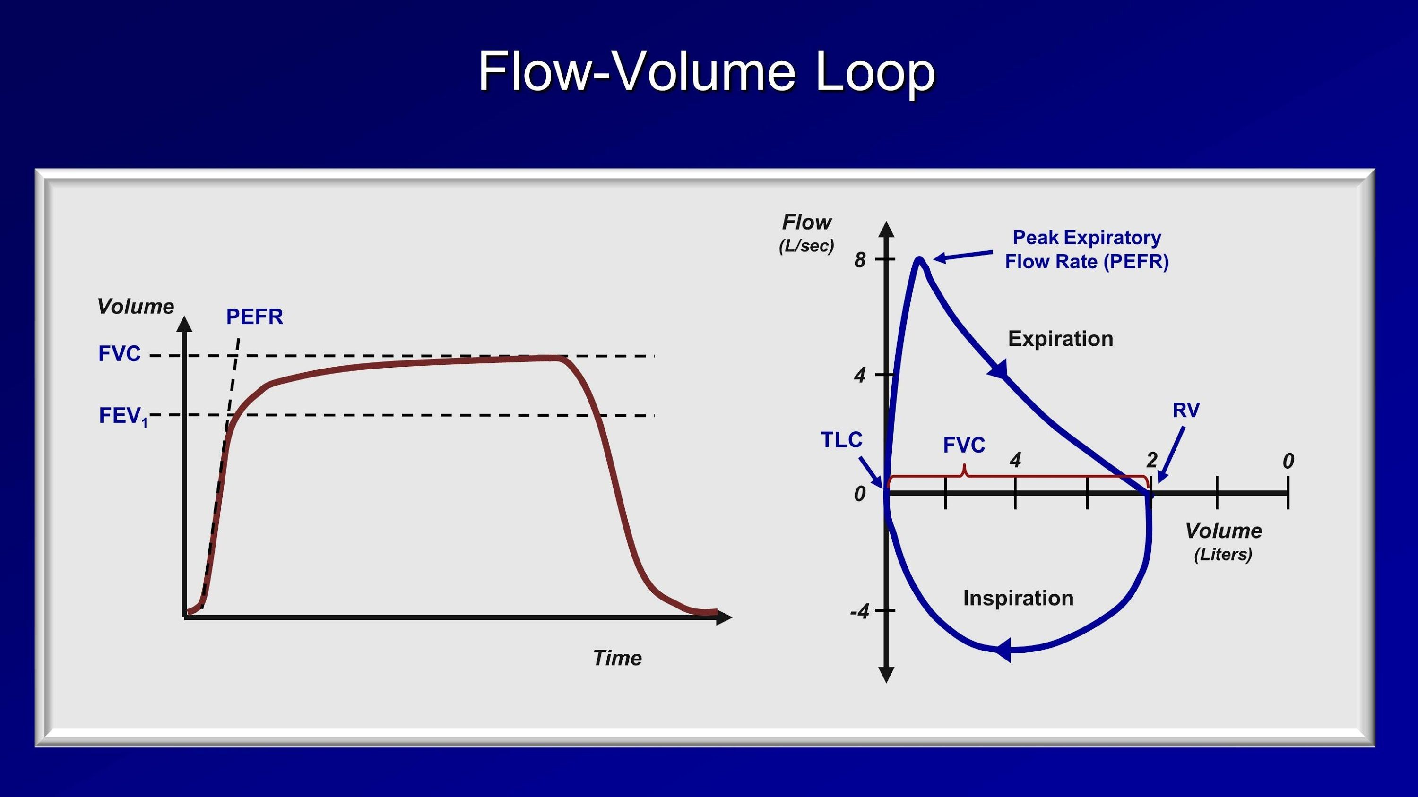

Slide 13
values meassured by spirometry :
Forced expiratory volume 1 (FEV₁) - the volume of air that is forcefully exhaled in one second.
Forced vital capacity (FVC) - the volume of air that can be maximally forcefully exhaled.
Ratio of FEV1 to FVC (FEV1/FVC) - expressed as a percentage.
Peak expiratory flow rate (PEFR)
FEF25-75%: the average flow from the time 25%of FVC exhaled to the time 75% has been exhaled
maximal voluntary ventillation (MVV) the maximum amount of air that can be exhaled and inhaled in 1 minute
Response to bronchodilator

Slide 14
Measures of interest are the forced expiratory volume exhaled in 1 second (FEV 1) and forced expiratory volume until full exhalation, or forced vital capacity (FVC).
The FEV1/FVC ratio is used to assess for airway obstruction; a value less than 70% (the lower limit of normal) is consistent with airflow obstruction. With evidence of obstruction, the degree of reduction in FEV 1 is used to characterize the degree of obstruction.
FEV1 ≥ 80% of predicted Normal
FEV1 60-80% of predicted mild obst.
FEV1 40-60% of predicted moderate
FEV1 ≤ 40% of predicted severe
*Predictors: Sex, Age, Ht

Slide 15
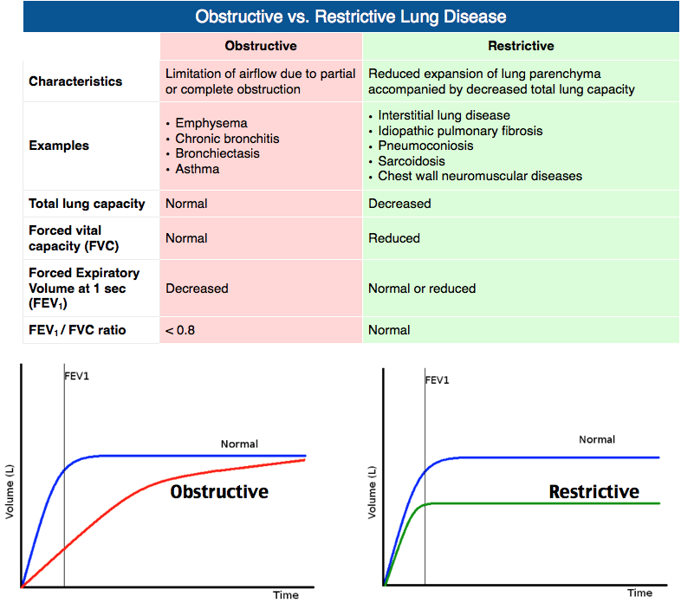
interpretation of FEV1, FVC and FEV1/FVC

Slide 16
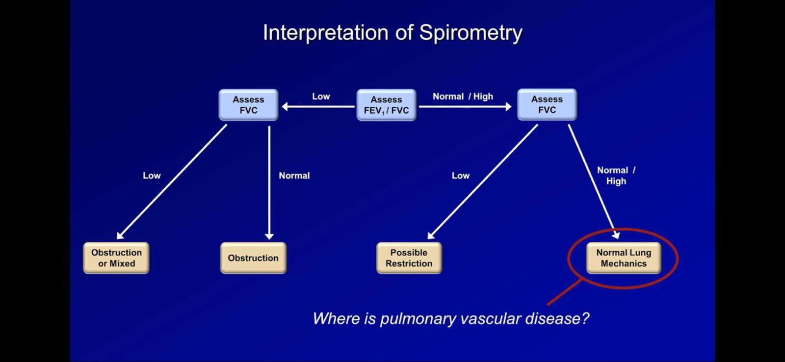

Slide 17
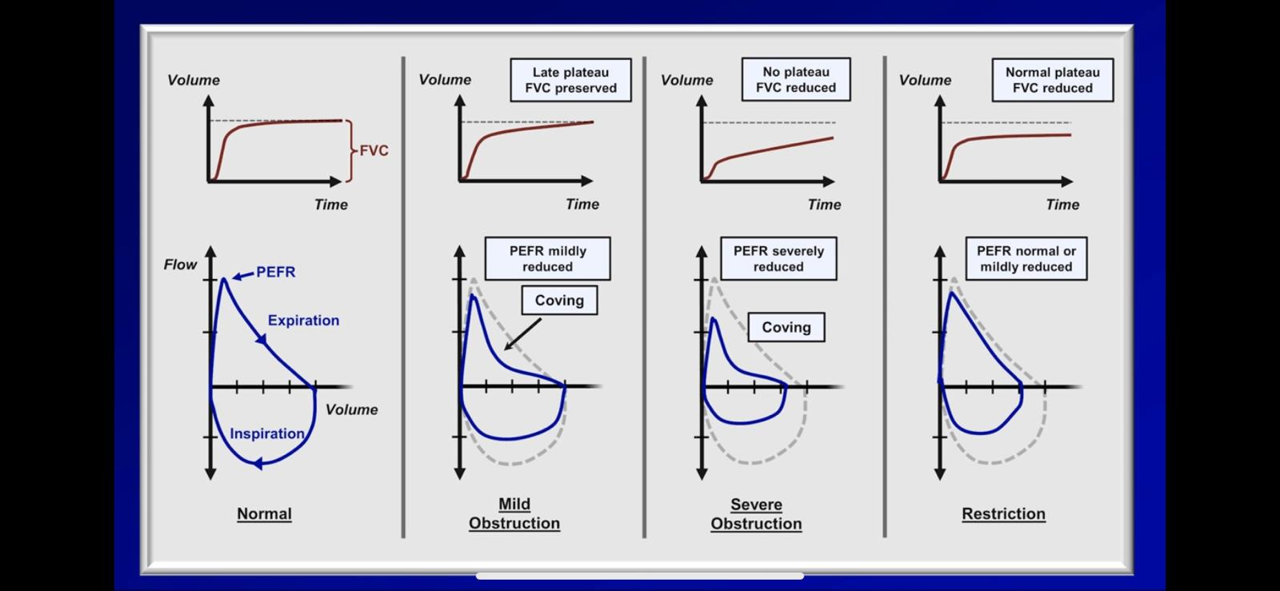

Slide 18
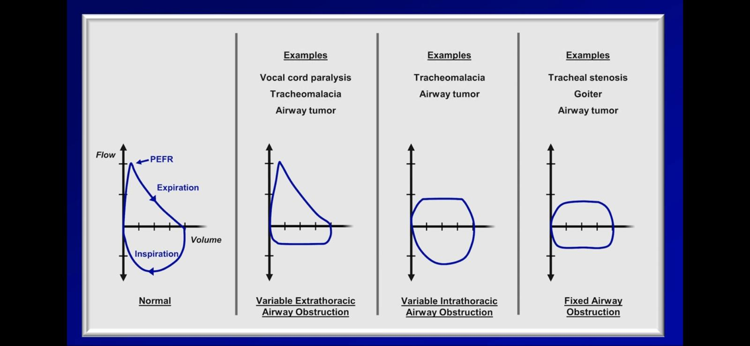

Slide 19
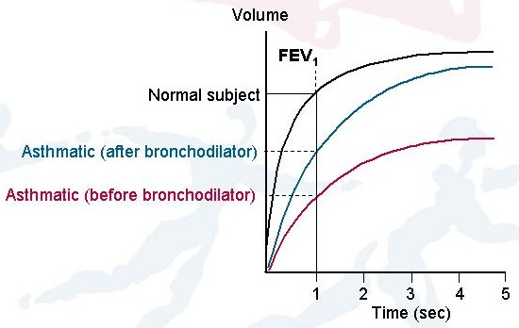
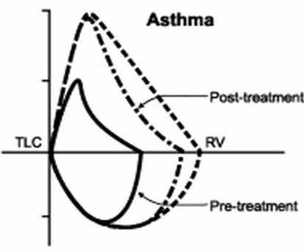
Common Obstructive Lung Diseases
Asthma
COPD (chronic bronchitis, emphysema and the overlap between them).
Cystic fibrosis.
-Airflow is reduced because the airways narrow and the FEV1 is reduced
-Spirogram may continue to rise for more than 6 seconds because lung take longer to empty
-FVC may also be reduced because gas is trapped behind obstructed bronchi due to increase in intrathoracic pressure during maneuver compresses airways causing early airway closure and gas trapping but this reduction to a lesser extent than FEV1

Slide 20
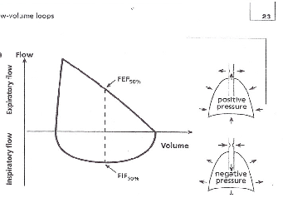
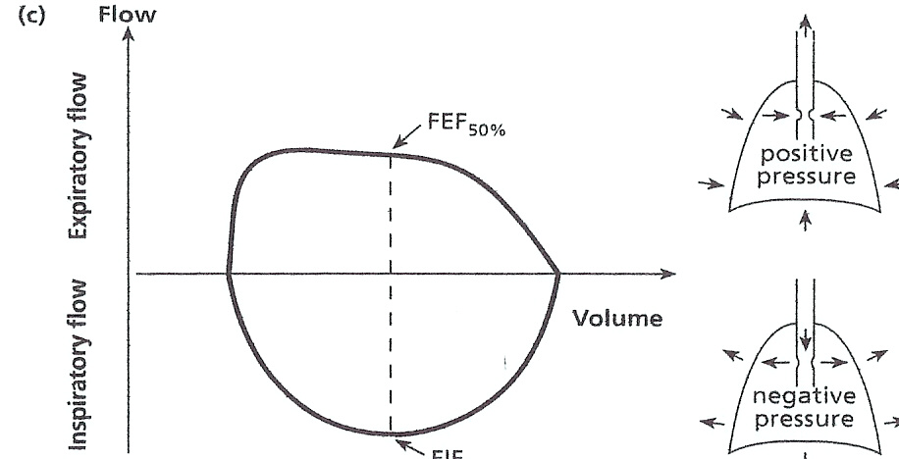
Variable Extrathoracic
Obstruction
The obstruction worsens in inspiration because the negative pressure narrows the trachea and inspiratory flow is reduced in inspiratory phase
Variable Intrathoracic obstruction
The narrowing is maximal in expiration because of increased intrathoracic pressure compressing the airway.
The flow volume loop shows a greater reduction in the expiratory phase

Slide 21
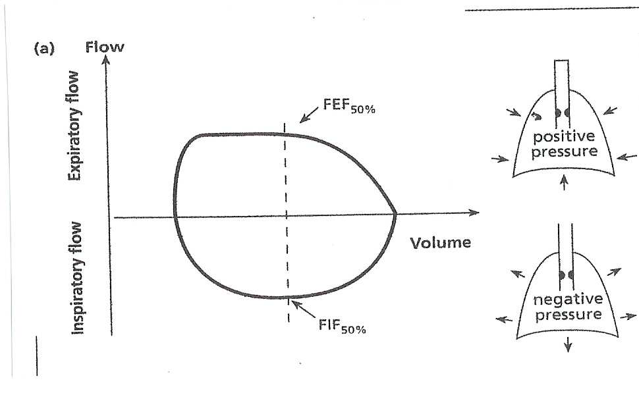
Fixed obstruction
Maximum airflow is limited to a similar extent in both inspiration and expiration

Slide 22
response to bronchodilators
Performance of spirometry before and after bronchodilator is used to determine the degree of reversibility of airflow limitation.
Administration of albuterol by metered-dose inhaler (MDI) is indicated if baseline spirometry demonstrates airway obstruction or if one suspects asthma or COPD.
Albuterol (4 inhalations of 90 to 100 mcg) or an equivalent short-acting beta agonist is administered by metered dose inhaler with a spacer or chamber device .
Spirometry should be repeated 10 to 15 minutes after administration of a bronchodilator
In a patient with airway obstruction, an increase in the FEV₁ or FVC of more than 12 percent and greater than 0.2 L suggests acute bronchodilator responsiveness.

Slide 23
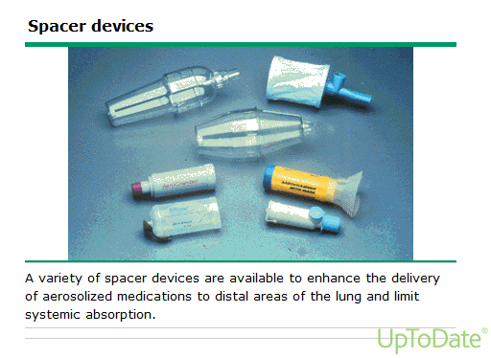

Slide 24
patients with asthma
patients with COPD
bronchodilator administration often results in improvement, and in some patients with asthma, post-bronchodilator testing may improve to normal spirometry values.
administration of bronchodilator sometimes leads to a significant change in FEV₁, but reversal to normal spirometry makes COPD less likely. Bronchodilators may also lead to improvement in flow in the small airways and a reduction in air trapping.

Slide 25
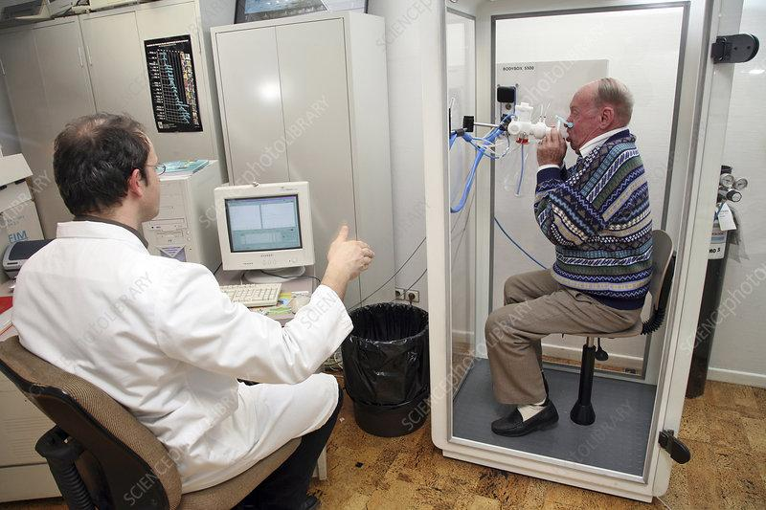
Lung Volumes
Lung volume testing directly and indirectly measures the static amount of air in the lungs and can be helpful in the diagnostic evaluation of dyspnea and abnormal spirometry results
Measurement of lung volumes is important when spirometry shows a decreased forced vital capacity.
Body plethysmography is the gold standard for measurement of lung volumes
Key measures include the total lung capacity (TLC), and residual volume (RV)

Slide 26
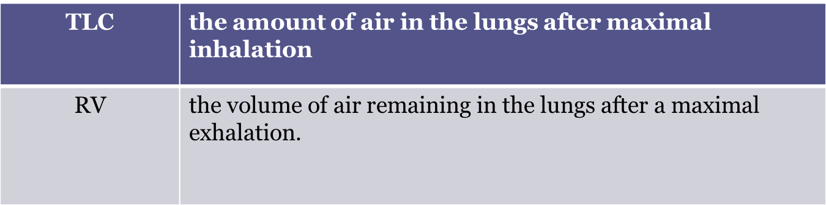

Slide 27
The components that are directly measurable by plethysmography are :
air in the lungs after a normal expiration(at the end of a tidal volume breath) | functional residual capacity
air in the lungs that is still able to be exhaled after normal expiration | expiratory reserve volume
the volume of air maximally exhaled during expiration with a slow exhalation maximum volume exhaled after maximum inspiration; | slow vital capacity Vital capacity (VC)

Slide 29
These measures are then used to calculate the RV and TLC.
RV= FRC-ERV
TLC= VC+RV
TLC is the key lung volume for determining restriction, defined as a TLC value less than the 5th percentile of predicted (roughly and imperfectly approximated by values less than 80 percent of predicted).
a reduced VC alone is not sufficient evidence of restriction because it can be caused by air trapping due to severe obstruction .
Air trapping is indicated when the RV is increased (>120 percent of predicted).
hyperinflation is indicated when the TLC are increased (>120 percent predicted).

Slide 30
A normal FEV/1FVC ratio may reflect normal lung function or may indicate a restrictive lung defect.
However, if the FEV 1 and the FVC are reduced proportionately with each other and are below the predicted normal values, the spirometry results are consistent with a restrictive defect, which may be confirmed by further testing demonstrating low lung volumes

Slide 31
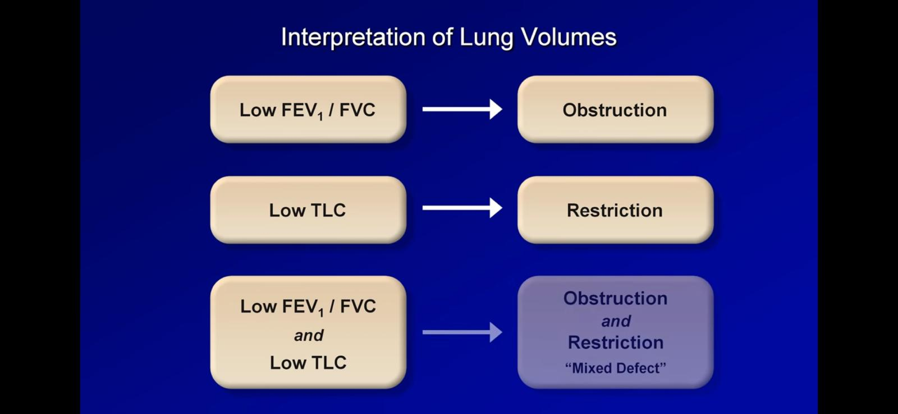

Slide 32
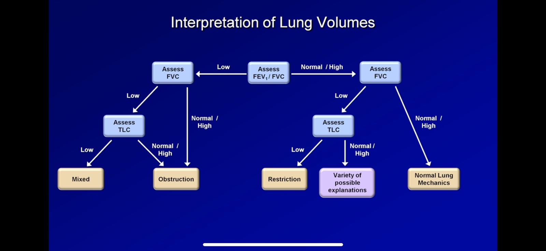

Slide 33
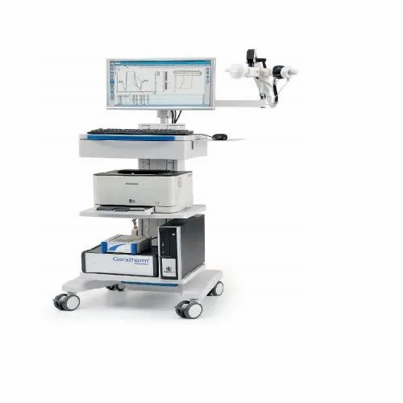
Diffusing Capacity for Carbon Monoxide

Slide 34
The diffusing capacity for carbon monoxide (DLco) is performed by having the patient take a single, deep breath of amixture of air, hilium, and 0.3%carbon monoxide then, the patient hold his/her breath in maximum inspiration for 10 secs during which carbon monoxide diffuses from alveoli across alveolar capillary membrane into the blood tream
after 10 secounds the patient exhales , then the exhaled gas is analyzed for the remaining carbon monoxide concentration after excluding the initial abount of gas from dead space
Dlco is the measurment of how much volume of carbon monoxide diffused oer minut per pressure unit across alveolar capillary membrane.
the process is repeated again after a few minutes and the mean is compaired agained a predected value
Dlco<40% of the predicted is considered severely impaired
Carbon monoxide is used because it is highly soluble in blood, has a high affinity for hemoglobin and is not normally present in blood or lungs at any significant quantities

Slide 35
INDICATIONS
to catagrize a patient with restrective lung disease as either probable ILD or extrathoracic restriction
to identify early ILD in high-risk patients
to quantify anatomic emphysema in patients with copd
document pulmonary diasbility
to detect pulmonary vascular disease

Slide 36
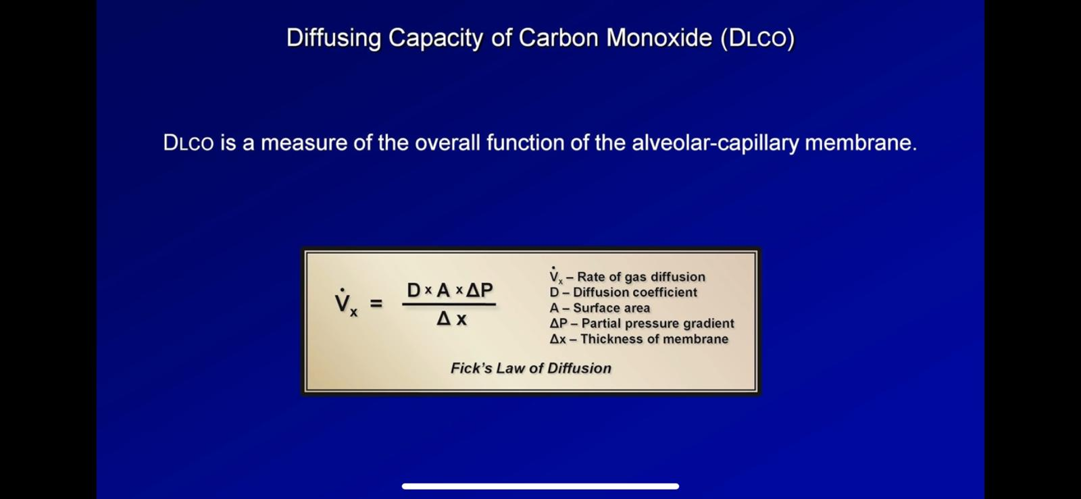

Slide 37
the diffusion of gas across the alveolar membrane increases with:
the diffusion of gas across the alveolar membrane decreases with:
Increased surface area of the membrane(A).
Increased alveolar pressure gradient(ΔP)
Increased solubility of the gas.
Decreased membrane thickness (T).
Decreased surface area of the membrane(A) .
Decreased alveolar. pressure gradient(ΔP)
Decreased solubility of the gas.
Increased membrane thickness (T).

Slide 38
Causes of increased DLCO
Causes of decreased DLCO
Asthma
Polycythemia
Pulmonary hemorrhage
Exercise
Left to right shunt
emphysema (decrease surface area)
ILD (increase membrane thickness)
Pulmonary edema
Anemia
Low cardiac output

Slide 39
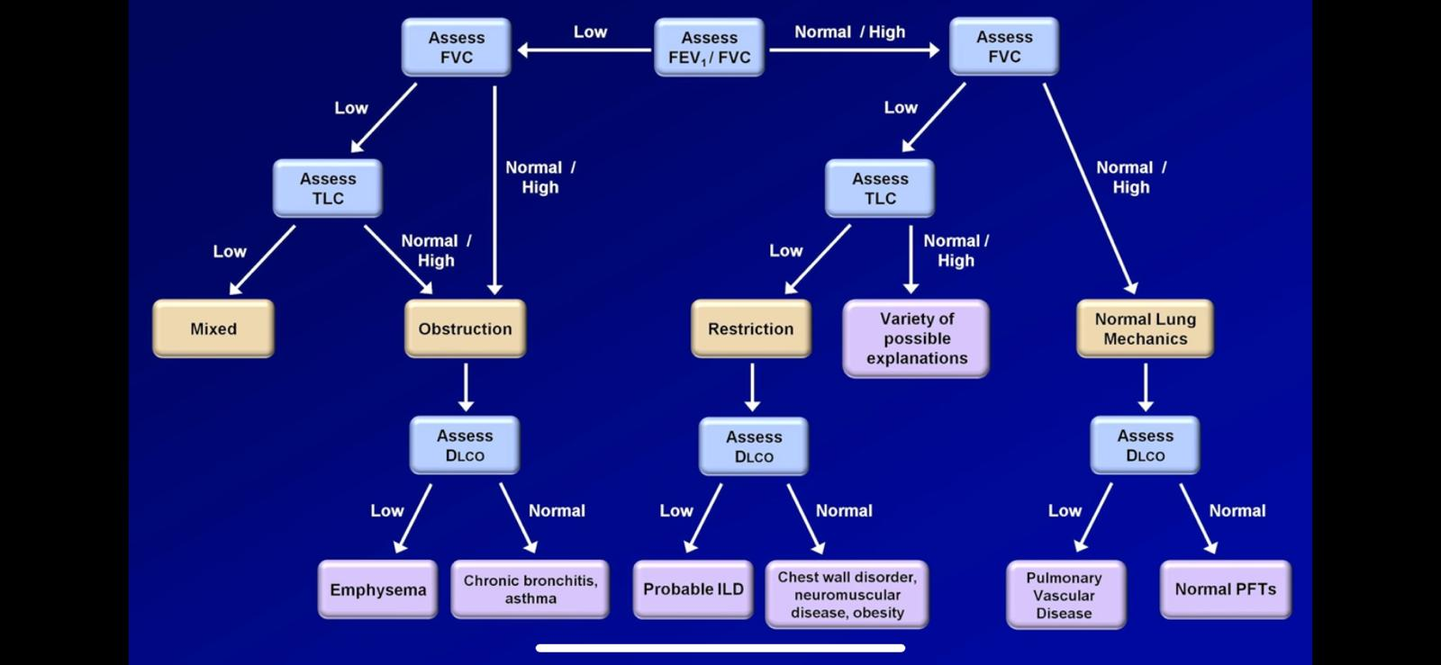

Slide 40
DLco is therefore useful as a measure of the capacity for gas transfer through the alveolar-capillary membrane. Clinical disorders that recruit blood to the alveoli (cardiac shunt, asthma, erythrocytosis, alveolar hemorrhage) can elevate DLco levels.
In contrast, conditions that decrease the surface area available for diffusion, decrease permeability across the alveolar-capillary membrane, or otherwise interfere with gas transfer can reduce DLco.
For example, a reduced DLCO in a patient with a low TLC or restriction on spirometry is suggestive of a parenchymal or interstitial process. The DLco may also be diminished in COPD (from parenchymal destruction) or in conditions that affect the pulmonary vasculature such as pulmonary hypertension or chronic pulmonary thromboembolic disease.

Slide 41
Bronchial Challenge Testing
In patients with clinical symptoms suggestive of bronchospastic disease (such as cough or unexplained dyspnea) but with normal spirometry, bronchial challenge testing may be diagnostically helpful.
Bronchial challenge testing uses a controlled inhaled stimulus to induce bronchospasm in association with spirometry; a positive test is indicated by a drop in the measured FEV 1 .
Because bronchial challenge testing may induce severe bronchospasm, it should only be performed in a controlled environment such as a pulmonary function testing laboratory.

Slide 42
Methacholine is a commonly used agent that induces cholinergic bronchospasm at low concentrations in patients with asthma. The provocative dose 20% (PD20) is the dose of methacholine that causes a significant drop in the FEV 1 of 20% or greater.
The ability to achieve a PD20 at low concentrations of methacholine indicates more easily induced obstruction and is sensitive for detecting asthma.
Similar principles apply to other forms of bronchial challenge testing, such as after exposure to cold air or exercise, in which case a 10% drop in FEV 1 from baseline in the context of a supporting clinical picture is diagnostic.
Bronchial challenge testing with a controlled stimulus is helpful in patients with dyspnea or cough of uncertain cause when spirometry results are normal.

Slide 43
6-Minute Walk Test
The six-minute walk test (6MWT) is a good index of physical function and therapeutic response in patients with chronic lung disease, such as
COPD.
pulmonary fibrosis.
pulmonary arterial hypertension.
The test should be performed according to standard methods , During a 6MWT, healthy subjects can typically walk 400 to 700 m. In addition to total distance walked, the magnitude of desaturation and timing of heart rate recovery have been associated with clinical outcomes.

Slide 44
Lung function during exertion using the 6-minute walk test (6MWT) is helpful to assess disability and prognosis in chronic lung conditions.
Simple pulse oximetry and oxygen desaturation studies performed at rest and with exertion assess the need for oxygen supplementation.
During a 6MWT, oxygen saturation, heart rate, dyspnea and fatigue level, and distance walked at a normal pace in 6 minutes are recorded.
This relatively simple maneuver quantifies exercise tolerance, determines effective interventions, and helps predict morbidity and mortality. The 6MWT is routinely used before, during, and after pulmonary rehabilitation programs.

Slide 45
Pulse Oximetry
Pulse oximetry is a noninvasive measurement of arterial hemoglobin saturation , estimates the arterial hemoglobin saturation. In general, resting oxygen saturation less than or equal to 95% or a desaturation with exercise greater than or equal to 5% is considered abnormal.
Pulse oximetry cannot distinguish between oxygen saturation of hemoglobin and similar abnormal hemoglobins such as carboxyhemoglobin.
In patients with high levels of carboxyhemoglobin, as seen in carbon monoxide poisoning, pulse oximetry will provide false-negative results. If the presence of carboxyhemoglobin is suspected, co-oximetry is the preferred test to measure oxyhemoglobin.

Slide 46
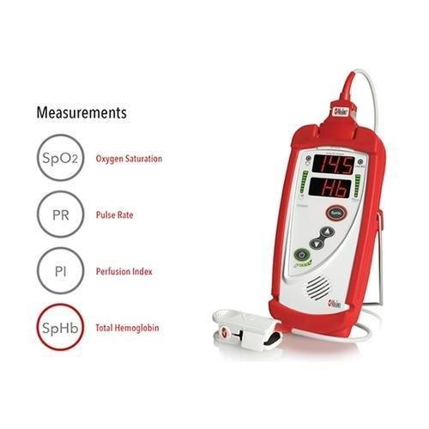

Slide 47
thank you

