Slide 1
Oxygen-Hemoglobin Saturation Curve / contribution of respiratory system to acid base balance
Prepared by : Dr Alaa AbuShahla

Slide 2
Oxygen-Hemoglobin Saturation Curve

Slide 3
Oxygen transport in the blood has two components: the oxygen
that is dissolved in the plasma (the PO2) and oxygen bound to
hemoglobin (Hb).
Total blood O2 content = dissolved O2 + O2 bound to Hb
due to low o2 solubility in plasma, less than 2% of all oxygen in the blood is dissolved. That means hemoglobin transports more than
98% of our oxygen
Hemoglobin, binds reversibly to oxygen, as summarized in the
equation
Hb + O2 ⇌ HbO2
hemoglobin is an effective oxygen carrier due its molecular structure

Slide 4
Oxygen Binding Obeys the Law of Mass Action
The hemoglobin binding reaction Hb + O2 ⇌ HbO2 obeys the law of mass action .
As the concentration of free O2 increases, more oxygen binds to hemoglobin and the equation shifts to the right, producing more HbO2.
If the concentration of O2 decreases, the equation shifts to the left. Hemoglobin releases oxygen, and the amount of oxyhemoglobin decreases.
In the blood, the free oxygen available to bind to hemoglobin
is dissolved oxygen, indicated by the PO2 of plasma

Slide 5
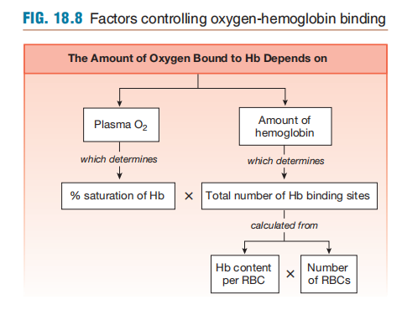

Slide 6
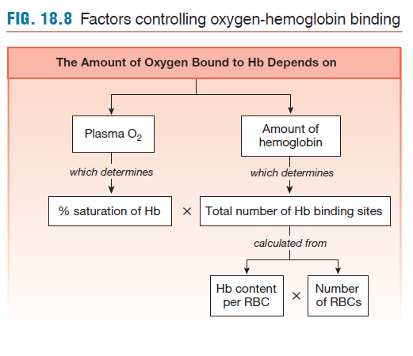
PO2 Determines Oxygen-Hb Binding
The amount of oxygen that binds to hemoglobin depends on two factors:
  (1) the PO2 in the plasma surrounding the red blood cells
  (2) the number of potential Hb binding sites available in the
  red blood cells
the total number of oxygen-binding sites depends on on the number of hemoglobin molecules in red blood cells.
counting the red blood cells and quantifying the amount of hemoglobin per red blood cell (mean corpuscular hemoglobin) or by determining the blood hemoglo_x0002_bin content (g Hb/dL whole blood)

Slide 7
Oxygen Binding Is Expressed as a Percentage
the amount of oxygen bound to hemoglobin at any given PO2 is expressed as the percent saturation of hemoglobin
percent saturation of hemoglobin=(Amount of O2 bound/maximum that could be bound) * 100
The relationship between plasma PO2 and percent saturation of hemoglobin was studied in vitro, samples of hemoglobin were exposed to various PO2 levels, quantitatively determining the amount of oxygen that binds
(Hb- O2 dissociation curves or Hb - O2 saturation curve )

Slide 8
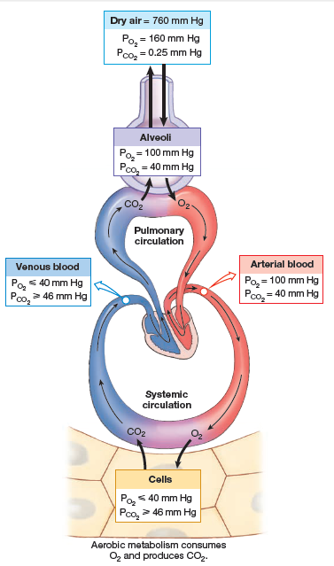
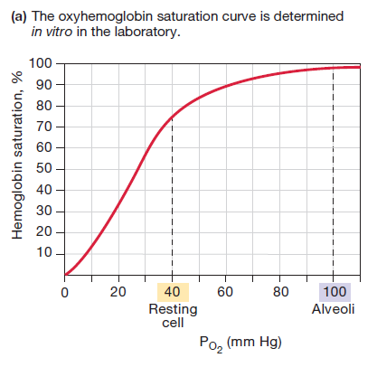

Slide 9
The shape of the HbO2 saturation curve reflects the properties of the hemoglobin molecule and its affinity for oxygen
at normal alveolar and arterial PO2 (100 mm Hg), 98% of the hemoglobin is bound to oxygen.
Notice that the curve is nearly flat at PO2 levels higher than 100 mm Hg , As PO2 in the alveoli (and thus in the pulmonary capillaries) stays above 60 mm Hg, hemoglobin is more than 90% saturated
That means that alveolar PO2 can fall a good bit below 100 mm Hg without significantly lowering hemoglobin saturation and maintains near-normal levels of oxygen transport.
However, once PO2 falls below 60 mm Hg, the curve becomes steeper. that means a small decrease in PO2 causes a relatively large release of oxygen and large decrease in O2 saturation
if PO2 falls from 100 mm Hg to 60 mm Hg, the percent saturation of hemoglobin goes from 98 to about 90%, a decrease of 8%. This is equivalent to a saturation change of 2% for each 10 mm Hg change.
If PO2 falls further, from 60 to 40 mm Hg, the percent saturation goes from 90 to 75%, a decrease of 7.5% for each 10 mm Hg.
In the 40–20 mm Hg range, the curve is even steeper. Hemoglobin saturation declines from 75 to 35%, a change of 20% for each 10 mm Hg change.

Slide 10
the physiological significance of the shape of the saturation curve:
In blood leaving systemic capillaries with a PO2 of 40 mm Hg (an average value for venous blood in a person at rest), Hemoglobin is still 75% saturated. This means that at the cells, Blood releases only one-fourth of the oxygen it is capable of carrying. The oxygen that remains bound serves as a reservoir that cells can draw on if metabolism increases. When metabolically active tissues use additional oxygen, their cellular PO2 decreases, and hemoglobin releases additional O2 at the cells. At a PO2 of 20 mm Hg (an average value for exercisingMuscle), hemoglobin saturation falls to about 35%. With this 20 mm Hg decrease in PO2 (40 mm Hg to 20 mm Hg), hemoglobin releases an additional 40% of the oxygen it is capable of carrying. This is another example of the built-in reserve capacity of the body .

Slide 11
Factors Affecting O2-Hb Binding
Any factor that changes the conformation of the hemoglobin protein affect its affinity to bind with oxygen. Such as :
Changes in plasma pH,
temperature,
PCO2 .
Changes in binding affinity are reflected by changes in the shape of the HbO2 saturation curve.
Decreased pH, increased temperature, or increased PCO2,decrease the affinity of hemoglobin for oxygen and shift the oxygen-Hemoglobin saturation curve to the right
When these factors change in the opposite direction, binding affinity increases, and the curve shifts to the left.
Notice that when the curve shifts in either direction, the changes are much more pronounced in the steep part of the curve.
This means that oxygen binding at the lungs (in the 90–100 mm Hg PO2 range)is not greatly affected, but oxygen delivery at the tissues (in the 20–40 mm Hg range) is significantly altered.

Slide 12
with maximal exertion that pushes cells into anaerobic
metabolism. Anaerobic metabolism in exercising muscle fibers
releases H+ into the cytoplasm and extracellular fluid. As H+ concentrations increase, pH falls, the affinity of hemoglobin for oxygen decreases, and the HbO2 saturation curve shifts to the right.
More oxygen is released at the tissues as the blood becomes more
acidic (pH decreases).
A shift in the hemoglobin saturation curve that results from a change in pH is called the Bohr effect.

Slide 13
An additional factor that affects oxygen-hemoglobin binding is 2,3-bisphosphoglycerate (2,3-BPG), a compound made from an intermediate of the glycolysis pathway. Chronic hypoxia (extended periods of low oxygen) triggers an increase in 2,3-BPG production in red blood cells. Increased levels of 2,3-BPG lower the binding affinity of hemoglobin and shift the HbO2 saturation curve to the right . Ascent to high altitude and anemia are two situations that increase 2,3-BPG production.
Changes in hemoglobin’s structure also change its oxygen binding affinity.
For example, fetal hemoglobin (HbF) has two Gamma protein chains in place of the two beta chains found in adult hemoglobin. The presence of gamma chains enhances the ability of fetal hemoglobin to bind oxygen in the low-oxygen environment of the placenta.

Slide 14
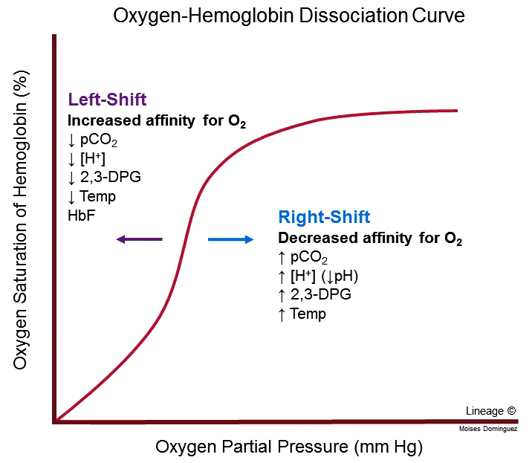

Slide 15
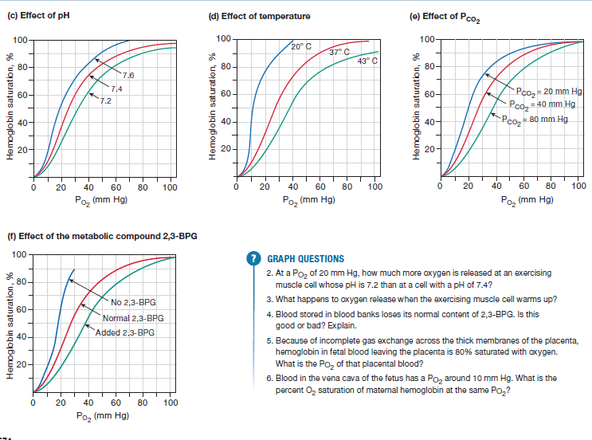

Slide 16
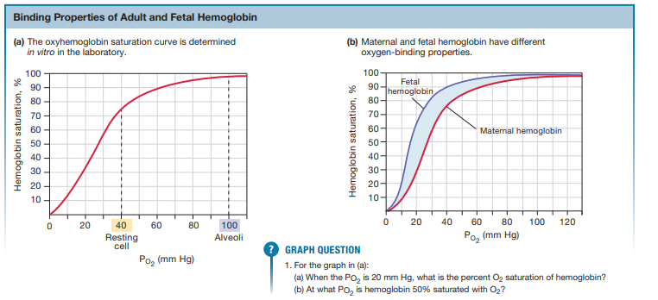

Slide 17
Contribution of respiratory system in
Acid-Base balance

Slide 18
Carbon dioxide is a by-product of cellular respiration
Elevated PCO2 (hypercapnia) causes the pH disturbance known as acidosis. Extremes of pH interfere with hydrogen bonding of molecules and can denature proteins
Abnormally high PCO2 levels also depress central nervous system function, causing confusion, coma, or even death

Slide 19
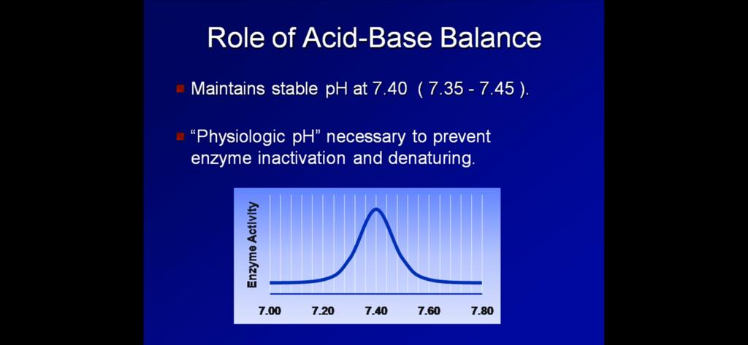

Slide 20
Carbon Dioxide Is Transported in Three Ways
Carbon dioxide is more soluble in body fluids than oxygen is, but the cells produce far more CO2 than can dissolve in the plasma. Only about 7% of the CO2 carried by venous blood is dissolved in the plasma.
The other 93% diffuses into red blood cells, where 23% binds to hemoglobin (HbCO2) while the remaining 70% is converted to bicarbonate ion (HCO3-),

Slide 21
Most of the CO2 that enters the blood is transported to the lungs as bicarbonate ions (HCO3-)dissolved in the plasma. The conversion of CO2 to HCO3- serves two purposes: (1) it provides an additional way to transport CO2 from cells to lungs, and (2) HCO3- is available to act as a buffer for metabolic acids
Dissolved CO2 in the plasma diffuses into red blood cells, where it can react with water in the presence of carbonic anhydrase(found concentrated in RBCs) to form a hydrogen ion and a bicarbonate ion
ca
CO2 + H2O ⇌H+ + HCO3-
This reaction is reversible and obeys the law of mass action
To keep the reaction going, the products (H+ and HCO3-) must be removed from the cytoplasm of the red blood cell.

Slide 22
Two separate mechanisms remove free H+ and HCO3
1- bicarbonate leaves the red blood cell on an antiport protein . This transport process, known as the chloride shift,exchanges HCO3- for Cl-.
The transfer of HCO3- into the plasma makes this buffer available to moderate pH changes caused by the production of metabolic acids
2-Hemoglobin within the red blood cell acts as a buffer and binds hydrogen ions in the reaction H+ + Hb ⇌ HbH
If blood PCO2is elevated much above normal, the hemoglobin buffer cannot soak up all the H+ produced from the reaction of CO2 and water. In those cases, excess H+ accumulates in the plasma, causing the condition known as respiratory acidosis

Slide 23
hasselbach hendreson equation :
PH = pk +log (A- /HA)
Increased H+ > decreased PH (acidosis)
Decreased H+> increased PH (alkalosis)
Normal blood PH =7.35 - 7.45
The most important buffer in the boody is HCO3-/CO2
CO2 + H2O ⇌H+ + HCO3-

Slide 24
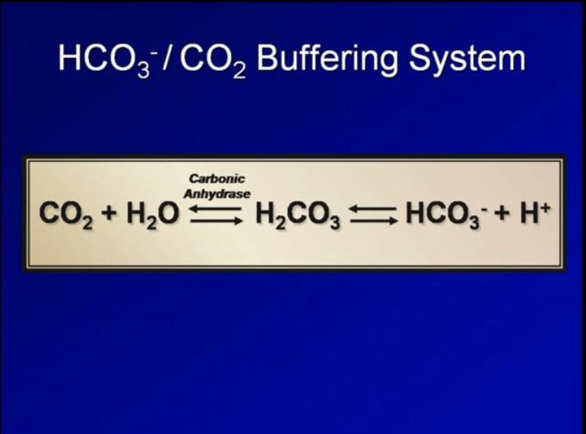

Slide 25
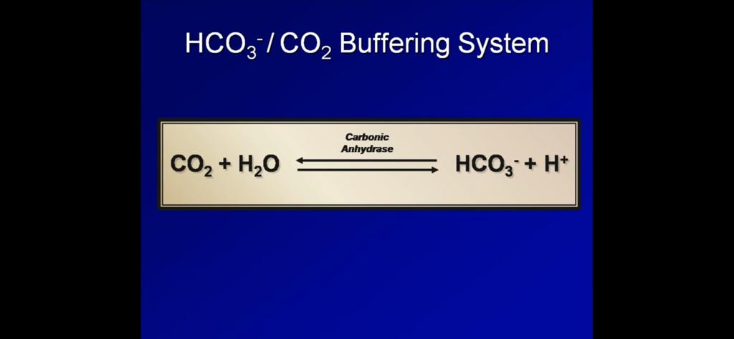

Slide 26
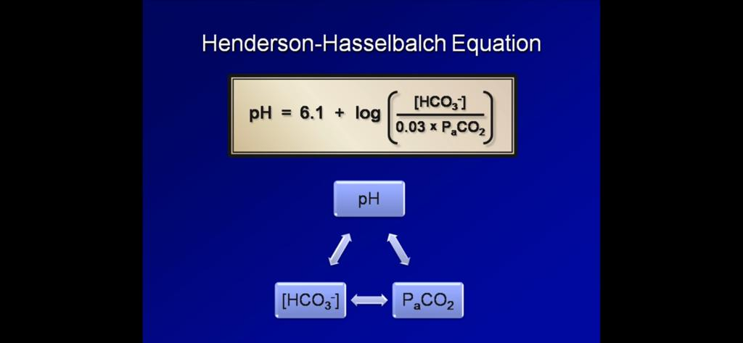

Slide 27
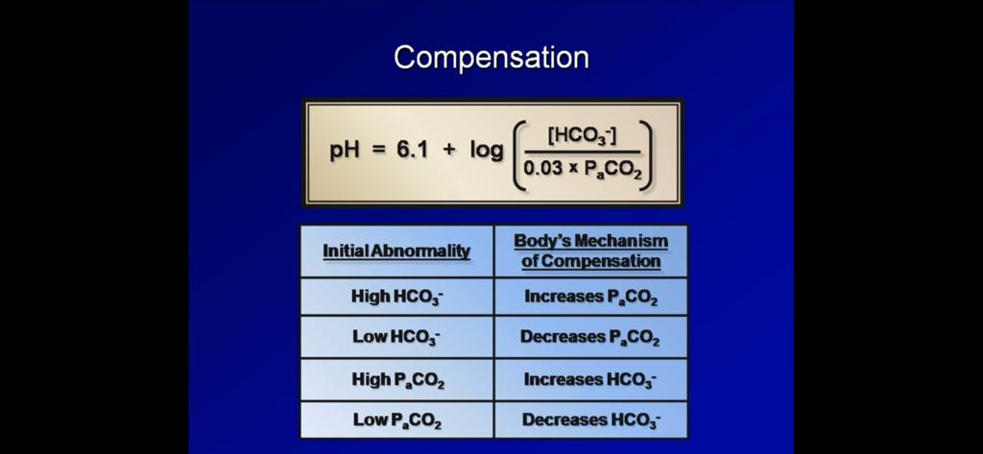

Slide 28
The lungs regulats paco2
pco2∝rate of matebolism /rate of ventillation
↓ventilation→↑pco2→↓PH→ repiratory acidosis
↑ventilation→↓pco2→↑PH→ repiratory alkalosis
PH∝HCO3-/CO2
Increased PCO2 causing decreased pH→ respiratory acidosis
Decreased PCO2 causing increased pH→ respiratory alkalosis
Decreased HCO3 causing decreased pH→ Metabolic acidosis
Increased HCO3 causing increased pH→ Metabolic alkalosis

Slide 29
Respiratory acidosis
Respiratory acidosis is defined as a pH less than 7.35 with a PaCO2 greater than 45 mm Hg. caused by an accumulation of CO2 which combines with water in the body to produce carbonic acid, thus, lowering the pH of the blood
Any condition that results in hypoventilation can cause respiratory acidosis. These conditions include:
Central nervous system depression related to head injury, or medications such as narcotics, sedatives, or anesthesia
Impaired respiratory muscle function related to spinal cord injury, neuromuscular diseases,
Pulmonary disorders such as atelectasis, pneumonia, pneumothorax, pulmonary edema, or bronchial obstruction
Massive pulmonary embolus
Hypoventilation due to pain, chest wall injury, or abdominal distension

Slide 30
Respiratory Alkalosis
Respiratory alkalosis is defined as a pH greater than 7.45 with a PaCO2 less than 35 mm Hg.
Any condition that causes hyperventilation can result in respiratory alkalosis. These conditions include:
Psychological responses, such as anxiety or fear
Pain
Increased metabolic demands, such as fever, sepsis, pregnancy, or thyrotoxicosis
Medications, such as respiratory stimulants.
Central nervous system lesions

Slide 31
Metabolic Acidosis
Metabolic acidosis is defined as a bicarbonate level of less than 22 mEq/L with a pH of less than 7.35. Metabolic acidosis is caused by either a deficit of base in the bloodstream or an excess of acids, other than CO2.
Diarrhea and intestinal fistulas may cause decreased levels of base.
Causes of increased acids include:
Renal failure
Diabetic ketoacidosis
Anaerobic metabolism
Starvation

Slide 32
Metabolic Alkalosis
Metabolic alkalosis is defined as a bicarbonate level greater than 26 mEq/liter with a pH greater than 7.45. Either an excess of base or a loss of acid within the body can cause metabolic alkalosis.
Excess base occurs from ingestion of antacids, excess use of bicarbonate, or use of lactate in dialysis.
Loss of acids can occur secondary to protracted vomiting, gastric suction or excess administration of diuretics

Slide 33
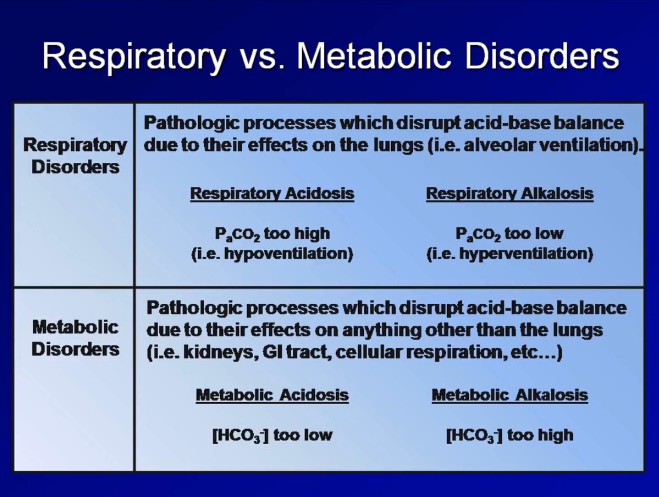

Slide 34
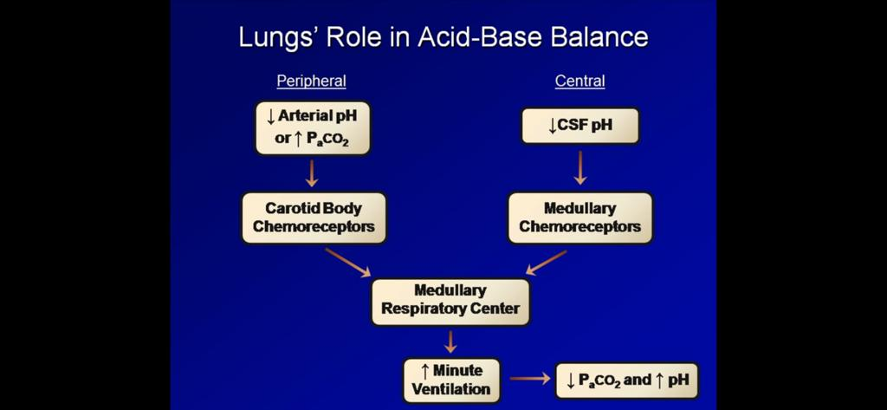
Elimination of Acid

Slide 35
Normal Arterial Blood Gases (ABGs)
 |  | Normal value
Partial pressure of O2 (PaO2): |  | 92 - 97 mmHg
Partial pressure of CO2 (PaCO2): |  | 35 - 45 mmHg
pH: |  | 7.35 - 7.45
Oxygen saturation (SaO2): |  | ≥ 95 %
Bicarbonate (HCO3): |  |  | 22 - 26 mEq/L
Acid-Base Excess (ABE): |  |  | ± 2

Slide 36
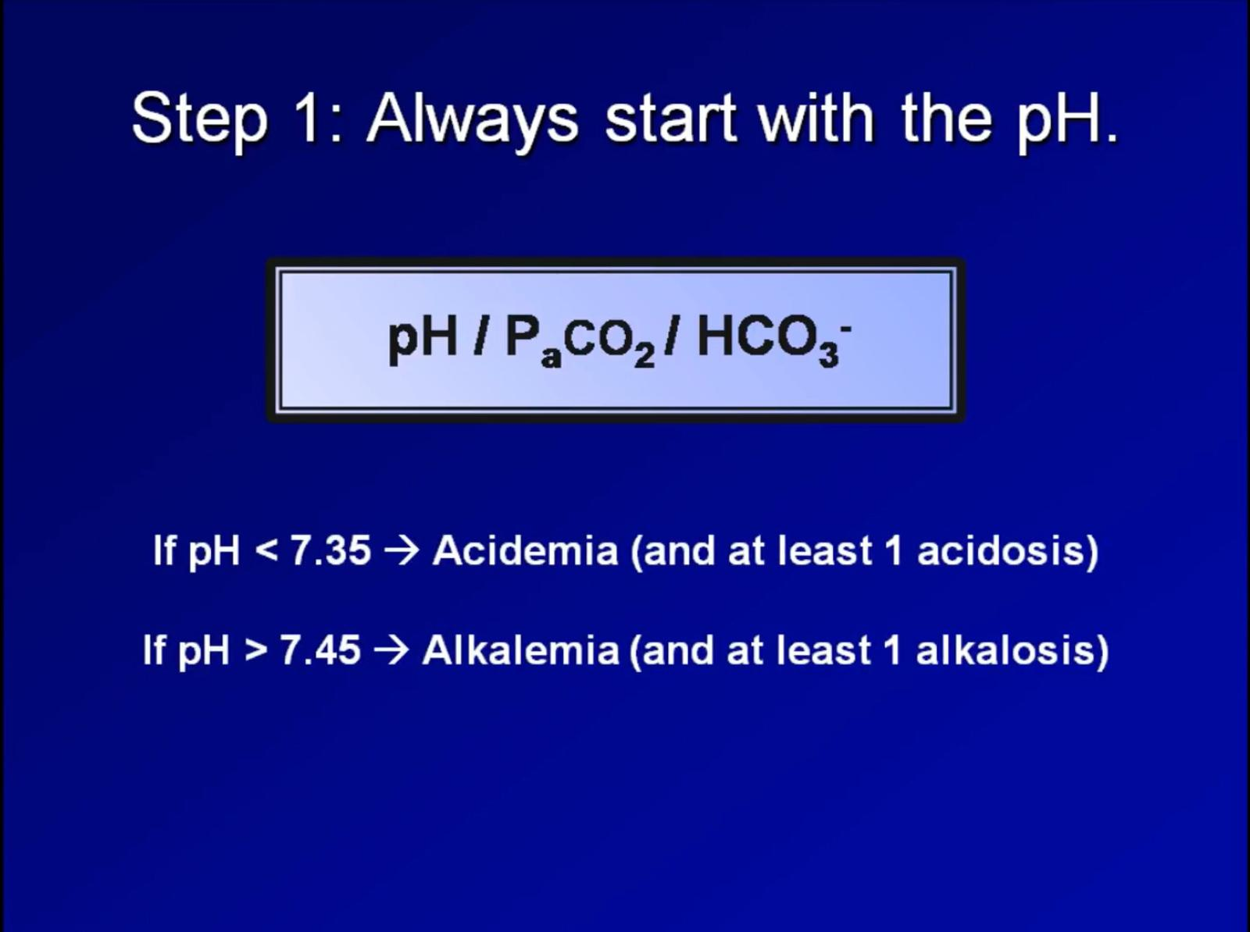

Slide 37
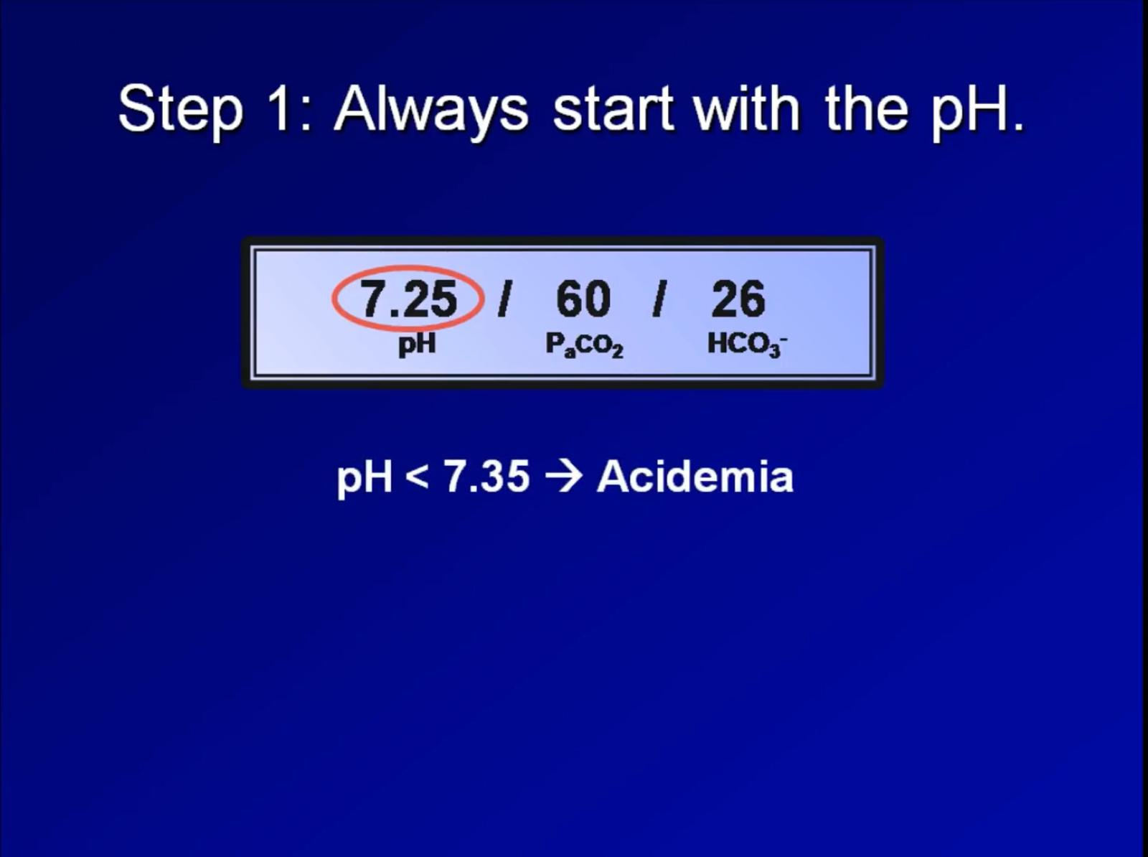

Slide 38
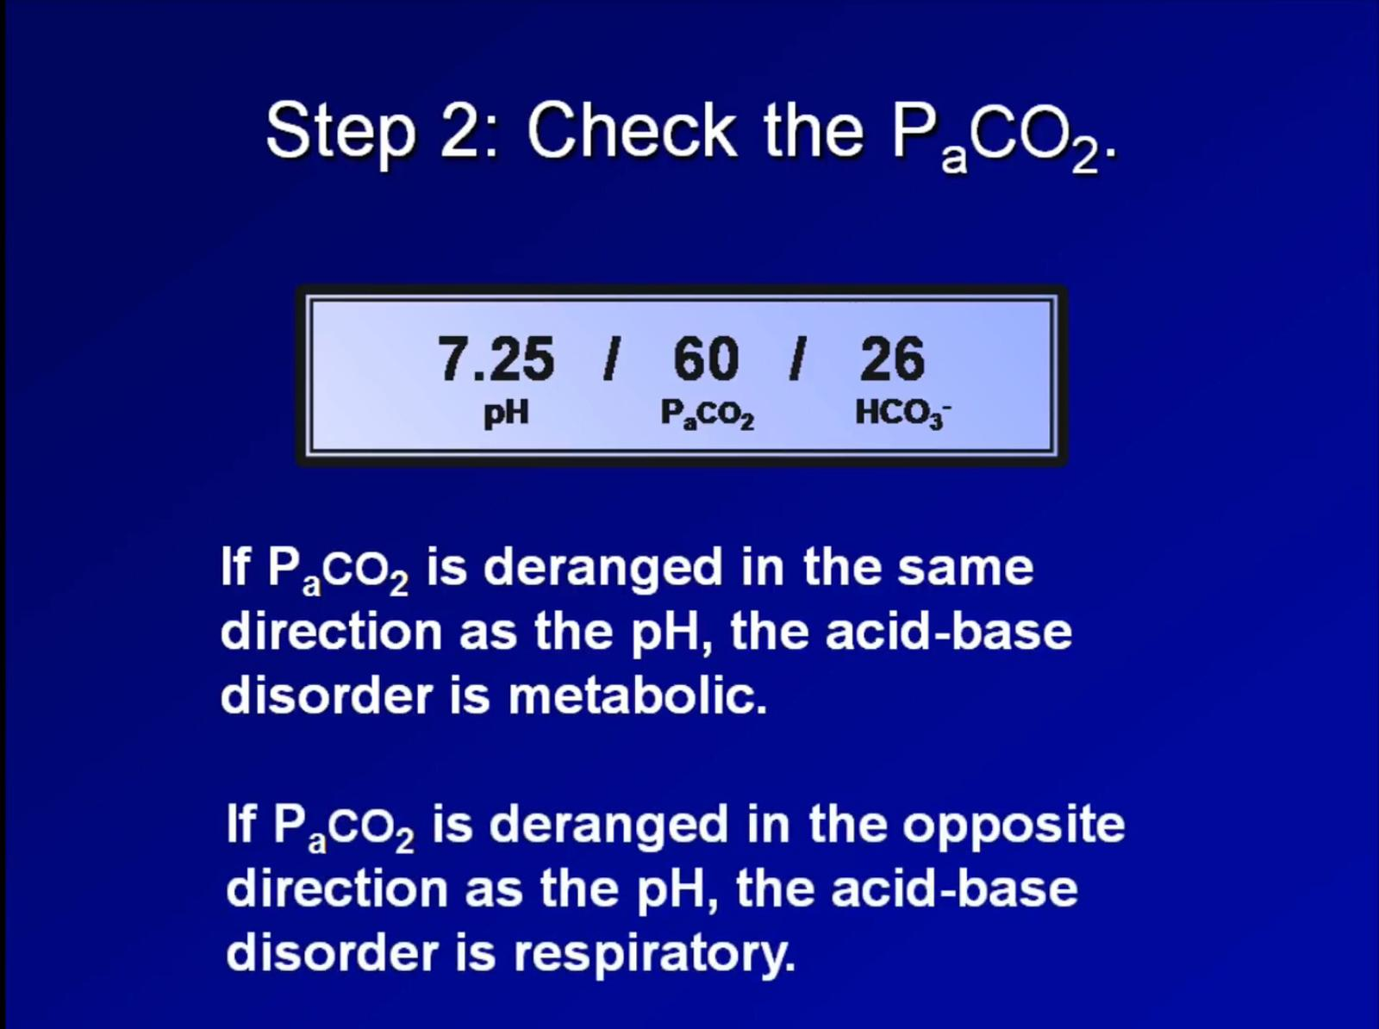

Slide 39
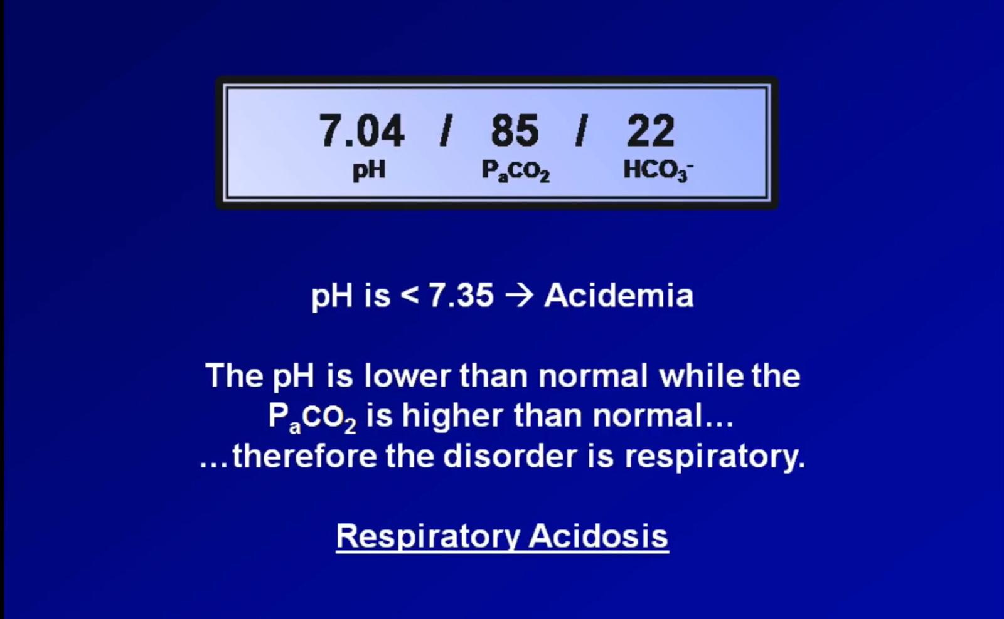

Slide 40
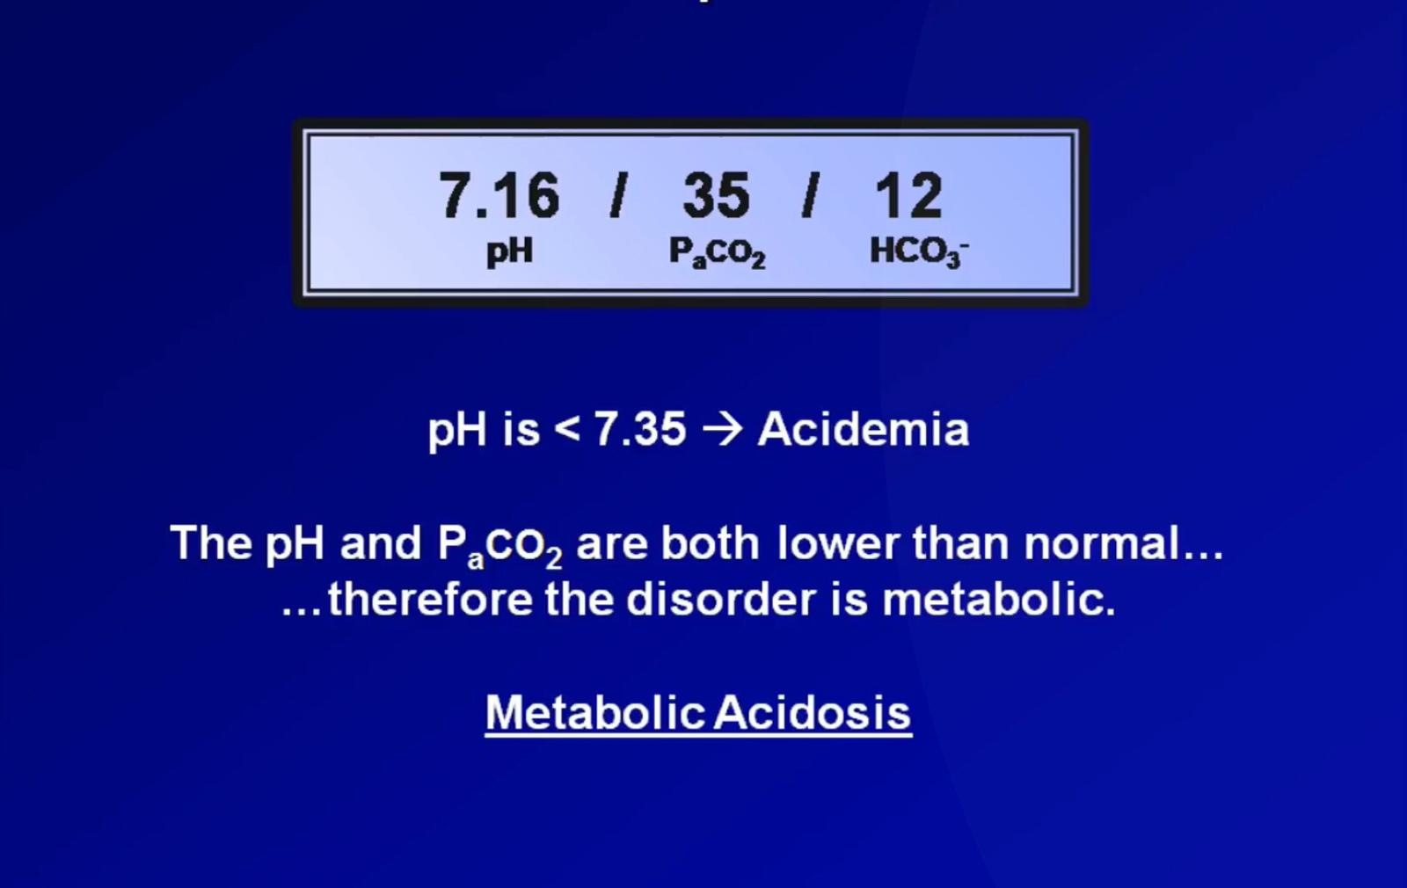

Slide 41
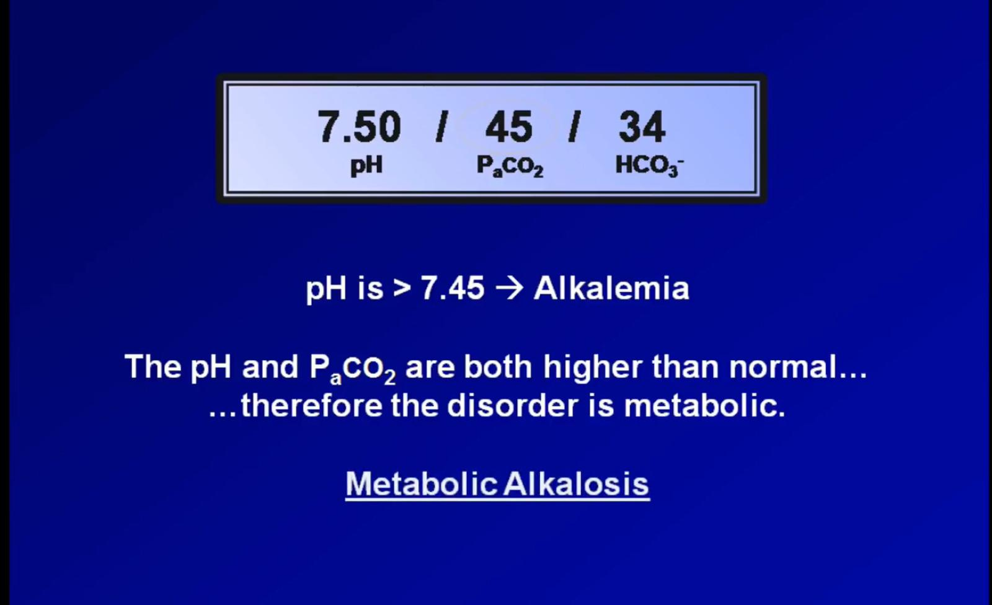

Slide 42
Mixed Acid-Base Disorders
Combination of 2 primary acid-base disorders with different range of compensation
Usually occurs in patients with chronic diseases or multiple primary pathologies.

Slide 43
compensation
the body attempts to compensate for acid base disorders in sucg a way as to mitegate derangements of arterial ph
For Respiratory disorders:
The body develops metabolic compensation through the kidney (retains HCO3).
For Metabolic disorders:
The body develops respiratory compensation through the lungs (CO2).

Slide 44
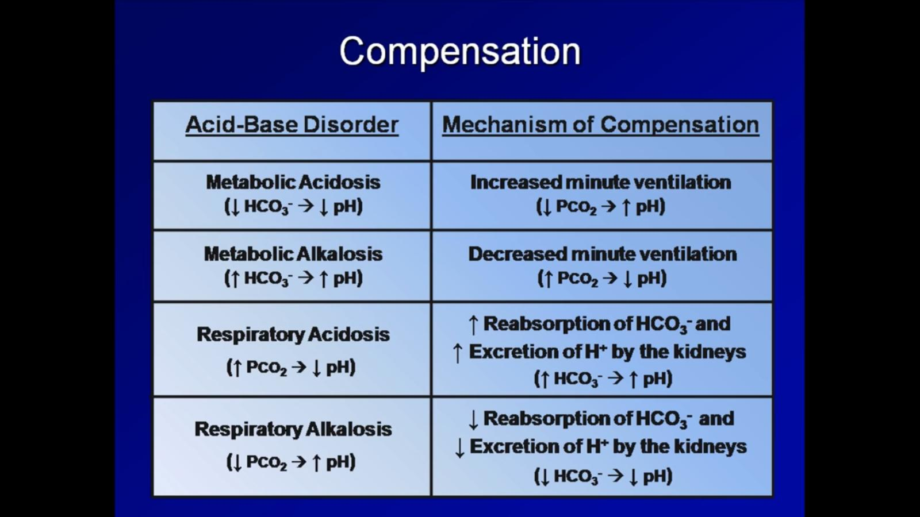

Slide 45
Thank you

