Slide 1

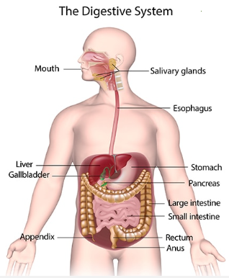
GIT Module
Digestive Enzymes
By:
Dr. Faten Allyan
Ph.D. of Medical Biochemistry

Slide 2
The Digestive System Function
Digestion
  Breakdown of ingested food
Absorption
  Passage of nutrients into the blood
Metabolism
  Production of cellular energy (ATP)

Slide 3
Organs of the Digestive System
Two main groups
  Alimentary canal – continuous coiled hollow tube
  Accessory digestive organs (teeth, tongue, and glandular organs such as salivary glands, liver, gallbladder, and pancreas)

Slide 4
Organs of the Alimentary Canal
Mouth
Pharynx
Esophagus
Stomach
Small intestine
Large intestine
Anus

Slide 5
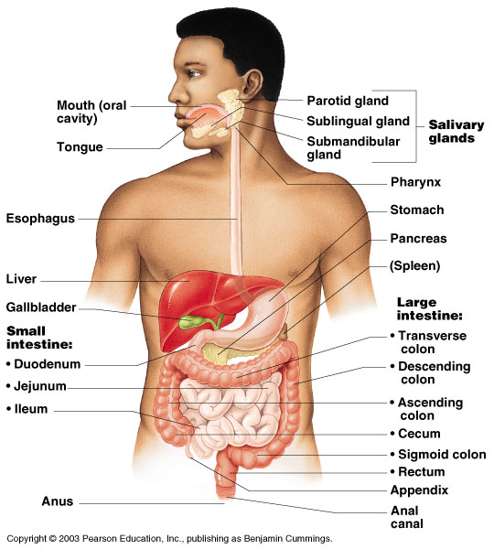
Organs of the Digestive System

Slide 6
Processes of the Mouth
Mastication (chewing) of food
Mixing masticated food with saliva
Initiation of swallowing by the tongue
Allowing for the sense of taste

Slide 7
Saliva
Mixture of mucus and serous fluids
to form a food bolus
ConHelpstains salivary amylase to begin starch digestion
Dissolves chemicals so they can be tasted

Slide 8
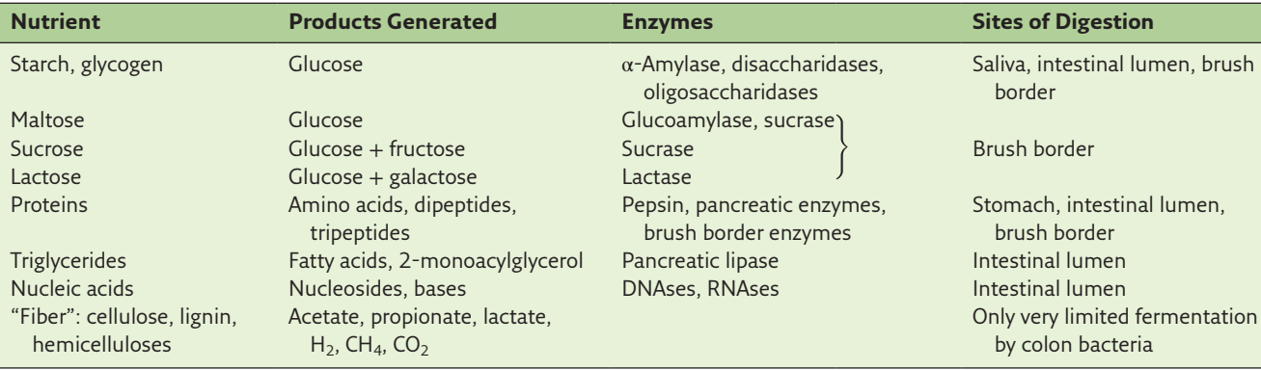
Dietary nutrients are large polymers (large molecules) that have to be hydrolyzed by enzymes in the gastrointestinal (GI) tract, and the breakdown products, including monosaccharides, amino acids, and fatty acids, are absorbed.
Dietary Nutrients and Their Fates in the GIT
disaccharide

Slide 9
Saliva
Saliva convert food into a homogeneous mass during mastication.
Salivary gland produce enzymes
The enzymes in saliva are α-amylase and lysozyme
Both are endoglycosidases (release particular saccharides from of glycoproteins and glycolipids). Examples include sucrose, lactose and maltose”
Exoglycosidases, in contrast glycoside hydrolase enzymes that cleave the glycosidic bonds of a terminal monosaccharide in an oligosaccharide or polysaccharide

Slide 10
α-Amylase cleaves α-1,4-glycosidic bonds in starch.
Starch occurs in two forms, amylose and amylopectin (two types of polysaccharides).
α-Amylase is specific for α(1→4) glycosidic bond
α-Amylase turns starch into maltose and α-limit dextrins
α- dextrins : Derived from dextrose low-molecular-weight carbohydrates produced by the hydrolysis of starch and glycogen

Slide 11
α-Amylase main function is to keep the teeth clean by dissolving starchy bits that remain lodged between the teeth after a meal.
This is why cancer patients whose salivary glands have been destroyed by radiation therapy develop rapid tooth decay.

Slide 12
Lysozyme enzyme that is able to lyse bacterial cell membranes and thus serve as an antimicrobial agent in foods
hydrolyzes β(1→4) glycosidic bonds in the bacterial cell wall
polysaccharide peptidoglycan (stimulate activation).
Normal flora in the mouth are resistant to lysozyme.
They use their saliva as an antiseptic.

Slide 13
Stomach
Located on the left side of the abdominal cavity
Food enters at the cardioesophageal sphincter (thickened muscular ring surrounding the opening between the esophagus and the stomach)

Slide 14
Stomach
Regions of the stomach
Cardiac region – near the heart
Pylorus – valve that opens and closes during digestion
Food empties into the small intestine at the pyloric sphincter

Slide 15
Specialized Mucosa of the Stomach
Simple columnar epithelium
  Mucous neck cells – produce a sticky alkaline mucus
  Gastric glands – secrete gastric juice
  Chief cells – produce protein-digesting enzymes (pepsin, lipase)
  Parietal cells – produce hydrochloric acid
  Endocrine cells – produce gastrin

Slide 16
Stomach Functions
Acts as a storage tank for food
Site of food breakdown
Chemical breakdown of protein begins
Delivers chyme (semifluid mass of partly digested food) to the small intestine

Slide 17
Protein and Fat digestion
Start in stomach of pH close to 2
The proton gradient (H⁺ ion ) between gastric juice and the blood an almost million-fold concentration (pH is acidic :1.5 to 3.5) &( 7.35 to 7.45)
Stomach acid's low pH level is largely due to hydrochloric acid (HCl). However, only a very small amount of HCl in stomach acid.
The cells lining your stomach wall secrete this acidic…………..
Acid that is released into the stomach from glands in the stomach wall.

Slide 18
The gastric acid has three major functions:
It kills most microorganisms
  - People with achlorhydria (lack of gastric acid) and those who
    have had a gastrectomy (surgical removal of the stomach)
    increased risk of intestinal infections
It denatures dietary proteins
    - Because it makes the peptide bonds more accessible for proteases most of the chemical reactions occur in the stomach and small intestine

Slide 19
3. It is required for the action of pepsin
- Pepsin is a protease with optimum pH of 2.0
- it produces a mix of oligopeptides with some free amino acids.
- This mix is known as peptone.
- Protein digestion has to be completed by other enzymes in the small
intestine.

Slide 20
Proteases are produced in the stomach and pancreas. The main ones are:
Pepsin: secreted by the stomach to break down proteins into peptide, or smaller groupings of amino acids. Those amino acids are then either absorbed or broken down further in the small intestine.
Trypsin: enzyme secreted by the pancreas is activated by an enzyme in the small intestine. Trypsin then activates additional pancreatic enzymes, such as carboxypeptidase and chymotrypsin, to help break down peptides
Chymotrypsin: enzyme secreted by the pancreas ,breaks down peptides into free amino acids that can be absorbed by the intestinal wall.

Slide 21
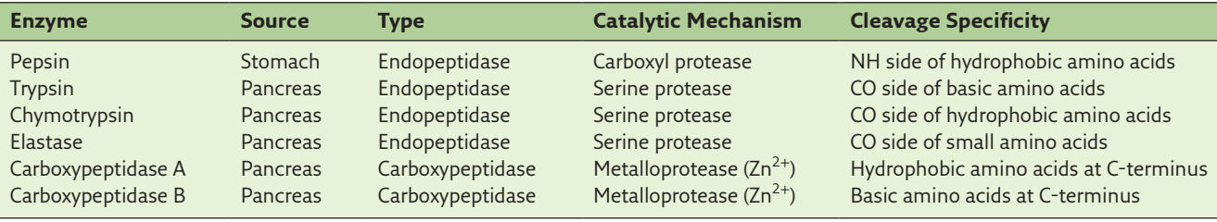
Enzymes of Protein Digestion
20% of dietary fat is digested by gastric lipase that is secreted by the chief cells of the stomach
Lipase is responsible for the breakdown of fats into fatty acids and glycerol (simple sugar alcohol).
It's produced in small amounts by your stomach, and in larger amounts by your pancreas.

Slide 22
Digestion in the Small Intestine
Enzymes from the brush border ( small intestine tract cells) lining are the site of carbohydrate digestions
  Break double sugars into simple sugars
  Complete some protein digestion
Pancreatic enzymes play the major digestive function
  Help complete digestion of starch (pancreatic amylase)
  Carry out about half of all protein digestion (trypsin)

Slide 23
Digestion in the Small Intestine
Pancreatic enzymes play the major digestive function
  Responsible for fat digestion (lipase)
  Digest nucleic acids (nucleases)
  Alkaline content neutralizes acidic chyme

Slide 24
Absorption in the Small Intestine
Water is absorbed along the length of the small intestine
End products of digestion
  Most substances are absorbed by active transport (energetic process& extremely selective& quick process )through cell membranes
  Lipids are absorbed by diffusion
Substances are transported to the liver by the hepatic portal vein or lymph

Slide 25
Pancreas
Produces a wide spectrum of digestive enzymes that break down all categories of food
Enzymes are secreted into the duodenum
Alkaline fluid introduced with enzymes neutralizes acidic chyme
Endocrine products of pancreas
  Insulin
  Glucagon

Slide 26
Amino acids and fatty acids produced in the stomach become powerful stimuli for endocrine cells in the duodenum.
These cells release the hormone cholecystokinin (CCK), also called pancreozymin it:
  - stimulates both gallbladder contraction (store bile. helps digestive system break down fats. Bile is a mixture of mainly cholesterol, bilirubin and bile salts)
- and pancreatic enzyme secretion.
The acidity of the gastric contents entering the duodenum (first part of the small intestine )stimulates the release of secretin.

Slide 27
Secretin a digestive hormone secreted by the wall of the upper part of the small intestine (the duodenum)
Secretin has 3 main functions:
Regulation of gastric acid secretion
Regulation of pancreatic bicarbonate
Stimulates the secretion of water & regulation of pH levels in the duodenum (osmoregulation)

Slide 28
Pancreatic supplies enzymes for the digestion of nearly all nutrients.
α-Amylase is secreted in large amounts, from salivary
whereas pancreatic amylase is secreted by the pancreas into the small intestine
α-Amylase role in starch digestion.
Starch chains breaks them into smaller pieces with two or three glucose units
For protein digestion, the pancreas supplies trypsin, chymotrypsin, and elastase. (proteases enzyme)
Other enzymes include pancreatic lipase, various phospholipases, and nucleases.

Slide 29
Excess fat in modern diets has been adverse health outcomes, most obviously obesity.
One strategy for reducing the impact of dietary fat is the prevention of fat digestion.
One drug that is based on this principle is tetrahydroolipstatin, better known as Orlistat, which is synthesized from a bacterial metabolite.
It inhibits gastric and pancreatic lipases by covalent binding to a the active site of the enzyme

Slide 30
It does lead to weight reduction in some patients, and it may reduce the level of LDL cholesterol slightly by reducing the intestinal absorption of cholesterol and bile acids
However, it also causes the undesirable effects of fat malabsorption, including intestinal discomfort and mild diarrhea.
The drug should be given with supplements of fat-soluble vitamins, whose absorption is reduced in the presence of undigested fat.

