Slide 1

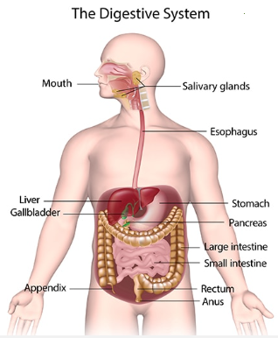
GIT Module
Digestive Enzymes
(Part 2)
By:
Dr. Faten Allyan
Ph.D. of Medical Biochemistry

Slide 2
Fat digestion
Fat are large molecules and generally are not water-soluble
They form large fat droplets that provide only a small surface area for enzymatic attack
The first task in fat digestion is to disperse the fat into smaller particles with a larger surface/volume ratio.
In the small intestine, pancreatic lipase and colipase (cofactor for pancreatic lipase) bind to the surface of the emulsion droplets.

Slide 3
Pancreatic lipase is secreted in an active form, but its activity is enhanced by bile salts.
Bile salts enhance the efficiency of lipolysis by increasing the surface area of fat at which lipase is effective.
The function of bile salts in the duodenum is to solubilize ingested fat and fat-soluble vitamins (Vitamins A, D, E, and K are soluble in organic solvents and are absorbed and transported in a manner similar to that of fats, facilitating their digestion and absorption)
Bile salts biologic detergents that enable the body to excrete cholesterol and potentially toxic compounds (eg, bilirubin, drug metabolites).
Colipase maintains the activity of the lipase in the presence of bile salts, which would otherwise inhibit its activity.

Slide 4
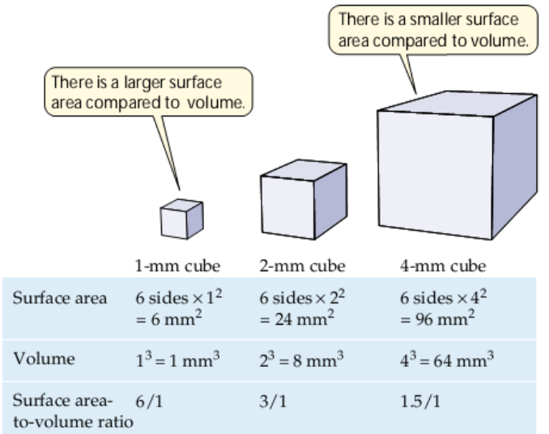

Slide 5
Pancreatic lipase hydrolyzes dietary TG to free fatty acids and 2-mono-acylglycerol.
The products of fat digestion diffuse to the intestinal brush border for absorption, but only to a very limited extent.
Their efficient absorption requires bile salts which are released into the intestine from the gallbladder after meals.
Bile salts are needed to form mixed micelles ( molecules, forming colloidal particle help the body absorb lipid and fat soluble vitamins )
From the micelles, fatty acids and 2-monoglyceride diffuse to the microvilli for uptake into the mucosal cells.

Slide 6
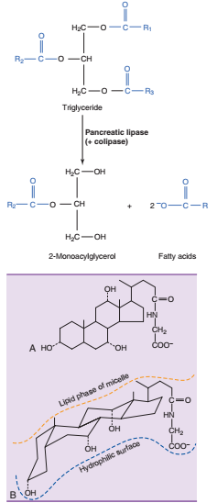
Structure of glycocholate, the most abundant bile salt in humans. The protonated forms of the bile salts are called “bile acids.” A, Structure. B, Stereochemistry. Note that the molecule has a hydrophilic surface and a hydrophobic surface
Notes:
crystalline bile acid involved in the emulsification of fats glycocholate:

Slide 7
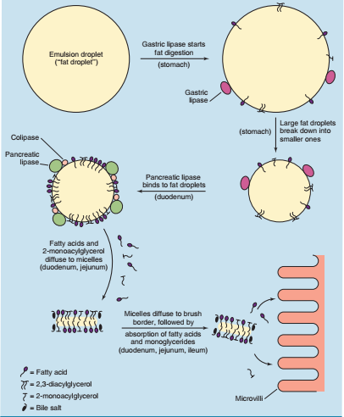
Sequence of events in fat digestion
A small amount of fat is hydrolyzed by gastric lipase in the stomach, but pancreatic lipase is the major enzyme of fat digestion.
Bile salts containing micelles are required for efficient absorption of fatty acids, mono-glycerides, and other dietary lipids.

Slide 8
Fatty acids with (18 and more carbons) require bile salts for efficient absorption, but medium-chain fatty acids (C-8 to C-14) are absorbed quite well in their absence of bile salts
Bile salts are also needed for cholesterol and fat-soluble vitamins.
Fat malabsorption can result from:
- pancreatic failure
- lack of bile salts due to biliary obstruction
- extensive intestinal diseases
Pancreatic failure leads to bulky, fatty, floating stools that contain undigested triglycerides (steatorrhea).

Slide 9
Steatorrhea, defined by the presence of more than 7 to 15 g of fat in the stools per day.
A lack of bile salts has similar consequences, but in this case most of the “fat” in the stools consists of unabsorbed fatty acids, monoglycerides, and diglycerides.
Recently, a transport system, involving the ABCG5 and ABCG8 transporters : sterol (subgroup of the steroids) transporter that acts in liver and intestine to prevent accumulation of dietary fat
ABCG5 and ABCG8 transporters has been described that prevents excess absorption of dietary cholesterol and plant sterols.

Slide 10
Individuals with defective ABCG5 or ABCG8 transporters have a disease called sitosterolemia
Rare genetic condition autosomal recessive genetic condition caused by changes (mutations) in the ABCG5 or ABCG8 gene that causes the body to store mainly sterols and secondly cholesterol.
There are at least two types of sterols: sterols from animals (example, cholesterol) and sterols from plants –also called phytosterols (example, sitosterol).

Slide 11
People normally absorb plant sterols from the food they eat and excrete them in the gut.
People with sitosterolemia resulting in the accumulation of sterols and cholesterol in the body, especially in the blood and the arteries.
Sitosterolemia and have a predisposition for atherosclerosis (fat in artery walls) and xanthomatosis (deposition of cholesterol-rich material anywhere in the body) because of increased cholesterol and plant sterol absorption

Slide 12
Anchored digestive enzymes
There are enzymes attached to the luminal surface of the mucosal cells.
This surface, known as the intestinal brush border.
Disaccharidases and oligosaccharidases hydrolyze “sucrose and lactose, as well as the maltose, maltotriose, and dextrins”
that are formed by the action of α-amylase on starch.
The absorption of the monosaccharides requires transporters in the apical (lumen-facing) and basolateral (blood-facing) membranes of the enterocytes.

Slide 13
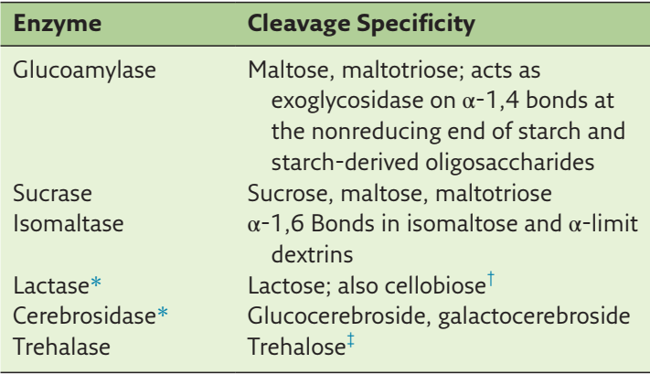
Disaccharidases and Oligosaccharidases of the Intestinal Brush Border
Notes:
Cerebrosides group of glycosphingolipids in muscle and nerve

Slide 14
Glucose and galactose are absorbed into the enterocyte by SGLT1 (sodium-glucose transporter 1), a carrier that mediates the coupled transport of 2 Na⁺ ions in to the cell together with the sugar.
Cotransport of sodium down its electrochemical gradient requires ATP by the Na-K ATPase pump
Na-K ATPase pump helps to maintain osmotic equilibrium and membrane potential in cells.
The sodium and potassium move against the concentration gradients. The Na+ K+-ATPase pump maintains the gradient of a higher concentration of sodium extracellularly and a higher level of potassium intracellularly
.

Slide 15
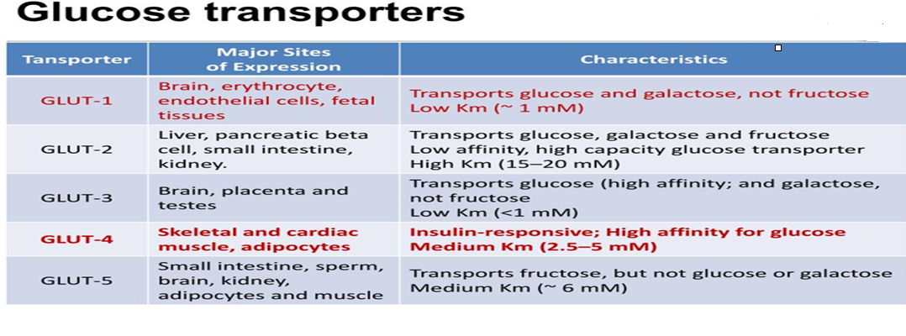
Transport of the monosaccharides across the basolateral membrane (barrier between the cell and the blood and/or other cells) is by facilitated diffusion using GLUT2. (glucose. galactose, fructose) and GLUT 5 (mainly fructose)
When intestinal glucose concentration is high after a carbohydrate-rich meal, GLUT2 also becomes deposited in the apical membrane (lumen-facing)

Slide 16
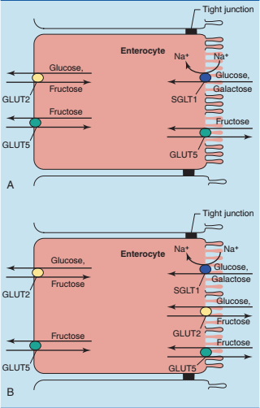
Absorption of monosaccharides in the small intestine. Glut 2&5 basolateral while SGLT1 apical membrane

Slide 17
Fructose is absorbed mainly by facilitated diffusion, using the bidirectional carrier GLUT5 in the apical membrane and primarily GLUT2 in the basolateral membrane.
Why does glucose absorption require secondary active transport while fructose absorption is cost-free using only facilitated diffusion?
The reason is that the glucose concentration in the blood is high at all times, approximately 90mg/dL.
Therefore a passive transport system “not require energy to move substances across cell membranes” would not be able to bring the glucose concentration in the intestinal lumen below 90mg/dL.

Slide 18
Fructose, however, is metabolized so fast by the liver that the fructose level in the blood remains very low, even after a fructose-rich meal.
Therefore ATP-dependent absorption against a concentration gradient is not required.
In addition to the glycosidases, the intestinal brush border contains several peptidases (proteases).
The amino acids are absorbed into the enterocytes by sodium cotransporters and cross the basolateral membrane by facilitated diffusion.

Slide 19
Poorly digestible nutrients cause flatulence
Most troublesome are food components that are resistant to human digestive enzymes but are fermented rapidly by intestinal bacteria.
Some vegetables contain oligosaccharides in which C-1 of galactose forms an α-1,6-glycosidic bond (two or more monosaccharides join together by O-glycosidic bonds. Examples include sucrose, lactose and maltose)

Slide 20
Bacteria α-galactosides are resistant to digestive enzymes but are hydrolyzed rapidly by intestinal bacteria.
Raffinose (trisaccharide units composed of galactose, glucose, and fructose ) and stachyose (tetra saccharide consisting of two α-D-galactose units, one α-D-glucose unit, and one β-D-fructose unit sequentially) in beans and peas are the most known examples.

Slide 21
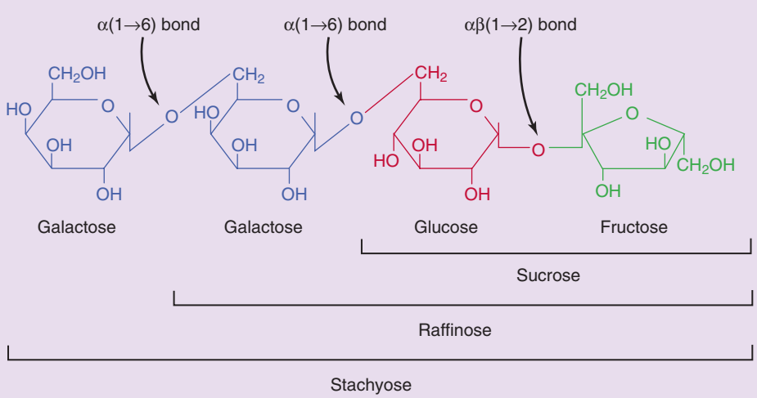
Structures of raffinose and stachyose. The α-1,6 bonds formed by galactose are undigestible but are hydrolyzed by bacterial α-galactosidases, leading to excessive bacterial growth and flatulence
Notes:
covalent bond formed between the -OH group on carbon 1 of one sugar

Slide 22
Released monosaccharides are rapidly fermented to acids and gas in the colon.
The acids can cause abdominal discomfort through their acidity and diarrhea through their osmotic activity; and the gas, though otherwise harmless

Slide 23
Many digestive enzymes are released as inactive precursors
Proteases and phospholipases are dangerous.
They must be kept chained until they reach the lumen of the GI tract, lest they attack proteins and membrane lipids in the cells of their birth
Dangerous enzymes (but not lipases and glycosidases) are secreted as inactive precursors called zymogens.
The zymogens (pancreatic secretion) are synthesized at the ER, stored in secretory vesicles, released by exocytosis, and activated by selective proteolytic cleavage in the lumen of the GI tract.

Slide 24
The pancreas protects itself by:
Synthesizing the dangerous enzymes as inactive zymogens
Trypsin inhibitor, a small (6-kD) polypeptide that binds very tightly to trypsin.
It is present in the cytoplasm of the pancreatic acinar cells (synthesize and secrete almost digestive enzymes), where it inactivates any trypsin that is accidentally activated within the organ.

Slide 25
The liver
There are integrative physiology processes of the liver related to metabolism, detoxification, and immune system function.
One of the main functions is to provide energy substrates to other cells in the body, especially in times when food is rare.
Metabolism
Carbohydrate:
The liver plays a major role in the storage and breakdown of glycogen.
Glycogenolysis release glucose into the systemic circulation.
The liver convert fructose and galactose into glucose as well as can perform gluconeogenesis.

Slide 26
2. Lipid:
The liver can mobilize fatty acids through lipolysis, to be released into the systemic circulation.
Lipolysis: triacylglycerols break down by hydrolysis into glycerol and free fatty acids
The liver also produces lipoproteins, phospholipids, ketone bodies, and cholesterol and has the ability to convert amino acids and carbohydrates into new lipids.

Slide 27
3. Protein
The liver is involved in protein synthesis and amino acid uptake and metabolism.
Proteins synthesized include plasma proteins, prohormones, clotting factors, apoproteins, and transport binding proteins.
The liver also has the capacity to deaminate amino acids, break down amino acids for energy.

Slide 28
B. Detoxification
Two of the most important detoxification processes are removal of ammonia and ethanol, and it also mediates various bio transformations.
Ammonia:
The intestines (primarily the large intestine) are responsible for about 50% of the ammonia produced.
The liver receives the majority of this ammonia via the portal circulation.
The liver removes most of the circulating ammonia through urea cycle.
Urea is released into the systemic circulation, where the majority can be excreted by the kidney.

Slide 29
2. Ethanol:
The liver contains alcohol dehydrogenase, which facilitates the conversion of ethanol into acetaldehyde and NADH.
These two products can then be converted into acetyl coenzyme by peripheral tissues such as skeletal muscles.

Slide 30
3. Drug bio transformations:
Biotransformation reactions involve two phases:
Phase I reactions (oxidation):
utilize cytochrome P450 enzymes to oxidize organic molecules (endogenous compounds, pharmacological agents, and environmental drugs, pesticides, cosmetics, flavorings, food additives, industrial chemicals and environmental pollutants )
These reactions metabolize the majority of drug classes, and there are only a few phase I cytochrome P450–independent reactions of amine containing compounds.
Phase I reactions can also be used to activate some drugs.

Slide 31
b. Phase II reactions (conjugation and elimination):
Phase II reactions conjugate the products to aid in solubility for release
into the systemic circulation to be filtered and excreted in the kidney or to
be secreted into the small intestine with bile for ultimate excretion.

