Slide 1
COPD
Dr Mahmoud Al Shaikh Ali
Consultant Internist
Nov /2022

Slide 2
Objectives
Definition and Overview
Diagnosis and Initial Assessment
Evidence Supporting Prevention & Maintenance Therapy
Management of Stable COPD
Management of Exacerbations
COPD and Comorbidities

Slide 3
Definition
Chronic Obstructive Pulmonary Disease (COPD) is a common, preventable and treatable disease that is characterized by persistent respiratory symptoms and airflow limitation that is due to airway and/or alveolar abnormalities usually caused by significant exposure to noxious particles or gases.

Slide 4
An overview
The most common respiratory symptoms of COPD include dyspnea, cough and/or sputum production.
The main risk factor for COPD is tobacco smoking but other contributors include - environmental exposures - fuel exposure and air pollution.
Host factors predisposing some individuals to develop COPD, include - genetic abnormalities, abnormal lung development and accelerated aging.
COPD may be punctuated by periods of acute exacerbations and remissions
In most patients, COPD is associated with significant concomitant chronic diseases, which increase its morbidity and mortality.

Slide 5
Venn diagram of chronic obstructive pulmonary disease (COPD). Chronic obstructive lung disease is a disorder in which subsets of patients may have dominant features of chronic bronchitis, emphysema, or asthma.
The result is airflow obstruction that is not fully reversible.

Slide 6
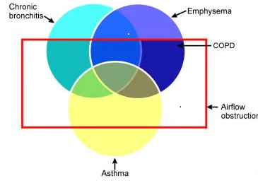

Slide 7
The main characteristic of COPD is chronic airflow limitation
caused by a mixture of small airways disease and parenchymal destruction (emphysema), that evolve at different rates over time.
Chronic inflammation causes structural changes, narrowing of the small airways and destruction of the lung parenchyma that leads to the loss of alveolar attachments to the small airways and decreases lung elastic recoil.
In turn, the ability of the airways to remain open during expiration is lost.
A loss of small airways may also contribute to airflow limitation and mucociliary dysfunction.

Slide 8
Definition
Chronic Bronchitis is defined clinically as the presence of a chronic productive cough for 3 months during each of 2 consecutive years (other causes of cough being excluded).
Emphysema is defined pathologically as an abnormal, permanent enlargement of the air spaces distal to the terminal bronchioles, accompanied by destruction of their walls and without obvious fibrosis.

Slide 9
Patients typically present with a combination of signs and symptoms of chronic bronchitis, emphysema, and reactive airway disease. Includes
Cough, mornings and productive of a small amount of colorless sputum
Breathlessness: The most significant symptom
Wheezing: during exertion and exacerbations

Slide 10
Prevalence of COPD
COPD is projected to be the 3rd leading cause of death.
Estimated global prevalence of 11.7%.
3 m deaths annually.
Median age and Prevalence of smoking is increasing developing countries hence the increasing COPD prevalence.
By 2030 predicted 4.5 million COPD related deaths annually.

Slide 11
Prevalence of COPD was higher in smokers and ex-smokers compared to non-smokers
Higher ≥ 40 year group compared to those < 40
Higher in men than women.

Slide 12
Factors that influence disease progression
Genetic factors
Age and gender
Lung growth and development
Exposure to particles
Socioeconomic status
Asthma & airway hyper-reactivity
Chronic bronchitis
Infections

Slide 13
Cigarette smoking
Is the most well studied COPD risk factor
However, non-smokers may also develop COPD.
Compared never smokers to smokers with COPD, they have fewer symptoms, milder disease and lower burden of systemic inflammation
Interestingly, never smokers with chronic airflow limitation do not appear to have an increased risk of lung cancer, or CVD, compared to those without chronic airflow limitation.
However, there is evidence that they have an increased risk of pneumonia and mortality from respiratory failure.

Slide 14
Predisposing host factors
include genetic abnormalities, abnormal lung development and aging.

Slide 15
The most obvious genetic risk factor that is best documented is a severe hereditary deficiency of alpha-1 antitrypsin (AATD),
But there are other few genes have been identified but their role still unclear.

Slide 16
Age and gender
It is unclear if aging leads to COPD or if age reflects the sum of cumulative exposures throughout life.
Prevalence and mortality are greater among men than women, but later data from developed countries has reported an equal prevalence of COPD - changing patterns of tobacco smoking
women may be more susceptible to the harmful effects of smoking than men

Slide 17
Exposure to particles
Exposure to other types of tobacco (e.g., pipe, cigar, water pipe and marijuana are risk factors for COPD.
Passive exposure to cigarette smoke, also known as environmental tobacco smoke (ETS), may also contribute to respiratory symptoms.
Occupational exposures, including organic and inorganic dusts, chemical agents and fumes, are an under-appreciated risk factor for COPD
Individuals with exposure to inhalation of high doses of pesticides have a higher incidence of respiratory symptoms, airways obstruction and COPD

Slide 18
High risk Occupations - sculptors, gardeners and warehouse workers that were associated with an increased COPD risk among never-smokers and never-asthmatics
The fraction of COPD attributable to workplace exposures was 19.2% overall, and 31.1% among never-smokers

Slide 19
Socioeconomic status
Poverty is consistently associated with airflow obstruction and lower socioeconomic status is associated with an increased risk of developing COPD.
It is not clear, however, whether this pattern reflects exposures to indoor and outdoor air pollutants, crowding, poor nutrition, infections, or other factors related to low socioeconomic status.

Slide 20
In most patients, COPD is associated with significant concomitant chronic diseases, which increase its morbidity and mortality.

Slide 21
Pathogenesis
Pathology
  Chronic inflammation
  Structural changes
Pathogenesis
  Oxidative stress
  Protease-antiprotease imbalance
  Inflammatory cells
  Inflammatory mediators
  Peribronchiolar and interstitial fibrosis
Pathophysiology
  Airflow limitation and gas trapping
  Gas exchange abnormalities
  Mucus hypersecretion
  Pulmonary hypertension

Slide 22
Diagnosis and Initial Assessment
COPD should be considered in any patient who has dyspnea, chronic cough or sputum production, and/or a history of exposure to risk factors for the disease.
Spirometry is required to make the diagnosis; the presence of a post-bronchodilator FEV1/FVC < 0.70 confirms the presence of persistent airflow limitation.
Concomitant chronic diseases occur frequently in COPD patients, including cardiovascular disease, skeletal muscle dysfunction, metabolic syndrome, osteoporosis, depression, anxiety, and lung cancer.

Slide 23

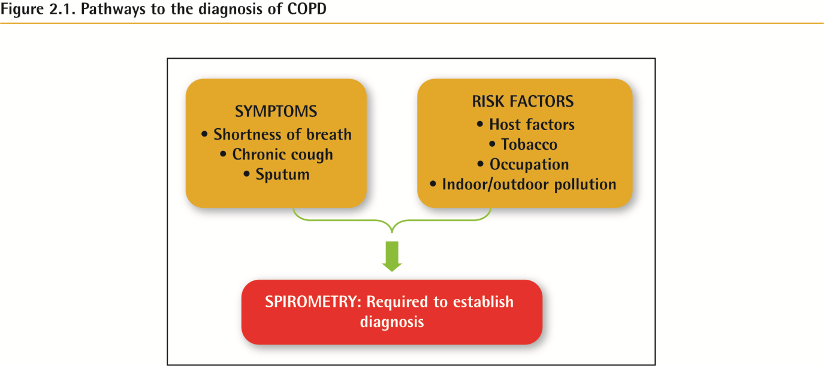
Diagnosis and Initial Assessment

Slide 24
History
Patient’s exposure to risk factors
Past medical history
Family history of COPD or other chronic respiratory disease.
Pattern of symptom development
History of exacerbations or previous hospitalizations for respiratory disorder
Presence of comorbidities
Impact of disease on patient’s life
Social and family support available to the patient.
Possibilities for reducing risk factors, especially smoking cessation.

Slide 25
COPD and co-morbidity
        Cardiovascular disease (CVD)
        Heart failure
        Ischaemic heart disease (IHD)
        Arrhythmias
        Peripheral vascular disease
        Hypertension
        Osteoporosis
        Anxiety and depression
        COPD and lung cancer
        Metabolic syndrome and diabetes
        Gastroesophageal reflux (GERD)
        Bronchiectasis
        Obstructive sleep apnea

Slide 26
Clinical findings
Tachypnea with simple activities
Use of accessory respiratory muscles
paradoxical indrawing of lower intercostal spaces (Hoover sign)
Cyanosis
Elevated jugular venous pulse (JVP)
Peripheral edema

Slide 27
Respiratory exam
Trachea
Barrel chest- Hyperinflation
Wheezing Diffusely decreased breath sounds
Hyper-resonance on percussion
Prolonged expiration
Coarse crackles

Slide 28
Chronic bronchitis characteristics
Obesity
Frequent productive cough
Use of accessory muscles
Coarse rhonchi and wheezing
Signs of right heart failure (ie, cor pulmonale), such as edema and cyanosis

Slide 30
Emphysema characteristics
Underweight
barrel chest
Little or no cough or expectoration
pursed lips breathing
use of accessory respiratory muscles
Tripod sitting position
Hyper-resonance
Distant heart sounds

Slide 31
Key features to diagnose COPD
Concider spirometry if any af these are present over age of 40
1- dyspnea
2- cough
3-sputum
Dyspnea – progressive , worse with exercise or persistant
Cough- chronic/ intermittent with wheezys
4- recurrent lower Resp infections
5- Hx of risk factors
6- family Hx of COPD or /and childhood factors

Slide 32
DDx of cough
Intra and extrathoracic
Dyspnea- assessed by
Hx
Possible DD
mMRC scale

Slide 33
mMRC scale
0- steranious exersion
1- walking uphill or running on a level
2- walking slower than mates
3- walking 100m or few min on level
4- to dyspnic to dress or undress and canot leave the house
CAT

Slide 34
Additional features in severe disease
Fatigue, weight loss, muscle loss, and anorexia
They have prognostic importance or sign of other diseases, such as TB, lung ca.
Syncope during cough occurs due to rapid increases in intrathoracic pressure during prolonged attacks of coughing. Coughing spells may also cause rib fractures, which are sometimes asymptomatic.
Ankle swelling may be the only indicator of the presence of cor pulmonale.
Symptoms of depression and/or anxiety are common in COPD and are associated with poorer health status, increased exacerbations, and admission.

Slide 35
Diagnosis
The formal diagnosis of COPD is made with spirometry;
FEV₁/FVC< 70% of predicted for a matched control
it is diagnostic for a significant obstructive defect.
(based on the percent predicted post bronchodilator FEV₁) are as follows:

Slide 36
Severity Criteria
Stage I (mild): FEV₁ 80% or greater of predicted
Stage II (moderate): FEV₁ 50-79% of predicted
Stage III (severe): FEV₁ 30-49% of predicted
Stage IV (very severe): FEV₁ less than 30% of predicted or FEV₁ less than 50% and chronic respiratory failure

Slide 37
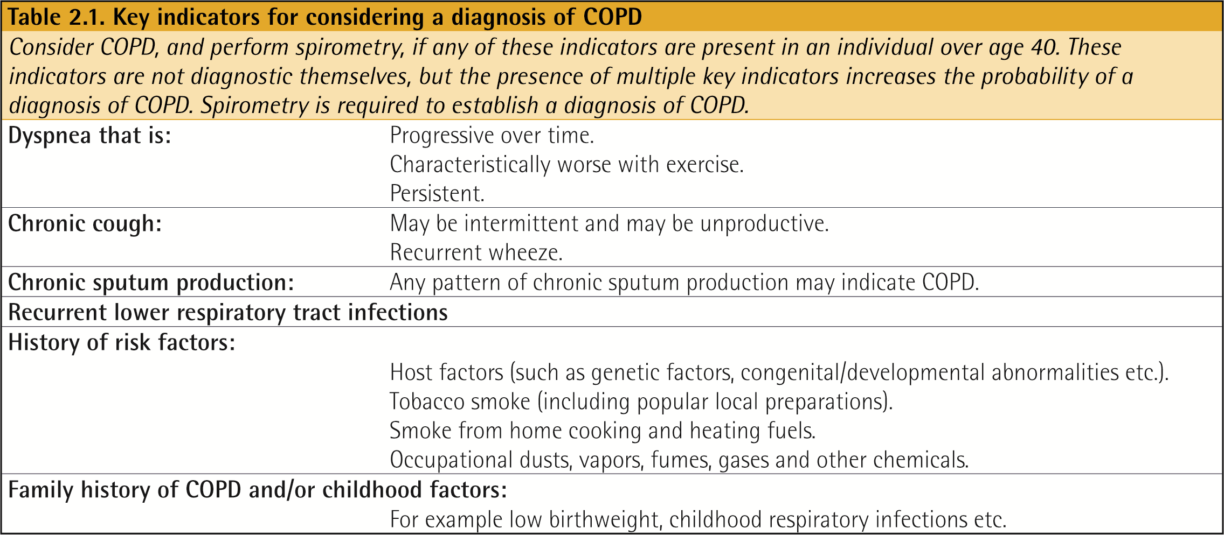
Diagnosis and Initial Assessment

Slide 38
Arterial blood gas (ABG)
Patients with mild COPD have mild to moderate hypoxemia without hypercapnia
Hypercapnia seen as the FEV₁ falls below 1 L/s or 30% of the predicted value
Chronic respiratory acidosis

Slide 39
CXR
Flattening of the diaphragm
Increased retrosternal air space
A long, narrow heart shadow
Rapidly tapering vascular shadows accompanied by hyperlucency of the lungs

Slide 40
Evidence Supporting Prevention & Maintenance Therapy
Smoking cessation is key.
The effectiveness and safety of e-cigarettes as a smoking cessation aid is uncertain at present.
Individualized Pharmacologic therapy can reduce COPD symptoms, reduce the frequency and severity of exacerbations, and improve health status and exercise tolerance.
Inhaler technique needs to be assessed regularly.

Slide 41
Vaccination: COVID Vaccine, Influenza , Pneumococcal vaccination
Pulmonary rehabilitation improves symptoms, quality of life, and physical and emotional participation in everyday activities.
LTOT In patients with stable COPD and resting or exercise-induced moderate desaturation, long-term oxygen treatment should not be prescribed routinely.

Slide 42
In patients with severe chronic hypercapnia and a history of hospitalization for acute respiratory failure, long-term non-invasive ventilation may decrease mortality and prevent re-hospitalization.
In select patients with advanced emphysema refractory to optimized medical care, surgical or bronchoscopic interventional treatments may be beneficial.

Slide 43
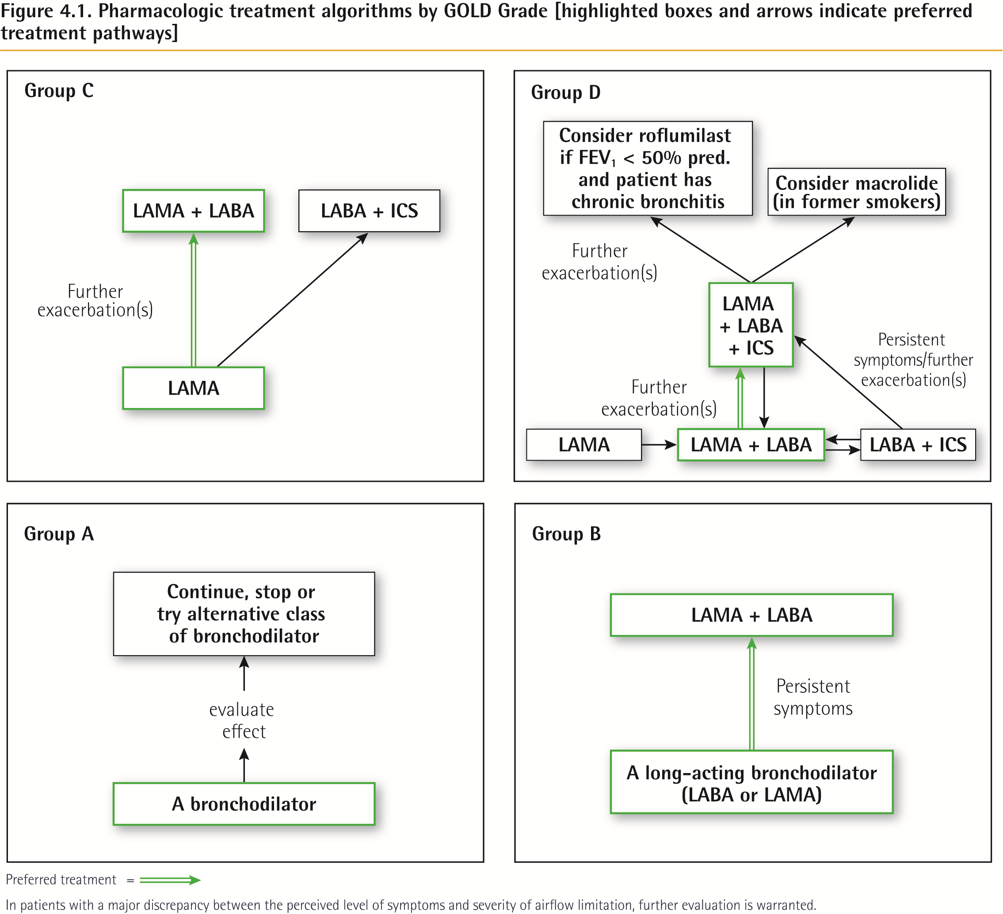
Treatment of Stable COPD
© 2017 Global Initiative for Chronic Obstructive Lung Disease

Slide 44
Non-Pharmacologic Treatment
Oxygen therapy
Long-term oxygen therapy is indicated for stable patients who have:
PaO₂ at or below 7.3 kPa (55 mmHg) or SaO₂ at or below 88%, with or without hypercapnia confirmed twice over a three week period; or
PaO₂ between 7.3 kPa (55 mmHg) and 8.0 kPa (60 mmHg), or SaO₂ of 88%, if there is evidence of pulmonary hypertension, peripheral edema suggesting congestive cardiac failure, or polycythemia (hematocrit > 55%).
© 2017 Global Initiative for Chronic Obstructive Lung Disease

Slide 45
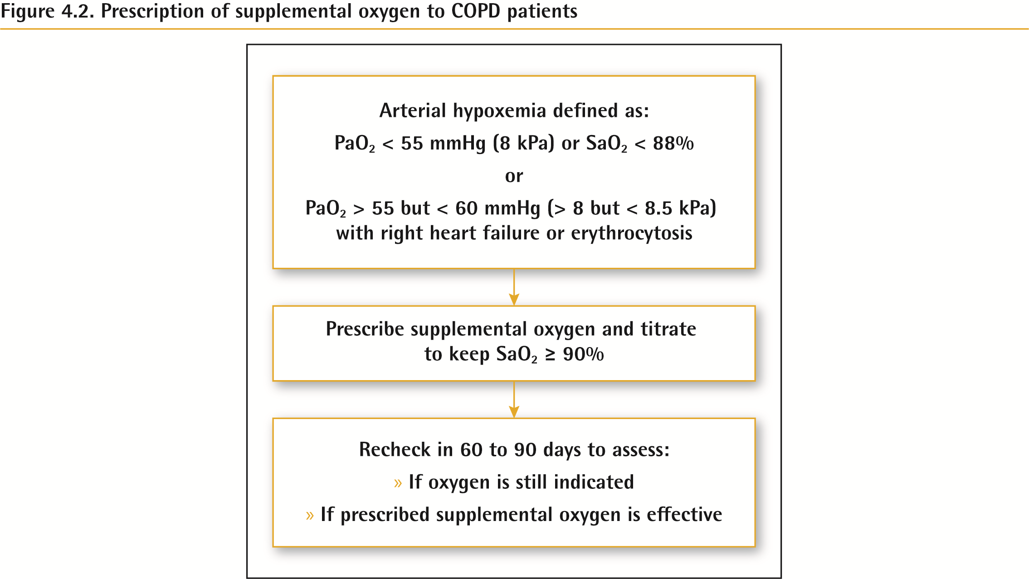
Non-Pharmacologic Treatment

Slide 46
Non-Pharmacologic Treatment
Interventional bronchoscopy and surgery
In selected patients with heterogeneous or homogenous emphysema and significant hyperinflation refractory to optimized medical care, surgical or bronchoscopic modes of lung volume reduction (e.g., endobronchial one-way valves or lung coils) may be considered.
In selected patients with a large bulla, surgical bullectomy may be considered.
In selected patients with very severe COPD and without relevant contraindications, lung transplantation may be considered.
© 2017 Global Initiative for Chronic Obstructive Lung Disease

Slide 47
COPD exacerbations are defined as an acute worsening of respiratory symptoms that result in additional therapy.
Classified as:
  Mild
  Moderate
  Severe

Slide 48
Management of Infection
In patients with COPD, chronic infection or colonization of the lower airways is common from S pneumoniae, H influenzae, and M catarrhalis. In patients with chronic severe airway obstruction, P aeruginosa infection may also be prevalent. The use of antibiotics for the treatment of acute exacerbations is well supported. ^{[23]} Patients who benefited most from antibiotic therapy were those with exacerbations that were characterized by at least 2 of the following: increases in dyspnea, sputum production, and sputum purulence (The Winnipeg criteria). No evidence supports the continuous or prophylactic use of antibiotics to prevent exacerbations.

Slide 49
Empiric antimicrobial therapy is recommended in patients with an acute exacerbation (as evidenced by an increase in baseline dyspnea and/or a change in the quantity or quality of cough) and evidence of an infectious process, such as fever, leukocytosis, or an infiltrate on chest radiograph. The antibiotic choice must be comprehensive and should cover all likely pathogens in the context of the clinical setting and local resistance patterns.

Slide 50
Steroids
Oxygen therapy
PPIs
VTEs prophylaxis

