Slide 1
Diseases of the pleura

Slide 2
Topics :
Pleurisy
Pleural effusion
Empyema
Pneumothorax

Slide 3
Anatomy and physiology
The pleura consists of two membranes:
- Visceral pleura : is innervated with somatic pain receptors supplied by the phrenic nerve (sharp and localized ).
- Parietal pleura : has an autonomic nerve supply from internal organs , pain sensation (dull , achy and slightly localized )
Pleural space.
Pleural fluid.

Slide 4
Pleurisy
Pleurisy is not a diagnosis but a term used to describe pleuritic pain resulting from any one of a number of disease processes involving the pleura.
There are many possible causes of pleurisy but viral infections spreading from the lungs to pleural cavity are the most common .
The inflamed pleural layers rub against each other every time the lungs expand to breathe in air , this can cause sharp pain when breathing , also called pleuritic chest pain. .
Pleurisy is a common feature of pulmonary infection and infarction ; it may also occur in malignancy .

Slide 5
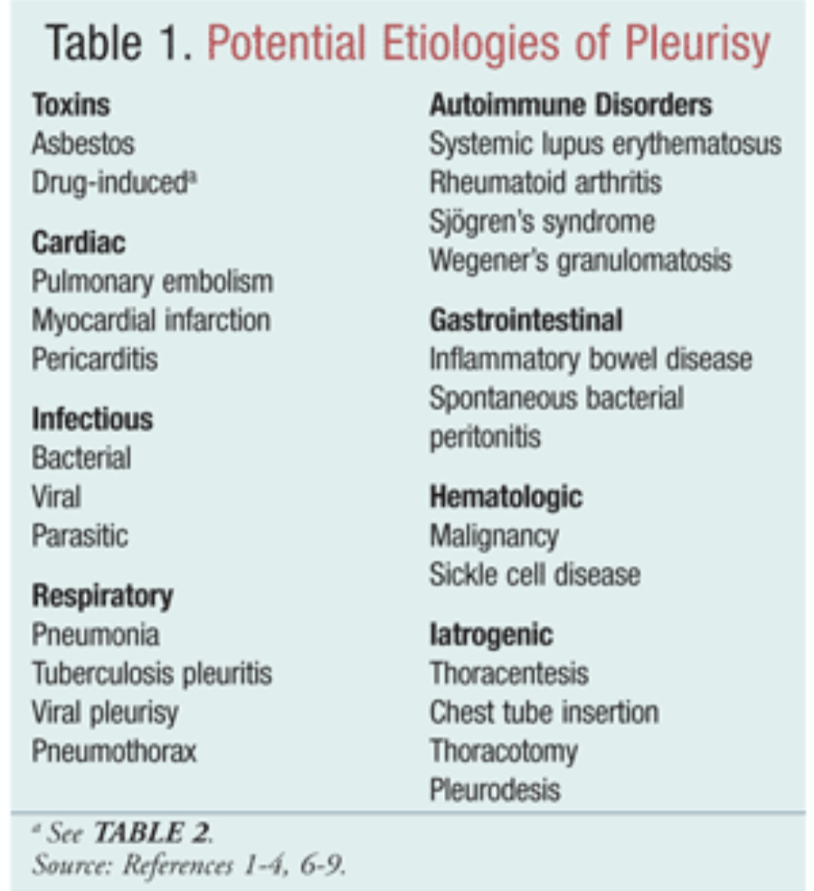

Slide 6
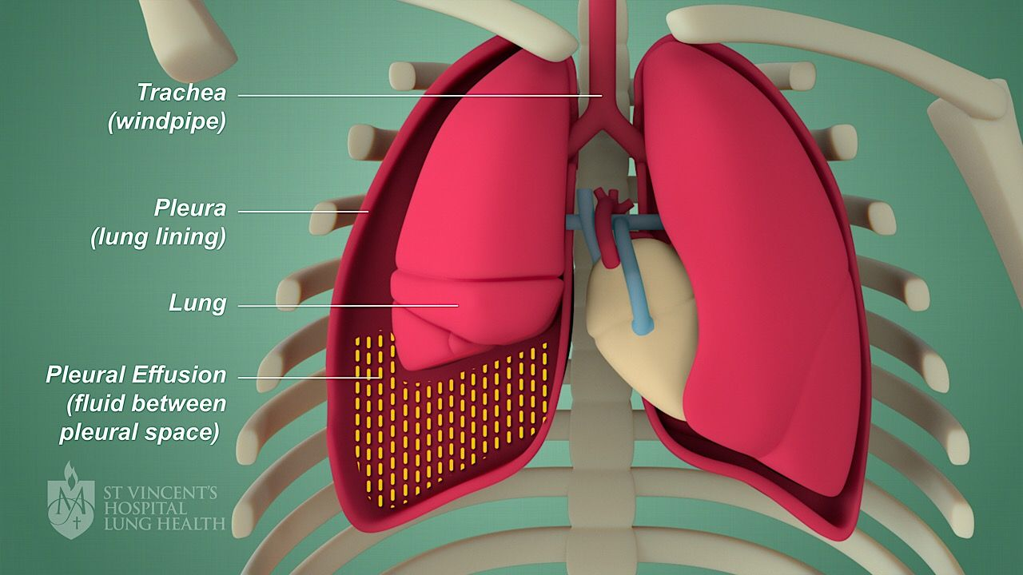
Pleural Effusion

Slide 7
Pleural anatomy / Physiology
Pleural space: the potential space between parietal and visceral pleura.
Pleural space normally contains small amount of fluid (10 ml).
Definition: A pleural effusion is an accumulation of >10 mL of fluid in the pleural space.

Slide 8
Pathophysiology
There are mainly two categories of change
1. Alteration of the permeability
2. Alteration in the driving pressure.
Hydrostatic/ Oncotic Pressure
Pleura becomes more permeable to the fluid and Large weight components of blood.
Accumulated fluid ⇒ Transudative
Changes seen most commonly in CHF.
Accumulated fluid ⇒ Exudative
Changes seen most commonly in inflammatory and neoplastic diseases

Slide 9
ETIOLOGY
Transudate:
• CHF
• Cirrhosis
• Atelectasis
• Nephrotic syndrome
• Constrictive pericarditis
• Pulmonary embolus (20% of cases)
Notes:
hepatic hydrothorax: right, SPEM,
Acute diuresis in heart failure can elevate protein levels into the exudative range .

Slide 10
EXUDATE
Parapneumonic effusion
• TB
• Pulmonary embolus
• CTDs ( RA , SLE )
• Asbestos
• Chylothorax

Slide 11
Diagnosis
Diagnosis of a PE is based on history, physical examination, and imaging, which includes CXR, CT scan, and US.
Differentiation into a specific pathology is based on history, imaging, and laboratory analysis (chemistry, microbiology, and cytology).

Slide 12
Clinical Presentation
Symptom onset may be chronic, or acute depending on the rapidity with which the pleural pathology developed.
Chest pain, SOB and Cough.
If the effusion is very large in nature, it may cause a mass effect potentially progressing to a hemodynamic instability resulting in a life-threatening hypotension.

Slide 13
Physical Examination
Dullness to percussion.
Decreased breath sounds on auscultation.
Asymmetric chest wall expansion.
Notes:
Diagnostic Criteria

Slide 14
Imaging
CXR: PA, 200 ml of fluid is needed and Lateral 100ml.
A lateral decubitus film can reveal an effusion of 10-15 mL and allows for assessment of a free-flowing versus loculated effusion.
Ultrasound can detects small amounts of fluid as well as the presence of septations.
CT is more sensitive and can detect the presence of even a very small amount of fluid and masses.
Notes:
Radiographic imaging and laboratory testing of pleural fluid are the two most useful diagnostic modalities for diagnosing pleural disease.

Slide 15
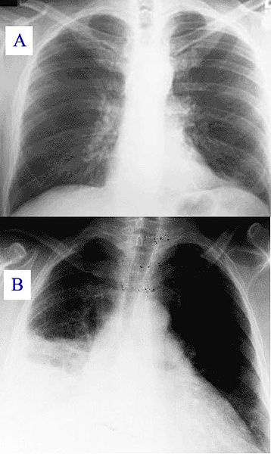
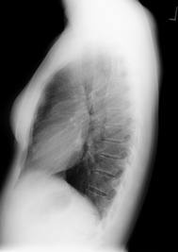
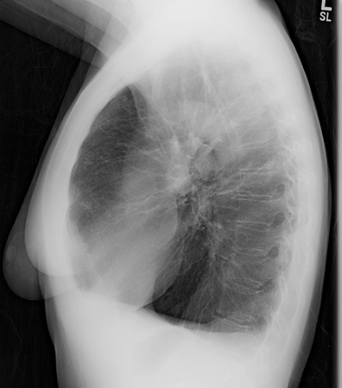
INVESTIGATIONS: Imaging Studies
Chest X-ray
Notes:
Pleural effusions accumulate in the most dependent part of the thoracic cavity because the lung floats on the effusion.
lateral costophrenic sulcus on PA CXR 200ml
Postereior costophrenic sulcus on Lat CXR 100ml

Slide 16
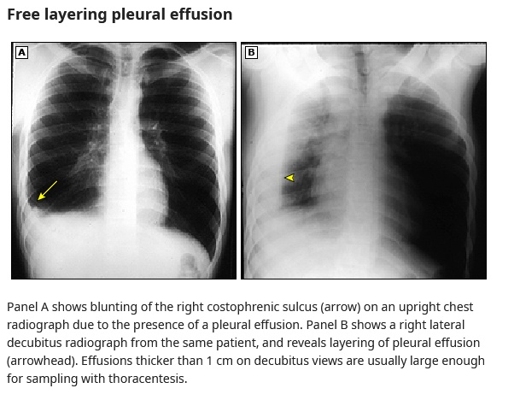
Notes:
Panel A shows blunting of the right costophrenic sulcus (arrow) on an upright chest radiograph due to the presence of a pleural effusion. Panel B shows a right lateral decubitus radiograph from the same patient, and reveals layering of pleural effusion (arrowhead). Effusions thicker than 1 cm on decubitus views are usually large enough for sampling with thoracentesis.

Slide 17
Diagnostic Procedures
Thoracentesis should be performed for diagnosis in cases of pleural effusion. (Therapeutic or Diagnostic)
Thoracentesis should be performed after ultrasound localization of pleural fluid to decrease risk of complications.
CXR should be performed after the procedure to rule out a pneumothorax.

Slide 18
Thoracentesis Indication
Indication:
  Larger than 1 cm on lateral decuibitus.
  New finding or an unexplained pleural effusion.
  Relieve with a large volume of fluid.

Slide 19
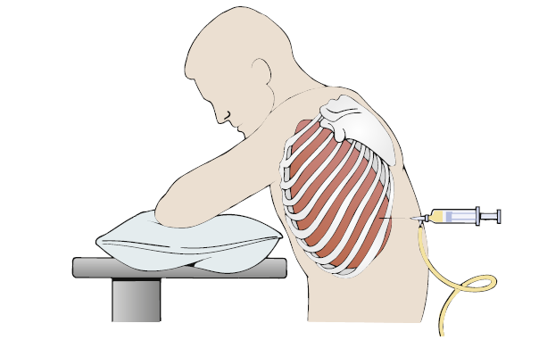
Test Explanation
Notes:
This position spreads the ribs and enlarges the intercostal space for insertion of the needle.

Slide 20
Test Explanation
1. Upright position with the arms and shoulders raised and supported on a padded overhead table.
2. Patients who cannot sit upright are placed in a side-lying position on the unaffected side with the side to be tapped uppermost.
3. The thoracentesis is performed under strict sterile technique.
4. The needle insertion site, which is determined.
5. The fluid is withdrawn with a syringe and a three-way stopcock.

Slide 21
Potential Complications
Pneumothorax
• Bleeding
• Reflex bradycardia and hypotension
• Pulmonary edema
• Empyema

Slide 22
Normal Findings
Gross appearance: clear, serous, light yellow.
RBCs: none
WBCs: <300/mL
Protein: <3 g/dL
Glucose: 70-100 mg/dL
LDH: similar to serum LDH
Cytology: no malignant cells
Bacteria: none

Slide 23
Tests routinely performed:
Cell count and differential
pH
Protein
Glucose
LDH

Slide 24
Nucleated cells
WBC count : The total nucleated cell count is never diagnostic.
<1000/μL suggests transudate
>1000/μL suggests exudate
Counts above 50,000/microL are usually found only in complicated parapneumonic effusions, including empyema.
>50% lymphocytes suggests TB or malignancy.
RBC count >100,000/μL suggests:
- Trauma
- Malignancy
- Pulmonary embolism with infarction.

Slide 25
Protein Content
Total protein levels greater than 3 g/dL are characteristic of exudates.
Transudates usually have a protein content of less than 3 g/dL.
Tuberculous effusions always have total protein concentrations above 4 g/dL.
Pleural fluid protein are in the 7 to 8 g/dL range, multiple myeloma should be considered.

Slide 26
Glucose
A low pleural fluid glucose (less than 60 mg/dL):
Rheumatoid pleurisy
Empyema
Malignant effusion
Tuberculous pleurisy
Lupus pleuritis
Esophageal rupture

Slide 27
The mechanism responsible for a low pleural fluid glucose :
Decreased diffusion of glucose from blood to pleural fluid with rheumatoid pleurisy.
Increased utilization of glucose by bacteria and malignant cells.

Slide 28
Pleural fluid pH
The pH of normal pleural fluid is 7.6
Transudates have a fluid pH in the 7.4 to 7.55 range, while exudates from 7.3 to 7.45.
pH <7.2 suggests:
Complicated parapneumonic effusion
Empyema
Esophageal rupture
Rheumatoid pleurisy
Malignant effusion
Notes:
due to a bicarbonate gradient between pleural fluid and blood

Slide 29
Triglycerides
TG >110 mg/dL indicates chylothorax
TG <50 mg/dL indicates no chylothorax.
If TG 50 to 110 mg/dL, send fluid for chylomicrons, Presence of chylomicrons indicates chylothorax

Slide 30
Cytology
The sensitivity is approximately 60 percent.
The sensitivity depending on the histology of malignancy; cytology has a sensitivity of 78 % for adenocarcinoma, 53 %for Small cell , and 25 %for SCC.
The diagnostic yield of cytology does not appear to depend on the volume of fluid sent for cytological smear.
Notes:
which may increase by 15 percent with a second thoracentesis pleural fluid sample.

Slide 31
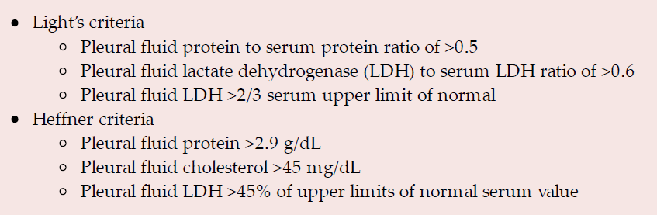

Slide 32
Pleural biopsy
Done in undiagnosed Usually exudative pleural effusion.
Percutaneous pleural biopsy : CT-guided cutting needle biopsy.
Thoracoscopic biopsy is used to diagnose malignancy when an obvious mass is not visible on CT.

Slide 33
Treatment
Generally, treatment of a pleural effusion depends on the etiology.
Symptomatic treatment may involve drainage of the effusion if the presenting symptom is dyspnea.
Chest tube insertion for large pleural effusions, empyema, chylothorax, and hemothorax.

Slide 34
Transudative pleural effusions can sometimes be treated effectively with diuretics in disease states such as CHF, renal failure, and liver failure.
Parapneumonic effusions and empyema are treated with antibiotics in conjunction with fluid drainage.
Notes:
Intrapleural use of tissue plasminogen activator and recombinant deoxyribonuclease (DNAse) in pleural infections resulting in improved fluid drainage and decreased need for VATS.

Slide 35
Antibiotics
Generally, empiric antibiotic regimens should include an antibiotic that targets anaerobic bacteria.
Community- acquired
A third-generation cephalosporin plus metronidazole
A carbapenem ( meropenem).
Combination therapy with a respiratory fluoroquinolone plus metronidazole.
Notes:
Additional antibiotics should be selected based on the site of acquisition (eg, community- versus hospital-acquired), mode of acquisition (eg, aspiration, trauma).

Slide 36
Hospital-acquired :
Targets MRSA, gram-negative bacteria.
Combining vancomycin with metronidazole and an antipseudomonal cephalosporin.
Vancomycin with metronidazole and an antipseudomonal fluoroquinolone
Notes:
However, there is growing concern that the combination of vancomycin plus piperacillin-tazobactam is nephrotoxic.

Slide 37
Duration
In general, therapy may last one to two weeks,
Two to three weeks for a complicated parapneumonic effusion and four to six weeks for empyema.
The initial IV antibiotic can be switched to an oral regimen when clinical response is clear, and the patient is able to tolerate oral medications.
Notes:
(eg, patient is afebrile, hemodynamically stable, clinically improving)

Slide 38
Treatment of recurrent PE
Pleurodesis: chemical or mechanical
instillation of a sclerosing agent into the pleural space to cause scarring and restriction of the space itself.
Surgical Management: VATS with decortication.
Placement of an indwelling catheter for malignant recurrent effusions.
Notes:
chemical pleurodesis is a therapeutic procedure applied to create the symphysis between the parietal and visceral pleura by intrapleural administration of various chemical agents (e.g. talk, tetracycline, iodopovidone)

Slide 39
Pneumothorax

Slide 40
Definition :
Pneumothorax : is an abnormal collection of air in the pleural space separating the lung from the chest wall which may interfere with normal breathing , causing the lungs to collapse.

Slide 41
Types :
1_ Spontaneous pneumothorax :
Primary : it occur in young healthy individuals without underlying lung disease , it is due to rupture of apical sub-pleural bleb .
Secondary : occurs in the presence of pre-existing lung pathology , Ex : Cystic lung disease , COPD , lung cancer .

Slide 42
2_ Traumatic pneumothorax :
it result from either penetrating or blunt injury to the chest .
Open : chest wall is damaged by any wound , outside air enters pleural space and causes lung to collapse .
Closed : here chest wall is punctured or air leaks from a ruptured bronchus .
Iatrogenic : Ex ,mechanical ventilation (barotrauma ), thoracentesis , central venous catheter placement .

Slide 43
3_ Tension pneumothorax :
It is life threatening condition .. The pleural pressure is more than the atmospheric pressure .
Radiological manifestation of large pneumothorax :
Mediastinal shift .
Flattening of the hemi diaphragm and lung collapse.
Associated with clinical manifestations of circulatory collapse ( tachycardia , hypotension and sweating )
It is more common with :
positive pressure ventilation .
Traumatic pneumothorax .

Slide 44
Clinical features :
Predominant symptom is acute pleuritic chest pain.
Dyspnea result from pulmonary compression .
On physical examination :
Breath sound may be diminished on the affected side
Percussion of the chest may be perceived as hyper resonant .
Physical signs include :
Tachypnea
Increased resonant
Absent breath sounds
Hypoxemia
Cyanosis
Hypercapnia

Slide 45
Risk factors :
Male sex .
Smoking .
Age ( less than 20 y , more than 50 y )
Family history of pneumothorax .
Tall and slender body build .
A history of pneumothorax .
Presence of underlying lung disease such as :
COPD
Severe asthma
TB
Cystic fibrosis
Mechanical ventilation .
Structural abnormalities (e.g. Marfan syndrome , Ehlers-Danlos syndrome )
Trauma

Slide 46
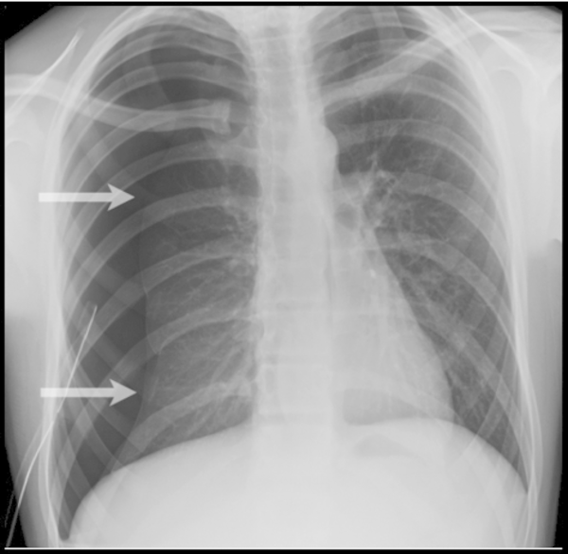
Diagnosis _ chest Xray
The characteristic of pneumothorax :
Pleural line .
No lung markings in pneumothorax .

Slide 47
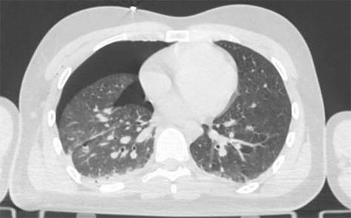
CT scanning
A further use of CT is the identification of underlying lung lesions .
Chest ultrasound

Slide 48
Size of pneumothorax
Often , the PA chest x-ray is used to quantify the size of the pneumothorax .
Small pneumothorax : a visible rim of <= 2cm between the lung margin and the chest wall at the level of the hilum on PA chest x-ray .
Large pneumothorax : a visible rim > 2cm between the lung margin and the chest wall at the level of the hilum on PA chest X-ray .

Slide 49
Treatment :
Goals :
To promote lung expansion.
To eliminate the pathogenesis .
To decrease pneumothorax recurrence (smoking cessation )
Treatment options :
Simple aspiration
Intercostal tube drainage
Guide wire tube thoracostomy
Surgical treatment

Slide 50
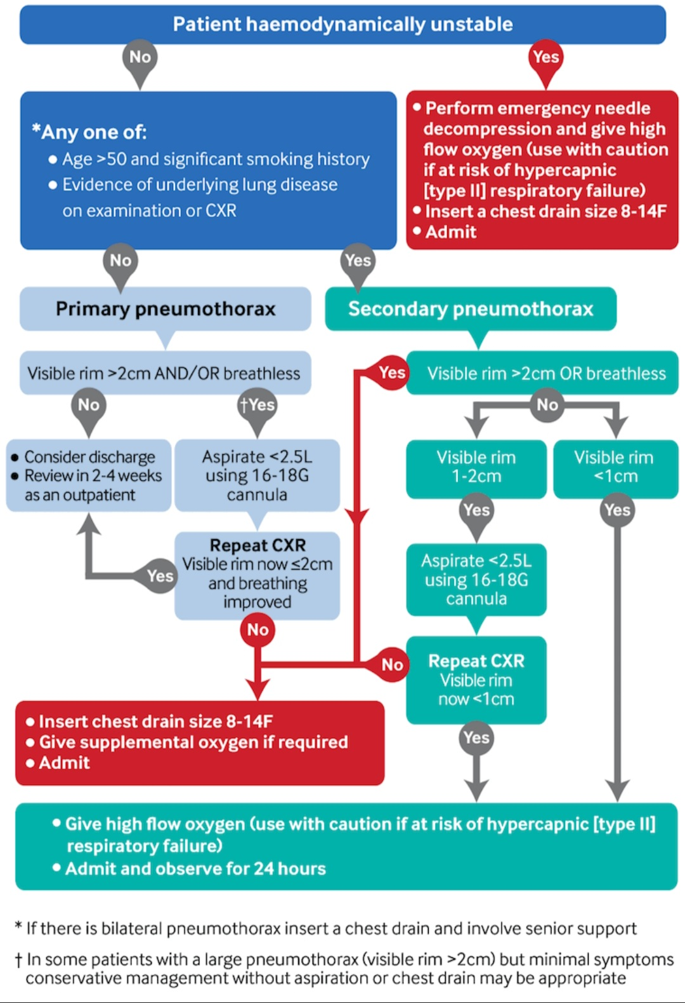

Slide 51
Thank you

