Slide 1

Development Male Reproductive System
Dr Amer H. Saleem
MRCS, London
FEBU, Egypt
Arab board, Jordan
Consultant, Shifa hospital

Slide 2
INTRODUCTION
- The genital system consists of gonads and genital (sex) ducts.
• Gonads include testes in male and ovaries in females.
- Gonads develop from the genital ridge with incorporation of primordial germ cells.
• Genital ducts in male include efferent ductules of testis, epididymis, vas deferens, seminal vesicle and
ejaculatory duct.
• Accessory sex glands in male include prostate and
bulbourethral glands

Slide 3
Development of Gonads
The gonads are derived from three sources
• Mesothelium ( lining the posterior abdominal wall )
• Underlying mesenchyme (embryonic connective tissue)
• Primordial germ cells (earliest undifferentiated sex cells)

Slide 4
FORMATION OF PRIMITIVE GONADS
Primordial germ cells
Primordial germ cells arise from epiblasts (primary ectoderm) in the second week.
Formation of genital ridge is the first sign of gonad formation.
These primordial germ cells remain within extraembryonic mesoderm of connecting stalk and wall of the yolk sac.
On formation of the tail fold, primordial germ cells come to lie in splanchnopleuric mesoderm that surrounds hindgut.

Slide 5
Genital Ridge :
In fifth week of IUL ,coelomic epithelium covering medial surface of mesonephros proliferates to form a genital ridge
Genital ridge is an elevation of posterior abdominal wall, in between dorsal aorta and mesonephros .

Slide 6
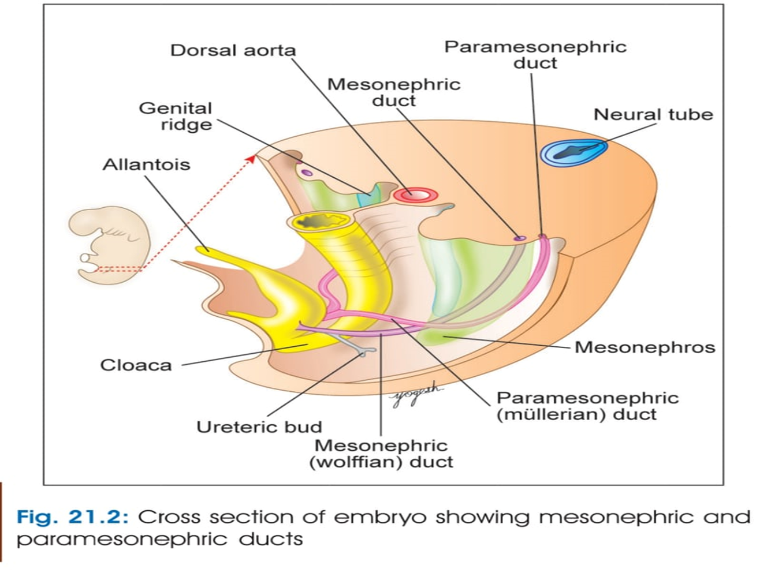

Slide 7
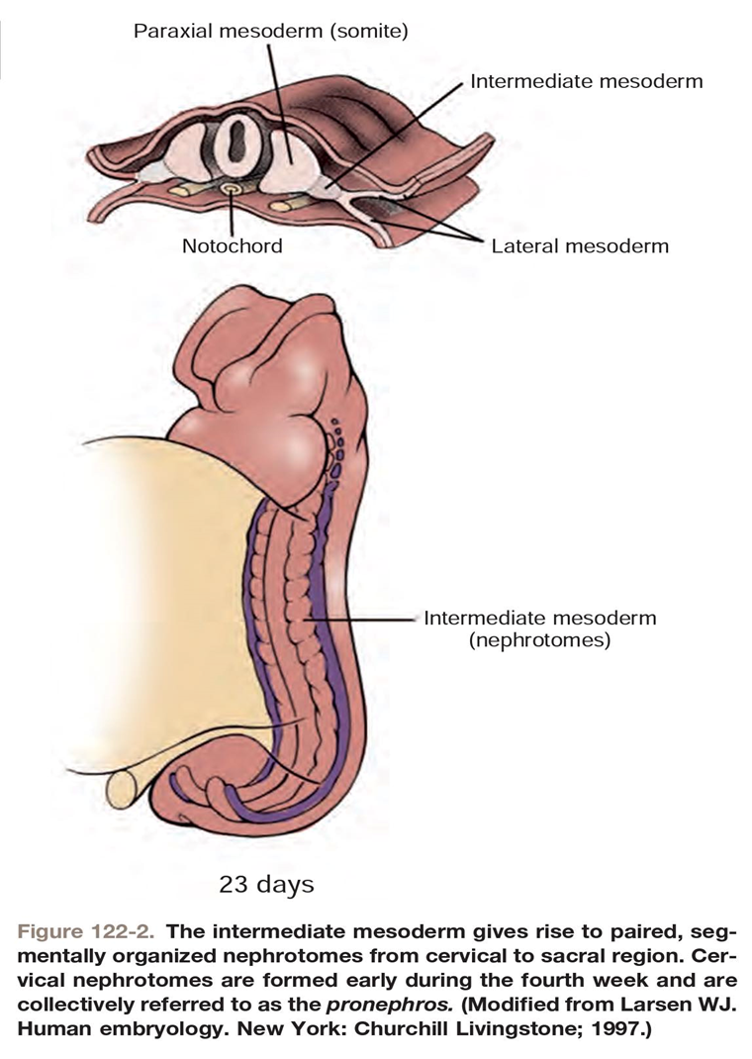
Testis or ovary arises from genital ridge (intermediate mesoderm) retroperitoneally , on the posterior abdominal wall in lumbar region (at T10 level)

Slide 8
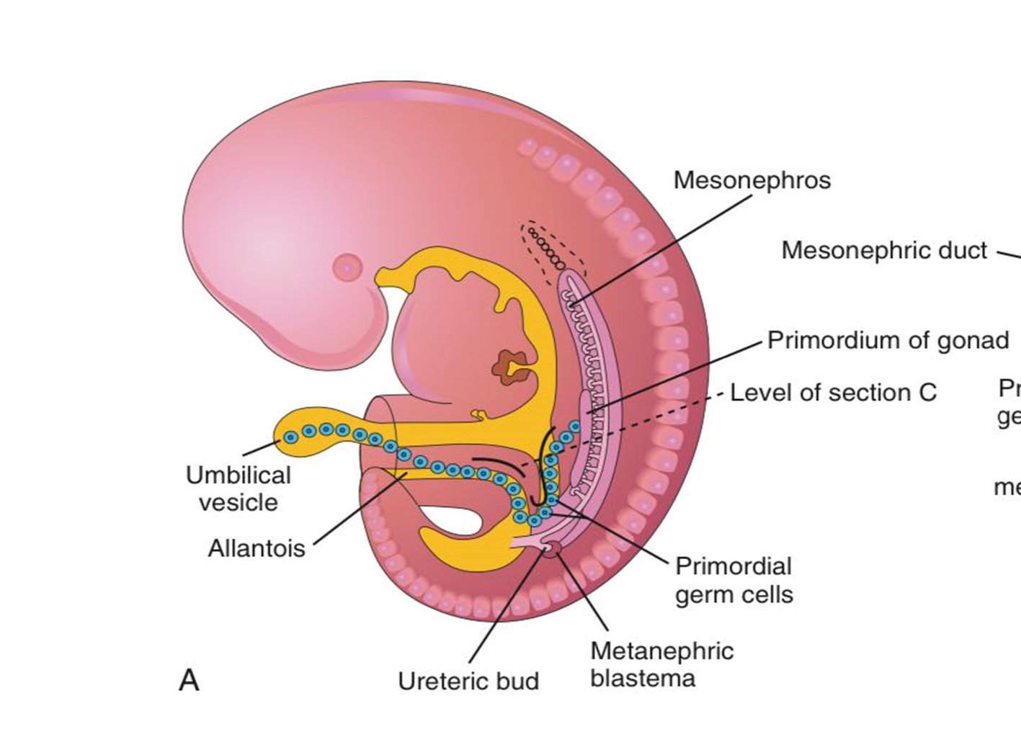
Sketch of a 5-week embryo illustrating the migration of primordial germ cells from the umbilical vesicle into the embryo

Slide 9
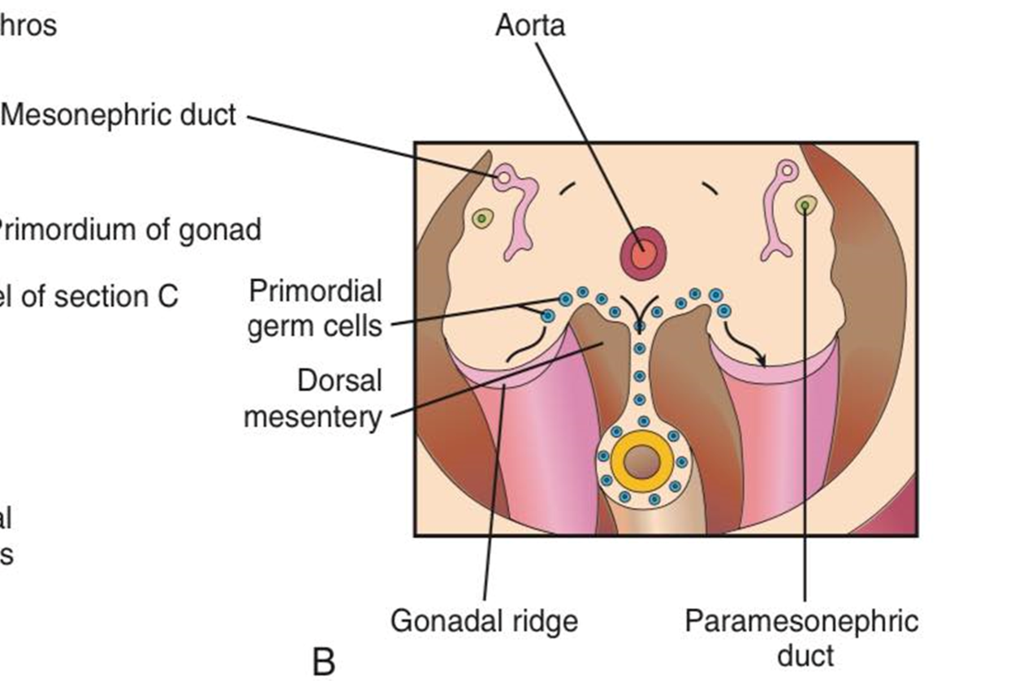
By 5th week, primordial germ cells migrate bilaterally through dorsal mesentery to the region of genital ridges

Slide 10
Formation of primitive sex cords:
From surface (coelomic) epithelium, numerous cord-like processes develop and enter the genital ridge to form finger- like cords called primitive sex cords.

Slide 11
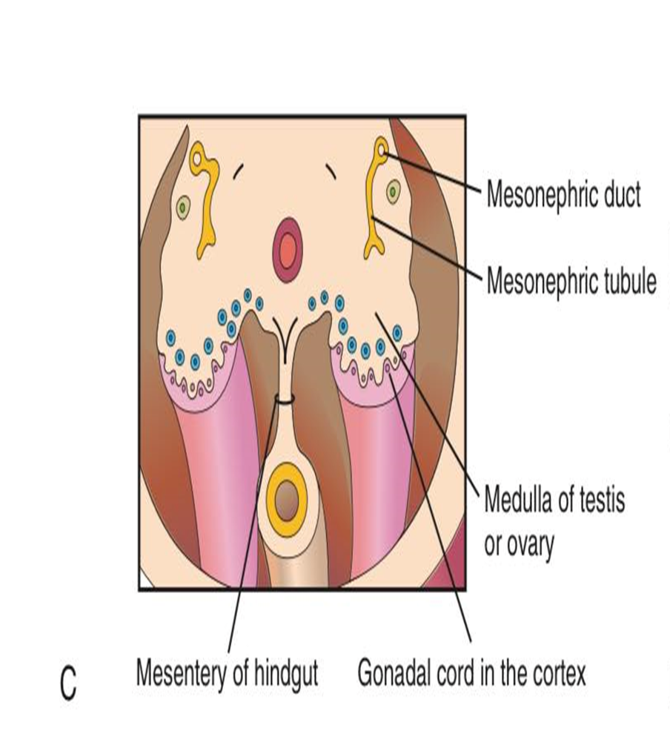

Slide 12
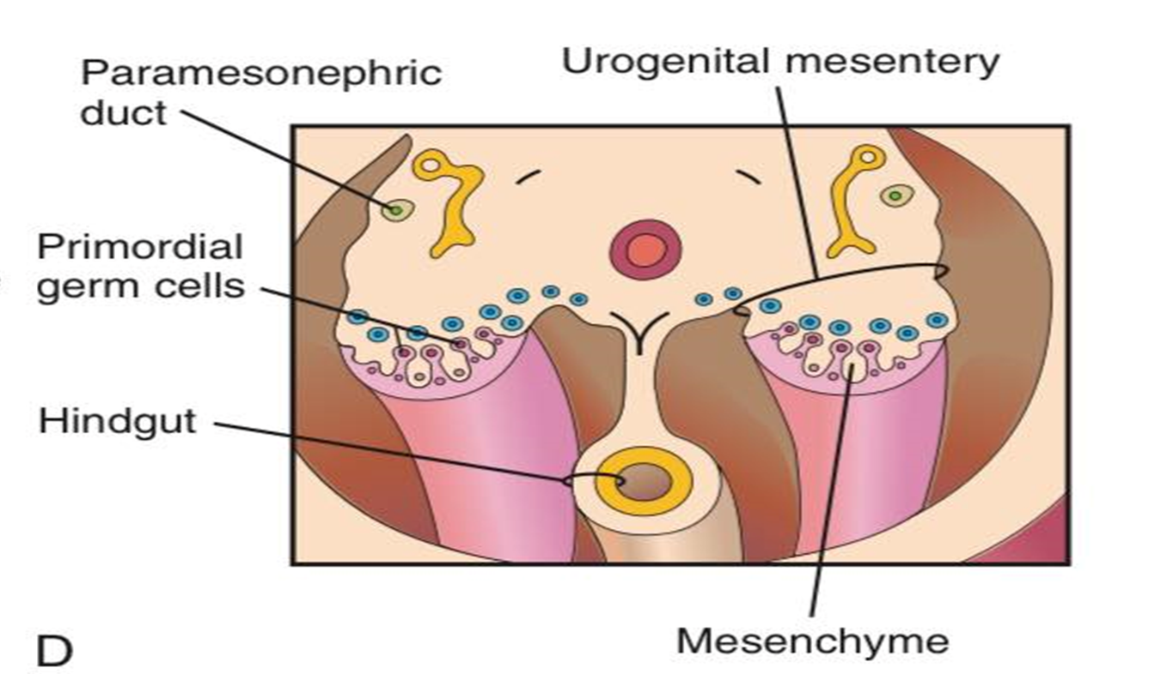
a later stage showing the indifferent gonads and paramesonephric ducts

Slide 13
Differentiation into Definitive Gonad
Up to 7th week of IUL, gonad is ambisexual or indifferent.
• Differentiation of genital ridge into testis or ovary entirely depends on chromosomal constitution.
• Testis- Determining Factor (TDF) is located on short arm of chromosome Y.
- TDF is controlled by SRY gene (sex- determining region of Y chromosome).MCQ
• In the absence of TDF, cells of sex cords differentiate into follicular cells of ovary

Slide 14
Both X chromosomes should be genetically active to form primary ovarian follicles.
After formation of definitive female gonad, only one X chromosome remains active, whereas the other X chromosome becomes inactive to form the Barr body.
Barr body appears soon after the beginning of embryonic period, after 2nd–3rd week

Slide 15
At 7th week , Genital ridge has an outer cortex and inner medulla.
In male foetus, medulla differentiates to form testis and cortex regresses.
TDF differentiate Sertoli cells that start producing anti-müllerian substance (AMS) or hormone
Anti-müllerian substance inhibits development of the müllerian ducts.
In female foetus, cortex differentiates to form ovary and medulla regresses.
Absence of Y-chromosome (SRY gene) or TDF results in the formation of ovary.

Slide 16
TDF also helps in differentiation of Leydig cells from mesoderm of gonadal ridge.
Leydig cells start secreting testosterone and dihydrotestosterone at 8th weeks .
Testosterone :
- stimulates growth of mesonephric duct that forms male genital duct system.
Dihydrotestosterone :
helps in formation of penis, penile urethra, prostate and scrotum

Slide 17
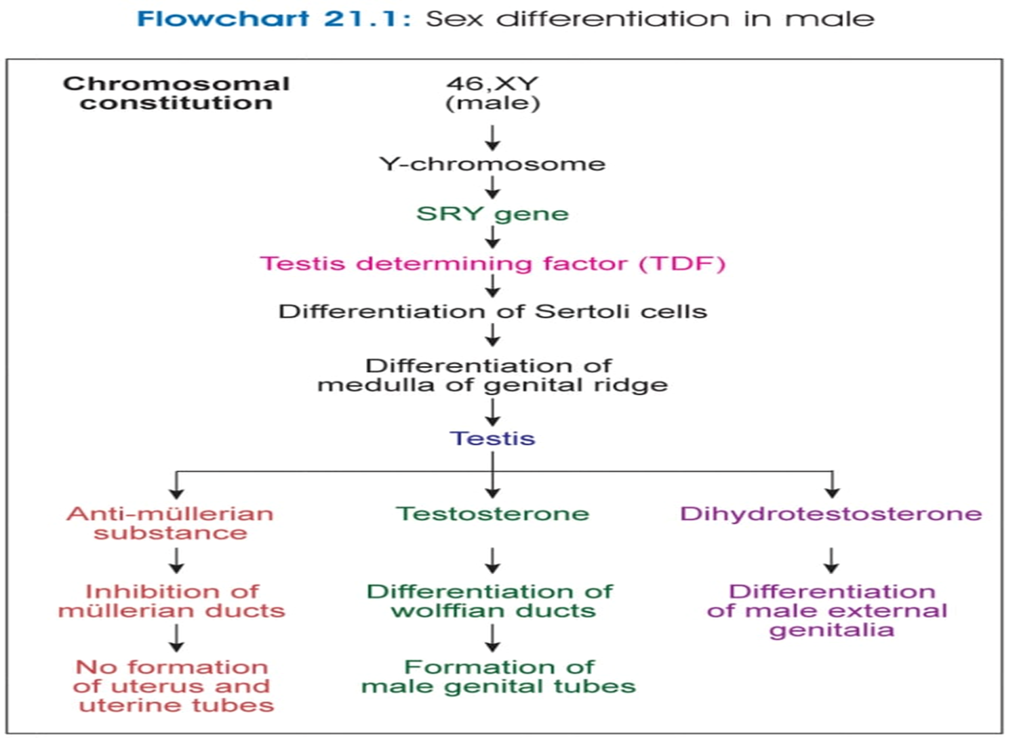

Slide 18
Stages of Development
Medulla of genital ridge:
It forms seminiferous tubules, rete testis, interstitial cells, fibrous septa and intrinsic coverings of testis.
2. Mesonephric tubules:
The tubules of rete testis develop communication with adjacent 12–15 mesonephric tubules forming efferent ductules of testis

Slide 19
. Mesonephric duct:
It forms duct of epididymis, vas deferens, seminal vesicles and ejaculatory duct.
4. Paramesonephric (müllerian) duct:
It gets degenerated (remnants—appendix of testis).
5. Mesonephros :
It degenerates (remnants—appendix of epididymis).
Sex cord cells derived from coelomic epithelium form Sertoli cells
Primordial germ cells form spermatogonia

Slide 20
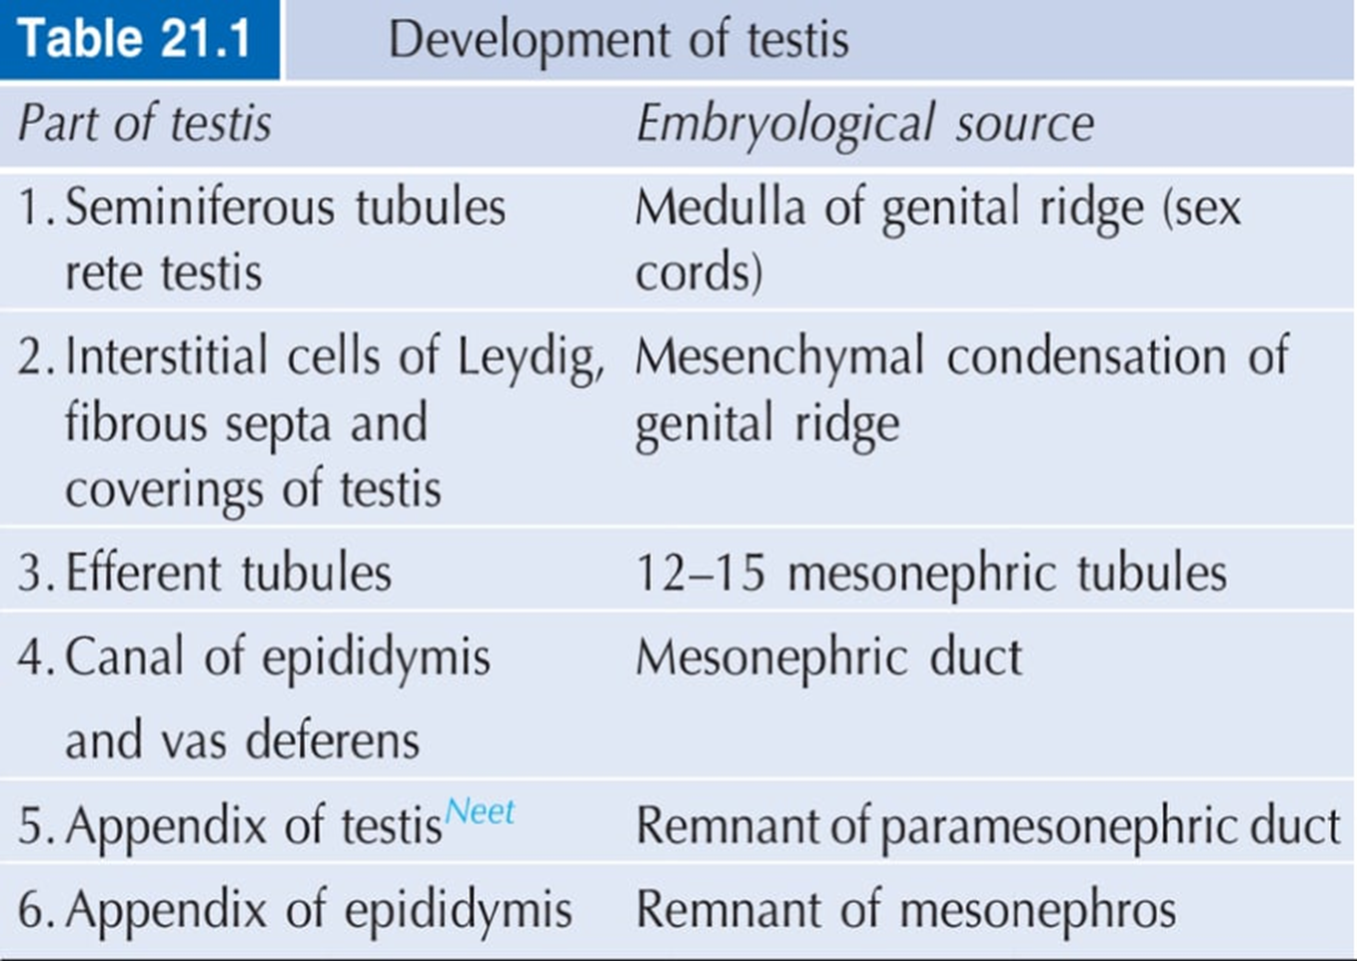

Slide 21
Descent of Testis
During development, testis descents slowly from lumbar region to the scrotum.
- Testis descent slowly with the following schedule
1. During 3rd month: Testis reaches to iliac fossa.
2. At the end of 6th month: It reaches to deep inguinal ring.
3. In 7th month: It travels through inguinal canal.
4. At the end of 8th month: It reaches to superficial
inguinal ring.
5. By the end of 9th month: It reaches to scrotum

Slide 22
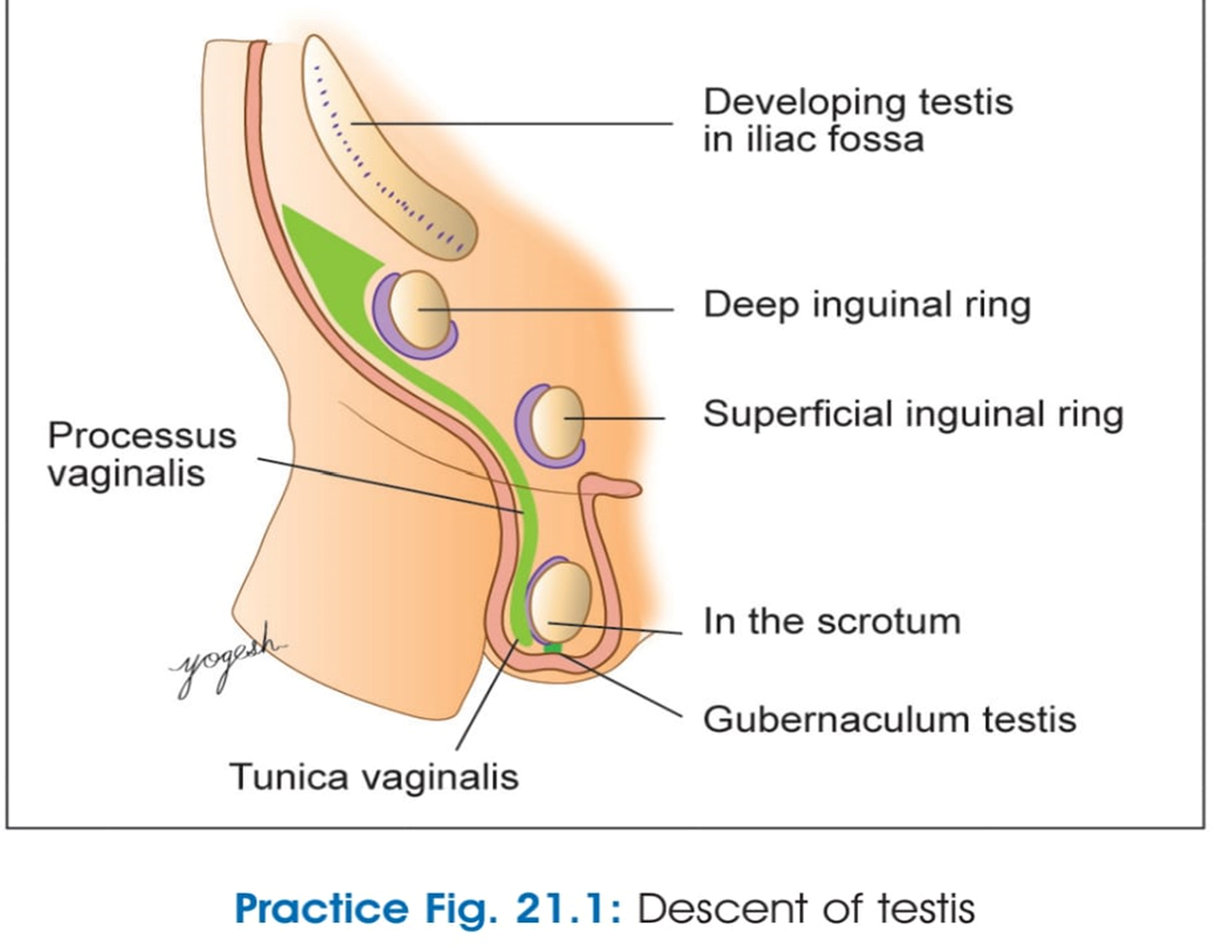

Slide 23
Factors Responsible for Descent of Testis
1.Differential growth of the posterior body wall.
2. Formation of inguinal bursa: Anterior abdominal wall forms an outpouching called inguinal bursa.
3. Gubernaculum testis: It is the mesenchymal band that connects lower pole of testis to bottom of scrotum .
4. Processus vaginalis: It is a diverticulum of the peritoneal cavity that extends into scrotum through inguinal canal

Slide 24
5. Other factors:
– Increased abdominal pressure due to growing
abdominal viscera
– Male sex hormones
– High abdominal temperature than scrotal
temperature (2-4°C higher)
–contraction of the cremaster muscle

Slide 25
Gubernaculum also helps to dilate inguinal bursa and guide testis to scrotum.
Processus vaginalis guide testis to the scrotum during descent and later it forms a covering of the testis called tunica vaginalis.
Proximal part of processus vaginalis is obliterated by androgens (via calcitonin gene related peptide, CGRP, released from genitofemoral nerve) and by hepatocyte growth factor.
Distal portion of processus vaginalis form tunica vaginalis

Slide 26
DEVELOPMENT OF GENITAL DUCTS
**Both male and female embryos have two pairs of genital ducts:
Mesonephric ducts (wolffian ducts)
Parameso- nephric ducts—müllerian ducts .

Slide 27
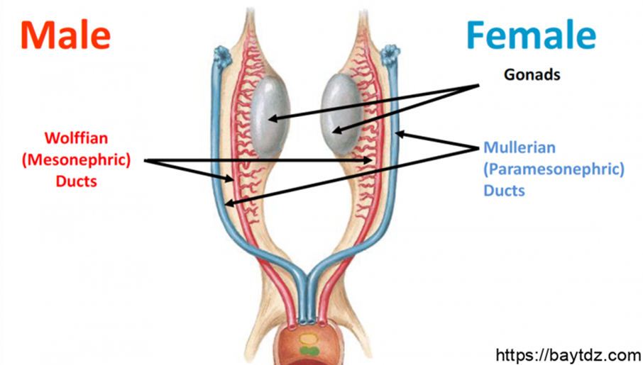

Slide 28
DEVELOPMENT OF MALE GENITAL DUCTS AND GLANDS
The fetal testes produce testosterone beginning in the 8th week and peaking at approximately week 12 and AMH at 6 to 7 weeks.
Testosterone :
stimulates the mesonephric ducts to form male genital ducts
AMH :
causes the paramesonephric ducts to disappear by epithelial-mesenchymal transformation.
During conversion of the mesonephric and paramesonephric ducts into adult structures, some parts of the ducts remain as vestigial structures (e.g., Gartner duct cysts).

Slide 29
Mesonephric Tubules and Ducts in Male
• Mesonephric duct forms
Canal of epididymis
b. Ductus deferens
c. Ejaculatory duct
• Ductus deferens gives rise to seminal vesicles

Slide 30
Seminal Glands
Lateral outgrowths from the caudal end of mesonephric duct .
The part of the mesonephric duct between the duct of this gland and the urethra becomes the ejaculatory duct.

Slide 31
DEVELOPMENT OF PROSTATE
Starts to develop at the 12th week of IUL.
Multiple endodermal outgrowths arise from the prostatic urethra .
The glandular epithelium of the prostate differentiates from these endodermal cells.
The associated mesenchyme differentiates into the dense stroma and smooth muscle of the prostate
The bulbourethral glands are pea-sized structures that develop from paired outgrowths derived from the spongy part of the urethra .
The smooth muscle fibers and the stroma differentiate from the adjacent mesenchyme

Slide 32
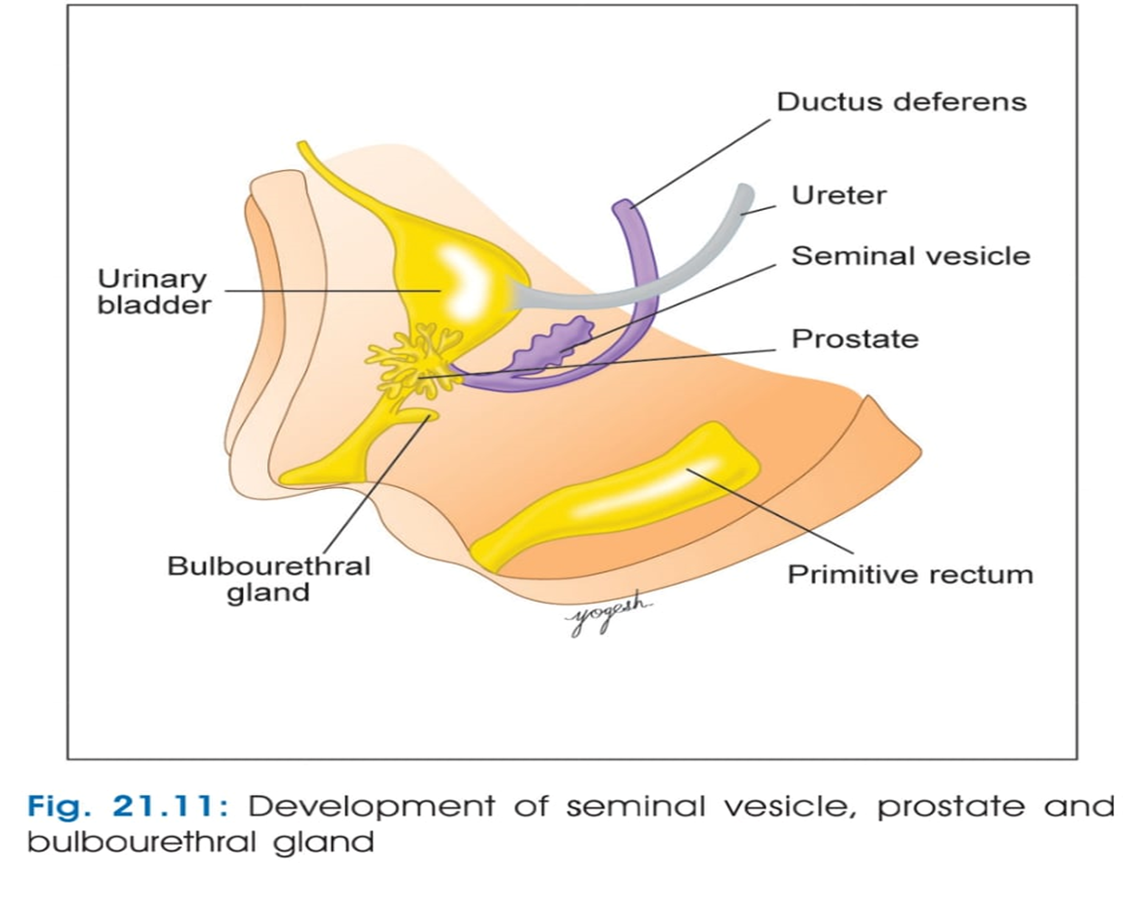

Slide 33
Development of Male External Genitalia
Stages of Development
1. Development of penile urethra
2. Development of prepuce of the penis
3. Development of scrotum

Slide 34
Development of Male External Genitalia
Masculinization of the indifferent external genitalia is induced by dihydrotestosterone
dihydrotestosterone is produced peripherally by 5α-reductase conversion of testosterone from the testicular Leydig cells.
The primordial phallus enlarges and elongates to become the penis.
A urethral plate forms in the ventral portion of the phallus.
The urethral plate canalizes and opens to form the urethral groove.
This groove is bounded by the urethral folds, which form the lateral walls

Slide 35
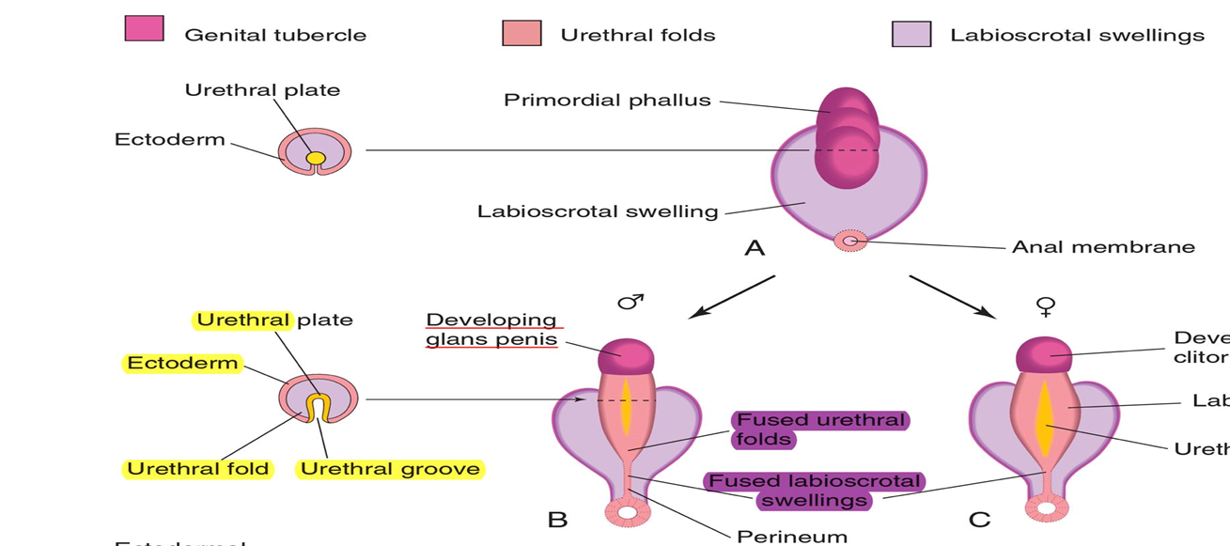

Slide 36
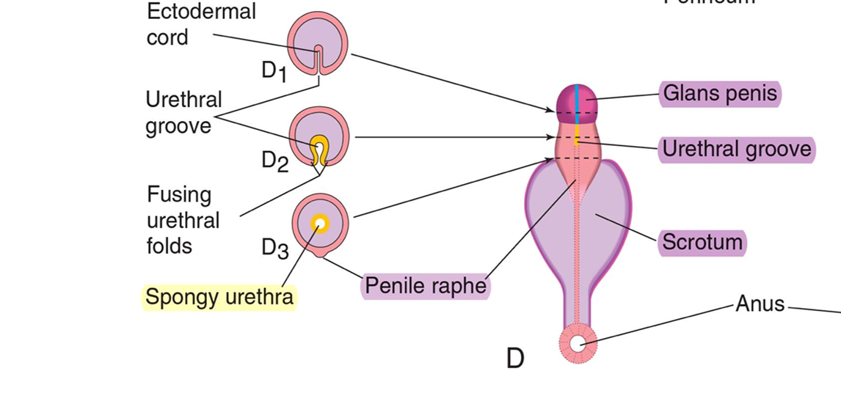
Under the influence of androgens, the urethral folds fuse with each other along the ventral surface of the penis to form the spongy urethra

Slide 37

The surface ectoderm fuses in the median plane of the penis, forming the penile raphe and enclosing the spongy urethra within the penis

Slide 38
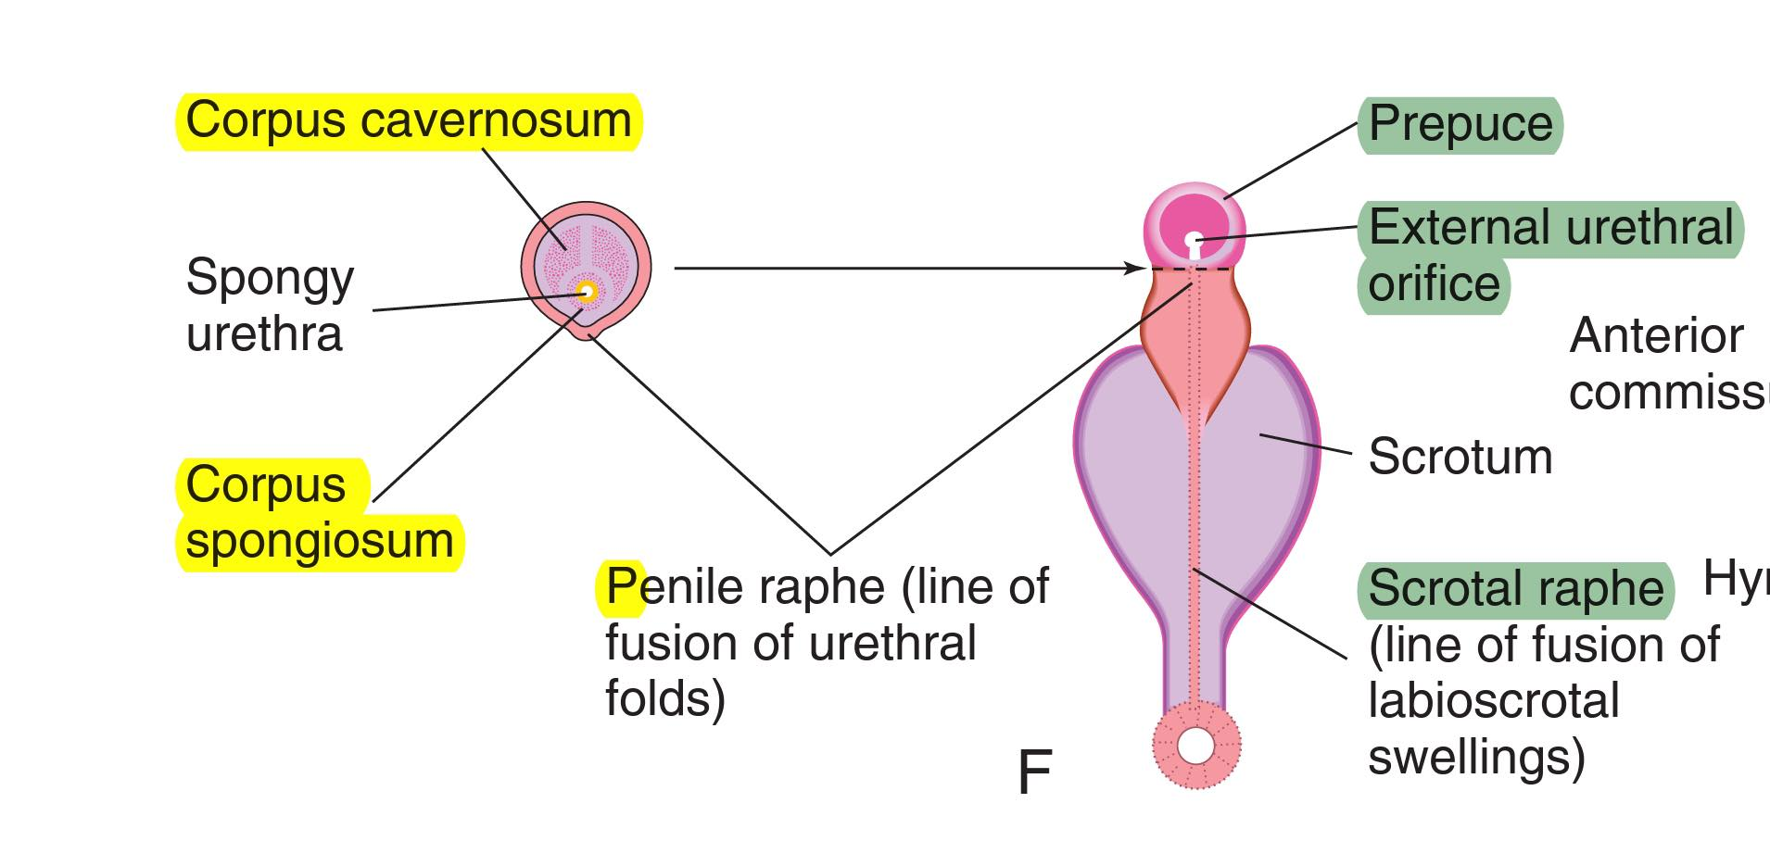
The corpora cavernosa and corpus spongiosum develop from mesenchyme in the phallus.
The labioscrotal swellings grow toward each other and fuse to form the scrotum .
- The line of fusion of these folds is clearly visible as the scrotal raphe

Slide 39
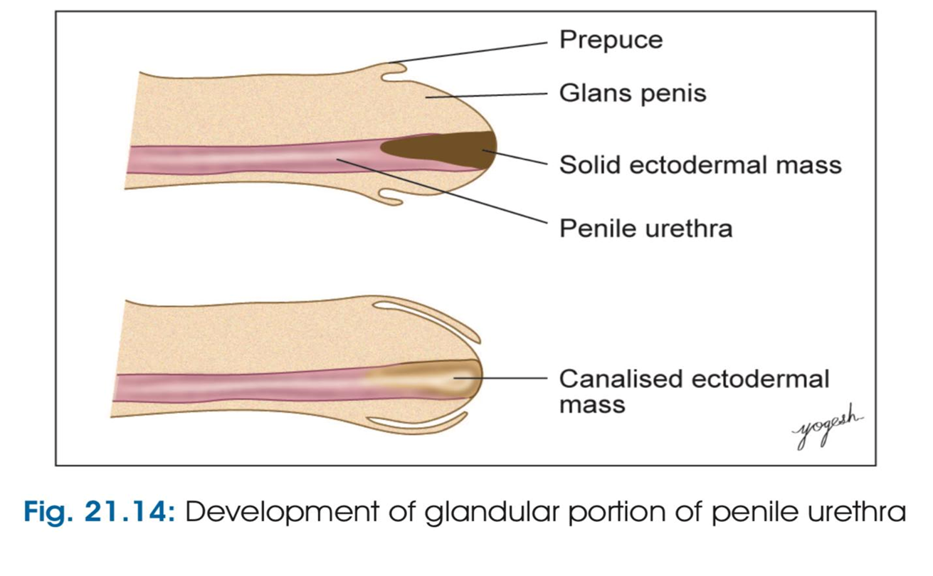
During the 12th week, a circular ingrowth of ectoderm occurs at the periphery of the glans penis When this ingrowth breaks down, it forms the prepuce (foreskin)

Slide 40
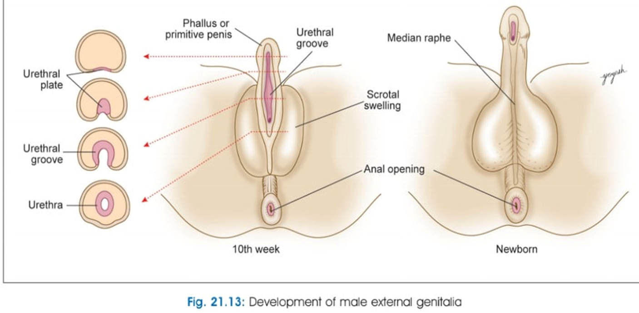

Slide 41
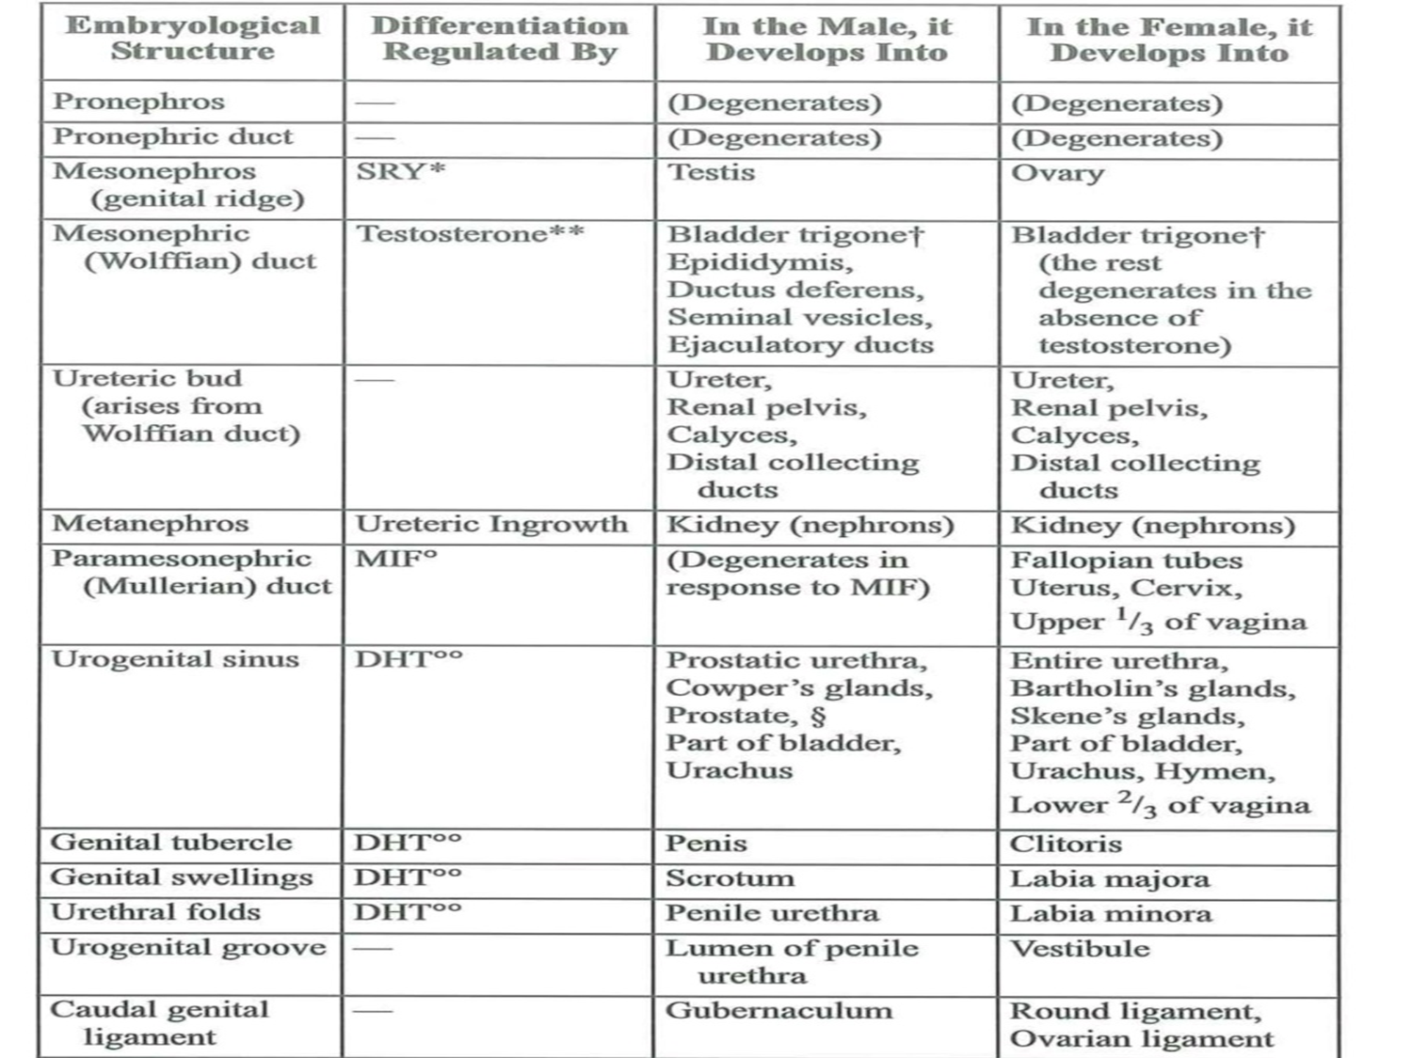

Slide 42
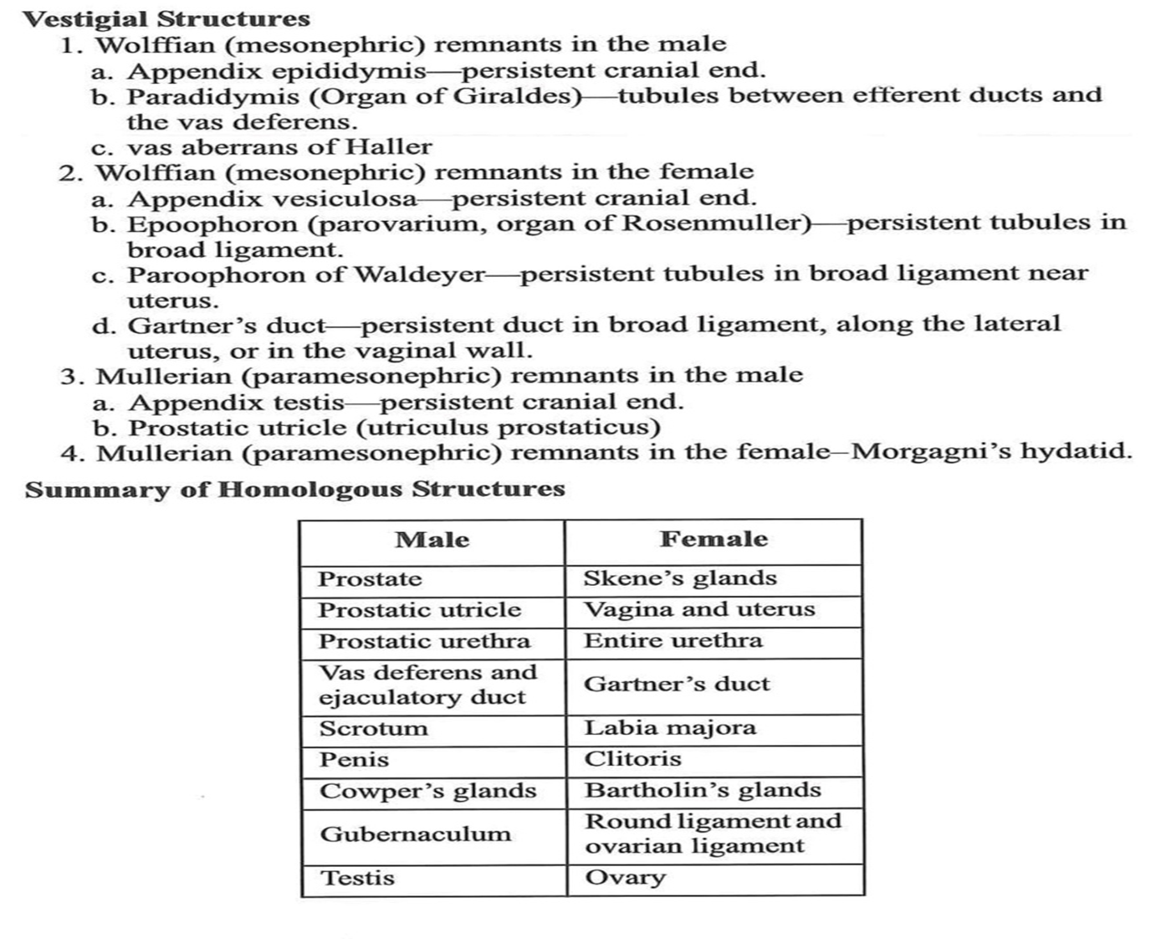

Slide 43
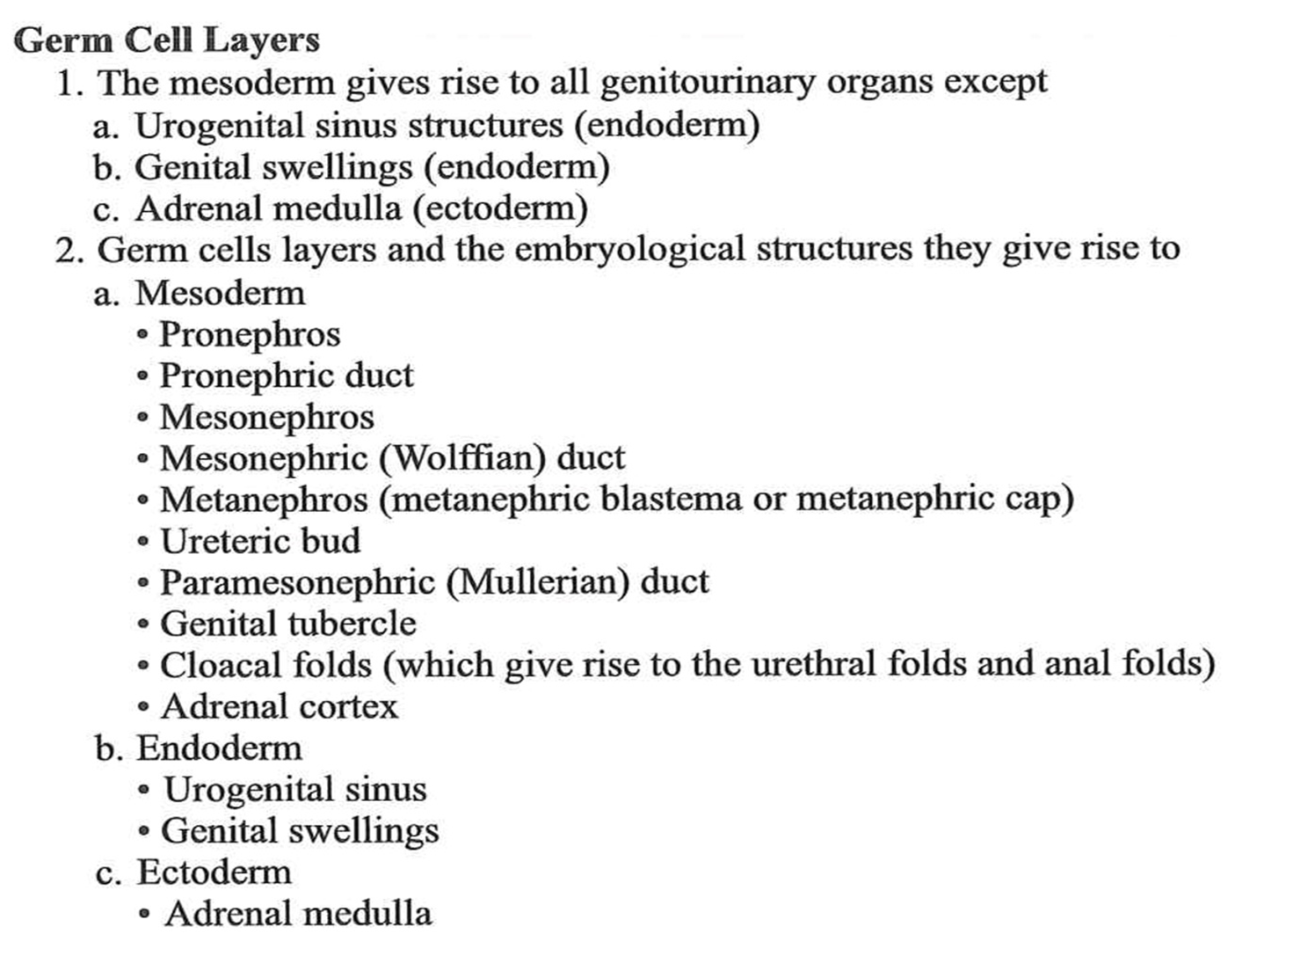

Slide 44
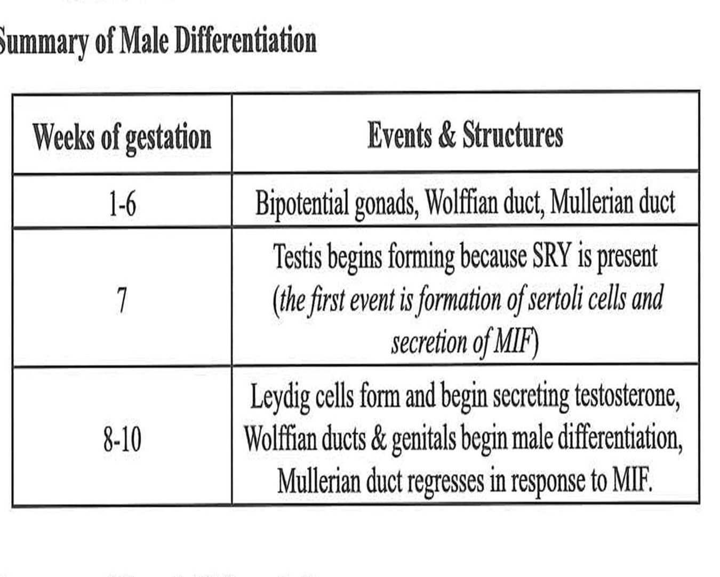

Slide 45


