Slide 1
Development of Reproductive System
Dr. Enas Halawa

Slide 2
The sexual identity of individuals depends on their genetic, gonadal and phenotypic sex.
Genetic or chromosomal sex is determined by the sex chromosomes, with XX karyotype being a genetic female and XY karyotype being a genetic male.
Chromosomal sex is determined at the time of fertilization and is dependent on the presence of Y chromosome.

Slide 3
The main gene which is involved for directing the development of testes is the SRY gene, located on the Y chromosome.
In the absence of Y chromosome, the bipotential gonad differentiates into an ovary about 2weeks later than when testicular development begins in the male.
Gonadal sex, which is determined by the genetic sex, is established next.
Gonadal sex is dependent on the presence of gonads: testes in males and ovaries in females.

Slide 4
Gonadal sex controls the development of both internal and external genitalia.
Internal genitalia in males comprises of testes, epididymis and vas deferens, while in females it comprises of fallopian tubes, uterus and cervix.
Phenotypic sex is determined by the appearance of external genitalia and secondary sexual characteristics, which develop at the time of puberty.

Slide 5
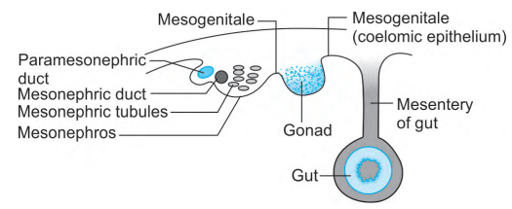
Development of Gonads
The development of gonads begins during the 5th week of gestation in the human embryos with the development of a protuberance known as the genital or gonadal ridge.

Slide 6
The appearance of the primitive gonad is similar in both sexes until 42 days after fertilisation when differentiation of seminiferous tubules occurs.
At this stage, the gonads are present in form of coelomic prominences overlying the mesonephros, which forms the gonadal ridges.
Just below this ridge lies the mesonephric duct.
Mesonephros and genital ridge are together termed as the urogenital ridge.

Slide 7
The differentiation of the primitive gonads along with a male or female line takes place at around 6–9 weeks of gestation.
The primordial germ cells which eventually give rise to the ova or sperms in females and males respectively migrate from the wall of the yolk sac into the genital ridge between 4th to 6th weeks of gestation, simultaneously proliferating at the same time.

Slide 8
As the cells of the genital ridge multiply and proliferate, its size increases and therefore the mesonephros gets displaced dorsally and laterally.
Once the germ cells arrive in the gonads, further differentiation into the male or female depends upon the sex of the gonadal somatic cells and the signals in the surrounding environment rather than the chromosomal sex of the germ cells themselves.
The gonads do not obtain male or female status until the 7th week of development.
The testis is formed in the lumbar region and thereafter descends to the scrotum by passing through the inguinal canal

Slide 9
The ovary develops from the primitive cortex.
Ovaries also develop in the lumbar region and they too descend, but their descent is arrested by the secondary attachment of gubernaculum to the uterus.
At 10 weeks conception there is meiotic entry of oocytes in the medulla of the primitive gonad of the developing foetus.
Gonocytes are diploid and only become haploid in the gonad via meiosis.
Mitosis in oogonia is completed in the 7th month of foetal life

Slide 10
Development of Internal Genitalia
The mesonephric ducts (Wolffian ducts) and paramesonephric ducts (Müllerian ducts) are two discreet duct systems, which are responsible for the development of internal genitalia in males and females respectively.
These duct systems coexist in all embryos during the ambisexual period of development (up to 8 weeks of gestation).
One duct system persists, giving rise to specialised ducts and glands and the other one regresses leaving behind the nonfunctional vestiges.
Both the duct systems arise within the urogenital ridge during embryogenesis, running in length and terminating in the cloaca.
The Wolffian duct or the mesonephric duct is the embryonic duct of the mesonephros.
It connects the primitive kidney (Wolffian body or mesonephros) to the cloaca

Slide 11
The Müllerian tube, one on each side, runs close to the lateral side of the Wolffian duct caudally until it reaches a lower level where it turns medially, crosses in front of the Wolffian duct and joins its fellow from the opposite side.
While forming the uterus Müllerian ducts fuse from below upwards. The epithelial covering of the ovary and the Müllerian duct are both formed from coelomic epithelium.

Slide 12
The Wolffian duct persists in the presence of a Y chromosome.
Differentiation of the Wolffian duct system is stimulated by high local concentration of the hormone, testosterone.
The Leydig cells of testis are responsible for producing testosterone and dihydrotestosterone
These respectively determine the development of the Wolffian ducts into male internal genitalia, and the male external genitalia.
The presence of testosterone in males facilitates the development of Wolffian duct into structures including rete testis, efferent ducts, epididymis, vas deferens, seminal vesicles and ductus deferens

Slide 13
Simultaneous with the development of Wolffian duct system, the Müllerian duct system regresses in males.
Müllerian inhibiting substance (MIS) is a non-steroidal substance, produced by the Sertoli cells in the testes, which causes regression of the paramesonephric duct.
In the male, the paramesonephric ducts degenerate into the appendix testes and utriculus masculinus.
The third (lower vertical) part of the paramesonephric duct remains rudimentary and gets incorporated in the prostate gland to form the prostatic utricle.
Presence of MIS is required for the normal development of the Wolffian ducts along the lines of male phenotype

Slide 14
In its absence the Müllerian ducts contribute to the development of female phenotype.
Embryological remnant of mesonephric duct in males is appendix of epididymis.

Slide 15
On the other hand, in females, the Wolffian duct system regresses.
The Müllerian duct system develops later and differentiates into the fallopian tubes, uterus and upper portion of the vagina.
The uterus and upper one-third of the vagina develop from the paramesonephric ducts with the lower two-thirds of the vagina developing from the urogenital sinus.
By the 5th month the vagina is usually completely canalised

Slide 16
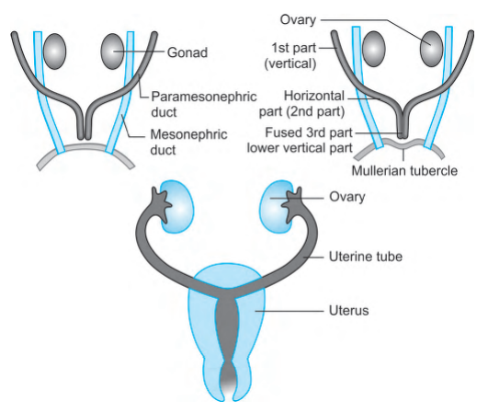
.

Slide 17
In females, the remnants of the Wolffian duct can form the structures such as epoöphoron, paroöphoron, Skene’s gland and Gartner’s duct.
The Gartner’s duct runs medially through the broad ligament and down the side of the vagina, where cysts may form in it.
It eventually gets incorporated into the wall of the cervix uteri.
In both males and females, the Wolffian duct goes to form the trigone of the bladder, and the ureters.

Slide 18
Development of the External Genitalia
External genitalia persists in the bipotential state until 9 weeks of gestation at which time it consists of a genital tubercle, urogenital sinus and lateral labioscrotal folds or swellings.
The external genitalia are neutral primordia, which can develop into either male or female structures depending on the signals produced by the gonadal steroid hormones.
The external genitalia can be full recognized as male or female by the 16th week of fetal life by ultrasound examination.
In females, the external genitalia are under the influence of oestrogen produced by the placenta and mother

Slide 19
In males, the Leydig cells of foetal testis begin to secrete testosterone at 8–9 weeks of gestation.
Under the influence of testosterone, the genital tubercle forms the penis, the edges of the urogenital sinus fuse to form the penile urethra and the labioscrotal folds fuse to form the scrotum.
This process is complete by 12–14 weeks of gestation.

Slide 20
Urogenital sinus also forms the prostate, bulbourethral glands, and urethra in males under the influence of androgens.
Complete differentiation of the male external genitalia also depends upon the presence of the hormone, dihydrotestosterone, which is derived from testosterone with the help of the enzyme 5-a reductase

Slide 21
In the females or males showing defects in androgen synthesis and action, the external genital primordia do not undergo masculinisation.
In these cases, the genital tubercle develops into clitoris; the margins of the urogenital sinus remain separate and form the labia minora, whereas the labioscrotal folds form the labia majora and the urogenital sinus develops into the lower vagina and urethra.

Slide 22
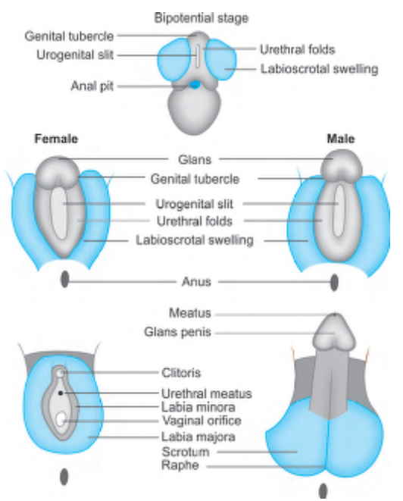

Slide 23
The urogenital sinus is endodermal because it is derived from the cloaca.
It gives rise to caudal two-thirds of vagina in females; oestrogen is not necessary for this process.
Female urethra is formed from the primitive urethra and the pelvic part of the urogenital sinus.

Slide 24
In females, abnormal androgen exposure between 9th to 14th week of gestation results in varying degree of masculinisation such as clitoral hypertrophy and labial fusion.
In males the external genitalia does not undergo complete masculinisation if the androgen action is deficient during this period. This may result in the development of a small phallus, hypospadias and scrotal defects

Slide 25
Development of Vagina
Vagina is derived from sinovaginal bulbs as well as from the vaginal plate.
It is partly mesodermal and partly endodermal in origin.
The endodermal cells of the urogenital sinus proliferate to form two sinovaginal bulbs.
A solid vaginal plate is formed by the fusion of mesodermal uterovaginal canal in the upper part and endodermal sinovaginal bulbs in the lower part.
The central cells of the vaginal plate eventually break down to form the vaginal canal.

Slide 26
