Slide 1
Immunological aspects of reproductive disorders
Malak Alshaikhali
MD, Al-Quds University
MSc Integrated Immunology, University Of Oxford.

Slide 2
Learning outcomes
Understand immune responses in pregnancy.
Overview of certain immune disorders affecting the fetus and mother during pregnancy.
Understand immunological basis of recurrent spontaneous miscarriage.
Understand immunological basis of infertility.
Understand HPV associated immune condition.
Understand immunological basis of endometriosis.

Slide 3
The immunological paradox of pregnancy
The immune system can distinguish normal healthy cells (self) from non-self (infected, malignant or allogeneic cells and toxins).
The human fetus carries an allograft status.
Thus, survival of the allogeneic fetus imposes a challenge to the laws of the immune system.

Slide 4
The immunological paradox of pregnancy
‘…how does the pregnant mother contrive to nourish within itself, for many weeks or months, the foetus that is an antigenically foreign body?’ Medawar.
This give rise to the concept the ‘immunological paradox’ of pregnancy, and the fetus being regarded as ‘natures perfect allograft’

Slide 5
Feto-maternal relationship during pregnancy.
Two immunological conditions prevail during pregnancy.
First: a fetus living in an isolated, sterile environment develops the essential framework of the immune system so that it can mount an adequate immune response.
Second: a combination of fetal and maternal immunological factors cooperates at the feto-maternal interface to allow and encourage growth of the semi-allogeneic conceptus.

Slide 6
Feto-maternal relationship during pregnancy.
The immunological recognition of pregnancy is important for the maintenance of gestation, as well as modulation of common disorders of pregnancy.

Slide 7
Feto-maternal relationship during pregnancy.
Central features of immunologic feto-maternal interactions in pregnancy include:
Maternal and fetal blood circulation are entirely separate, but interact and overlap in providing protection.
The antigens most involved in graft rejection are only gradually developed through fetal life.
Maternal and fetal factors generate immune privilege at the feto-maternal interface.
Factors derived from placentas and extra placental membranes program maternal immune responses to the direction of the conceptus acceptance and growth.

Slide 8
The feto-maternal interface
Maternal (uterus) and fetal (placenta) organs and tissues contribute to fetal tolerance at the feto-maternal interface.
The cooperative interactions between them result in a particular immune response.
They produce soluble factors (hormones, cytokines, chemokines, prostaglandins).
Both are populated by immune cells and are also able to express surface molecules and produce several soluble factors.

Slide 9
The feto-maternal interface
Immunological changes can be documented during pregnancy:
Reduction in T cells (mainly CD4+).
Reduced NK-cell numbers.
B-cell numbers and function remain static.
Antibody synthesis and serum immunoglobulin levels are essentially unchanged.

Slide 10
The feto-maternal interface
Change from Th1 to Th2, but there is no evidence for increased susceptibility to infection- with the exception of Listeria, which has a tropism for the placenta and requires macrophages and T cells for clearance (these are locally suppressed).
There are no changes in solid organ allograft tolerance.
Autoimmune diseases may behave unpredictably- eg Lupus may become worse or better during pregnancy, but may relapse immediately after delivery because of the sudden hormonal changes.
Vaccine responses are normal.

Slide 11
Immunological diseases in pregnancy
Aberrancies in modulation of both fetal and maternal immunological – inflammatory responses can result in many disorders of the fetus or the mother.
Examples include:
Spontaneous abortions
Preeclampsia
Fetal death
Fetal growth retardation
Platelet alloimmunisation
Idiopathic thrombocytopenic purpura
Myasthenia gravis
Neonatal systemic lupus erythematosous

Slide 12
Immunopathology involving the fetus/newborn
Hemolytic disease of the newborn
Blood group antigens are known as alloantigens- eg. ABO antigens & the rhesus antigen.
They can be the target of immune responses directed at molecular differences between individuals within a species.
Antibodies directed against an antigenic determinant are called alloantibodies.

Slide 13
Hemolytic disease of the newborn
A serious problem is posed frequently by alloantibodies induced by a fetus in the pregnant mother.
Alloimmunization most often results from rhesus incompatibility between mother and fetus.

Slide 14
Hemolytic disease of the newborn
Pathogenesis:
Rhesus-negative mother X a rhesus-positive father → rhesus-positive baby.
During delivery some blood escapes from the fetal circulation into the maternal circulation and the mother develops alloantibodies to the rhesus antigen.
During a subsequent pregnancy with a rhesus-positive fetus, the maternal IgG alloantibodies cross the placenta and cause hemolysis of the fetal red cells.

Slide 15
Hemolytic disease of the newborn
Haemolysis of foetal RBCs results in anaemia which can cause:
Foetal heart failure and hydrops.
Neurological impairment due to accumulation of bilirubin and excessive deposition in the brain.
Foetal erythroblastosis.

Slide 16
Hemolytic disease of the newborn
Diagnosis:
It was very difficult to detect rhesus antibodies because IgG antibodies to the rhesus antigen do not agglutinate rhesus-positive RBCs.
Until Prof. R. Coombs developed antibodies against human immunoglobulin.
The test is known as Coombs test.
Prevention: rhesus antigen immunoglobulin given to all rhesus negative mothers during pregnancy and at birth.

Slide 17
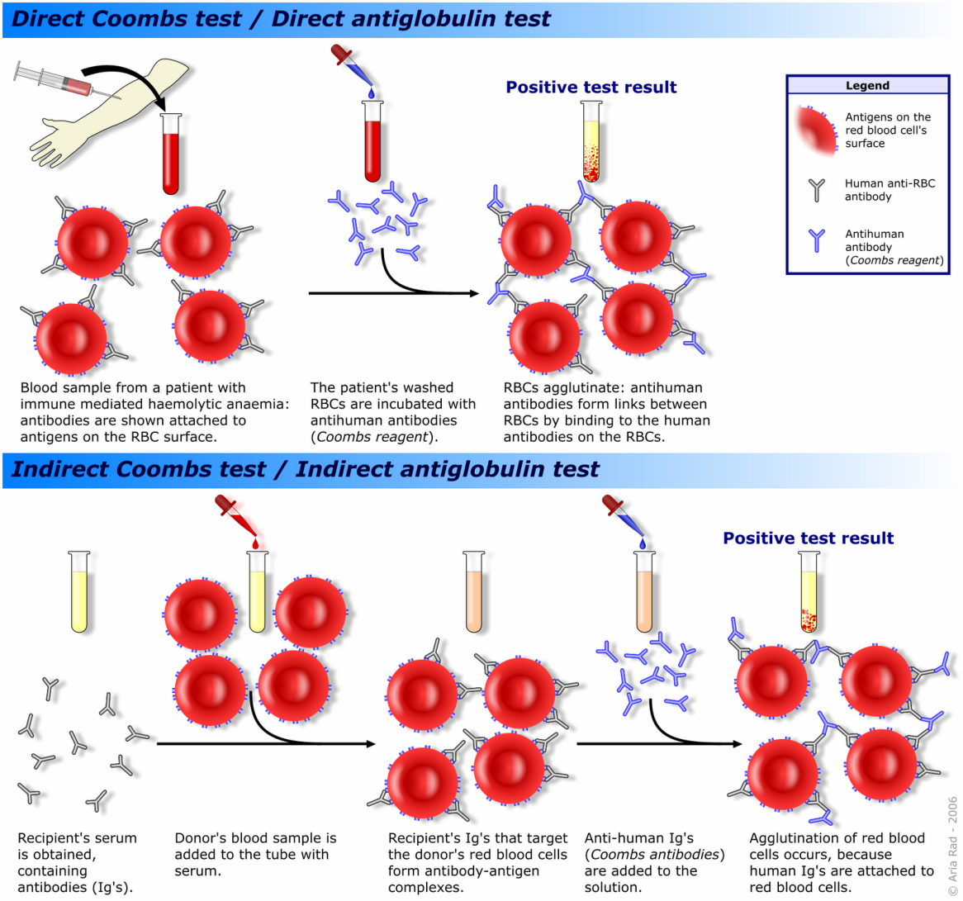

Slide 18
Alloimmune thrombocytopenic purpura
Transfer of fetal platelets across the placenta may elicit a maternal antifetal platelet response.
If the resultant antibodies are IgG , they may cross the placenta and result in alloimmune neonatal thrombocytopenic purpura (AITP).
Occur in 1:1000 births.
The target antigen is HPA-1A- majority of mothers are positive.
ITP VS. AITP.
Notes:
HPA-1A human platelet antigen.

Slide 19
The immunology of recurrent spontaneous miscarriage
Definition: a women with two consecutive miscarriages with the same partner, and no more than one live birth.
The known causes of recurrent miscarriage include:
Immunological.
Thrombophilia-related.
Hormonal.
Infection-related.
Anatomical.
Chromosomal.
Environmental.

Slide 20
Recurrent spontaneous miscarriage
There are many immunological theories for recurrent miscarriage
Antibody-mediated theory.
Anti-phospholipid antibodies.
Anti-sperm antibodies.
Anti-trophoblast antibodies.
Blocking antibody deficiency (anti-paternal antibodies): these antibodies are well documented but appear to be irrelevant to pregnancy outcome-(agammaglobulinaemic women and mice have normal pregnancies).

Slide 21
Recurrent spontaneous miscarriage
Cell-mediated theory.
Excessive Th1 response: increased Th1 cytokines (IFN-G and TNF-A, both of which are abortifacient in mice) and Th1 responses to trophoblast antigens in recurrent aborters.
Deficiency of Th2 cells/cytokines.
Deficiency of decidual ‘suppressor’ cells: uncertain whether this is cause or effect.
Inappropriate MHC class I and II expression.

Slide 22
Immunological infertility
Aberrant immune responses might cause infertility.
Immunological causes of infertility in women are very rare as opposed to men.
Sperm antibodies (SpAbs) are regarded as one of the commonest known causes of male infertility.
Antibodies directed at sperm antigens can be detected in seminal fluid and in the blood serum of men.
Prevalence rates of SpAbs in infertile men range between 6 and 11%.
The specific sperm antigen involved still unknown.

Slide 23
Male immunological infertility
Many sperm proteins do not arise until spermatogenesis commences at puberty- after the development of immune tolerance.
Many mechanisms are normally in place to modify the immune response and prevent SpAb formation including:
Effective separation of sperm and the immune system- e.g occlusive Sertoli cell junctions isolate the developing germ cells from the testicular interstitium.

Slide 24
Male immunological infertility
Immunomodulatory mechanisms to prevent SpAb formation:
Immunosuppressive cytokines in the testes and seminal fluid- rich in suppressor T cells and lacks Th cells.
Antigen-presenting cells are infrequent in the normal epididymal epithelium.
Sperm are deficient in MHC-1 and -2 antigens required for recognition by lymphocytes.
Complement levels are extremely low in normal epididymal luminal fluid.

Slide 25
Male immunological infertility
Risk factors for the development of SpAbs : disruption of the blood-testis barrier
Vasectomy: SpAbs occur in > 70% of men.
Any cause of obstruction- e.g congenital absence of the vas (CAV) or damage related to hernia repair.
Blunt testicular trauma.
Testicular biopsy.
Orchitis or acute epididymitis.
Genital tract infection- e.g association between asymptomatic Chlamydia infection and SpAbs.

Slide 26
Male immunological infertility
Functional consequences of SpAbs:
SpAbs may affect a wide range of sperm functions.
Impairment of sperm motility- SpAbs on the sperm surface can lead to agglutination in seminal plasma.
Reduced sperm survival in vitro as a result of cytotoxic SpAbs and phagocytosis.
Impairment of sperm-oocyte interaction.

Slide 27
Male immunological infertility
Diagnosis: difficult due to the absence of knowledge about the biologically significant sperm antigens involved in antigen-antibody interactions. .
Management:
First line: assisted reproduction using ICSI.
Second line: Immunosuppressive therapy with high doses of glucocorticoid.
Notes:
ICSI: Intracytoplasmic sperm injection.

Slide 28
Female immunological infertility
The occurrence of antiovarian autoantibodies, causing autoimmune gonaditis and hypogonadism, is often seen as part of the autoimmune polyglandular syndrome.
Characterized by the presence of autoantibodies reactive with steroid hormone-secreting cells.

Slide 29
Female immunological infertility
Antiovarian antibodies can cause premature ovarian failure and therefore infertility- there is no clear evidence that ovarian antibodies cause infertility outside the context of APS.
Other causes: Antisperm antibodies which can also be found in women.

Slide 30
HPV infection and associated reproductive disorders
The human papillomavirus (HPV) is a sexually transmitted infection affecting men and women.
HPV are ubiquitous: >130 genotypes.
HPV exhibit tropism: cutaneotropic & mucosotropic
Can be categorized as low-risk and high risk types.
Low risk types: e.g HPV 6, 11 are predominantly associated with benign anogenital warts.
High-risk types: e.g HPV 16, 18, 31, 33, 35, 45 are associated with anogenital cancers and cervical intraepithelial lesions and neoplasia.
Notes:
16 and 18, which cause 70% of cervical cancer and high-grade cervical intraepithelial neoplasia; and 6 and 11, which cause 90% of anogenital warts

Slide 31
HPV infection
Transmission: skin-to-skin contact and infects the epithelial cells in genital mucosa, oral mucosa, or skin.
Many infections are transient or subclinical and resolve.
Most lesions that develop are self-limiting and regress.
A small population of women develop persistent infections- latent infection (10-15%).
Persistent/latent infections with a high-risk HPV type, may progress to cervical intraepithelial neoplasia, and invasive carcinoma.

Slide 32
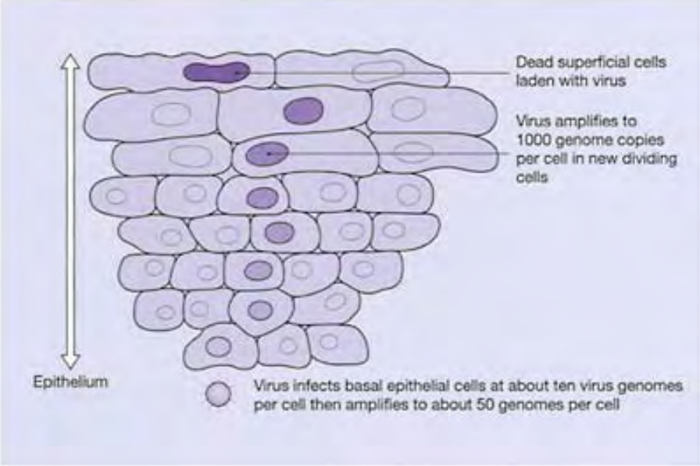
Replication cycle of HPV

Slide 33
HPV infection
HPV infections can induce two different pathways:
Infectious virion-producing pathway: involved in fertility alteration.
Noninfectious cancer-producing pathway.

Slide 34
HPV and Cancers
HPV is an oncogenic virus: play a role in the development of various cancers- eg cervical, anal, vulvovaginal and oropharyngeal cancers.
The clearance HPV infections occurs due to the development of cell-mediated immunity, accompanied by seroconversion and the antibody to the L1 major capsid protein.
Some women fail to mount successful cell-mediated immune response and they remain persistently infected- poses risk for developing high-grade disease and possibly cancer.

Slide 35
HPV and Cancers
Oncogenic properties of high-risk HPV are related to the E6 and E7 proteins- play a role in disrupting the normal cell cycle of the host.
Memory CTLs become reactivated if latently infected cells start shed large volumes of viral particles and infect other cells.
This keeps the latent infection under control.
Immunosuppressed individuals tend to have a high rate of virus-associated tumors—they lack the memory CTLs to keep latent infections under control, and more cells acquire the latent infection and therefore raise the numbers of cells with the potential to become malignant.
Notes:
E6 immortalizes primary human keratinocytes in co-operation with E7 binds p53 and directs p53 degradation by ubiquitin-targeted proteolysis.
E7 immortalizes primary human keratinocytes in co-operation with E6, transcriptase transactivator binds pRb with deregulation G1/S checkpoint in the cell cycle.

Slide 36
HPV and Fertility
HPV infection may affect fertility in men and wonen and alter the efficacy of assisted reproductive technologies.
In men, HPV infection can affect sperm parameters- specifically motility.
HPV-infected sperm can transmit viral DNA to oocytes, which may be expressed in the developing blastocyst- leading to increased DNA fragmentation and trophoblast death in the blastocysts.

Slide 37
HPV and Fertility
HPV can increase trophoblastic apoptosis and reduce the endometrial implantation of trophoblastic cells, thus increasing the risk of miscarriage.
Vertical transmission of HPV during pregnancy may be involved in the pathophysiology of preterm rupture of membranes and spontaneous preterm birth.
In patients undergoing intrauterine insemination for idiopathic infertility, HPV infection confers a lower pregnancy rate.

Slide 38
Autoimmune diseases in pregnancy
Autoimmune diseases in the pregnant mother that are accompanied by IgG autoantibodies may occur in the fetus/neonate due to placental transmission of the antibody- eg myasthenia gravis and thyroid disease.
This also confirms the pathogenicity of some antibodies.

Slide 39
SLE in pregnancy
The fetus of SLE mothers is a patient too.
There is increased risk for miscarriage, intrauterine growth restriction due to placental insufficiency, neonatal lupus and heart block.
Mothers with SLE who are anti-Ro or anti-La antibody positive are at increased risk of having babies affected with:
Neonatal lupus: photosensitive rash- self-limiting and disappears over the first 6 months as maternal IgG is catabolized.
Development of in utero complete heart block (Ro+ = 2%; Ro+/La+ = 5%).

Slide 40
SLE in pregnancy
Congenital complete heart block is caused by anti-Ro antibodies crossing the placenta- result in inflammation and fibrosis of fetal cardiac conduction system.
Complications: intrauterine death, immediate pacemaker insertion at birth.
1 in 20 Ro+ mothers will be affected; if there has been an affected pregnancy, risk rises to 1 in 4.
Anti-La may also be associated with congenital complete heart block.
Children with neonatal lupus or congenital complete heart block are at increased risk of developing lupus later in life.

Slide 41
Endometriosis
Endometriosis, a common oestrogen-dependent inflammatory disorder in women of reproductive age, is characterized by endometrial-like tissue outside its normal location in the uterus, which causes pelvic scarring, pain and infertility.
The immune system possibly play a central role in its aetiology, pathophysiology and associated morbidities of pain, infertility and poor pregnancy outcomes.

Slide 42
Endometriosis
Endometriosis is thought to originate from retrograde menstruation: at menses, endometrial cells and tissue fragments reflux through the fallopian tubes, survive and attach to and invade pelvic structures.
They further undergo neuroangiogensis and elicit a local inflammatory response, fibrosis/scarring and pain.
Other factors involved: hereditary or acquired abnormalities in the endometrium or in the peritoneal epithelium and/or defective immune clearance of the sloughed tissue in the pelvic cavity.

Slide 43
Endometriosis
Endometriosis can cause infertility and pregnancy failure in different ways:
Producing adhesions that may result in tubal occlusion.
Distortion of pelvic anatomy by producing large ovarian masses.
Causing damage to germinal epithelium and decreasing the number of available oocytes.

Slide 44
Immune responses in endometriosis
Both the peripheral immune system and the immune status of endometrium are altered in women with endometriosis and likely contribute to infertility, early pregnancy failure and abnormal tissue homeostasis in affected women.
Altered pro-inflammatory immune environment in the endometrium of women with compared to those without the disease possibly contribute to endometriosis establishment, its pathophysiology and known adverse reproductive outcomes.

Slide 45
Immune responses in endometriosis
Immunolgical aberrations detected in endometriosis include:
Increased WBCs and macrophages and increased macrophage activation.
Expression of IL-1, IL-6, and TNF-a is increased in peritoneal fluid of women with endometriosis- endometriotic lesions may secrete TNF-a and IL-1.
Both IL-6 and TNF-a promote endometrial cell proliferation, adhesion, and angiogenesis.

Slide 46
Immune responses in endometriosis
Autoimmune responses may contribute to the onset of endometriosis.
Endometriosis results in tissue damage, production of antibodies against endometrium, ovary, phospholipids, histones.
Endometriosis is also associated with other autoimmune diseases such as thyroiditis or systemic lupus erythematosus (SLE), all of which suggest an autoimmune cause.

